Slide 1
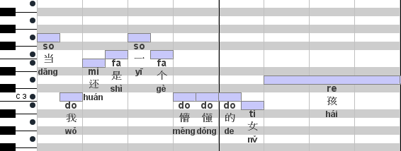
Pitch
trend
= < -4, 2, 1, 1, -1, -3, 0, 0, -1, 2>
Tone
= < -4, 2, 1, 1, -1, -3, 0, 1, -1, 2>
trend
Diff. in sol-fa name = -3
Diff. in sol-fa name = 2

