Slide 1
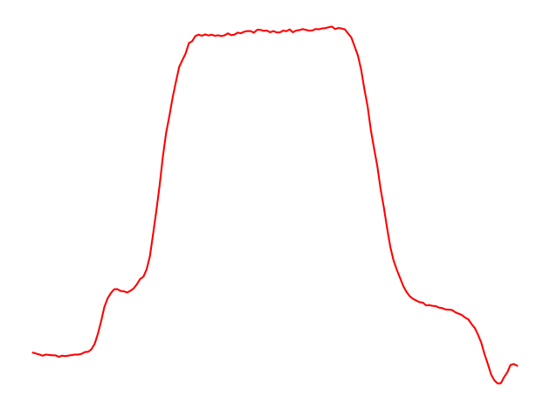
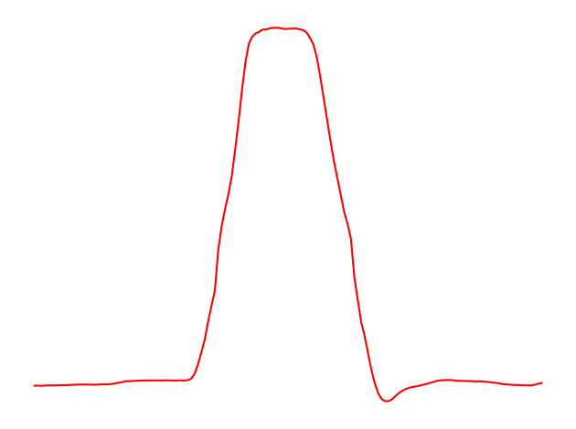
Shoulder level
Hand moving down to grasp the gun
Pointing
Aiming
Hand moving above the holster
Hand at rest
Hand at rest

