Slide 1
NNU Gen-Ed Data Management
Cole McCall, Cody Lirazan, Gabe Murphy

Slide 2
The Problem

Slide 3
Our Goals
Using Canvas data from Spring 2022 and Fall 2022, determine who at NNU has been compliant in assessing General Education course outcomes
Which colleges?
Which departments?
Which professors?
Predict (based on any of our features) who will be compliant in future sections
Establish a set of data cleaning and visualization procedures for all data used
Pipeline these procedures so that they can be automated in the future

Slide 4
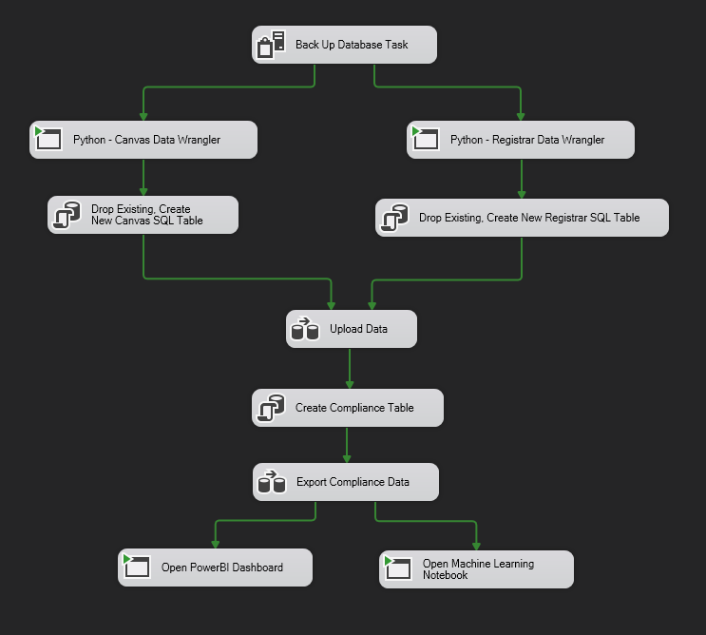
Our Solution
SSIS Package
SQL Server Integration Services
Performs the entire ETL process
Can be automated and set to run every so often
Uses Python scripts, SQL queries, SQL Server, and PowerBI to clean, upload, query, visualize, and predict compliance
Based on Canvas and registrar spreadsheet data

Slide 5
SSIS Step 1 - Backups
Backup everything that already exists in SQL Server
As we are gathering, transforming, and loading new data, while unlikely, mistakes can be made.
Each backup is saved to a backups folder that can be imported into SQL at any point

Slide 6
SSIS Step 2 – Data Wrangling
Python Scripts are used to find all spreadsheets in a directory and join them together, then clean up missing values and normalize weird data.
Canvas Data Fields
Unnecessary
Student Name, ID
Assessment Title, ID, Type
Submission Score, Attempt
Assessment Question, ID
Assignment URL
Account ID, Enrollment Status
Messy/Unclean
Submission Date
Learning Outcome Name, Code
Learning Outcome Score, Rating
Duplicates
Course Name, Course ID, Course SIS ID
Section Name, Section ID, Section SIS ID

Slide 7
SSIS Step 3 – Drop Existing and Create New SQL
Since our data wranglers have concatenated all our datasets, we need to “reset” our tables in the database
Ideally, we would create an upsert that inserts some rows and updates others.

Slide 8
SSIS Step 4 – Upload Prepared Data to SQL
This task takes our cleaned spreadsheet data and uploads it into tables in our database

Slide 9
SSIS Step 5 – Create Compliance Table
Using Joins and Unions and other SQL operations, we can create a table that calculates the compliance of each course
This method also includes information like College, Department, and Professor for each course

Slide 10
SSIS Step 6 – Export Compliance Data
For two reasons, we need to export the compliance table we just created
After each semester, things change. This will create a historical record
We want to use ML to predict future compliance and need the compliance table to do so.

Slide 11
SSIS Step 7 – Data Visualization and Prediction
In our final task, SSIS runs two batch files, opening up PowerBI and our Machine Learning notebook automatically

Slide 12
Possible Concerns
Finding a way to distinguish not attaching a course in canvas at all versus simply not assessing because the semester is not over
Our results are not super helpful because most of the data from this fall is inconclusive but shows up as non-compliant and a failure to access.
With the data provided, this project should only be used at the end of semesters, not during the semester
Predictions need to be made based on semesters that have ended, not semesters in progress

Slide 13
Future Work
This entire process can be automated, but…
PowerBI is currently on a localhost
Connected to SQL database on localhost
Powered by an SSIS package on a localhost
This entire repository is on GitHub, but file paths are specific to Cole’s machine. A much more in-depth explanation of the code behind the SSIS tasks can be read about there.

