Slide 1
MIS 407
c03
Guy Helmer

Slide 2
Recap
Last class we reviewed terminal/command line interfaces, and basic commands
In addition: use the command less to view long files
You’ve submitted your first ICA (marks have been posted).
Read section 1.1 through 1.3 of the ProGit online book
https://git-scm.com/book/en/v2

Slide 3
For Today…
Goals:
We’ll come back to the “Setup Atom” topic later
Introduce Git and and GitHub
Conduct our second in-class assignment ICA02

Slide 4
Intro to Git
Git is a VCS (version control system).
Most large, multi-member, group projects will use some form of VCS
Git is one of the most popular.

Slide 5
History of Git
Developed by Linus Torvalds (Linux Fame)
Was using Larry McVoy’s BitKeeper
Proprietary commercial software granted free license to use for Linux
Until a falling out in the community...
Linus developed Git to fill the gap

Slide 6
Why Git
Our projects really won’t be that large, so why use Git?
Group work requires complex coordination of updates and code, Git helps make this “safer”
The power of “versioning” and “branching”
MOST importantly, it’s a key means through which to participate in a programming community.
See 7:13 onward of … https://www.youtube.com/watch?v=Vo9KPk-gqKk

Slide 7
Intro Concepts
A repository (“repo”) is a collection of files
State is managed by Git
Synchronized to remote Git server(s)
Files are tracked, untracked, or ignored.
There are multiple Git clients
We’ll use www.git-scm.com
NOTE: We will only be using the command-line tools. Knowing the command line tools will allow you to more fully understand and control Git.

Slide 8
General Process
Initialize a repo (later, you’ll usually clone one from GitHub)
Add and commit files to the repos.
Modify files in the repos, stage them, and them commit them back into the repo.

Slide 9
Git Repo File States
Untracked
A file that has never been committed to the repo and is not staged.
Unmodified
A file that has been previously committed to the repos (thus, it is tracked) but no changes to the file have been made since the last commit.
Modified
A file that is being tracked, and changes have been made to the file since the last commit.
Staged
A tracked file that has bee readied to be committed to the repos. You add any modified files to a staging area. The staging area is “built up” and organized until you are ready to commit the changes to the repo.
Committed
This is a state of a file, but is worth nothing here.
Once you “commit” the changes that are staged, the file moves to the Unmodified state.

Slide 10
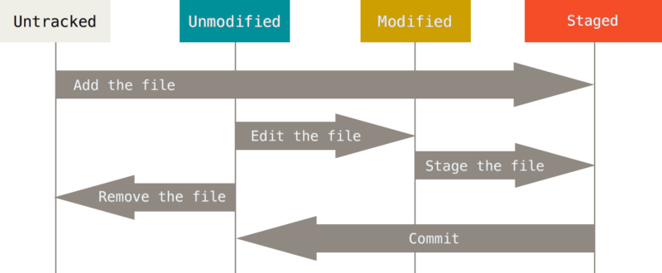
Stages of a file in your repo

Slide 11
Let’s try this…
Go to our GitHub site mis407f18
https://github.com/mis407f18/mis407f18-Class-Notes
We’ll work through this together
c03-git_and_github/1.git_basic_local_workflow.md

Slide 12
By next class…
First: Review sections 2.1 through 2.5 of ProGit, Chapter 2 “Git Basics”
https://git-scm.com/book/en/v2
During Next class…
Continue with working with/learning Git
Review how to submit an assignment using Git/GitHub.
Quick intro to Atom
Review for first test (challenge).
Hint: It will be a Git/GitHub challenge where you need to accomplish a task using techniques covered and submit a copy of your Bash session (as a text file).

