Slide 1
Income by Technology hubs
Cole Miller, Kevin Zhao

Slide 2
Question:
What city should I live in if I want to maximize income in the tech industry?

Slide 3
DATA: Ipums CPS (2016)
Integrated Public Use Microdata Series (IPUMS)
Aggregates state surveys into one database
Current Population Survey (CPS) – monthly
About 60,000 surveyed
Sample tries to represent state population
Weights are added to represent probability of the observation
Annual Social and Economic (ASEC) - yearly supplement
Comprehensive survey including total income

Slide 4
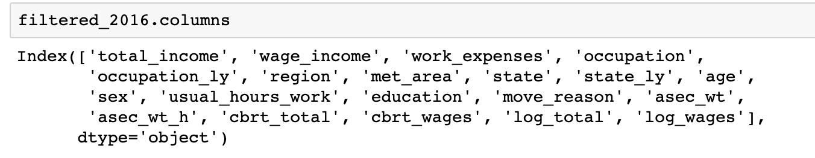
Variables

Slide 5
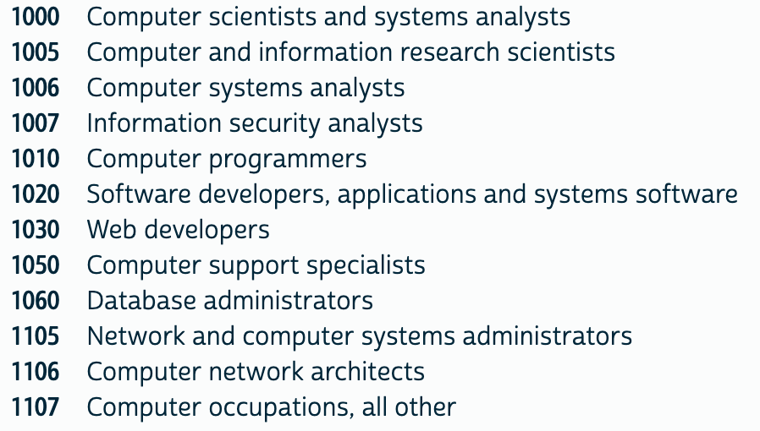
Technology occupations

Slide 6
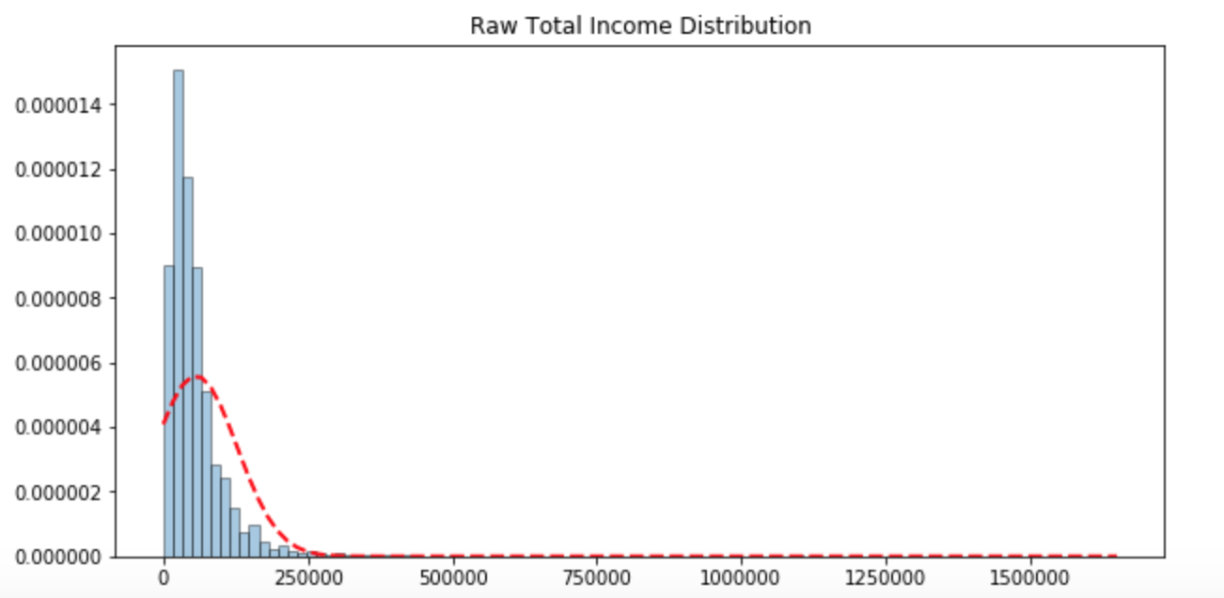
Income distribution

Slide 7
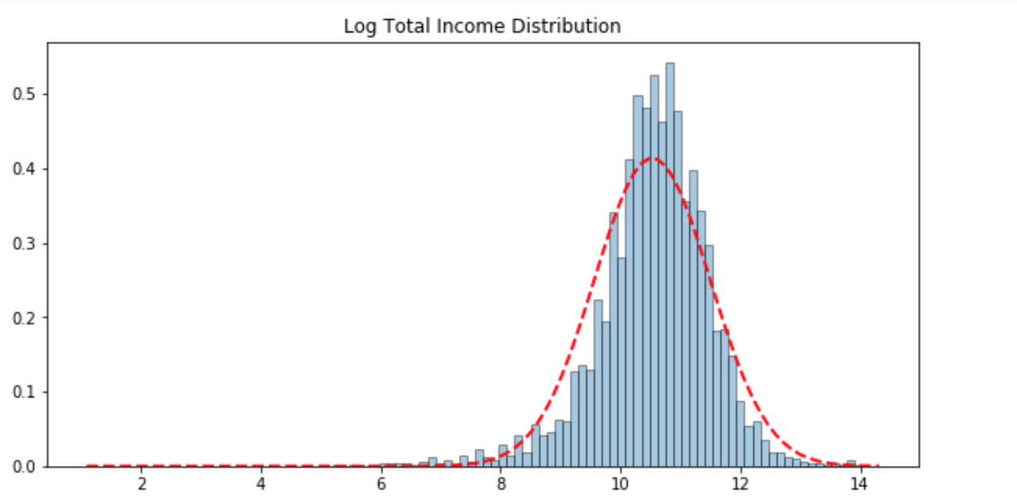
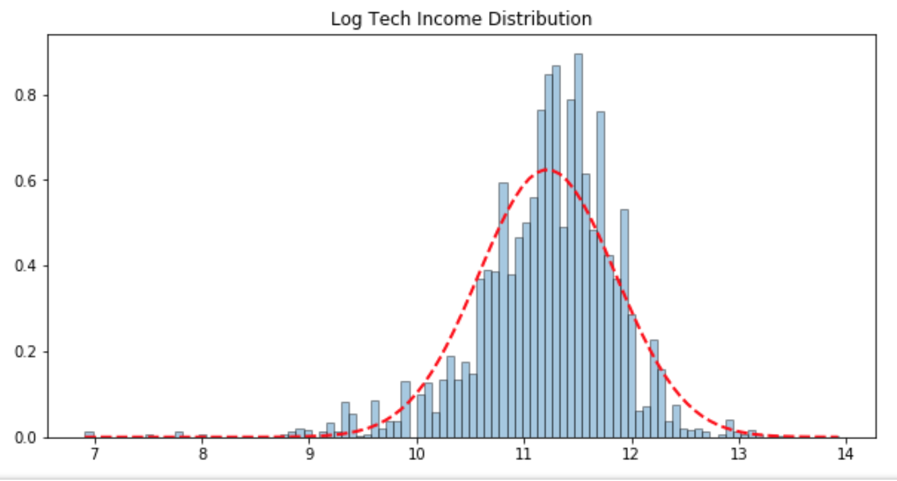
Normalized Income

Slide 8
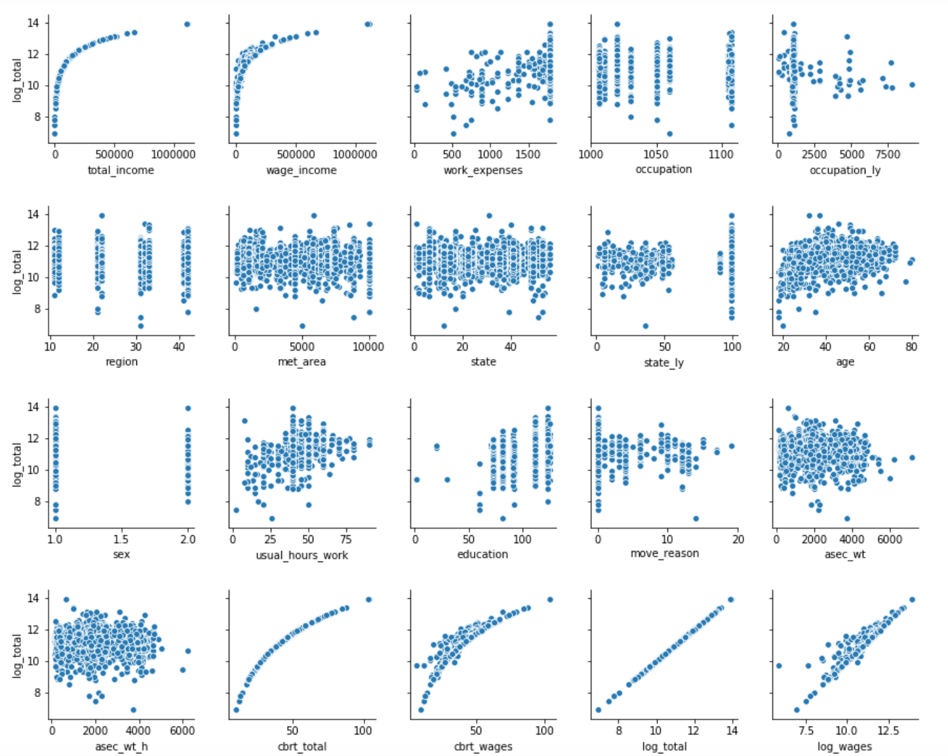

Slide 9
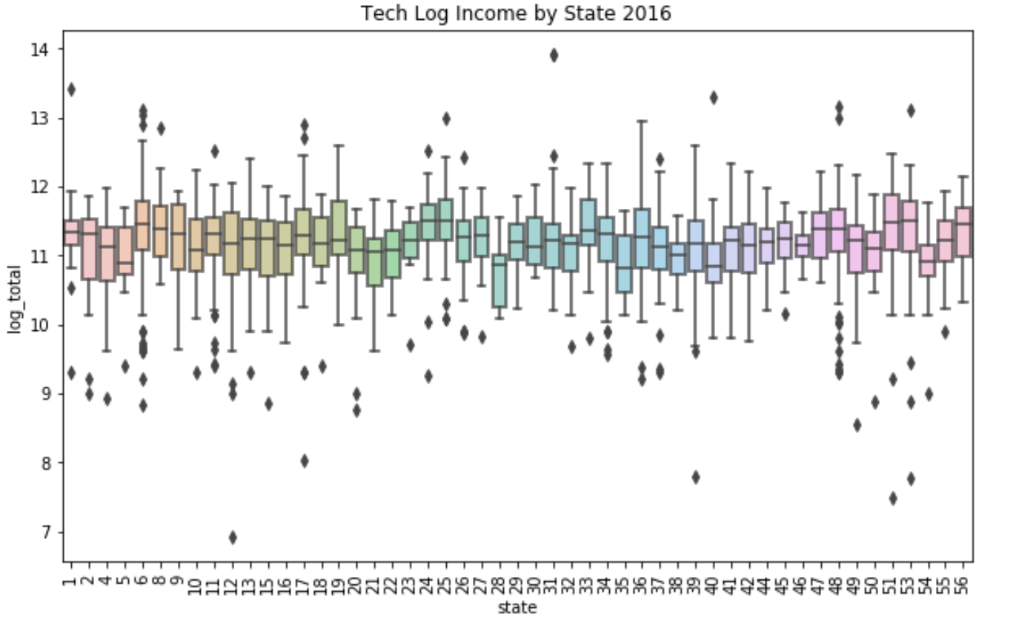
Boxplot: Income by State

Slide 10
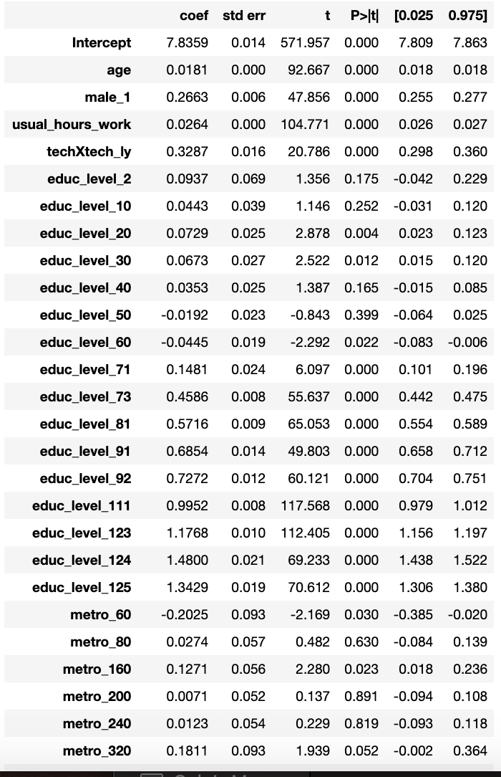
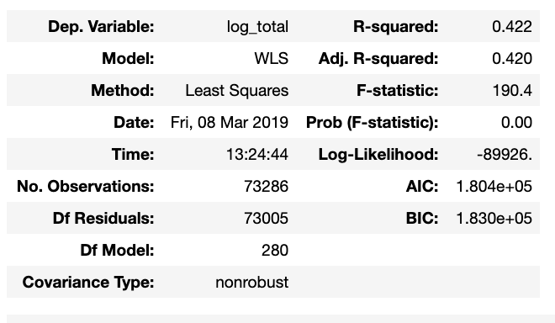
Weighted Least Squares (Overall)

Slide 11
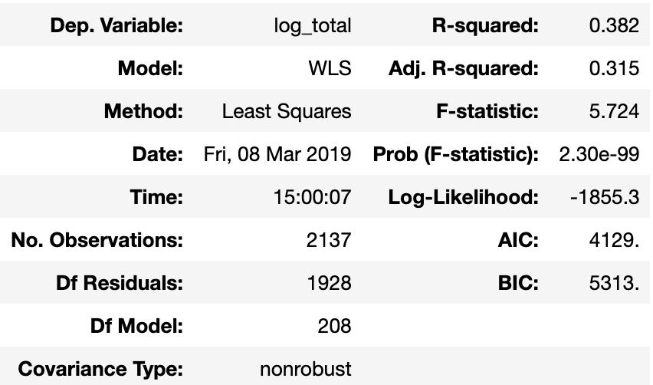
Weighted Least Squares (Tech)

Slide 12
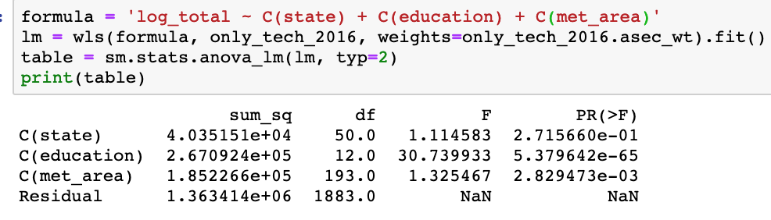
Anova

Slide 13
Cities
New York
San Francisco
D.C.
New Orleans
Seattle
Chicago

Slide 14
Takeaways
Formulate hypothesis before exploring data set
Stay in school
Weights correct for heteroscedasticity

