Slide 1
Bayle and the Atheist-Friendly
Euthyphro Dilemma
Cole Mitchell
Nov. 4th, 2024

Slide 2
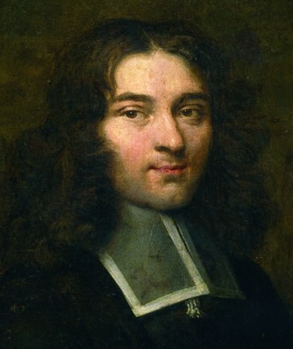
Who is Pierre Bayle?
1647–1706, Huguenot exile in the Dutch Refuge: “Le Philosophe de Rotterdam” who provided “the arsenal of the Enlightenment”
Wrote the Dictionnaire Historique et Critique (1696, 1702).

Slide 3
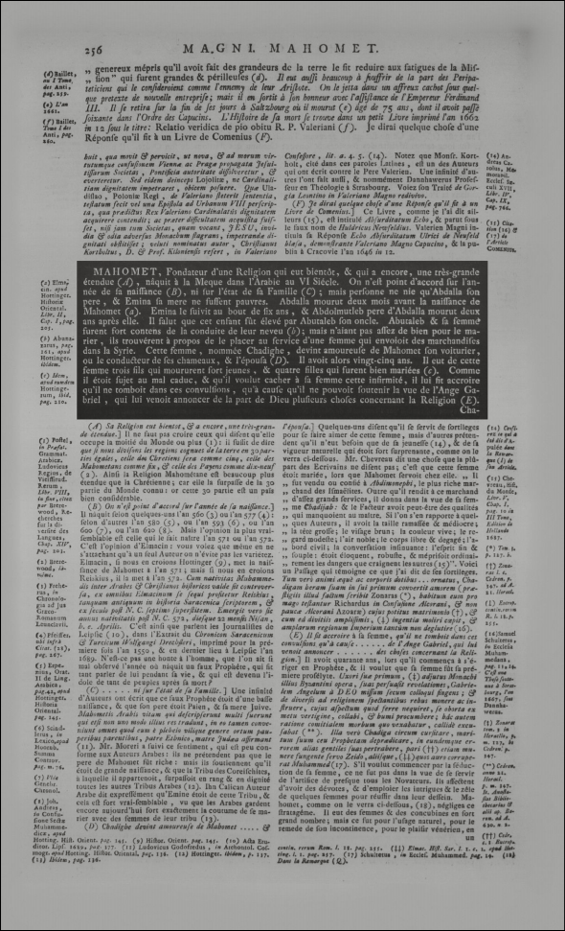
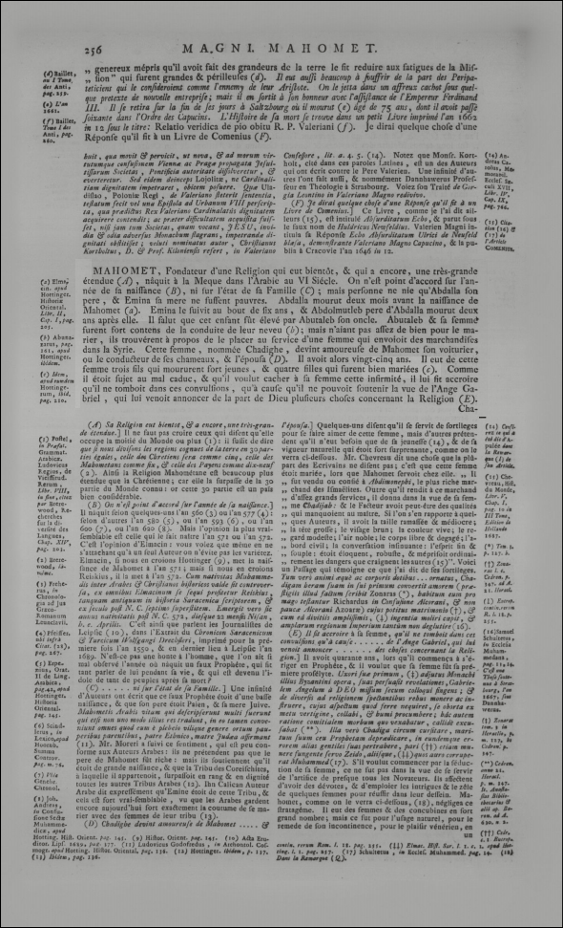
Who is Pierre Bayle?

Slide 4
Who is Pierre Bayle?

Slide 5
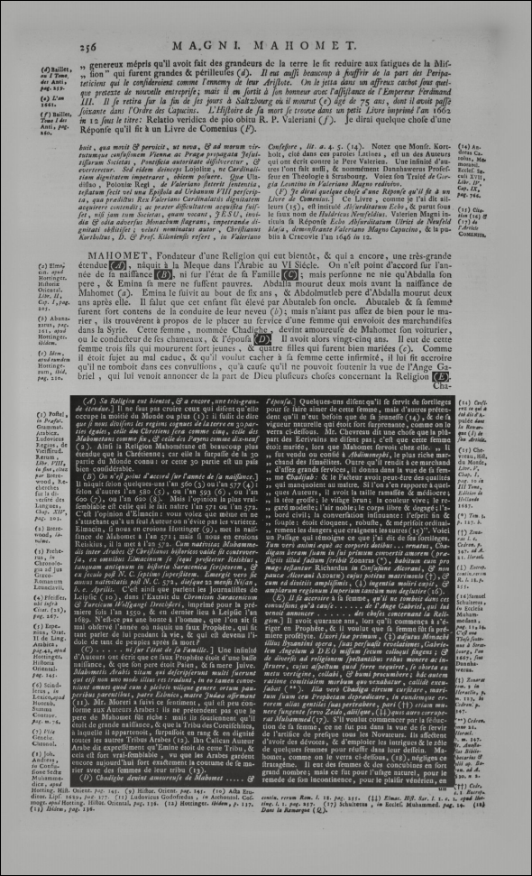
Who is Pierre Bayle?

Slide 6
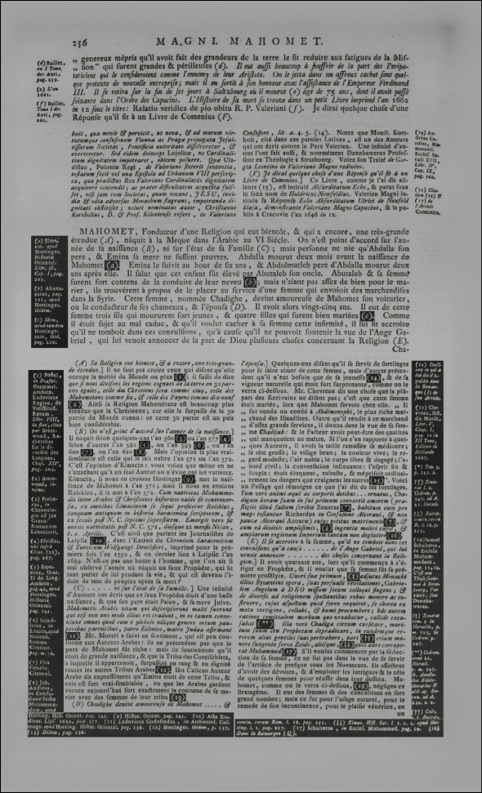
Who is Pierre Bayle?

Slide 7
Who is Pierre Bayle?
1647–1706, Huguenot exile in the Dutch Refuge: “Le Philosophe de Rotterdam” who provided “the arsenal of the Enlightenment”
Wrote the Dictionnaire Historique et Critique (1696, 1702).
The “Bayle Enigma”: Secret atheist? Fideist Calvinist? Pyrrhonian superskeptic? Academic skeptic? (Moral rationalist? Cartesian?)

Slide 8
Who is Pierre Bayle?
Hugely influential—both in his day and indirectly today:
Skepticism: “Pyrrho” article in the DHC
Toleration/Conscience: Commentaire philosophique (1686–87)
Problem of evil: Several articles in the DHC, especially “Manichéens” and “Pauliciens”; Dialogues (1707)
Leibniz’s Theodicy was a book-length commentary on Bayle
Law’s version of King’s De origine mali
Voltaire’s Candide, Hume’s Dialogues
Problem of the continuum: DHC article “Zénon d’Elée”
Leibniz
Berkeley’s earliest arguments against matter, infinite divisibility
Hume’s Treatise on space and time
And many more:
Berkeley and Hume’s argument against the 1q/2q distinction
Early critiques of pre-established harmony, of Spinoza
Shaftesbury’s ethics, Mandeville’s ethics

Slide 9
Continuation des Pensées diverses
Pensées diverses sur la Comète (1682)
Great Comet of 1680
paradox of the virtuous atheist
Continuation des Pensées diverses (1704)
‘Stratonician’ atheism
mindless nature → objective essences
rules of intellectual operations ≈ rules of acts of will
epistemic obligations ≈ moral obligations
commonplace divine intellectualism + Cajetan’s rose
Euthyphro dilemma?

Slide 11
Why to care about this
Birth of modern non-naturalism
The non-naturalist metaethics we associate with Moore is known to have important historical antecedents (whether or not Moore knew of them): obviously Sidgwick, but also e.g. Richard Price.
But we need an explanation for how we got from these historical antecedents all the way to the detheologized and depsychologized non-naturalism we know and love (?) today.
Early modern rationalists: for Malebranche, Leibniz, Cudworth, Clarke, and even Richard Price, God’s mind provides the ontological foundation for ethical truths.
19th-century intuitionists: This tendency continues into the 19th century, with such lesser-known figures as William Whewell, W. G. Ward, H. Calderwood. Other intuitionists (Dugald Stewart, Alexander Smith) seem to ignore ontological questions.
Understanding Moore’s ethical ontology and where it came from helps us understand how this important shift took place.

Slide 12
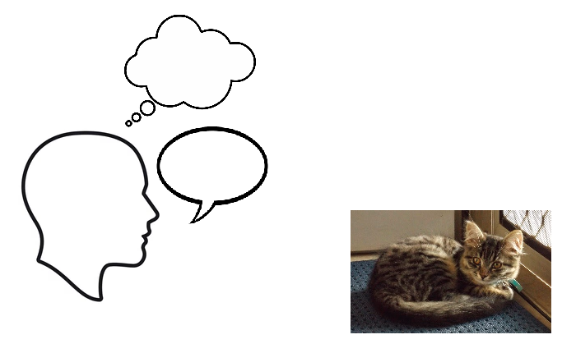
Moore’s background metaphysics

Slide 13
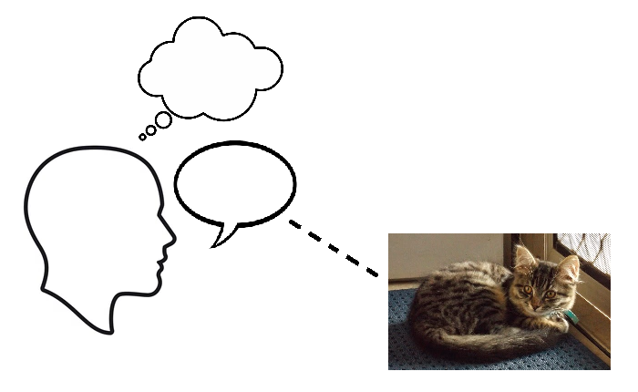
Moore’s background metaphysics

Slide 14
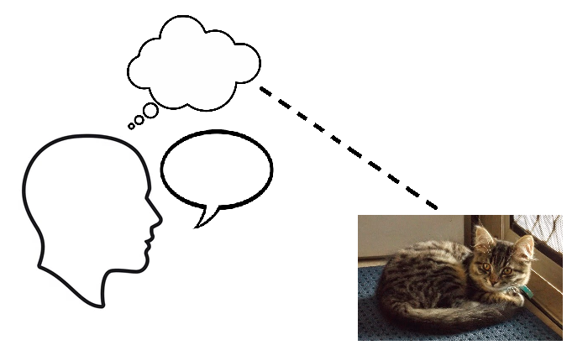
Moore’s background metaphysics

Slide 15
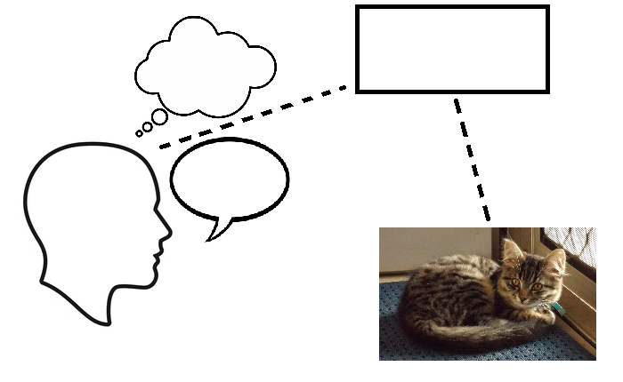
Moore’s background metaphysics

Slide 16

Moore’s background metaphysics

Slide 17
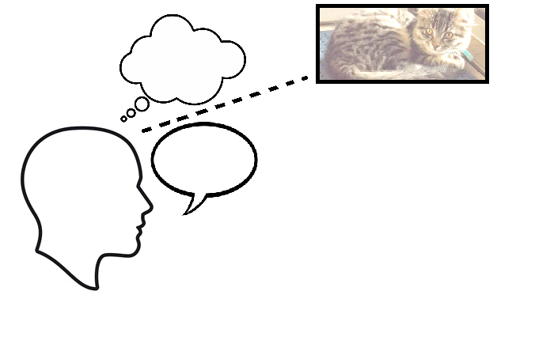
Moore’s background metaphysics

Slide 18
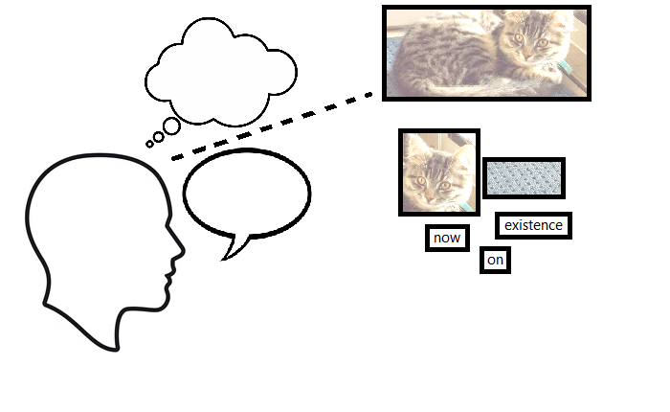
Moore’s background metaphysics

Slide 19
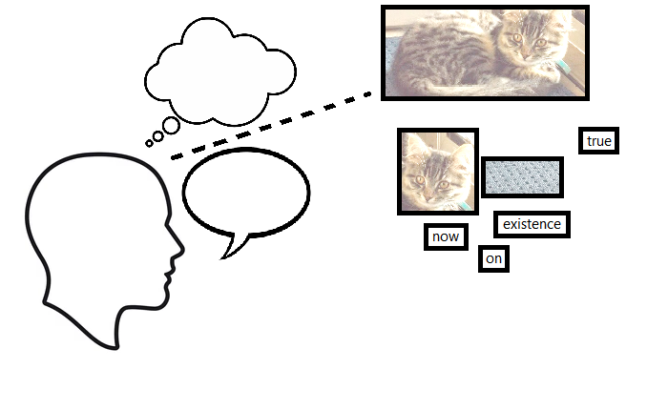
Moore’s background metaphysics

Slide 20
Moore’s background metaphysics
1. Semantic-ontological fusion

Slide 21
Moore’s background metaphysics
1. Semantic-ontological fusion 2. Correspondence theory

Slide 22
Moore’s background metaphysics
1. Semantic-ontological fusion 2. Correspondence theory
3. Being vs. existence

Slide 23
Moore’s background metaphysics
1. Semantic-ontological fusion 2. Correspondence theory
3. Being vs. existence 4. Subject-predicate breakdown

Slide 24
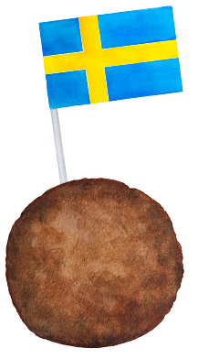
Doctrine of the Mere Predicate

Slide 25
Doctrine of the Mere Predicate
“By ‘nature,’ then, I do mean and have meant that which is the subject-matter of the natural sciences and also of psychology. It may be said to include all that has existed, does exist, or will exist in time.”
[…]
“There is, indeed, no difficulty about the ‘objects’ themselves, in the sense in which I have just used the term. It is easy to say which of them are natural, and which (if any) are not natural. But when we begin to consider the properties of objects, then I fear the problem is more difficult. Which among the properties of natural objects are natural properties, and which are not? For I do not deny that good is a property of certain natural objects: certain of them, I think, are good; and yet I have said that ‘good’ itself is not a natural property.”

Slide 26
Doctrine of the Mere Predicate
“Well, my test for these too also concerns their existence in time. Can we imagine ‘good’ as existing by itself in time, and not merely as a property of some natural object? For myself, I cannot so imagine it, whereas with the greater number of properties of objects—those which I call the natural properties—their existence does seem to me to be independent of the existence of those objects. They are, in fact, rather parts of which the object is made up than mere pred-icates which attach to it. If they were all taken away, no object would be left, not even a bare substance: for they are in themselves substantial and give to the object all the substance that it has. But this is not so with good.”
“If indeed good were a feeling, as some would have us believe, then it would exist in time. But that is why to call it so is to commit the naturalistic fallacy. It will always remain pertinent to ask, whether the feeling itself is good; and if so, then good cannot itself be identical with any feeling.” (PE, §26)

Slide 27
Doctrine of the Mere Predicate
Why natural properties can exist by themselves in time
Bundle theory
Subject-predicate breakdown
Extreme existential atomism
Why good cannot, but can only be a mere predicate attached to an object
Analogies: existence, truth
Running theme: nature-determining vs. nature-determined
Proposed argument: redundancy or incompleteness
Problems
Horse objection
Adjective problem

Slide 28
Doctrine of the Mere Predicate
Bundle Theory
Moore (along with Russell) rejects the traditional category of substance as a noun-like ‘subject’ prior to the adjective-like ‘predicates’ inhering in it. He sees this bringing an untenable commitment to a “bare substance” whose identity as a distinct individual is somehow independent of any predicate.
Instead, a natural object is simply a whole composed of constituent parts from which its substantial character is derived.
Subject-Predicate Breakdown
Q: Are these parts substantival or adjectival?
A: They are concepts, which may look adjectival but are as sub-stantival as it gets: “in the end, the concept turns out to be the only substantive or subject, and no one concept either more or less an adjective than any other” (NJ 192–193).
Russell agrees: concepts may play either role.

Slide 29
Doctrine of the Mere Predicate
Extreme Existential Atomism
Given bundle theory, it doesn’t necessarily follow that each constituent part can exist by itself.
But it seems to have been an attractive line of thought:
“If instead of answering these questions [about the origin of our alleged idea of mental substance], any one shou’d evade the difficulty, by saying, that the definition of a substance is something which may exist by itself; and that this definition ought to satisfy us: Shou’d this be said, I shou’d ob-serve, that this definition agrees to every thing, that can possibly be con-ceiv’d; and never will serve to distinguish substance from accident, or the soul from its perceptions. … [S]ince all our perceptions are different from each other, and from every thing else in the universe, they are also distinct and separable, and may be consider’d as separately existent, and may exist separately, and have no need of any thing else to support their existence. They are, therefore, substances, as far as this definition explains a sub-stance.” (Hume, Treatise 1.4.5.5)

Slide 30
Doctrine of the Mere Predicate
Extreme Existential Atomism: possible lines of thought
Derived substantiality: Perhaps Moore thinks that, since the constituent parts of a natural object give it all the substance it has (make it capable of existing by itself in time), these parts must themselves be substantial (be capable of existing by themselves in time).
Anti-Holism: Perhaps Moore thinks that, since each part of a whole must be what it is independently of its belonging to the whole (anti-holism), the part must itself be capable of existing independently of the existence of the whole.
Slippery slope: Perhaps Moore thinks that any reason for doubting that a substantial part can exist by itself (without depending on an object) will end up as a reason for doubting that the whole natural object can exist by itself (without depending on a universe). — Hello again to substance monism à la Bradley!

Slide 31
Doctrine of the Mere Predicate
Why is good a mere predicate, not a substantial part?
Analogies: Existence, Truth
When an existential proposition like “This cat exists” is true, there is a complex concept cat standing in certain relations to the other con-cepts this and existence. In virtue of these relations (not some exter-nal correspondence), the entire proposition has the property true.
Existence: The existence of an existent is not part of that existent (e.g., the concept existence is not part of the complex concepts cat or this cat) Take away existence and cat is still there. In any true existen-tial proposition, the concept existence must have another concept (e.g. cat) it can be ‘attached’ to.
Truth: The property true is a concept like anything else. The truth of a proposition is not part of that proposition. Take away true and the proposition is still there. Instead of its being true determining the nature of the proposition, its being true depends upon the nature of the proposition (its internal relations) that true is ‘attached’ to.

Slide 32
Doctrine of the Mere Predicate
Why is good a mere predicate, not a substantial part?
Running theme: value as nature-determined, not nature-determining
“A speculative reasoner concerning triangles or circles considers the several known and given relations of the parts of these figures; and thence infers some unknown relation, which is dependent on the for-mer. But in moral deliberations, we must be acquainted, before-hand, with all the objects, and all their relations to each other; and from a comparison of the whole, fix our choice or approbation. No new fact to be ascertained: No new relation to be discovered. All the circumstances of the case are supposed to be laid before us, ere we can fix any sen-tence of blame or approbation. … In all the sciences, our mind, from the known relations, investigates the unknown: But in all decisions of taste or external beauty, all the relations are before-hand obvious to the eye. … [T]he beauty is not in any of the parts or members of a pillar, but results from the whole.” (Hume, 2nd Enq. App. I)

Slide 33
Doctrine of the Mere Predicate
Why is good a mere predicate, not a substantial part?
Running theme: value as nature-determined, not nature-determining
“[T]he difference between goodness or value and such attributes as yellowness is that whereas the latter are differentiae (i.e. fundamen-tal or constitutive attributes) of their possessors, the former is a prop-erty (i.e. a consequential attribute) of them. … Valu[e] seems quite definitely to be based on certain other qualities of its possessors, and not the other qualities on the value. … [W]hile mathematical (i.e. spa-tial, temporal, and numerical) properties follow from part of the intrin-sic nature of their possessors, value follows from the whole intrinsic na-ture of its possessors. If a patch of colour is in shape an equilateral tri-angle, it will be an equiangular triangle, whatever be its size or colour[.] … These attributes which are based on some single element in the nature of their possessors may be called parti-resultant properties. In contrast with these, value is a toti-resultant property, based on the whole nature of its possessors. And this is true not only of ‘good’, the adjective which expresses intrinsic value, but also of ‘right’ and ‘beauti-ful’” (Ross, The Right and the Good, Ch. IV, pp. 121–22).

Slide 34
Doctrine of the Mere Predicate
Why is good a mere predicate, not a substantial part?
Running theme: value as nature-determined, not nature-determining
“[T]hough both yellowness and beauty are predicates which depend only on the intrinsic nature of what possesses them, yet while yellow-ness is itself an intrinsic predicate, beauty is not. Indeed it seems to me to be one of the most important truths about predicates of value, that though many of them are intrinsic kinds of value, in the sense I have defined, yet none of them are intrinsic properties, in the sense in which such properties as “yellow” or the property of “being a state of plea-sure” or “being a state of things which contains a balance of pleasure” are intrinsic properties. … I can only vaguely express the kind of differ-ence I feel there to be by saying that intrinsic properties seem to des-cribe the intrinsic nature of what possesses them in a sense in which predicates of value never do. If you could enumerate all the intrinsic properties a given thing possessed, you would have given a complete description of it, and would not need to mention any predicates of value it possessed; whereas no description of a given thing could be complete which omitted any intrinsic property.” (Moore, CIV (1922))

Slide 35
Doctrine of the Mere Predicate
Proposed argument: redundancy or incompleteness
Here’s an argument inspired by Hume, Ross, and Moore:
If x’s value is part of x’s nature, then evaluation of x is either (a) based on x’s nature including its value, or (b) based on x’s nature excluding its value.
If (a), then the evaluation fails because it is redundant, i.e. based on an account of x’s nature that explicitly cites its value.
If (b), then the evaluation fails because it is incomplete, i.e. based on an account of x’s nature that omits material.
So, if x’s value is part of x’s nature, then any evaluation of x fails.

Slide 36
Doctrine of the Mere Predicate
Problem 1: Horse objection
A horse’s property of being a horse cannot exist by itself in time: it can exist only due to countless underlying physical properties.
In general, any property other than those at the most fundamental level will be like this: e.g., being warm-blooded.
Does that make them non-natural properties for Moore!?
Possible solutions:
‘This property can exist by itself in time’ means ‘This property of this object can exist in time without the object’s also existing’.
Might handle being warm-blooded, but being a horse?
Perhaps Moore’s distinction tacitly operates at the level of simple properties: being incapable of existing by oneself may be typical for complex properties of natural objects, but it is still quite atypical for simple properties of natural objects.

Slide 37
Doctrine of the Mere Predicate
Problem 2: Adjective problem
In “Nature of Judgment” (1899), Moore writes that “no one concept [is] either more or less an adjective than any other.”
But doesn’t this doctrine make good more adjectival and less substantival than natural properties?
Possible solutions:
Developmental: Maybe Moore changed his mind between 1899 and 1903? (see Hochberg 1962)
No: the material presenting this doctrine was written for Moore’s Autumn 1898 lectures.
Bite the textual bullet: When Moore wrote that, he was thinking of natural objects and the natural properties that make them up, and not about the atypical case of good.

Slide 38
Doctrine of the Mere Predicate
Summing up
Moore’s “utterly silly and preposterous” view that good is non-natural because it cannot exist by itself in time turns out to be his early version of the following claim:
If x has intrinsic value, then although many of x’s properties play a role in determining x’s nature, its value plays no such role and is (on the contrary) determined by x’s nature being what it is.
Moore’s later work develops a new version of the claim.
The underlying idea is something Mooreans, Humeans, and others may well find (at least initially) plausible.

Slide 39
Doctrine of Non-Existential Being
“I call those philosophers preeminently ‘metaphysical’ who have recog-nised most clearly that not everything which is is a ‘natural object.’ ‘Metaphysicians’ have, therefore, the great merit of insisting that our knowledge is not confined to the things which we can touch and see and feel. They have always been much occupied … with the class of ob-jects or properties of objects, which certainly do not exist in time, are not therefore parts of Nature, and which, in fact, do not exist at all. To this class, as I have said, belongs what we mean by the adjective ‘good.’ It is not goodness, but only the things or qualities which are good, which can exist in time—can have duration, and begin and cease to exist—can be objects of perception. But the most prominent members of this class are perhaps numbers. It is quite certain that two natural objects may exist; but it is equally certain that two itself does not exist and never can. Two and two are four. But that does not mean that either two or four exists. Yet it certainly means something. Two is somehow, although it does not exist.”

Slide 40
Doctrine of Non-Existential Being
“And it is not only simple terms of propositions—the objects about which we know truths—that belong to this class. The truths which we know about them form, perhaps, a still more important subdivision. No truth does, in fact, exist; but this is peculiarly obvious with regard to truths like ‘Two and two are four,’ in which the objects, about which they are truths, do not exist either.”
[…]
“But though, if we are to define ‘metaphysics’ by the contribution which it has actually made to knowledge, we should have to say that it has emphasized the importance of objects which do not exist at all, metaphysicians themselves have not recognised this. [T]hey have in general supposed that whatever does not exist in time, must at least exist elsewhere, if it is to be at all—that, what-ever does not exist in Nature, must exist in some supersensible reality, whether timeless or not. … I think that the most prominent characteristic of meta-physics, in history, has been its profession to prove the truth about non-natural existents. I define ‘metaphysical,’ therefore, by a reference to supersensible reality; although I think that the only non-natural objects, about which it has succeeded in obtaining truth, are objects which do not exist at all.” (PE, §66)

Slide 41
Doctrine of Non-Existential Being
Origins: where did Moore get it from?
Classics? Earlier Non-Existential Platonism? Austrian irrealia?
Clarifying: puzzle of timeless existence
What exactly is the difference supposed to be between timeless existence and timeless being?
Arguments? Advantages?
Does Moore have a positive argument here? Is it a matter of ontological modesty? What advantages might he have seen in this doctrine?

Slide 42
Doctrine of Non-Existential Being
Origins: where did Moore get it from?
Classics:
Plato: The Good is beyond being? Being vs. Becoming?
Aristotle: Being is said in many ways.
Stoics: Incorporeal lekta do not exist, but do subsist and can obtain.

Slide 43
Doctrine of Non-Existential Being
Origins: where did Moore get it from?
Moore on Plato (dissertations):
“On our view, then, the distinction between ‘what ought to be’ and ‘what is’ is not such as to justify a fundamental division of Philosophy or of the Reason into the two parts ‘Theoretical’ and ‘Practical’. … In fact the distinction between ‘what ought to be’ and ‘what is’ is not as great as the distinction between what is and what exists; and the ‘practical’ is so far from representing ‘what ought to be’ that it is inextricably bound up with mere existence. … So far therefore as general philosophical scheme goes, the standpoint here taken up seems to agree most with that of Plato. The ‘good’ is to be considered as an Idea ἐπέκεινα τῆς οὐσίας perhaps—(the meaning that can be attached to such a phrase will be subsequently considered): but the really essen-tial distinction is between ὄντα and γιγνόμενα and the ‘prac-tical’, by its very notion, belongs to the latter class.” (Intro.)

Slide 44
Doctrine of Non-Existential Being
Origins: where did Moore get it from?
Moore on Plato (proto-PE lectures):
“Well then, the metaphysical philosophers have recognised this peculiar kind of being which belongs to concepts as such[.] And that, I think, is the great merit of metaphysicians. They have proved it is not true that nothing is but that which we can touch and see and feel, even though it may be true that nothing else exists. This, I think, is the chief significance of Plato’s doctrine of Ideas, of which you all have heard. They are not ideas in the sense in which we commonly use the word. The Greek word for them is εἶδος or ἰδέα which just means ‘form’. And they are what I have called concepts, something which is whether it exists or not, the only thing which can be known with absolute precision.”

Slide 45
Doctrine of Non-Existential Being
Origins: where did Moore get it from?
Moore on Plato (proto-PE lectures):
“But neither Plato nor the other metaphysicians have been con-tent with this. They have also wished to assert of certain con-cepts, not only that they are but that they do exist, and exist not in space and time, but in another world which is not temporal but eternal. And this other world has been called reality, as op-posed to nature, which is condemned as mere appearance. The arguments for the existence of this other world, this truly real world, are too long and complicated for me to discuss them here. I can only say that none of them appear to be convincing. The most convincing appear to me to rest on the confusion of these very notions of being and existence, which metaphysics has once for all distinguished. Such is the ontological argument, both in the old form, which Kant refuted, and in the new form which Hegel gave to it.” (Elements of Ethics, Lect. V)

Slide 46
Doctrine of Non-Existential Being
Origins: where did Moore get it from?
Thomas Reid on universals as “things conceived”?:
“The nature of every species, whether of substance, of quality, or of relation, and in general every thing which the ancients called an universal, answers to the description of a Platonic idea, if in that description you leave out the attribute of existence. … When we say that they are in the mind, this can mean no more but that they are conceived by the mind, or that they are objects of thought. The act of conceiving them is no doubt in the mind; the things conceived have no place, because they have not exis-tence. … The natural prejudice of mankind, that what we con-ceive must have existence, led those ancient Philosophers to at-tribute existence to ideas; and by this they were led into all the extravagant and mysterious parts of their system. When it is purged of these, I apprehend it to be the only intelligible and rational system concerning ideas.” (Intellectual Powers 4.2–4.3)

Slide 47
Doctrine of Non-Existential Being
Origins: where did Moore get it from?
Hermann Lotze on ideas as non-existent?:
Lotze proposes a fourfold division of ontological status (being real/actual, what affirming ascribes):
Things: are/exist [sein]
Events: occur [geschieht]
Relations: obtain/subsist [besteht]
Propositions: hold/are valid [gilt]
“Now Ideas, in so far as they are present in our minds, possess reality in the sense of an Event,—they occur in us: for as utterances of an activity of presentation they are never a Being at rest but a continual Becom-ing; their content on the other hand, so far as we regard it in abstrac-tion from the mental activity which we direct to it, can no longer be said to occur, though neither again does it exist as things exist, we can only say that it possesses Validity.” (Logic, §316)

Slide 48
Doctrine of Non-Existential Being
Origins: where did Moore get it from?
Hermann Lotze on ideas as non-existent?:
“While Plato by thus describing the Ideas, takes security for their inde-pendent validity, he has at the same time abundantly provided against the confusion of the validity thus implied with that wholly distinct re-ality of Existence which could only be ascribed to a durable thing. When he places the home of the Ideas in a super-celestial world, a world of pure intelligence (νοητός, ὑπερουράνιος τόπος), when again more than this he expressly describes them as having no local habita-tion, such language makes it abundantly clear to any one who under-stands the mind of Greek Antiquity, that they do not belong to what we call the real world. To the Greek that which is not in Space is not at all, and when Plato relegates the Ideas to a home which is not in space, he is not trying to hypostasize that which we call their mere validity into any kind of real existence, but on the contrary he is plainly seeking to guard by anticipation against any such attempt being made.” (Ibid., §318)

Slide 49
Doctrine of Non-Existential Being
Origins: where did Moore get it from?
Bernard Bolzano on objects without actual existence?:
“By objective idea I mean the certain something which constitutes the immediate matter [Stoff] of a subjective idea, and which is not to be found in the realm of the actual. An objective idea does not require a subject but subsists [bestehen], not indeed as something existing, but as a certain something even though no thinking being may grasp it.” (Theory of Science, §48)

Slide 50
Doctrine of Non-Existential Being
Origins: where did Moore get it from?
Bernard Bolzano on objects without actual existence?:
“One attribute which all ideas have in common is that they do not have actual existence. … No one will doubt the correctness of this claim once he understands from our usage what concept we con-nect with the words existence, actuality and actual existence. Who-ever understands us when we say that God has actual existence, that the world is something actual, but that a round square is noth-ing existing, etc., will readily grant that ideas in themselves belong to the class of things that have no actuality. Thought ideas, i.e., thoughts, certainly have existence in the minds of those who think, and insofar as all ideas are grasped by God's infinite intelligence, there is not a single idea in itself to which there does not corres-pond a thought, and thus an actual (indeed eternally actual) idea in God's understanding. But these thought ideas must not be con-fused with their matter, the ideas in themselves. The latter have no existence.” (Ibid., §54)

Slide 51
Doctrine of Non-Existential Being
Origins: where did Moore get it from?
Bernard Bolzano on objects without actual existence?:
“Now you see how I can then differentiate between ideas that have no existing object and those that are completely objectless. Other-wise, for example, the two ideas "supreme moral law" and "a prop-osition that has neither a subject nor a predicate" could no longer be distinguished. The object that corresponds to the first is a cer-tain truth in itself (perhaps one that is still unknown to us); thus not something existing, yet nevertheless something. The second idea, however, has, or rather can have, no object at all, for every proposition must have both a subject and a predicate.” (Bolzano-Exner Correspondence, 9 July 1833)

Slide 52
Doctrine of Non-Existential Being
Origins: where did Moore get it from?
Commonalities among Reid, Bolzano, and Lotze:
Domains of unchanging objective truth fit for demonstrations (mathematics, ethics).
Not to be accounted for in terms of ideas (i.e., ideas under-stood as psychological phenomena).
Distinction between act and object—where the objects are extra-mental universals, propositions, concepts, numbers, …
Denial that the object has existence (even in God’s mind).
Insistence that the object is still something, not nothing.
Framing of this as a reconceived version of Plato’s ideas, and/or a non-psychological middle ground between Realism and Nominalism.

Slide 53
Doctrine of Non-Existential Being
Origins: where did Moore get it from?
Austrian irrealia:
Brentano (early), Stumpf, Marty, Twardowski, et al. accepted a distinction between the real and the non-real.
A real thing is a particular concrete thing that comes into and goes out of existence due to causal relations with other real things.
What is non-real comes into and goes out of existence only in virtue of underlying causal activity among real things.
Examples of irrealia (for Marty): collectives, relations, states of affairs, values(!), lacks/absences, possibilities. (B. Smith 1990)
They did not accept a plural ontology: my (irreal) lack of an third ear exists in the same way my (real) two ears do. (Cf. the view that abstract objects exist in the same way concrete objects do.)

Slide 54
Doctrine of Non-Existential Being
Origins: where did Moore get it from?
Austrian irrealia:
This was the tradition in which Meinong and Husserl were trained, and these were the kinds of things to which they applied their plural ontology (typically put in terms of the real and the ideal).
And (despite Brentano’s misgivings) they did so under the influence of Bolzano and Lotze.
This was also the tradition that informed much of the work of Moore and Russell’s Cambridge professor G. F. Stout—who, along with James Ward, exposed them to Lotze.
Hypothesis: It was G. F. Stout who (running parallel to Meinong) taught Moore the distinction between being and existence, and how to apply it in distinguishing mental acts from their extra-mental objects.

Slide 55
Doctrine of Non-Existential Being
Origins: where did Moore get it from?
Stout on being vs. existence:
“Whatever we can in any way perceive or think has a being and nature of its own independently of the processes by which we cognise it. We do not create it, but only become aware of it in the process of cognition. The number two, the fact that 2 + 1 = 3, the validity of a syllogism in Barbara, the necessity or the arbit-rariness of the transitions in Hegel's Logic, a symphony of Bee-thoven, the moral law, all these are possible objects of our cognition, and all these, inasmuch us they are objects, possess a being and nature of their own, whether anyone is actually thin-king of them or not. But their independent being and nature dif-fers profoundly from that of material things, because it does not consist in independent persistence and change in time and space.” (1900-01 article)

Slide 56
Doctrine of Non-Existential Being
Origins: where did Moore get it from?
Stout on being vs. existence:
“Now I do not see how it can be denied that there is a system of evidently true propositions which are not directly concerned with actual existence. Further, it seems clear that truths cannot be true of nothing. They must ex-press what in some sense has being. We cannot know and yet know noth-ing. Nor will it do to say that what we are dealing with is a creature of thought. It may indeed be true that all being, including actual existence, is relative to mind, in the sense that it could not be without mind. But what is here suggested is that the process of knowing may make or produce its own object, that the being of a concept may consist of being conceived. This seems a quite untenable position, and has in fact been sufficiently re-futed by Plato. To think is to think something; thought, therefore, cannot exist prior to what is thought of; it cannot therefore make or produce what is thought of. The subject-matter of logic and pure mathematics has a na-ture of its own which our thinking simply discovers and does not, in any sense, create. ... There is then a region of being, of vast extent and impor-tance, distinct from that of actually existing particulars.” (1919/1921 response to Russell’s Problems of Philosophy)

Slide 57
Doctrine of Non-Existential Being
Clarifying: puzzle of timeless existence
Timeless being vs. timeless existence:
The metaphysics Moore opposes infers a “supersensible reality” of existing objects. And (commonly enough) this reality and its objects are supposed to be timeless.
For Moore, it is very important that good is not a timeless existent, but only a timeless being (incapable of existence).
But what exactly is the difference supposed to be?
Possible accounts
Structural: existence is an added ontological status, whereas being is a standard/default ontological status
Epistemic: existents are known via observation or inference, not immediate awareness
Causal: existents are causally efficacious

Slide 58
Doctrine of Non-Existential Being
Arguments? Advantages?
Moore may not have a positive argument:
No one would think good is a timeless existent if they weren’t bamboozled by the naturalistic fallacy into defining good.
“[Metaphysical Ethics] involves the naturalistic fallacy. It rests upon the failure to perceive that any truth which asserts ‘This is good in itself’ is quite unique in kind—that it cannot be reduced to any assertion about reality, and therefore must remain unaffected by any conclusions we may reach about the nature of reality. This confusion as to the unique nature of ethical truths is, I have said, involved in all those ethical theories which I have called metaphysical. It is plain that, but for some confusion of the sort, no-one would think it worth while even to describe the Supreme Good in metaphysical terms.” (PE, §67)

Slide 59
Doctrine of Non-Existential Being
Arguments? Advantages?
Moore may not have a positive argument:
And one major reason they commit the NF—i.e. try to define good in terms of an existent—is something like force of habit.
“This reason lies in the supposition that the proposition ‘This is good’ or ‘This would be good, if it existed’ must, in a certain respect, be of the same type as other propositions. The fact is that there is one type of proposition so familiar to everyone, and therefore having such a strong hold upon the imagination, that philosophers have always sup-posed that all other types of propositions must be reducible to it. This type is that of the objects of experience[.] … All these truths, however much they may differ, have this in common that in them both the grammatical subject and the grammatical object stand for something which exists. Immensely the commonest type of truth, then, is one which asserts a relation between two existing things. Ethical truths are immediately felt not to conform to this type, and the naturalistic fallacy arises from the attempt to make out that, in some roundabout way, they do conform to it.” (PE, §73)

Slide 60
Doctrine of Non-Existential Being
Arguments? Advantages?
Moore may have more indirect considerations:
Once you see how Naturalistic Fallacy considerations (e.g., the Open Question Argument) can defeat any particular meta-physical definition of good, you’ll be left without any reason to think good is a supersensible/timeless existent.
And once you get past the habitual prejudice of thinking all truths must be existential truths, you can easily see the truth of the face-value view: ethical truths carry only the implication of non-existential being.
“But it is beyond even their powers [viz., metaphysical philoso-phers] to believe that what you do mean is merely what you say. They still think you must mean, somehow or other, that some-thing does exist, since that is what you generally mean when you say anything. They are as unable as the empiricists to imagine that you can ever mean that 2 + 2 = 4.” (PE, §73)

Slide 61
Doctrine of Non-Existential Being
Arguments? Advantages?
What about ontological modesty?:
“Moore himself said little about his non-natural property and even tried to limit his metaphysical claims, saying that though goodness is an object and therefore ‘is somehow’, it does not ‘exist’, and in par-ticular does not exist in a ‘supersensible reality’. … Moore can even be read here as holding a version of the modest view defended by Derek Parfit, which says normative properties ‘exist’ but only in a ‘non-onto-logical’ sense that has no metaphysical implications[.] I doubt Moore unambiguously intended a view like Parfit’s, since he never clearly explained his contrast between being and existing[.] ... But he did try to make his view less metaphysical.” (Hurka 2015, p. 90)
It’s not clear to me whether Moore can claim credit for modestly holding that good and the number two don’t exist when, on his view, neither is even capable of existing.
Ontological modesty makes more sense for God and unicorns: concepts that are ‘existence-apt’ in a way that good isn’t.

Slide 62
Doctrine of Non-Existential Being
Arguments? Advantages?
Did Moore see advantages?

Slide 63
Doctrine of Non-Existential Being
Arguments? Advantages?
Did Moore see advantages? Independence from existence
“The great merit of [Brentano’s] view over all except Sidgwick’s is its recognition that all truths of the form ‘This is good in itself’ are logically independent of any truth about what exists. No eth-ical proposition of this form is such that, if a certain thing exists, it is true, whereas, if that thing does not exist, it is false. All such ethical truths are true, whatever the nature of the world may be.” (Review of Brentano, p. 116)
Fundamental ethical principles tell us not what existing things are good, but what would be good if it existed (“things which ought to exist, whether they do exist or not”).
Presumably, Moore thinks ethical truths would be true even if nothing existed whatsoever. (Cf. Parfit thinks they would be true even if “nothing had ever existed in any ontological sense,” Parfit 2011 vol. 2, p. 485)

Slide 64
Doctrine of Non-Existential Being
Arguments? Advantages?
Did Moore see advantages? Metaphysical precariousness
If good were a timeless existent known via metaphysical inference rather than immediate awareness, ethical truths would be vulnerable to metaphysical counterarguments.
“Kant’s assertion of the ‘Autonomy of the Practical Reason’ thus has the very opposite effect to that which he desired; it makes his Ethics ultimately and hopelessly ‘heteronomous.’ … He admits that Freedom is the ratio essendi of the Moral Law[.] And this means that, unless Reality be such as he says, no assertion that ‘This is good’ can possibly be true: it can indeed have no meaning. He has, therefore, furnished his opponents with a conclusive method of attacking the validity of the Moral Law. … [I]f it can be shewn that there is no Free Will which wills anything, it will follow that nothing ought to be done.” (PE, §75)

Slide 65
Doctrine of Non-Existential Being
Summing up
Moore’s “historical curiosity” of a doctrine is his attempt to model moral objectivity on the non-existential Platonism his teachers and peers had been developing for logic and other domains (under the influence of Bolzano and Lotze).
He takes it as a face-value view that resists the urge to find some or other independently specified metaphysical existent for good to be defined in terms of.
It allows us to do ethics without needing to commit our-selves to any view on the nature of the world.
It avoids the danger of building vulnerable metaphysical presuppositions into one’s fundamental ethical principles.
But it requires an ontology of timeless objects knowable via immediate awareness.

Slide 66
Conclusion: Moore’s ontology and NF/OQA
Defeating naturalistic and metaphysical definitions of good (with such ‘Naturalistic Fallacy’ considerations as the Open Question Argument) is not enough to show that good is neither a natural property nor a metaphysical property.
Even if definitions are ontologically freighted!
Of course, doing so can indirectly help you reach this con-clusion: by countering your resistance to Moore’s argument that good isn’t a natural property, or by removing your reasons for thinking good must exist in some supersensible reality.
Still, these considerations play only a subsidiary role in motivating Moore’s non-naturalist ontology in PE.

Slide 67
The End

