Slide 1
Inferencia Bayesiana
Modelos Bayesianos con aplicaciones ecológicas
Dr. Cole Monnahan
University of Concepción, Chile
Enero, 2018

Slide 2
Recap
The posterior probability of the parameters given data is:
P(θ |y)=cP(θ)P(y|θ)
Posterior = (constant)(prior)(likelihood)
To do inference (mean, median, quantiles) we must integrate
Integration is done with MCMC which draws correlated samples
Must check for signs of non-convergence

Slide 3
Building Bayesian models
Gelman et al (2014) recommend three basic steps
Set up a joint probability distribution for all observable and unobservable quantities, consistent with underlying expertise
Condition on the observed data and fit the model to get a posterior distribution
Evaluate the fit of the model. Are conclusions reasonable, sensitive to assumptions?

Slide 4
Setting up the model: data generation
Specify the data-generating process
What is the structure of the model?
What kind of data can arise from it?
These determine the likelihood
E.g., somatic growth always increases and can never be negative
Imperfect measurements can be lower than truth but never negative
So we chose a VB growth curve with log-normal error

Slide 5
Setting up the model: the prior
Identify the unknown parameters of this process and specify priors
This is the controversial “subjective” step
Sometimes we have information from previous studies, while sometimes explicit expert opinion.
Other times it is not as clear what to use.
What do we “know” about a system **before** we have data?

Slide 6
Advice for setting priors
Terms “vague”, “weakly informative” etc. are not defined
It is often best when parameters are roughly on unit scale
E.g., standardize predictors, divide by scale
If true priors are easier to interpret
Avoid hard constraints unless there’s a physical reason, e.g., θ>0 or 0<p<1.
E.g., if you think 0< θ <1, use N(.5,.5) instead of U(0,1)
https://github.com/stan-dev/stan/wiki/Prior-Choice-Recommendations

Slide 7
Setting up the model: the prior
It is also recommended to plot the prior vs the marginal posterior after the fact.
Exploring different priors like this can help gauge the sensitivity

Slide 8
The prior predictive distribution
Almost always we know something. E.g. “we can be fairly sure that we won’t observe any particularly healthy [birds] cruising near the speed of light”¹
We identify a meaningful statistic (e.g., speed) and ensure that:
Few values are beyond the threshold (extreme is unreasonable but not impossible)
But not excessive values beyond them
This is *before* the data is added
¹ https://betanalpha.github.io/assets/case_studies/principled_bayesian_workflow.html

Slide 9
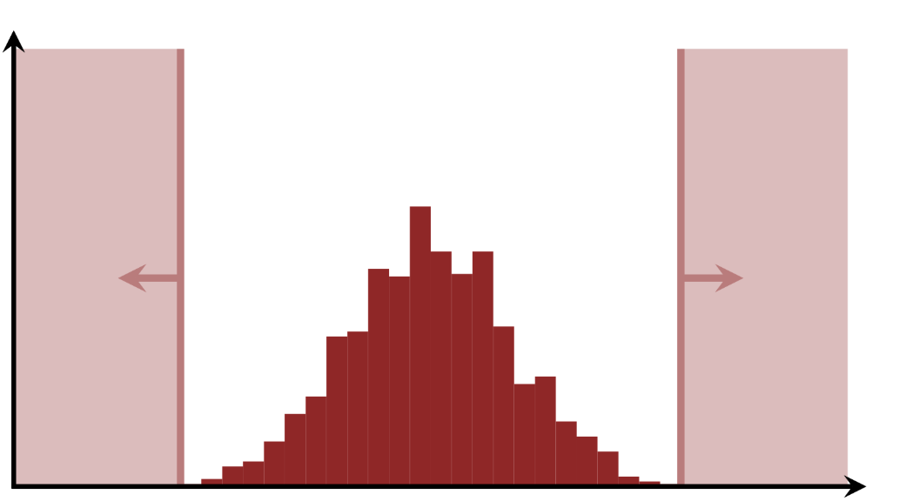
The prior predictive distribution
Run model with priors and model structure
But *no data*
Plot histogram of meaningful statistic
Is it realistic?
If not, priors do not reflect your expertise
Thresholds
Statisic
Extremes unlikely but possible
¹ https://betanalpha.github.io/assets/case_studies/principled_bayesian_workflow.html

Slide 10
Exercise
Track 20 animals over a year, expect that between 10 and 20 will survive (S) (i.e., binomial likelihood)
Let probability of survival = p =ilogit(theta) where ilogit=1/(1+exp(-x))
Assume prior: theta~N(0,100)
Plot the implied prior on p and the prior predictive distribution for S
Recalibrate theta to match our prior knowledge

Slide 11
Running the model
Once happy with the model, introduce the data and fit it (draw samples)
We check for signs of non-convergence
[Demo in R]
model {
# Prior
theta~dnorm(1, 1/(.5*.5))
logit(p) <- theta
# likelihood
y ~ dbin(p, N)
}

Slide 12
Exercise
Update model and R code to accept 3 individual replicates of the experiment
dat2 <- list(y=c(15, 12, 11), N=c(20,20,20), R=3)
dat3 <- list(y=c(15, 12, 11, 12, 4, 15, 17, 12, 16, 14),
N=rep(20, 10), R=10)
Then repeat with data set 3. Plot priors vs posterior for theta.

Slide 13
Checking the model
Rember that MCMC is a method for fitting (drawing samples)
Convergence does not mean the model fits well
So how do we tell if our model is appropriate for the data?
One common way is a posterior predictive distribution.

Slide 14
Posterior predictive distribution
Rember that MCMC is a method for fitting (drawing samples)
MCMC convergence does not mean the model fits well
So how do we tell if our model is appropriate for the data?
One common way is a posterior predictive distribution.

Slide 15
Posterior predictive distribution
The idea is to replicate the data generating process given the posterior distribution
Can do it in R or inside the model
We then compare the observed data, to those that the model predicts *would be* observed
The real data should fall within the observed, or the model is not adequately describing the process

Slide 16
Posterior predictive distribution
Specifically, if we have a posterior sample θ* then we can simulate a new data point y* by generating it from the process
E.g., in our case y*=rbinom(1, 20, p*). This gives one predicted data point. Repeat for all values of θ* to form a distribution.
Then compare this (often visually) to the observed data and look for bad patterns

Slide 17
Exercise
Take the previous JAGS model and add a posterior predictive distribution, one for each replicate for each sample
[Hint: ypred[i] ~ dbin(p,N[i]) will actually do random number generation like rbinom]
Plot the distribution of replicate vs posterior predictive and then add the real data on top
[Hint: use jittering for visual clarity]

Slide 18
Bayesian model selection
Model selection is not trivial. There are many existing tools and more being developed.
According to Hobbs & Hooten (2018)
Out of sample is the best approach if possible
K-fold cross validation good but slow
DIC is good when prediction is important and model is slow, works best when (# pars << # data)
WAIC good for hierarchical models
Hobbs & Hooten (2018)

Slide 19
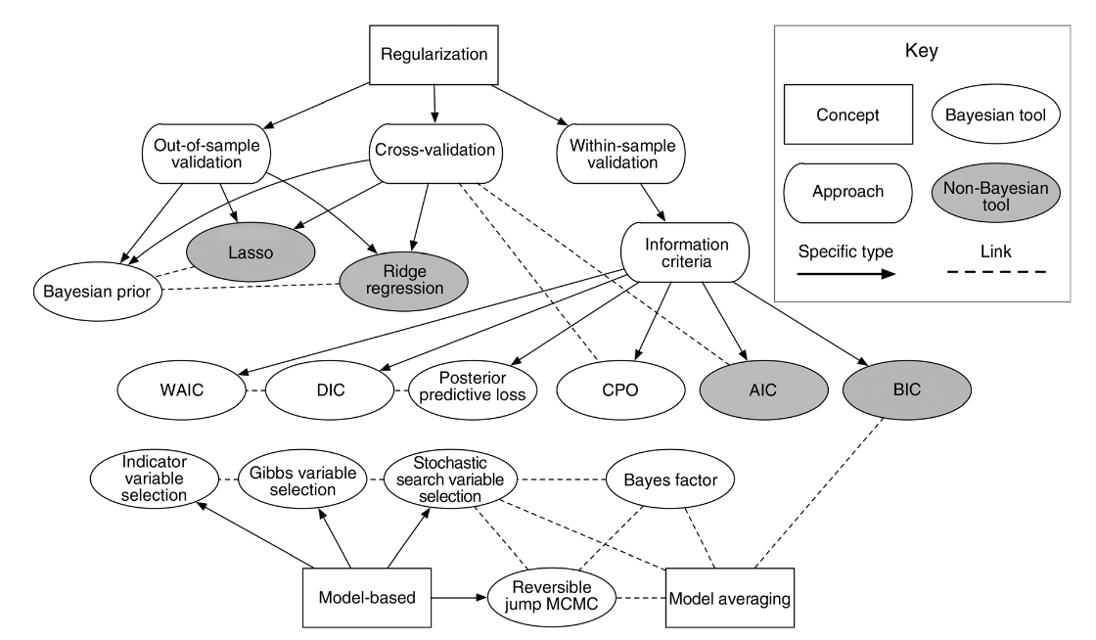
Bayesian model selection
Hobbs & Hooten (2018)

