Slide 1
Modelos jerárquicos Bayesianos
Modelos Bayesianos con aplicaciones ecológicas
Dr. Cole Monnahan
University of Concepción, Chile
Enero, 2018

Slide 2
Recap
Yesterday we practiced the steps for building a Bayesian model
Specify priors, model structure, and likelihood
Fit the model to data to get posterior
Evaluate the fit of the model.
We used prior and posterior predictive checks for assessing fit, and DIC for selection among models

Slide 3
Modelos jerarchicos
Hierarchical models are a type or class of model
Some of the parameters are assumed to be related (correlated)
This

Slide 4
Hierarchical model: overview
Class of model with a hierarchical structure
Known by other names:
Random effects (mixed effects) models
State-space models
Multi-level models
Hierarchies occur naturally: individuals within sites, subpopulations within populations, etc.
Many ways to think about this class of models, can be conceptually difficult and overwhelming
Royle and Dorazio 2008

Slide 5
What are hierarchical models (HM)?
Hierarchical models are those with random effects
So what are random effects?
An additional source of variation
Typically structured by time, space, site, region, individual, etc.
Typically assumed to be normally distributed, but we estimate (hyper)mean and (hyper)variance

Slide 6
Exchangeability
Particularly important in the Bayesian literature (Gelman et al. 2004)
Exchangeability suggests:
random effects come from a common grouping
no expected differences in the stochastic process generating the effects
For example 2 wild populations and 1 captive population would NOT be exchangeable

Slide 7
Vocabulary related to random effects
Term | Definition
Random effect | Coefficient that is “exchangeable” with one or more other coefficients
Hyperdistribution | Distribution for random effects
Exchangeable | No information is available to distinguish between residual variability in random effects
Fixed effect | Coefficient that is not exchangeable with others, and which hence is estimated without a hyperdistribution
Mixed-effect model | Model with both fixed and random effects
Definitions
Notes:
Exchangability
Given value for stream 1, gives no info on stream 2, conditional on knowing true value.
The D values are random effects

Slide 8
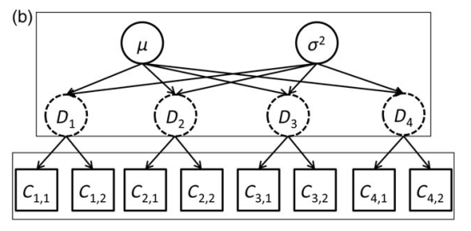
Motivating example
Average density and variability among sites
Density at 4 sites
Observed counts from 2 surveys at each site
The site densities are related (dependent)
The site densities are not directly observed (latent)
Thorson and Minto 2014

Slide 9
Reasons for HM
More closely match natural processes
Improved scope of inference – apply randomness to a new, unstudied population
Borrowing strength – effects not estimated independently but grouped so share information among group
Combining information – meta-analysis of repeated studies by grouping studies

Slide 10
Constructing model
Step 1 – Distribution for data C₁, .. C₄
Step 2 – Function for expected value
Step 3 - Distribution for random effects
Thorson and Minto 2014

Slide 11
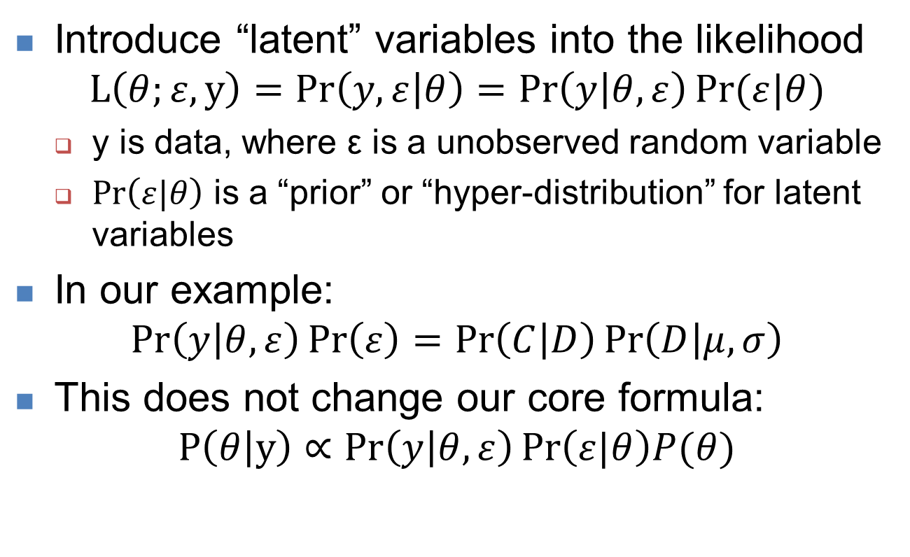
Hierarchical likelihoods
Introduce “latent” variables into the likelihood
$$L\left(θ;ε,y\right)=Pr\left(y,ε | θ\right)=\operatorname{Pr}\left(y | θ,ε\right)Pr⁡(ε|θ)$$
y is data, where ε is a unobserved random variable
$\operatorname{Pr}\left(ε|θ\right)$ is a “prior” or “hyper-distribution” for latent variables
In our example:
$$\operatorname{Pr}\left(y | θ,ε\right)\operatorname{Pr}\left(ε\right)=\operatorname{Pr}\left(C | D\right)\operatorname{Pr}\left(D | μ,σ\right)$$
This does not change our core formula:
$$P\left(θ | y\right)∝Pr\left(y | θ,ε\right)\operatorname{Pr}\left(ε|θ\right)P(θ)$$
Some slides borrowed from: https://github.com/James-Thorson/2016_Spatio-temporal_models

Slide 12
Exercise: Simulating hierarchical data
Assume we have 15 exchangeable sites, whose mean density is log-normal, i.e., loglambda~N(mu,tau)=N(3,.5)
Assume a Poisson sampling process, such that y~Poisson(lambda) for each site.
Simulate this data with 12 replicates at each site
Make a boxplot of the data

Slide 13
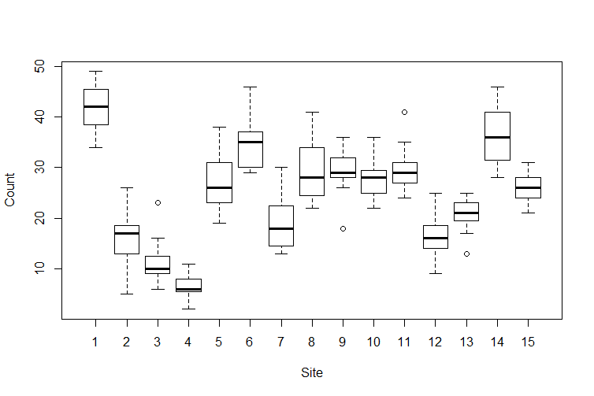
Exercise: Simulating hierarchical data

Slide 14
Behavior of the hyperdistribution
Let’s ignore the likelihood and prior for now.
What happens if random effects equal the mean
And the hypervariance goes to zero?
> hyper <- function(lambda, mu, tau) {
+ sum(dnorm(lambda, mu, tau), log=TRUE)
+ }
> lambda <- rep(3,10)
> hyper(lambda, mu=3, tau=1)
[1] 146.8516
> hyper(lambda, mu=3, tau=.01)
[1] 4.928621e+173
> hyper(lambda, mu=3, tau=.0001)
[1] Inf

Slide 15
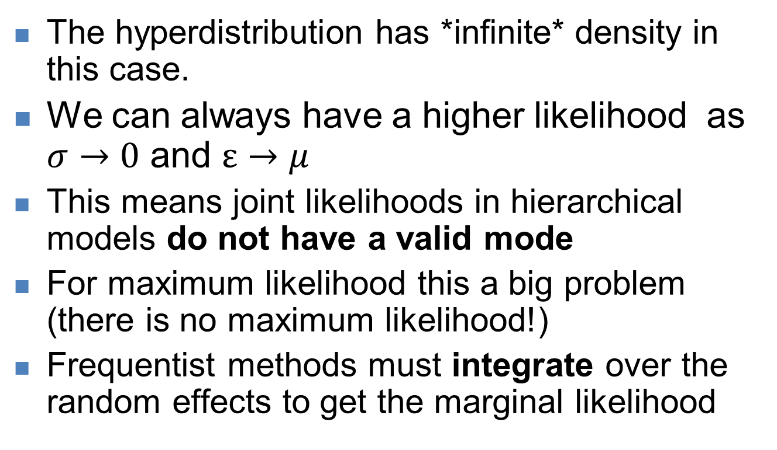
Behavior of the hyperdistribution
The hyperdistribution has *infinite* density in this case.
We can always have a higher likelihood as $σ→0$ and $ε→μ$
This means joint likelihoods in hierarchical models do not have a valid mode
For maximum likelihood this a big problem (there is no maximum likelihood!)
Frequentist methods must integrate over the random effects to get the marginal likelihood

Slide 16
Behavior of the hyperdistribution
This makes inference on frequentist hierarchical models very difficult
(Until, of course, TMB)
How does this affect Bayesian inference?
The density is infinitely high, but the volume is equally small
So this part of the posterior is not important¹
MCMC never samples there because its mass is very low
So it is not a problem. This is why Bayesian methods are so common for hierarchical models
¹ Section 1.4 of Betancourt 2017 arXiv preprint arXiv:1701.02434.

Slide 17
Important concepts 1
Hierarchical models require integration to do inference
This is very difficult in maximum likelihood
But very natural in Bayesian methods
We are already integrating!
HM are powerful tools but different to do inference.
Until flexible Bayesian tools like BUGS/JAGS

Slide 18
Exercise
Let’s fit the model
First, create a prior predictive distribution in R.
*Before* seeing the data we suspect that a site with 250 would be extreme
Use tau~N(0, sigma) for a prior (specify sigma). This is generally recommended.
Simulate data from a single site.

Slide 19
References
Full details and math of the LA in
Skaug, H. J., & Fournier, D. A. (2006). Automatic approximation of the marginal likelihood in non-Gaussian hierarchical models. Computational Statistics & Data Analysis, 51(2), 699-709. doi: 10.1016/j.csda.2006.03.005
Kristensen, K., Nielsen, A., Berg, C. W., Skaug, H., & Bell, B. M. (2016). TMB: Automatic differentiation and Laplace approximation. [automatic differentiation; AD; random effects; latent variables; C++ templates; R]. Journal of Statistical Software, 70(5), 21. doi: 10.18637/jss.v070.i05
See this paper for working with Emprical Bayes estimates:
Thorson, J. T., & Kristensen, K. (2016). Implementing a generic method for bias correction in statistical models using random effects, with spatial and population dynamics examples. Fisheries Research, 175, 66-74. doi: 10.1016/j.fishres.2015.11.016

