Slide 1
Bayesian model selection
Modelos Bayesianos con aplicaciones ecológicas
Dr. Cole Monnahan
University of Concepción, Chile
Enero, 2018

Slide 2
Recap
Usamos posterior predictive distributions para probar “model self-consistency”
El modelo tuvo un dato que no era bueno
Quizas con extra estructura con covariables el modelo puede explicar los datos
Vamos a usar posterior predictive distribution y DIC

Slide 3
Bayesian model selection
Model selection is not trivial. There are many existing tools and more being developed.
According to Hobbs & Hooten (2018)
Out of sample is the best approach if possible
K-fold cross validation good but slow
DIC is good when prediction is important and model is slow, works best when (# pars << # data)
WAIC good for hierarchical models
Hobbs & Hooten (2018)

Slide 4
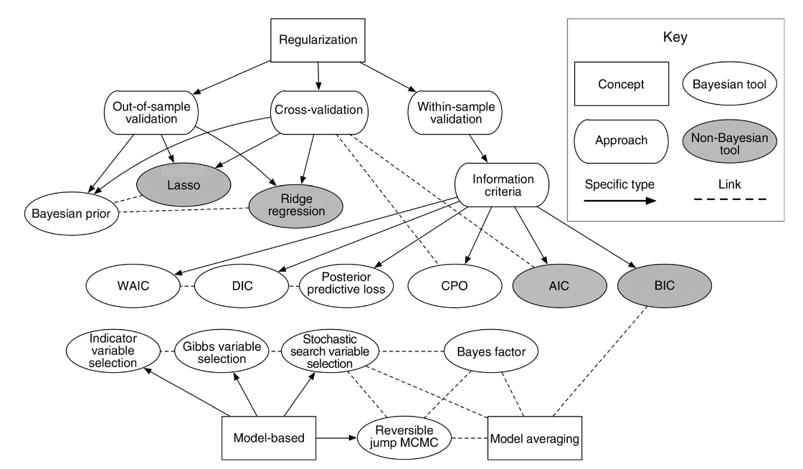
Bayesian model selection
Hobbs & Hooten (2018)

Slide 5
Tarea
We will try 3 versions of our binomial survival model (GLM)
Fit3= de lectura (problema con sitio 5)
Fit4= con solo covariable x1
Fit5= con covariables x1 y x2
x1 <- c(9.450, 8.079, 7.686, 8.003, 2.882, 11.095, 10.696, 8.263, 12.043,
9.238)
x2 <- c(0.08, 0.252, 0.158, 0.25, 0.081, 0.037, 0.002, 0.042, 0.053,
-0.02, 0.141, -0.001, -0.078, 0.103, -0.076, 0.037, 0.071, 0.113,
0.23, 0.246)
Assume p= ilogit( theta + beta1*x1 + beta2*x2)

Slide 6
Tarea
Fit the 3 versions of the model (use separate .jags files)
Recreate posterior predictive plots for all three
Which model does DIC select? (fit3$BUGSoutput$DIC etc.)
[What should you use for priors on coefficients?]
[Suggestion: Normalize the covariates]

Slide 7
Tarea
Use the results to select which model you think is most appropriate.
Write down the model, likelihood and priors.
Calculate the probability of survival greater than 0.8. P(p>0.8) from this model

