Slide 1
Una revisión de los metodólogos de integración
Modelos Bayesianos con aplicaciones ecológicas
Dr. Cole Monnahan
University of Concepción, Chile
Enero, 2018

Slide 2
When we have continuous distributions then we must integrate to get a probability

Slide 3
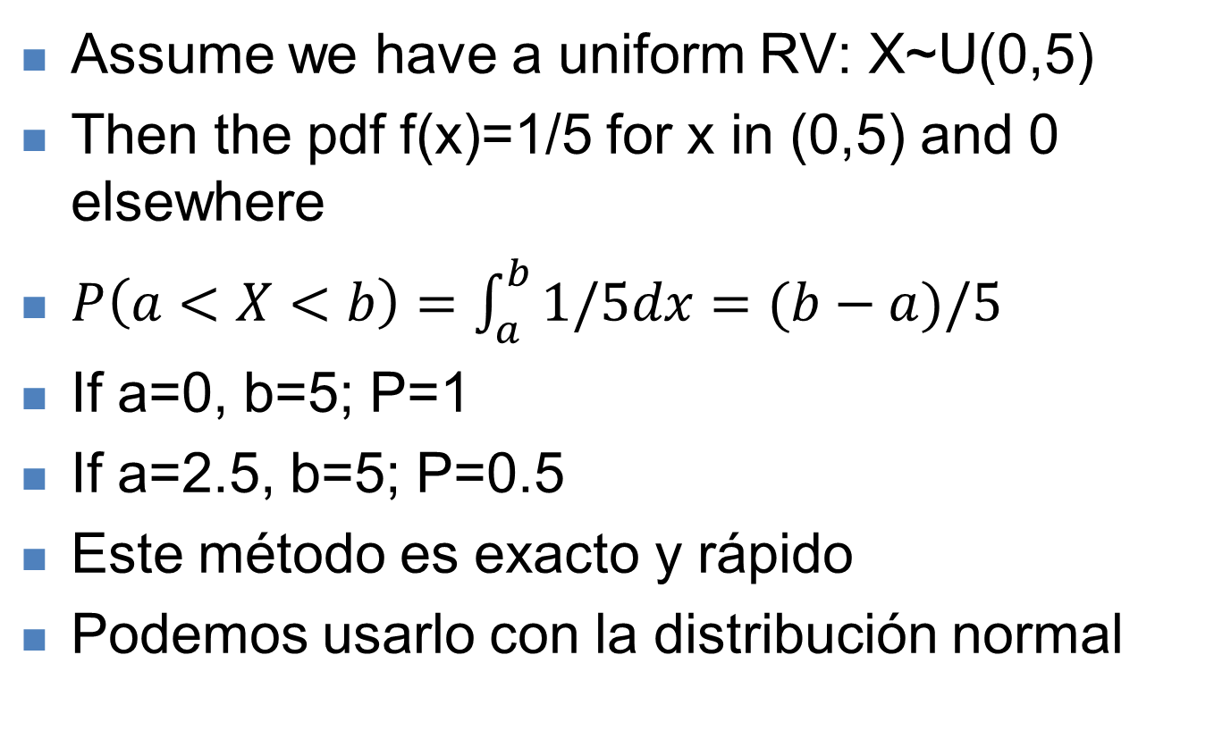
Método 1: Integración analítica
Assume we have a uniform RV: X~U(0,5)
Then the pdf f(x)=1/5 for x in (0,5) and 0 elsewhere
$P\left(a<X<b\right)=\int_{a}^{b}{1/5dx}=(b−a)/5$
If a=0, b=5; P=1
If a=2.5, b=5; P=0.5
Este método es exacto y rápido
Podemos usarlo con la distribución normal

Slide 4
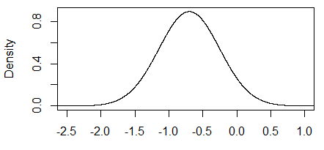

Método 1: Integración analítica
P.ej. $P\left(θ<0\right)=\int_{−∞}^{0}{\frac{1}{\sqrt{2πσ^{2}}}exp⁡(}$ $−\frac{{\left(θ−μ\right)}^{2}}{{2σ}^{2}})dθ$
Es exacto…
Es rápido…
…Es arduo para modelos reales (complejos)
> pnorm(q=0, mean=mu1, sd=tau1)
[1] 0.9412376
> qnorm(p=c(0.025, .975), mean=mu1, sd=tau1)
[1] -1.5765225 0.1765225

Slide 5

Método 2: Integración por Monte Carlo
Idea = generar muestras aleatorias y calcular porcentajes para aproximar probabilidades
Strong Law of Large Numbers
Given a function h(x) and a distribution f(x), want to
find expected value
which converges surely to
for large n.
Stanislaw Ulam

Slide 6
Implications of Monte Carlo
These results also allow us to use Monte Carlo samples to estimate other quantities of interest:
Variance and standard deviations
Quantiles of the distribution
Probability intervals
And to calculate estimates of quantities that are functions of the Monte Carlo distributions (as they are also Monte Carlo samples)

Slide 7
Método 2: Integración por Monte Carlo
Idea = generar muestras aleatorias y calcular porcentajes para aproximar probabilidades
> x <- rnorm(10, mean=mu1, sd=tau1)
> mean(x<0) [1] 1
> quantile(x, probs=c(0.025, 0.975))
-1.14731923 -0.08842335
Porcentaje de x<0
> x <- rnorm(1e6, mean=mu1, sd=tau1)
> mean(x<0) [1] 0.940683
> quantile(x, probs=c(0.025, 0.975))
-1.5768345 0.1790194

Slide 8
Método 2: Monte Carlo integración
Para poder implementarlo necesitamos conocer la forma exacta de la distribución a posteriori como en el ejemplo anterior con rnorm
En este método mientras más muestras generamos mejor será la aproximación
Sin embargo, esta situación es muy raro
Que hacemos cuando no podemos usar los métodos anteriores?

Slide 9
Homework 1.1
Let X~U(-pi, 1). Integrate this analytically for P(a<X<b).
Now let X be a triangle:
Draw this or use R to plot it.
Integrate it from 0 to 1. What does c need to be so this is a probability distribution? Calculate P(.35<X< .98)

Slide 10
Homework 1.2
Assume X~N(0,1). Use rnorm to estimate P(X< -5). Repeat but use pnorm. Why different?
Generate 500 samples and plot the cumulative mean of samples vs replicate. How many samples are “good enough” to approximate the mean?
Using samples from #2, approximate mean of the function h(x)=x^2. Is this equal to mean(x)^2?
[Extra: find the pdf for Y=h(x) and add to histogram]

