Slide 1
Una revisión de la teoría de probabilidades
Modelos Bayesianos con aplicaciones ecológicas
Dr. Cole Monnahan
University of Concepción, Chile
Enero, 2018

Slide 2
Estadísticas frecuentes (clásicas)
Mas común paradigma de inferencia, con larga historia
Normalmente usas el método máxima verosimilitud
Piensa: linear models, generalized linear models, AIC, p-values, confidence intervals, hypothesis testing, significance, etc.

Slide 3
Inferencia bayesiana
“… The process of fitting a probability model to a set of data and summarizing the result by a probability distribution of the parameters of the model…”
Un paradigma alternativo que clásico
Piensas: Prior, posterior, Markov chain Monte Carlo (MCMC)
Software especiales: JAGS, BUGS, Stan, etc.
Gelman et al. (2014)

Slide 4
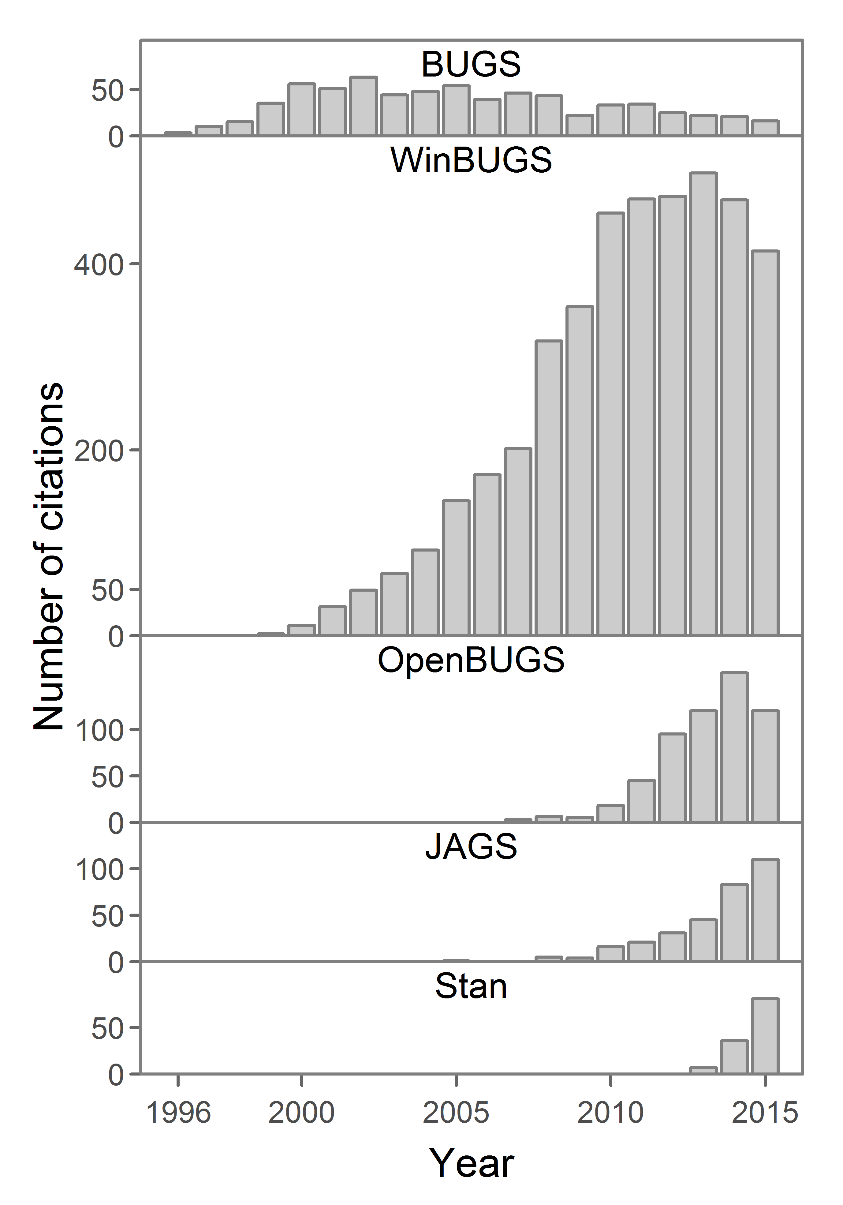
Popularidad
Creciente con avances de computadores
Software especial se usado normalmente
Popular en muchos campos, incluyendo ecología y ciencia pesquera
Fig 1, Monnahan et al. (2017)

Slide 5
Los pasos de un análisis bayesiana
Hacer un modelo colectivo por todos los cantidades (datos y parámetros) del problema
Condicionar el modelo a los datos observados y estimar la probabilidad a posteriori
Evaluar el ajuste, realizar si necesario, y después hacer inferencia (calcular probabilidades).
Gelman et al. (2014)

Slide 6
Review of probability theory
In nature we have random processes
The sample space is the possible outcomes of this process (events)
A random variable maps the sample space to be numbers
A probability mass/density is the relative frequency of occurrence.

Slide 7
Review: basics of probabilities
P(A)=Probability of event A
P(A,B)=Probability of A and B
P(A,C)=P(A)P(C) if independent
P(A|B)=P(A,B)/P(B) [conditional probability]
P(A)
P(B)
P(C)
P(A,B)

Slide 8
Review: basics of probabilities
Assume X is a rv that maps to the real line
If discrete: f(x) is probability mass (pmf)
If continuous, f(x) is probability density function f (pdf) and needs to be integrated:
Law of total probability

Slide 9
Randomness in R
Generate n random samples: rnorm(n, mean, sd)
Probability density function (height): dnorm(x, mean, sd)
Probability that X<q (integration): pnorm(q, mean, sd)
What value of X gives quantile of p? qnorm(p, mean, sd)
Same for other RVs: rpois, rbeta, rbinom, etc.

Slide 10
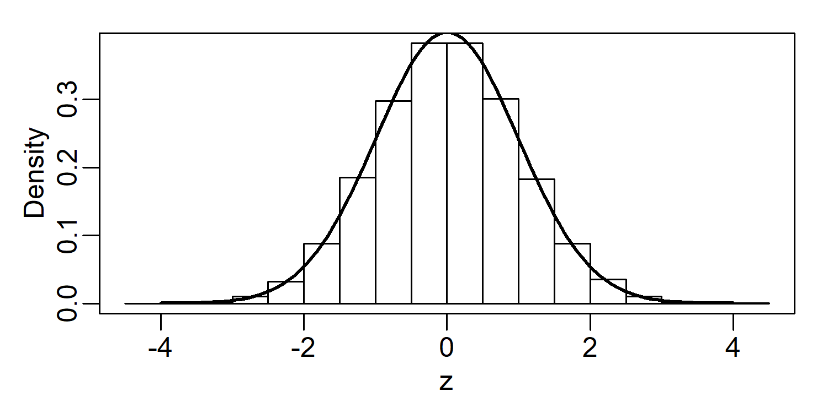
Exercise 1.1
Create R function which uses rnorm and dnorm to reproduce this plot for n random samples
Use mar() to create 1x3 multipanel plot and repeat above with n=3, 100, 10000
[Hint: look up argument prob=TRUE in hist()]

Slide 11
Questions?

