Slide 1
Bayesian model selection
Modelos Bayesianos con aplicaciones ecológicas
Dr. Cole Monnahan
University of Concepción, Chile
Enero, 2019

Slide 2
Recap
Usamos posterior predictive distributions para probar “model self-consistency”
El modelo tuvo un dato que no era bueno
Quizás con extra estructura con covariables el modelo puede explicar los datos
Vamos a usar posterior predictive distribution y DIC

Slide 3
Bayesian model selection
Model selection is not trivial. There are many existing tools and more being developed.
According to Hobbs & Hooten (2018)
Out of sample is the best approach if possible
K-fold cross validation good but slow
DIC is good when prediction is important and model is slow, works best when (# pars << # data)
WAIC good for hierarchical models
Hobbs & Hooten (2018)

Slide 4
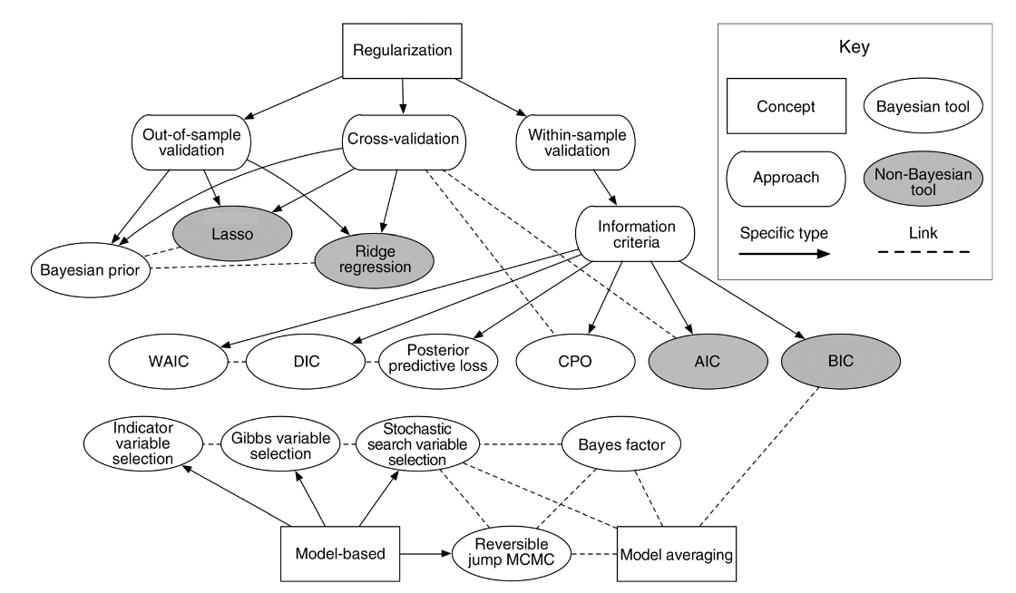
Bayesian model selection
Hobbs & Hooten (2018)

Slide 5
Tarea
We will try 2 versions of our binomial survival model (GLM)
Fit3= de lectura (problema con sitio 5)
Fit4= con covariable x1
x1 <- c(9.450, 8.079, 7.686, 8.003, 2.882, 11.095, 10.696, 8.263, 12.043,
9.238)
Assume p= ilogit( theta + beta1*x1)

Slide 6
Tarea
Fit the 2 versions of the model (create logistic 4.jags)
Recreate posterior predictive plots for both
Which model does DIC select? (fit3$BUGSoutput$DIC etc.)
[What should you use for priors on coefficients?]
[Suggestion: Normalize the covariates]

Slide 7
Tarea
Use the results to select which model you think is most appropriate.
Calculate the probability of survival greater than 0.8, P(p>0.8), for site 3
Read the paper http://www.scielo.org.mx/scielo.php?pid=S0185-38802009000200005&script=sci_arttext&tlng=pt
And write down:
What is the type of model?
What is the likelihood function?
What are the priors?

