Slide 1
Faster estimation of Bayesian models in ecology
Modelos Bayesianos con aplicaciones ecológicas
Dr. Cole Monnahan
University of Concepción, Chile
Enero, 2018

Slide 2
Introduction
Bayesian inference is increasingly common in fisheries in ecology
Common software (JAGS etc.) can be too slow for large, complex models
A new class of algorithms is gaining traction in the statistical community (Stan)

Slide 3
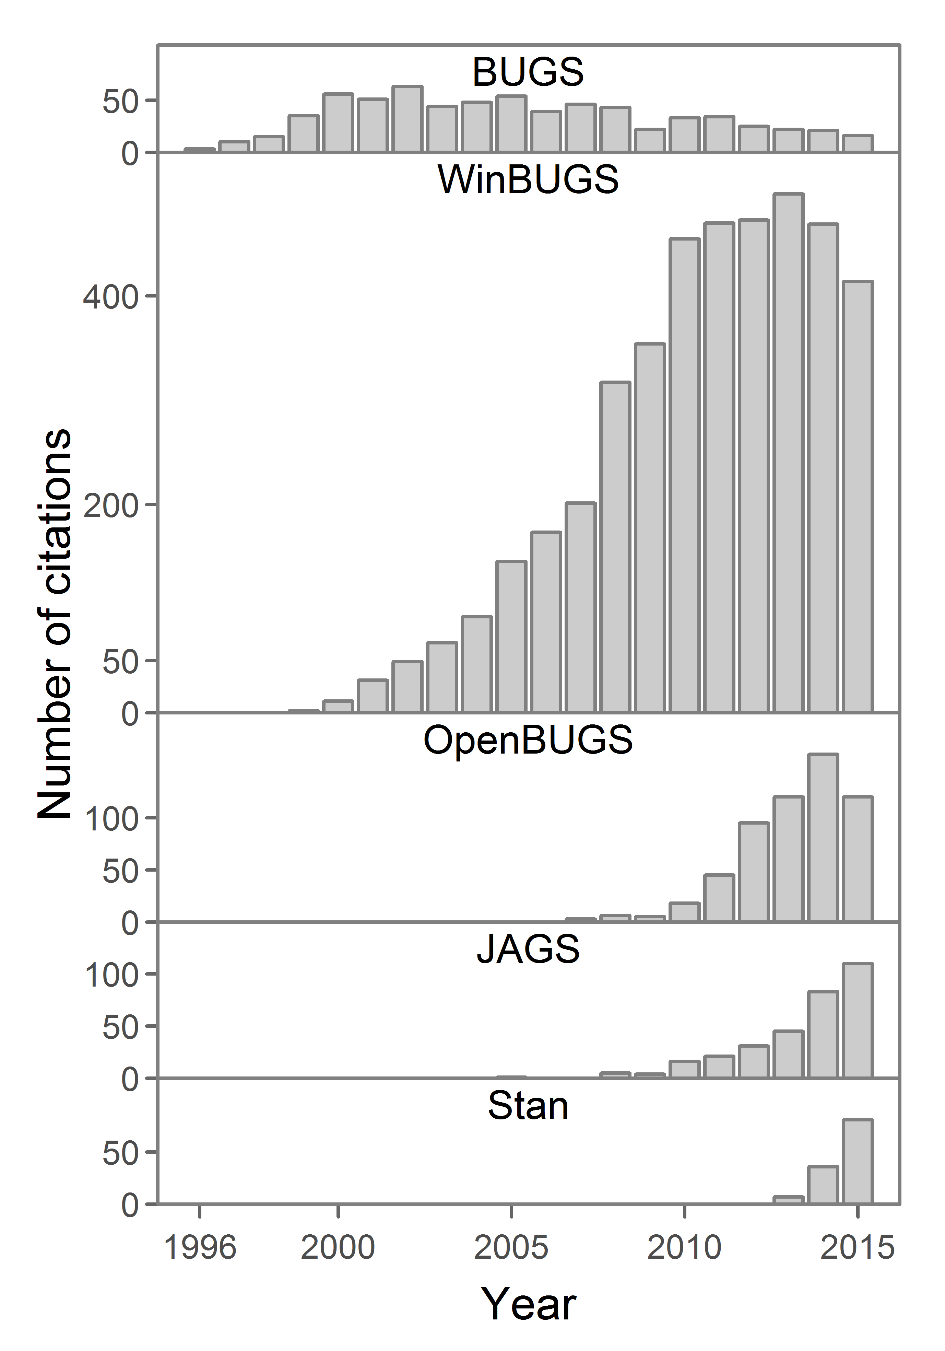
Stan: the new frontier in Bayesian analysis
Stan is growing rapidly compared to other programs
Stan is more than software:
Valuable resources
Helpful community
Development of methods
Suite of supporting software

Slide 4
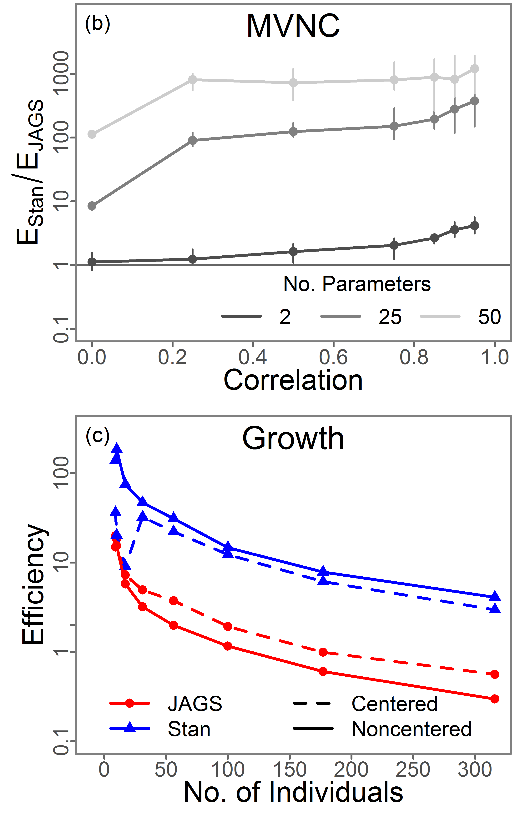
Stan: the new frontier in Bayesian analysis
It is FAST.
Sometimes hundreds or thousands of times faster than JAGS
Scales well with dimensionality & complexity
It expands the possible models that can be fit

Slide 5
Plan of attack
Bayesian intro and background
Gibbs and Metropolis overview
Intro to Hamiltonian dynamics
Hamiltonian Monte Carlo & No-U-Turn
Develop intuition for these MCMC algorithms
Review software options
Performance and concluding thoughts
Goal: Understand algorithms enough to diagnose and interpret MCMC output

Slide 6
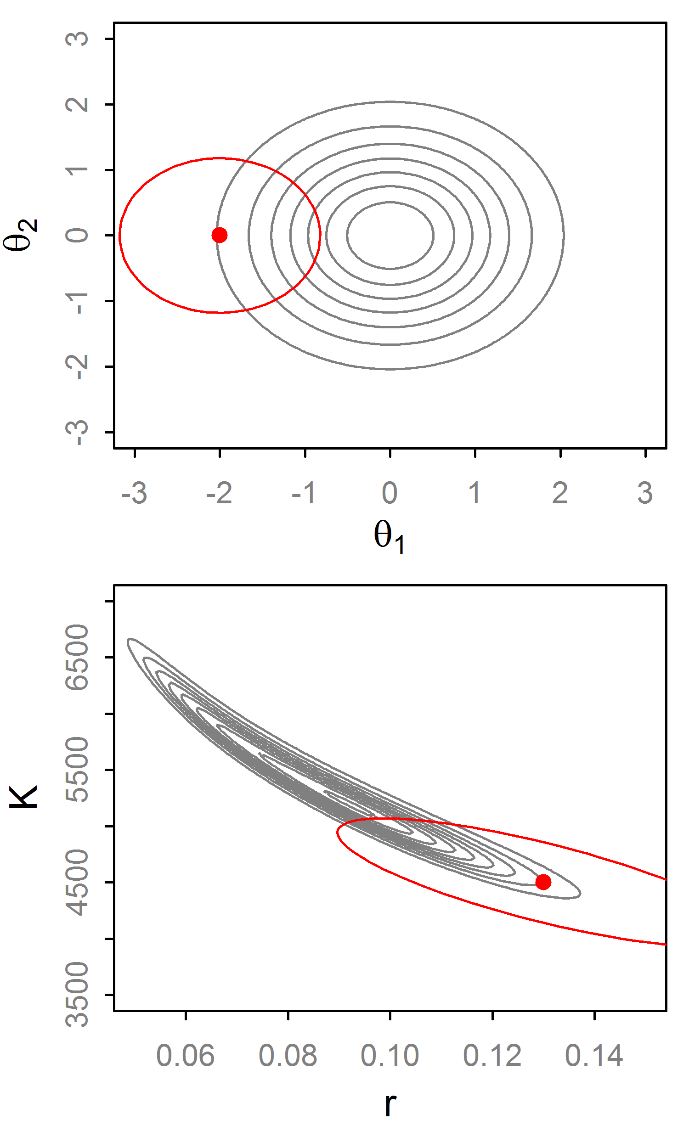
Random Walk Metropolis (RWM)
Propose θ* with distribution q~N(θ_{t}, Σ).
Then set:
If q is symmetric this cancels out
q affects efficiency of RWM so it needs to be ‘tuned’

Slide 7
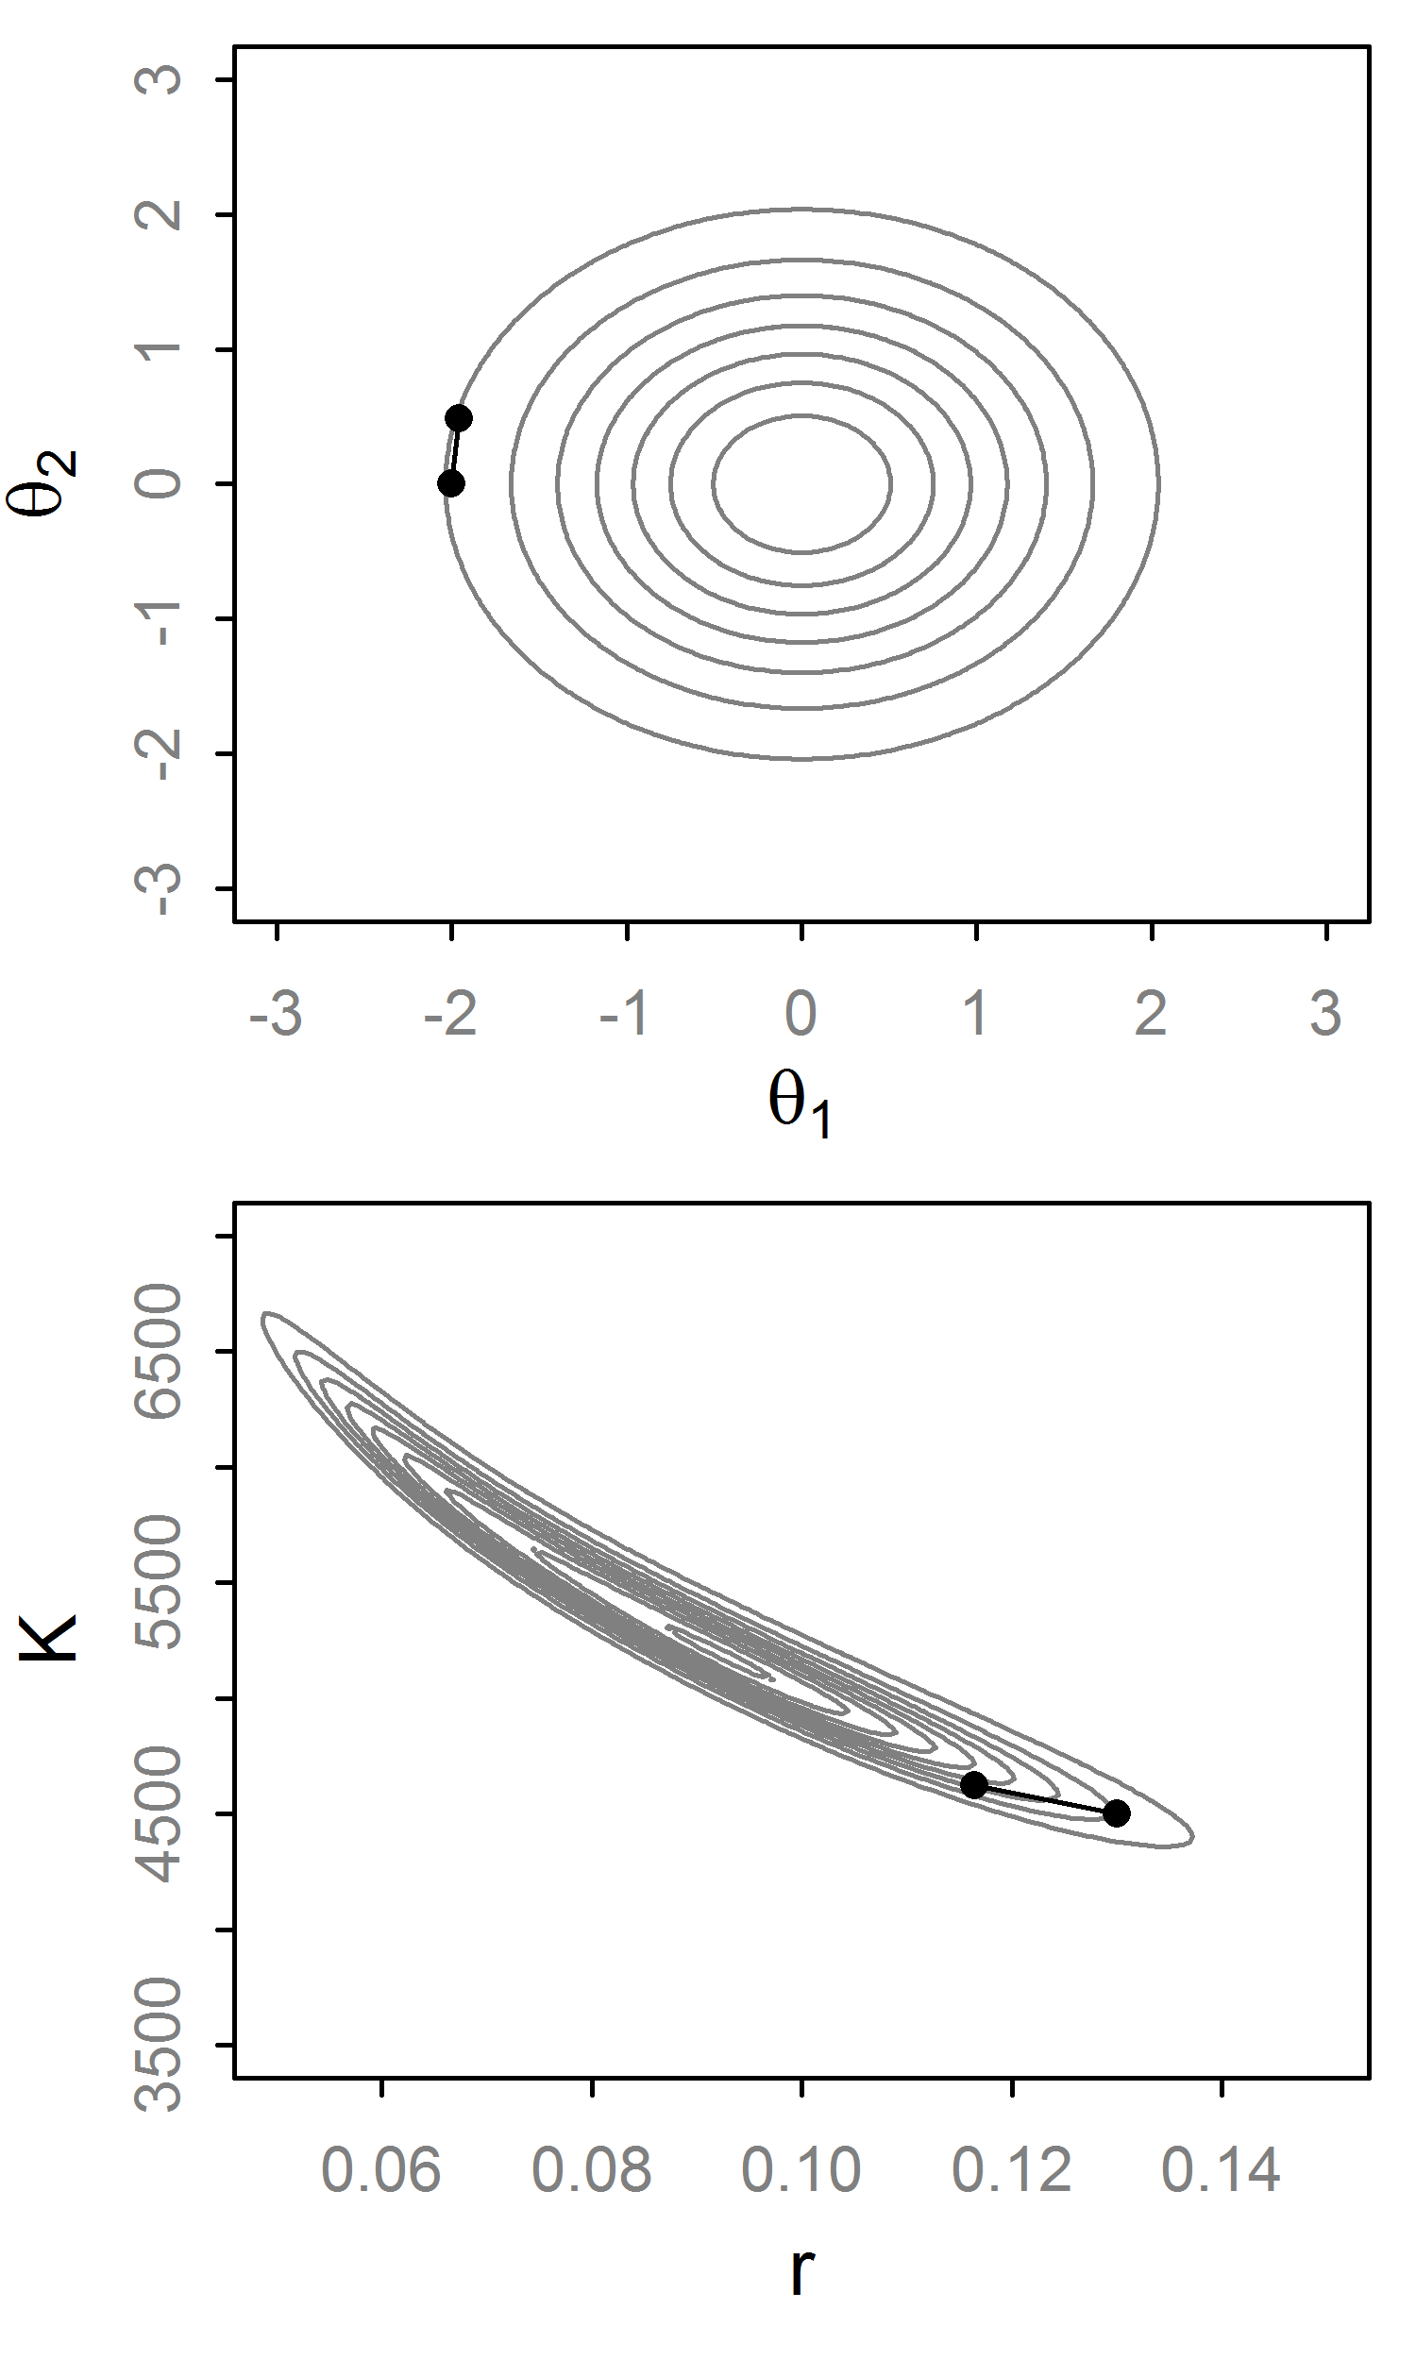
Random Walk Metropolis (RWM)
Propose θ* with distribution q~N(θ_{t}, Σ).
Then set:
If q is symmetric this cancels out
q affects efficiency of RWM so it needs to be ‘tuned’

Slide 8
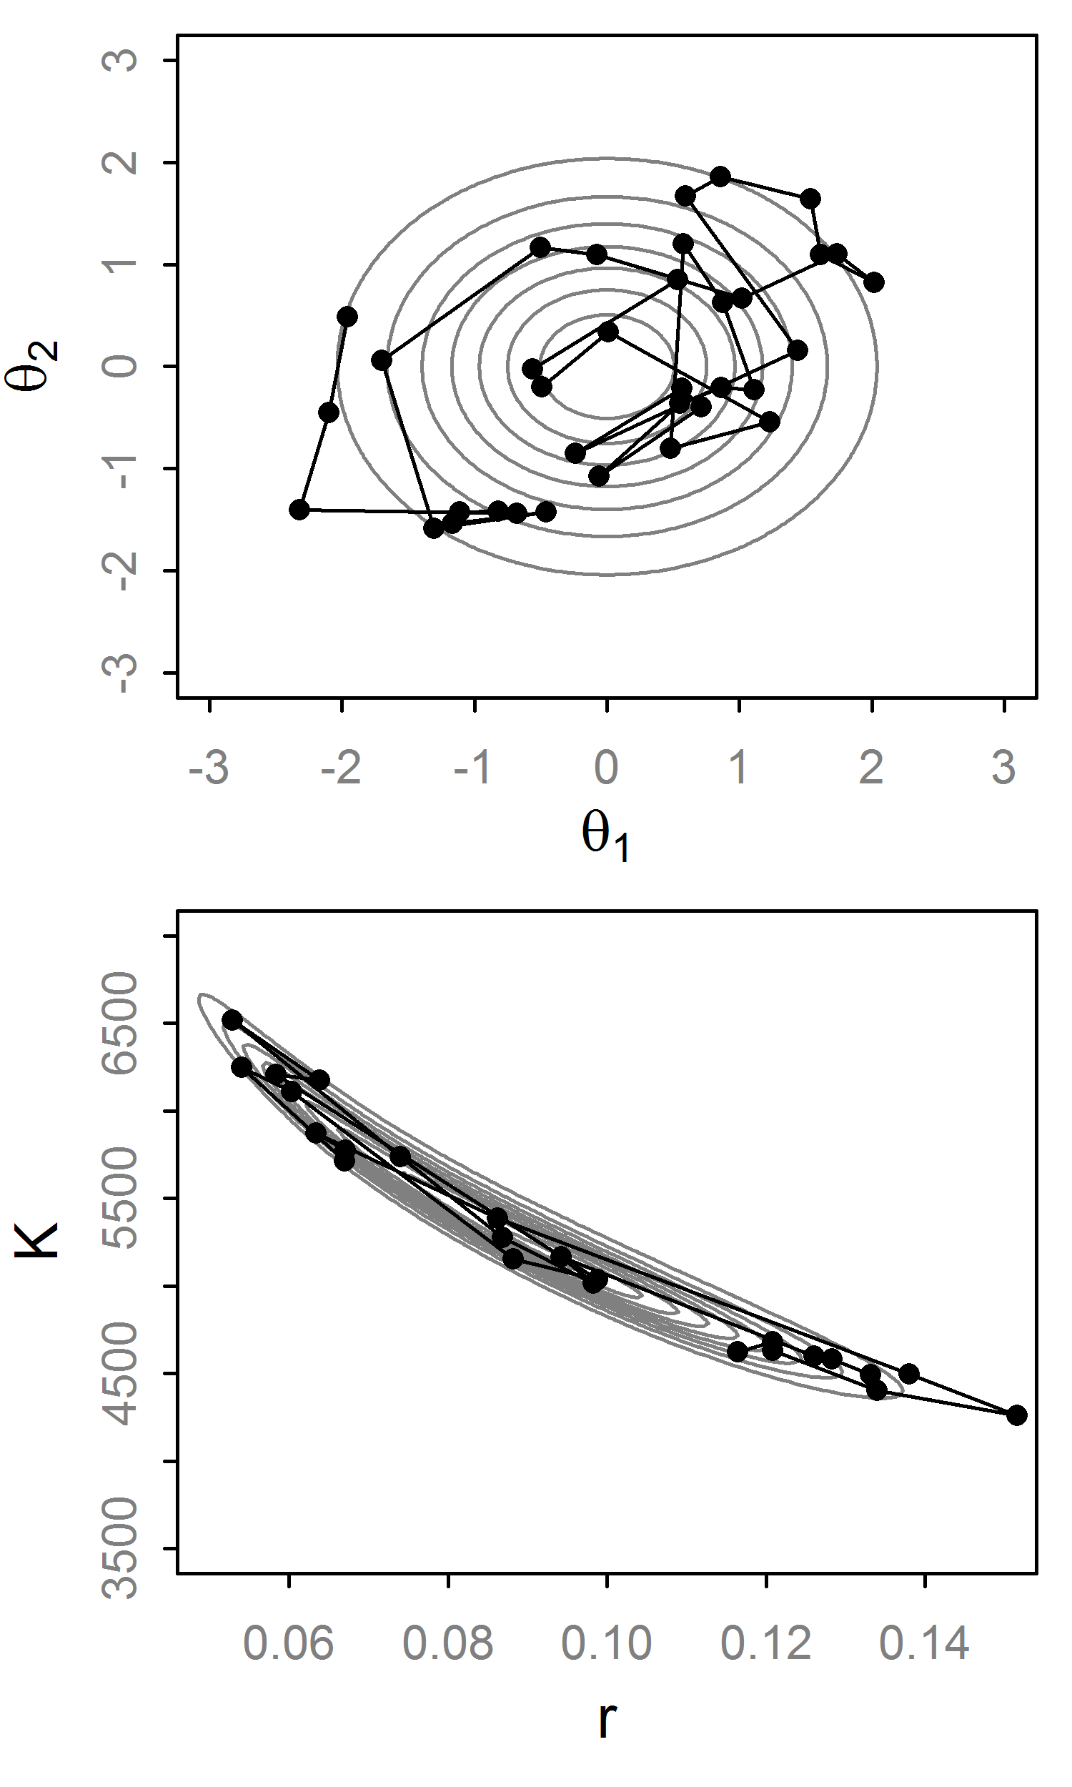
Random Walk Metropolis (RWM)
Propose θ* with distribution q~N(θ_{t}, Σ).
Then set:
If q is symmetric this cancels out
q affects efficiency of RWM so it needs to be ‘tuned’

Slide 9
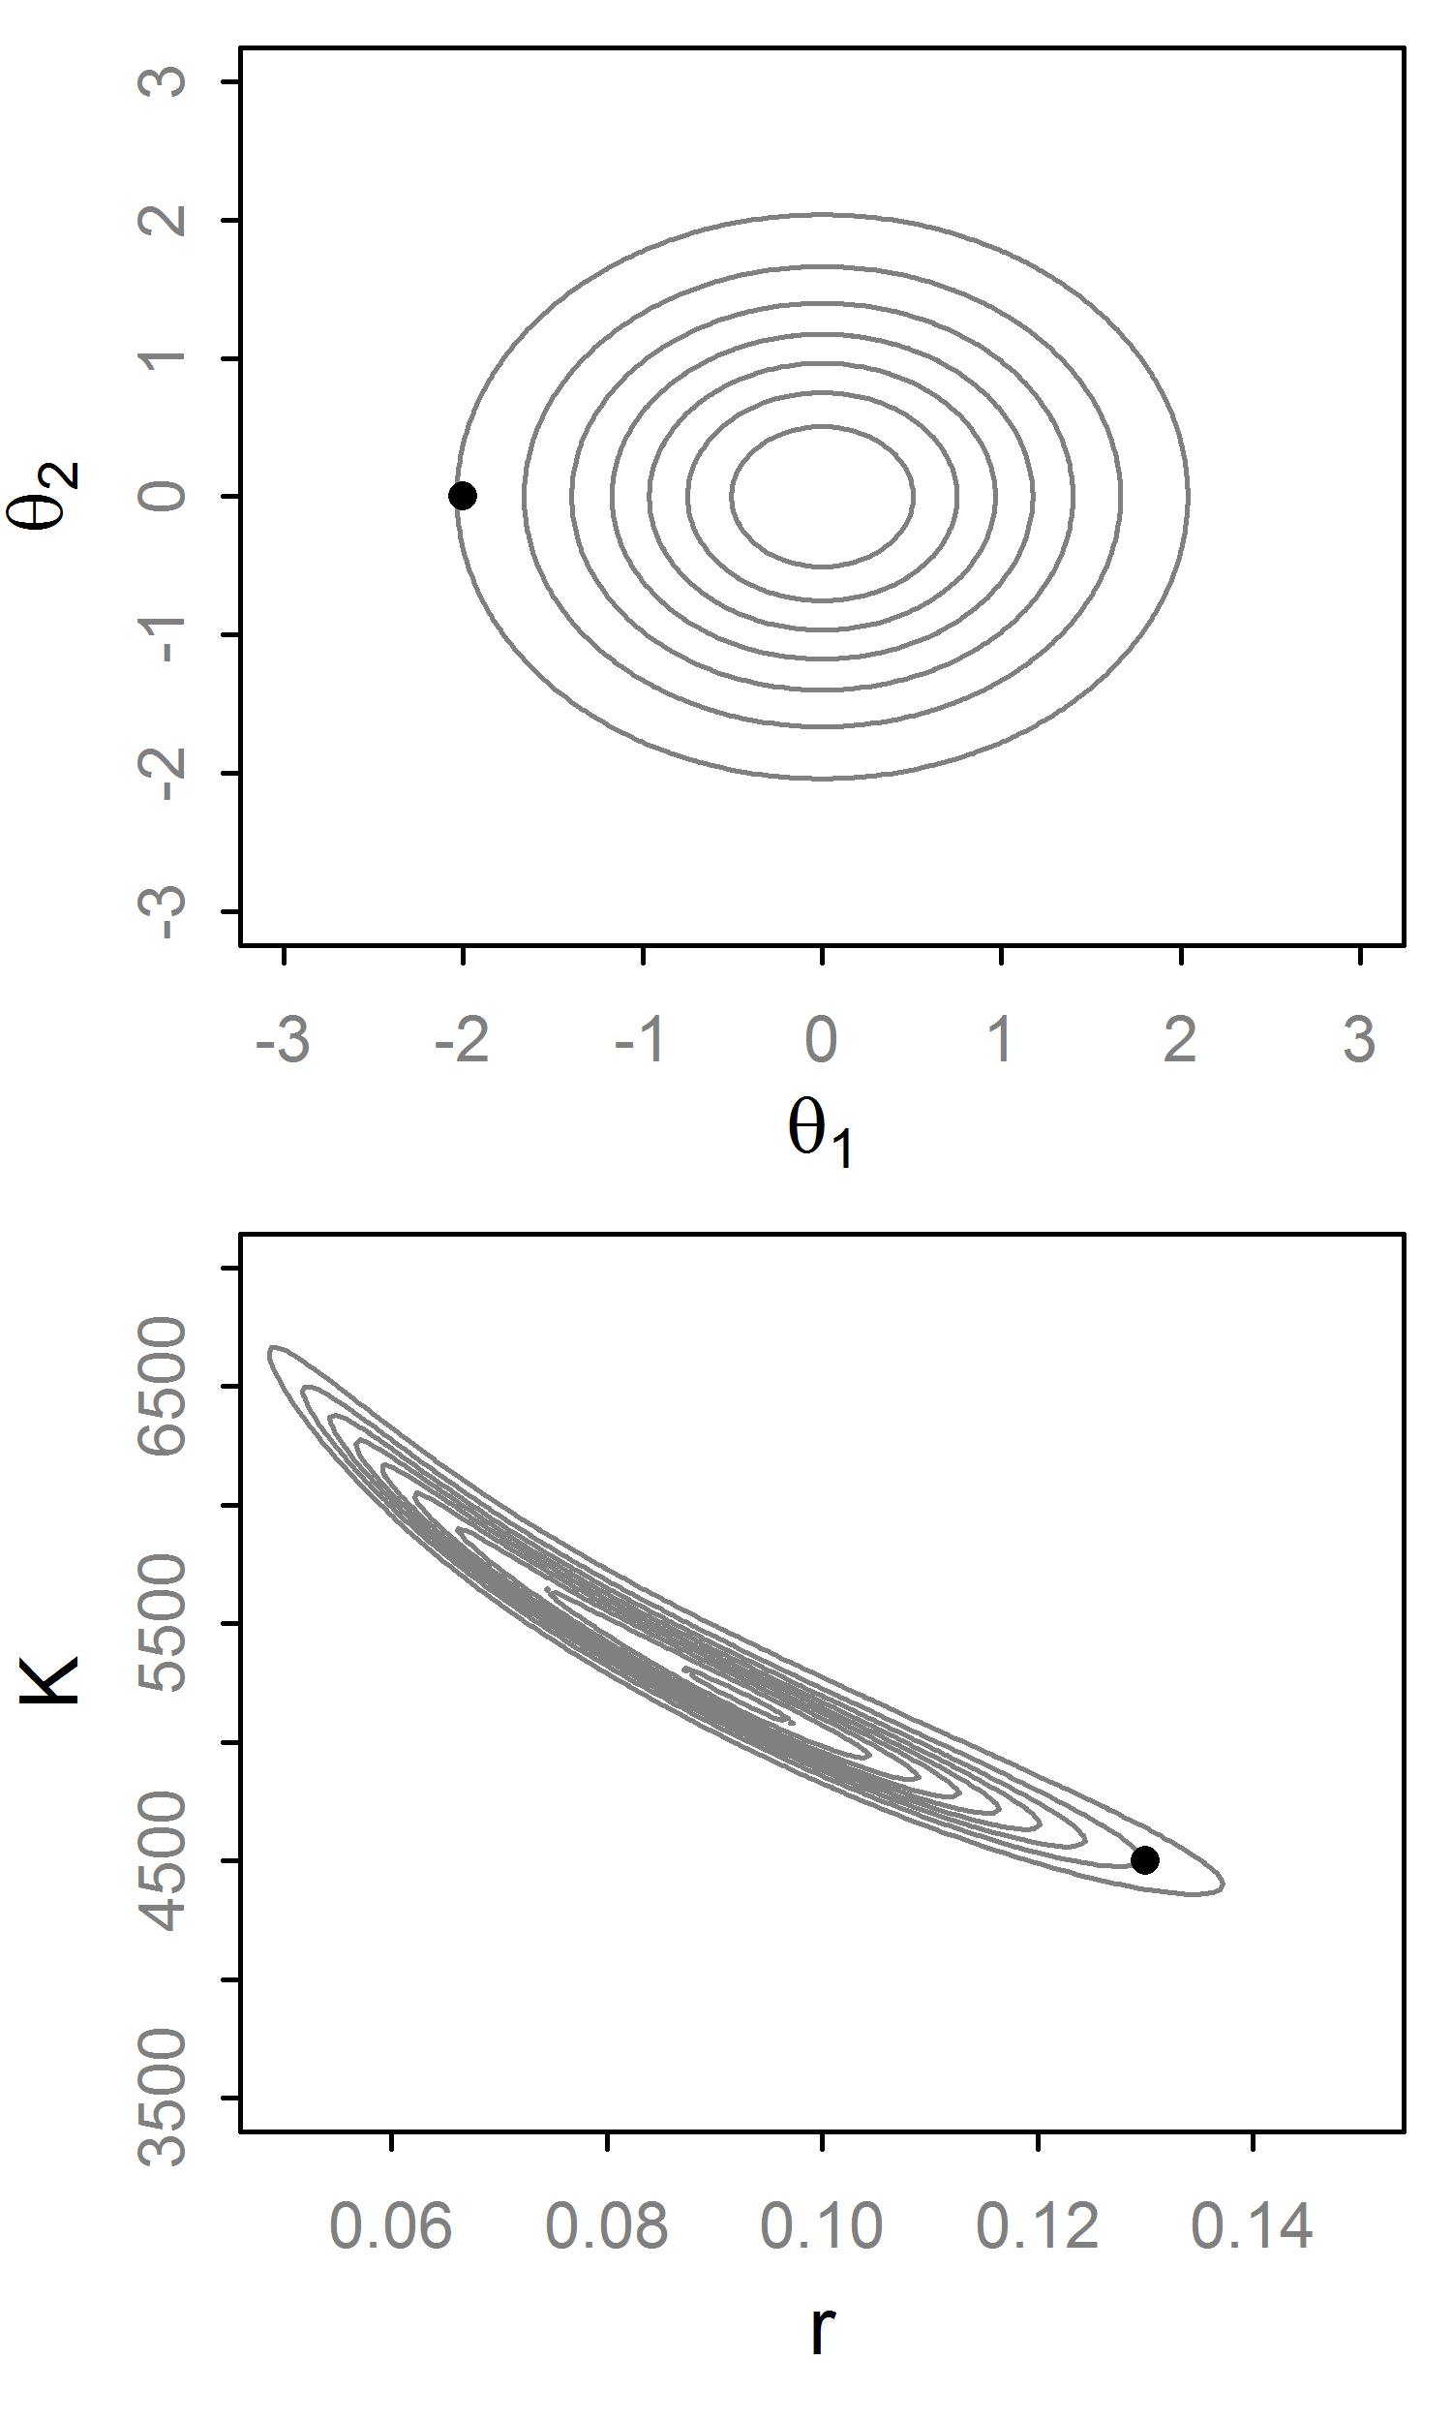
Gibbs Sampler
Condition on all but first variable, find conjugate form
Generate a value from this “full conditional” distribution.
Repeat for all variables. That is a single step.
If not conjugate, do Metropolis-within-Gibbs
No tuning necessary, but poor efficiency for correlated parameters

Slide 10
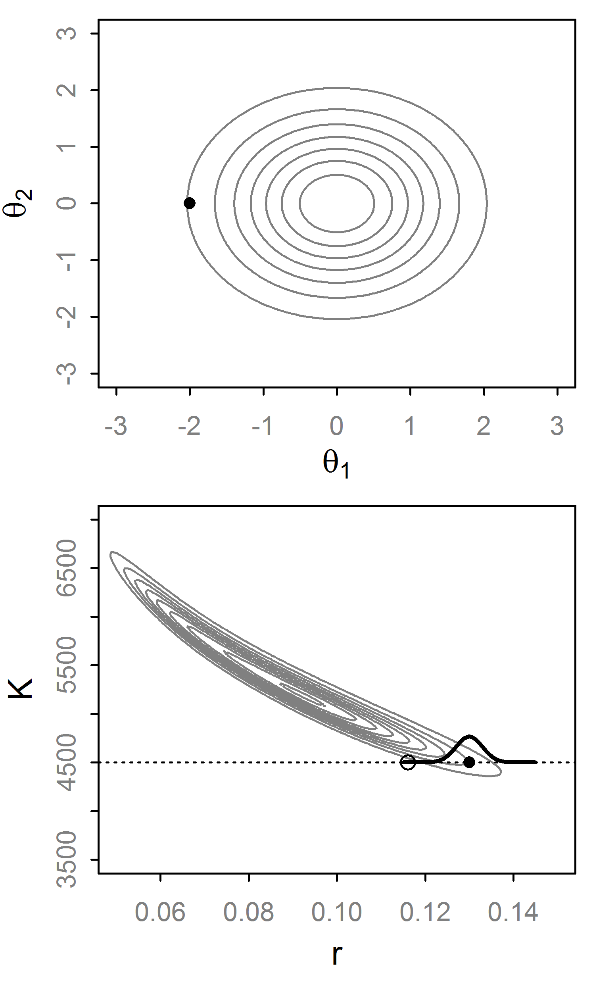
Gibbs Sampler
Condition on all but first variable, find conjugate form
Generate a value from this “full conditional” distribution.
Repeat for all variables. That is a single step.
If not conjugate, do Metropolis-within-Gibbs
No tuning necessary, but poor efficiency for correlated parameters

Slide 11
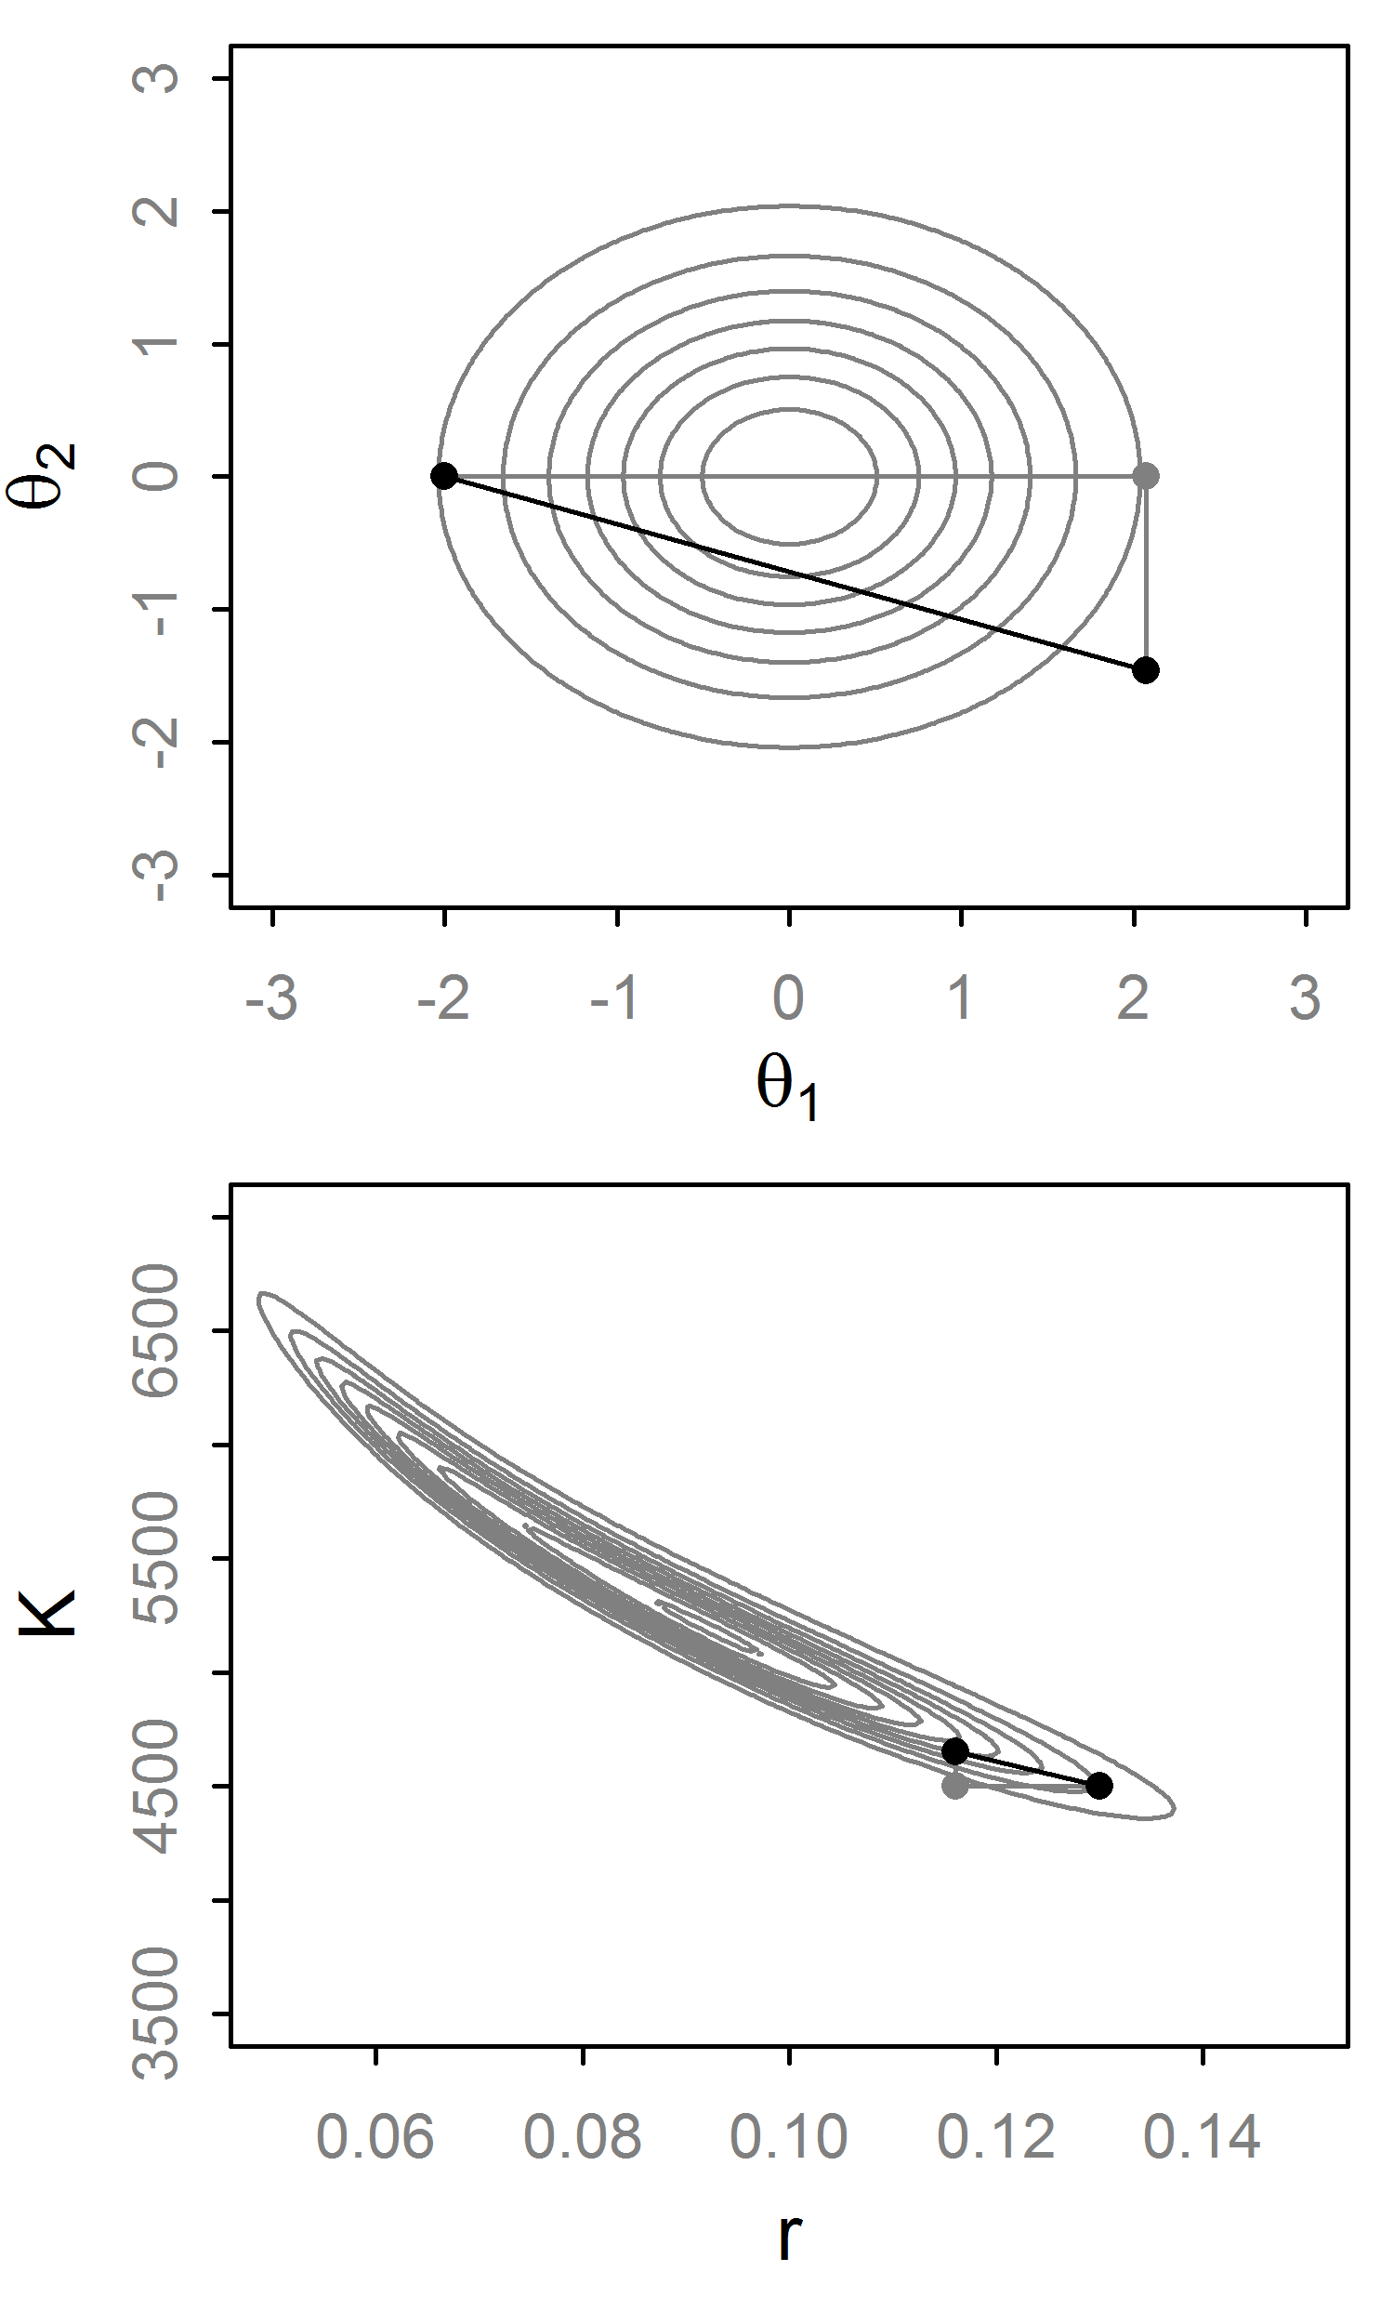
Gibbs Sampler
Condition on all but first variable, find conjugate form
Generate a value from this “full conditional” distribution.
Repeat for all variables. That is a single step.
If not conjugate, do Metropolis-within-Gibbs
No tuning necessary, but poor efficiency for correlated parameters

Slide 12
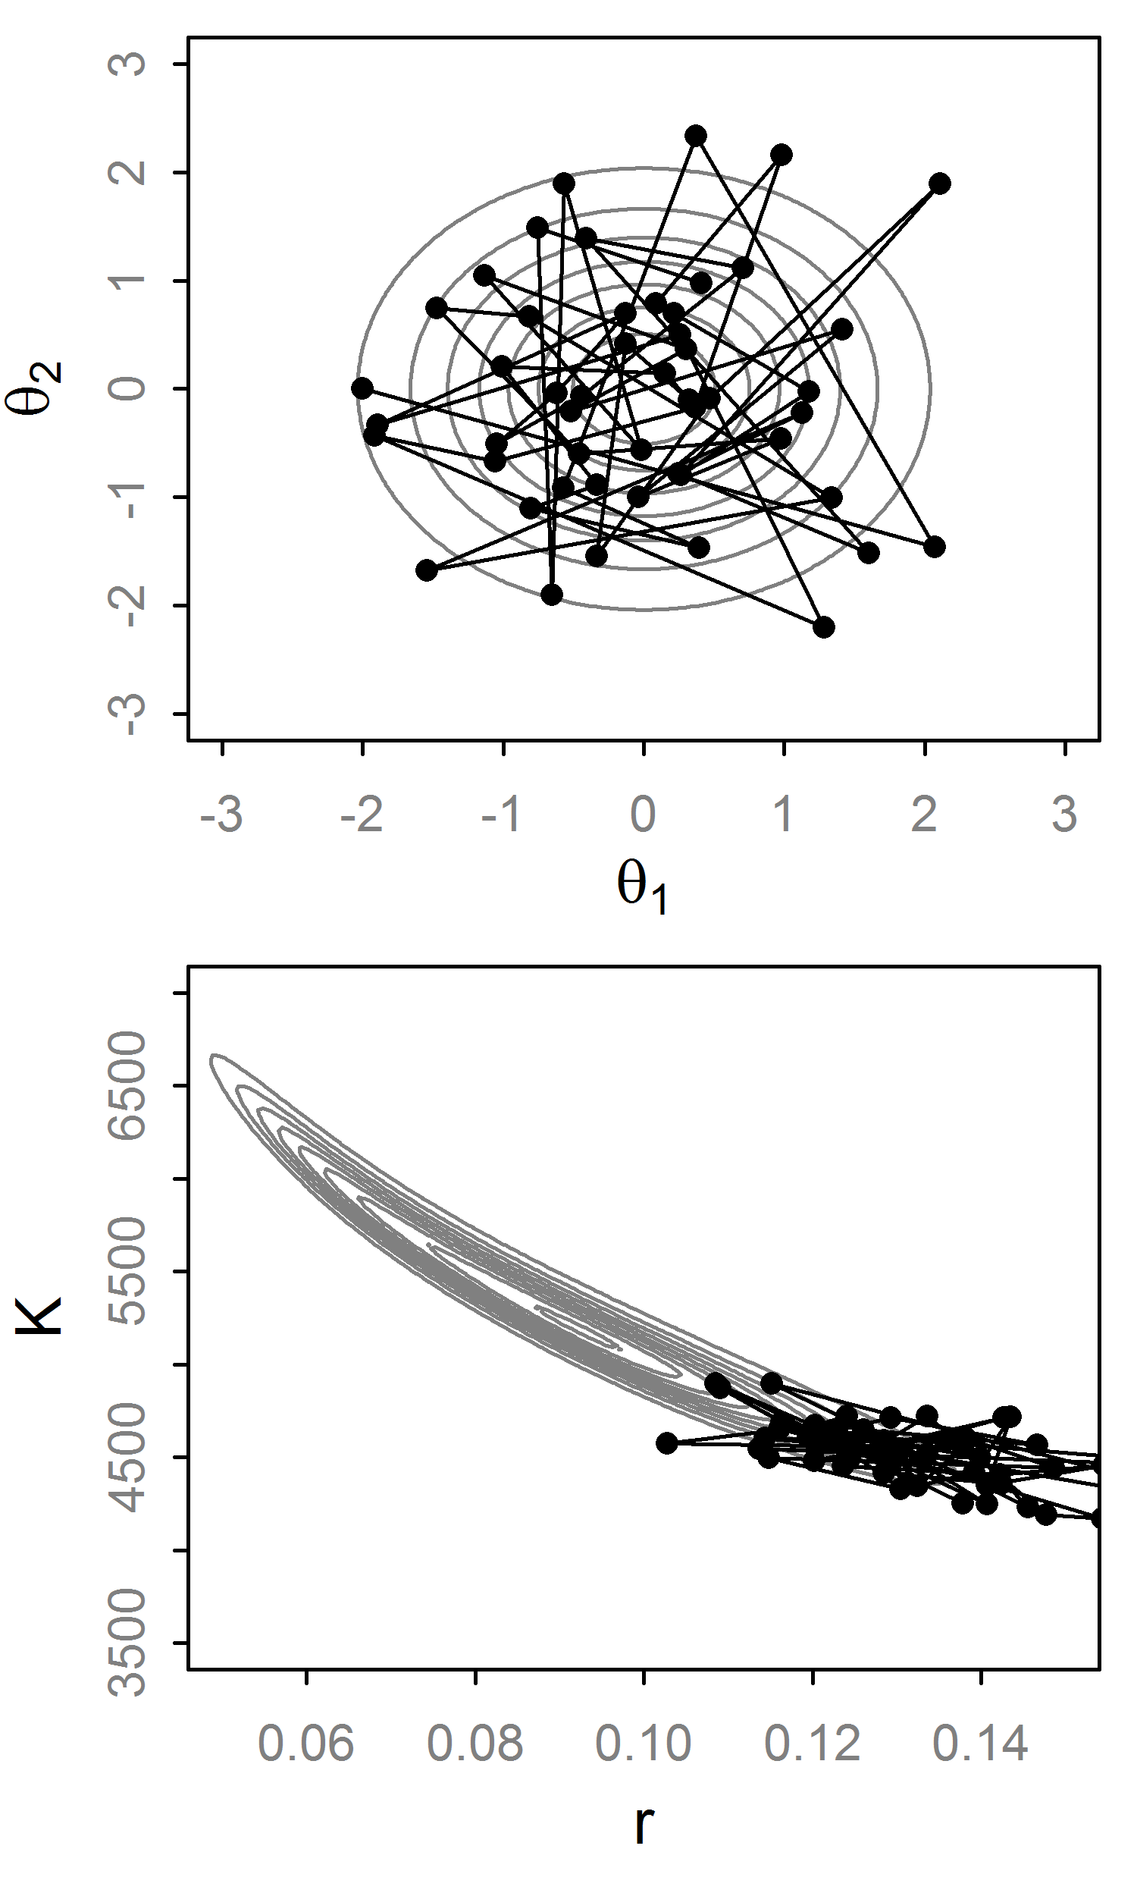
Gibbs Sampler
Condition on all but first variable, find conjugate form
Generate a value from this “full conditional” distribution.
Repeat for all variables. That is a single step.
If not conjugate, do Metropolis-within-Gibbs
No tuning necessary, but poor efficiency for correlated parameters

Slide 13
Beyond RWM and Gibbs
RWM pros/cons:
Easy to implement and works well for many problems w/o conjugacy.
Must be tuned, can be very sensitive to this
Gibbs pros/cons:
No tuning needed, if full conditionals are possible
Easy to implement (JAGS, BUGS, etc.)
As the dimensionality and complexity increases, these algorithms can struggle.
Thought: We could use the gradient to quickly move between areas regardless of dimensionality

Slide 14
Hamiltonian Dynamics
Imagine a puck moving on a frictionless surface
It has position θ with a potential energy U(θ)
And momentum r, with kinetic energy K(r).
The Hamiltonian [H(θ,r)] describes the behavior of the system over time. For MCMC:H=U(θ)+K(r)
Trivial to calculate
Derivative of log-posterior

Slide 15
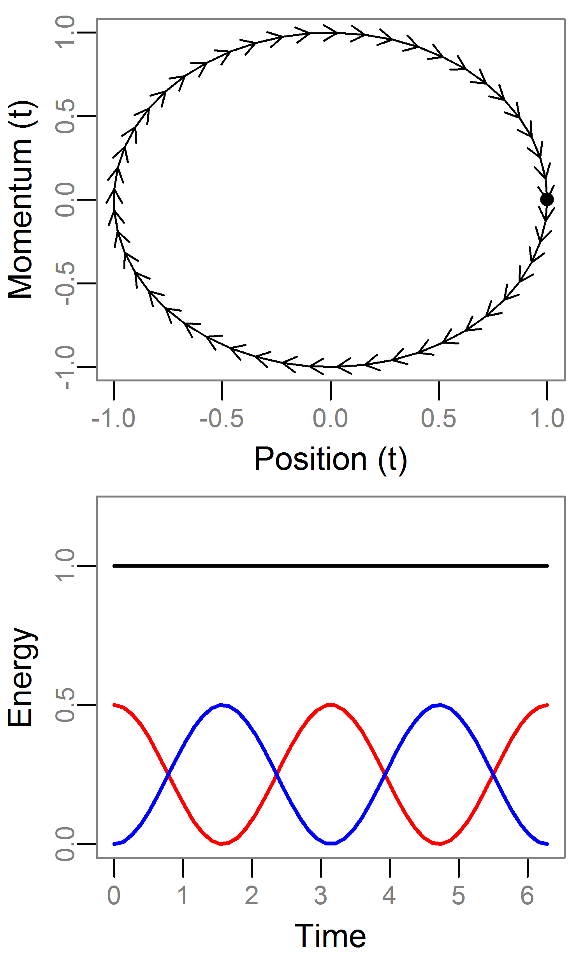
Hamiltonian Dynamics: Example
See Neal (2010) for good review
For MCMC we set U=log posterior and K=log N(0,Σ)
Take a 1d example where:
U=θ²/2 [θ~N(0,1)]
K=r²/2 [r~N(0,1)]
We can solve these equations analytically
Note:
H is constant over time
Each r is a different contour
Most systems are not solvable
H
U
K

Slide 16
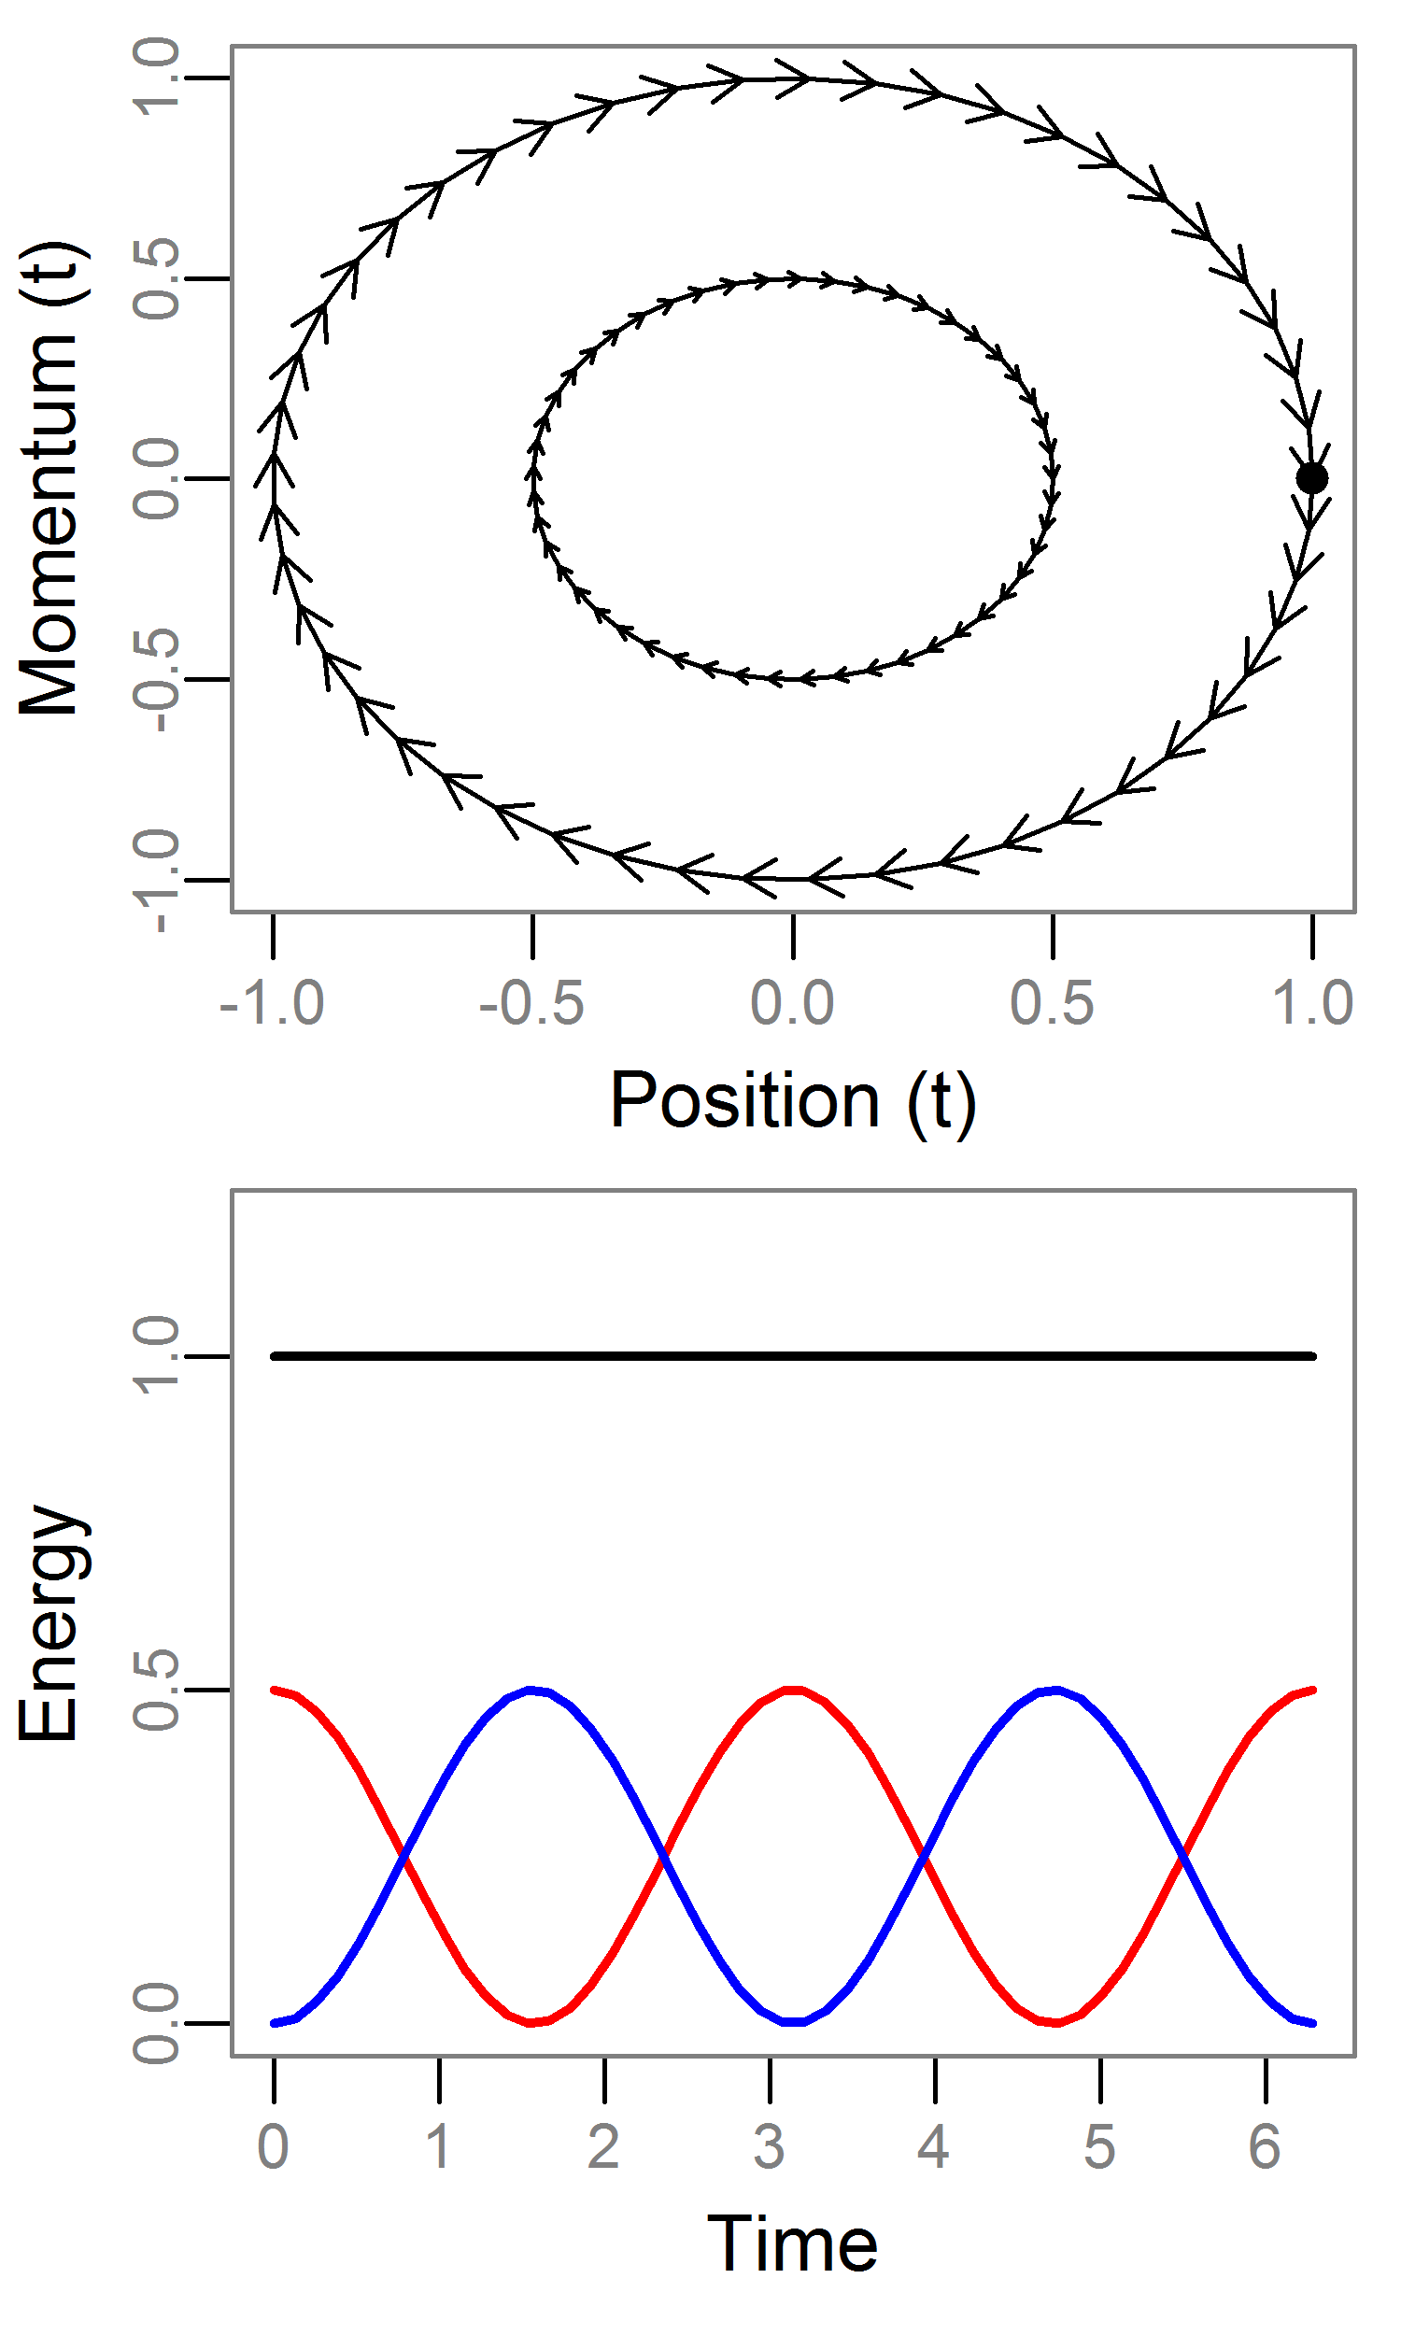
Hamiltonian Dynamics: Example
See Neal (2010) for good review
For MCMC we set U=log posterior and K=log N(0,Σ)
Take a 1d example where:
U=θ²/2 [θ~N(0,1)]
K=r²/2 [r~N(0,1)]
We can solve these equations analytically
Note:
H is constant over time
Each r is a different contour
Most systems are not solvable
H
U
K

Slide 17
Static Hamiltonian Monte Carlo
Draw r~MVN(0,Σ) (Σ ¹ is unit diagonal)
Project forward² L discrete steps of size ɛ.
The final value of trajectory is our proposed value (q!!).
Note:
H varies due to discretization, so use RWM step:
This generates joint samples (θ,r), so we discard (ignore) the r samples.
¹ This is known as the “mass matrix”
² Using the Leapfrog integrator which is more stable/robust than Euler’s method

Slide 18
Hamiltonian Monte Carlo
Q: Why do we need to utilize a Hamiltonian system?
A: Detailed balance!
HMC has several mathematical properties advantageous for MCMC:
Reversible + Volume preserving.
Informally: the q cancels out. Impossible to calculate otherwise.
Crucially, these hold under discretization
Bottom line: The chain gives us samples from the posterior

Slide 19
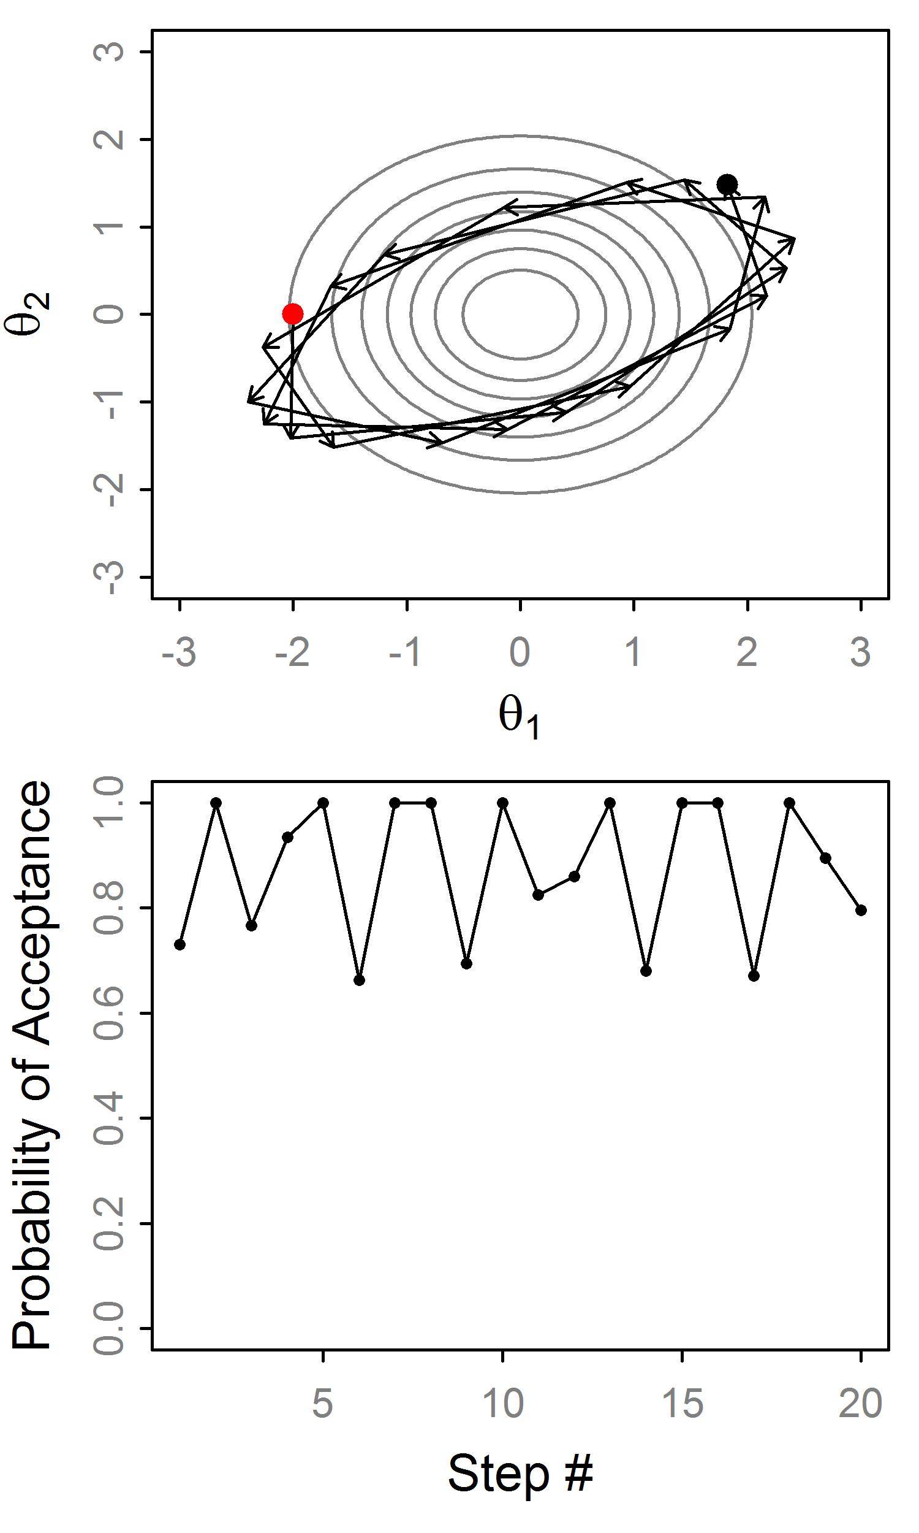
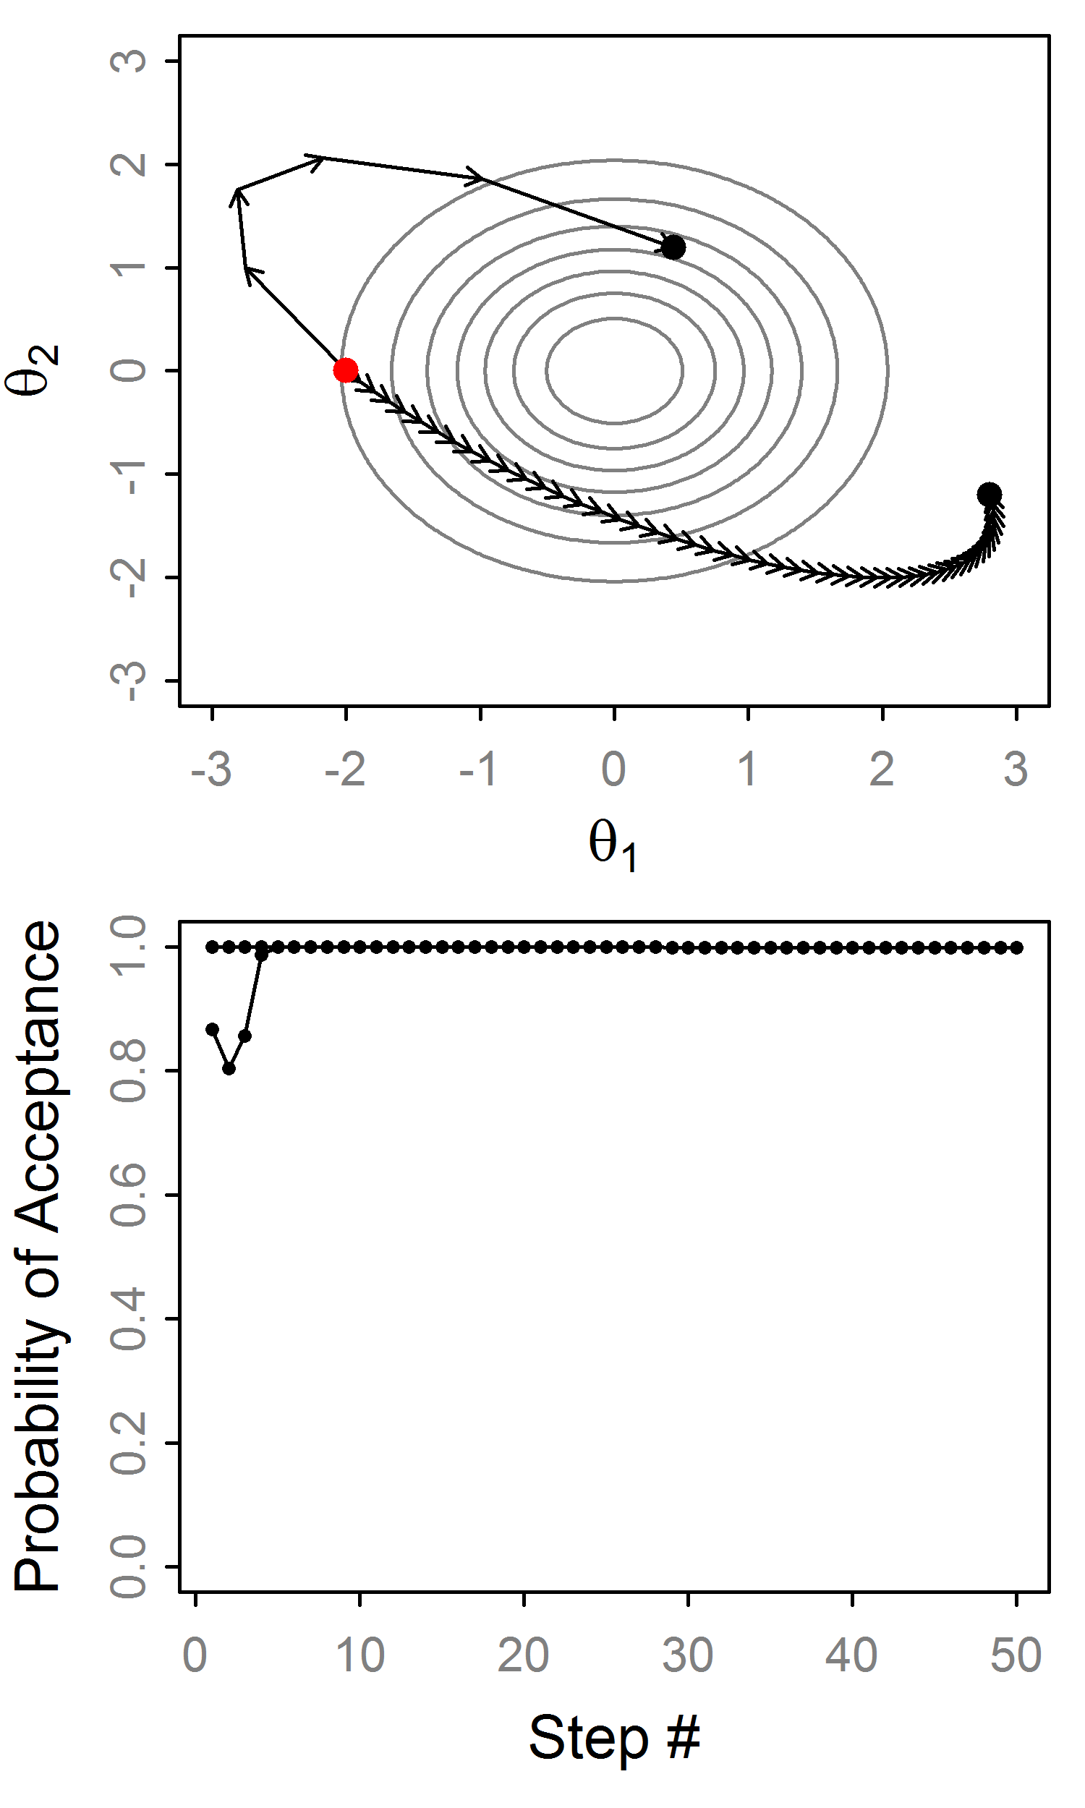
HMC: Example trajectories
Very stable!
Big ɛ, small L
Small ɛ, big L
Big ɛ leads to variation in H
Errors don’t accumulate

Slide 20
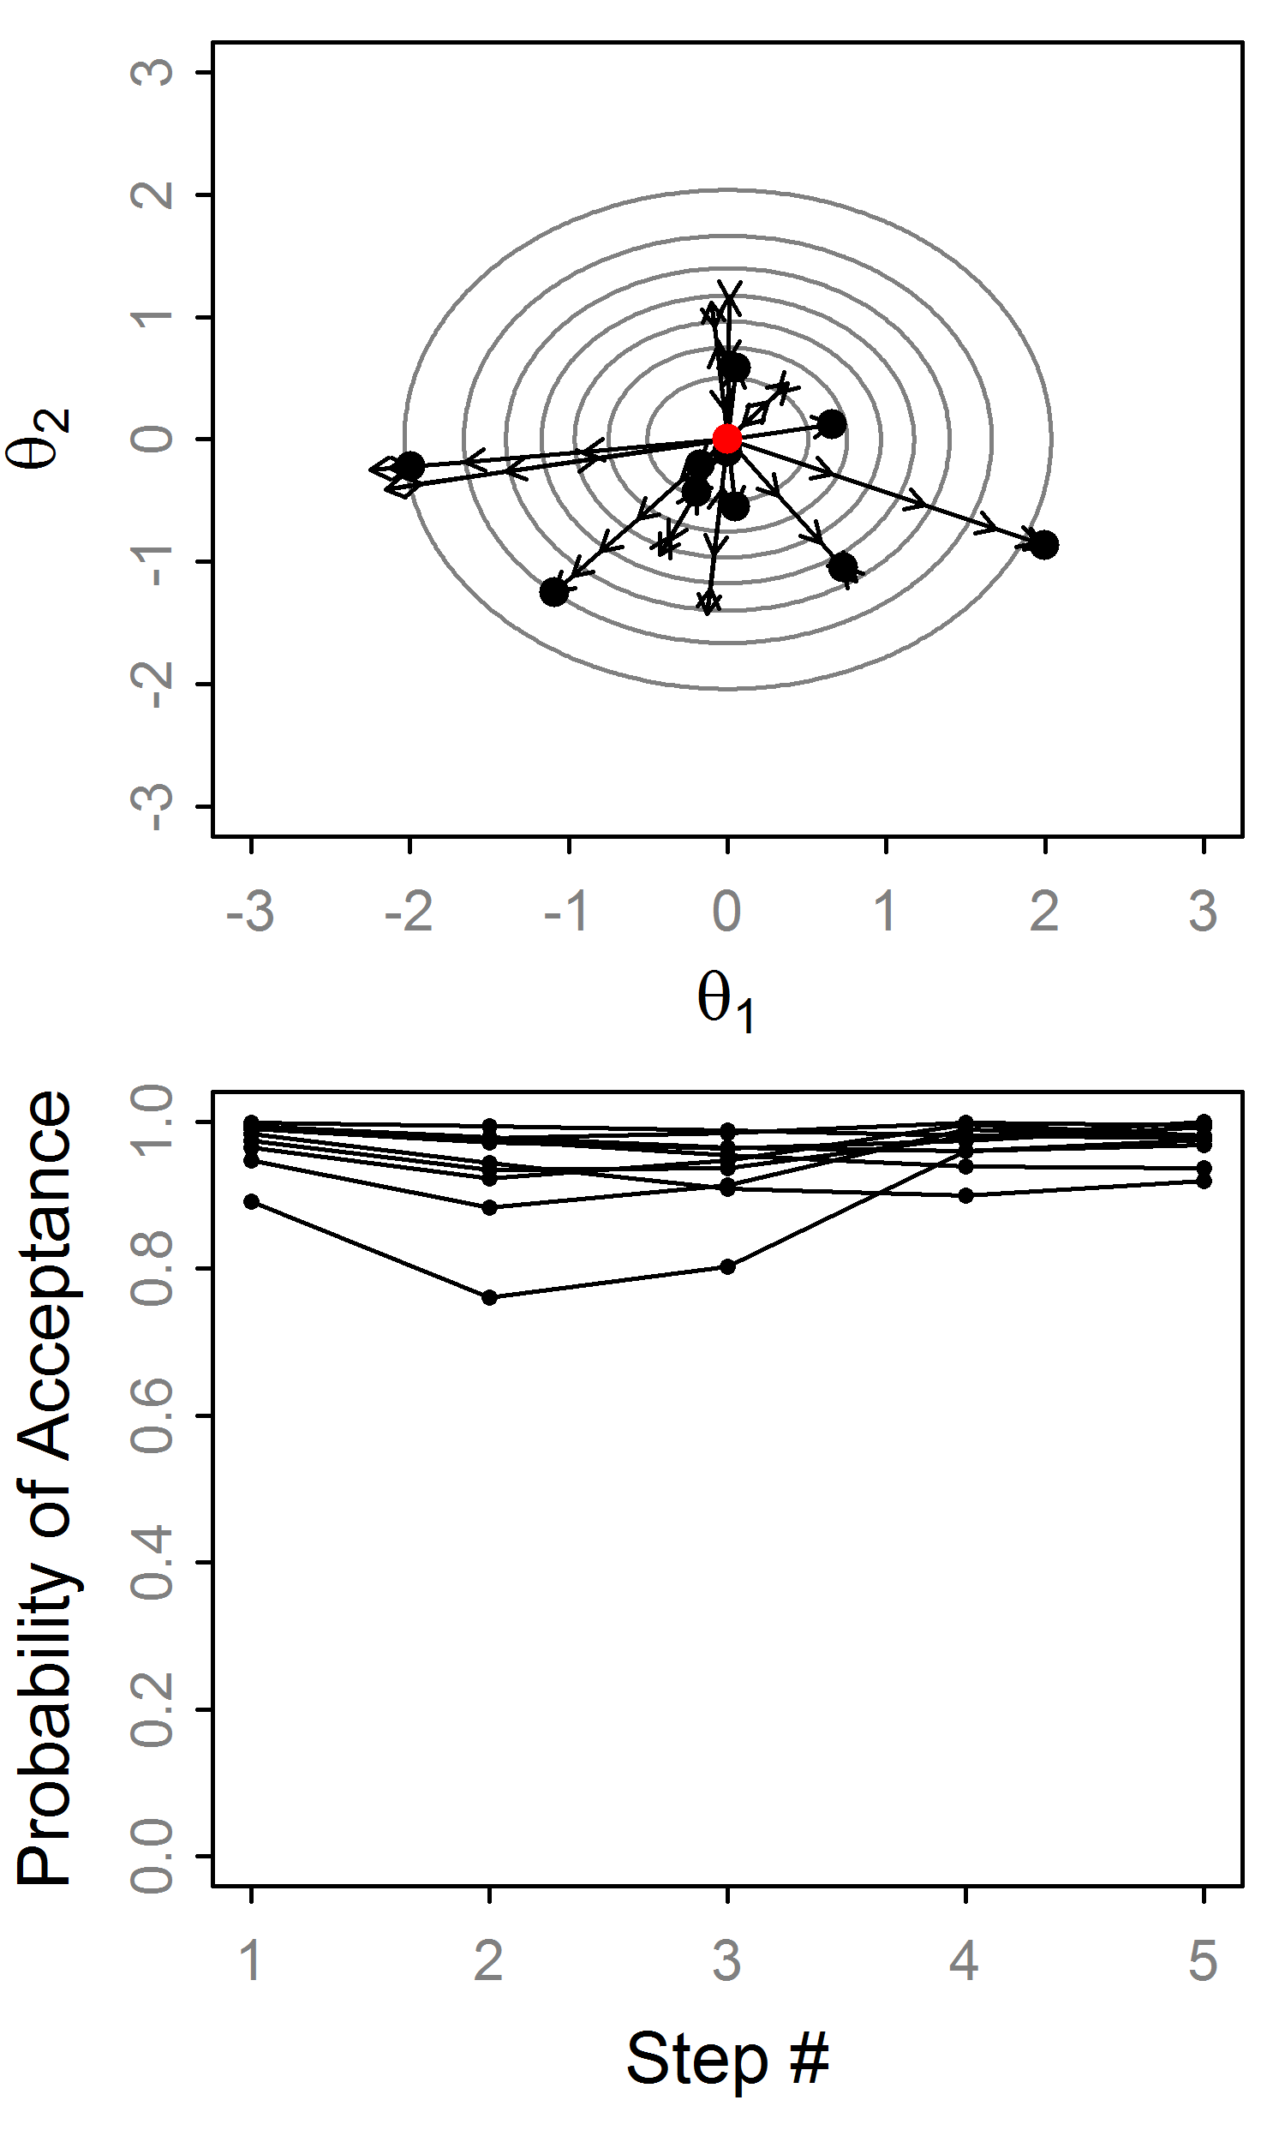
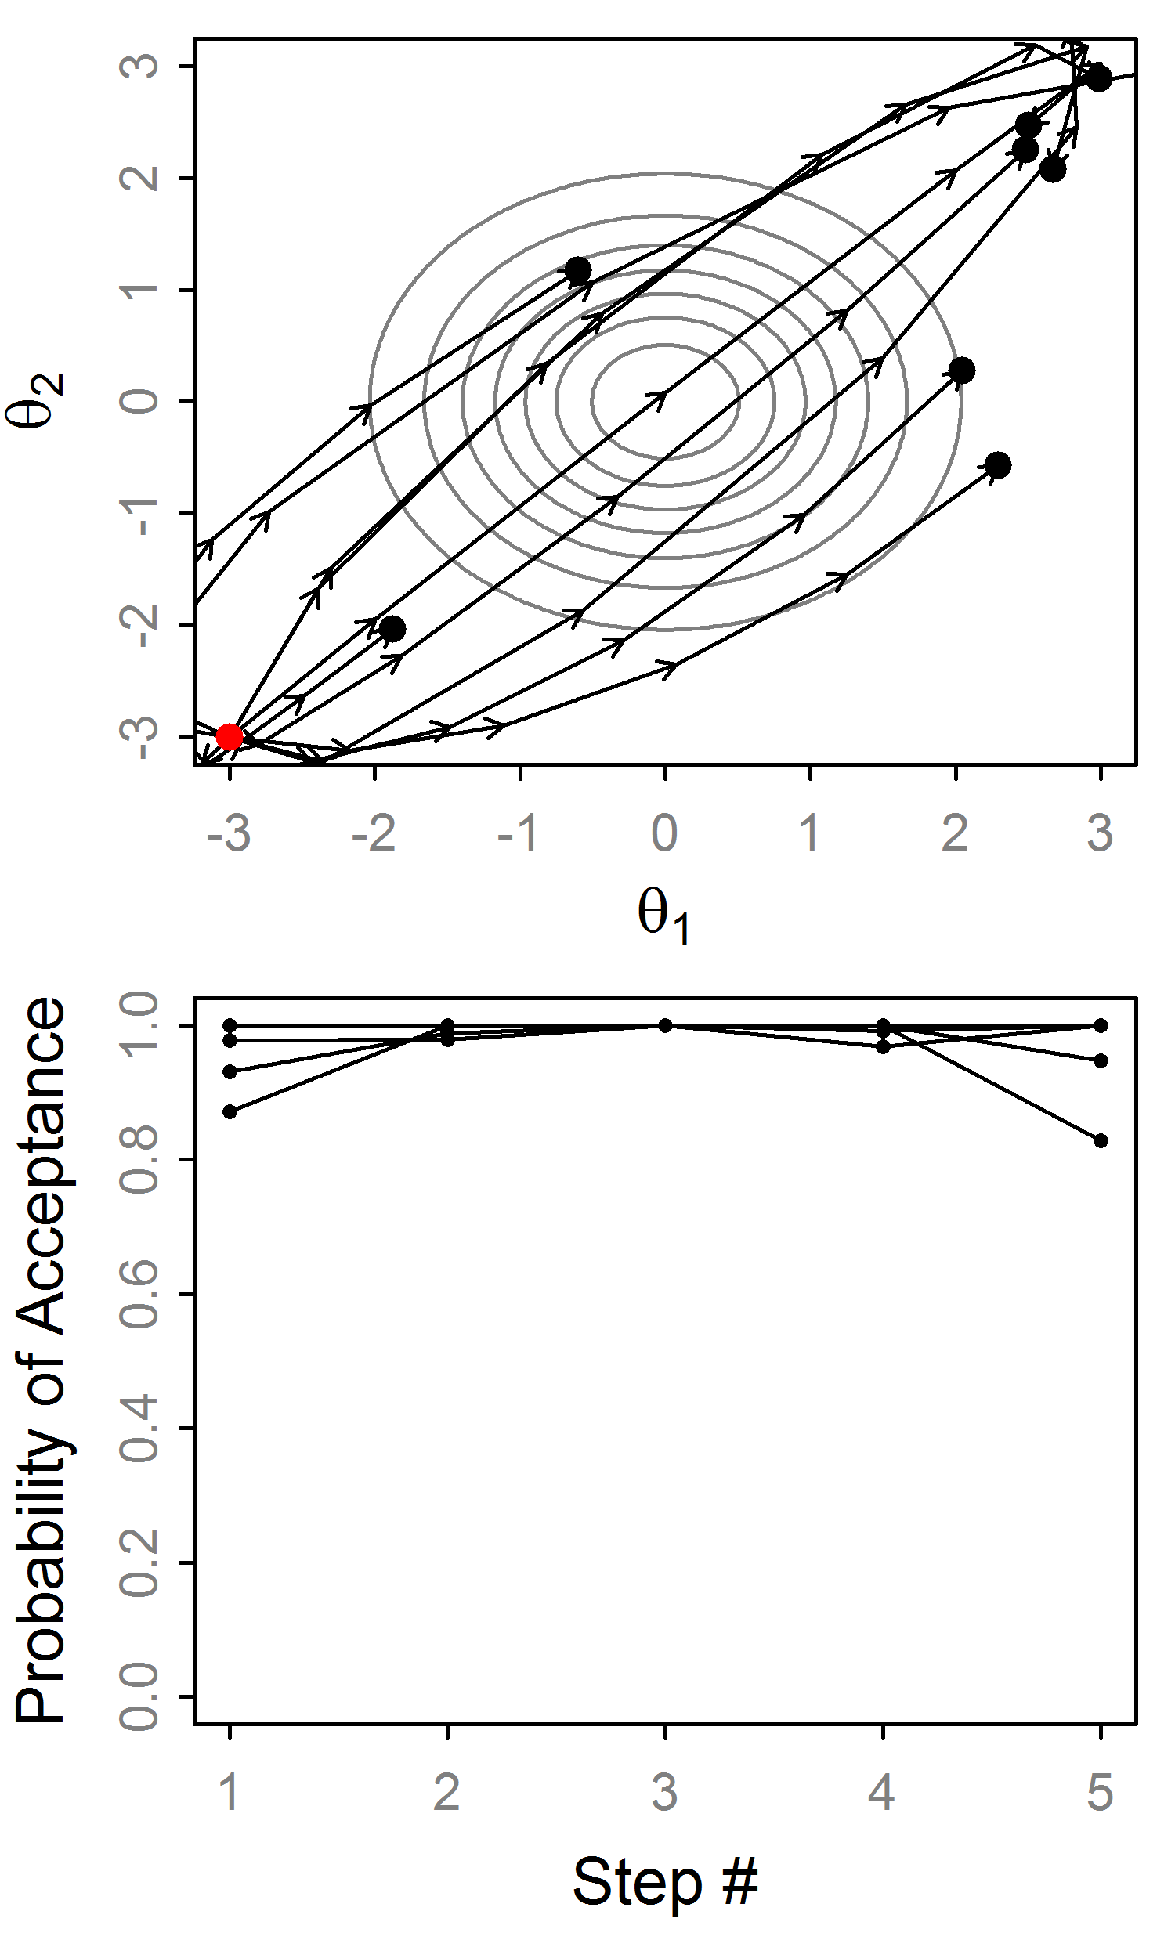
Effect of random momentum
Random momentum and ɛ
w/o random ɛ we’d alternate here!!!

Slide 21
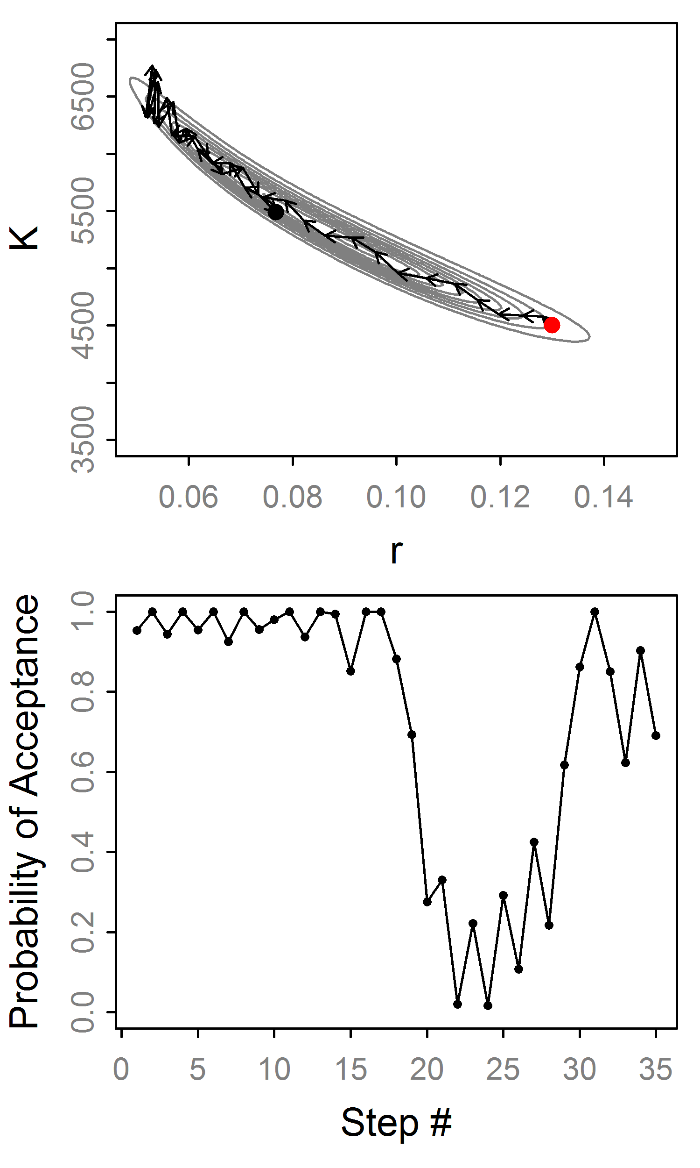
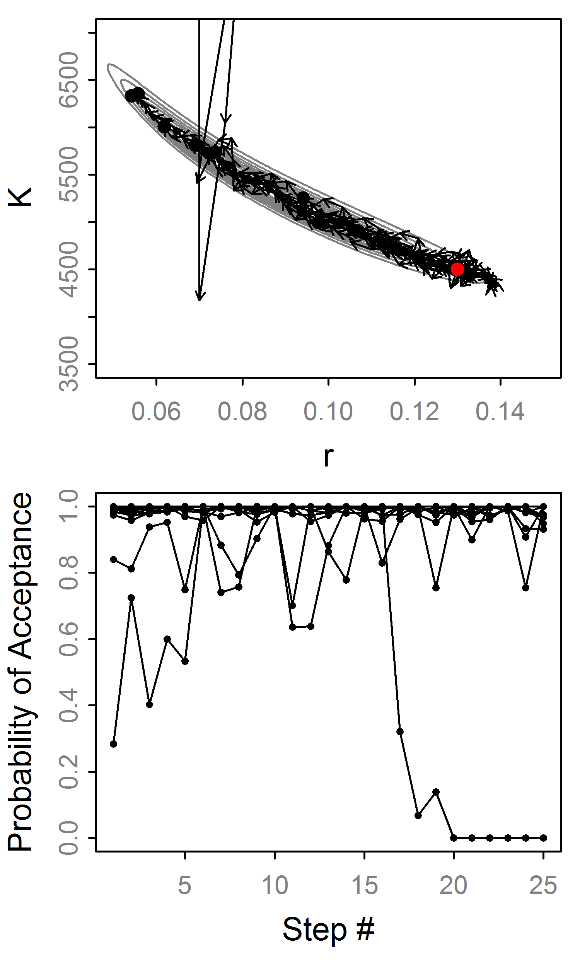
HMC: Example trajectories
“Divergent”
“Divergent”

Slide 22
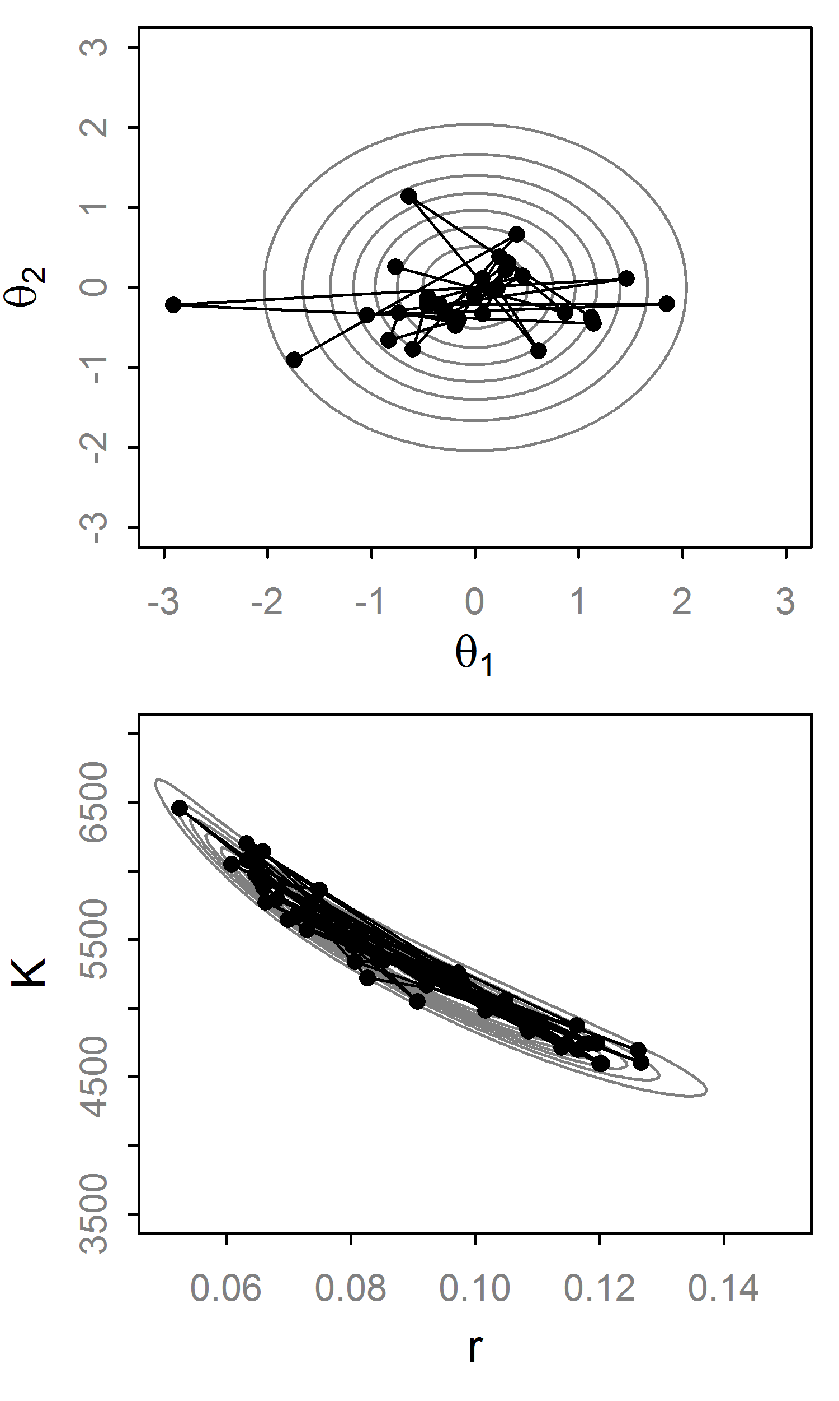
Hamiltonian Monte Carlo
HMC eliminates inefficient random walk behavior
Fancy way to propose values
Often produces nearly independent samples (for large L)
Has high computational cost (L ≈ to thinning)

Slide 23
Implementation Hurdles of HMC
Introduced by Duane et al. (1987)… why uncommon?
Some in the physics/stats literature¹, but it “seems to be under-appreciated by statisticians” (Neal, 2010).
Mainly for two reasons:
Hard to calculate derivatives of log posteriors
Efficiency is notoriously sensitive to the tuning parameters: (L, ɛ, Σ)
¹ e.g., Neal (1996), Ishwaran (1999) and Schmidt (2009)

Slide 24
Solution #1: Automatic Differentiation
AD is a numerical technique to get precise derivative of any continuous function.
The computer applies the chain rule successively
It is as precise as analytical derivatives up to computer precision.
Available widely, e.g., ADMB, TMB, Stan
Posterior must be continuously differentiable

Slide 25
Solution #2: No-U-Turn Sampler
Extends HMC to avoid specifying L and ɛ.
ɛ is adapted with ‘dual averaging’. Works for HMC too. Skipping this...
L is set automatically with a sophisticated algorithm that detects a “U-turn” in the trajectory and stops.
Thus L varies at each iteration, avoiding wasteful steps.
Hoffman and Gelman (2011)

Slide 26
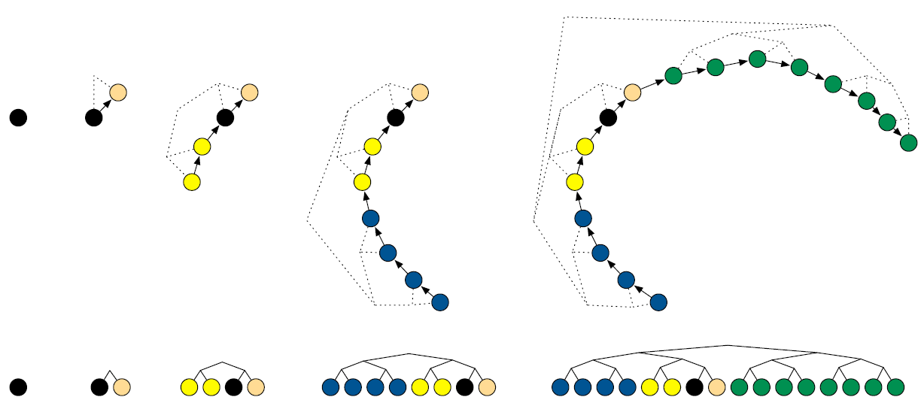
No-U-Turn Trajectory
for j in 0:max_depth
Pick random direction (left or right)
Recursively build tree of size 2^{j}
If U-turn occur in subtree or divergence
break, excluding subtree
Balanced Binary Tree
Fig 1, Hoffman and Gelman (2011)

Slide 27
Sampling from Trajectory
Let B be set of states (θ,r) in trajectory.
Generate a slice variable
Set C is states in B where
Uniformly select from C to get θ_{t+1}
Why so complicated? Detailed balance!
Note: There is no Metropolis step, this is technically Gibbs sampling [p(θ,r,u,B,C|ɛ)]

Slide 28
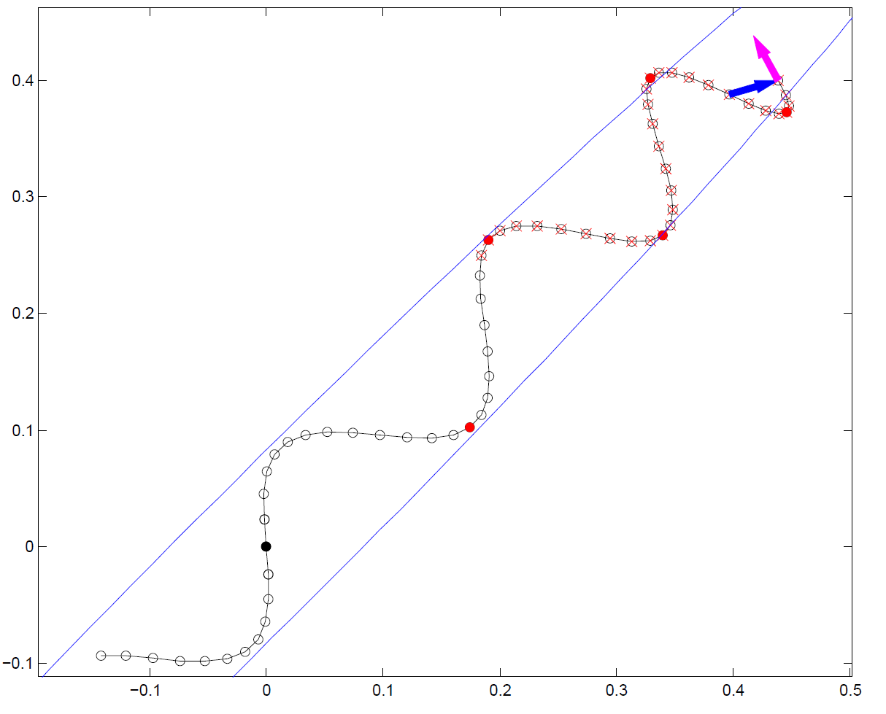
No-U-Turn Example
Exclude this subtree
U-Turn!!
Exclude due to slice variable
Fig 2, Hoffman and Gelman (2011)

Slide 29
Tuning the No-U-Turn Sampler
Eliminates the need to specify ɛ or L: ɛ is tuned during the warmup phase, L dynamically.
But, introduces new tuning parameters:
max_treedepth=12: Maximum tree depth.
Delta=0.8: The target acceptance rate (increase toward 1 as needed)
However, this seems to work smoothly without intervention (good for general use)

Slide 30
Divergent transitions indicate issues
Divergences occur when a trajectory hits a region of high curvature and the total energy goes to infinity
This diagnostic tells us the MCMC sampler may be biased
Try rerunning with a higher adapt_delta
Or reparametrize if possible

Slide 31
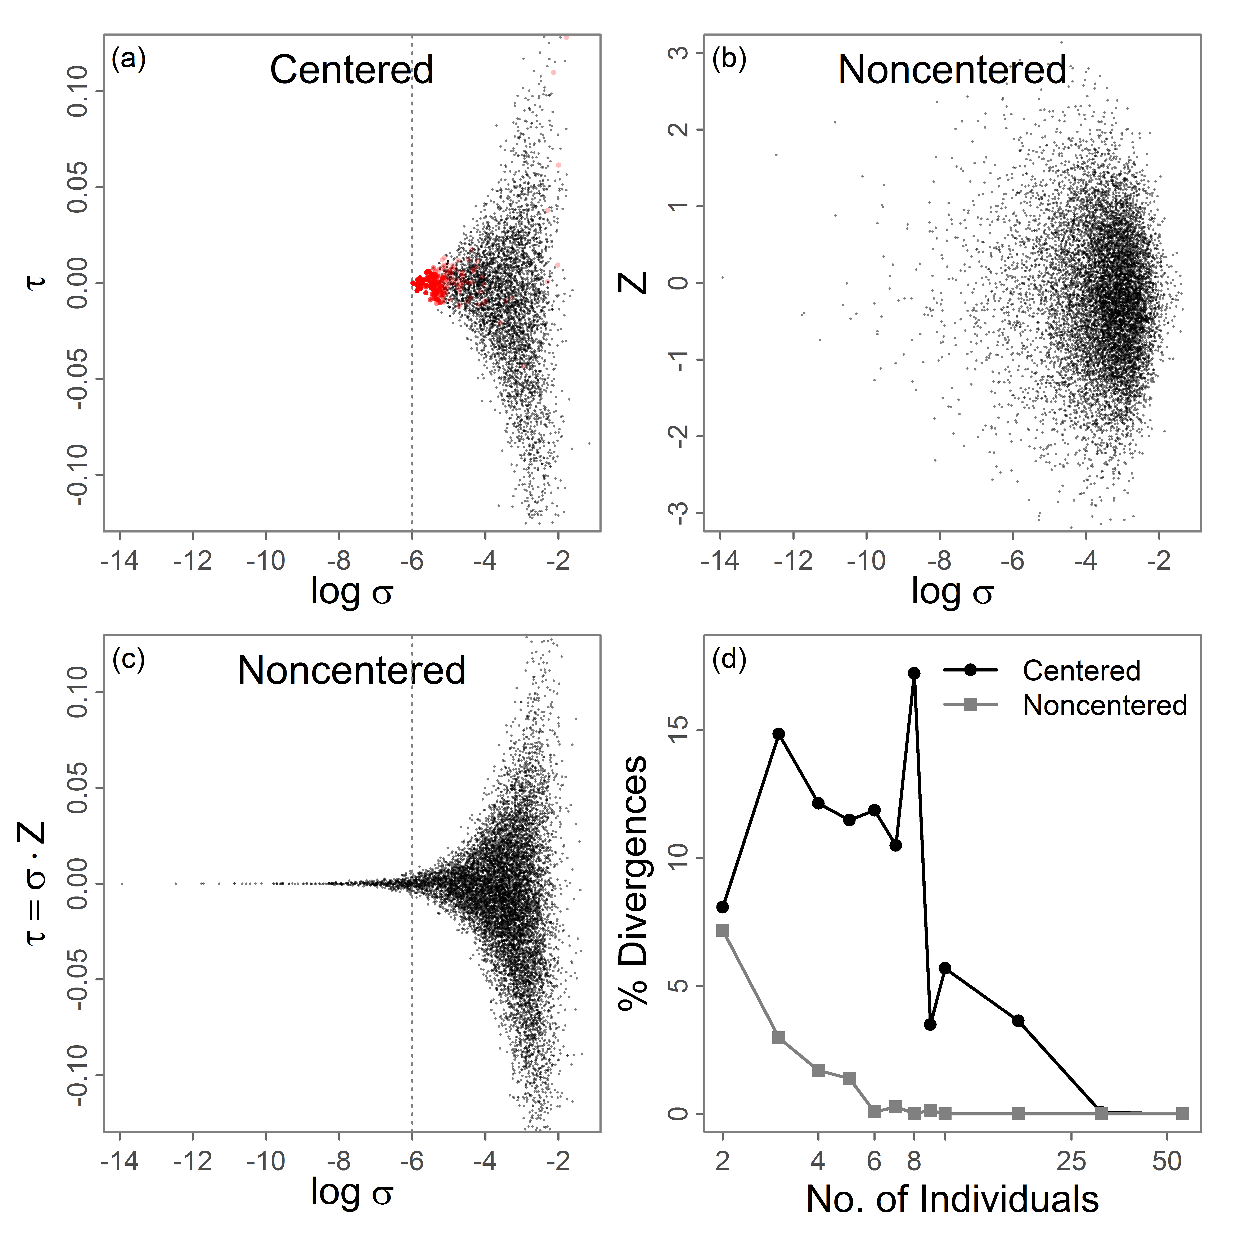
Divergent transitions indicate issues
This is a non-linear mixed effects growth model
There are two ways to parametrize the random effects: ‘centered’ and ‘non-centered’
The non-centered version has divergences and bias
Non-centering fixes this and is a recommended solution

Slide 32
Concluding thoughts
HMC/NUTS are extremely sophisticated and powerful MCMC algorithms
A basic understanding helps interpret and diagnose output
Stan is replacing JAGS as a generic platform
Stan’s divergences warning of bias (good)
Advice: JAGS is good starting place. Switch to Stan and gradient-based MCMC if needed.

Slide 33
References
Monnahan, C. C., J. T. Thorson, and T. A. Branch. 2017. Faster estimation of Bayesian models in ecology using Hamiltonian Monte Carlo. Methods in Ecology and Evolution 8:339-348.
Papaspiliopoulos, O., G. O. Roberts, and M. Skold. 2007. A general framework for the parametrization of hierarchical models. Statistical Science 22:59-73.
Betancourt, M., and M. Girolami. 2015. Hamiltonian Monte Carlo for hierarchical models. Current Trends in Bayesian Methodology with Applications:79.
Hoffman, M. D., and A. Gelman. 2014. The no-U-turn sampler: adaptively setting path lengths in Hamiltonian Monte Carlo. Journal of Machine Learning Research 15:1593-1623.
Carpenter, B., A. Gelman, M. D. Hoffman, D. Lee, B. Goodrich, M. Betancourt, M. Brubaker, J. Guo, P. Li, and A. Riddell. 2017. Stan: A Probabilistic Programming Language. Journal of Statistical Software 76:1-29.

