Slide 1
Course introduction 14 January 2019
Fitting hierarchical models with TMB
14-18 Enero, 2019
Universidad de Concepción, Chile
Dr. Cole Monnahan

Slide 2
Dr. Cole Monnahan
Formación Académica
University of Washington, M.S.& PhD
Quantitative Ecology
Actividades Laborales
Post-doc con Billy Ernst (UdeC & UW)
Conexión con Chile
Quería vivir en América Latina y aprender español.

Slide 3
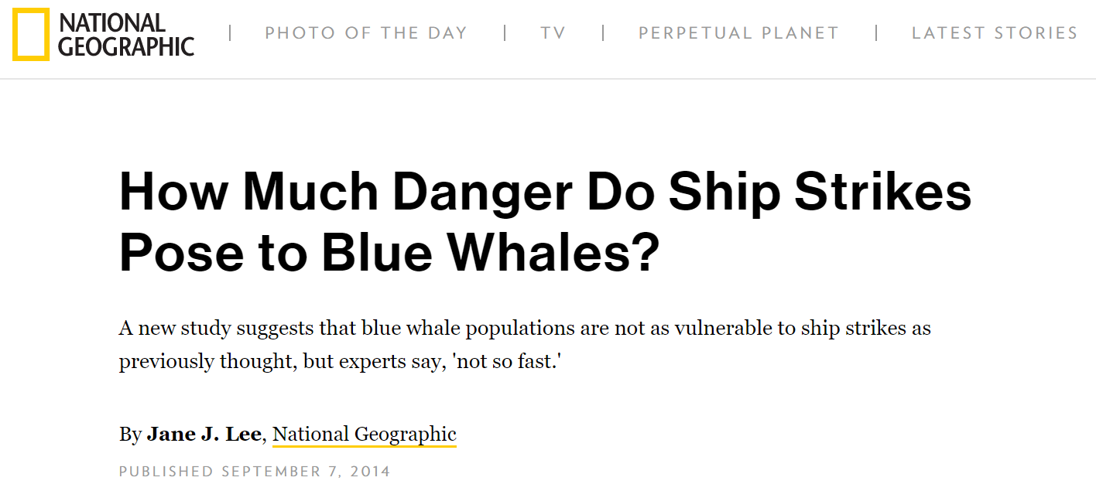
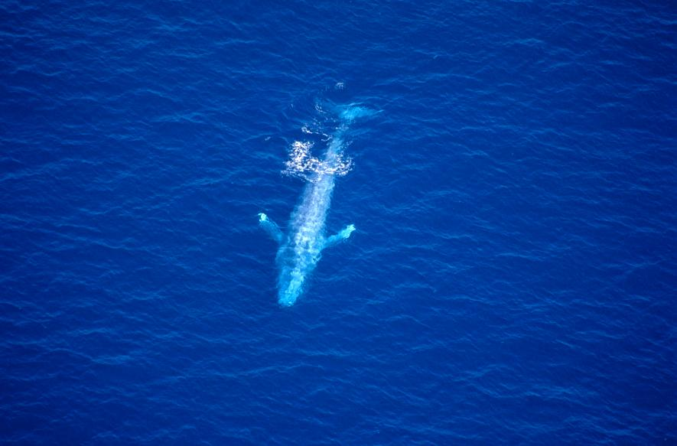
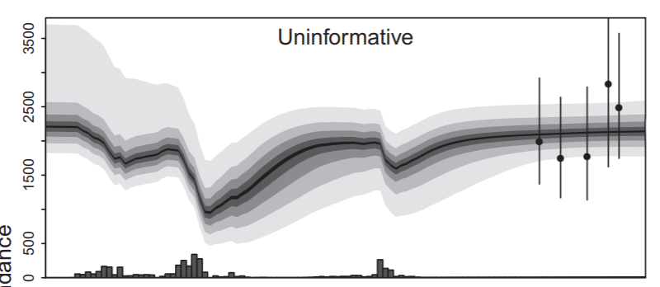
California blue whale recovery

Slide 4
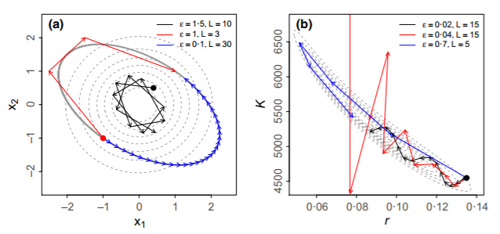
Bayesian fisheries stock assessments
Hamiltonian Monte Carlo MCMC for ADMB assessments

Slide 5


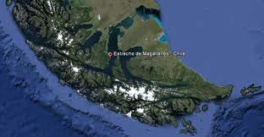
Postdoc: Un análisis de Ballenas jorobadas Estrecho de Magallanes
Crédito: Luis Bertea

Slide 6
Y ahora es su turno…
¿Experiencia & Interés?
¿Qué espera a realizar del curso?
¿Que es su experiencia con modelos Bayesianos?
¿Qué es su experiencia con el idioma R

Slide 7
Course goals
Gain comfort with distributions and how to integrate them numerically
Basics of Bayesian modeling: likelihood, prior, posterior
Understand what MCMC is and why necessary
Robust workflow for real problems, including hierarchical Bayesian modeling
Basic understanding of Hamiltonian Monte Carlo and Stan

Slide 8
Bayesian modeling: overview
Class of model with a hierarchical structure
Royle and Dorazio 2008

Slide 9
HM by Royle & Dorazio
Statistical models used widely in ecology
A “conceptual and philosophical approach to doing science” with distinct models:
Observation: How data are observed (with error), given the process.
Process: Describes the dynamics of the ecological process (e.g. animal abundance over time/space)
P(data|process, parameters)*P(process|parameters)
observation
process
Royle and Dorazio 2008

Slide 10
Table of frequentist vs Bayesian

Slide 11
Fitting Bayesian models
Possible as either Bayesian or frequentist

Slide 12
What is JAGS?
TMB is an R package and environment for fitting statistical models

Slide 13
TMB Workflow Overview
Postulate a statistical model
Write a C++ template file to calculate the negative log-likelihood given parameters
Compile the model and link to it in R
Declare which parameters are “random”
Fit model using R minimizer and the objective and gradient functions returned by TMB
Make inference from the maximum likelihood

Slide 14
TMB examples
Spatial (geospatial)
Thorson, James T., et al. "The importance of spatial models for estimating the strength of density dependence." Ecology 96.5 (2015): 1202-1212.

Slide 15
Review of key concepts
Hierarchical models contain random effects
Occur widely and naturally in ecology
A useful way to model our data
Requires integration of random effects
TMB is integrated with R, but requires writing some C++ code
TMB can fit almost all statistical models

Slide 16
Questions?

