Slide 1
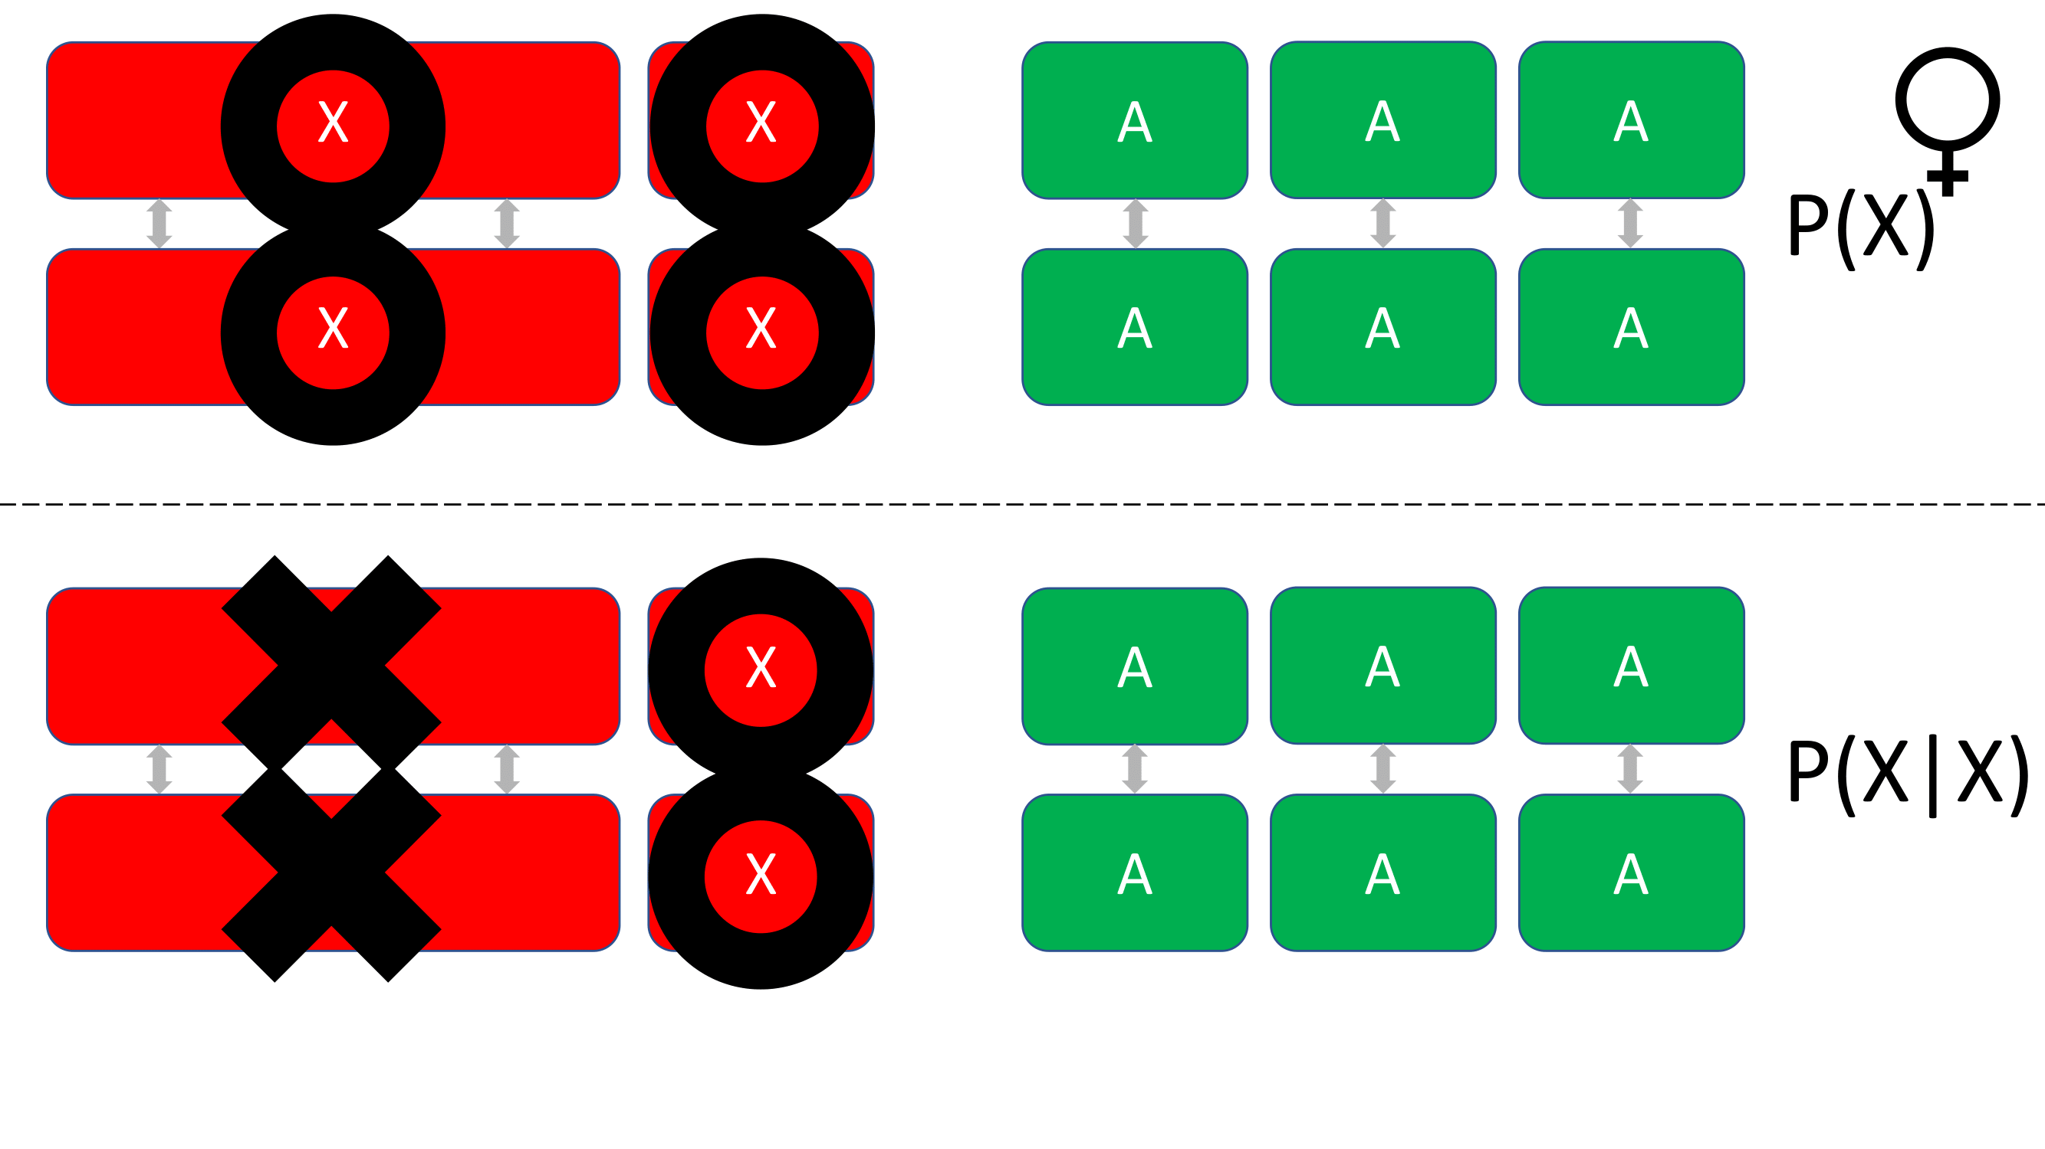
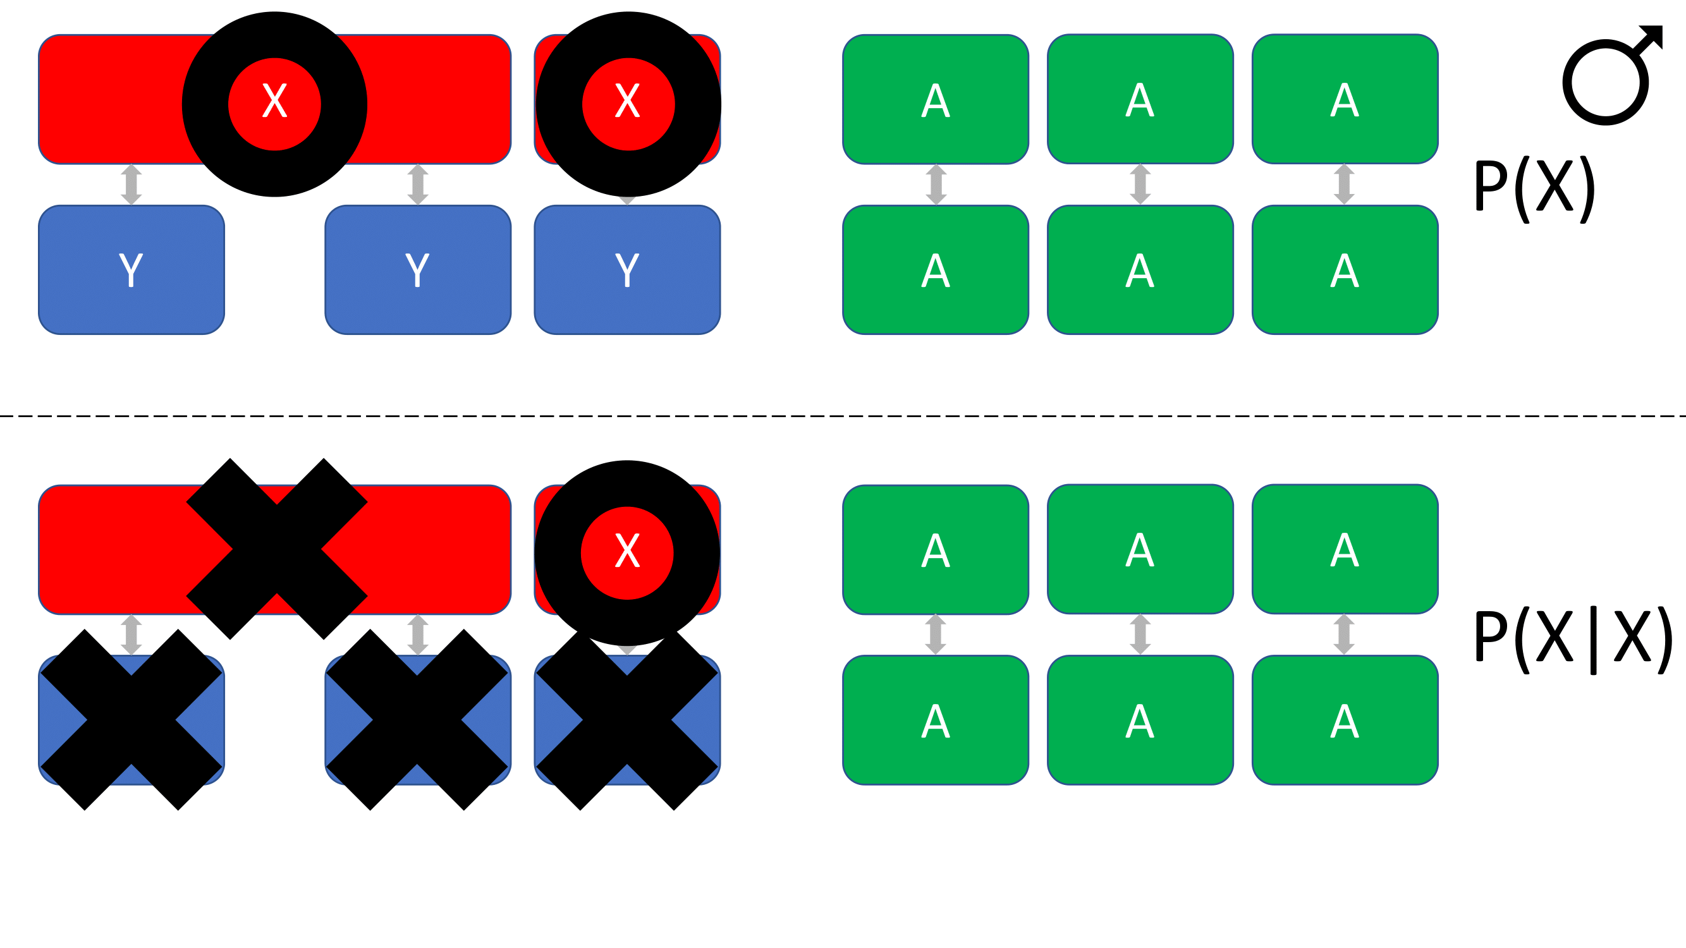
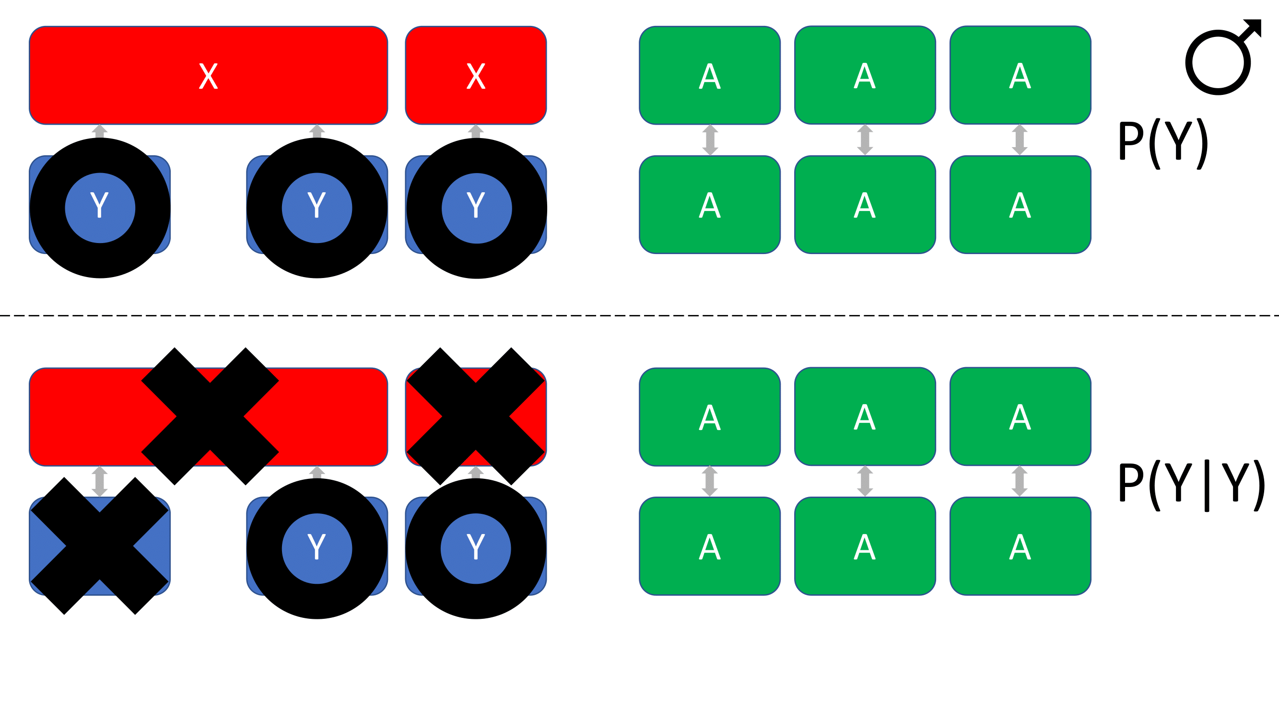
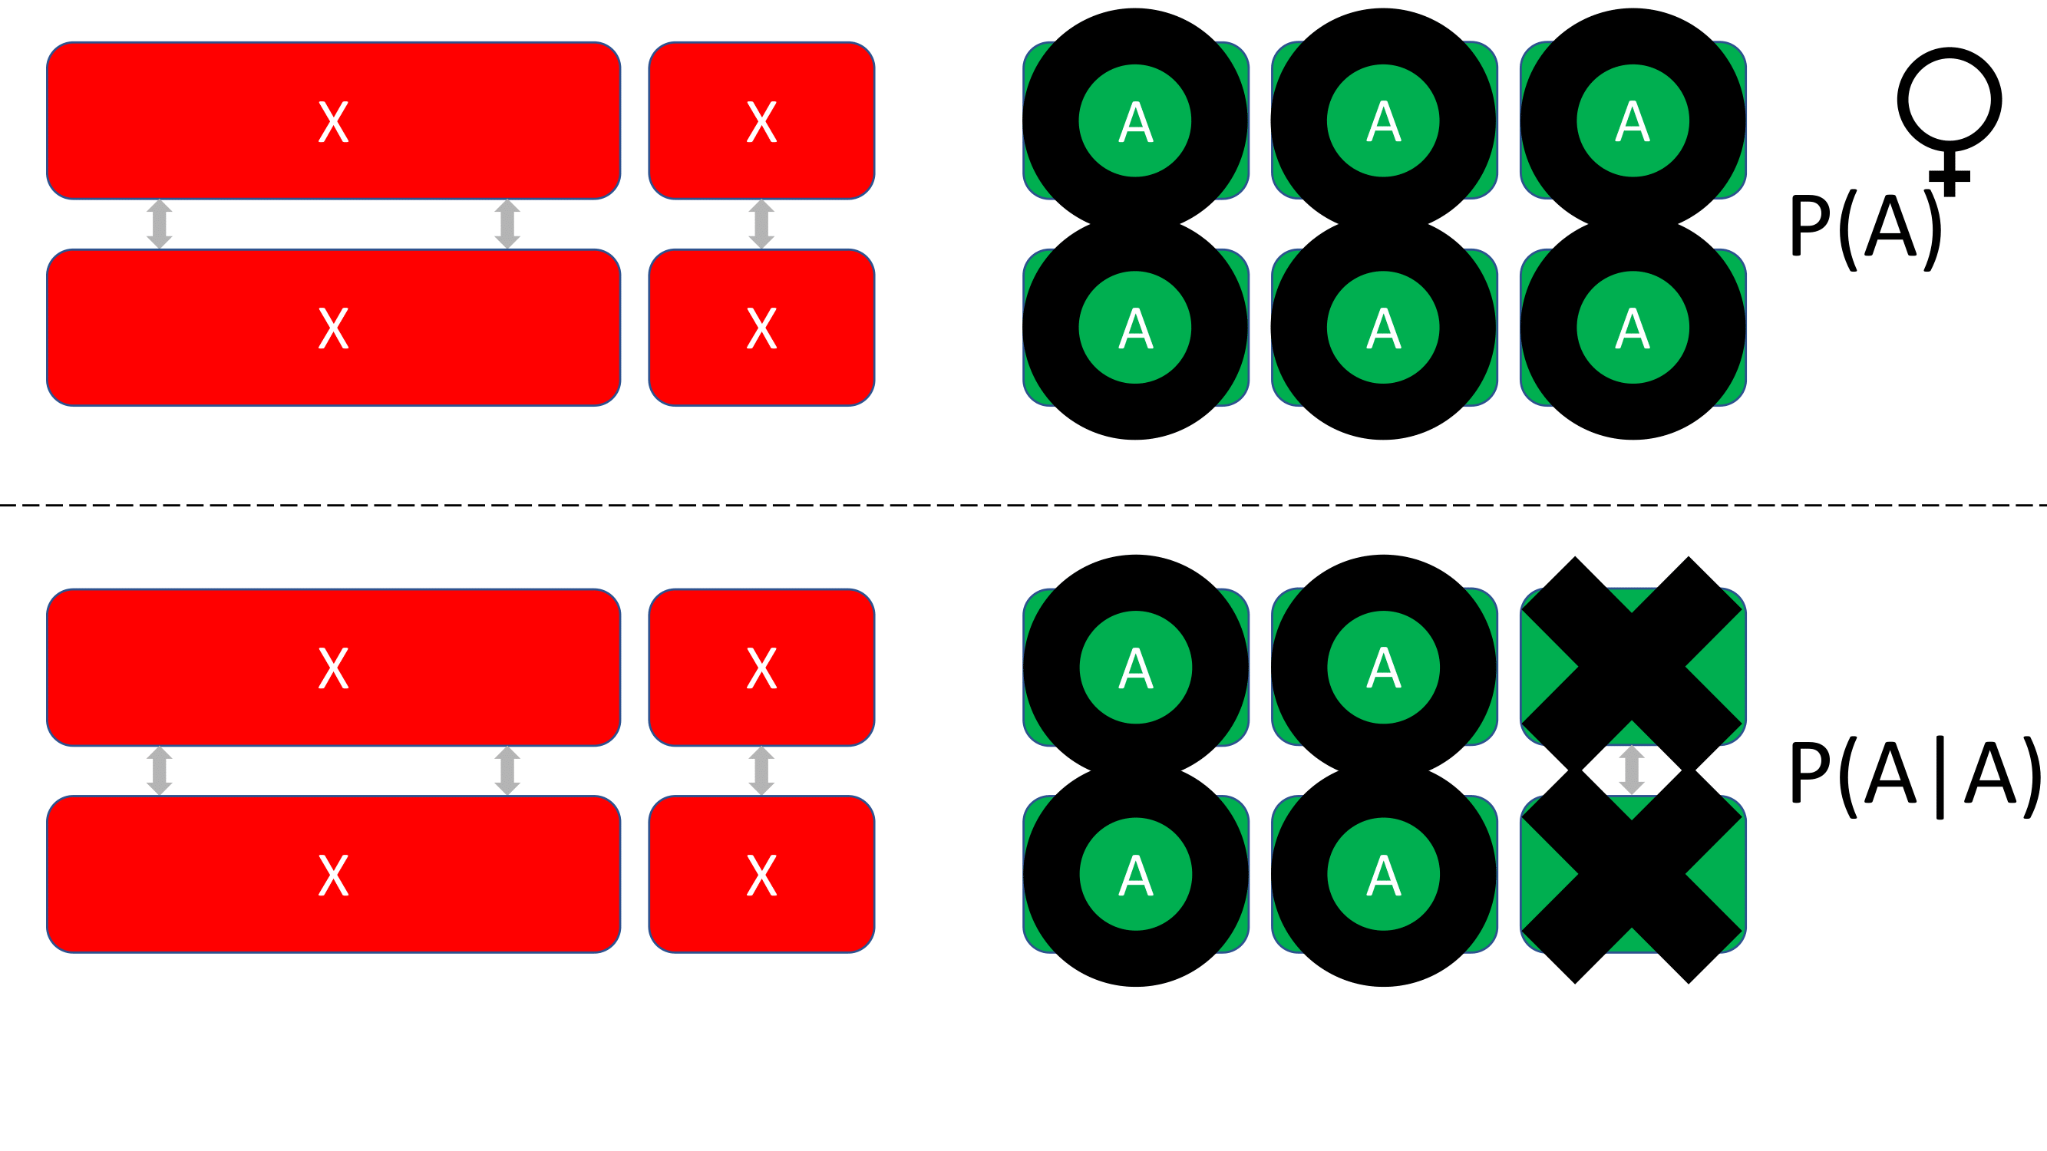
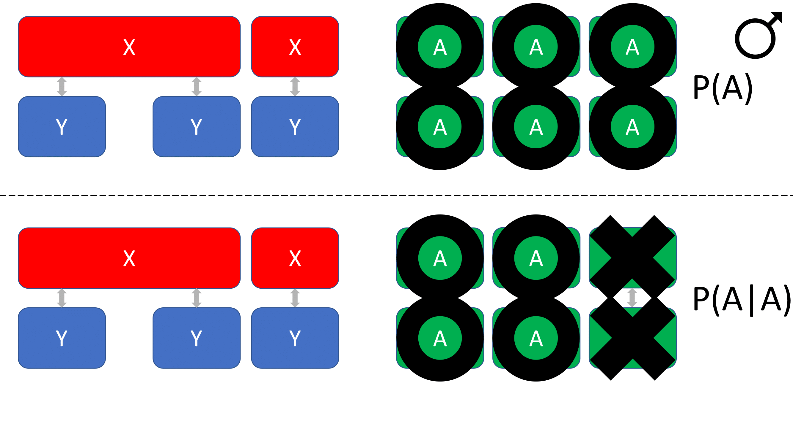
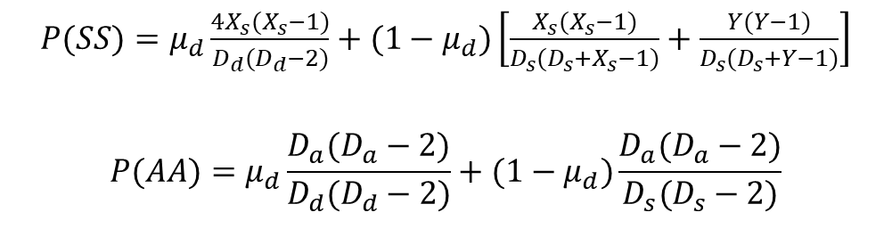
Graphical representation of the counting argument used to derive each fraction in the case of an XXYYY system with a diploid autosome count of six. Circles are found on the chromosome we are ‘choosing’ and X’s are placed on chromosomes which are unavailable to be ‘chosen’ due to a previously ‘chosen’ chromosome. The diagrams represent the fractions surrounded by boxes of matching color. For instance, the fraction in the red box represents P(A)P(A|A), the probability of an autosome is first ‘chosen’ to fuse, and a second autosome is ‘chosen’ to fuse with it and is represented by the diagram surrounded by the same color. The diagram above the dotted line shows the probability of choosing one of the six autosomes out of all of the chromosomes. The diagram below the line shows the probability of choosing one of the four autosomes remaining available to be chosen after the first autosome had been chosen.
$P(SS)=μ_{d}\frac{4X_{s}(X_{s}−1)}{D_{d}(D_{d}−2)}+(1−μ_{d})\left[\frac{X_{s}(X_{s}−1)}{D_{s}(D_{s}+X_{s}−1)}+\frac{Y(Y−1)}{D_{s}(D_{s}+Y−1)}\right]$
$$P(AA)=μ_{d}\frac{D_{a}(D_{a}−2)}{D_{d}(D_{d}−2)}+(1−μ_{d})\frac{D_{a}(D_{a}−2)}{D_{s}(D_{s}−2)}$$

