Slide 1
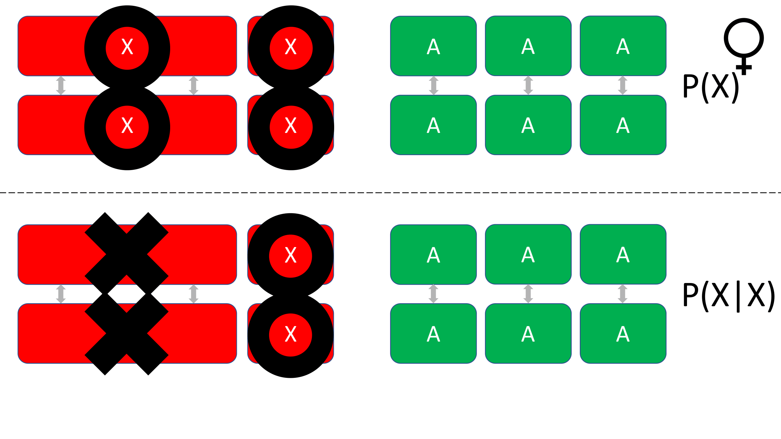
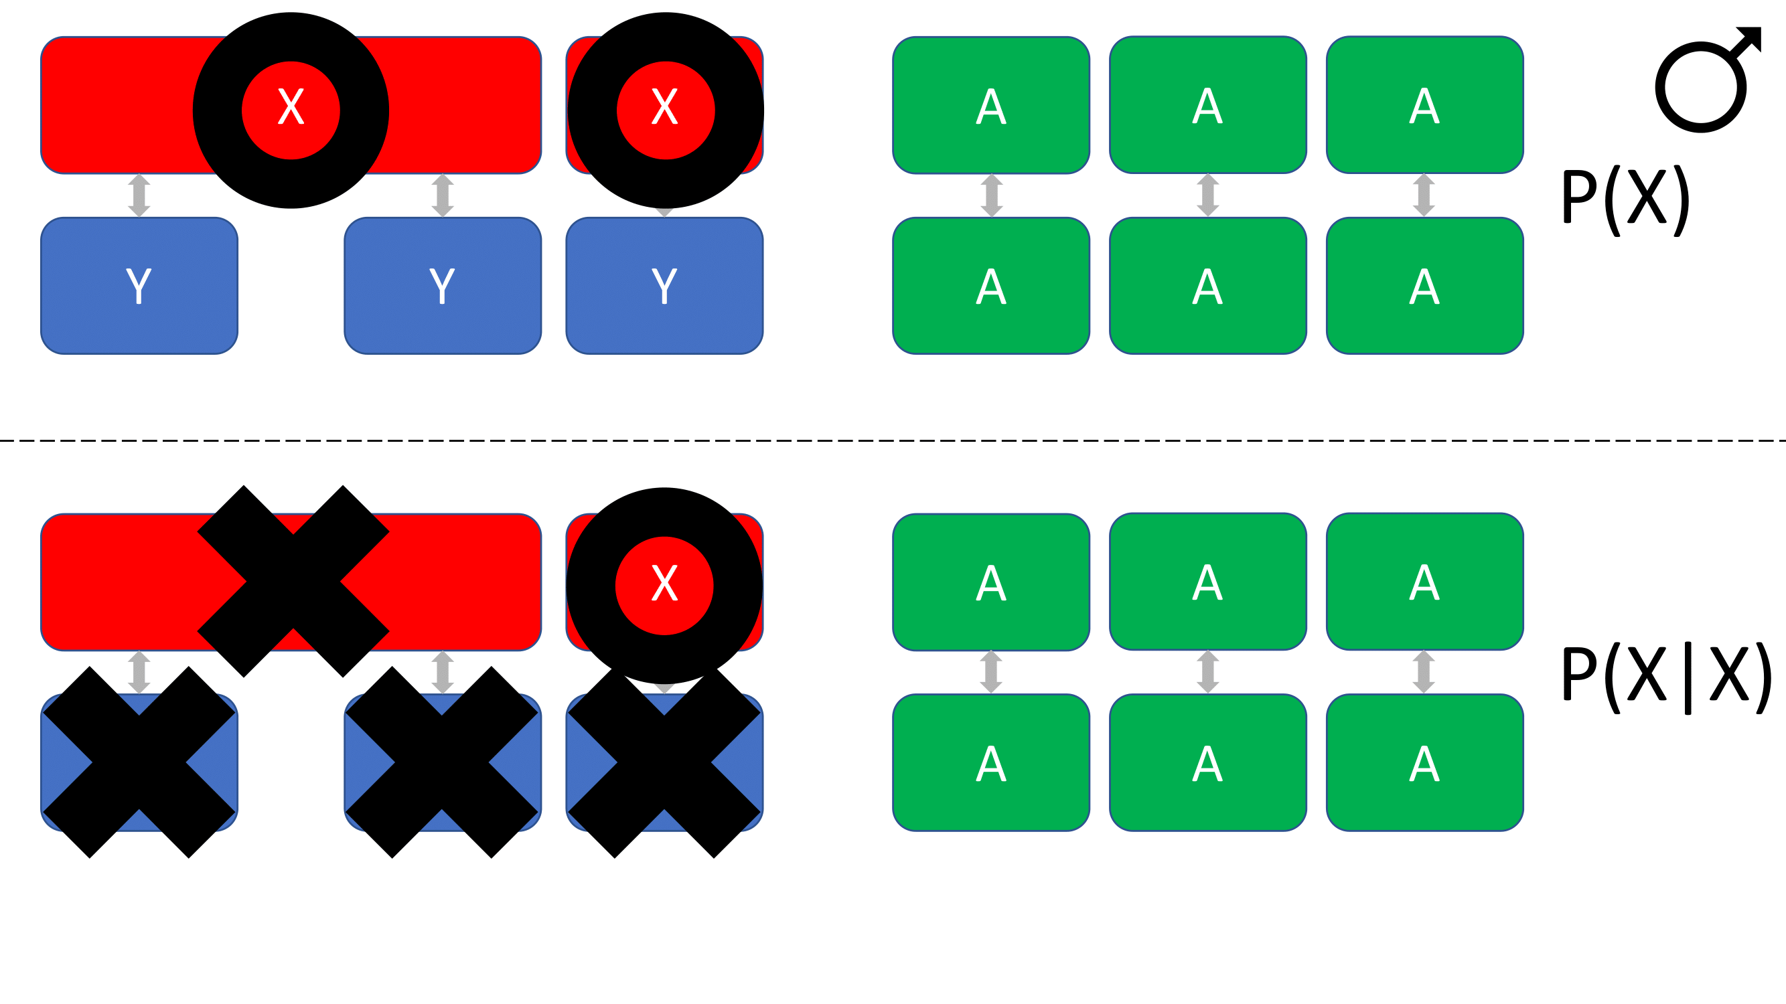
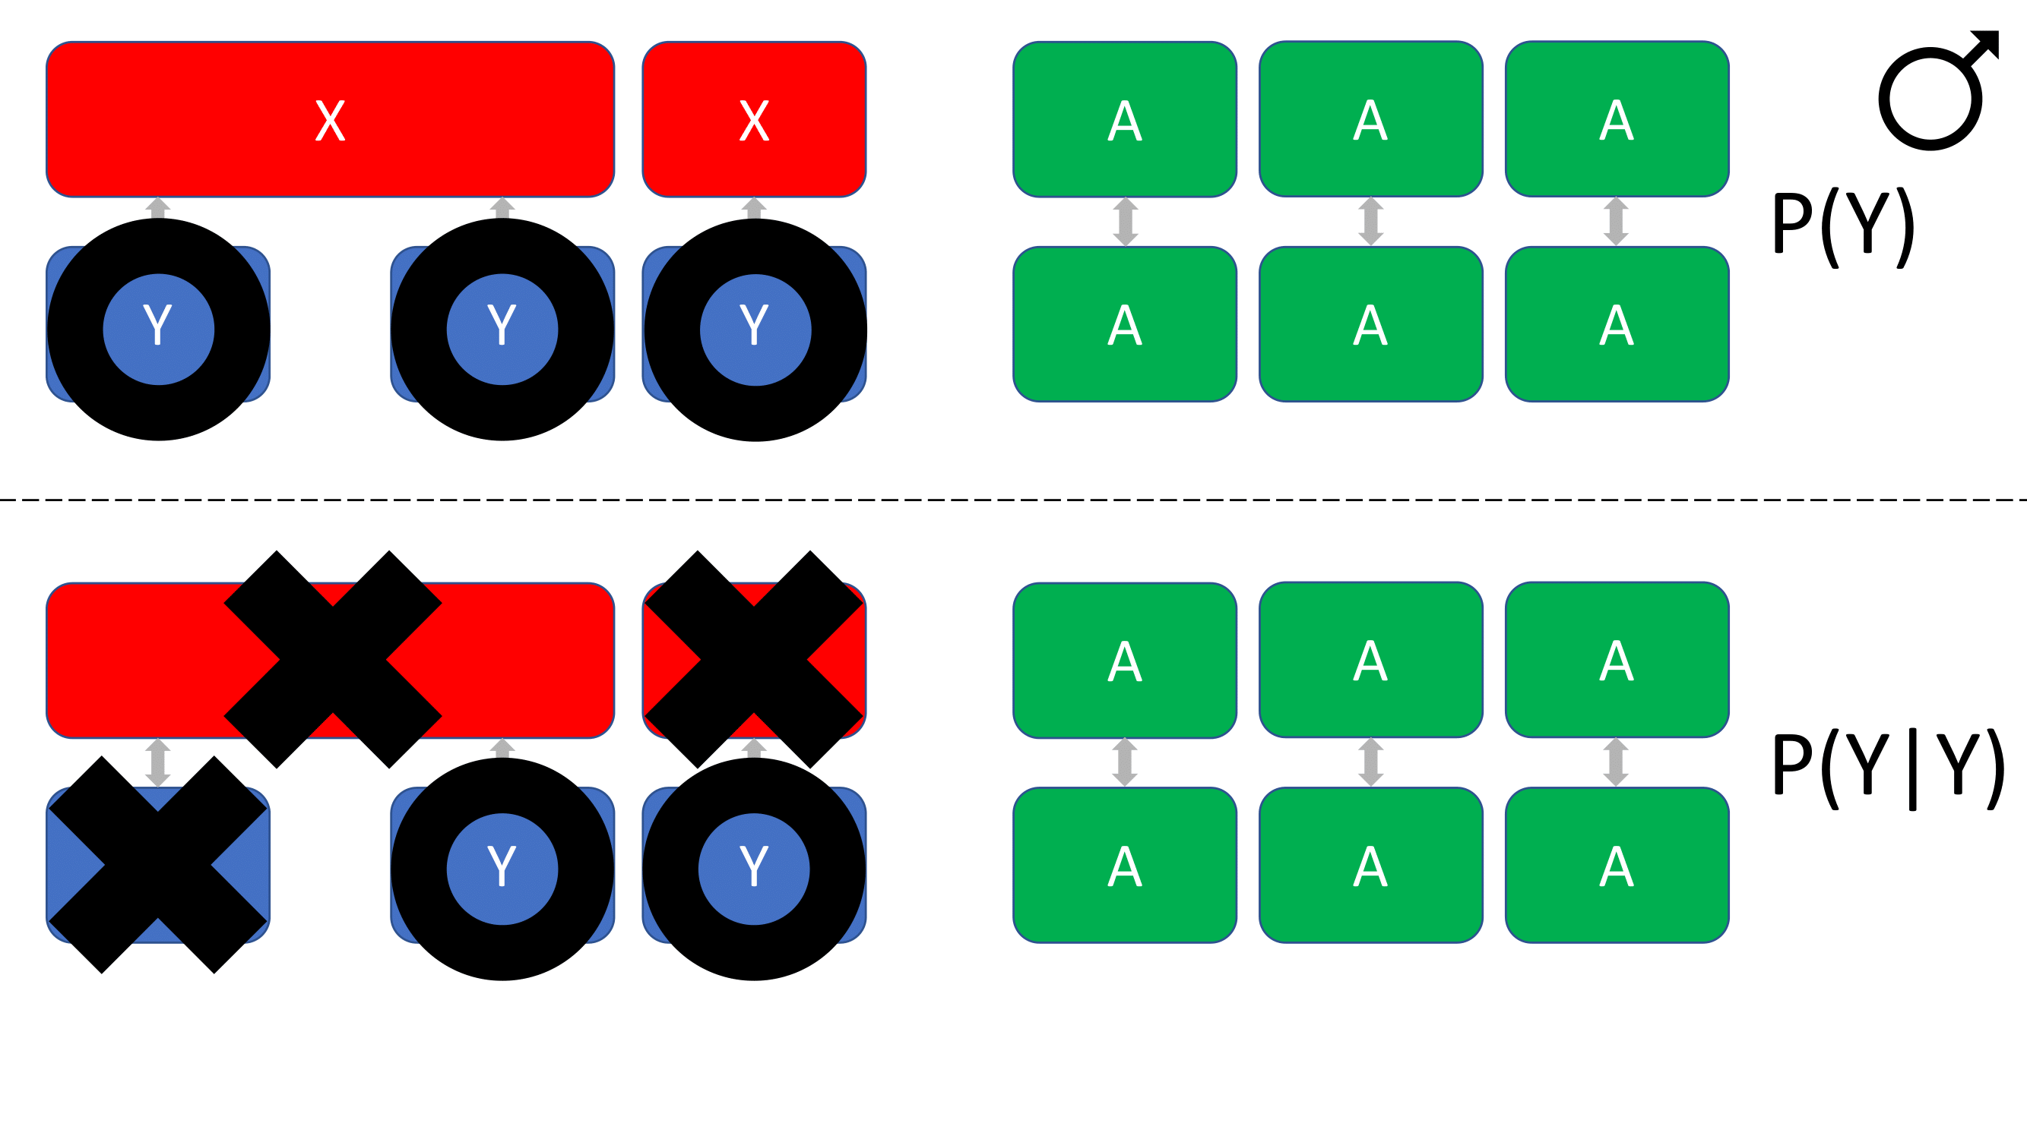
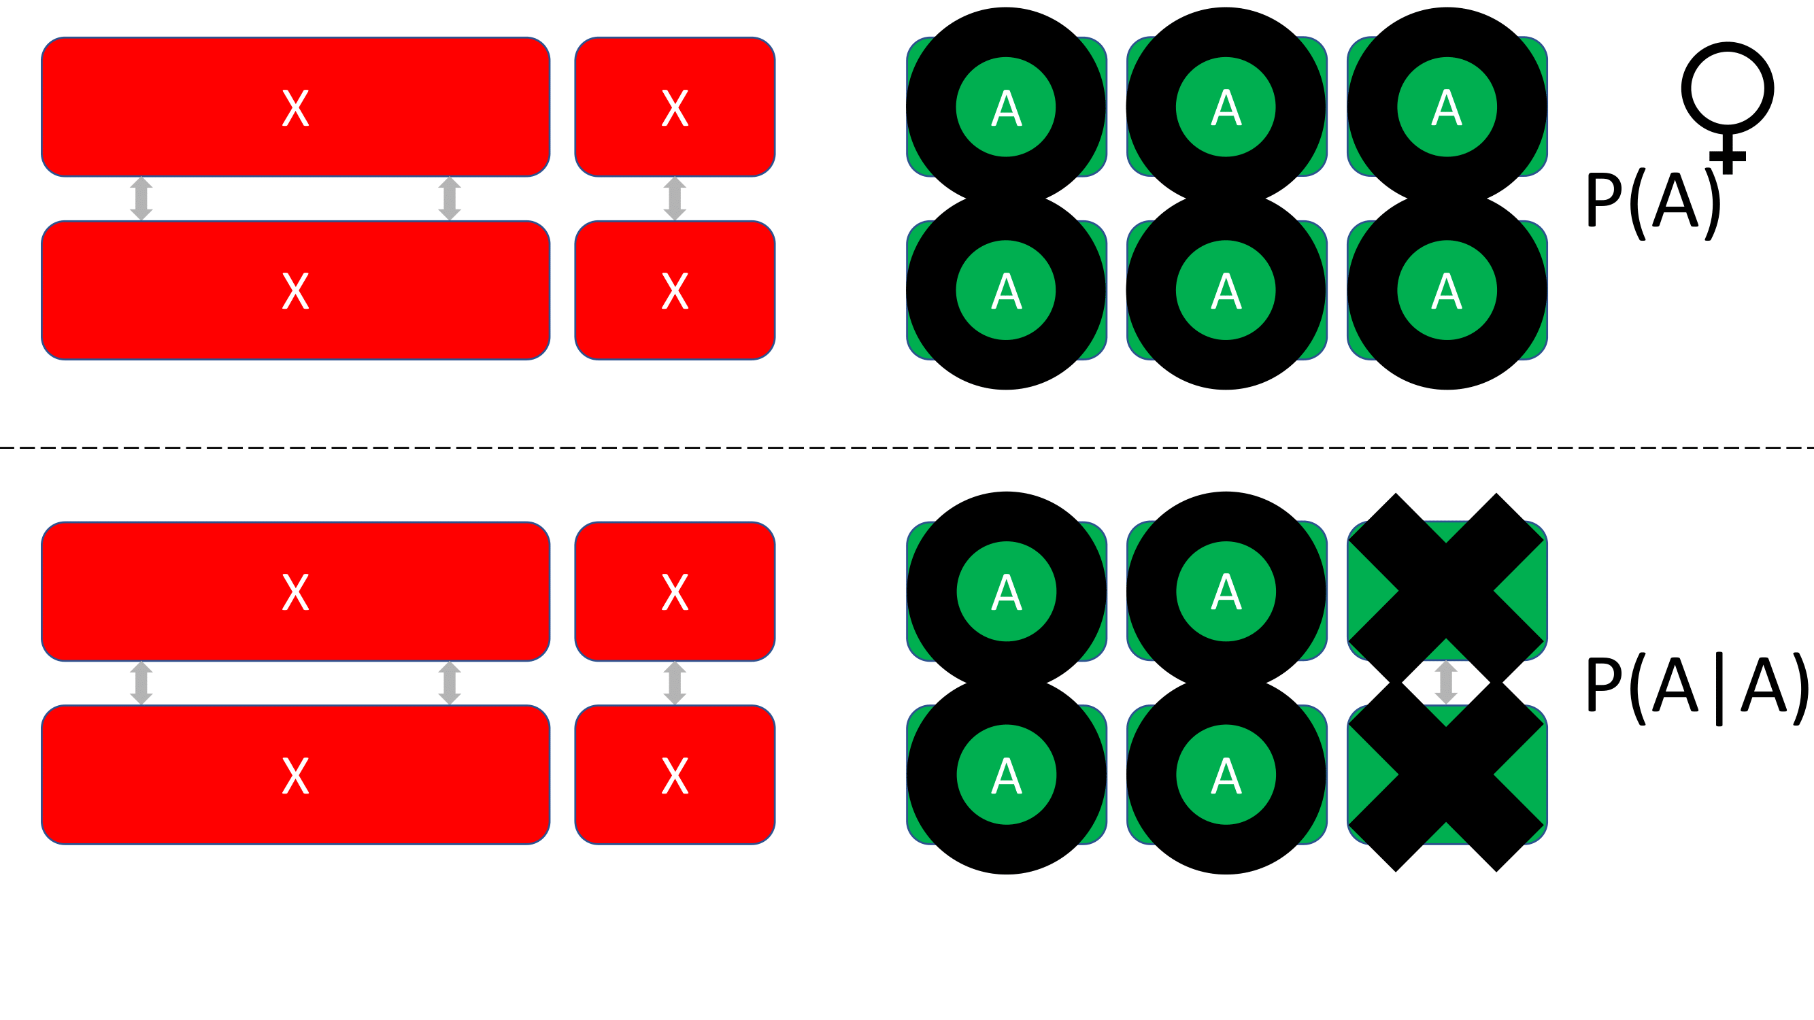
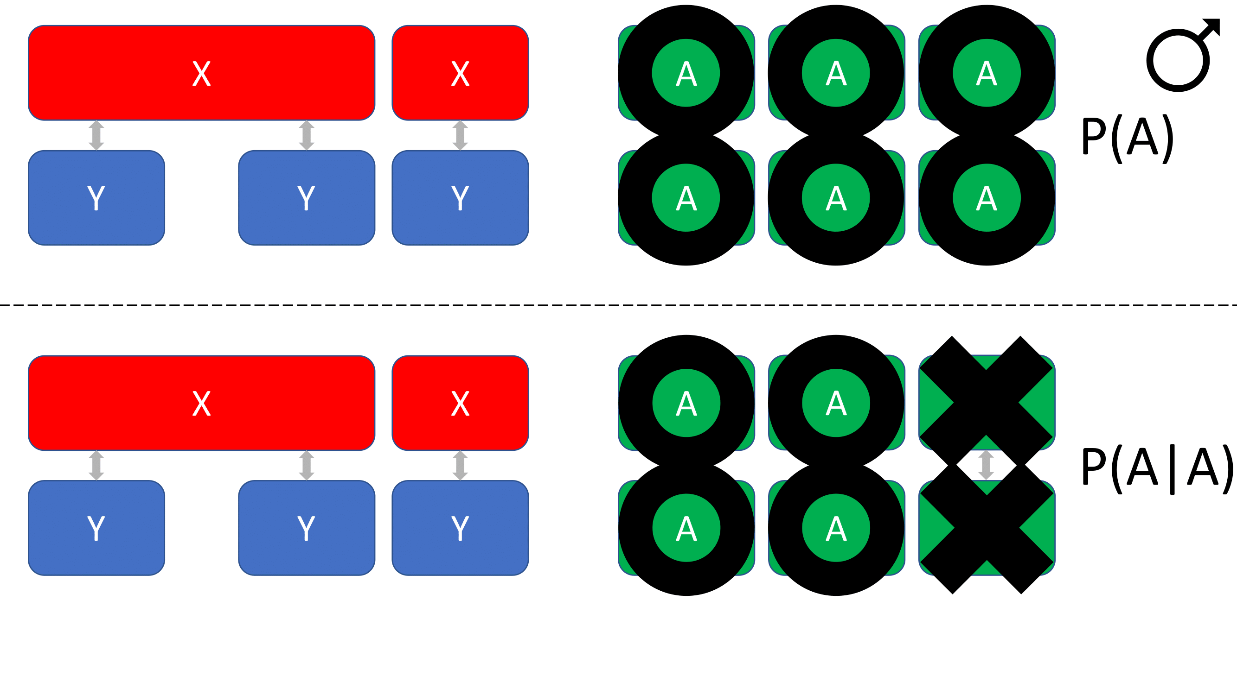
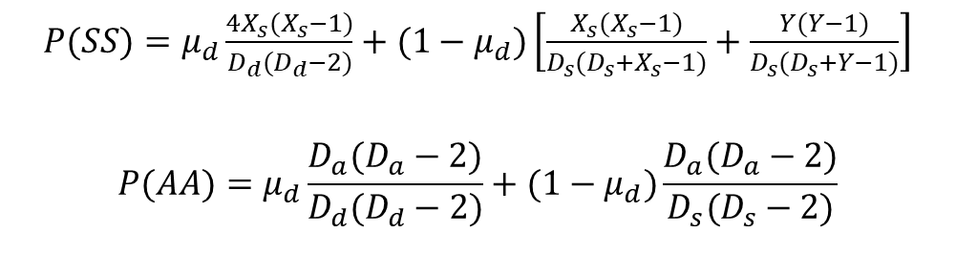
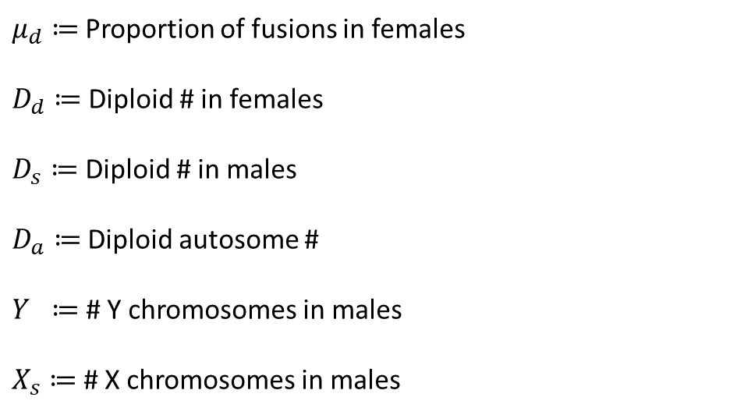
$μ_{d}≔$Proportion of fusions in females
$D_{d}≔$Diploid # in females
$D_{s}≔$ Diploid # in males
$D_{a}≔$Diploid autosome #
$Y ≔$ # Y chromosomes in males
$X_{s}≔$# X chromosomes in males
$P(SS)=μ_{d}\frac{4X_{s}(X_{s}−1)}{D_{d}(D_{d}−2)}+(1−μ_{d})\left[\frac{X_{s}(X_{s}−1)}{D_{s}(D_{s}+X_{s}−1)}+\frac{Y(Y−1)}{D_{s}(D_{s}+Y−1)}\right]$
$$P(AA)=μ_{d}\frac{D_{a}(D_{a}−2)}{D_{d}(D_{d}−2)}+(1−μ_{d})\frac{D_{a}(D_{a}−2)}{D_{s}(D_{s}−2)}$$

