Slide 1






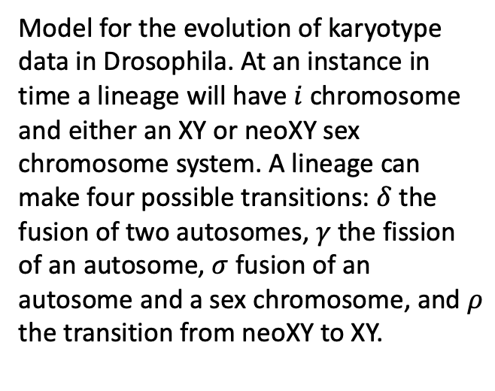


XY
Model for the evolution of karyotype data in Drosophila. At an instance in time a lineage will have $i$chromosome and either an XY or neoXY sex chromosome system. A lineage can make four possible transitions: $δ$ the fusion of two autosomes, $γ$ the fission of an autosome, $σ$ fusion of an autosome and a sex chromosome, and $ρ$ the transition from neoXY to XY.
$$δ$$
$$γ$$
$$i−1 i i+1$$
$ρ$
neoXY
$σ$
$$δ$$
$$γ$$
$$i−1 i i+1$$

