Slide 1


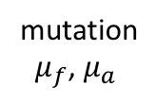
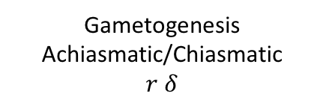

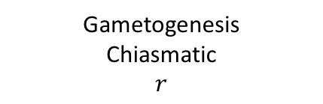
mutation
$μ_{f}$, $μ_{a}$
add pairing region
Selection
on parents
$$1, \frac{1}{1+hs}, \frac{1}{1+s}$$
Selection
on parents
$$1, 1+hs, 1+s$$
♀
♂
Random
Fertilization
Gametogenesis
Chiasmatic
$$r$$
Gametogenesis
Achiasmatic/Chiasmatic
$r$ $δ$
Sex determining locus X allele
Sex determining locus Y allele
Sexually Antagonistic locus (A₁, A₂)
$$r$$
$$h$$
$$s$$
$$μ_{f}$$
$$μ_{a}$$
$$δ$$
= recombination rate
= dominance factor of the male benefit allele
= selection coefficient for sexually antagonistic locus
= mutation rate at general fitness loci
= mutation rate at meiosis locus
= aneuploidy rate
General fitness loci
Meiosis locus (A₀, A₁)

Slide 2
X, Y, A
small and large PAR
s.ant(large)=s.ant(small)
PAR
small=high aneuploidy
large= low aneuploidy
?
prob fixation (achiasmy)
prob fixation (achiasmy)
prob fixation (achiasmy)
mutation rate
mutation rate
mutation rate
PAR
small=high aneuploidy
large= low aneuploidy
small and large PAR
small and large PAR
s.ant(large)=2*s.ant(small)
?
prob fixation (achiasmy)
prob fixation (achiasmy)
mutation rate
mutation rate

