Slide 1
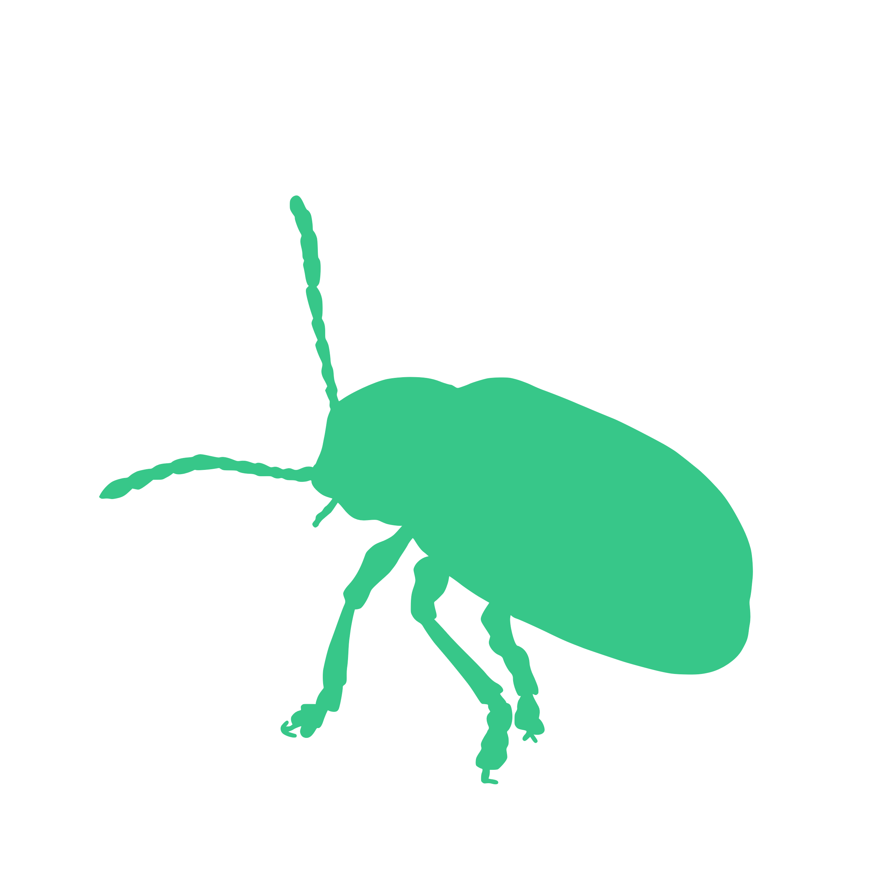


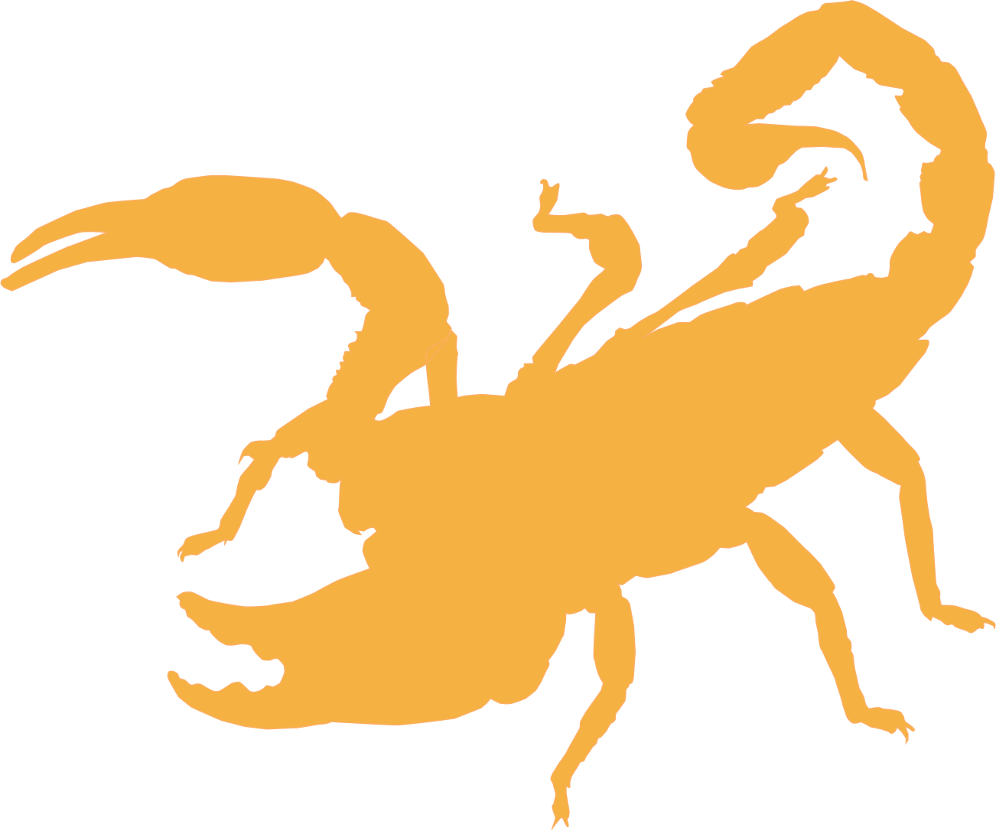
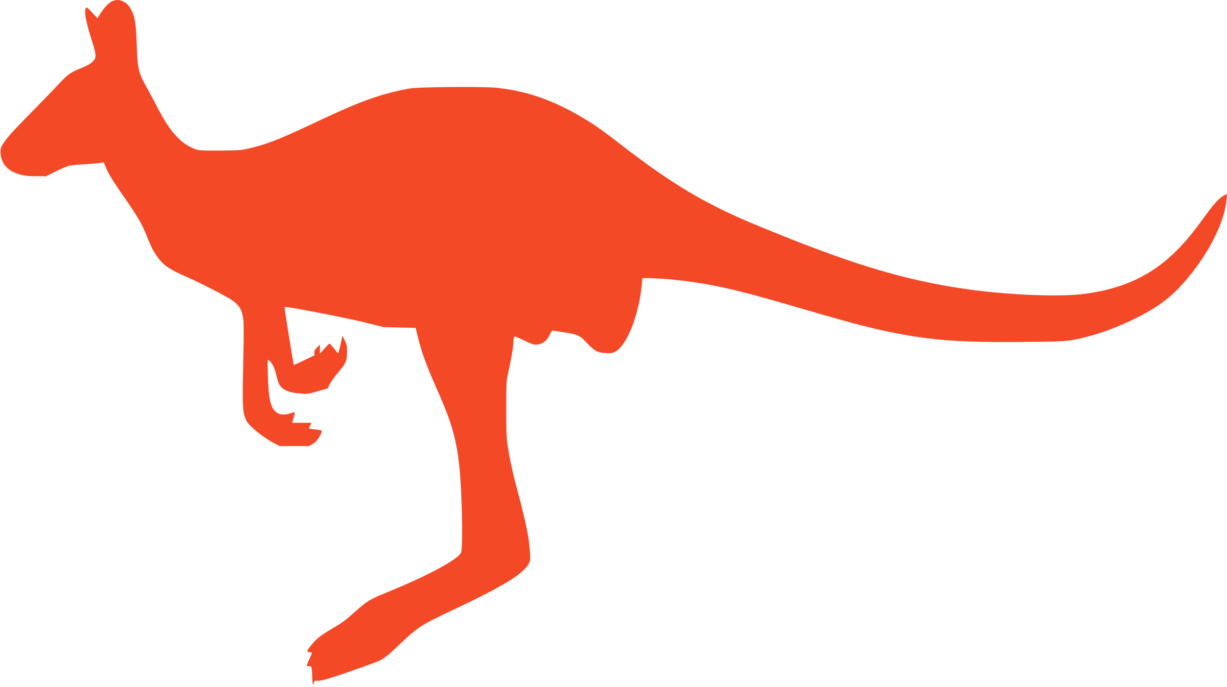
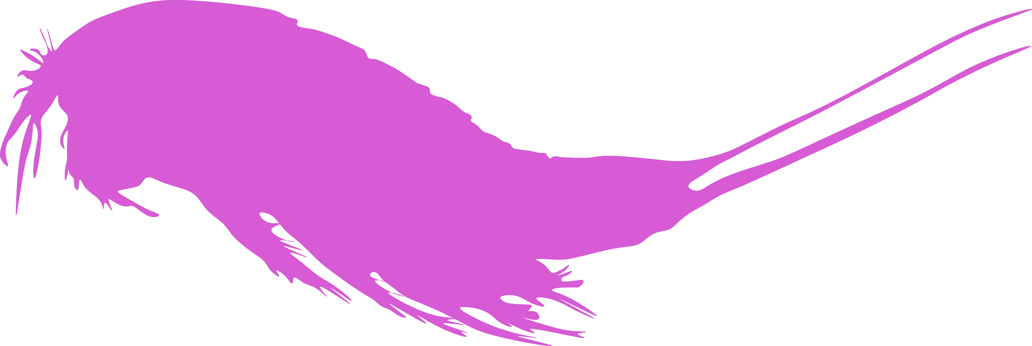
Coleoptera
n = 2042
Diptera
n = 2239
Misc. Insect Orders
n = 251
Segregation
Type
Sex without Recombination
Sex Chromosome
System
Diploid Number
Arachnida
n = 461
Mammalia
n = 149
Maxillopoda
n = 33

Slide 2
Coleoptera
n = 2095
Diptera
n = 2240
Misc. Insect Orders
n = 250
Segregation
Type
Sex without Recombination
Sex Chromosome
System
Mammalia
n = 149
Diploid Number
Arachnida
n = 462
Maxillopoda
n = 33

