Slide 1
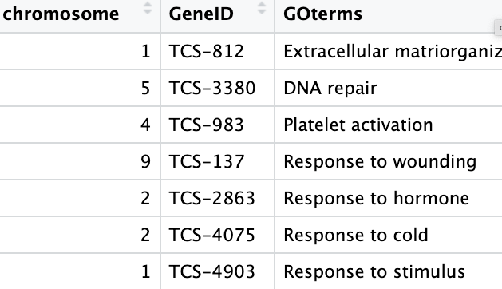
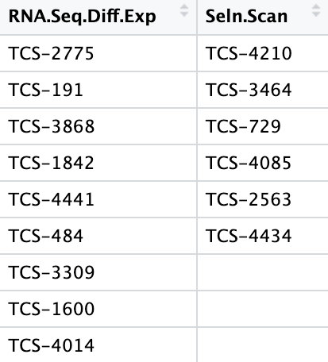
Gene Ontology: A standardized system used to describe the attributes of genes and gene products (such as proteins) across all species in a consistent way.
GO Enrichment Analysis: When a subset of genes have been identified a GO enrichment analysis can be performed to see if the identified genes share in a common process or function at a molecular or cellular level. These analyses are common in GWAS, selection scans, expression studies, and more.
2,000 rows describing GO terms for your genome
Genes identified from 2 studies
Use a Monte Carlo to do GO Enrichment Analysis

Slide 2
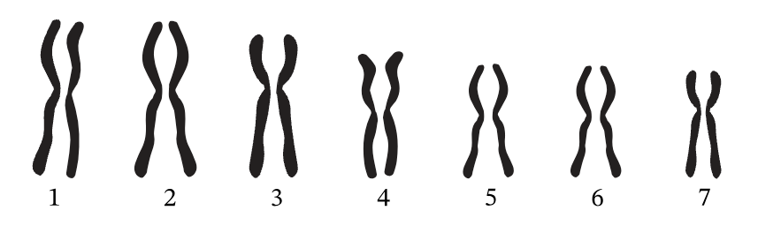
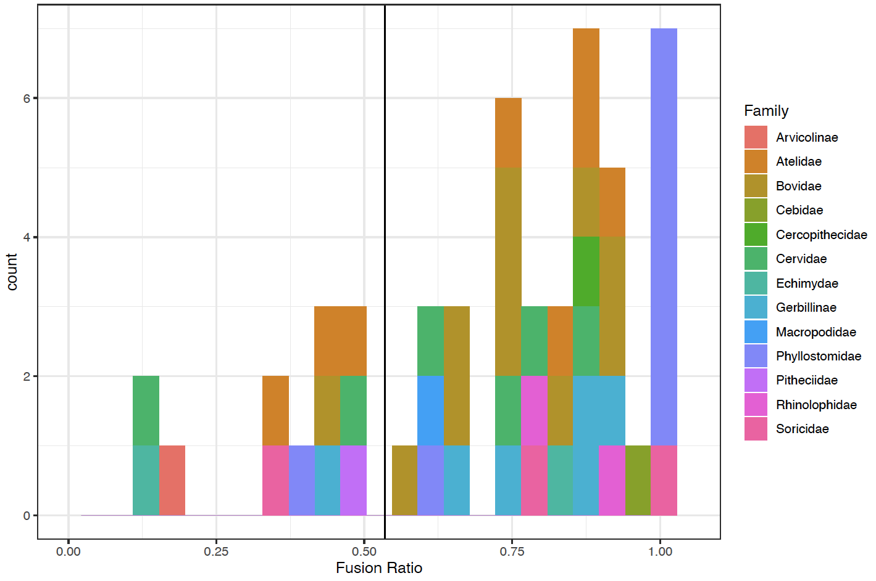
Small Chromosomes Fuse
1/7 2/7 3/7 4/7 5/7 6/7 7/7
0.14 to 1.00

Slide 3
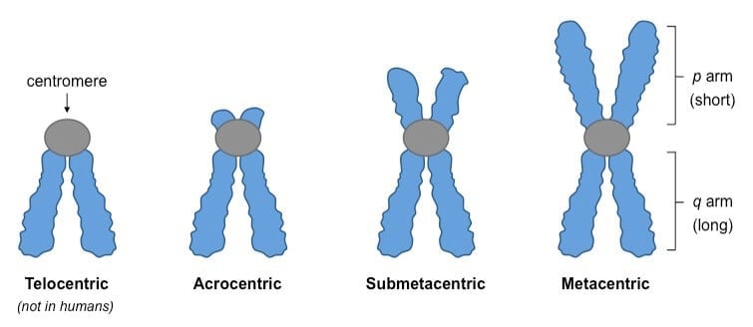
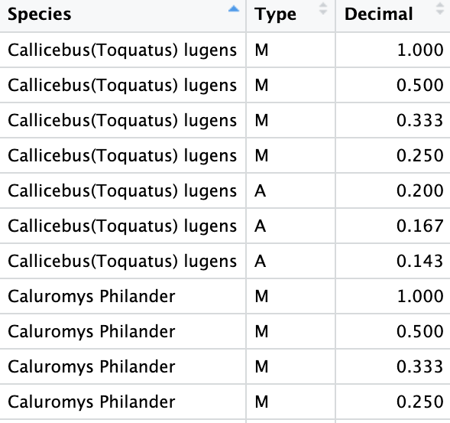
Small Chromosomes Fuse
17 Species 281 Rows
ACRO
More likely to fuse
META
Less likely to fuse

