Slide 1
Publications

Slide 2
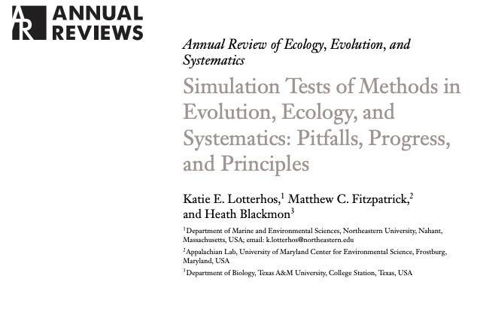

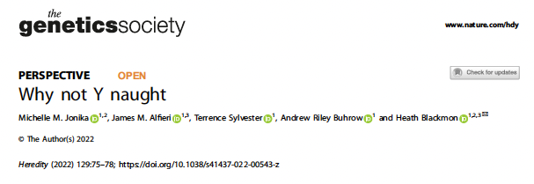
Review Article
Empirical/Theoretical
Hypothesis driven
Descriptive
Perspective/Hypothesis

Slide 3
The typical publication process
You receive reviews and correct errors and/or perform additional experiments and then resubmit
You have an idea and perform experiments and collect data to learn more.
Your paper goes out for review a second time
Paper goes out for review
You write a manuscript that tells a clear and compelling story.
It is accepted after months with the journal. You now have 24 hours to proofread final version
You are published as long as you can pay $500-$10,000 for it to be published (your mom probably can’t read it because its behind a paywall).
You submit a second time
You submit to a journal
You get rejected
You submit to other journals
And get a reject and resubmit

Slide 4
How do you get feedback on papers?
What is peer review (who will review your paper)?
Where should you be publishing?
What is an impact factor/H-factor?
Do you need to publish in glossy journals?
Does your science need to be open access?
How do you pay publication fees?
How many papers should you publish?
Is your dissertation a “publication”?
How good do your figures and writing need to be?

