Slide 1
Statistical tests in biology
Choose the question. Match the null. Interpret the result.
Experimental Design · Heath Blackmon

Slide 2
The route through every example
Describe the data and identify the independent biological unit.
State the scientific question and the test’s null.
Choose the options, check the important assumptions, then interpret the effect and uncertainty.
Notes:
The deck is a comprehensive course reference. Use its module links to move quickly. Each method has the same eight parts: data, simulation, plot, plot code, question/null/options, assumptions/responses, analysis/results, interpretation/practice. Biological examples are simulated and each has a separate runnable script.

Slide 3
Start with the question
A mean difference, a rank shift, a probability, and an association are different targets.
Say what result would answer the biological question before choosing a test.
Ask: “If this null were rejected, would that answer my question?”
Notes:
Use a concrete example: greater average parasite burden is a mean-count question; a higher chance of any infection is binary; a tendency for one group to rank higher is a rank question. The same dataset may support several questions, but their tests are not interchangeable.

Slide 4
What is one independent unit?
The unit is the independently sampled or assigned animal, plant, culture, or population.
Repeated measurements and technical replicates do not create new independent units.
Keep IDs for pairs, individuals, cages, families, and populations.
Notes:
A dish receiving a treatment is the experimental unit when all seedlings in the dish receive that shared treatment. More measurements can improve measurement precision without increasing treatment replication. Mixed models account for appropriate dependence but cannot manufacture missing independent treatment replicates.

Slide 5
Design creates the comparison
Replicate independent units; randomize treatment assignment when possible.
Block or match known sources of variation and preserve that structure in analysis.
Use appropriate controls, consistent measurement, and blinding where practical.
Notes:
Separate random sampling, which helps population representation, from random treatment assignment, which supports a causal comparison under the design. Blocking is most helpful when a nuisance variable affects the response. Randomization does not guarantee that one realized sample is perfectly balanced.

Slide 6
Name the response and predictors
Response: continuous, binary, count, unordered category, ordered category, or time to event.
Predictors: group, quantitative measurement, or several variables and interactions.
Then identify pairing, repeated measurements, clustering, exposure, and censoring.
Notes:
Numeric coding alone does not establish scale: labels 1, 2 and 3 can be unordered or ordered categories. A regression model assigns a response role; correlation treats the two measured variables symmetrically. Preserve units in the data dictionary.

Slide 7
Denominators change the data
8 successes out of 10 trials differs from 80 out of 100: retain both counts.
20 events in 10 minutes differs from 20 in 60 minutes: retain exposure.
A continuous fraction, such as time spent feeding, is not automatically binomial data.
Notes:
Binomial data are successes from known trials. Count-rate models can use an offset when mean count is proportional to measured exposure. Continuous fractions require a sampling model that matches how they were measured; an arcsine transformation is not a universal default.

Slide 8
See the observations before the test
Plot individuals, groups, pairs, or trajectories in a way that shows the design.
Label biological units and distinguish spread from uncertainty.
Look for missing groups, recording errors, outliers, and patterns the model might miss.
Notes:
Do not remove genuine observations simply because they weaken a result. Investigate unusual observations, correct verified recording errors, and use a justified sensitivity analysis. A figure is a way to understand the data and model, not a decoration after testing.

Slide 9
SD, SE, and confidence intervals
SD describes variation among observations.
SE describes sampling uncertainty in an estimate.
A confidence interval shows a range from an interval-producing procedure; state what quantity it covers.
Notes:
For an independent mean, SE = SD/sqrt(n). Correlated repeated rows do not justify plugging their row count into that expression. Repeated use of a valid 95% confidence-interval procedure covers the fixed population parameter in 95% of repetitions. A prediction interval describes a new observation and is different from a mean interval.

Slide 10
The null and the p-value
Write the null in biological language: equal means, zero slope, equal probabilities, or another stated target.
The p-value measures how unusual the result is under the null and the analysis assumptions.
A large p-value does not prove equality; a small p-value does not measure biological importance.
Notes:
A p-value is not the probability that the null is true. Specify a one-sided alternative only when that directional test was justified before inspecting the outcome. A two-sided test allows departures in either direction. Report the effect estimate and uncertainty alongside the test.

Slide 11
Test the contrast you care about
Compare the actual group difference or slope and its confidence interval.
Overlapping group intervals are not a formal test of their difference.
An omnibus result says some groups differ; a contrast says which comparison is supported.
Notes:
Choose planned contrasts based on the scientific question. Do not teach every contrast as requiring a significant omnibus gate. If many comparisons are explored, define the family and use a suitable adjustment. The Fisher LSD chapter distinguishes its gate from stronger all-pairs protection.

Slide 12
Assumptions point to the next move
Start with independence, matching, and how the observations were generated.
Then check the model feature that matters: shape, spread, linearity, count variation, or dependence.
First consider a suitable parametric model; then ask whether a nonparametric alternative answers the intended question.
Notes:
Normality tests are evidence, not an automatic switch. For a paired t test, inspect differences; for regression, inspect residuals rather than requiring normal predictors. Welch allows unequal variances while preserving a mean question. A rank alternative often changes the target. A transformation changes the scale on which a mean or model is interpreted.

Slide 13
Nonparametric does not mean no assumptions
Ranks can answer questions about ordering or location when mean-model assumptions are unsuitable.
Permutation schemes must preserve the randomization, pairing, or blocks.
State the new null explicitly before replacing the original method.
Notes:
Signed-rank requires meaningful difference magnitudes and a symmetric difference distribution for its usual location interpretation; a sign test uses direction. Mann–Whitney and Kruskal–Wallis are not unrestricted tests of medians. Permutation inference needs exchangeability or the actual assignment mechanism. The course gives these alternatives the same full example sequence as parametric methods.

Slide 14
Association, prediction, and causation
Correlation describes association; regression estimates a specified response relationship.
Including a covariate changes the adjusted question.
A model alone does not turn observational data into a randomized experiment.
Notes:
Ask which predictors are plausible causes, consequences, or confounders before interpreting adjustment. Avoid extrapolating well beyond the observed predictor range. An interaction means an effect depends on another predictor. R² describes fitted variation, not causal validity or necessarily useful future prediction.

Slide 15
Power and multiple questions
Power depends on effect size, independent replication, variability, design, and the chosen test.
More tests create more opportunities for false positives; define the comparison family.
Compare procedures by simulation across repeated datasets, not by two p-values from one dataset.
Notes:
Type I error is rejection of a true null; Type II error is failure to reject a specified false null. Power is one minus the latter probability for a specified alternative. Bonferroni controls the chance of any false rejection in a family; BH targets the expected false-discovery proportion under its conditions. Simulation repetitions are not biological replicates.

Slide 16
Make the analysis reproducible
Record set.seed(), the data-generating model, units, and package versions.
Save the data before analysis and report results computed from that saved file.
Check that the code, null, figure, and written interpretation describe the same analysis.
Notes:
Every module script in this course simulates its own dataset, saves data.csv, reads it back, and creates its plot and results. The course R Markdown reruns those scripts on each knit. An LLM can help explain code or output, but students still need to check the scientific target, data structure, options, and conclusions. The instructor guide distinguishes the known simulated population truth from realized estimates.

Slide 17
Pick a test: continuous measurement
Predictor / design | Scientific target | Methods to consider
Reference or description | Is the population mean 12 units? | One-sample t; Signed-rank; Sign
2 groups | Do the environments differ in mean wing length? | Welch t; Pooled t; Rank-sum; Permutation
3+ groups | Are all four population means equal? | ANOVA; Welch ANOVA; Kruskal–Wallis
1 predictor | Predict horn length, or describe association between traits? | Simple regression; Pearson; Spearman
Multiple predictors | Which effects or interactions explain mean growth? | Multiple LM; Factorial ANOVA; ANCOVA; LMM
Notes:
Keep independent units and pairing/cluster IDs explicit; click a method to open its section.
independent-continuous-reference. Enzyme activity in 30 independent cultures; reference = 12 units. Is the population mean 12 units?
independent-continuous-two_groups. Wing length in independent beetles from two rearing environments. Do the environments differ in mean wing length?
independent-continuous-many_groups. Plant biomass in independent pots assigned to four nutrient levels. Are all four population means equal?
independent-continuous-one_predictor. Body mass and horn length measured once in each independent beetle. Predict horn length, or describe association between traits? Regression assigns a response and a predictor. Correlation asks a symmetric association question.
independent-continuous-many_predictors. Growth measured with genotype, temperature, and initial size recorded. Which effects or interactions explain mean growth? Use the repeated/clustered route when multiple rows share an individual, cage, or population.
These are routes, not automatic substitutes. Check the method null and assumptions. A repeated-survival row needs an event-process definition; repeated follow-up checks are not independent event times.

Slide 18
Pick a test: binary / successes out of trials
Predictor / design | Scientific target | Methods to consider
Reference or description | Does transmission probability differ from 0.5? | Exact binomial; 1 proportion
2 groups | Are infection probabilities equal? | 2 proportions; χ² independence; Fisher exact
3+ groups | Is germination probability the same in all treatments? | χ² independence; Logistic
1 predictor | Does survival probability change with divergence? | Logistic
Multiple predictors | Does a predictor affect survival after accounting for the others? | Logistic; Binary GLMM
Notes:
Keep independent units and pairing/cluster IDs explicit; click a method to open its section.
independent-binary-reference. A marker is transmitted to 38 of 60 independent offspring. Does transmission probability differ from 0.5?
independent-binary-two_groups. Infection status is recorded for independent hosts in two habitats. Are infection probabilities equal?
independent-binary-many_groups. Germination success or failure is recorded for seeds in four treatments. Is germination probability the same in all treatments? If seeds share a dish, the dish can create dependence; keep its ID.
independent-binary-one_predictor. Each hybrid survives or dies; parental genetic divergence is recorded. Does survival probability change with divergence?
independent-binary-many_predictors. Survival status with divergence, cross direction, and rearing temperature. Does a predictor affect survival after accounting for the others? Known trial denominators matter. A percent without a trial count may be continuous-fraction data, which need a different model.
These are routes, not automatic substitutes. Check the method null and assumptions. A repeated-survival row needs an event-process definition; repeated follow-up checks are not independent event times.

Slide 19
Pick a test: count / events per exposure
Predictor / design | Scientific target | Methods to consider
Reference or description | Does the mutation rate differ from a reference rate? | Exact Poisson
2 groups | Are mean colonies per mL equal? | Poisson GLM; Negative binomial; Exact Poisson
3+ groups | Do conditional mean parasite counts differ among treatments? | Poisson GLM; Negative binomial; Quasi-Poisson
1 predictor | Does the expected visit rate change with flower number? | Poisson GLM; Negative binomial
Multiple predictors | Which predictors alter the conditional mean mutation rate? | Poisson GLM; Negative binomial; Count GLMM
Notes:
Keep independent units and pairing/cluster IDs explicit; click a method to open its section.
independent-count-reference. Mutations counted across a known number of sequenced base-generations. Does the mutation rate differ from a reference rate?
independent-count-two_groups. Colony counts in two media; plated volume recorded for each replicate. Are mean colonies per mL equal?
independent-count-many_groups. Parasite counts per host in four independent treatment groups. Do conditional mean parasite counts differ among treatments?
independent-count-one_predictor. Pollinator visits per plant versus flower number; observation minutes vary. Does the expected visit rate change with flower number? Include observation time as exposure when the mean count is proportional to time.
independent-count-many_predictors. Mutation counts with genotype, stress, and sequenced exposure recorded. Which predictors alter the conditional mean mutation rate? If libraries, individuals, or populations contribute repeated rows, retain that cluster structure.
These are routes, not automatic substitutes. Check the method null and assumptions. A repeated-survival row needs an event-process definition; repeated follow-up checks are not independent event times.

Slide 20
Pick a test: unordered categories (3+)
Predictor / design | Scientific target | Methods to consider
Reference or description | Do phenotype probabilities match the expected ratio? | χ² goodness-of-fit
2 groups | Does nest-material distribution differ by habitat? | χ² independence; Fisher exact
3+ groups | Are site and feeding strategy independent? | χ² independence; Fisher exact
1 predictor | Does salinity change the probabilities of the morphs? | Multinomial
Multiple predictors | Which predictors change guild probabilities? | Multinomial
Notes:
Keep independent units and pairing/cluster IDs explicit; click a method to open its section.
independent-nominal-reference. Offspring fall into three phenotypes predicted in a 1:2:1 ratio. Do phenotype probabilities match the expected ratio?
independent-nominal-two_groups. Independent birds in two habitats choose among three nest materials. Does nest-material distribution differ by habitat?
independent-nominal-many_groups. Independent fish from four sites use three feeding strategies. Are site and feeding strategy independent?
independent-nominal-one_predictor. Three unordered bacterial colony morphs observed along a salinity gradient. Does salinity change the probabilities of the morphs?
independent-nominal-many_predictors. Pollinator guild with habitat, flower color, and floral size recorded. Which predictors change guild probabilities? Guild is unordered; assigning codes 1, 2, 3 does not make it a continuous response.
These are routes, not automatic substitutes. Check the method null and assumptions. A repeated-survival row needs an event-process definition; repeated follow-up checks are not independent event times.

Slide 21
Pick a test: ordered categories
Predictor / design | Scientific target | Methods to consider
Reference or description | Among scores not at the threshold, are higher and lower equally likely? | Sign; Signed-rank
2 groups | Does one group tend to have higher damage scores? | Rank-sum; Ordinal model
3+ groups | Do treatment groups differ in their rank/category distributions? | Kruskal–Wallis; Ordinal model
1 predictor | Model category probabilities, or ask about monotone association? | Ordinal model; Spearman
Multiple predictors | Which predictors shift scores after adjustment? | Ordinal model; CLMM
Notes:
Keep independent units and pairing/cluster IDs explicit; click a method to open its section.
independent-ordinal-reference. Lesion severity: none, mild, moderate, severe; compare with “moderate.” Among scores not at the threshold, are higher and lower equally likely? A sign test asks this specific threshold question. Use signed-rank only if numerical spacings are defensible, not merely category labels.
independent-ordinal-two_groups. Independent leaves receive ordered damage scores in two treatments. Does one group tend to have higher damage scores?
independent-ordinal-many_groups. Ordered disease scores recorded in independent plants under four treatments. Do treatment groups differ in their rank/category distributions?
independent-ordinal-one_predictor. Ordered courtship intensity recorded along a hormone gradient. Model category probabilities, or ask about monotone association?
independent-ordinal-many_predictors. Ordered disease scores with genotype, temperature, and age recorded. Which predictors shift scores after adjustment? Use a cumulative-link mixed model when observations share an individual or cluster.
These are routes, not automatic substitutes. Check the method null and assumptions. A repeated-survival row needs an event-process definition; repeated follow-up checks are not independent event times.

Slide 22
Pick a test: time to event + censoring
Predictor / design | Scientific target | Methods to consider
Reference or description | What fraction remain alive over time? | Kaplan–Meier
2 groups | Do the event-time distributions differ between cohorts? | Log-rank
3+ groups | Do any treatment survival curves differ? | Log-rank
1 predictor | Does seed mass alter event hazard? | Cox PH; AFT
Multiple predictors | What are the adjusted hazard or time effects? | Cox PH; AFT; Frailty
Notes:
Keep independent units and pairing/cluster IDs explicit; click a method to open its section.
independent-survival-reference. Days to seedling death; some plants are still alive when follow-up ends. What fraction remain alive over time? Estimation is useful here; there is no required hypothesis test.
independent-survival-two_groups. Time to pupation in two independent cohorts; some have not pupated yet. Do the event-time distributions differ between cohorts?
independent-survival-many_groups. Time to infection under four treatments with right-censored individuals. Do any treatment survival curves differ?
independent-survival-one_predictor. Time to germination versus seed mass, with ungerminated seeds censored. Does seed mass alter event hazard? Cox targets a hazard ratio; an AFT model targets a time ratio.
independent-survival-many_predictors. Time to death with dose, sex, and population recorded. What are the adjusted hazard or time effects? Use a dependence-aware model when individuals share clusters; do not treat censored times as observed deaths.
These are routes, not automatic substitutes. Check the method null and assumptions. A repeated-survival row needs an event-process definition; repeated follow-up checks are not independent event times.

Slide 23
Paired/repeated: continuous measurement
Predictor / design | Scientific target | Methods to consider
Pairs / 2 measurements | Is the mean within-plant change zero? | Paired t; Signed-rank; Sign; Paired permutation
3+ repeated conditions | Do within-animal means differ across temperatures? | Repeated ANOVA; LMM; Friedman
Within + between predictors | Do growth trajectories differ while accounting for repeated larvae and families? | LMM
Notes:
Keep independent units and pairing/cluster IDs explicit; click a method to open its section.
repeated-continuous-pairs. Photosynthesis measured before and after stress in the same plants. Is the mean within-plant change zero?
repeated-continuous-repeated. Oxygen consumption measured in every animal at four temperatures. Do within-animal means differ across temperatures? Nonparametric rank coverage follows the repeated-model assumptions; a change of method can change the null.
repeated-continuous-mixed. Growth tracked through time in treated and control larvae from several families. Do growth trajectories differ while accounting for repeated larvae and families?
These are routes, not automatic substitutes. Check the method null and assumptions. A repeated-survival row needs an event-process definition; repeated follow-up checks are not independent event times.

Slide 24
Paired/repeated: binary outcome
Predictor / design | Scientific target | Methods to consider
Pairs / 2 measurements | Are positive-to-negative and negative-to-positive changes equally likely? | McNemar
3+ repeated conditions | Is response probability equal across conditions? | Cochran Q; Binary GLMM; Binary GEE
Within + between predictors | How does disease probability change with time and treatment? | Binary GLMM; Binary GEE
Notes:
Keep independent units and pairing/cluster IDs explicit; click a method to open its section.
repeated-binary-pairs. The same hosts tested for infection before and after treatment. Are positive-to-negative and negative-to-positive changes equally likely?
repeated-binary-repeated. The same flies scored as courting or not under three cue conditions. Is response probability equal across conditions?
repeated-binary-mixed. Weekly disease status in individuals assigned to treatment groups. How does disease probability change with time and treatment? GLMM gives effects conditional on random effects; GEE describes population-average effects.
These are routes, not automatic substitutes. Check the method null and assumptions. A repeated-survival row needs an event-process definition; repeated follow-up checks are not independent event times.

Slide 25
Paired/repeated: ordered categories
Predictor / design | Scientific target | Methods to consider
Pairs / 2 measurements | Are upward and downward changes equally likely? | Sign; Signed-rank
3+ repeated conditions | Do conditions consistently rank differently within plants? | Friedman; CLMM
Within + between predictors | Do predictors shift category probabilities within the repeated design? | CLMM
Notes:
Keep independent units and pairing/cluster IDs explicit; click a method to open its section.
repeated-ordinal-pairs. The same fish receive ordered stress scores before and after an intervention. Are upward and downward changes equally likely? Signed-rank additionally needs meaningful difference sizes and a symmetric difference distribution.
repeated-ordinal-repeated. The same plants receive ordered damage scores under four assay conditions. Do conditions consistently rank differently within plants?
repeated-ordinal-mixed. Weekly disease severity categories in treated and control plants from several lines. Do predictors shift category probabilities within the repeated design?
These are routes, not automatic substitutes. Check the method null and assumptions. A repeated-survival row needs an event-process definition; repeated follow-up checks are not independent event times.

Slide 26
Paired/repeated: count / rate
Predictor / design | Scientific target | Methods to consider
Pairs / 2 measurements | Does the within-host expected count or rate change? | Count GLMM; Count GEE; Paired permutation
3+ repeated conditions | Do expected visit rates change across days? | Count GLMM; Count GEE
Within + between predictors | How do treatment and time affect mutation rates across lines? | Count GLMM; Count GEE
Notes:
Keep independent units and pairing/cluster IDs explicit; click a method to open its section.
repeated-count-pairs. Parasite counts in the same hosts before and after treatment. Does the within-host expected count or rate change? Record exposure if observation effort varies; arbitrary count ranks answer a different question.
repeated-count-repeated. Visit counts from the same plants on four days; observation minutes recorded. Do expected visit rates change across days?
repeated-count-mixed. Repeated mutation counts from lines assigned to stress treatments. How do treatment and time affect mutation rates across lines? Retain line IDs and exposure; repeated sequencing samples are not new independent lines.
These are routes, not automatic substitutes. Check the method null and assumptions. A repeated-survival row needs an event-process definition; repeated follow-up checks are not independent event times.

Slide 27
Paired/repeated: time to event + censoring
Predictor / design | Scientific target | Methods to consider
Pairs / 2 measurements | Do survival functions differ within the matched strata? | Stratified log-rank; Cox PH
3+ repeated conditions | Is the scientific target first-event survival or recurrent events? | Define the event process; then Cox framework / frailty
Within + between predictors | How do predictors alter risk while accounting for enclosure dependence? | Frailty; Cox PH
Notes:
Keep independent units and pairing/cluster IDs explicit; click a method to open its section.
repeated-survival-pairs. Related genotypes matched in blocks, then followed to death under two treatments. Do survival functions differ within the matched strata? Matching defines strata. Two follow-up visits do not create two independent event times.
repeated-survival-repeated. Animals checked repeatedly; some have one event, others can relapse. Is the scientific target first-event survival or recurrent events? Define the event process before choosing a test. There is no generic “repeated survival” test.
repeated-survival-mixed. Time to infection in animals sharing enclosures and treatment predictors. How do predictors alter risk while accounting for enclosure dependence? Frailty models cluster heterogeneity; cluster-robust uncertainty and stratification make different assumptions.
These are routes, not automatic substitutes. Check the method null and assumptions. A repeated-survival row needs an event-process definition; repeated follow-up checks are not independent event times.

Slide 28
One-sample t: the data
Cell biologists measure oxygen consumption in independently cultured cell lines.
One continuous response
One independent sample
A fixed reference mean
Other data like these
Enzyme activity versus a reference
Leaf nitrogen versus a target
Offspring size versus a historical mean
Notes:
One-sample t test
One measurement from each of 24 independent cultures; compare with a prespecified reference of 10 nmol/min.
culture: Independent culture identifier (none)
oxygen: Oxygen consumption (nmol/min)

Slide 29
One-sample t: simulate and save
set.seed(1101)
d <- data.frame(culture = 1:24,
oxygen = rnorm(24, mean = 10.8, sd = 1.5))
write.csv(d, file.path(output_dir, "data.csv"), row.names = FALSE)
First saved row
culture: 1
oxygen: 9.364
Notes:
Seed: 1101
Generating model: 24 independent oxygen-consumption values are drawn from Normal(mean 10.8, SD 1.5). Each row is one culture.
Population truth: The population mean is 10.8 nmol/min, so the reference-mean null of 10 is false; the true mean difference is +0.8.
The script writes data.csv before reading it for analysis. output_dir or out_dir is the folder supplied to the standalone script.
Original saved-data preview:
culture oxygen
1 9.363654
2 10.462996
3 9.493642
4 6.730010

Slide 30
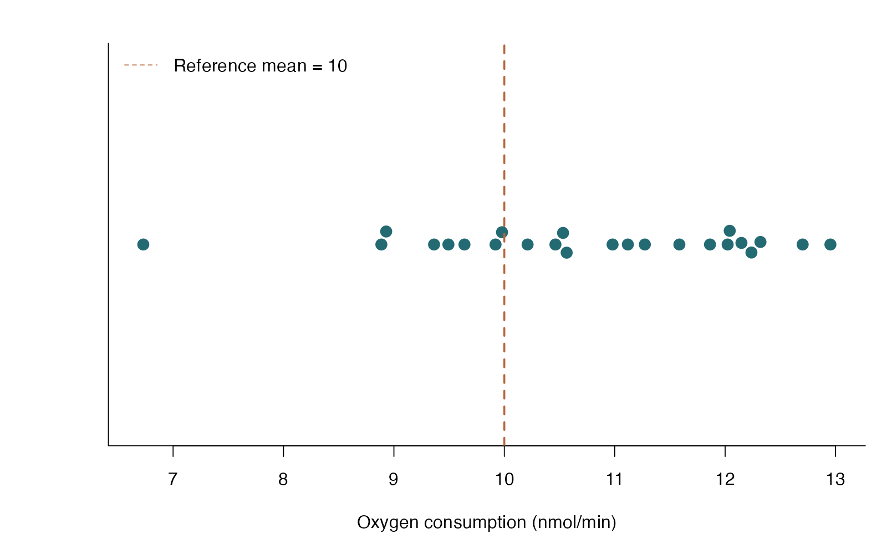
One-sample t: see the data
beeswarm arguments
method — How observations are spread sideways
pch / cex — Point symbol and size
horizontal — Put the measured response on the x-axis
abline(v=…) — Draw the reference value
One-sample t test — simulated biological data
Notes:
This figure is generated from the saved CSV by modules/one_sample_t/analysis.R. The reference must express the biological question; the test is about a population mean.

Slide 31
One-sample t: plot code
beeswarm(d$oxygen, horizontal = TRUE, method = "swarm",
pch = 21, bg = "#246A73", col = "white", cex = 1.6,
xlab = "Oxygen consumption (nmol/min)", ylab = "", yaxt = "n")
abline(v = 10, lty = 2, col = "#B7663E", lwd = 2)
legend("topleft", "Reference mean = 10", lty = 2,
col = "#B7663E", bty = "n")
Arguments to change
method — How observations are spread sideways
pch / cex — Point symbol and size
horizontal — Put the measured response on the x-axis
abline(v=…) — Draw the reference value
Notes:
This is an exact excerpt from analysis.R. Any preparation referenced by the excerpt appears in the complete companion script. The script opens a ragg PNG device before these lines and closes it afterward.

Slide 32
One-sample t: question and null
Scientific question
Is mean oxygen consumption different from 10 nmol/min?
Null / estimation target
The population mean is 10 nmol/min.
Relevant options
mu = 10 sets the scientific reference
alternative = “two.sided” allows either direction
conf.level = .95 sets interval coverage
Notes:
Ask whether rejecting this null, or estimating this target, answers the biological question. The reference must express the biological question; the test is about a population mean.

Slide 33
One-sample t: assumptions
What matters here
Independent cultures
No extreme outliers; normality matters more at small n
Reference value treated as known
Parametric responses
Investigate unusual values; retain genuine biology
Model log values only if a ratio/geometric mean answers the question
Nonparametric responses
Sign test targets the median, not the mean
A bootstrap mean interval retains the mean target
Notes:
Begin with the design. A model change should address a specific issue and preserve the scientific target where possible. A rank or permutation alternative has its own assumptions and may change the null; do not choose it solely from a normality-test p-value.

Slide 34
One-sample t: run and read
fit <- t.test(d$oxygen, mu = 10,
alternative = "two.sided", conf.level = .95)
Generated results
Mean = 10.75 nmol/min; n = 24
95% CI for mean: 10.12 to 11.37
t = 2.48; df = 23; p = 0.02107
Notes:
Full executed model/test output:
One Sample t-test
data: d$oxygen
t = 2.4762, df = 23, p-value = 0.02107
alternative hypothesis: true mean is not equal to 10
95 percent confidence interval:
10.12316 11.37336
sample estimates:
mean of x
10.74826

Slide 35
One-sample t: interpret
Mean oxygen consumption was 10.75 nmol/min (95% CI 10.12 to 11.37); against the reference mean of 10, t(23) = 2.48, p = 0.02107. This tests a population mean, not whether every culture exceeds 10.
Discuss: If the reference were 11 rather than 10, what would change in the hypothesis and R call?
Notes:
Teaching point: The reference must express the biological question; the test is about a population mean.
Instructor comparison with the simulated population: The population mean is 10.8 nmol/min, so the reference-mean null of 10 is false; the true mean difference is +0.8.
The reported estimate and p-value are calculated from this realized dataset; they need not exactly match the known population effect.

Slide 36
Paired t: the data
Plant physiologists measure photosynthesis in the same leaves before and after heat stress.
Continuous response measured twice
Independent pairs; dependent observations within pairs
Analyze one difference per plant
Other data like these
Blood pressure before/after treatment
Bilateral organ measurements
Matched-site productivity
Notes:
Paired t test
Twenty independent plants contribute one before/after pair each.
plant: Independent plant and pair identifier (none)
before: Photosynthesis before heat (micromol CO2 / m2 / s)
after: Photosynthesis after heat (micromol CO2 / m2 / s)

Slide 37
Paired t: simulate and save
set.seed(1103)
before <- rnorm(20, 18, 2.2)
after <- before + rnorm(20, -1.3, 1.7)
d <- data.frame(plant = 1:20, before = before, after = after)
write.csv(d, file.path(output_dir, "data.csv"), row.names = FALSE)
First saved row
plant: 1
before: 18.13
after: 16.59
Notes:
Seed: 1103
Generating model: 20 independent baseline values come from Normal(18, 2.2 SD). Each after value is its own baseline plus an independent Normal(-1.3, 1.7 SD) change.
Population truth: The mean after-minus-before difference is -1.3 photosynthesis units, even if this sample provides limited evidence against zero.
The script writes data.csv before reading it for analysis. output_dir or out_dir is the folder supplied to the standalone script.
Original saved-data preview:
plant before after
1 18.12874 16.59089
2 19.70048 17.18796
3 17.09360 15.92467
4 19.16011 18.17996

Slide 38
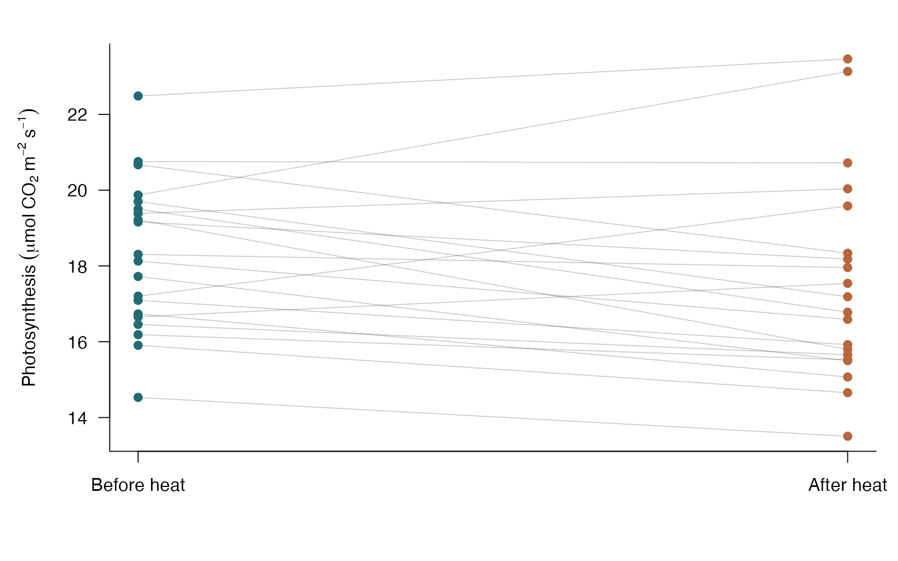
Paired t: see the data
base R arguments
matplot / type=“l” — Connect each plant’s paired measurements
lty / col — Keep paired lines quiet
points — Add raw observations
axis — Label the two measurement occasions
Paired t test — simulated biological data
Notes:
This figure is generated from the saved CSV by modules/paired_t/analysis.R. A large p-value does not make the simulated nonzero effect disappear; paired differences define the target.

Slide 39
Paired t: plot code
matplot(1:2, t(as.matrix(d[c("before", "after")])), type = "l",
lty = 1, col = "#00000033", xaxt = "n", xlab = "",
ylab = expression(Photosynthesis~(mu*mol~CO[2]~m^{-2}~s^{-1})))
axis(1, 1:2, c("Before heat", "After heat"))
points(rep(1, nrow(d)), d$before, pch = 19, col = "#246A73")
points(rep(2, nrow(d)), d$after, pch = 19, col = "#B7663E")
Arguments to change
matplot / type=“l” — Connect each plant’s paired measurements
lty / col — Keep paired lines quiet
points — Add raw observations
axis — Label the two measurement occasions
Notes:
This is an exact excerpt from analysis.R. Any preparation referenced by the excerpt appears in the complete companion script. The script opens a ragg PNG device before these lines and closes it afterward.

Slide 40
Paired t: question and null
Scientific question
Is the mean within-plant change in photosynthesis zero?
Null / estimation target
The population mean of after minus before differences is zero.
Relevant options
paired = TRUE preserves matching
Keep the same pair order in both vectors
First minus second determines the change sign
Notes:
Ask whether rejecting this null, or estimating this target, answers the biological question. A large p-value does not make the simulated nonzero effect disappear; paired differences define the target.

Slide 41
Paired t: assumptions
What matters here
Pairs are independent
Differences are roughly normal at small n
Outlying differences warrant examination
Parametric responses
Model paired differences directly
For multiple times use repeated-measures or mixed models
Nonparametric responses
Signed-rank requires symmetric differences
Sign test needs no symmetry but targets direction/median
Notes:
Begin with the design. A model change should address a specific issue and preserve the scientific target where possible. A rank or permutation alternative has its own assumptions and may change the null; do not choose it solely from a normality-test p-value.

Slide 42
Paired t: run and read
change <- d$after - d$before
fit <- t.test(d$after, d$before, paired = TRUE,
alternative = "two.sided")
Generated results
Mean change (after - before) = -0.73
95% CI for mean change: -1.52 to 0.07
Paired t = -1.91; df = 19; p = 0.07128
Notes:
Full executed model/test output:
Paired t-test
data: d$after and d$before
t = -1.9105, df = 19, p-value = 0.07128
alternative hypothesis: true mean difference is not equal to 0
95 percent confidence interval:
-1.52238792 0.06942308
sample estimates:
mean difference
-0.7264824

Slide 43
Paired t: interpret
Photosynthesis changed by a mean of -0.73 units after heat stress (95% CI -1.52 to 0.07); paired t(19) = -1.91, p = 0.07128. Pairing makes the biological unit the plant and the analyzed response its change.
Discuss: Would treating the before and after vectors as independent answer the design correctly?
Notes:
Teaching point: A large p-value does not make the simulated nonzero effect disappear; paired differences define the target.
Instructor comparison with the simulated population: The mean after-minus-before difference is -1.3 photosynthesis units, even if this sample provides limited evidence against zero.
The reported estimate and p-value are calculated from this realized dataset; they need not exactly match the known population effect.

Slide 44
Sign test: the data
Behavioral biologists record the change in refuge-use time after a predator cue.
One continuous response or paired differences
A reference location, often zero
Uses signs and discards magnitudes
Other data like these
Median lifespan versus a reference
Direction of paired expression changes
Before/after foraging time
Notes:
Sign test
Each independent fish is measured twice; the changes are skewed.
fish: Independent fish and pair identifier (none)
change_seconds: After-minus-before refuge-use time (seconds)

Slide 45
Sign test: simulate and save
set.seed(1104)
change <- rgamma(30, shape = 1.4, scale = 5) - 3
d <- data.frame(fish = 1:30, change_seconds = round(change, 1))
write.csv(d, file.path(output_dir, "data.csv"), row.names = FALSE)
First saved row
fish: 1
change_seconds: 1.3
Notes:
Seed: 1104
Generating model: 30 independent changes are Gamma(shape 1.4, scale 5) minus 3 seconds, rounded to 0.1 seconds. Exact zeros, if present, are excluded from the sign comparison.
Population truth: Positive changes are more likely than negative changes. The unrounded mean is 4 seconds, but the sign test is about direction rather than that mean.
The script writes data.csv before reading it for analysis. output_dir or out_dir is the folder supplied to the standalone script.
Original saved-data preview:
fish change_seconds
1 1.3
2 -0.6
3 10.0
4 8.4

Slide 46
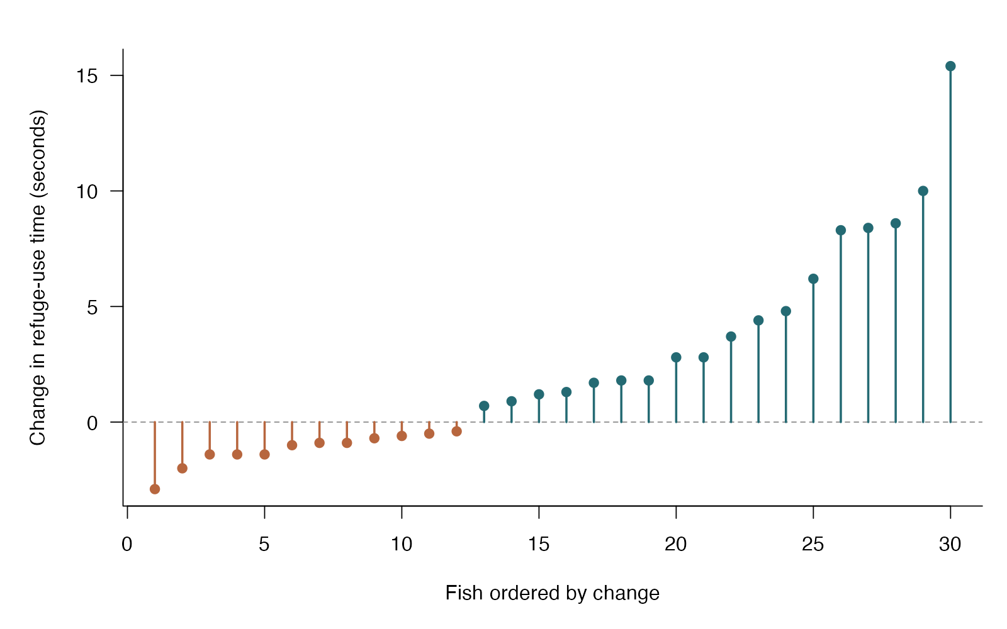
Sign test: see the data
base R arguments
reorder — Order fish by their change
segments — Draw each change from zero
abline(h=0) — Mark the null reference
col — Encode decrease versus increase
Sign test — simulated biological data
Notes:
This figure is generated from the saved CSV by modules/sign_test/analysis.R. A sign test handles asymmetric differences by asking about the probability of a positive change.

Slide 47
Sign test: plot code
values <- sort(d$change_seconds)
cols <- ifelse(values > 0, "#246A73", "#B7663E")
plot(seq_along(values), values, type = "n", xlab = "Fish ordered by change",
ylab = "Change in refuge-use time (seconds)")
abline(h = 0, col = "gray55", lty = 2)
segments(seq_along(values), 0, seq_along(values), values, col = cols, lwd = 2)
points(seq_along(values), values, pch = 19, col = cols)
Arguments to change
reorder — Order fish by their change
segments — Draw each change from zero
abline(h=0) — Mark the null reference
col — Encode decrease versus increase
Notes:
This is an exact excerpt from analysis.R. Any preparation referenced by the excerpt appears in the complete companion script. The script opens a ragg PNG device before these lines and closes it afterward.

Slide 48
Sign test: question and null
Scientific question
Is an increase just as likely as a decrease in refuge-use time?
Null / estimation target
Among nonzero changes, positive and negative changes are equally likely; for continuous differences, the median is zero.
Relevant options
Subtract the reference first
Drop and report exact zero differences
binom.test tests the number of positive changes
Notes:
Ask whether rejecting this null, or estimating this target, answers the biological question. A sign test handles asymmetric differences by asking about the probability of a positive change.

Slide 49
Sign test: assumptions
What matters here
Independent fish
Pairing is retained in differences
Median interpretation assumes a continuous distribution
Parametric responses
A paired t test answers a mean-change question
Model skew explicitly if the mean is the target
Nonparametric responses
Sign test allows asymmetric differences
Signed-rank adds magnitude information but needs symmetry
Notes:
Begin with the design. A model change should address a specific issue and preserve the scientific target where possible. A rank or permutation alternative has its own assumptions and may change the null; do not choose it solely from a normality-test p-value.

Slide 50
Sign test: run and read
nonzero <- d$change_seconds[d$change_seconds != 0]
positive <- sum(nonzero > 0)
fit <- binom.test(positive, length(nonzero), p = .5,
alternative = "two.sided")
Generated results
Positive changes: 18 of 30 nonzero differences
Zero changes excluded: 0
Median observed change = 1.25 seconds
95% CI for positive-change probability: 0.41 to 0.77
Exact two-sided p = 0.3616
Notes:
Full executed model/test output:
Exact binomial test
data: positive and length(nonzero)
number of successes = 18, number of trials = 30, p-value = 0.3616
alternative hypothesis: true probability of success is not equal to 0.5
95 percent confidence interval:
0.4060349 0.7734424
sample estimates:
probability of success
0.6

Slide 51
Sign test: interpret
18 of 30 nonzero changes were positive (exact sign-test p = 0.3616; 95% CI for the positive-change probability 0.41 to 0.77). The test asks about direction, not mean change; 0 exact zero differences were excluded.
Discuss: If a few fish change by a very large amount, does that affect the sign test statistic?
Notes:
Teaching point: A sign test handles asymmetric differences by asking about the probability of a positive change.
Instructor comparison with the simulated population: Positive changes are more likely than negative changes. The unrounded mean is 4 seconds, but the sign test is about direction rather than that mean.
The reported estimate and p-value are calculated from this realized dataset; they need not exactly match the known population effect.

Slide 52
Signed-rank: the data
Microbiologists compare log bacterial density before and after a treatment in matched cultures.
One sample versus a location or paired differences
Continuous differences with meaningful magnitudes
Symmetric differences for a location interpretation
Other data like these
Paired log gene expression
Matched-site changes in biomass
Before/after physiological scores
Notes:
Wilcoxon signed-rank test
Each independent culture contributes one difference; occasional large differences make ranks useful.
culture: Independent culture and pair identifier (none)
before: Log10 bacterial density before treatment (log10 CFU/mL)
after: Log10 bacterial density after treatment (log10 CFU/mL)

Slide 53
Signed-rank: simulate and save
set.seed(1105)
before <- rnorm(28, 6, .4)
after <- before + .28 + .28 * rt(28, df = 4)
d <- data.frame(culture = 1:28, before = before, after = after)
write.csv(d, file.path(output_dir, "data.csv"), row.names = FALSE)
First saved row
culture: 1
before: 6.786
after: 7.185
Notes:
Seed: 1105
Generating model: 28 baselines come from Normal(6, 0.4 SD). Paired changes equal 0.28 + 0.28 times a Student t variable with 4 degrees of freedom; after equals before plus change.
Population truth: The symmetric difference distribution is centered at +0.28 log10 units; its zero-center null is false.
The script writes data.csv before reading it for analysis. output_dir or out_dir is the folder supplied to the standalone script.
Original saved-data preview:
culture before after
1 6.785938 7.184926
2 6.078931 5.861092
3 5.478518 5.659185
4 6.187042 6.519684

Slide 54
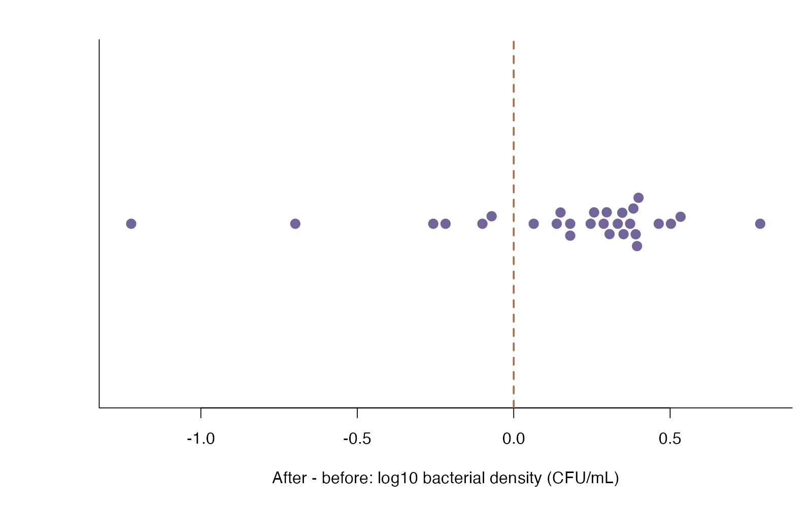
Signed-rank: see the data
beeswarm arguments
horizontal — Display changes on one horizontal scale
pch — Choose a filled point symbol
xlab — State both transformation and units
abline(v=0) — Mark no within-culture change
Wilcoxon signed-rank test — simulated biological data
Notes:
This figure is generated from the saved CSV by modules/signed_rank/analysis.R. Signed-rank is useful for symmetric heavy-tailed differences; sign is the simpler alternative when symmetry is doubtful.

Slide 55
Signed-rank: plot code
beeswarm(change, horizontal = TRUE, pch = 21, bg = "#73649A",
col = "white", cex = 1.5, yaxt = "n", ylab = "",
xlab = "After - before: log10 bacterial density (CFU/mL)")
abline(v = 0, lty = 2, col = "#B7663E", lwd = 2)
Arguments to change
horizontal — Display changes on one horizontal scale
pch — Choose a filled point symbol
xlab — State both transformation and units
abline(v=0) — Mark no within-culture change
Notes:
This is an exact excerpt from analysis.R. Any preparation referenced by the excerpt appears in the complete companion script. The script opens a ragg PNG device before these lines and closes it afterward.

Slide 56
Signed-rank: question and null
Scientific question
Is the distribution of within-culture changes centered at zero?
Null / estimation target
The difference distribution is symmetric about zero.
Relevant options
paired = TRUE for matched measurements
exact = FALSE uses the large-sample approximation
conf.int = TRUE estimates a pseudomedian under the shift model
Notes:
Ask whether rejecting this null, or estimating this target, answers the biological question. Signed-rank is useful for symmetric heavy-tailed differences; sign is the simpler alternative when symmetry is doubtful.

Slide 57
Signed-rank: assumptions
What matters here
Independent cultures/pairs
Approximately symmetric differences
Do not use ranks to repair mismatched pairs
Parametric responses
Paired t test targets the mean difference
A model for heavy-tailed errors can preserve a mean/location target
Nonparametric responses
Signed-rank uses ranks of absolute differences
If differences are asymmetric, use a sign test for direction/median
Notes:
Begin with the design. A model change should address a specific issue and preserve the scientific target where possible. A rank or permutation alternative has its own assumptions and may change the null; do not choose it solely from a normality-test p-value.

Slide 58
Signed-rank: run and read
change <- d$after - d$before
fit <- wilcox.test(d$after, d$before, paired = TRUE,
exact = FALSE, conf.int = TRUE)
Generated results
Pseudomedian change estimate = 0.249
95% CI: 0.094 to 0.341
V = 328.0; p = 0.004582
Notes:
Full executed model/test output:
Wilcoxon signed rank test with continuity correction
data: d$after and d$before
V = 328, p-value = 0.004582
alternative hypothesis: true location shift is not equal to 0
95 percent confidence interval:
0.09375924 0.34088634
sample estimates:
(pseudo)median
0.2486103

Slide 59
Signed-rank: interpret
The estimated pseudomedian log10 density change was 0.249 (95% CI 0.094 to 0.341); signed-rank V = 328.0, p = 0.004582. Under a symmetric location-shift model this describes the common center of the differences; the procedure does not generally test a mean.
Discuss: Which alternative would you use if the distribution of paired differences were strongly asymmetric?
Notes:
Teaching point: Signed-rank is useful for symmetric heavy-tailed differences; sign is the simpler alternative when symmetry is doubtful.
Instructor comparison with the simulated population: The symmetric difference distribution is centered at +0.28 log10 units; its zero-center null is false.
The reported estimate and p-value are calculated from this realized dataset; they need not exactly match the known population effect.

Slide 60
Paired permutation: the data
Two comparable leaves per plant receive randomized control or shade treatment.
Two matched observations per plant
One row per pair
Permutation preserves every pair
Other data like these
Matched tissue preparations
Split-clutch treatments
Left/right organ experiments
Notes:
Paired permutation test
Matched leaves within 28 independent plants; treatment labels are randomized within each plant.
plant: Independent matched unit (ID)
control: Control-leaf rate (photosynthesis units)
shaded: Shaded-leaf rate (photosynthesis units)

Slide 61
Paired permutation: simulate and save
set.seed(240504)
baseline <- rnorm(28, 15, 2)
d <- data.frame(plant=1:28, control=baseline+rnorm(28,0,1),
shaded=baseline-1.2+rnorm(28,0,1))
write.csv(d, file.path(out_dir, "data.csv"), row.names = FALSE)
First saved row
plant: 1
control: 15.28
shaded: 12.68
Notes:
Seed: 240504
Generating model: Plant baselines are Normal(15, SD=2). Independent leaf errors are Normal(0, SD=1). Shading subtracts 1.2 photosynthesis units.
Population truth: The true mean shaded-minus-control difference is −1.2; plants also differ in their shared baseline.
The script writes data.csv before reading it for analysis. output_dir or out_dir is the folder supplied to the standalone script.
Original saved-data preview:
plant control shaded
1 15.28146 12.68400
2 12.96687 11.61147
3 19.05530 19.78525
4 14.14044 12.48421

Slide 62
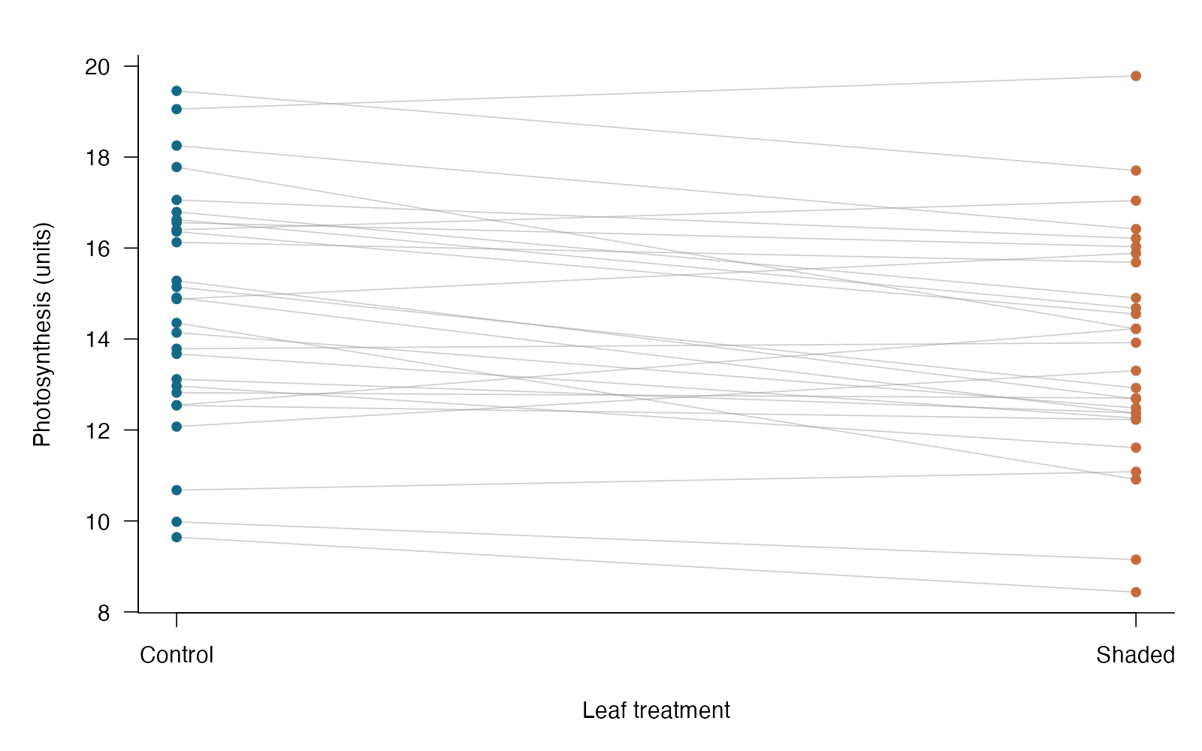
Paired permutation: see the data
base R arguments
t(as.matrix(…)) — Connects two values from each plant
col=“#99999980” — Light transparent paired lines
axis(1,…) — Replaces numeric positions with treatment labels
Paired permutation test — simulated biological data
Notes:
This figure is generated from the saved CSV by modules/permutation_paired/analysis.R. Swapping labels within a pair is equivalent to reversing the sign of that pair’s difference.

Slide 63
Paired permutation: plot code
matplot(c(1,2), t(as.matrix(d[c("control","shaded")])), type="l", lty=1,
col="#99999980", xaxt="n", xlab="Leaf treatment", ylab="Photosynthesis (units)")
axis(1, 1:2, c("Control", "Shaded"))
points(rep(1,28), d$control, pch=16, col="#146A85")
points(rep(2,28), d$shaded, pch=16, col="#C56B3B")
Arguments to change
t(as.matrix(…)) — Connects two values from each plant
col=“#99999980” — Light transparent paired lines
axis(1,…) — Replaces numeric positions with treatment labels
Notes:
This is an exact excerpt from analysis.R. Any preparation referenced by the excerpt appears in the complete companion script. The script opens a ragg PNG device before these lines and closes it afterward.

Slide 64
Paired permutation: question and null
Scientific question
Is the within-pair or within-block contrast unusual under the actual randomization?
Null / estimation target
Under a paired randomized design, treatment assignment has no effect on any unit; permitted within-pair swaps are equally plausible.
Relevant options
Swap labels within randomized pairs/blocks; never shuffle all rows together.
Use set.seed(), a stated statistic, and a finite-simulation p-value.
Notes:
Ask whether rejecting this null, or estimating this target, answers the biological question. Swapping labels within a pair is equivalent to reversing the sign of that pair’s difference.

Slide 65
Paired permutation: assumptions
What matters here
The assignment scheme permits the swaps.
For observational sign flips, a symmetric difference distribution is a separate justification.
Parametric responses
Paired t targets the mean change; mixed models add covariates and complex dependence.
Nonparametric responses
A sign test needs only change direction; signed-rank also uses meaningful symmetric differences.
Notes:
Begin with the design. A model change should address a specific issue and preserve the scientific target where possible. A rank or permutation alternative has its own assumptions and may change the null; do not choose it solely from a normality-test p-value.

Slide 66
Paired permutation: run and read
difference <- d$shaded-d$control
observed <- mean(difference)
B <- 4999
null <- numeric(B)
for (i in 1:B) null[i] <- mean(difference * sample(c(-1,1), nrow(d), replace=TRUE))
p_value <- (1+sum(abs(null)>=abs(observed)))/(B+1)
result <- data.frame(mean_difference=observed, permutations=B, p=p_value)
Generated results
Shaded − control = -0.97 units
Two-sided permutation p = 0.0006
28 pairs; labels swap only within plants
Notes:
Full executed model/test output:
mean_difference permutations p
1 -0.9724543 4999 6e-04

Slide 67
Paired permutation: interpret
Within plants, shading changed mean photosynthesis by -0.97 units (paired permutation p = 0.0006). Swaps preserve plant pairing.
Discuss: Why would shuffling all 56 leaf measurements destroy useful information?
Notes:
Teaching point: Swapping labels within a pair is equivalent to reversing the sign of that pair’s difference.
Instructor comparison with the simulated population: The true mean shaded-minus-control difference is −1.2; plants also differ in their shared baseline.
The reported estimate and p-value are calculated from this realized dataset; they need not exactly match the known population effect.

Slide 68
Welch t: the data
Evolutionary biologists compare adult beetle body length from two rearing environments.
Continuous response
Two independent groups
Unequal variances allowed
Other data like these
Control versus treated enzyme activity
Biomass in two habitats
Hormone concentration in two populations
Notes:
Welch two-sample t test
Independent beetles assigned to cool or warm rearing; each beetle measured once.
environment: Independent rearing group (category)
length_mm: Adult beetle body length (mm)

Slide 69
Welch t: simulate and save
set.seed(1102)
d <- data.frame(environment = rep(c("Cool", "Warm"), c(26, 30)),
length_mm = c(rnorm(26, 10, .65), rnorm(30, 10.7, 1.15)))
write.csv(d, file.path(output_dir, "data.csv"), row.names = FALSE)
First saved row
environment: Cool
length_mm: 9.711
Notes:
Seed: 1102
Generating model: 26 independent Cool lengths come from Normal(10, 0.65 SD), and 30 independent Warm lengths from Normal(10.7, 1.15 SD).
Population truth: The true Cool minus Warm mean difference is -0.7 mm. Variances differ (0.4225 versus 1.3225 mm squared).
The script writes data.csv before reading it for analysis. output_dir or out_dir is the folder supplied to the standalone script.
Original saved-data preview:
environment length_mm
Cool 9.711176
Cool 10.244752
Cool 10.735937
Cool 9.850995

Slide 70
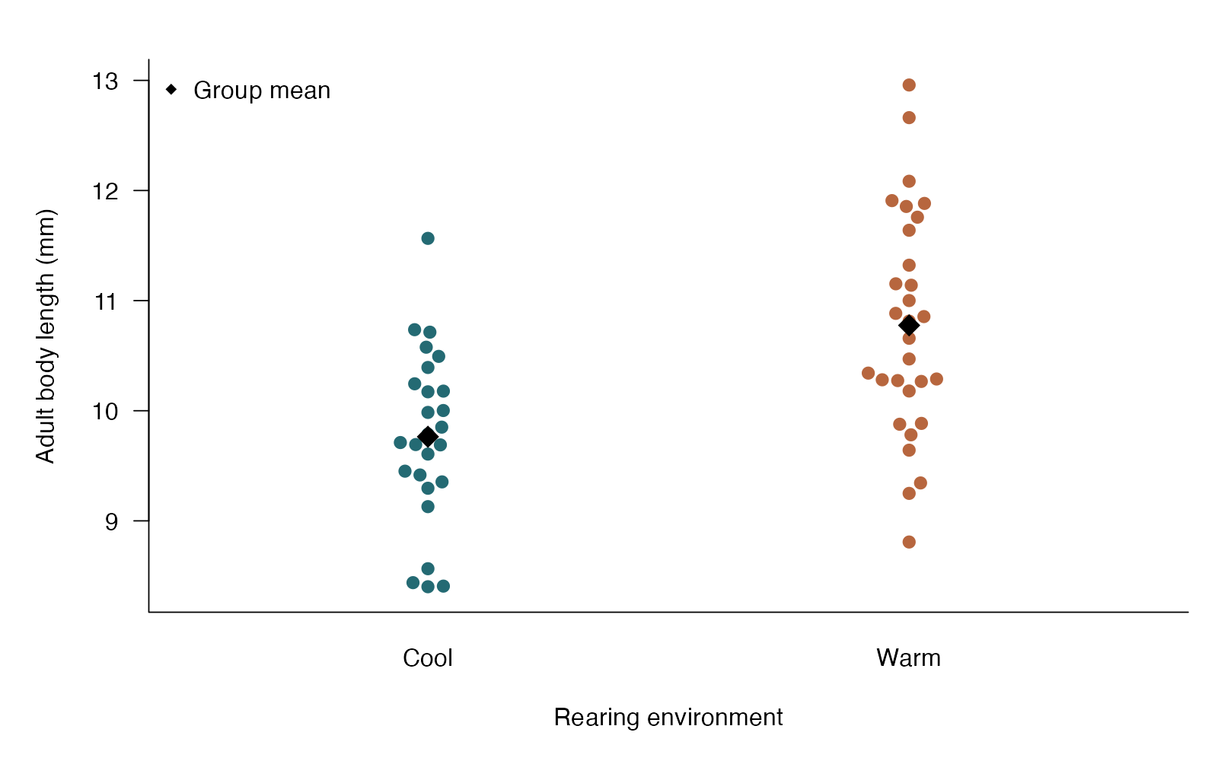
Welch t: see the data
beeswarm arguments
response ~ group — Map measurements to groups
bg — Use a color for each group
corral — Control overly wide swarms
points — Add group means with a distinct symbol
Welch two-sample t test — simulated biological data
Notes:
This figure is generated from the saved CSV by modules/welch_t/analysis.R. Welch answers the equal-means question while allowing unequal group variances.

Slide 71
Welch t: plot code
beeswarm(length_mm ~ environment, data = d, pch = 21,
bg = c("#246A73", "#B7663E"), col = "white", cex = 1.3,
xlab = "Rearing environment", ylab = "Adult body length (mm)")
points(1:2, tapply(d$length_mm, d$environment, mean), pch = 18, cex = 2)
legend("topleft", "Group mean", pch = 18, bty = "n")
Arguments to change
response ~ group — Map measurements to groups
bg — Use a color for each group
corral — Control overly wide swarms
points — Add group means with a distinct symbol
Notes:
This is an exact excerpt from analysis.R. Any preparation referenced by the excerpt appears in the complete companion script. The script opens a ragg PNG device before these lines and closes it afterward.

Slide 72
Welch t: question and null
Scientific question
Do mean body lengths differ between cool and warm environments?
Null / estimation target
The two population means are equal.
Relevant options
var.equal = FALSE uses Welch (default)
Factor order defines the reported difference
Use a paired test only for genuine pairs
Notes:
Ask whether rejecting this null, or estimating this target, answers the biological question. Welch answers the equal-means question while allowing unequal group variances.

Slide 73
Welch t: assumptions
What matters here
Independent beetles
No severe outliers; check small samples closely
Groups need not share a variance
Parametric responses
Welch handles unequal variances
A scientifically sensible transformation may reduce strong skew
Nonparametric responses
Rank-sum tests distributions; it is not a general test of means
A bootstrap interval can retain the mean-difference target
Notes:
Begin with the design. A model change should address a specific issue and preserve the scientific target where possible. A rank or permutation alternative has its own assumptions and may change the null; do not choose it solely from a normality-test p-value.

Slide 74
Welch t: run and read
d$environment <- factor(d$environment, levels = c("Cool", "Warm"))
fit <- t.test(length_mm ~ environment, data = d,
var.equal = FALSE, conf.level = .95)
difference <- mean(d$length_mm[d$environment == "Cool"]) -
mean(d$length_mm[d$environment == "Warm"])
Generated results
Cool - Warm mean difference = -1.01 mm
95% CI: -1.49 to -0.53 mm
Welch t = -4.21; df = 53.33; p = 9.973e-05
Notes:
Full executed model/test output:
Welch Two Sample t-test
data: length_mm by environment
t = -4.2066, df = 53.33, p-value = 9.973e-05
alternative hypothesis: true difference in means between group Cool and group Warm is not equal to 0
95 percent confidence interval:
-1.4937879 -0.5292964
sample estimates:
mean in group Cool mean in group Warm
9.763781 10.775323

Slide 75
Welch t: interpret
Mean body length differed by -1.01 mm (Cool minus Warm; 95% CI -1.49 to -0.53). Welch’s t = -4.21, df = 53.33, p = 9.973e-05. Group ordering determines the sign; unequal group variances do not require switching to ranks.
Discuss: If the Warm group is more variable, do you need ranks to test a mean difference?
Notes:
Teaching point: Welch answers the equal-means question while allowing unequal group variances.
Instructor comparison with the simulated population: The true Cool minus Warm mean difference is -0.7 mm. Variances differ (0.4225 versus 1.3225 mm squared).
The reported estimate and p-value are calculated from this realized dataset; they need not exactly match the known population effect.

Slide 76
Pooled t: the data
Evolutionary biologists compare adult beetle body length from two rearing environments.
Continuous response
Two independent groups
A shared population variance is assumed
Other data like these
Control versus treated enzyme activity
Biomass in two habitats
Hormone concentration in two populations
Notes:
Pooled two-sample t test
Independent beetles in two rearing environments; a common population variance is a substantive model assumption.
environment: Independent rearing group (category)
length_mm: Adult beetle body length (mm)

Slide 77
Pooled t: simulate and save
set.seed(1118)
d <- data.frame(environment = rep(c("Cool", "Warm"), c(26, 30)),
length_mm = c(rnorm(26, 10, .65), rnorm(30, 10.7, .65)))
write.csv(d, file.path(output_dir, "data.csv"), row.names = FALSE)
First saved row
environment: Cool
length_mm: 9.949
Notes:
Seed: 1118
Generating model: 26 independent Cool beetles are Normal(10, 0.65 SD), and 30 independent Warm beetles are Normal(10.7, 0.65 SD).
Population truth: The true Cool minus Warm mean difference is -0.7 mm, and the two population variances are both 0.4225 mm squared.
The script writes data.csv before reading it for analysis. output_dir or out_dir is the folder supplied to the standalone script.
Original saved-data preview:
environment length_mm
Cool 9.949494
Cool 10.115089
Cool 10.006459
Cool 11.635352

Slide 78
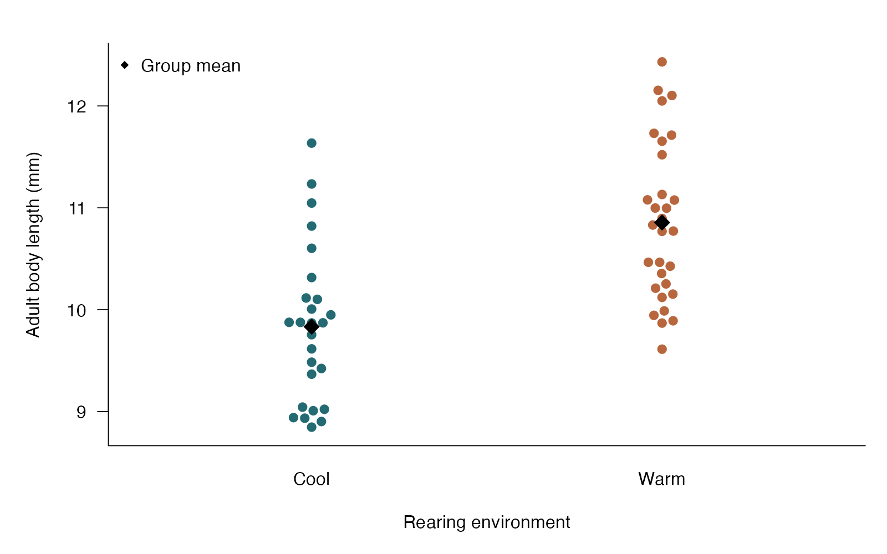
Pooled t: see the data
beeswarm arguments
response ~ group — Map measurements to groups
pwcol — Use a color for each observation
corral — Control overly wide swarms
points — Add group means with a distinct symbol
Pooled two-sample t test — simulated biological data
Notes:
This figure is generated from the saved CSV by modules/pooled_t/analysis.R. Pooled and Welch t tests share the mean-difference null; their variance assumptions differ.

Slide 79
Pooled t: plot code
beeswarm(length_mm ~ environment, data = d, pch = 21,
bg = c("#246A73", "#B7663E"), col = "white", cex = 1.3,
xlab = "Rearing environment", ylab = "Adult body length (mm)")
points(1:2, tapply(d$length_mm, d$environment, mean), pch = 18, cex = 2)
legend("topleft", "Group mean", pch = 18, bty = "n")
Arguments to change
response ~ group — Map measurements to groups
pwcol — Use a color for each observation
corral — Control overly wide swarms
points — Add group means with a distinct symbol
Notes:
This is an exact excerpt from analysis.R. Any preparation referenced by the excerpt appears in the complete companion script. The script opens a ragg PNG device before these lines and closes it afterward.

Slide 80
Pooled t: question and null
Scientific question
Do mean body lengths differ between cool and warm environments?
Null / estimation target
The two population means are equal.
Relevant options
var.equal = TRUE requests the pooled t test
Factor order determines the difference sign
Choose the variance model deliberately; avoid a preliminary variance-test gate
Notes:
Ask whether rejecting this null, or estimating this target, answers the biological question. Pooled and Welch t tests share the mean-difference null; their variance assumptions differ.

Slide 81
Pooled t: assumptions
What matters here
Independent beetles
Similar approximately normal population shapes at small n
Equal population variances
Parametric responses
Welch tests the same mean-difference null without equal variances
Use a scientifically meaningful transformation for severe skew
Nonparametric responses
Rank-sum changes the target to response distributions
A bootstrap interval can retain the mean-difference target
Notes:
Begin with the design. A model change should address a specific issue and preserve the scientific target where possible. A rank or permutation alternative has its own assumptions and may change the null; do not choose it solely from a normality-test p-value.

Slide 82
Pooled t: run and read
d$environment <- factor(d$environment, levels = c("Cool", "Warm"))
fit <- t.test(length_mm ~ environment, data = d,
var.equal = TRUE, conf.level = .95)
difference <- mean(d$length_mm[d$environment == "Cool"]) -
mean(d$length_mm[d$environment == "Warm"])
Generated results
Cool - Warm mean difference = -1.02 mm
95% CI: -1.44 to -0.61 mm
Pooled t = -4.94; df = 54.00; p = 7.927e-06
Notes:
Full executed model/test output:
Two Sample t-test
data: length_mm by environment
t = -4.9399, df = 54, p-value = 7.927e-06
alternative hypothesis: true difference in means between group Cool and group Warm is not equal to 0
95 percent confidence interval:
-1.4367878 -0.6072203
sample estimates:
mean in group Cool mean in group Warm
9.833382 10.855386

Slide 83
Pooled t: interpret
Mean body length differed by -1.02 mm (Cool minus Warm; 95% CI -1.44 to -0.61). Pooled t = -4.94, df = 54.00, p = 7.927e-06. This analysis assumes equal population variances. Welch tests the same null without that assumption.
Discuss: Which argument changes a Welch test into the pooled test, and what assumption have you added?
Notes:
Teaching point: Pooled and Welch t tests share the mean-difference null; their variance assumptions differ.
Instructor comparison with the simulated population: The true Cool minus Warm mean difference is -0.7 mm, and the two population variances are both 0.4225 mm squared.
The reported estimate and p-value are calculated from this realized dataset; they need not exactly match the known population effect.

Slide 84
Rank-sum: the data
Ecologists compare parasite burdens among fish from two independent lakes.
Ordinal or continuous response, including ranked counts
Two independent groups
Uses relative ordering rather than raw distances
Other data like these
Skewed enzyme concentrations
Ordinal disease scores in two treatments
Time-to-task completion without censoring
Notes:
Wilcoxon rank-sum test
Each fish is sampled once; counts are strongly skewed and tied.
lake: Lake of independently sampled fish (category)
parasites: Parasite burden of one fish (count)

Slide 85
Rank-sum: simulate and save
set.seed(1106)
d <- data.frame(lake = rep(c("Clear", "Reedy"), each = 32),
parasites = c(rnbinom(32, mu = 5, size = 1.5),
rnbinom(32, mu = 10, size = 1.5)))
write.csv(d, file.path(output_dir, "data.csv"), row.names = FALSE)
First saved row
lake: Clear
parasites: 7
Notes:
Seed: 1106
Generating model: 32 independent fish per lake have negative-binomial parasite counts. Clear has mean 5 and Reedy mean 10, both with size parameter 1.5; variances are mean + mean squared / 1.5.
Population truth: The lake distributions differ, including their mean and spread. The same-distribution null is false; there is not a simple equal-shape location shift.
The script writes data.csv before reading it for analysis. output_dir or out_dir is the folder supplied to the standalone script.
Original saved-data preview:
lake parasites
Clear 7
Clear 4
Clear 0
Clear 6

Slide 86
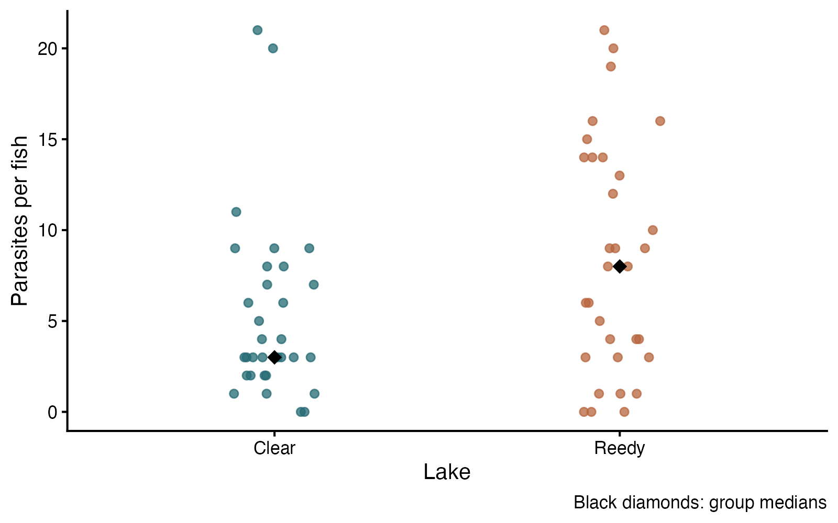
Rank-sum: see the data
ggplot2 arguments
aes — Map lake and burden to axes
geom_jitter / width — Separate overlapping observations horizontally
shape / alpha — Set point appearance and transparency
stat_summary — Add a labeled descriptive median
Wilcoxon rank-sum test — simulated biological data
Notes:
This figure is generated from the saved CSV by modules/rank_sum/analysis.R. A rank-sum result can reflect distributional differences; the mean-count question also has a direct count-model route.

Slide 87
Rank-sum: plot code
p <- ggplot(d, aes(lake, parasites, color = lake)) +
geom_jitter(width = .12, height = 0, size = 2.7, alpha = .75) +
stat_summary(fun = median, geom = "point", shape = 18, size = 5, color = "black") +
scale_color_manual(values = c("#246A73", "#B7663E")) +
labs(x = "Lake", y = "Parasites per fish", caption = "Black diamonds: group medians") +
theme_classic(base_size = 18) + theme(legend.position = "none")
print(p)
Arguments to change
aes — Map lake and burden to axes
geom_jitter / width — Separate overlapping observations horizontally
shape / alpha — Set point appearance and transparency
stat_summary — Add a labeled descriptive median
Notes:
This is an exact excerpt from analysis.R. Any preparation referenced by the excerpt appears in the complete companion script. The script opens a ragg PNG device before these lines and closes it afterward.

Slide 88
Rank-sum: question and null
Scientific question
Do parasite-burden distributions differ between the two lakes?
Null / estimation target
The two groups have the same response distribution.
Relevant options
exact = FALSE handles these tied counts
correct = TRUE applies continuity correction
Location-shift interpretation needs similarly shaped distributions
Notes:
Ask whether rejecting this null, or estimating this target, answers the biological question. A rank-sum result can reflect distributional differences; the mean-count question also has a direct count-model route.

Slide 89
Rank-sum: assumptions
What matters here
Independent fish and groups
Measurements can be meaningfully ranked
Different shapes/spreads can affect the result
Parametric responses
Negative-binomial regression models the count response directly
Welch t tests a mean difference when that is the target
Nonparametric responses
Rank-sum compares independent groups
Use signed-rank or sign for paired observations
Notes:
Begin with the design. A model change should address a specific issue and preserve the scientific target where possible. A rank or permutation alternative has its own assumptions and may change the null; do not choose it solely from a normality-test p-value.

Slide 90
Rank-sum: run and read
fit <- wilcox.test(parasites ~ lake, data = d,
exact = FALSE, correct = TRUE)
Generated results
Observed medians: Clear 3.0; Reedy 8.0 parasites
W = 362.5; asymptotic p = 0.04452
Medians describe these data; the general null concerns distributions.
Notes:
Full executed model/test output:
Wilcoxon rank sum test with continuity correction
data: parasites by lake
W = 362.5, p-value = 0.04452
alternative hypothesis: true location shift is not equal to 0

Slide 91
Rank-sum: interpret
Parasite burdens had observed medians 3.0 (Clear) and 8.0 (Reedy). The rank-sum comparison gave W = 362.5, p = 0.04452. This is evidence about the distributions; calling it a median test requires additional shape assumptions.
Discuss: If your target is the ratio of mean parasite counts, would a rank-sum result answer that directly?
Notes:
Teaching point: A rank-sum result can reflect distributional differences; the mean-count question also has a direct count-model route.
Instructor comparison with the simulated population: The lake distributions differ, including their mean and spread. The same-distribution null is false; there is not a simple equal-shape location shift.
The reported estimate and p-value are calculated from this realized dataset; they need not exactly match the known population effect.

Slide 92
Independent permutation: the data
Independent insect larvae are randomly assigned to ambient or warm rearing.
Continuous growth measurement
One row per larva
Group labels can be reassigned under the null
Other data like these
Fertilizer and biomass
Drug and enzyme activity
Resource treatment and fecundity
Notes:
Independent-sample permutation test
Two independent randomized groups; statistic is the mean difference.
group: Randomized treatment (category)
growth_mm: Larval growth (mm)

Slide 93
Independent permutation: simulate and save
set.seed(240503)
group <- rep(c("Control", "Warm"), each=25)
d <- data.frame(group, growth_mm=rnorm(50, 8+1.1*(group=="Warm"), 1.8))
write.csv(d, file.path(out_dir, "data.csv"), row.names = FALSE)
First saved row
group: Control
growth_mm: 7.975
Notes:
Seed: 240503
Generating model: 25 independent values per group. Control growth is Normal(8, SD=1.8) mm; warm growth is Normal(9.1, SD=1.8) mm. No rounding or clipping.
Population truth: The simulated warm-minus-control mean difference is 1.1 mm; the same-distribution null is false.
The script writes data.csv before reading it for analysis. output_dir or out_dir is the folder supplied to the standalone script.
Original saved-data preview:
group growth_mm
Control 7.975045
Control 4.894258
Control 9.026126
Control 8.055585

Slide 94
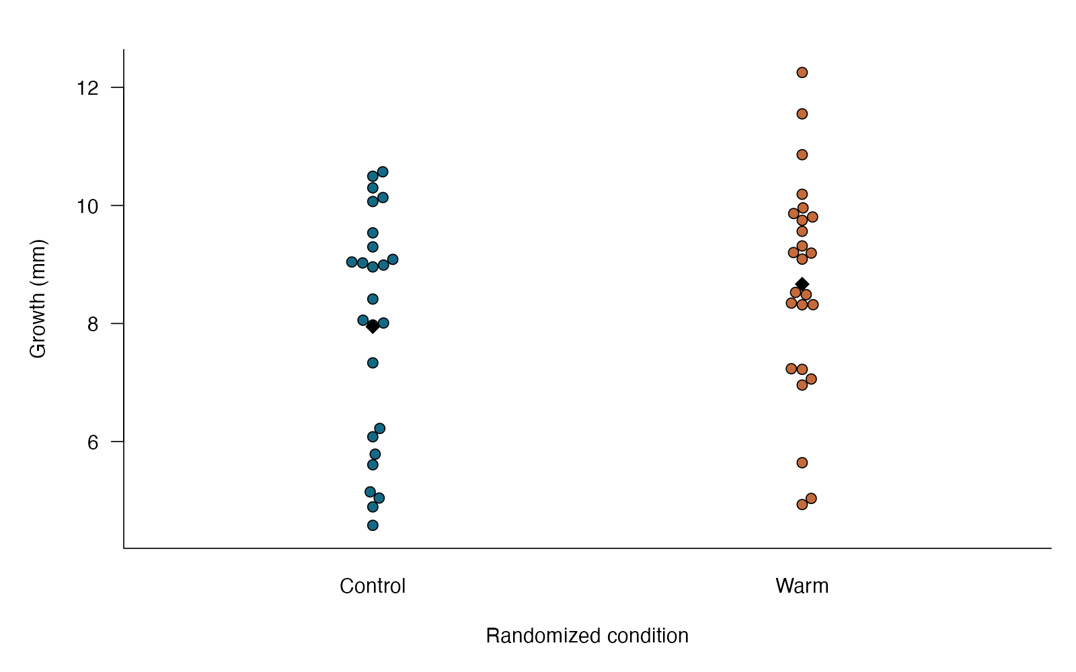
Independent permutation: see the data
beeswarm arguments
growth_mm ~ group — Separates independent groups
pch=21 / bg — Outlined points with treatment fills
points(…,pch=18) — Adds a diamond at each mean
Independent-sample permutation test — simulated biological data
Notes:
This figure is generated from the saved CSV by modules/permutation_independent/analysis.R. Choose the statistic for the scientific question, then shuffle in a way the design permits.

Slide 95
Independent permutation: plot code
beeswarm::beeswarm(growth_mm ~ group, data=d, pch=21,
bg=c("#146A85", "#C56B3B"), cex=1.1,
xlab="Randomized condition", ylab="Growth (mm)")
points(1:2, tapply(d$growth_mm, d$group, mean), pch=18, cex=1.6)
Arguments to change
growth_mm ~ group — Separates independent groups
pch=21 / bg — Outlined points with treatment fills
points(…,pch=18) — Adds a diamond at each mean
Notes:
This is an exact excerpt from analysis.R. Any preparation referenced by the excerpt appears in the complete companion script. The script opens a ragg PNG device before these lines and closes it afterward.

Slide 96
Independent permutation: question and null
Scientific question
Would the observed group statistic be unusual under assignments permitted by the design?
Null / estimation target
For ordinary group-label permutation, group labels are exchangeable under the null; in a randomized experiment, the sharp null is no treatment effect on any unit.
Relevant options
Choose the statistic and permitted shuffles first; set.seed() records reproducibility.
With B random permutations, use (1 + number_at_least_as_extreme)/(B + 1).
Notes:
Ask whether rejecting this null, or estimating this target, answers the biological question. Choose the statistic for the scientific question, then shuffle in a way the design permits.

Slide 97
Independent permutation: assumptions
What matters here
Exchangeability or a known randomization scheme; preserve any blocks and unequal assignment probabilities.
Parametric responses
Welch targets a mean difference while allowing unequal variances; ordinary label shuffling is not automatically valid for that null.
Nonparametric responses
Already a randomization/resampling method. Pair or block restrictions are essential when the design requires them.
Notes:
Begin with the design. A model change should address a specific issue and preserve the scientific target where possible. A rank or permutation alternative has its own assumptions and may change the null; do not choose it solely from a normality-test p-value.

Slide 98
Independent permutation: run and read
observed <- mean(d$growth_mm[d$group=="Warm"])-mean(d$growth_mm[d$group=="Control"])
B <- 4999
null <- numeric(B)
for (i in 1:B) {
shuffled <- sample(d$group)
null[i] <- mean(d$growth_mm[shuffled=="Warm"])-mean(d$growth_mm[shuffled=="Control"])
}
p_value <- (1+sum(abs(null)>=abs(observed)))/(B+1)
result <- data.frame(mean_difference=observed, permutations=B, p=p_value)
Generated results
Warm − control = 0.72 mm
Two-sided Monte Carlo p = 0.187
4999 permitted label shuffles
Notes:
Full executed model/test output:
mean_difference permutations p
1 0.7207885 4999 0.187

Slide 99
Independent permutation: interpret
Mean growth was 0.72 mm higher under warming; the two-sided permutation p-value is 0.187 from 4999 random assignments. The shuffle must match the design.
Discuss: Would shuffling individual leaves be valid if treatment was assigned to pots?
Notes:
Teaching point: Choose the statistic for the scientific question, then shuffle in a way the design permits.
Instructor comparison with the simulated population: The simulated warm-minus-control mean difference is 1.1 mm; the same-distribution null is false.
The reported estimate and p-value are calculated from this realized dataset; they need not exactly match the known population effect.

Slide 100
Normality checks: the data
Cell biologists examine the distribution of time to lysis among independent cultured cells.
One continuous variable
A distributional diagnostic, not the biological comparison
For models, examine residuals rather than pooled responses
Other data like these
Approximate normality of paired differences
Shape of independent measurement errors
Distribution of a continuous trait within a group
Notes:
Shapiro–Wilk and graphical checks
One lysis time for each independently treated culture; use a diagnostic to investigate shape.
culture: Independent culture identifier (none)
lysis_minutes: Time until lysis (minutes)

Slide 101
Normality checks: simulate and save
set.seed(1111)
d <- data.frame(culture = 1:36,
lysis_minutes = rlnorm(36, log(45), .5))
write.csv(d, file.path(output_dir, "data.csv"), row.names = FALSE)
First saved row
culture: 1
lysis_minutes: 43.09
Notes:
Seed: 1111
Generating model: 36 independent lysis times follow a log-normal distribution with meanlog log(45) and log-scale SD 0.5.
Population truth: The population is log-normal and positively skewed, not normal. The population geometric mean is 45 minutes.
The script writes data.csv before reading it for analysis. output_dir or out_dir is the folder supplied to the standalone script.
Original saved-data preview:
culture lysis_minutes
1 43.09351
2 87.17562
3 61.96152
4 80.96814

Slide 102
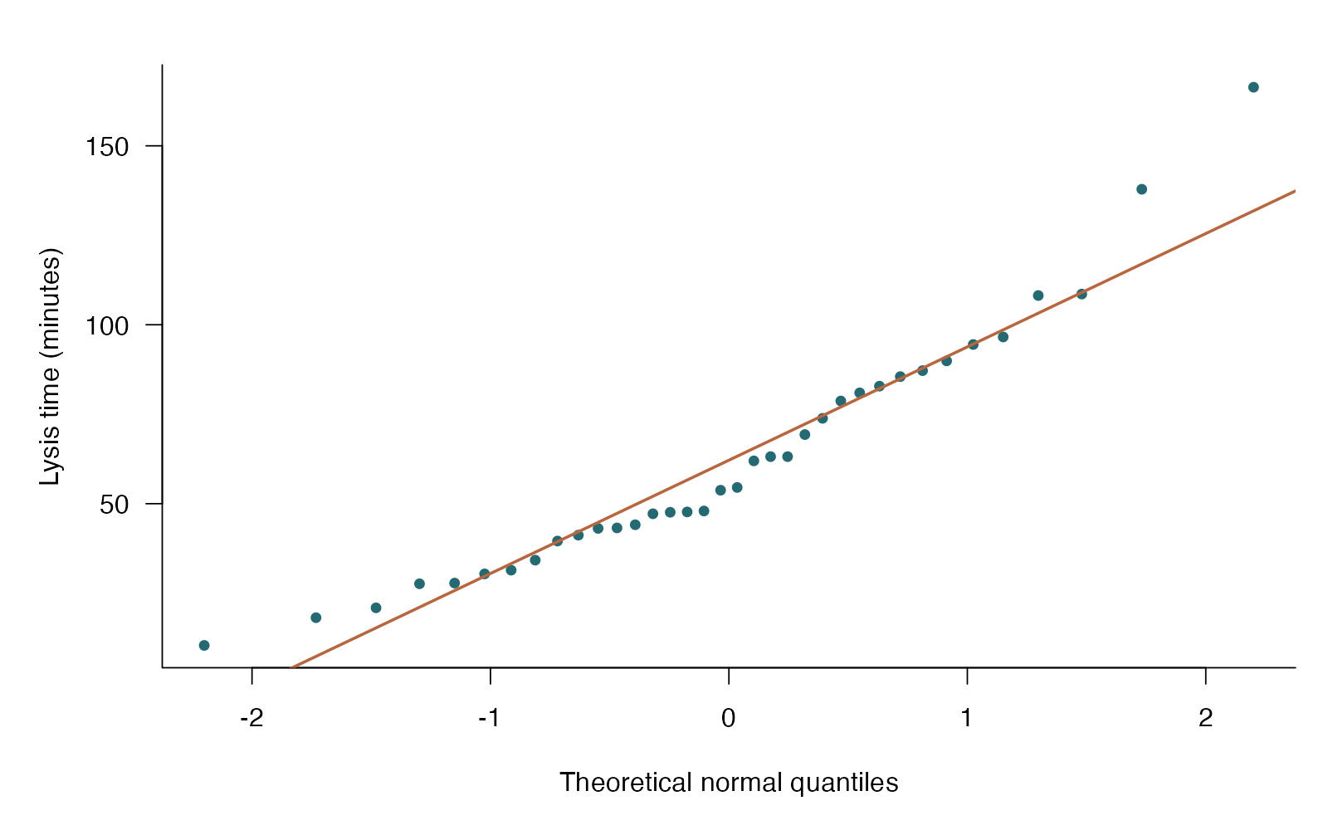
Normality checks: see the data
base R arguments
qqnorm — Compare observed to normal quantiles
qqline — Add a quartile-based reference line
pch / col — Keep observations visually distinct
ylab — Keep the response and units explicit
Shapiro–Wilk and graphical checks — simulated biological data
Notes:
This figure is generated from the saved CSV by modules/shapiro/analysis.R. A diagnostic explains how a working model misses the data; its p-value should not automatically select the scientific analysis.

Slide 103
Normality checks: plot code
qqnorm(d$lysis_minutes, pch = 21, bg = "#246A73", col = "white",
main = "", xlab = "Theoretical normal quantiles", ylab = "Lysis time (minutes)")
qqline(d$lysis_minutes, col = "#B7663E", lwd = 2)
Arguments to change
qqnorm — Compare observed to normal quantiles
qqline — Add a quartile-based reference line
pch / col — Keep observations visually distinct
ylab — Keep the response and units explicit
Notes:
This is an exact excerpt from analysis.R. Any preparation referenced by the excerpt appears in the complete companion script. The script opens a ragg PNG device before these lines and closes it afterward.

Slide 104
Normality checks: question and null
Scientific question
Is a normal model a reasonable working description of these lysis times?
Null / estimation target
The independent observations come from a normal distribution.
Relevant options
shapiro.test accepts 3–5000 observations
Use a Q–Q plot alongside the test
Choose an analysis for the scientific target, not a p-value gate
Notes:
Ask whether rejecting this null, or estimating this target, answers the biological question. A diagnostic explains how a working model misses the data; its p-value should not automatically select the scientific analysis.

Slide 105
Normality checks: assumptions
What matters here
Observations are independent
A normal population is the reference
Diagnostic sensitivity changes with sample size
Parametric responses
Model positive skew with log-normal or gamma errors
Consider a meaningful transformation and check its new interpretation
Nonparametric responses
Ranks can address a different distributional question
Bootstrap uncertainty can retain the mean target
Notes:
Begin with the design. A model change should address a specific issue and preserve the scientific target where possible. A rank or permutation alternative has its own assumptions and may change the null; do not choose it solely from a normality-test p-value.

Slide 106
Normality checks: run and read
fit <- shapiro.test(d$lysis_minutes)
Generated results
Shapiro–Wilk W = 0.937; p = 0.04064; n = 36
Curvature in the Q–Q plot indicates a shape mismatch.
A nonsignificant result would not establish normality.
Notes:
Full executed model/test output:
Shapiro-Wilk normality test
data: d$lysis_minutes
W = 0.93687, p-value = 0.04064

Slide 107
Normality checks: interpret
For the 36 lysis times, Shapiro–Wilk W = 0.937, p = 0.04064. Use the Q–Q plot to understand the mismatch; this diagnostic alone does not choose the scientific test or show that a mean comparison is invalid.
Discuss: Would a nonsignificant Shapiro–Wilk result prove that these known log-normal data are normal?
Notes:
Teaching point: A diagnostic explains how a working model misses the data; its p-value should not automatically select the scientific analysis.
Instructor comparison with the simulated population: The population is log-normal and positively skewed, not normal. The population geometric mean is 45 minutes.
The reported estimate and p-value are calculated from this realized dataset; they need not exactly match the known population effect.

Slide 108
F test of variances: the data
Evolutionary developmental biologists compare variation in wing length between two inbred fly lines.
Continuous response
Two independent groups
Variability is the scientific target
Other data like these
Developmental variability in two genotypes
Variation in enzyme activity across two treatments
Body-size variability in two populations
Notes:
F test of two variances
Thirty independent flies per line are reared under a common environment.
line: Fly line (category)
wing_mm: Wing length of one independent fly (mm)

Slide 109
F test of variances: simulate and save
set.seed(1109)
d <- data.frame(line = rep(c("Line A", "Line B"), each = 30),
wing_mm = c(rnorm(30, 2.6, .11), rnorm(30, 2.6, .21)))
write.csv(d, file.path(output_dir, "data.csv"), row.names = FALSE)
First saved row
line: Line A
wing_mm: 2.466
Notes:
Seed: 1109
Generating model: 30 wing lengths per independent fly line come from normal distributions with shared mean 2.6 mm, SD 0.11 for Line A and SD 0.21 for Line B.
Population truth: Population means are equal, but the true variance ratio A/B is 0.11 squared / 0.21 squared, approximately 0.274.
The script writes data.csv before reading it for analysis. output_dir or out_dir is the folder supplied to the standalone script.
Original saved-data preview:
line wing_mm
Line A 2.465816
Line A 2.528231
Line A 2.703526
Line A 2.709543

Slide 110
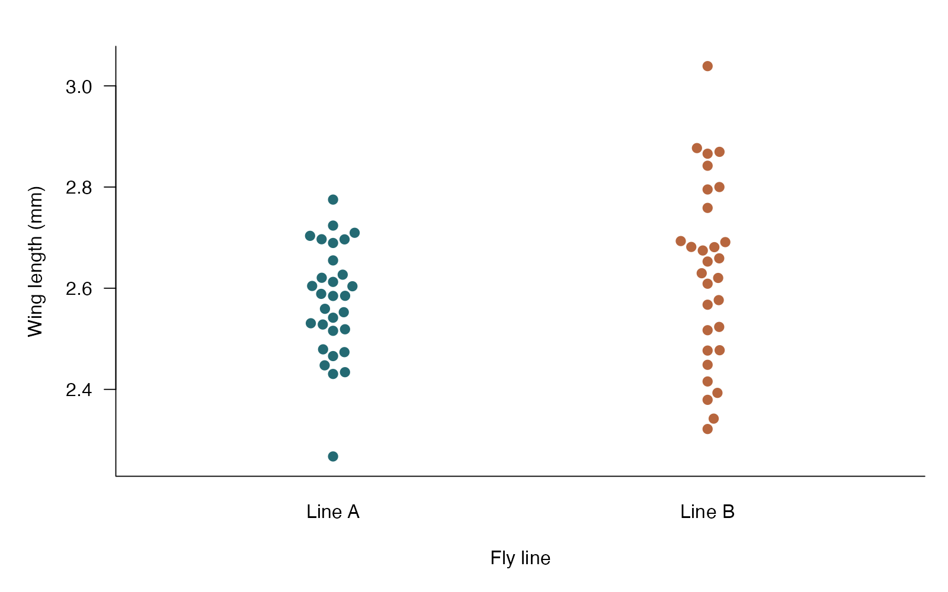
F test of variances: see the data
beeswarm arguments
response ~ line — Display the two distributions side by side
bg — Give each group its own color
pch / cex — Use visible, unobscured raw points
ylab — Give the actual measurement units
F test of two variances — simulated biological data
Notes:
This figure is generated from the saved CSV by modules/f_variance/analysis.R. A variance question can have a different answer from a mean question; the exact F test depends strongly on normality.

Slide 111
F test of variances: plot code
beeswarm(wing_mm ~ line, data = d, pch = 21,
bg = c("#246A73", "#B7663E"), col = "white", cex = 1.3,
xlab = "Fly line", ylab = "Wing length (mm)")
Arguments to change
response ~ line — Display the two distributions side by side
bg — Give each group its own color
pch / cex — Use visible, unobscured raw points
ylab — Give the actual measurement units
Notes:
This is an exact excerpt from analysis.R. Any preparation referenced by the excerpt appears in the complete companion script. The script opens a ragg PNG device before these lines and closes it afterward.

Slide 112
F test of variances: question and null
Scientific question
Is wing-length variance the same in the two fly lines?
Null / estimation target
The population variance ratio (Line A / Line B) is 1.
Relevant options
ratio = 1 specifies equal variances
Factor order defines the numerator
alternative = “two.sided” detects either variance direction
Notes:
Ask whether rejecting this null, or estimating this target, answers the biological question. A variance question can have a different answer from a mean question; the exact F test depends strongly on normality.

Slide 113
F test of variances: assumptions
What matters here
Independent observations
Both populations approximately normal
Highly sensitive to outliers and non-normality
Parametric responses
If comparing means, use Welch without a variance pretest
Model group-specific variances when variability is the target
Nonparametric responses
Brown–Forsythe is less sensitive to non-normality
Resample within groups for a variance-ratio interval
Notes:
Begin with the design. A model change should address a specific issue and preserve the scientific target where possible. A rank or permutation alternative has its own assumptions and may change the null; do not choose it solely from a normality-test p-value.

Slide 114
F test of variances: run and read
d$line <- factor(d$line, levels = c("Line A", "Line B"))
fit <- var.test(wing_mm ~ line, data = d, ratio = 1,
alternative = "two.sided", conf.level = .95)
Generated results
Variance ratio (A / B) = 0.376
95% CI for variance ratio: 0.179 to 0.791
F = 0.376; df = 29, 29; p = 0.01048
Notes:
Full executed model/test output:
F test to compare two variances
data: wing_mm by line
F = 0.37637, num df = 29, denom df = 29, p-value = 0.01048
alternative hypothesis: true ratio of variances is not equal to 1
95 percent confidence interval:
0.1791387 0.7907512
sample estimates:
ratio of variances
0.3763697

Slide 115
F test of variances: interpret
Wing-length variance in Line A was 0.376 times that in Line B (95% CI 0.179 to 0.791); F(29, 29) = 0.376, p = 0.01048. The target is variability, and this exact F reference relies strongly on normal populations.
Discuss: Could the variance test detect a difference even when the two population means are identical?
Notes:
Teaching point: A variance question can have a different answer from a mean question; the exact F test depends strongly on normality.
Instructor comparison with the simulated population: Population means are equal, but the true variance ratio A/B is 0.11 squared / 0.21 squared, approximately 0.274.
The reported estimate and p-value are calculated from this realized dataset; they need not exactly match the known population effect.

Slide 116
Levene / Brown–Forsythe: the data
Microbiologists compare the variability of colony diameters across three nutrient media.
Continuous response
Two or more independent groups
The spread, rather than the mean, is the target
Other data like these
Developmental stability across genotypes
Assay reproducibility across treatments
Variation in growth among environments
Notes:
Levene and Brown–Forsythe tests
Independent colonies are grown in separately inoculated culture wells; one colony measured per well.
medium: Nutrient medium (category)
diameter_mm: Diameter of a colony from one independent well (mm)

Slide 117
Levene / Brown–Forsythe: simulate and save
set.seed(1110)
d <- data.frame(medium = rep(c("Low", "Medium", "High"), each = 28),
diameter_mm = c(rlnorm(28, log(4), .12),
rlnorm(28, log(4), .20), rlnorm(28, log(4), .35)))
write.csv(d, file.path(output_dir, "data.csv"), row.names = FALSE)
First saved row
medium: Low
diameter_mm: 3.98
Notes:
Seed: 1110
Generating model: 28 independently cultured colonies per medium have log-normal diameters. All have meanlog log(4); log-scale SD is 0.12, 0.20, or 0.35 for Low, Medium, and High medium.
Population truth: Group geometric means are 4 mm, but variances differ. Arithmetic means also vary slightly because log-normal means depend on log-scale spread.
The script writes data.csv before reading it for analysis. output_dir or out_dir is the folder supplied to the standalone script.
Original saved-data preview:
medium diameter_mm
Low 3.980470
Low 4.612878
Low 3.647417
Low 3.983068

Slide 118
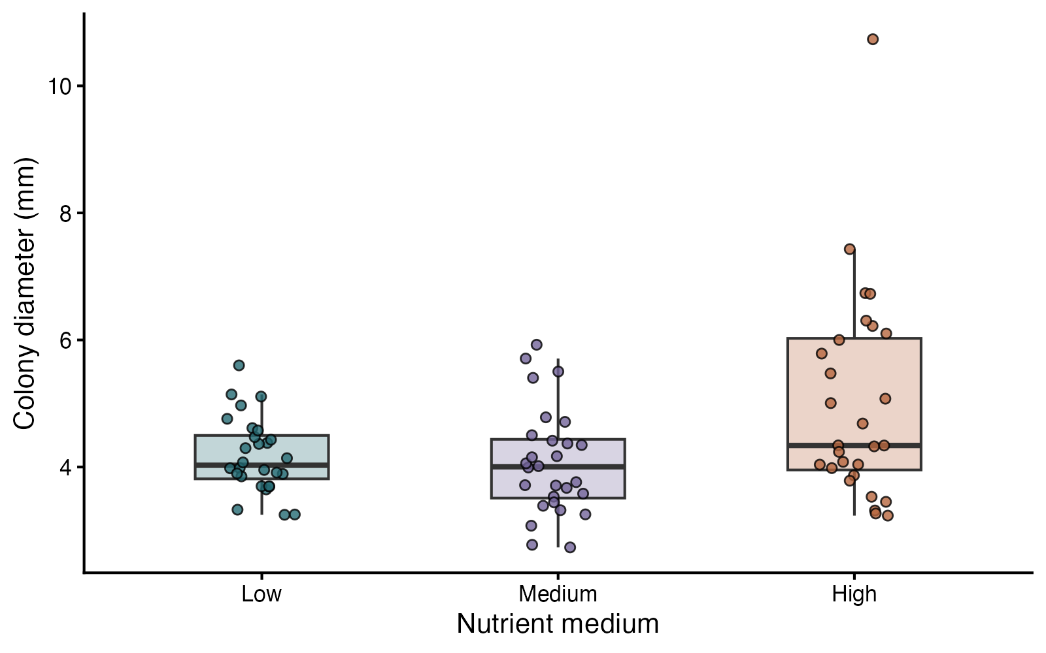
Levene / Brown–Forsythe: see the data
ggplot2 arguments
geom_boxplot / outlier.shape — Show spread without duplicating outlier points
geom_jitter / width — Retain individual observations
scale_fill_manual — Keep treatment colors consistent
theme_classic — Use clean axes and a white background
Levene and Brown–Forsythe tests — simulated biological data
Notes:
This figure is generated from the saved CSV by modules/levene/analysis.R. Median-centered Brown–Forsythe reduces sensitivity to long tails; it is not a required gate before Welch mean comparisons.

Slide 119
Levene / Brown–Forsythe: plot code
p <- ggplot(d, aes(medium, diameter_mm, fill = medium)) +
geom_boxplot(width = .45, alpha = .28, outlier.shape = NA) +
geom_jitter(width = .12, height = 0, shape = 21, size = 2.5, alpha = .8) +
scale_fill_manual(values = c("#246A73", "#73649A", "#B7663E")) +
labs(x = "Nutrient medium", y = "Colony diameter (mm)") +
theme_classic(base_size = 18) + theme(legend.position = "none")
print(p)
Arguments to change
geom_boxplot / outlier.shape — Show spread without duplicating outlier points
geom_jitter / width — Retain individual observations
scale_fill_manual — Keep treatment colors consistent
theme_classic — Use clean axes and a white background
Notes:
This is an exact excerpt from analysis.R. Any preparation referenced by the excerpt appears in the complete companion script. The script opens a ragg PNG device before these lines and closes it afterward.

Slide 120
Levene / Brown–Forsythe: question and null
Scientific question
Do population variances differ among nutrient media?
Null / estimation target
The groups have equal variances; the test compares absolute deviations from their group centers.
Relevant options
center = median gives Brown–Forsythe
center = mean gives original Levene
Treat the grouping variable as a factor
Notes:
Ask whether rejecting this null, or estimating this target, answers the biological question. Median-centered Brown–Forsythe reduces sensitivity to long tails; it is not a required gate before Welch mean comparisons.

Slide 121
Levene / Brown–Forsythe: assumptions
What matters here
Independent culture wells
Similar distribution shapes help a variance interpretation
Large differences in shape can also change absolute deviations
Parametric responses
For mean comparisons, Welch already allows unequal variance
Model unequal residual variances directly when needed
Nonparametric responses
Brown–Forsythe reduces sensitivity to tails
Bootstrap group SDs if uncertainty in spread is the objective
Notes:
Begin with the design. A model change should address a specific issue and preserve the scientific target where possible. A rank or permutation alternative has its own assumptions and may change the null; do not choose it solely from a normality-test p-value.

Slide 122
Levene / Brown–Forsythe: run and read
d$medium <- factor(d$medium, levels = c("Low", "Medium", "High"))
brown_forsythe <- leveneTest(diameter_mm ~ medium, data = d,
center = median)
original_levene <- leveneTest(diameter_mm ~ medium, data = d,
center = mean)
Generated results
Brown–Forsythe F = 5.55; df = 2, 81; p = 0.005524
Original Levene F = 9.72; p = 0.0001645
Observed group SDs: Low 0.59; Medium 0.84; High 1.64
Notes:
Full executed model/test output:
Levene's Test for Homogeneity of Variance (center = median)
Df F value Pr(>F)
group 2 5.5471 0.005524 **
81
---
Signif. codes: 0 ‘***’ 0.001 ‘**’ 0.01 ‘*’ 0.05 ‘.’ 0.1 ‘ ’ 1
Levene's Test for Homogeneity of Variance (center = mean)
Df F value Pr(>F)
group 2 9.7209 0.0001645 ***
81
---
Signif. codes: 0 ‘***’ 0.001 ‘**’ 0.01 ‘*’ 0.05 ‘.’ 0.1 ‘ ’ 1

Slide 123
Levene / Brown–Forsythe: interpret
The median-centered Brown–Forsythe comparison gave F(2, 81) = 5.55, p = 0.005524. Inspect the distributions as well as the p-value: the procedure compares absolute deviations, which can reflect both spread and shape.
Discuss: If the research question concerns mean diameter, should a significant spread test force a rank test?
Notes:
Teaching point: Median-centered Brown–Forsythe reduces sensitivity to long tails; it is not a required gate before Welch mean comparisons.
Instructor comparison with the simulated population: Group geometric means are 4 mm, but variances differ. Arithmetic means also vary slightly because log-normal means depend on log-scale spread.
The reported estimate and p-value are calculated from this realized dataset; they need not exactly match the known population effect.

Slide 124
One-way ANOVA: the data
Ecologists compare seedling biomass under three independent soil treatments.
One continuous response
Three or more independent groups
Compare population means
Other data like these
Mean development time across diets
Mean enzyme activity across treatments
Mean trait values across populations
Notes:
One-way ANOVA
Twenty-five independently assigned pots per soil treatment; one biomass value per pot.
soil: Assigned soil treatment (category)
biomass_g: Seedling biomass from one independent pot (g)

Slide 125
One-way ANOVA: simulate and save
set.seed(1117)
d <- data.frame(soil = rep(c("Sand", "Loam", "Clay"), each = 25),
biomass_g = c(rnorm(25, 4.5, .85), rnorm(25, 5.4, .85),
rnorm(25, 5.1, .85)))
write.csv(d, file.path(output_dir, "data.csv"), row.names = FALSE)
First saved row
soil: Sand
biomass_g: 1.987
Notes:
Seed: 1117
Generating model: 25 independent biomass values per soil come from normal distributions: Sand mean 4.5, Loam mean 5.4, Clay mean 5.1 g; every group has SD 0.85 g.
Population truth: The equal-means null is false. All three populations share variance 0.85 squared; Loam minus Sand is truly 0.9 g.
The script writes data.csv before reading it for analysis. output_dir or out_dir is the folder supplied to the standalone script.
Original saved-data preview:
soil biomass_g
Sand 1.986656
Sand 3.194575
Sand 3.816050
Sand 5.405235

Slide 126
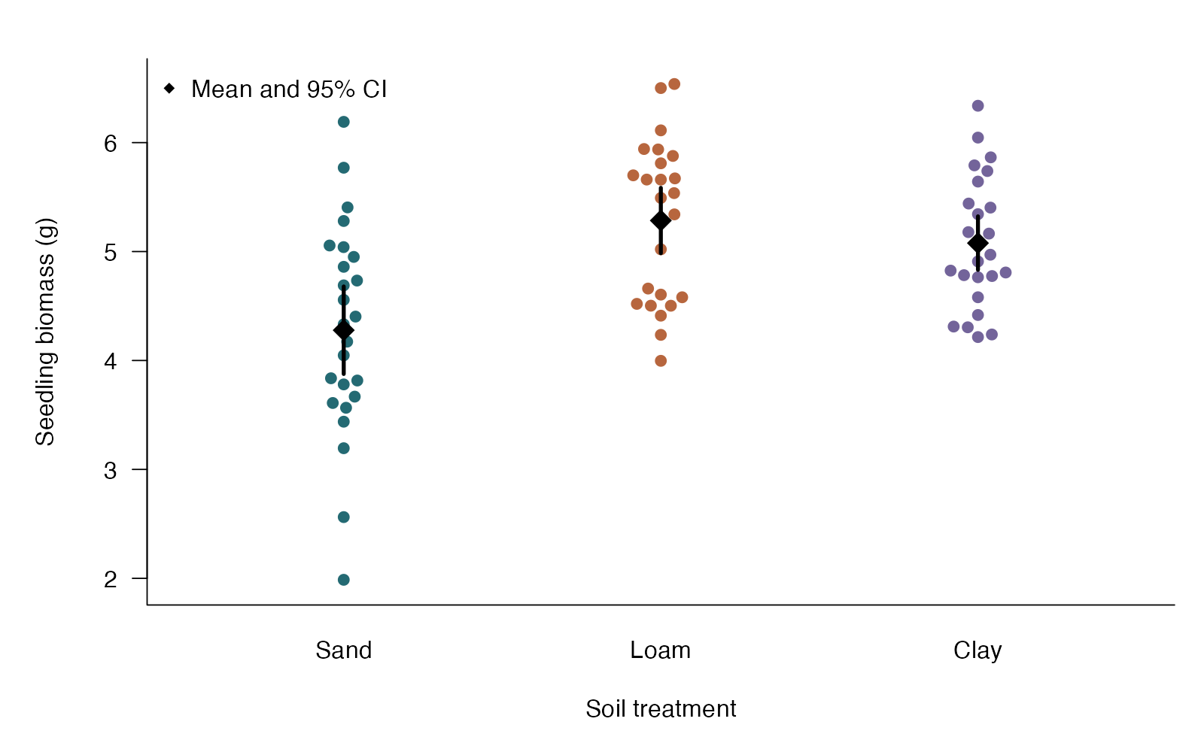
One-way ANOVA: see the data
beeswarm arguments
response ~ group — Arrange observations by treatment
bg — Use one persistent color per treatment
points — Mark group means
segments — Show clearly labeled confidence intervals for means
One-way ANOVA — simulated biological data
Notes:
This figure is generated from the saved CSV by modules/one_way_anova/analysis.R. The omnibus equal-means question differs from a scientific question about one particular contrast.

Slide 127
One-way ANOVA: plot code
beeswarm(biomass_g ~ soil, data = d, pch = 21,
bg = c("#246A73", "#B7663E", "#73649A"), col = "white", cex = 1.2,
xlab = "Soil treatment", ylab = "Seedling biomass (g)")
means <- tapply(d$biomass_g, d$soil, mean)
se <- tapply(d$biomass_g, d$soil, sd) / sqrt(table(d$soil))
half <- qt(.975, df = table(d$soil) - 1) * se
segments(1:3, means - half, 1:3, means + half, lwd = 3)
points(1:3, means, pch = 18, cex = 2)
legend("topleft", "Mean and 95% CI", pch = 18, bty = "n")
Arguments to change
response ~ group — Arrange observations by treatment
bg — Use one persistent color per treatment
points — Mark group means
segments — Show clearly labeled confidence intervals for means
Notes:
This is an exact excerpt from analysis.R. Any preparation referenced by the excerpt appears in the complete companion script. The script opens a ragg PNG device before these lines and closes it afterward.

Slide 128
One-way ANOVA: question and null
Scientific question
Are mean seedling biomasses equal across the three soils?
Null / estimation target
All soil-treatment population means are equal.
Relevant options
aov uses a shared within-group variance
oneway.test(var.equal = FALSE) uses Welch ANOVA
An omnibus result does not identify a particular pair
Notes:
Ask whether rejecting this null, or estimating this target, answers the biological question. The omnibus equal-means question differs from a scientific question about one particular contrast.

Slide 129
One-way ANOVA: assumptions
What matters here
Independent pots
Approximately normal errors, especially at small n
Ordinary ANOVA assumes equal group variances
Parametric responses
Welch ANOVA allows unequal group variances
Transform only if the new scale answers the scientific question
Nonparametric responses
Kruskal–Wallis compares group distributions using ranks
Use adjusted follow-up comparisons that match the chosen method
Notes:
Begin with the design. A model change should address a specific issue and preserve the scientific target where possible. A rank or permutation alternative has its own assumptions and may change the null; do not choose it solely from a normality-test p-value.

Slide 130
One-way ANOVA: run and read
d$soil <- factor(d$soil, levels = c("Sand", "Loam", "Clay"))
fit <- aov(biomass_g ~ soil, data = d)
anova_table <- summary(fit)[[1]]
welch <- oneway.test(biomass_g ~ soil, data = d,
var.equal = FALSE)
Generated results
Ordinary ANOVA F(2, 72) = 11.59; p = 4.335e-05
Welch ANOVA F = 8.89; denominator df = 46.37; p = 0.0005408
Observed means (g): Sand 4.28; Loam 5.28; Clay 5.08
Neither omnibus test identifies a specific differing pair.
Notes:
Full executed model/test output:
Df Sum Sq Mean Sq F value Pr(>F)
soil 2 14.14 7.068 11.59 4.34e-05 ***
Residuals 72 43.92 0.610
---
Signif. codes: 0 ‘***’ 0.001 ‘**’ 0.01 ‘*’ 0.05 ‘.’ 0.1 ‘ ’ 1
One-way analysis of means (not assuming equal variances)
data: biomass_g and soil
F = 8.8862, num df = 2.000, denom df = 46.371, p-value = 0.0005408

Slide 131
One-way ANOVA: interpret
Mean seedling biomass was compared across soils with ordinary ANOVA: F(2, 72) = 11.59, p = 4.335e-05. Welch ANOVA, which relaxes equal variances, gave p = 0.0005408. Use a planned contrast or adjusted pairwise comparisons to answer which means differ.
Discuss: If you care only about Loam versus Sand, what follow-up quantity should you estimate?
Notes:
Teaching point: The omnibus equal-means question differs from a scientific question about one particular contrast.
Instructor comparison with the simulated population: The equal-means null is false. All three populations share variance 0.85 squared; Loam minus Sand is truly 0.9 g.
The reported estimate and p-value are calculated from this realized dataset; they need not exactly match the known population effect.

Slide 132
Welch ANOVA: the data
Ecologists compare seedling biomass under three independent soil treatments.
Continuous response
Three or more independent groups
Unequal group variances and sizes allowed
Other data like these
Mean development time across diets
Mean enzyme activity across treatments
Mean trait values across populations
Notes:
Welch one-way ANOVA
Independent pots in three soil treatments; sample sizes and group variances differ.
soil: Assigned soil treatment (category)
biomass_g: Seedling biomass from one independent pot (g)

Slide 133
Welch ANOVA: simulate and save
set.seed(1119)
d <- data.frame(soil = rep(c("Sand", "Loam", "Clay"), c(20, 26, 32)),
biomass_g = c(rnorm(20, 4.5, .6), rnorm(26, 5.4, 1.1),
rnorm(32, 5.1, 1.5)))
write.csv(d, file.path(output_dir, "data.csv"), row.names = FALSE)
First saved row
soil: Sand
biomass_g: 4.656
Notes:
Seed: 1119
Generating model: Independent soil groups have different sample sizes and normal biomass distributions: Sand n=20, mean 4.5, SD 0.6; Loam n=26, mean 5.4, SD 1.1; Clay n=32, mean 5.1, SD 1.5.
Population truth: The true means differ, and variances differ (0.36, 1.21, and 2.25 g squared). Welch addresses the equal-means null without a shared variance.
The script writes data.csv before reading it for analysis. output_dir or out_dir is the folder supplied to the standalone script.
Original saved-data preview:
soil biomass_g
Sand 4.656127
Sand 4.690143
Sand 4.865685
Sand 4.259580

Slide 134
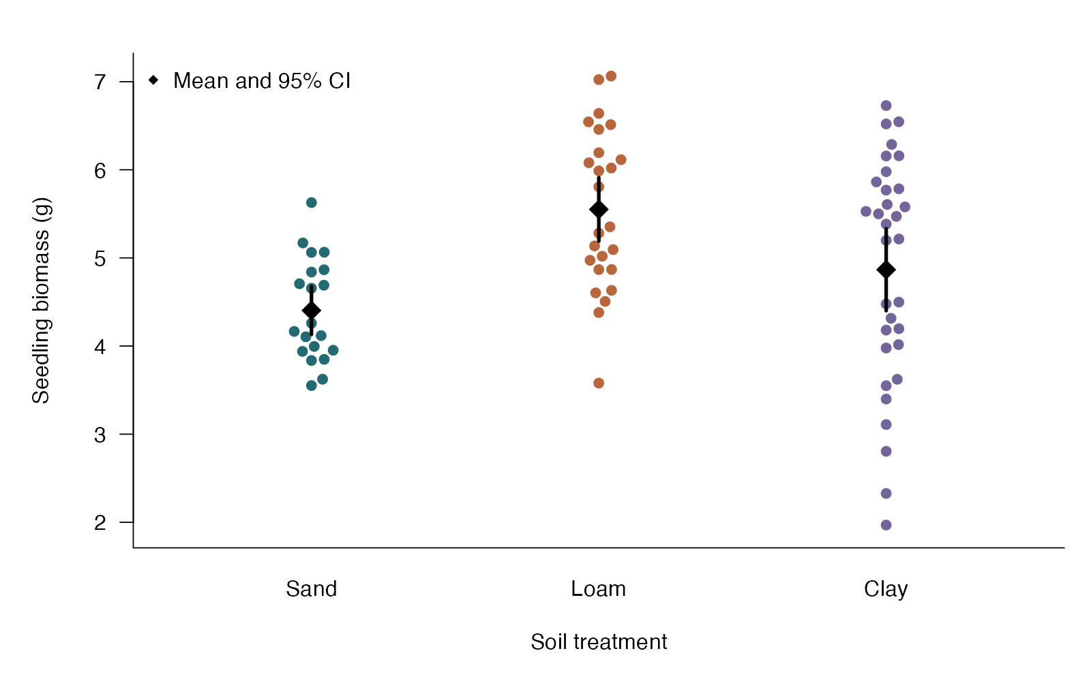
Welch ANOVA: see the data
beeswarm arguments
response ~ group — Arrange observations by treatment
bg — Use one persistent color per treatment
points — Mark group means
segments — Show clearly labeled confidence intervals for means
Welch one-way ANOVA — simulated biological data
Notes:
This figure is generated from the saved CSV by modules/welch_anova/analysis.R. Unequal variances have a parametric solution that preserves the scientific question about means.

Slide 135
Welch ANOVA: plot code
beeswarm(biomass_g ~ soil, data = d, pch = 21,
bg = c("#246A73", "#B7663E", "#73649A"), col = "white", cex = 1.2,
xlab = "Soil treatment", ylab = "Seedling biomass (g)")
means <- tapply(d$biomass_g, d$soil, mean)
se <- tapply(d$biomass_g, d$soil, sd) / sqrt(table(d$soil))
half <- qt(.975, df = table(d$soil) - 1) * se
segments(1:3, means - half, 1:3, means + half, lwd = 3)
points(1:3, means, pch = 18, cex = 2)
legend("topleft", "Mean and 95% CI", pch = 18, bty = "n")
Arguments to change
response ~ group — Arrange observations by treatment
bg — Use one persistent color per treatment
points — Mark group means
segments — Show clearly labeled confidence intervals for means
Notes:
This is an exact excerpt from analysis.R. Any preparation referenced by the excerpt appears in the complete companion script. The script opens a ragg PNG device before these lines and closes it afterward.

Slide 136
Welch ANOVA: question and null
Scientific question
Are mean seedling biomasses equal across the three soils?
Null / estimation target
All soil-treatment population means are equal.
Relevant options
oneway.test(…, var.equal = FALSE) uses Welch ANOVA
Factor levels define the groups
Use variance-robust follow-up comparisons for particular pairs
Notes:
Ask whether rejecting this null, or estimating this target, answers the biological question. Unequal variances have a parametric solution that preserves the scientific question about means.

Slide 137
Welch ANOVA: assumptions
What matters here
Independent pots
No severe outliers; approximately normal errors at small n
Group variances may differ
Parametric responses
Welch directly handles unequal variances
For adjusted pairwise means consider Games–Howell or planned robust contrasts
Nonparametric responses
Kruskal–Wallis tests group distributions, not the same mean null
A bootstrap approach can retain the mean target
Notes:
Begin with the design. A model change should address a specific issue and preserve the scientific target where possible. A rank or permutation alternative has its own assumptions and may change the null; do not choose it solely from a normality-test p-value.

Slide 138
Welch ANOVA: run and read
d$soil <- factor(d$soil, levels = c("Sand", "Loam", "Clay"))
fit <- oneway.test(biomass_g ~ soil, data = d,
var.equal = FALSE)
Generated results
Welch ANOVA F = 13.65; df = 2, 49.85; p = 1.873e-05
Group sample sizes: Sand 20; Loam 26; Clay 32
Observed means (g): Sand 4.4; Loam 5.55; Clay 4.87
Unequal variance is modeled; the omnibus test does not select a pair.
Notes:
Full executed model/test output:
One-way analysis of means (not assuming equal variances)
data: biomass_g and soil
F = 13.65, num df = 2.000, denom df = 49.854, p-value = 1.873e-05

Slide 139
Welch ANOVA: interpret
Welch ANOVA compared mean biomass across soils while allowing unequal variances: F(2, 49.85) = 13.65, p = 1.873e-05. This answers the same equal-means question as ordinary ANOVA; a specific pair requires an appropriate adjusted follow-up.
Discuss: Does unequal variance by itself require changing the scientific target from means to ranks?
Notes:
Teaching point: Unequal variances have a parametric solution that preserves the scientific question about means.
Instructor comparison with the simulated population: The true means differ, and variances differ (0.36, 1.21, and 2.25 g squared). Welch addresses the equal-means null without a shared variance.
The reported estimate and p-value are calculated from this realized dataset; they need not exactly match the known population effect.

Slide 140
Kruskal–Wallis: the data
Plant pathologists score leaf damage in three independently assigned pathogen treatments.
Ordered response or a continuous response
Three or more independent groups
An omnibus rank comparison
Other data like these
Skewed abundance across habitats
Disease-severity categories across treatments
Development time across diets
Notes:
Kruskal–Wallis test
Twenty-four independent plants per treatment; ordinal damage scores run from 0 to 8.
treatment: Assigned pathogen treatment (category)
damage: Ordered leaf-damage score (score 0 to 8)

Slide 141
Kruskal–Wallis: simulate and save
set.seed(1107)
d <- data.frame(treatment = rep(c("Control", "Strain A", "Strain B"), each = 24),
damage = c(rbinom(24, 8, .25), rbinom(24, 8, .40),
rbinom(24, 8, .58)))
write.csv(d, file.path(output_dir, "data.csv"), row.names = FALSE)
First saved row
treatment: Control
damage: 2
Notes:
Seed: 1107
Generating model: 24 independent plants per group receive binomial damage scores with 8 trials and probabilities 0.25 (Control), 0.40 (Strain A), and 0.58 (Strain B). The score is used as an ordered severity scale.
Population truth: The score distributions differ across all three generating probabilities; expected scores are 2.0, 3.2, and 4.64. The equal-distributions null is false.
The script writes data.csv before reading it for analysis. output_dir or out_dir is the folder supplied to the standalone script.
Original saved-data preview:
treatment damage
Control 2
Control 2
Control 4
Control 0

Slide 142
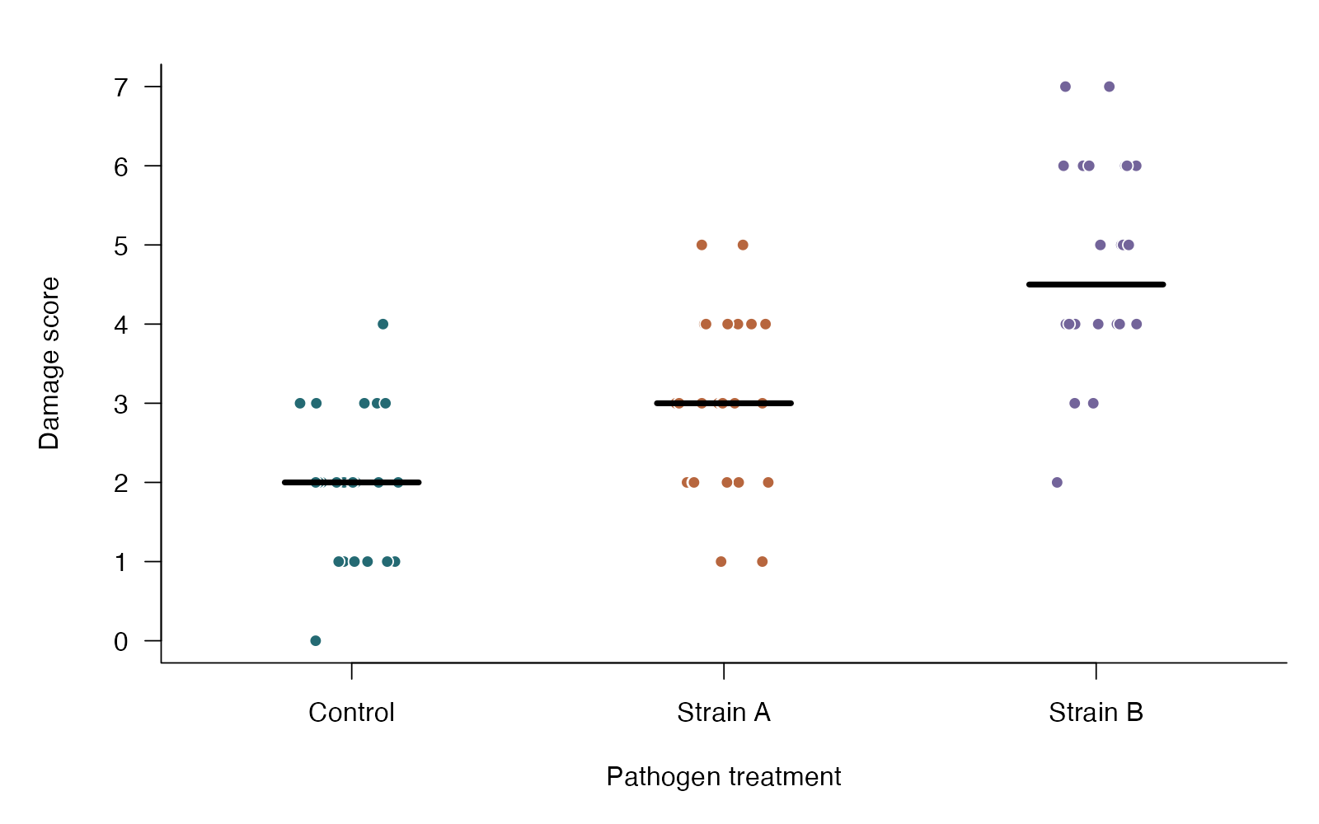
Kruskal–Wallis: see the data
base R arguments
jitter / amount — Separate tied points without changing scores
pch / col — Use group-specific point styling
axis — Display the actual ordered score values
segments — Add descriptive median marks
Kruskal–Wallis test — simulated biological data
Notes:
This figure is generated from the saved CSV by modules/kruskal_wallis/analysis.R. An omnibus rank result identifies a group-level difference without choosing a pair.

Slide 143
Kruskal–Wallis: plot code
x <- as.integer(d$treatment)
plot(jitter(x, amount = .14), d$damage, pch = 21,
bg = c("#246A73", "#B7663E", "#73649A")[x], col = "white",
xaxt = "n", yaxt = "n", xlim = c(.6, 3.4), xlab = "Pathogen treatment", ylab = "Damage score")
axis(1, 1:3, levels(d$treatment)); axis(2, 0:8)
med <- tapply(d$damage, d$treatment, median)
segments(1:3 - .18, med, 1:3 + .18, med, lwd = 4)
Arguments to change
jitter / amount — Separate tied points without changing scores
pch / col — Use group-specific point styling
axis — Display the actual ordered score values
segments — Add descriptive median marks
Notes:
This is an exact excerpt from analysis.R. Any preparation referenced by the excerpt appears in the complete companion script. The script opens a ragg PNG device before these lines and closes it afterward.

Slide 144
Kruskal–Wallis: question and null
Scientific question
Do damage-score distributions differ among pathogen treatments?
Null / estimation target
All groups share the same response distribution.
Relevant options
Response must have a meaningful order
kruskal.test applies a tie correction
Follow a relevant omnibus result with adjusted planned/Dunn comparisons
Notes:
Ask whether rejecting this null, or estimating this target, answers the biological question. An omnibus rank result identifies a group-level difference without choosing a pair.

Slide 145
Kruskal–Wallis: assumptions
What matters here
Independent plants
Groups defined before analysis
A common-shape shift model is needed for a median comparison
Parametric responses
Ordinal regression uses the score categories explicitly
Welch ANOVA handles unequal variances for a mean question
Nonparametric responses
Kruskal–Wallis extends rank-sum to several groups
Friedman handles complete matched blocks
Notes:
Begin with the design. A model change should address a specific issue and preserve the scientific target where possible. A rank or permutation alternative has its own assumptions and may change the null; do not choose it solely from a normality-test p-value.

Slide 146
Kruskal–Wallis: run and read
d$treatment <- factor(d$treatment, levels = c("Control", "Strain A", "Strain B"))
fit <- kruskal.test(damage ~ treatment, data = d)
Generated results
Kruskal–Wallis chi-square = 35.75; df = 2; p = 1.73e-08
Observed medians: Control 2; Strain A 3; Strain B 4.5
The omnibus result does not identify which pairs differ.
Notes:
Full executed model/test output:
Kruskal-Wallis rank sum test
data: damage by treatment
Kruskal-Wallis chi-squared = 35.745, df = 2, p-value = 1.73e-08

Slide 147
Kruskal–Wallis: interpret
Damage-score distributions were compared using Kruskal–Wallis: chi-square(2) = 35.75, p = 1.73e-08. An omnibus result concerns at least one group difference; it does not identify a particular pair or generally establish different medians.
Discuss: A small omnibus p-value appears. Can you conclude that Strain A differs from Strain B?
Notes:
Teaching point: An omnibus rank result identifies a group-level difference without choosing a pair.
Instructor comparison with the simulated population: The score distributions differ across all three generating probabilities; expected scores are 2.0, 3.2, and 4.64. The equal-distributions null is false.
The reported estimate and p-value are calculated from this realized dataset; they need not exactly match the known population effect.

Slide 148
Dunn comparisons: the data
Ecologists compare skewed leaf-damage measurements among four treatments.
Continuous or ordered response
Independent groups
Pairwise pooled-rank comparisons
Other data like these
Parasite burden across habitats
Ordered injury scores across treatments
Skewed behavioral responses across environments
Notes:
Dunn rank comparisons
21 independent leaves from different plants per treatment.
leaf: Independent leaf from a distinct plant (ID)
treatment: Treatment A–D (category)
damage: Area removed from a leaf (mm²)

Slide 149
Dunn comparisons: simulate and save
set.seed(2105)
d <- data.frame(leaf = 1:84,
treatment = rep(c("A", "B", "C", "D"), each = 21))
d$damage <- rlnorm(84, rep(c(1.2, 1.3, 1.7, 1.9), each = 21), .48)
write.csv(d, file.path(output_dir, "data.csv"), row.names = FALSE)
First saved row
leaf: 1
treatment: A
damage: 2.386
Notes:
Seed: 2105
Generating model: 21 independent leaves in each of four groups have log-normal damage. Log damage is Normal(mean, 0.48²), with means 1.2, 1.3, 1.7 and 1.9 for A–D. Damage remains positive and unrounded. All leaves come from different plants.
Population truth: Group distributions differ; their population medians are exp(1.2), exp(1.3), exp(1.7) and exp(1.9) mm². Dunn tests pooled-rank tendencies, not arithmetic mean equality. The distributions also differ in original-scale spread.
The script writes data.csv before reading it for analysis. output_dir or out_dir is the folder supplied to the standalone script.
Original saved-data preview:
leaf treatment damage
1 A 2.385584
2 A 5.565609
3 A 2.182752
4 A 6.045659

Slide 150
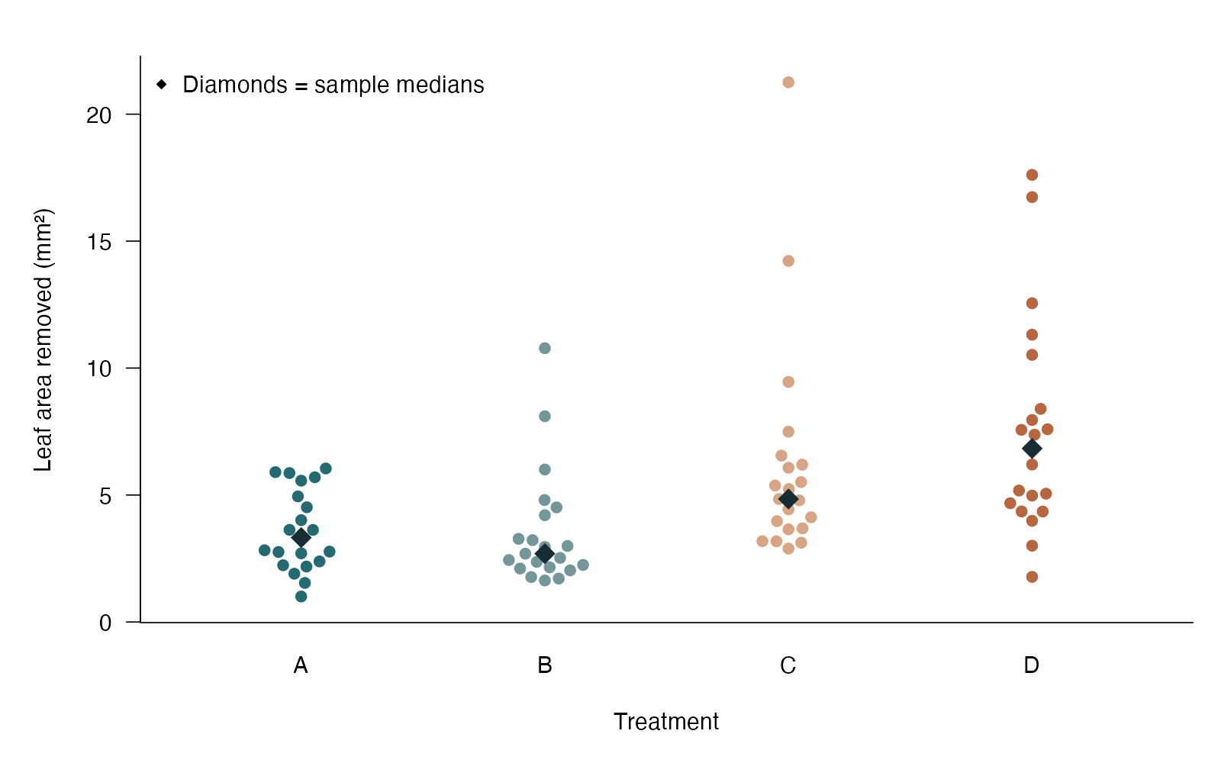
Dunn comparisons: see the data
beeswarm arguments
beeswarm — Show individual observations
bg — Color treatment groups
points — Add summary diamonds
ylab — Keep original measurement units
Dunn rank comparisons — simulated biological data
Notes:
This figure is generated from the saved CSV by modules/dunn/analysis.R. After choosing a rank question, retain multiplicity protection for pairwise follow-ups.

Slide 151
Dunn comparisons: plot code
par(mar = c(5, 5, 2, 1), las = 1, bty = "l", cex = 1.15)
beeswarm::beeswarm(damage ~ treatment, data = d,
pch = 21, bg = c("#246A73", "#73969B", "#D7A583", "#B7663E"),
col = "white", cex = 1.25, xlab = "Treatment",
ylab = "Leaf area removed (mm²)")
points(1:4, tapply(d$damage, d$treatment, median),
pch = 18, cex = 2, col = "#172D34")
legend("topleft", "Diamonds = sample medians", pch = 18, bty = "n")
Arguments to change
beeswarm — Show individual observations
bg — Color treatment groups
points — Add summary diamonds
ylab — Keep original measurement units
Notes:
This is an exact excerpt from analysis.R. Any preparation referenced by the excerpt appears in the complete companion script. The script opens a ragg PNG device before these lines and closes it afterward.

Slide 152
Dunn comparisons: question and null
Scientific question
Which pairs differ in their rank tendencies?
Null / estimation target
For a chosen pair, pooled-rank tendencies are equal under the common-distribution null.
Relevant options
method = “holm” adjusts the six comparisons
altp = TRUE prints ordinary two-sided p-values
kw = FALSE avoids repeating the omnibus calculation
Notes:
Ask whether rejecting this null, or estimating this target, answers the biological question. After choosing a rank question, retain multiplicity protection for pairwise follow-ups.

Slide 153
Dunn comparisons: assumptions
What matters here
Independent leaves/plants
Rankable observations
Comparable shapes are needed for a simple location interpretation
Parametric responses
If mean damage is the target, use an appropriate response model
Model scale changes rather than relabeling ranks as mean effects
Nonparametric responses
This is already a rank procedure
A design-valid permutation can use a different prespecified statistic
Notes:
Begin with the design. A model change should address a specific issue and preserve the scientific target where possible. A rank or permutation alternative has its own assumptions and may change the null; do not choose it solely from a normality-test p-value.

Slide 154
Dunn comparisons: run and read
overall <- kruskal.test(damage ~ treatment, data = d)
comparisons <- dunn.test::dunn.test(d$damage, d$treatment,
method = "holm", altp = TRUE, kw = FALSE, list = FALSE)
Generated results
Kruskal–Wallis p = 1.352e-05
Highlighted pair: B - D
Dunn z = -4.30
Two-sided Holm-adjusted p = 0.0001018
Notes:
Full executed model/test output:
Kruskal-Wallis rank sum test
data: damage by treatment
Kruskal-Wallis chi-squared = 25.276, df = 3, p-value = 1.352e-05
$chi2
[1] 25.27627
$Z
[1] 0.5693239 -2.5682832 -3.1376070 -3.7322342 -4.3015580 -1.1639510
$altP
[1] 5.691364e-01 1.022036e-02 1.703331e-03 1.897889e-04 1.696014e-05
[6] 2.444439e-01
$altP.adjusted
[1] 0.5691363809 0.0306610890 0.0068133231 0.0009489447 0.0001017608
[6] 0.4888877458
$comparisons
[1] "A - B" "A - C" "B - C" "A - D" "B - D" "C - D"

Slide 155
Dunn comparisons: interpret
Across the six rank comparisons, the highlighted B - D comparison had Dunn z = -4.30 and two-sided Holm-adjusted p = 0.0001018. This compares pooled rank tendencies; with unequal distribution shapes, it is not simply a test of equal medians. The smallest adjusted p-value is highlighted after protecting the full six-pair family.
Discuss: Can this result be reported as a difference in mean damage?
Notes:
Teaching point: After choosing a rank question, retain multiplicity protection for pairwise follow-ups.
Instructor comparison with the simulated population: Group distributions differ; their population medians are exp(1.2), exp(1.3), exp(1.7) and exp(1.9) mm². Dunn tests pooled-rank tendencies, not arithmetic mean equality. The distributions also differ in original-scale spread.
The reported estimate and p-value are calculated from this realized dataset; they need not exactly match the known population effect.

Slide 156
Tukey comparisons: the data
Plant growth is compared across four nutrient regimes.
Continuous response
Four independent groups
Define the comparison family
Other data like these
Growth among microbial media
Expression among genotypes
Fitness among environments
Notes:
Tukey / Tukey–Kramer comparisons
20 independent plants per regime; all procedures use the same simulated dataset.
plant: Independent plant identifier (ID)
nutrient: Nutrient regime A–D (category)
biomass: Dry biomass (g)

Slide 157
Tukey comparisons: simulate and save
set.seed(2104)
d <- data.frame(plant = 1:80,
nutrient = rep(c("A", "B", "C", "D"), each = 20))
d$biomass <- rnorm(80, rep(c(8, 9, 11.3, 12.1), each = 20), 1.7)
write.csv(d, file.path(output_dir, "data.csv"), row.names = FALSE)
First saved row
plant: 1
nutrient: A
biomass: 6.671
Notes:
Seed: 2104
Generating model: 20 independent plants per nutrient regime have normal biomass with means 8, 9, 11.3 and 12.1 g for A–D and a common SD of 1.7 g. Values are not rounded. The identical dataset is regenerated separately for each comparison procedure.
Population truth: Population means for A–D are 8, 9, 11.3 and 12.1 g; all distinct pairwise mean-equality nulls are false.
The script writes data.csv before reading it for analysis. output_dir or out_dir is the folder supplied to the standalone script.
Original saved-data preview:
plant nutrient biomass
1 A 6.670805
2 A 9.421266
3 A 6.285608
4 A 7.799042

Slide 158
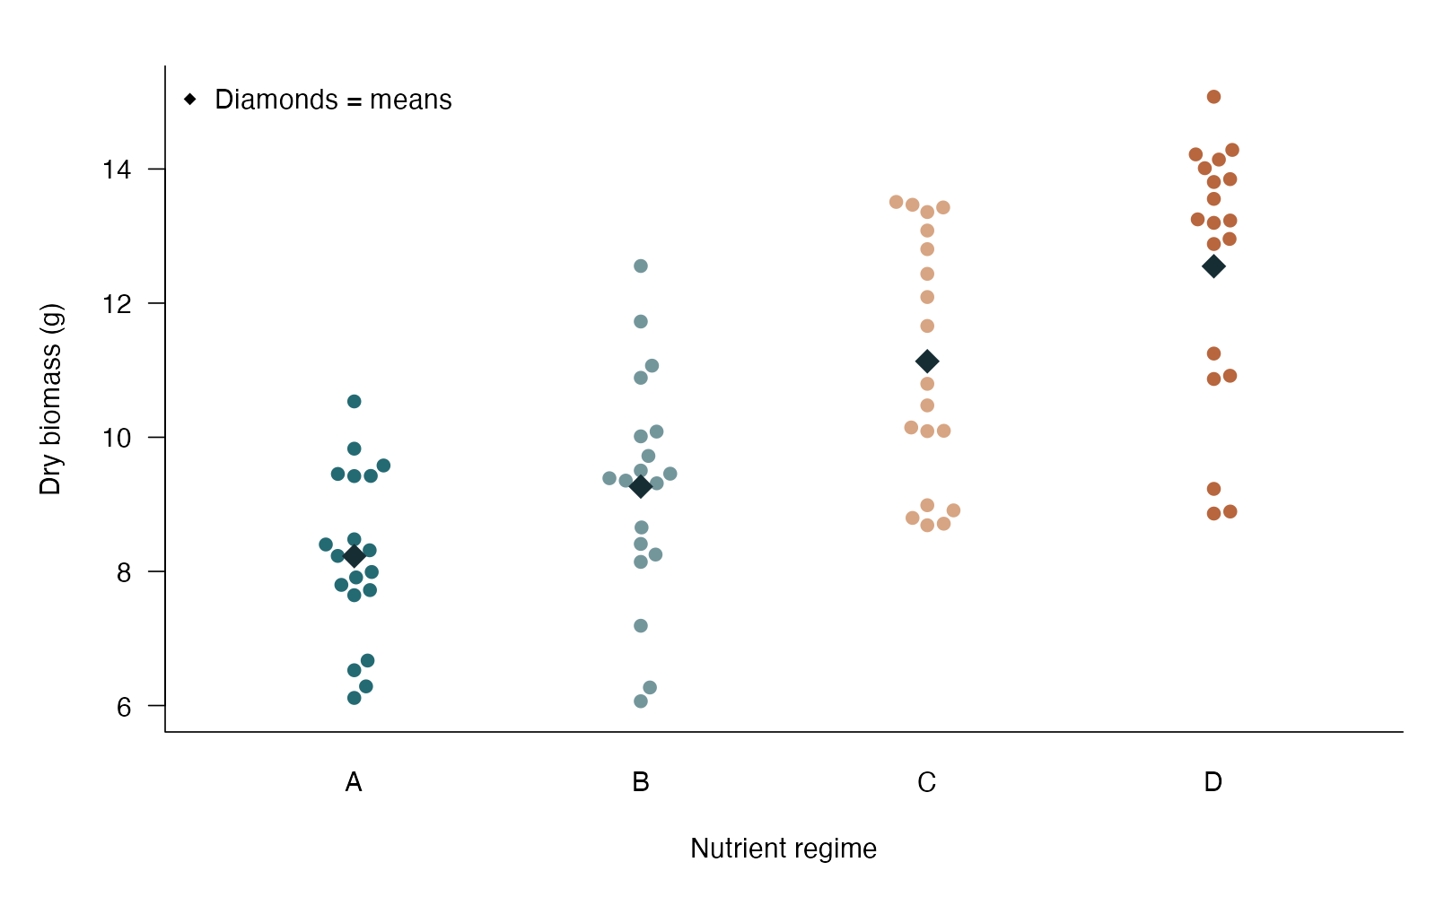
Tukey comparisons: see the data
beeswarm arguments
bg — Group fill colors
pch / cex — Point symbol and size
points — Add mean diamonds
xlab / ylab — Name groups and units
Tukey / Tukey–Kramer comparisons — simulated biological data
Notes:
This figure is generated from the saved CSV by modules/tukey/analysis.R. Protect the family of all six pairwise mean comparisons.

Slide 159
Tukey comparisons: plot code
par(mar = c(5, 5, 2, 1), las = 1, bty = "l", cex = 1.15)
beeswarm::beeswarm(biomass ~ nutrient, data = d,
pch = 21, bg = c("#246A73", "#73969B", "#D7A583", "#B7663E"),
col = "white", cex = 1.25, xlab = "Nutrient regime",
ylab = "Dry biomass (g)")
points(1:4, tapply(d$biomass, d$nutrient, mean),
pch = 18, cex = 2, col = "#172D34")
legend("topleft", "Diamonds = means", pch = 18, bty = "n")
Arguments to change
bg — Group fill colors
pch / cex — Point symbol and size
points — Add mean diamonds
xlab / ylab — Name groups and units
Notes:
This is an exact excerpt from analysis.R. Any preparation referenced by the excerpt appears in the complete companion script. The script opens a ragg PNG device before these lines and closes it afterward.

Slide 160
Tukey comparisons: question and null
Scientific question
Which pairs of nutrient means differ?
Null / estimation target
For each pair, the two population means are equal.
Relevant options
TukeyHSD requests all pairwise mean contrasts
conf.level sets simultaneous interval coverage
Unequal group sizes use the Tukey–Kramer adjustment
Notes:
Ask whether rejecting this null, or estimating this target, answers the biological question. Protect the family of all six pairwise mean comparisons.

Slide 161
Tukey comparisons: assumptions
What matters here
Independent plants
ANOVA residual assumptions and common variance
Specify the family of comparisons
Parametric responses
Use appropriate unequal-variance comparisons when needed
Fit a justified response model before forming contrasts
Nonparametric responses
Dunn compares pooled ranks with an explicit adjustment
Rank comparisons change the target from means
Notes:
Begin with the design. A model change should address a specific issue and preserve the scientific target where possible. A rank or permutation alternative has its own assumptions and may change the null; do not choose it solely from a normality-test p-value.

Slide 162
Tukey comparisons: run and read
fit <- aov(biomass ~ nutrient, data = d)
comparisons <- TukeyHSD(fit, "nutrient", conf.level = .95)
comparisons
Generated results
Family: all six pairwise nutrient comparisons
D minus C = 1.42 g
Simultaneous 95% CI 0.04 to 2.80
Tukey-adjusted p = 0.0415
Notes:
Full executed model/test output:
Df Sum Sq Mean Sq F value Pr(>F)
nutrient 3 222.4 74.14 26.94 5.68e-12 ***
Residuals 76 209.2 2.75
---
Signif. codes: 0 ‘***’ 0.001 ‘**’ 0.01 ‘*’ 0.05 ‘.’ 0.1 ‘ ’ 1
Tukey multiple comparisons of means
95% family-wise confidence level
Fit: aov(formula = biomass ~ nutrient, data = d)
$nutrient
diff lwr upr p adj
B-A 1.037343 -0.34073261 2.415418 0.2056314
C-A 2.905036 1.52696022 4.283111 0.0000025
D-A 4.322102 2.94402599 5.700177 0.0000000
C-B 1.867693 0.48961729 3.245768 0.0035291
D-B 3.284759 1.90668306 4.662834 0.0000001
D-C 1.417066 0.03899023 2.795141 0.0415003

Slide 163
Tukey comparisons: interpret
Regime D exceeded C by 1.42 g (simultaneous 95% CI 0.04 to 2.80; Tukey-adjusted p = 0.0415). The interval and p-value account for all six pairwise comparisons; they do not protect every possible weighted contrast.
Discuss: Why is the adjusted p-value different from a single unadjusted t test?
Notes:
Teaching point: Protect the family of all six pairwise mean comparisons.
Instructor comparison with the simulated population: Population means for A–D are 8, 9, 11.3 and 12.1 g; all distinct pairwise mean-equality nulls are false.
The reported estimate and p-value are calculated from this realized dataset; they need not exactly match the known population effect.

Slide 164
Fisher LSD: the data
Plant growth is compared across four nutrient regimes.
Continuous response
Four independent groups
Define the comparison family
Other data like these
Growth among microbial media
Expression among genotypes
Fitness among environments
Notes:
Fisher least significant difference
20 independent plants per regime; all procedures use the same simulated dataset.
plant: Independent plant identifier (ID)
nutrient: Nutrient regime A–D (category)
biomass: Dry biomass (g)

Slide 165
Fisher LSD: simulate and save
set.seed(2104)
d <- data.frame(plant = 1:80,
nutrient = rep(c("A", "B", "C", "D"), each = 20))
d$biomass <- rnorm(80, rep(c(8, 9, 11.3, 12.1), each = 20), 1.7)
write.csv(d, file.path(output_dir, "data.csv"), row.names = FALSE)
First saved row
plant: 1
nutrient: A
biomass: 6.671
Notes:
Seed: 2104
Generating model: 20 independent plants per nutrient regime have normal biomass with means 8, 9, 11.3 and 12.1 g for A–D and a common SD of 1.7 g. Values are not rounded. The identical dataset is regenerated separately for each comparison procedure.
Population truth: Population means for A–D are 8, 9, 11.3 and 12.1 g; all distinct pairwise mean-equality nulls are false.
The script writes data.csv before reading it for analysis. output_dir or out_dir is the folder supplied to the standalone script.
Original saved-data preview:
plant nutrient biomass
1 A 6.670805
2 A 9.421266
3 A 6.285608
4 A 7.799042

Slide 166
Fisher LSD: see the data
beeswarm arguments
bg — Group fill colors
pch / cex — Point symbol and size
points — Add mean diamonds
xlab / ylab — Name groups and units
Fisher least significant difference — simulated biological data
Notes:
This figure is generated from the saved CSV by modules/fisher_lsd/analysis.R. An omnibus gate plus unadjusted comparisons is not general all-pairs protection.

Slide 167
Fisher LSD: plot code
par(mar = c(5, 5, 2, 1), las = 1, bty = "l", cex = 1.15)
beeswarm::beeswarm(biomass ~ nutrient, data = d,
pch = 21, bg = c("#246A73", "#73969B", "#D7A583", "#B7663E"),
col = "white", cex = 1.25, xlab = "Nutrient regime",
ylab = "Dry biomass (g)")
points(1:4, tapply(d$biomass, d$nutrient, mean),
pch = 18, cex = 2, col = "#172D34")
legend("topleft", "Diamonds = means", pch = 18, bty = "n")
Arguments to change
bg — Group fill colors
pch / cex — Point symbol and size
points — Add mean diamonds
xlab / ylab — Name groups and units
Notes:
This is an exact excerpt from analysis.R. Any preparation referenced by the excerpt appears in the complete companion script. The script opens a ragg PNG device before these lines and closes it afterward.

Slide 168
Fisher LSD: question and null
Scientific question
What does an unadjusted pairwise comparison after the ANOVA gate test?
Null / estimation target
For a chosen pair, the two population means are equal.
Relevant options
The omnibus ANOVA is the protected-LSD gate
adjust = “none” gives individual pairwise inference
Use the shared ANOVA residual variance
Notes:
Ask whether rejecting this null, or estimating this target, answers the biological question. An omnibus gate plus unadjusted comparisons is not general all-pairs protection.

Slide 169
Fisher LSD: assumptions
What matters here
Independent plants and common residual variance
Appropriate normal-error model
The gate does not guarantee broad familywise protection
Parametric responses
Tukey protects the all-pairs comparison family
Use planned contrasts with a justified adjustment
Nonparametric responses
Dunn plus adjustment addresses rank comparisons
Switching to ranks does not remove multiplicity
Notes:
Begin with the design. A model change should address a specific issue and preserve the scientific target where possible. A rank or permutation alternative has its own assumptions and may change the null; do not choose it solely from a normality-test p-value.

Slide 170
Fisher LSD: run and read
fit <- lm(biomass ~ nutrient, data = d)
omnibus_p <- anova(fit)$`Pr(>F)`[1]
means <- emmeans::emmeans(fit, ~ nutrient)
comparisons <- NULL
if (omnibus_p < .05) {
comparisons <- summary(emmeans::contrast(means, "pairwise"),
infer = c(TRUE, TRUE), adjust = "none")
}
Generated results
Omnibus p = 5.683e-12
A - B = -1.04 g
Individual 95% CI -2.08 to 0.01
Unadjusted p = 0.05163
Protected LSD first requires a significant omnibus test.
Notes:
Full executed model/test output:
Call:
lm(formula = biomass ~ nutrient, data = d)
Residuals:
Min 1Q Median 3Q Max
-3.6874 -1.0377 0.1064 1.2669 3.2888
Coefficients:
Estimate Std. Error t value Pr(>|t|)
(Intercept) 8.2277 0.3710 22.179 < 2e-16 ***
nutrientB 1.0373 0.5246 1.977 0.0516 .
nutrientC 2.9050 0.5246 5.537 4.21e-07 ***
nutrientD 4.3221 0.5246 8.239 3.85e-12 ***
---
Signif. codes: 0 ‘***’ 0.001 ‘**’ 0.01 ‘*’ 0.05 ‘.’ 0.1 ‘ ’ 1
Residual standard error: 1.659 on 76 degrees of freedom
Multiple R-squared: 0.5153, Adjusted R-squared: 0.4962
F-statistic: 26.94 on 3 and 76 DF, p-value: 5.683e-12
contrast estimate SE df lower.CL upper.CL t.ratio p.value
A - B -1.04 0.525 76 -2.08 0.00753 -1.977 0.0516
A - C -2.91 0.525 76 -3.95 -1.86016 -5.537 <0.0001
A - D -4.32 0.525 76 -5.37 -3.27723 -8.239 <0.0001
B - C -1.87 0.525 76 -2.91 -0.82282 -3.560 0.0006
B - D -3.28 0.525 76 -4.33 -2.23988 -6.261 <0.0001
C - D -1.42 0.525 76 -2.46 -0.37219 -2.701 0.0085
Confidence level used: 0.95

Slide 171
Fisher LSD: interpret
The omnibus test had p = 5.683e-12, so the protected LSD gate is passed in this example. The A - B difference was -1.04 g (individual 95% CI -2.08 to 0.01; unadjusted p = 0.05163). This gate does not generally protect all pairwise decisions when some of four or more means differ; use Tukey for the all-pairs family.
Discuss: What protection does the word “protected” fail to guarantee?
Notes:
Teaching point: An omnibus gate plus unadjusted comparisons is not general all-pairs protection.
Instructor comparison with the simulated population: Population means for A–D are 8, 9, 11.3 and 12.1 g; all distinct pairwise mean-equality nulls are false.
The reported estimate and p-value are calculated from this realized dataset; they need not exactly match the known population effect.

Slide 172
Scheffé contrasts: the data
Plant growth is compared across four nutrient regimes.
Continuous response
Four independent groups
Define the comparison family
Other data like these
Growth among microbial media
Expression among genotypes
Fitness among environments
Notes:
Scheffé contrasts
20 independent plants per regime; all procedures use the same simulated dataset.
plant: Independent plant identifier (ID)
nutrient: Nutrient regime A–D (category)
biomass: Dry biomass (g)

Slide 173
Scheffé contrasts: simulate and save
set.seed(2104)
d <- data.frame(plant = 1:80,
nutrient = rep(c("A", "B", "C", "D"), each = 20))
d$biomass <- rnorm(80, rep(c(8, 9, 11.3, 12.1), each = 20), 1.7)
write.csv(d, file.path(output_dir, "data.csv"), row.names = FALSE)
First saved row
plant: 1
nutrient: A
biomass: 6.671
Notes:
Seed: 2104
Generating model: 20 independent plants per nutrient regime have normal biomass with means 8, 9, 11.3 and 12.1 g for A–D and a common SD of 1.7 g. Values are not rounded. The identical dataset is regenerated separately for each comparison procedure.
Population truth: Population means for A–D are 8, 9, 11.3 and 12.1 g; all distinct pairwise mean-equality nulls are false. The specified (C+D)/2 − (A+B)/2 contrast equals 3.2 g.
The script writes data.csv before reading it for analysis. output_dir or out_dir is the folder supplied to the standalone script.
Original saved-data preview:
plant nutrient biomass
1 A 6.670805
2 A 9.421266
3 A 6.285608
4 A 7.799042

Slide 174
Scheffé contrasts: see the data
beeswarm arguments
bg — Group fill colors
pch / cex — Point symbol and size
points — Add mean diamonds
xlab / ylab — Name groups and units
Scheffé contrasts — simulated biological data
Notes:
This figure is generated from the saved CSV by modules/scheffe/analysis.R. A weighted contrast asks a specific biological question; Scheffé protects the larger all-contrast family.

Slide 175
Scheffé contrasts: plot code
par(mar = c(5, 5, 2, 1), las = 1, bty = "l", cex = 1.15)
beeswarm::beeswarm(biomass ~ nutrient, data = d,
pch = 21, bg = c("#246A73", "#73969B", "#D7A583", "#B7663E"),
col = "white", cex = 1.25, xlab = "Nutrient regime",
ylab = "Dry biomass (g)")
points(1:4, tapply(d$biomass, d$nutrient, mean),
pch = 18, cex = 2, col = "#172D34")
legend("topleft", "Diamonds = means", pch = 18, bty = "n")
Arguments to change
bg — Group fill colors
pch / cex — Point symbol and size
points — Add mean diamonds
xlab / ylab — Name groups and units
Notes:
This is an exact excerpt from analysis.R. Any preparation referenced by the excerpt appears in the complete companion script. The script opens a ragg PNG device before these lines and closes it afterward.

Slide 176
Scheffé contrasts: question and null
Scientific question
Does the average of regimes C and D differ from the average of A and B?
Null / estimation target
The contrast (μC + μD)/2 − (μA + μB)/2 is zero.
Relevant options
Contrast weights sum to zero
adjust = “scheffe” protects a contrast family
scheffe.rank = 3 covers all contrasts of four means
Notes:
Ask whether rejecting this null, or estimating this target, answers the biological question. A weighted contrast asks a specific biological question; Scheffé protects the larger all-contrast family.

Slide 177
Scheffé contrasts: assumptions
What matters here
Independent plants
Normal-error ANOVA model with common variance
Specify the means and contrast family
Parametric responses
Tukey is focused on pairwise comparisons
A smaller prespecified contrast family can use a targeted adjustment
Nonparametric responses
A contrast-specific permutation must preserve the design
Dunn comparisons do not test this weighted mean contrast
Notes:
Begin with the design. A model change should address a specific issue and preserve the scientific target where possible. A rank or permutation alternative has its own assumptions and may change the null; do not choose it solely from a normality-test p-value.

Slide 178
Scheffé contrasts: run and read
fit <- lm(biomass ~ nutrient, data = d)
means <- emmeans::emmeans(fit, ~ nutrient)
contrast <- emmeans::contrast(means,
list("CD average minus AB average" = c(-.5, -.5, .5, .5)))
comparison <- summary(contrast, infer = c(TRUE, TRUE),
adjust = "scheffe", scheffe.rank = 3)
Generated results
Contrast: (C + D)/2 − (A + B)/2
Estimated difference = 3.09 g
Scheffé 95% CI 2.03 to 4.16
Scheffé-adjusted p = 9.177e-11
Notes:
Full executed model/test output:
Call:
lm(formula = biomass ~ nutrient, data = d)
Residuals:
Min 1Q Median 3Q Max
-3.6874 -1.0377 0.1064 1.2669 3.2888
Coefficients:
Estimate Std. Error t value Pr(>|t|)
(Intercept) 8.2277 0.3710 22.179 < 2e-16 ***
nutrientB 1.0373 0.5246 1.977 0.0516 .
nutrientC 2.9050 0.5246 5.537 4.21e-07 ***
nutrientD 4.3221 0.5246 8.239 3.85e-12 ***
---
Signif. codes: 0 ‘***’ 0.001 ‘**’ 0.01 ‘*’ 0.05 ‘.’ 0.1 ‘ ’ 1
Residual standard error: 1.659 on 76 degrees of freedom
Multiple R-squared: 0.5153, Adjusted R-squared: 0.4962
F-statistic: 26.94 on 3 and 76 DF, p-value: 5.683e-12
contrast estimate SE df lower.CL upper.CL t.ratio
CD average minus AB average 3.09 0.371 76 2.03 4.16 8.343
p.value
<0.0001
Confidence level used: 0.95
Conf-level adjustment: scheffe method with rank 3
P value adjustment: scheffe method with rank 3

Slide 179
Scheffé contrasts: interpret
The average of regimes C and D exceeded the average of A and B by 3.09 g (Scheffé simultaneous 95% CI 2.03 to 4.16; adjusted p = 9.177e-11). Using rank 3 protects all mean contrasts among these four groups, a larger family than the pairwise comparisons protected by Tukey.
Discuss: Why can broader protection make an interval wider?
Notes:
Teaching point: A weighted contrast asks a specific biological question; Scheffé protects the larger all-contrast family.
Instructor comparison with the simulated population: Population means for A–D are 8, 9, 11.3 and 12.1 g; all distinct pairwise mean-equality nulls are false. The specified (C+D)/2 − (A+B)/2 contrast equals 3.2 g.
The reported estimate and p-value are calculated from this realized dataset; they need not exactly match the known population effect.

Slide 180
Factorial ANOVA: the data
Beetle larvae from two genotypes are independently reared at two temperatures.
Continuous response: growth
Two categorical predictors
Independent treatment combinations
Other data like these
Genotype × nutrient effects on biomass
Drug × pathogen strain effects
Light × water effects on photosynthesis
Notes:
Factorial ANOVA: interactions
22 independent larvae per genotype × temperature combination.
replicate: Larva number within a genotype/temperature combination (ID)
genotype: Genotype A or B (category)
heat: Cool or warm rearing condition (category)
growth: Larval growth rate (mg/week)

Slide 181
Factorial ANOVA: simulate and save
set.seed(2101)
d <- expand.grid(replicate = 1:22, genotype = c("A", "B"),
heat = c("Cool", "Warm"))
d$growth <- with(d, 14 + 1.4 * (genotype == "B") +
2 * (heat == "Warm") + 2.3 * (genotype == "B" & heat == "Warm") +
rnorm(nrow(d), 0, 2.1))
write.csv(d, file.path(output_dir, "data.csv"), row.names = FALSE)
First saved row
replicate: 1
genotype: A
heat: Cool
growth: 16.71
Notes:
Seed: 2101
Generating model: There are 22 larvae in each of four genotype-by-temperature combinations. Growth = 14 + 1.4 if genotype B + 2 if warm + 2.3 if both genotype B and warm + independent Normal(0, 2.1²) error, in mg/week. Values are not rounded.
Population truth: The temperature effect is 2 mg/week in genotype A and 4.3 mg/week in B, so the interaction is 2.3 mg/week. The interaction null is false.
The script writes data.csv before reading it for analysis. output_dir or out_dir is the folder supplied to the standalone script.
Original saved-data preview:
replicate genotype heat growth
1 A Cool 16.70898
2 A Cool 13.52018
3 A Cool 15.58859
4 A Cool 14.19103

Slide 182
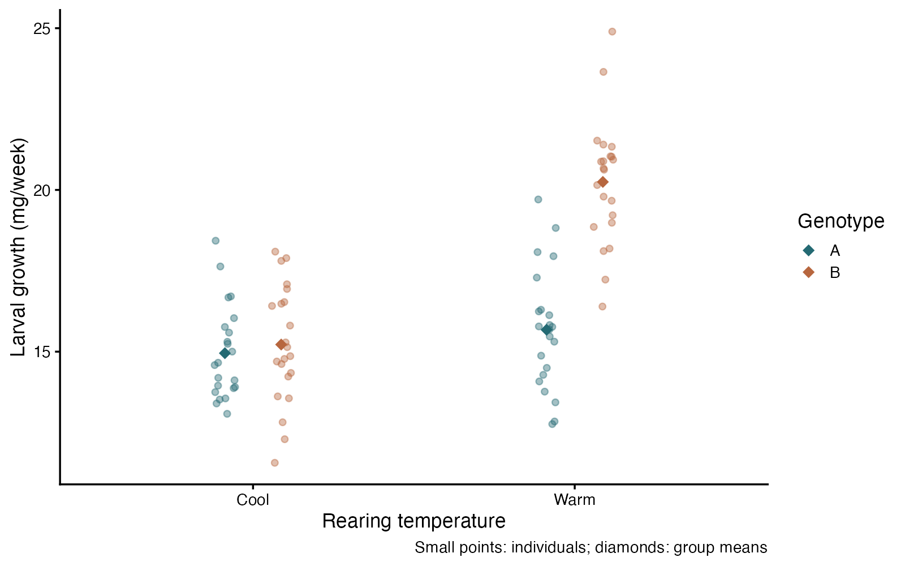
Factorial ANOVA: see the data
ggplot2 arguments
position_jitterdodge — Separate raw points within groups
alpha — Reduce point overlap
stat_summary(fun = mean) — Mark each mean
shape — Use diamonds for summaries
Factorial ANOVA: interactions — simulated biological data
Notes:
This figure is generated from the saved CSV by modules/factorial_anova/analysis.R. An interaction is a difference of differences: a main-effect summary can conceal it.

Slide 183
Factorial ANOVA: plot code
p <- ggplot(d, aes(heat, growth, color = genotype)) +
geom_point(position = position_jitterdodge(jitter.width = .13,
dodge.width = .35, seed = 21), alpha = .42, size = 2) +
stat_summary(fun = mean, geom = "point",
position = position_dodge(.35), size = 4, shape = 18) +
scale_color_manual(values = c("#246A73", "#B7663E")) +
labs(x = "Rearing temperature", y = "Larval growth (mg/week)",
color = "Genotype", caption = "Small points: individuals; diamonds: group means") +
theme_classic(base_size = 16)
print(p)
Arguments to change
position_jitterdodge — Separate raw points within groups
alpha — Reduce point overlap
stat_summary(fun = mean) — Mark each mean
shape — Use diamonds for summaries
Notes:
This is an exact excerpt from analysis.R. Any preparation referenced by the excerpt appears in the complete companion script. The script opens a ragg PNG device before these lines and closes it afterward.

Slide 184
Factorial ANOVA: question and null
Scientific question
Does the temperature effect on mean growth depend on genotype?
Null / estimation target
The warm-minus-cool mean growth difference is the same for genotypes A and B.
Relevant options
genotype * heat includes both main effects and their interaction
The interaction coefficient is a difference of differences
Factor levels define the reference comparison
Notes:
Ask whether rejecting this null, or estimating this target, answers the biological question. An interaction is a difference of differences: a main-effect summary can conceal it.

Slide 185
Factorial ANOVA: assumptions
What matters here
Independent larvae
Appropriate residual distribution and comparable residual spread
Replicate each treatment combination
Parametric responses
Model unequal residual spread if needed
Transform only when the transformed mean answers the question
Nonparametric responses
A factorial permutation must preserve the design and tested term
Separate rank tests do not test the interaction
Notes:
Begin with the design. A model change should address a specific issue and preserve the scientific target where possible. A rank or permutation alternative has its own assumptions and may change the null; do not choose it solely from a normality-test p-value.

Slide 186
Factorial ANOVA: run and read
fit <- lm(growth ~ genotype * heat, data = d)
summary(fit)
interaction_ci <- confint(fit)["genotypeB:heatWarm", ]
Generated results
Interaction = 4.30 mg/week
95% CI 2.80 to 5.81
t(84) = 5.69; p = 1.78e-07
Notes:
Full executed model/test output:
Call:
lm(formula = growth ~ genotype * heat, data = d)
Residuals:
Min 1Q Median 3Q Max
-3.8521 -1.1843 -0.0363 1.0850 4.6476
Coefficients:
Estimate Std. Error t value Pr(>|t|)
(Intercept) 14.9526 0.3779 39.567 < 2e-16 ***
genotypeB 0.2676 0.5344 0.501 0.618
heatWarm 0.7240 0.5344 1.355 0.179
genotypeB:heatWarm 4.3035 0.7558 5.694 1.78e-07 ***
---
Signif. codes: 0 ‘***’ 0.001 ‘**’ 0.01 ‘*’ 0.05 ‘.’ 0.1 ‘ ’ 1
Residual standard error: 1.773 on 84 degrees of freedom
Multiple R-squared: 0.6099, Adjusted R-squared: 0.5959
F-statistic: 43.77 on 3 and 84 DF, p-value: < 2.2e-16

Slide 187
Factorial ANOVA: interpret
The warm-minus-cool growth effect was 4.30 mg/week greater in genotype B than A (95% CI 2.80 to 5.81; p = 1.78e-07). The interaction asks whether the temperature effect depends on genotype; a single average temperature effect would hide this difference.
Discuss: Explain the interaction in words before reading its p-value.
Notes:
Teaching point: An interaction is a difference of differences: a main-effect summary can conceal it.
Instructor comparison with the simulated population: The temperature effect is 2 mg/week in genotype A and 4.3 mg/week in B, so the interaction is 2.3 mg/week. The interaction null is false.
The reported estimate and p-value are calculated from this realized dataset; they need not exactly match the known population effect.

Slide 188
ANCOVA: the data
Plant ecologists compare nutrient treatment while accounting for initial plant height.
Continuous response
One factor plus a quantitative covariate
An adjusted mean comparison
Other data like these
Group morphology adjusted for body size
Enzyme activity adjusted for temperature
Fitness adjusted for initial mass
Notes:
ANCOVA: an adjusted group comparison
90 independent plants; treatment groups overlap in initial height.
plant: Independent plant identifier (ID)
treatment: Control or nutrient addition (category)
initial: Height before treatment (cm)
biomass: Final dry biomass (g)

Slide 189
ANCOVA: simulate and save
set.seed(2102)
d <- data.frame(plant = 1:90, treatment = rep(c("Control", "Nutrient"), each = 45),
initial = runif(90, 3, 9))
d$biomass <- with(d, 2 + 1.5 * initial +
2.4 * (treatment == "Nutrient") + rnorm(90, 0, 1.8))
write.csv(d, file.path(output_dir, "data.csv"), row.names = FALSE)
First saved row
plant: 1
treatment: Control
initial: 5.71
biomass: 11.32
Notes:
Seed: 2102
Generating model: 45 independent plants are assigned to each treatment. Initial height is Uniform(3, 9) cm. Biomass = 2 + 1.5 × initial height + 2.4 if nutrient-treated + independent Normal(0, 1.8²) error, in g. No rounding is applied.
Population truth: The nutrient treatment increases the population mean biomass by 2.4 g at any shared initial height. Both groups have slope 1.5 g/cm. The adjusted treatment null is false.
The script writes data.csv before reading it for analysis. output_dir or out_dir is the folder supplied to the standalone script.
Original saved-data preview:
plant treatment initial biomass
1 Control 5.709542 11.31708
2 Control 7.877332 12.85633
3 Control 4.503380 11.12236
4 Control 5.569663 12.57494

Slide 190
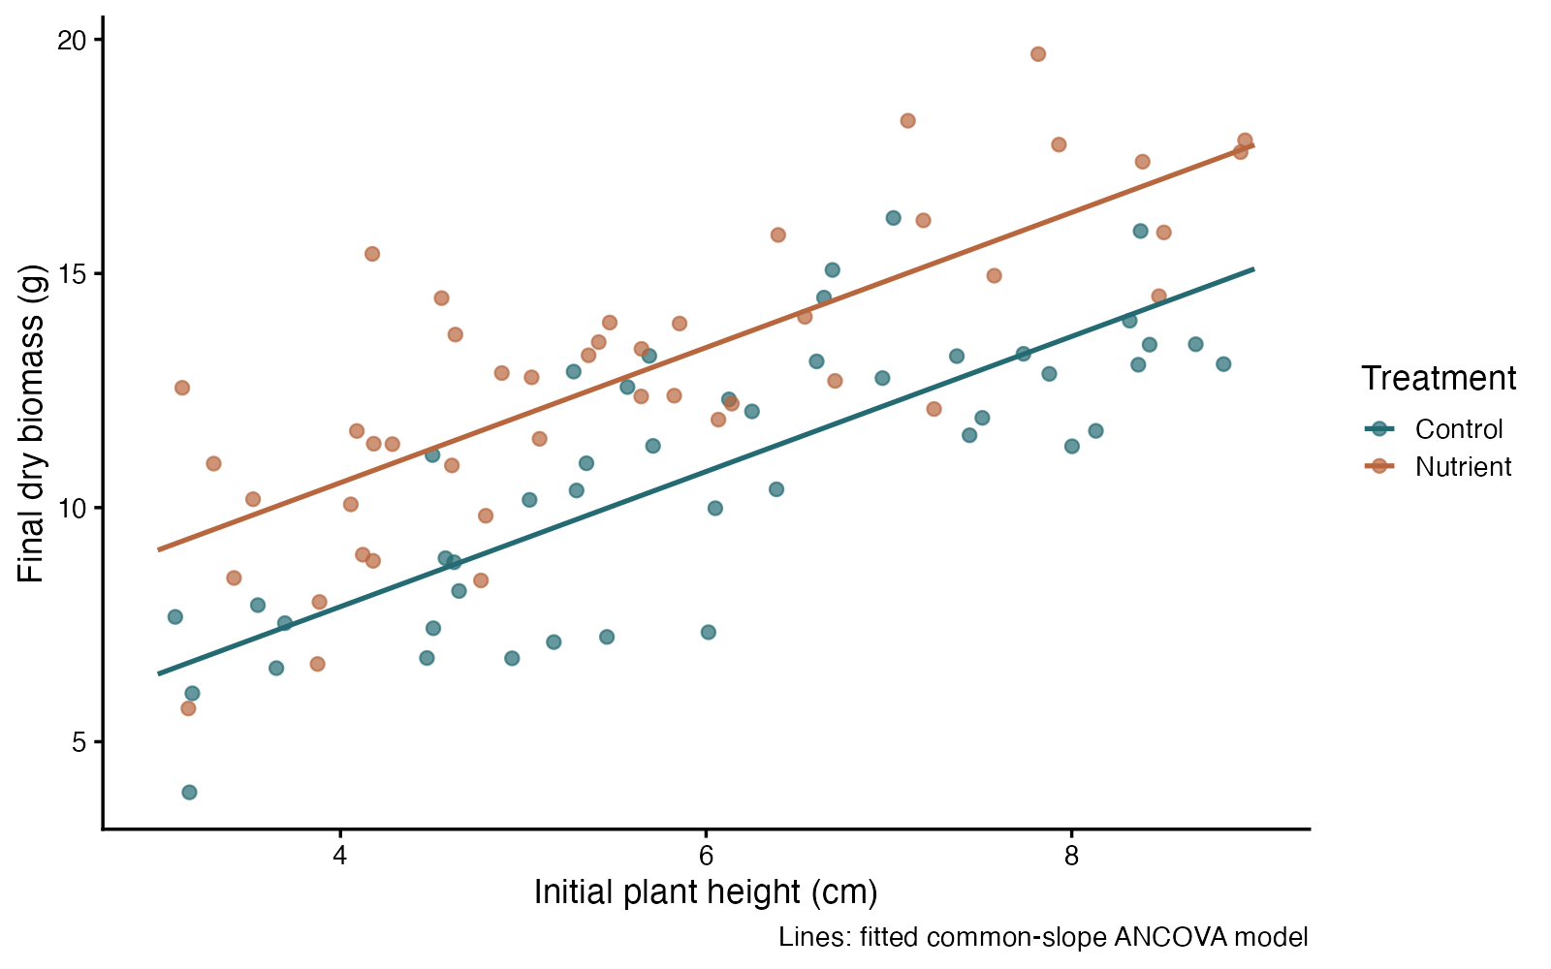
ANCOVA: see the data
ggplot2 arguments
aes(color = treatment) — Distinguish groups
alpha — Make overlap visible
geom_line(data=…) — Draw the fitted model
labs — State biological units
ANCOVA: an adjusted group comparison — simulated biological data
Notes:
This figure is generated from the saved CSV by modules/ancova/analysis.R. The scientific comparison holds the covariate fixed; the raw mean comparison is different.

Slide 191
ANCOVA: plot code
p <- ggplot(d, aes(initial, biomass, color = treatment)) +
geom_point(size = 2.5, alpha = .7) +
geom_line(data = predictions, aes(y = fit), linewidth = 1.1) +
scale_color_manual(values = c("#246A73", "#B7663E")) +
labs(x = "Initial plant height (cm)", y = "Final dry biomass (g)",
color = "Treatment", caption = "Lines: fitted common-slope ANCOVA model") +
theme_classic(base_size = 16)
print(p)
Arguments to change
aes(color = treatment) — Distinguish groups
alpha — Make overlap visible
geom_line(data=…) — Draw the fitted model
labs — State biological units
Notes:
This is an exact excerpt from analysis.R. Any preparation referenced by the excerpt appears in the complete companion script. The script opens a ragg PNG device before these lines and closes it afterward.

Slide 192
ANCOVA: question and null
Scientific question
Do treatments differ in mean biomass at the same initial height?
Null / estimation target
The treatment mean difference is zero at a common initial height in the stated model.
Relevant options
treatment + initial fits parallel slopes
treatment * initial allows different slopes
Factor reference sets the direction of the contrast
Notes:
Ask whether rejecting this null, or estimating this target, answers the biological question. The scientific comparison holds the covariate fixed; the raw mean comparison is different.

Slide 193
ANCOVA: assumptions
What matters here
Independent plants; appropriate residual spread
A suitable linear height relationship
Overlapping covariate ranges across treatments
Parametric responses
Allow an interaction if slopes differ
Model unequal variance or a justified transformation
Nonparametric responses
A covariate-aware permutation can test an adjusted effect
A rank-sum test would discard the height adjustment
Notes:
Begin with the design. A model change should address a specific issue and preserve the scientific target where possible. A rank or permutation alternative has its own assumptions and may change the null; do not choose it solely from a normality-test p-value.

Slide 194
ANCOVA: run and read
fit <- lm(biomass ~ treatment + initial, data = d)
summary(fit)
adjusted_ci <- confint(fit)["treatmentNutrient", ]
Generated results
Adjusted nutrient minus control = 2.65 g
95% CI 1.84 to 3.45
t(87) = 6.55; p = 3.797e-09
Notes:
Full executed model/test output:
Call:
lm(formula = biomass ~ treatment + initial, data = d)
Residuals:
Min 1Q Median 3Q Max
-3.692 -1.195 0.030 1.050 4.634
Coefficients:
Estimate Std. Error t value Pr(>|t|)
(Intercept) 2.1147 0.7830 2.701 0.00831 **
treatmentNutrient 2.6479 0.4040 6.555 3.8e-09 ***
initial 1.4427 0.1212 11.900 < 2e-16 ***
---
Signif. codes: 0 ‘***’ 0.001 ‘**’ 0.01 ‘*’ 0.05 ‘.’ 0.1 ‘ ’ 1
Residual standard error: 1.899 on 87 degrees of freedom
Multiple R-squared: 0.6571, Adjusted R-squared: 0.6492
F-statistic: 83.35 on 2 and 87 DF, p-value: < 2.2e-16

Slide 195
ANCOVA: interpret
At the same initial height, nutrient-treated plants had 2.65 g greater mean biomass (95% CI 1.84 to 3.45; p = 3.797e-09). This fitted model assumes a common height slope; the adjusted treatment comparison is supported by overlapping height ranges.
Discuss: Why is comparing raw group means a different question?
Notes:
Teaching point: The scientific comparison holds the covariate fixed; the raw mean comparison is different.
Instructor comparison with the simulated population: The nutrient treatment increases the population mean biomass by 2.4 g at any shared initial height. Both groups have slope 1.5 g/cm. The adjusted treatment null is false.
The reported estimate and p-value are calculated from this realized dataset; they need not exactly match the known population effect.

Slide 196
Repeated ANOVA: the data
Physiologists measure the same animals at four assay temperatures.
Continuous response
Four observations per animal
Subject ID defines pairing
Other data like these
Photosynthesis across light levels
Hormones across sampling times
Enzyme activity across assay conditions
Notes:
Repeated-measures ANOVA
Each of 24 animals provides all four measurements.
temperature: Assay temperature (°C)
subject: Animal measured at all four temperatures (ID)
oxygen: Measured oxygen consumption (µmol/hour)

Slide 197
Repeated ANOVA: simulate and save
set.seed(2103)
d <- expand.grid(temperature = c(15, 20, 25, 30), subject = 1:24)
individual <- rnorm(24, 0, 2)
d$oxygen <- 8 + .35 * (d$temperature - 15) +
individual[d$subject] + rnorm(nrow(d), 0, 1.3)
write.csv(d, file.path(output_dir, "data.csv"), row.names = FALSE)
First saved row
temperature: 15
subject: 1
oxygen: 8.108
Notes:
Seed: 2103
Generating model: 24 animals are measured at 15, 20, 25 and 30°C. Oxygen use = 8 + 0.35 × (temperature − 15) + an animal-specific Normal(0, 2²) intercept + independent Normal(0, 1.3²) observation error. Intercepts are shared within animals, producing repeated-measure dependence and a spherical covariance structure. No rounding is applied.
Population truth: Population means are 8, 9.75, 11.5 and 13.25 µmol/hour. The endpoint difference is 5.25 µmol/hour and the equal-means null is false.
The script writes data.csv before reading it for analysis. output_dir or out_dir is the folder supplied to the standalone script.
Original saved-data preview:
temperature subject oxygen condition
15 1 8.108364 15
20 1 7.987102 20
25 1 13.787232 25
30 1 14.056866 30

Slide 198
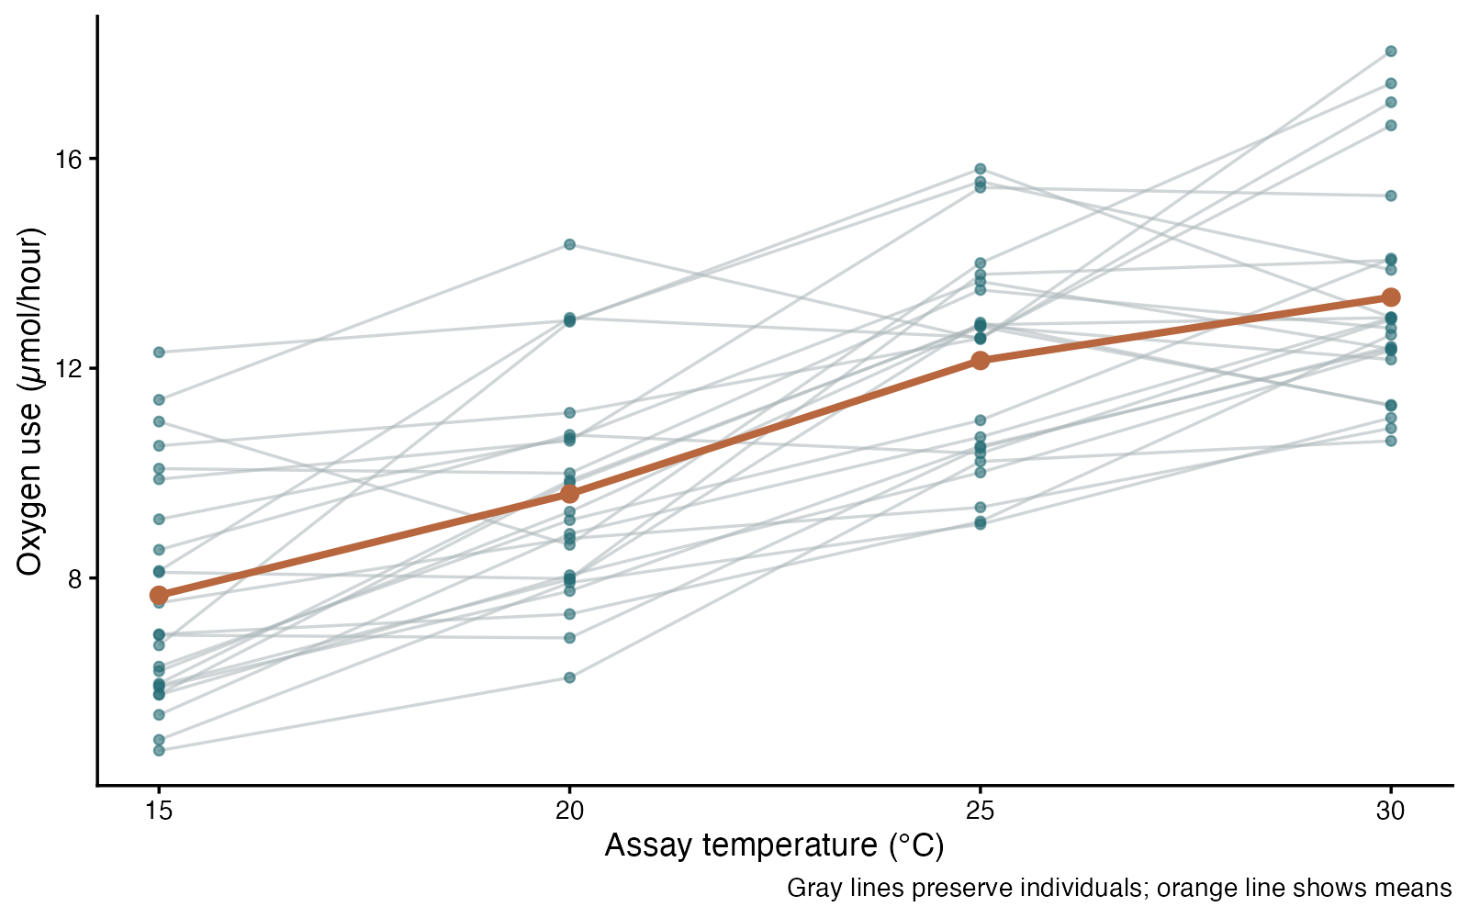
Repeated ANOVA: see the data
ggplot2 arguments
group = subject — Connect measurements from the same animal
alpha — Reduce line clutter
stat_summary — Show the mean trajectory
breaks — Label actual assay temperatures
Repeated-measures ANOVA — simulated biological data
Notes:
This figure is generated from the saved CSV by modules/repeated_anova/analysis.R. The subject ID, not the row, defines independent replication.

Slide 199
Repeated ANOVA: plot code
p <- ggplot(d, aes(temperature, oxygen)) +
geom_line(aes(group = subject), color = "#A9B5B8", alpha = .55) +
geom_point(color = "#246A73", alpha = .6, size = 1.8) +
stat_summary(fun = mean, geom = "line", color = "#B7663E", linewidth = 1.7) +
stat_summary(fun = mean, geom = "point", color = "#B7663E", size = 3.5) +
scale_x_continuous(breaks = c(15, 20, 25, 30)) +
labs(x = "Assay temperature (°C)", y = "Oxygen use (µmol/hour)",
caption = "Gray lines preserve individuals; orange line shows means") +
theme_classic(base_size = 16)
print(p)
Arguments to change
group = subject — Connect measurements from the same animal
alpha — Reduce line clutter
stat_summary — Show the mean trajectory
breaks — Label actual assay temperatures
Notes:
This is an exact excerpt from analysis.R. Any preparation referenced by the excerpt appears in the complete companion script. The script opens a ragg PNG device before these lines and closes it afterward.

Slide 200
Repeated ANOVA: question and null
Scientific question
Are mean oxygen-use rates equal across temperatures within animals?
Null / estimation target
All four population temperature means are equal.
Relevant options
Error(subject/condition) preserves the within-animal design
Treat condition as a factor for a general timepoint comparison
The endpoint contrast is prespecified separately
Notes:
Ask whether rejecting this null, or estimating this target, answers the biological question. The subject ID, not the row, defines independent replication.

Slide 201
Repeated ANOVA: assumptions
What matters here
Independent animals
Sphericity for the usual repeated-measures F test
Appropriate residual behavior and complete measurements
Parametric responses
Use a sphericity correction when needed
An LMM supports a more flexible covariance structure
Nonparametric responses
Friedman compares within-subject ranks in complete blocks
A within-block permutation must preserve the assignment design
Notes:
Begin with the design. A model change should address a specific issue and preserve the scientific target where possible. A rank or permutation alternative has its own assumptions and may change the null; do not choose it solely from a normality-test p-value.

Slide 202
Repeated ANOVA: run and read
fit <- aov(oxygen ~ condition + Error(subject/condition), data = d)
summary(fit)
endpoints <- t.test(d$oxygen[d$temperature == 30],
d$oxygen[d$temperature == 15], paired = TRUE)
Generated results
Condition F(3, 69) = 84.32
Omnibus p = 4.966e-23
Planned 30−15°C mean difference = 5.68 µmol/hour
95% CI 4.99 to 6.38
Notes:
Full executed model/test output:
Error: subject
Df Sum Sq Mean Sq F value Pr(>F)
Residuals 23 285.9 12.43
Error: subject:condition
Df Sum Sq Mean Sq F value Pr(>F)
condition 3 467.9 155.98 84.32 <2e-16 ***
Residuals 69 127.6 1.85
---
Signif. codes: 0 ‘***’ 0.001 ‘**’ 0.01 ‘*’ 0.05 ‘.’ 0.1 ‘ ’ 1

Slide 203
Repeated ANOVA: interpret
Within the same 24 animals, temperature means differed (F(3, 69) = 84.32, p = 4.966e-23). The prespecified 30−15°C mean increase was 5.68 µmol/hour (95% CI 4.99 to 6.38). The repeated-measures F test assumes sphericity; the experiment has 24 independent animals, not 96 independent rows.
Discuss: Why does ignoring subject ID create the wrong analysis?
Notes:
Teaching point: The subject ID, not the row, defines independent replication.
Instructor comparison with the simulated population: Population means are 8, 9.75, 11.5 and 13.25 µmol/hour. The endpoint difference is 5.25 µmol/hour and the equal-means null is false.
The reported estimate and p-value are calculated from this realized dataset; they need not exactly match the known population effect.

Slide 204
Friedman: the data
Sensory biologists record activity scores from each insect under three light conditions.
Ordered or continuous response
Three or more matched conditions
Complete blocks: one value per insect per condition
Other data like these
Each donor tested with three reagents
Matched sites under three protocols
Repeated preference ratings
Notes:
Friedman test
Eighteen independent insects each complete all three conditions in randomized order.
insect: Independent insect/block identifier (none)
condition: Light condition (category)
activity_score: Rounded and bounded activity measure (score 0 to 10)

Slide 205
Friedman: simulate and save
set.seed(1108)
insect <- rep(1:18, each = 3)
condition <- rep(c("Dim", "Moderate", "Bright"), 18)
score <- pmax(0, pmin(10, round(rep(rnorm(18, 5, 1.3), each = 3) +
rep(c(0, .8, 1.6), 18) + rnorm(54, 0, 1))))
d <- data.frame(insect, condition, activity_score = score)
write.csv(d, file.path(output_dir, "data.csv"), row.names = FALSE)
First saved row
insect: 1
condition: Dim
activity_score: 6
Notes:
Seed: 1108
Generating model: 18 insects each receive all 3 conditions. Each insect has a Normal(5, 1.3 SD) baseline; Dim, Moderate, and Bright add 0, 0.8, and 1.6. Independent Normal(0, 1 SD) noise is added, then scores are rounded and restricted to 0–10.
Population truth: Condition effects exist before rounding (0, +0.8, +1.6), and condition score distributions differ after rounding. Repeated observations share an insect baseline.
The script writes data.csv before reading it for analysis. output_dir or out_dir is the folder supplied to the standalone script.
Original saved-data preview:
insect condition activity_score
1 Dim 6
1 Moderate 7
1 Bright 7
2 Dim 7

Slide 206
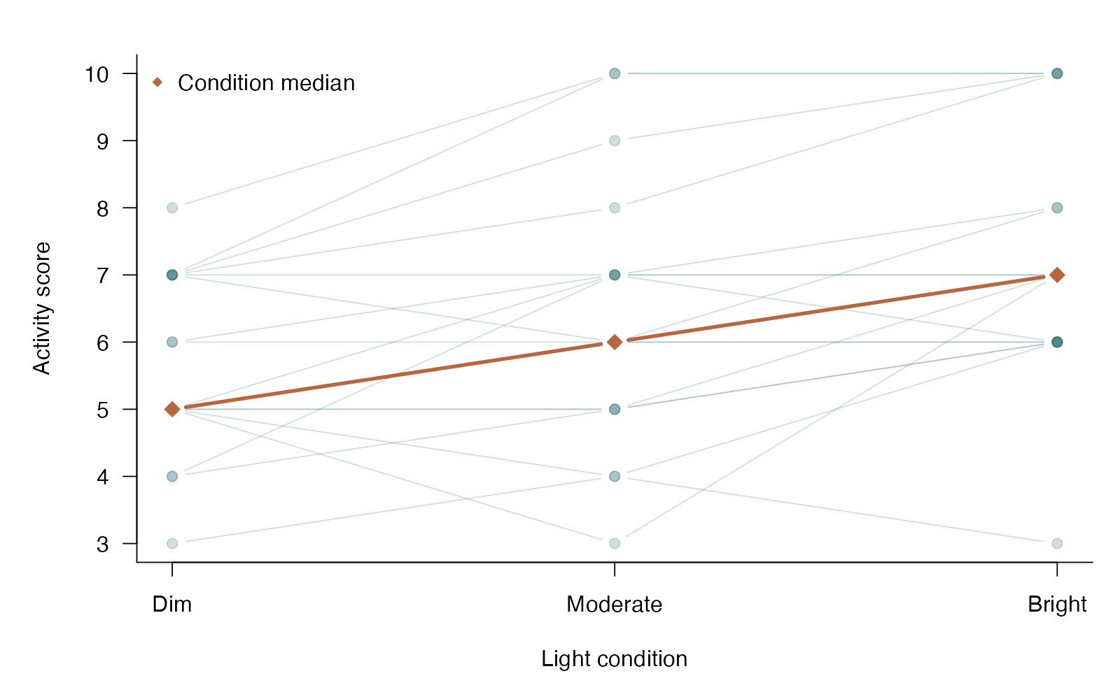
Friedman: see the data
base R arguments
matplot — Draw one profile for each independent insect
type=“b” — Show both observations and their pairing
col — Use translucent lines for repeated observations
points / type=“b” — Overlay condition medians
Friedman test — simulated biological data
Notes:
This figure is generated from the saved CSV by modules/friedman/analysis.R. Rank within each insect so that between-insect differences do not masquerade as condition effects.

Slide 207
Friedman: plot code
wide <- xtabs(activity_score ~ insect + condition, data = d)
matplot(1:3, t(wide), type = "b", pch = 19, lty = 1, col = "#246A7338",
xaxt = "n", xlab = "Light condition", ylab = "Activity score")
axis(1, 1:3, levels(d$condition))
points(1:3, apply(wide, 2, median), type = "b", pch = 18,
col = "#B7663E", lwd = 3, cex = 1.6)
legend("topleft", "Condition median", pch = 18, col = "#B7663E", bty = "n")
Arguments to change
matplot — Draw one profile for each independent insect
type=“b” — Show both observations and their pairing
col — Use translucent lines for repeated observations
points / type=“b” — Overlay condition medians
Notes:
This is an exact excerpt from analysis.R. Any preparation referenced by the excerpt appears in the complete companion script. The script opens a ragg PNG device before these lines and closes it afterward.

Slide 208
Friedman: question and null
Scientific question
Do light conditions differ after accounting for insect-to-insect variation?
Null / estimation target
Within blocks, condition labels are exchangeable: no systematic condition effect.
Relevant options
response ~ condition | insect declares the block
Require a complete observation for each block-condition
Post hoc paired comparisons need multiplicity control
Notes:
Ask whether rejecting this null, or estimating this target, answers the biological question. Rank within each insect so that between-insect differences do not masquerade as condition effects.

Slide 209
Friedman: assumptions
What matters here
Independent insects/blocks
Comparable measurement across conditions
No unmodeled order/carryover explanation for the contrast
Parametric responses
Repeated-measures ANOVA for mean questions with suitable covariance
Mixed models handle more complex dependence or incomplete data
Nonparametric responses
Friedman ranks within each complete block
It does not repair missing cells or arbitrary clustering
Notes:
Begin with the design. A model change should address a specific issue and preserve the scientific target where possible. A rank or permutation alternative has its own assumptions and may change the null; do not choose it solely from a normality-test p-value.

Slide 210
Friedman: run and read
d$condition <- factor(d$condition, levels = c("Dim", "Moderate", "Bright"))
d$insect <- factor(d$insect)
fit <- friedman.test(activity_score ~ condition | insect, data = d)
Generated results
Independent blocks = 18; conditions = 3
Friedman chi-square = 17.63; df = 2; p = 0.0001482
Condition medians: Dim 5; Moderate 6; Bright 7
Notes:
Full executed model/test output:
Friedman rank sum test
data: activity_score and condition and insect
Friedman chi-squared = 17.633, df = 2, p-value = 0.0001482

Slide 211
Friedman: interpret
For 18 insects measured under all three conditions, the Friedman comparison gave chi-square(2) = 17.63, p = 0.0001482. This tests a systematic condition effect within insects; it does not identify which conditions differ.
Discuss: Why is Kruskal–Wallis inappropriate if the same insects appear in every condition?
Notes:
Teaching point: Rank within each insect so that between-insect differences do not masquerade as condition effects.
Instructor comparison with the simulated population: Condition effects exist before rounding (0, +0.8, +1.6), and condition score distributions differ after rounding. Repeated observations share an insect baseline.
The reported estimate and p-value are calculated from this realized dataset; they need not exactly match the known population effect.

Slide 212
Pearson correlation: the data
Evolutionary biologists measure wing and tail lengths in adult birds from a single population.
Two continuous variables
Independent pairs of measurements
Strength of a linear association is the target
Other data like these
Protein and transcript abundance
Leaf area and dry mass
Metabolic rate and organ size
Notes:
Pearson correlation
Each independent bird contributes one pair of continuous traits.
bird: Independent bird identifier (none)
wing_mm: Wing length (mm)
tail_mm: Tail length (mm)

Slide 213
Pearson correlation: simulate and save
set.seed(1112)
wing <- rnorm(45, 75, 5)
tail <- 15 + .55 * wing + rnorm(45, 0, 3.5)
d <- data.frame(bird = 1:45, wing_mm = wing, tail_mm = tail)
write.csv(d, file.path(output_dir, "data.csv"), row.names = FALSE)
First saved row
bird: 1
wing_mm: 78.94
tail_mm: 53.92
Notes:
Seed: 1112
Generating model: 45 independent wing lengths are Normal(75, 5 SD). Tail length is 15 + 0.55 times wing length + independent Normal(0, 3.5 SD) noise.
Population truth: The generating population Pearson correlation is 0.555 / sqrt((0.555)^2 + 3.5^2), approximately 0.618. It is not the observed sample correlation.
The script writes data.csv before reading it for analysis. output_dir or out_dir is the folder supplied to the standalone script.
Original saved-data preview:
bird wing_mm tail_mm
1 78.93843 53.92165
2 72.88988 57.83499
3 75.28451 58.11559
4 78.55287 59.64707

Slide 214
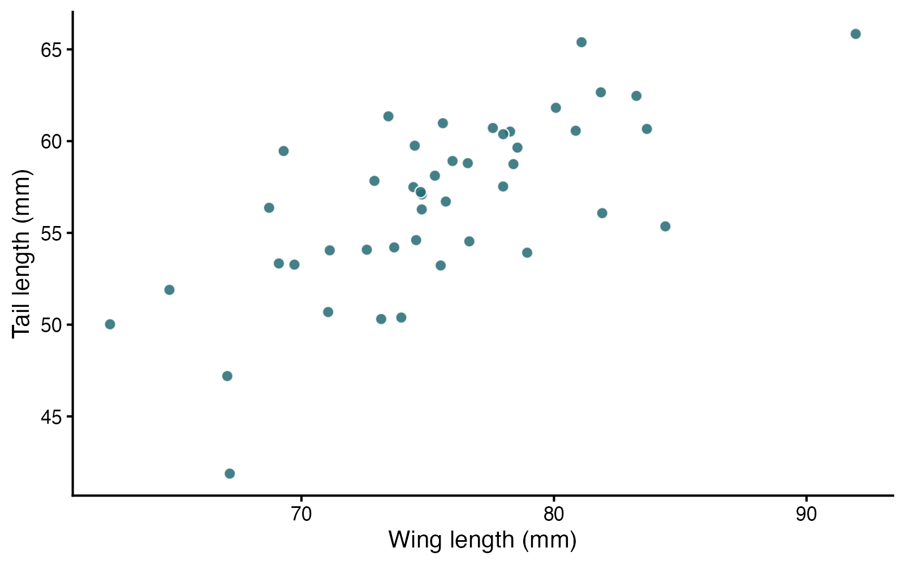
Pearson correlation: see the data
ggplot2 arguments
aes(x,y) — Choose the two traits whose association is of interest
geom_point / alpha — Display every bird while limiting overlap
shape / fill — Use a filled symbol with a contrasting outline
labs — Use trait names and measurement units
Pearson correlation — simulated biological data
Notes:
This figure is generated from the saved CSV by modules/pearson/analysis.R. Correlation describes linear association symmetrically; causal direction and a slope are separate questions.

Slide 215
Pearson correlation: plot code
p <- ggplot(d, aes(wing_mm, tail_mm)) +
geom_point(shape = 21, fill = "#246A73", color = "white", size = 3.5, alpha = .85) +
labs(x = "Wing length (mm)", y = "Tail length (mm)") +
theme_classic(base_size = 18)
print(p)
Arguments to change
aes(x,y) — Choose the two traits whose association is of interest
geom_point / alpha — Display every bird while limiting overlap
shape / fill — Use a filled symbol with a contrasting outline
labs — Use trait names and measurement units
Notes:
This is an exact excerpt from analysis.R. Any preparation referenced by the excerpt appears in the complete companion script. The script opens a ragg PNG device before these lines and closes it afterward.

Slide 216
Pearson correlation: question and null
Scientific question
Are wing and tail lengths linearly associated in this population?
Null / estimation target
The population Pearson correlation is zero.
Relevant options
method = “pearson” tests linear association
alternative = “two.sided” allows positive or negative
conf.level controls the correlation interval
Notes:
Ask whether rejecting this null, or estimating this target, answers the biological question. Correlation describes linear association symmetrically; causal direction and a slope are separate questions.

Slide 217
Pearson correlation: assumptions
What matters here
Independent birds
A linear pattern with no dominating outliers
Classical inference assumes approximately bivariate-normal observations
Parametric responses
Regression models a directional mean response and covariates
Transform traits when a log-scale association is the question
Nonparametric responses
Spearman assesses monotonic rank association
A bootstrap interval can retain Pearson correlation as the target
Notes:
Begin with the design. A model change should address a specific issue and preserve the scientific target where possible. A rank or permutation alternative has its own assumptions and may change the null; do not choose it solely from a normality-test p-value.

Slide 218
Pearson correlation: run and read
fit <- cor.test(d$wing_mm, d$tail_mm, method = "pearson",
alternative = "two.sided", conf.level = .95)
Generated results
Pearson r = 0.700
95% CI for population correlation: 0.512 to 0.824
t = 6.43; df = 43; p = 8.606e-08
Notes:
Full executed model/test output:
Pearson's product-moment correlation
data: d$wing_mm and d$tail_mm
t = 6.4317, df = 43, p-value = 8.606e-08
alternative hypothesis: true correlation is not equal to 0
95 percent confidence interval:
0.5119136 0.8243291
sample estimates:
cor
0.7002284

Slide 219
Pearson correlation: interpret
Wing and tail lengths had Pearson r = 0.700 (95% CI 0.512 to 0.824), p = 8.606e-08. This describes linear association within the sampled population; it does not establish that one trait causes the other.
Discuss: Would swapping wing and tail in cor.test change r? Would it leave a regression slope unchanged?
Notes:
Teaching point: Correlation describes linear association symmetrically; causal direction and a slope are separate questions.
Instructor comparison with the simulated population: The generating population Pearson correlation is 0.555 / sqrt((0.555)^2 + 3.5^2), approximately 0.618. It is not the observed sample correlation.
The reported estimate and p-value are calculated from this realized dataset; they need not exactly match the known population effect.

Slide 220
Spearman correlation: the data
Microbial ecologists compare soil salinity with bacterial richness across independent soil cores.
Two ordered or continuous variables
Independent measurement pairs
A monotonic association, possibly curved
Other data like these
Ordinal condition score and body size
Dose and a saturating response
Ranked expression across tissues
Notes:
Spearman rank correlation
Forty-five independent sites contribute one salinity and richness measurement each.
site: Independent site identifier (none)
salinity_ppt: Soil salinity (parts per thousand)
richness: Observed bacterial taxon richness (taxa)

Slide 221
Spearman correlation: simulate and save
set.seed(1113)
salinity <- runif(45, .5, 8)
richness <- round(90 - 25 * log(salinity + 1) + rnorm(45, 0, 7))
d <- data.frame(site = 1:45, salinity_ppt = salinity, richness = richness)
write.csv(d, file.path(output_dir, "data.csv"), row.names = FALSE)
First saved row
site: 1
salinity_ppt: 2.095
richness: 60
Notes:
Seed: 1113
Generating model: 45 independent site salinities are Uniform(0.5, 8). Richness is 90 - 25*log(salinity + 1) + Normal(0, 7 SD) noise, rounded to the nearest taxon.
Population truth: The underlying mean response decreases nonlinearly with salinity, creating a negative monotonic association. No fixed numeric population Spearman coefficient was specified.
The script writes data.csv before reading it for analysis. output_dir or out_dir is the folder supplied to the standalone script.
Original saved-data preview:
site salinity_ppt richness
1 2.095406 60
2 7.344500 42
3 3.973588 46
4 1.952997 62

Slide 222
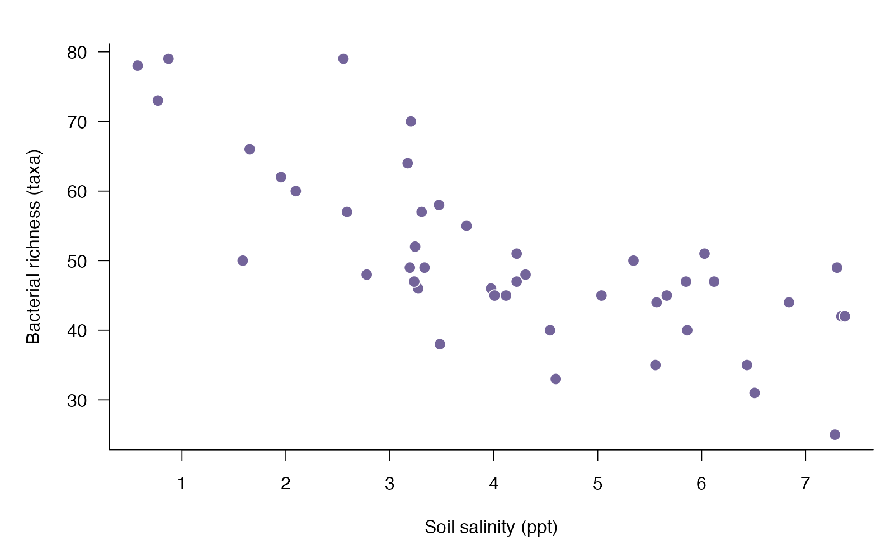
Spearman correlation: see the data
base R arguments
pch / bg — Use readable filled symbols
xlab / ylab — Name the original variables, not their ranks
col — Separate point fill and outline
cex — Keep the point size readable in a lecture room
Spearman rank correlation — simulated biological data
Notes:
This figure is generated from the saved CSV by modules/spearman/analysis.R. Ranks can summarize a monotonic curve without claiming a constant change in the original response units.

Slide 223
Spearman correlation: plot code
plot(d$salinity_ppt, d$richness, pch = 21, bg = "#73649A", col = "white",
cex = 1.4, xlab = "Soil salinity (ppt)", ylab = "Bacterial richness (taxa)")
Arguments to change
pch / bg — Use readable filled symbols
xlab / ylab — Name the original variables, not their ranks
col — Separate point fill and outline
cex — Keep the point size readable in a lecture room
Notes:
This is an exact excerpt from analysis.R. Any preparation referenced by the excerpt appears in the complete companion script. The script opens a ragg PNG device before these lines and closes it afterward.

Slide 224
Spearman correlation: question and null
Scientific question
Does bacterial richness tend to decline as salinity increases?
Null / estimation target
The population Spearman rank correlation is zero.
Relevant options
method = “spearman” uses ranks
exact = FALSE handles tied richness values
Choose a one-sided alternative only before seeing the data
Notes:
Ask whether rejecting this null, or estimating this target, answers the biological question. Ranks can summarize a monotonic curve without claiming a constant change in the original response units.

Slide 225
Spearman correlation: assumptions
What matters here
Independent sites
Meaningful rank order
Monotonic association is the target; zero does not rule out every pattern
Parametric responses
Model the curved mean relationship directly if prediction is needed
A suitable transformation may linearize the mean
Nonparametric responses
Spearman reduces the influence of extreme magnitudes
Nonmonotonic patterns require a different model or question
Notes:
Begin with the design. A model change should address a specific issue and preserve the scientific target where possible. A rank or permutation alternative has its own assumptions and may change the null; do not choose it solely from a normality-test p-value.

Slide 226
Spearman correlation: run and read
fit <- cor.test(d$salinity_ppt, d$richness,
method = "spearman", exact = FALSE,
alternative = "two.sided")
Generated results
Spearman rho = -0.752; n = 45
S = 26599.8; asymptotic two-sided p = 2.549e-09
The coefficient describes rank association, not a change in taxa per ppt.
Notes:
Full executed model/test output:
Spearman's rank correlation rho
data: d$salinity_ppt and d$richness
S = 26600, p-value = 2.549e-09
alternative hypothesis: true rho is not equal to 0
sample estimates:
rho
-0.7522922

Slide 227
Spearman correlation: interpret
Salinity and bacterial richness had Spearman rho = -0.752 (two-sided p = 2.549e-09). This quantifies their monotonic rank association. It does not estimate a change in mean richness per unit salinity.
Discuss: Does rho tell you how many taxa are lost per additional ppt of salinity?
Notes:
Teaching point: Ranks can summarize a monotonic curve without claiming a constant change in the original response units.
Instructor comparison with the simulated population: The underlying mean response decreases nonlinearly with salinity, creating a negative monotonic association. No fixed numeric population Spearman coefficient was specified.
The reported estimate and p-value are calculated from this realized dataset; they need not exactly match the known population effect.

Slide 228
Simple regression: the data
Plant ecologists grow seedlings under a gradient of nitrogen supply.
One continuous response
One continuous predictor
A linear mean response and its slope
Other data like these
Body size predicting horn size
Temperature predicting enzyme activity
Resource supply predicting growth
Notes:
Simple linear regression
Thirty-six independently assigned pots receive one nitrogen level and yield one biomass measurement.
pot: Independent pot identifier (none)
nitrogen_mg: Assigned nitrogen dose (mg)
biomass_g: Seedling biomass (g)

Slide 229
Simple regression: simulate and save
set.seed(1114)
nitrogen <- runif(36, 0, 12)
biomass <- 2.2 + .42 * nitrogen + rnorm(36, 0, .8)
d <- data.frame(pot = 1:36, nitrogen_mg = nitrogen, biomass_g = biomass)
write.csv(d, file.path(output_dir, "data.csv"), row.names = FALSE)
First saved row
pot: 1
nitrogen_mg: 9.546
biomass_g: 5.992
Notes:
Seed: 1114
Generating model: 36 nitrogen doses are Uniform(0, 12) mg. Independent biomass values follow 2.2 + 0.42*nitrogen + Normal(0, 0.8 SD).
Population truth: The conditional mean intercept is 2.2 g and slope is +0.42 g per mg nitrogen. The zero-slope null is false.
The script writes data.csv before reading it for analysis. output_dir or out_dir is the folder supplied to the standalone script.
Original saved-data preview:
pot nitrogen_mg biomass_g
1 9.545618 5.992226
2 2.359066 4.640125
3 7.314201 6.118743
4 2.363184 3.585433

Slide 230
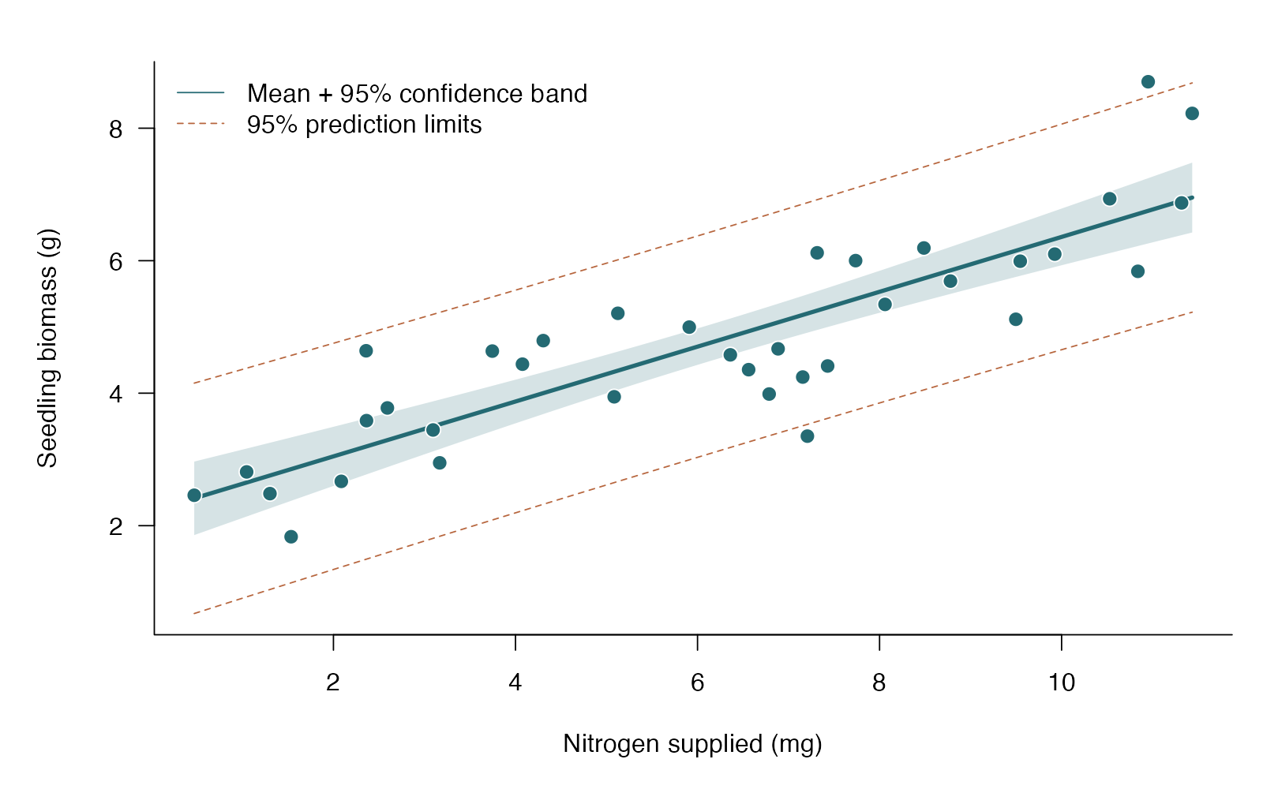
Simple regression: see the data
base R arguments
polygon — Draw a confidence band behind the points
lines / lty — Distinguish fitted mean and prediction limits
points — Keep all observed pots visible
legend — Name each kind of uncertainty
Simple linear regression — simulated biological data
Notes:
This figure is generated from the saved CSV by modules/simple_lm/analysis.R. Choose confidence intervals for a mean response and prediction intervals for a new individual pot.

Slide 231
Simple regression: plot code
plot(d$nitrogen_mg, d$biomass_g, type = "n", ylim = range(new_pot),
xlab = "Nitrogen supplied (mg)", ylab = "Seedling biomass (g)")
polygon(c(grid$nitrogen_mg, rev(grid$nitrogen_mg)),
c(mean_ci[, "lwr"], rev(mean_ci[, "upr"])), col = "#246A7330", border = NA)
lines(grid$nitrogen_mg, mean_ci[, "fit"], col = "#246A73", lwd = 3)
matlines(grid$nitrogen_mg, new_pot[, c("lwr", "upr")], lty = 2, col = "#B7663E")
points(d$nitrogen_mg, d$biomass_g, pch = 21, bg = "#246A73", col = "white", cex = 1.3)
legend("topleft", c("Mean + 95% confidence band", "95% prediction limits"),
lty = c(1, 2), col = c("#246A73", "#B7663E"), bty = "n")
Arguments to change
polygon — Draw a confidence band behind the points
lines / lty — Distinguish fitted mean and prediction limits
points — Keep all observed pots visible
legend — Name each kind of uncertainty
Notes:
This is an exact excerpt from analysis.R. Any preparation referenced by the excerpt appears in the complete companion script. The script opens a ragg PNG device before these lines and closes it afterward.

Slide 232
Simple regression: question and null
Scientific question
How much does mean seedling biomass change per additional mg of nitrogen?
Null / estimation target
The population slope of mean biomass on nitrogen is zero.
Relevant options
response ~ predictor defines the direction
confint(fit) gives coefficient intervals
confidence predicts a mean; prediction predicts a new pot
Notes:
Ask whether rejecting this null, or estimating this target, answers the biological question. Choose confidence intervals for a mean response and prediction intervals for a new individual pot.

Slide 233
Simple regression: assumptions
What matters here
Independent pot errors
Mean response roughly linear; inspect residuals
Similar residual variance; normal errors for small-sample intervals/tests
Parametric responses
Transform or model curvature when scientifically useful
Use variance models/robust SEs for unequal residual spread
Nonparametric responses
Theil–Sen provides a robust linear slope
Spearman answers a rank-association question instead of slope
Notes:
Begin with the design. A model change should address a specific issue and preserve the scientific target where possible. A rank or permutation alternative has its own assumptions and may change the null; do not choose it solely from a normality-test p-value.

Slide 234
Simple regression: run and read
fit <- lm(biomass_g ~ nitrogen_mg, data = d)
coefficients <- summary(fit)$coefficients
ci <- confint(fit)
grid <- data.frame(nitrogen_mg = seq(min(d$nitrogen_mg), max(d$nitrogen_mg), length.out = 100))
mean_ci <- predict(fit, grid, interval = "confidence")
new_pot <- predict(fit, grid, interval = "prediction")
Generated results
Slope = 0.414 g biomass per mg nitrogen
95% slope CI: 0.329 to 0.499
Slope t = 9.90; df = 34; p = 1.525e-11
R-squared = 0.742
Notes:
Full executed model/test output:
Call:
lm(formula = biomass_g ~ nitrogen_mg, data = d)
Residuals:
Min 1Q Median 3Q Max
-1.8507 -0.4546 -0.1079 0.4972 1.9486
Coefficients:
Estimate Std. Error t value Pr(>|t|)
(Intercept) 2.21791 0.29034 7.639 7.05e-09 ***
nitrogen_mg 0.41409 0.04185 9.896 1.52e-11 ***
---
Signif. codes: 0 ‘***’ 0.001 ‘**’ 0.01 ‘*’ 0.05 ‘.’ 0.1 ‘ ’ 1
Residual standard error: 0.811 on 34 degrees of freedom
Multiple R-squared: 0.7423, Adjusted R-squared: 0.7347
F-statistic: 97.93 on 1 and 34 DF, p-value: 1.525e-11
2.5 % 97.5 %
(Intercept) 1.6278685 2.8079514
nitrogen_mg 0.3290528 0.4991331

Slide 235
Simple regression: interpret
Each additional mg of nitrogen was associated with 0.414 g higher mean biomass (95% CI 0.329 to 0.499); slope t(34) = 9.90, p = 1.525e-11. The narrow band concerns mean biomass; the wider prediction limits concern a new individual pot.
Discuss: Which interval answers what biomass a newly grown individual seedling may have?
Notes:
Teaching point: Choose confidence intervals for a mean response and prediction intervals for a new individual pot.
Instructor comparison with the simulated population: The conditional mean intercept is 2.2 g and slope is +0.42 g per mg nitrogen. The zero-slope null is false.
The reported estimate and p-value are calculated from this realized dataset; they need not exactly match the known population effect.

Slide 236
Theil–Sen slope: the data
Physiologists measure enzyme activity along a temperature gradient with occasional unusually high assays.
One continuous response and predictor
A roughly linear trend
A slope resistant to extreme response values
Other data like these
Phenological date versus year
Growth versus resource supply
Morphological allometry on log scales
Notes:
Theil–Sen robust slope
Forty independent assay preparations contribute one temperature/activity pair each.
assay: Independent assay identifier (none)
temp_c: Assay temperature (degrees C)
activity: Enzyme activity (U/mL)

Slide 237
Theil–Sen slope: simulate and save
set.seed(1116)
temperature <- runif(40, 16, 30)
activity <- 8 + 1.4 * temperature + rt(40, df = 4) * 2
activity[c(5, 18)] <- activity[c(5, 18)] + 25
d <- data.frame(assay = 1:40, temp_c = temperature, activity = activity)
write.csv(d, file.path(output_dir, "data.csv"), row.names = FALSE)
First saved row
assay: 1
temp_c: 25.62
activity: 45.04
Notes:
Seed: 1116
Generating model: 40 temperatures are Uniform(16, 30) degrees C. Core activity = 8 + 1.4*temperature + 2 times a Student t variable with 4 degrees of freedom. Assays 5 and 18 then receive an extra +25 U/mL.
Population truth: The underlying uncontaminated linear trend has slope 1.4 U/mL per degree C. Two deliberately elevated assays illustrate robustness; the bootstrap interval comes from the saved contaminated sample.
The script writes data.csv before reading it for analysis. output_dir or out_dir is the folder supplied to the standalone script.
Original saved-data preview:
assay temp_c activity
1 25.61605 45.04250
2 19.70680 35.56085
3 23.09819 38.79565
4 18.94864 37.20150

Slide 238
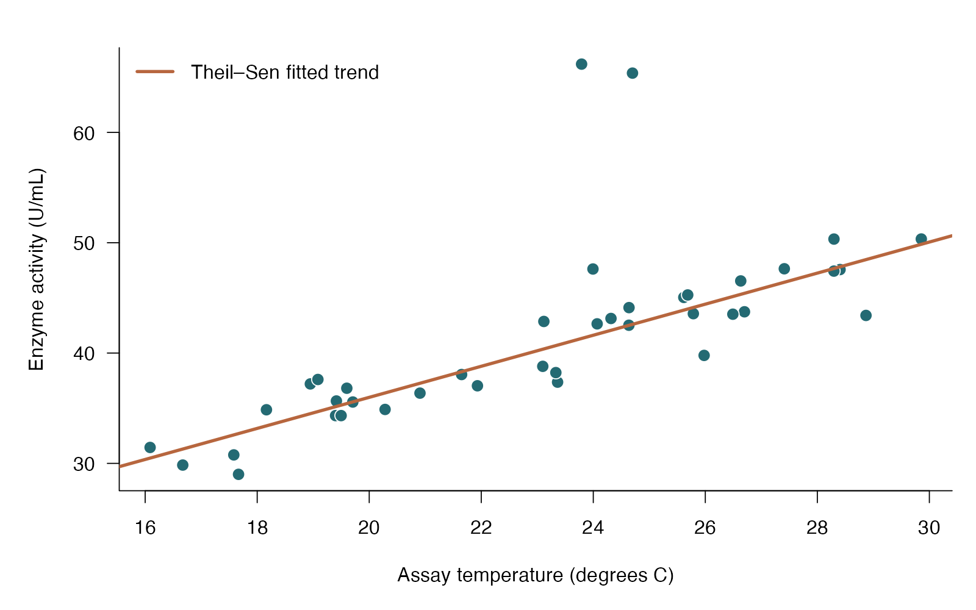
Theil–Sen slope: see the data
base R arguments
pch / bg — Show every assay, including unusual ones
abline — Add the robust intercept and slope
lwd — Keep the fitted trend legible
legend — Label exactly which line is displayed
Theil–Sen robust slope — simulated biological data
Notes:
This figure is generated from the saved CSV by modules/theil_sen/analysis.R. A robust slope retains interpretable units while limiting extreme-response influence; uncertainty here is an approximate pairs-bootstrap interval.

Slide 239
Theil–Sen slope: plot code
plot(d$temp_c, d$activity, pch = 21, bg = "#246A73", col = "white", cex = 1.4,
xlab = "Assay temperature (degrees C)", ylab = "Enzyme activity (U/mL)")
abline(intercept, slope, col = "#B7663E", lwd = 3)
legend("topleft", "Theil–Sen fitted trend", lty = 1, lwd = 3,
col = "#B7663E", bty = "n")
Arguments to change
pch / bg — Show every assay, including unusual ones
abline — Add the robust intercept and slope
lwd — Keep the fitted trend legible
legend — Label exactly which line is displayed
Notes:
This is an exact excerpt from analysis.R. Any preparation referenced by the excerpt appears in the complete companion script. The script opens a ragg PNG device before these lines and closes it afterward.

Slide 240
Theil–Sen slope: question and null
Scientific question
What is the robust linear change in enzyme activity per degree?
Null / estimation target
The target is the robust linear activity–temperature slope; zero means no linear location trend.
Relevant options
Use the median of all finite pairwise slopes
Resample complete pairs for a slope interval
This example uses a percentile bootstrap, not an exact p-value
Notes:
Ask whether rejecting this null, or estimating this target, answers the biological question. A robust slope retains interpretable units while limiting extreme-response influence; uncertainty here is an approximate pairs-bootstrap interval.

Slide 241
Theil–Sen slope: assumptions
What matters here
Independent assay preparations
A linear trend remains scientifically sensible
Bootstrap intervals are approximate; leverage can still matter
Parametric responses
Fit a suitable error model if the conditional mean is the target
Check whether unusual assays are errors or genuine observations
Nonparametric responses
Theil–Sen estimates a robust location trend
Spearman addresses monotonic association without slope units
Notes:
Begin with the design. A model change should address a specific issue and preserve the scientific target where possible. A rank or permutation alternative has its own assumptions and may change the null; do not choose it solely from a normality-test p-value.

Slide 242
Theil–Sen slope: run and read
pairs <- combn(seq_len(nrow(d)), 2)
slopes <- (d$activity[pairs[2, ]] - d$activity[pairs[1, ]]) /
(d$temp_c[pairs[2, ]] - d$temp_c[pairs[1, ]])
slope <- median(slopes)
intercept <- median(d$activity - slope * d$temp_c)
Generated results
Theil–Sen slope = 1.408 U/mL per degree C
95% pairs-bootstrap interval: 1.184 to 1.618
Finite original pairwise slopes = 780; bootstrap replicates = 999
The interval is approximate; no exact test p-value is reported.
Notes:
Full executed model/test output:
intercept slope
7.832577 1.407600
2.5% 97.5%
1.183998 1.618227
[1] 999

Slide 243
Theil–Sen slope: interpret
The robust slope was 1.408 U/mL per degree C, with a 95% percentile pairs-bootstrap interval of 1.184 to 1.618 (999 replicates). This estimates a linear location trend resistant to extreme responses; its interval is approximate and is not an exact slope test.
Discuss: How does a slope answer a different question from Spearman correlation?
Notes:
Teaching point: A robust slope retains interpretable units while limiting extreme-response influence; uncertainty here is an approximate pairs-bootstrap interval.
Instructor comparison with the simulated population: The underlying uncontaminated linear trend has slope 1.4 U/mL per degree C. Two deliberately elevated assays illustrate robustness; the bootstrap interval comes from the saved contaminated sample.
The reported estimate and p-value are calculated from this realized dataset; they need not exactly match the known population effect.

Slide 244
Multiple regression: the data
Evolutionary biologists relate beetle horn length to body size and larval nutrition.
One continuous response
Two or more predictors
A conditional slope holding other predictors fixed
Other data like these
Growth predicted by temperature and resources
Physiology predicted by size and treatment
Expression predicted by genotype and age
Notes:
Multiple linear regression
Sixty independent beetles are raised across a nutrient gradient and measured as adults.
beetle: Independent beetle identifier (none)
body_mm: Adult body length (mm)
nutrition_mg: Larval nutrition amount (mg)
horn_mm: Adult horn length (mm)

Slide 245
Multiple regression: simulate and save
set.seed(1115)
body <- runif(60, 7, 12)
nutrition <- runif(60, 2, 10)
horn <- .4 + .35 * body + .16 * nutrition + rnorm(60, 0, .65)
d <- data.frame(beetle = 1:60, body_mm = body, nutrition_mg = nutrition, horn_mm = horn)
write.csv(d, file.path(output_dir, "data.csv"), row.names = FALSE)
First saved row
beetle: 1
body_mm: 9.028
nutrition_mg: 3.092
horn_mm: 2.491
Notes:
Seed: 1115
Generating model: 60 independent body lengths are Uniform(7, 12) mm and nutrition values independently Uniform(2, 10) mg. Horn length = 0.4 + 0.35body + 0.16nutrition + Normal(0, 0.65 SD).
Population truth: The true conditional body slope is 0.35 mm/mm and nutrition slope 0.16 mm/mg, with no interaction. Both zero-coefficient nulls are false.
The script writes data.csv before reading it for analysis. output_dir or out_dir is the folder supplied to the standalone script.
Original saved-data preview:
beetle body_mm nutrition_mg horn_mm
1 9.02822 3.092071 2.490570
2 11.00832 8.331630 6.743573
3 10.59940 3.747668 4.572635
4 10.50767 9.840460 5.364367

Slide 246
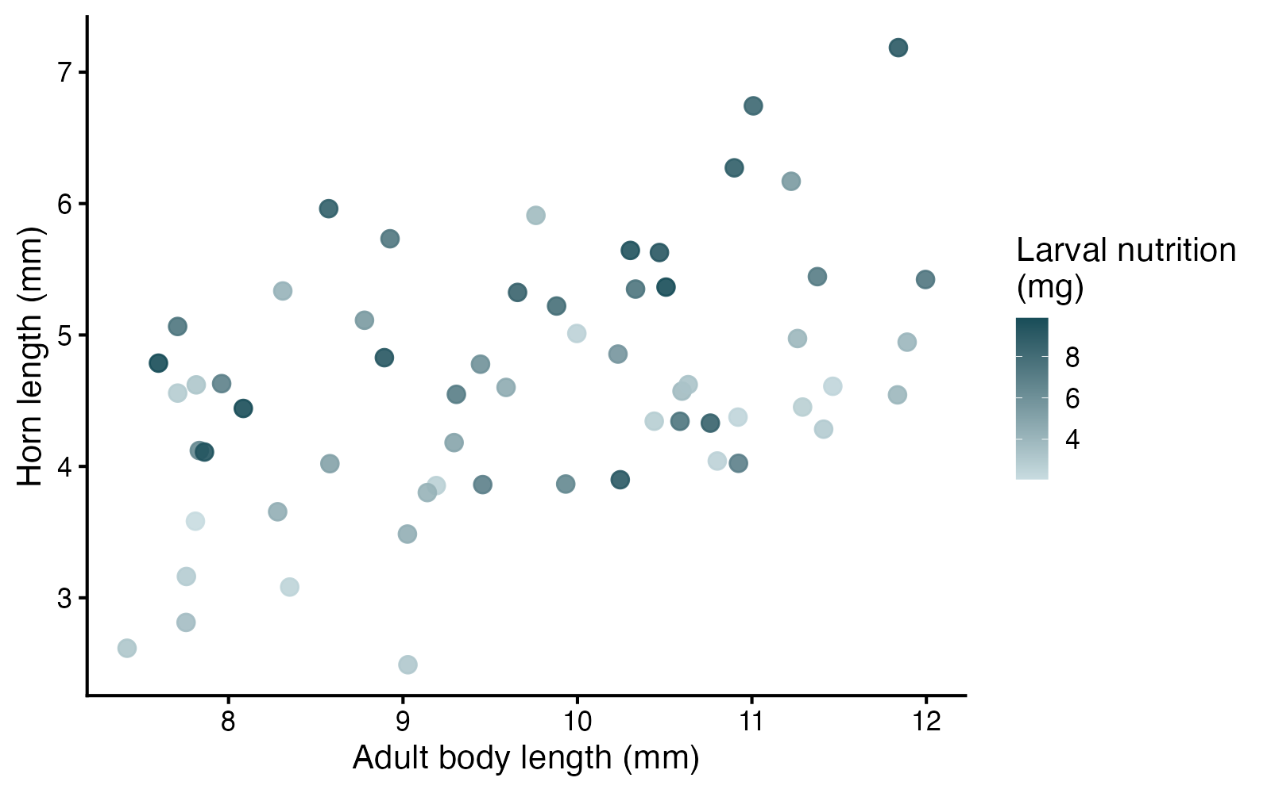
Multiple regression: see the data
ggplot2 arguments
color — Map nutrition to a continuous color scale
scale_color_gradient — Give low/high values clear colors
geom_point — Show each beetle once
labs — State response, predictor and color units
Multiple linear regression — simulated biological data
Notes:
This figure is generated from the saved CSV by modules/multiple_lm/analysis.R. Read each coefficient conditionally on the other variables in the stated model.

Slide 247
Multiple regression: plot code
p <- ggplot(d, aes(body_mm, horn_mm, color = nutrition_mg)) +
geom_point(size = 3.8, alpha = .9) +
scale_color_gradient(low = "#C8DCE0", high = "#174D58") +
labs(x = "Adult body length (mm)", y = "Horn length (mm)", color = "Larval nutrition
(mg)") +
theme_classic(base_size = 18)
print(p)
Arguments to change
color — Map nutrition to a continuous color scale
scale_color_gradient — Give low/high values clear colors
geom_point — Show each beetle once
labs — State response, predictor and color units
Notes:
This is an exact excerpt from analysis.R. Any preparation referenced by the excerpt appears in the complete companion script. The script opens a ragg PNG device before these lines and closes it afterward.

Slide 248
Multiple regression: question and null
Scientific question
Does body size predict mean horn length after accounting for larval nutrition?
Null / estimation target
The body-size coefficient is zero conditional on nutrition in the specified model.
Relevant options
x1 + x2 gives additive effects
x1 * x2 also includes an interaction
anova(reduced, full) compares nested models fit to the same rows
Notes:
Ask whether rejecting this null, or estimating this target, answers the biological question. Read each coefficient conditionally on the other variables in the stated model.

Slide 249
Multiple regression: assumptions
What matters here
Independent beetles
Correct mean pattern and residual spread
Strong predictor collinearity limits separate interpretation
Parametric responses
Include a justified interaction or curved term
Use robust SEs/variance models for unequal error variance
Nonparametric responses
A design-respecting permutation can test a specified effect
Separate rank correlations do not replace an adjusted regression
Notes:
Begin with the design. A model change should address a specific issue and preserve the scientific target where possible. A rank or permutation alternative has its own assumptions and may change the null; do not choose it solely from a normality-test p-value.

Slide 250
Multiple regression: run and read
fit <- lm(horn_mm ~ body_mm + nutrition_mg, data = d)
reduced <- lm(horn_mm ~ nutrition_mg, data = d)
comparison <- anova(reduced, fit)
coefficients <- summary(fit)$coefficients
ci <- confint(fit)
Generated results
Body slope, adjusted for nutrition = 0.299 mm/mm
95% CI: 0.159 to 0.440
Body coefficient p = 7.658e-05; nested-model F = 18.17
Nutrition slope = 0.181 mm/mg; p = 1.112e-05
Adjusted R-squared = 0.411
Notes:
Full executed model/test output:
Call:
lm(formula = horn_mm ~ body_mm + nutrition_mg, data = d)
Residuals:
Min 1Q Median 3Q Max
-1.51574 -0.38170 -0.00496 0.19296 1.60870
Coefficients:
Estimate Std. Error t value Pr(>|t|)
(Intercept) 0.69688 0.70981 0.982 0.33
body_mm 0.29930 0.07021 4.263 7.66e-05 ***
nutrition_mg 0.18104 0.03757 4.818 1.11e-05 ***
---
Signif. codes: 0 ‘***’ 0.001 ‘**’ 0.01 ‘*’ 0.05 ‘.’ 0.1 ‘ ’ 1
Residual standard error: 0.7242 on 57 degrees of freedom
Multiple R-squared: 0.4306, Adjusted R-squared: 0.4106
F-statistic: 21.55 on 2 and 57 DF, p-value: 1.07e-07
2.5 % 97.5 %
(Intercept) -0.7244990 2.1182587
body_mm 0.1587143 0.4398833
nutrition_mg 0.1057975 0.2562805

Slide 251
Multiple regression: interpret
Holding larval nutrition fixed in the additive model, each additional mm of body length was associated with 0.299 mm higher mean horn length (95% CI 0.159 to 0.440; p = 7.658e-05). This conditional association is not the same as the unadjusted relationship or proof of causation.
Discuss: What does holding nutrition fixed mean when interpreting the body-size coefficient?
Notes:
Teaching point: Read each coefficient conditionally on the other variables in the stated model.
Instructor comparison with the simulated population: The true conditional body slope is 0.35 mm/mm and nutrition slope 0.16 mm/mg, with no interaction. Both zero-coefficient nulls are false.
The reported estimate and p-value are calculated from this realized dataset; they need not exactly match the known population effect.

Slide 252
Exact binomial: the data
Host choice in a parasitoid wasp
Binary outcome: native or introduced host
80 independent wasps; one trial each
Known null probability: 0.50
Other data like these
Mendelian allele transmission
Seed germination against a target
Choice of one of two odors
Notes:
Exact binomial test
One independent choice per wasp; two equally available host species.
wasp: Unique independent wasp identifier (none)
native: 1 = native host chosen; 0 = introduced host (binary)

Slide 253
Exact binomial: simulate and save
set.seed(3101)
d <- data.frame(wasp = 1:80,
native = rbinom(80, 1, 0.68))
write.csv(d, file.path(out_dir, "data.csv"), row.names = FALSE)
First saved row
wasp: 1
native: 0
Notes:
Seed: 3101
Generating model: Generate 80 independent Bernoulli choices, each with probability 0.68 of a native-host choice. Each wasp appears once. No rounding or dependence is introduced.
Population truth: The true native-host probability is 0.68, so the null probability 0.50 is false. The population difference from the null is +0.18.
The script writes data.csv before reading it for analysis. output_dir or out_dir is the folder supplied to the standalone script.
Original saved-data preview:
1 | 0
2 | 0
3 | 1
4 | 1
5 | 0

Slide 254
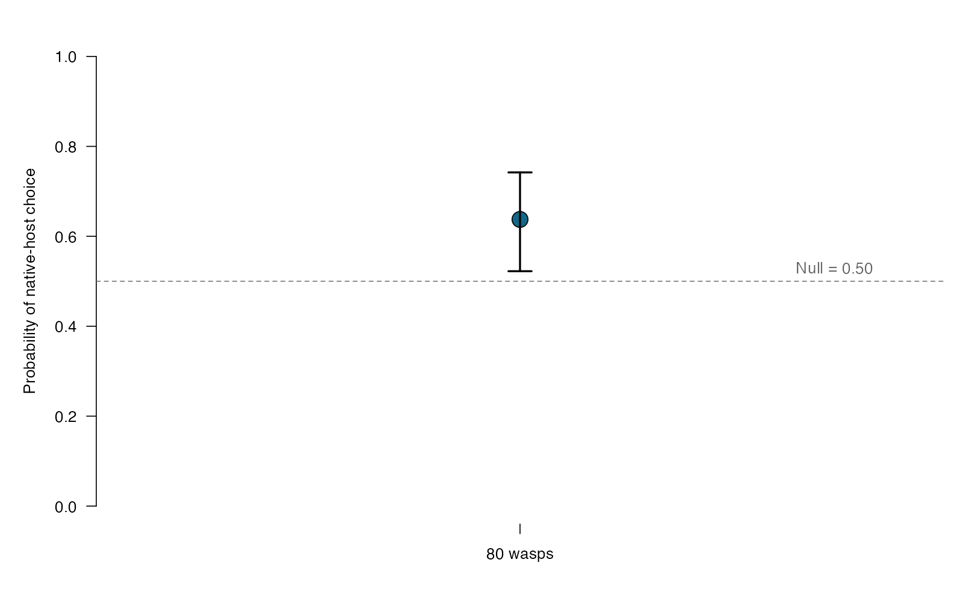
Exact binomial: see the data
base R arguments
ylim — Keep the full 0–1 probability scale.
abline(h = .5) — Mark the null probability.
arrows(code = 3) — Draw both confidence-interval caps.
pch / cex — Choose the point shape and size.
Exact binomial test — simulated biological data
Notes:
This figure is generated from the saved CSV by modules/binomial/analysis.R. The null probability comes from the scientific prediction, not automatically from the fact that there are two outcomes.

Slide 255
Exact binomial: plot code
par(mar = c(4, 5, 2, 1), las = 1)
plot(1, estimate, xlim = c(0.5, 1.5), ylim = c(0, 1),
xaxt = "n", xlab = "", ylab = "Probability of native-host choice",
pch = 21, bg = "#126887", cex = 2.2, bty = "n")
arrows(1, ci[1], 1, ci[2], angle = 90, code = 3, length = .12, lwd = 2)
abline(h = 0.5, lty = 2, col = "#777777")
axis(1, 1, paste(nrow(d), "wasps"))
text(1.45, .53, "Null = 0.50", adj = 1, col = "#666666")
Arguments to change
ylim — Keep the full 0–1 probability scale.
abline(h = .5) — Mark the null probability.
arrows(code = 3) — Draw both confidence-interval caps.
pch / cex — Choose the point shape and size.
Notes:
This is an exact excerpt from analysis.R. Any preparation referenced by the excerpt appears in the complete companion script. The script opens a ragg PNG device before these lines and closes it afterward.

Slide 256
Exact binomial: question and null
Scientific question
Do wasps choose the native host with probability 0.50?
Null / estimation target
The population probability of choosing the native host is 0.50.
Relevant options
x = number of native-host choices; n = all choices
p = the probability specified by the null
alternative = “two.sided”; choose direction in advance
Notes:
Ask whether rejecting this null, or estimating this target, answers the biological question. The null probability comes from the scientific prediction, not automatically from the fact that there are two outcomes.

Slide 257
Exact binomial: assumptions
What matters here
Trials are independent.
The response has two possible outcomes.
The null uses the correct availability or expected probability.
Parametric responses
Use logistic regression if choice probability depends on predictors.
Use a mixed logistic model for repeated choices by the same wasp.
Nonparametric responses
The exact binomial test already handles small counts.
A design-based randomization test requires the treatment-assignment scheme.
Notes:
Begin with the design. A model change should address a specific issue and preserve the scientific target where possible. A rank or permutation alternative has its own assumptions and may change the null; do not choose it solely from a normality-test p-value.

Slide 258
Exact binomial: run and read
x <- sum(d$native)
fit <- binom.test(x, nrow(d), p = 0.5,
alternative = "two.sided")
estimate <- x / nrow(d)
ci <- fit$conf.int
Generated results
Native-host choices: 51 / 80
Estimated probability: 0.637
95% exact CI: 0.522 to 0.742
Exact two-sided p = 0.01832
Notes:
Full executed model/test output:
Exact binomial test
data: x and nrow(d)
number of successes = 51, number of trials = 80, p-value = 0.01832
alternative hypothesis: true probability of success is not equal to 0.5
95 percent confidence interval:
0.5223873 0.7421051
sample estimates:
probability of success
0.6375

Slide 259
Exact binomial: interpret
Native-host choice was 63.7% (95% exact CI 52.2–74.2%; p = 0.0183 against 50%). This estimates preference under the simulated choice conditions.
Discuss: If native hosts were offered twice as often, would a null probability of 0.50 still answer the intended question?
Notes:
Teaching point: The null probability comes from the scientific prediction, not automatically from the fact that there are two outcomes.
Instructor comparison with the simulated population: The true native-host probability is 0.68, so the null probability 0.50 is false. The population difference from the null is +0.18.
The reported estimate and p-value are calculated from this realized dataset; they need not exactly match the known population effect.

Slide 260
One proportion: the data
Germination of salt-tolerant seeds
Binary success/failure for every seed
120 independent seeds
Compare a population probability with a prespecified benchmark
Other data like these
Hatching success against a breeding target
Infection prevalence against a reference
Fraction of cells expressing a marker
Notes:
One-proportion test
One germination outcome per seed under a fixed salt treatment.
seed: Unique independent seed identifier (none)
germinated: 1 = germinated; 0 = did not germinate (binary)

Slide 261
One proportion: simulate and save
set.seed(3102)
d <- data.frame(seed = 1:120,
germinated = rbinom(120, 1, 0.67))
write.csv(d, file.path(out_dir, "data.csv"), row.names = FALSE)
First saved row
seed: 1
germinated: 1
Notes:
Seed: 3102
Generating model: Generate 120 independent seeds with Bernoulli germination probability 0.67. Every seed has the same probability. No rounding or tray dependence is simulated.
Population truth: The true germination probability is 0.67 rather than the null benchmark 0.50; the population difference is +0.17.
The script writes data.csv before reading it for analysis. output_dir or out_dir is the folder supplied to the standalone script.
Original saved-data preview:
1 | 1
2 | 1
3 | 0
4 | 0
5 | 1

Slide 262
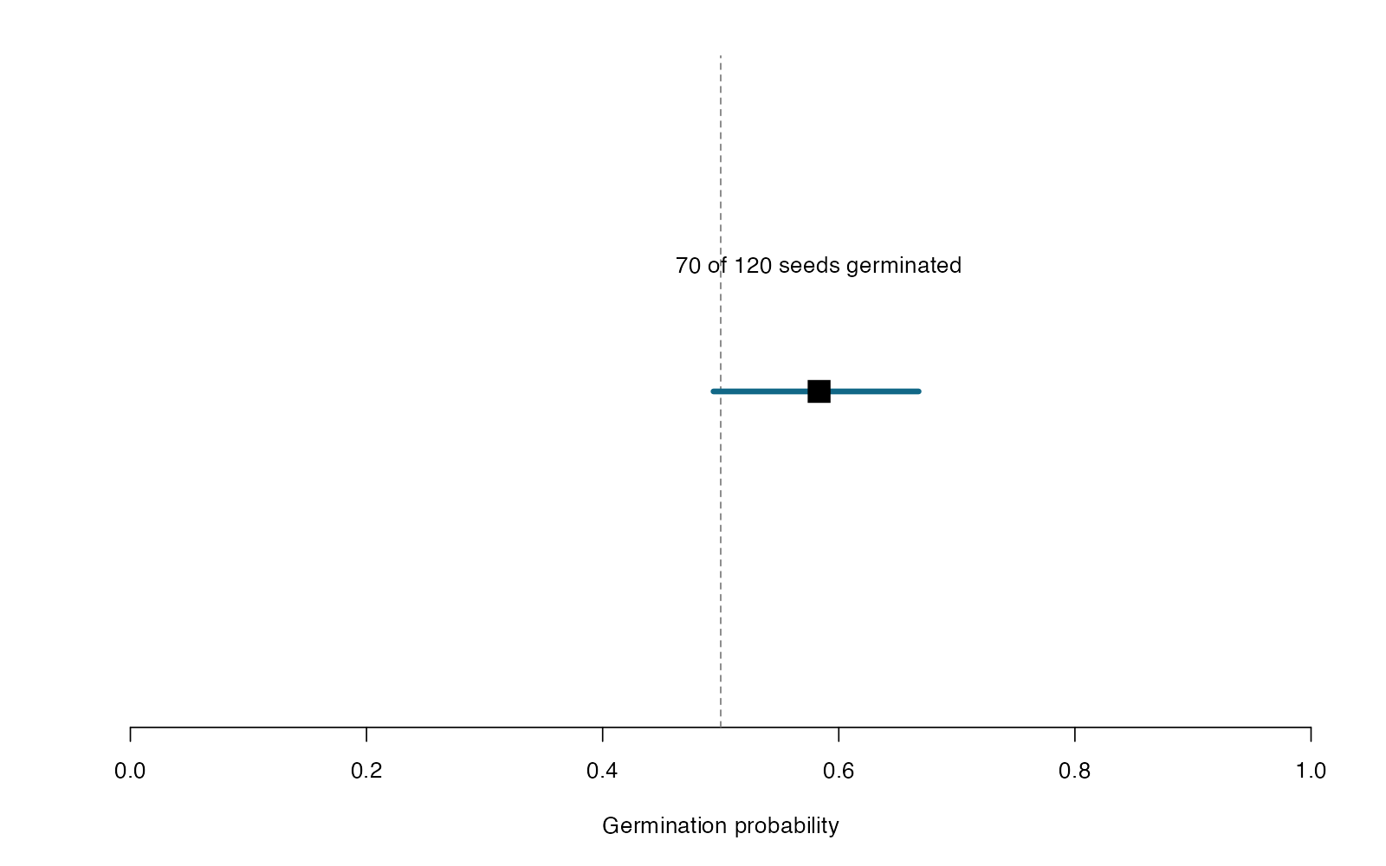
One proportion: see the data
base R arguments
pch = 15 — A filled square marks the estimated probability.
segments — Draw the confidence interval.
xlim — Use the full probability scale.
abline(v = .5) — Show the null benchmark.
One-proportion test — simulated biological data
Notes:
This figure is generated from the saved CSV by modules/one_proportion/analysis.R. A binomial proportion is successes out of a known number of trials; arbitrary continuous percentages are different data.

Slide 263
One proportion: plot code
par(mar = c(5, 3, 2, 1), las = 1)
plot(estimate, 1, xlim = c(0, 1), ylim = c(.7, 1.3), yaxt = "n",
xlab = "Germination probability", ylab = "", bty = "n", type = "n")
abline(v = 0.5, lty = 2, col = "#777777")
segments(ci[1], 1, ci[2], 1, lwd = 4, col = "#126887")
points(estimate, 1, pch = 15, cex = 2.2)
text(estimate, 1.12, paste(x, "of", nrow(d), "seeds germinated"))
Arguments to change
pch = 15 — A filled square marks the estimated probability.
segments — Draw the confidence interval.
xlim — Use the full probability scale.
abline(v = .5) — Show the null benchmark.
Notes:
This is an exact excerpt from analysis.R. Any preparation referenced by the excerpt appears in the complete companion script. The script opens a ragg PNG device before these lines and closes it afterward.

Slide 264
One proportion: question and null
Scientific question
Does the germination probability differ from the 50% benchmark?
Null / estimation target
The population germination probability is 0.50.
Relevant options
prop.test(x, n, p = .5)
correct = FALSE omits continuity correction
The reported interval is for one probability
Notes:
Ask whether rejecting this null, or estimating this target, answers the biological question. A binomial proportion is successes out of a known number of trials; arbitrary continuous percentages are different data.

Slide 265
One proportion: assumptions
What matters here
Independent Bernoulli trials.
Expected successes and failures are sufficiently large.
Seeds sharing an unmodeled tray may be clustered.
Parametric responses
Use a binomial GLM to include dose or genotype.
Use a binomial mixed model to account for trays.
Nonparametric responses
Use binom.test for an exact small-sample test.
A rank test is not a replacement for binary trial data.
Notes:
Begin with the design. A model change should address a specific issue and preserve the scientific target where possible. A rank or permutation alternative has its own assumptions and may change the null; do not choose it solely from a normality-test p-value.

Slide 266
One proportion: run and read
x <- sum(d$germinated)
fit <- prop.test(x, nrow(d), p = 0.5,
alternative = "two.sided", correct = FALSE)
estimate <- x / nrow(d)
ci <- fit$conf.int
Generated results
Germination: 70 / 120
Estimated probability: 0.583
95% score CI: 0.494 to 0.668
Two-sided p = 0.06789
Notes:
Full executed model/test output:
1-sample proportions test without continuity correction
data: x out of nrow(d), null probability 0.5
X-squared = 3.3333, df = 1, p-value = 0.06789
alternative hypothesis: true p is not equal to 0.5
95 percent confidence interval:
0.4938803 0.6676165
sample estimates:
p
0.5833333

Slide 267
One proportion: interpret
Germination was 58.3% (95% score CI 49.4–66.8%; p = 0.0679 against 50%). The test concerns this germination probability, not the mean of arbitrary continuous percentages.
Discuss: What information is lost if you record only a percentage without the number of seeds tested?
Notes:
Teaching point: A binomial proportion is successes out of a known number of trials; arbitrary continuous percentages are different data.
Instructor comparison with the simulated population: The true germination probability is 0.67 rather than the null benchmark 0.50; the population difference is +0.17.
The reported estimate and p-value are calculated from this realized dataset; they need not exactly match the known population effect.

Slide 268
Two proportions: the data
Heat survival in evolved and ancestral yeast
Binary survival in two independent groups
Known number of trials in each group
The target is a difference in survival probabilities
Other data like these
Vaccine uptake in two populations
Hatching success in two crosses
Rooting success under two treatments
Notes:
Two-proportion test
Independent cultures assigned to one genotype; survival is scored once.
group: Culture genotype: Evolved or Ancestral (none)
survived: 1 = survived heat; 0 = died (binary)

Slide 269
Two proportions: simulate and save
set.seed(3103)
d <- data.frame(group = rep(c("Evolved", "Ancestral"), each = 110))
d$survived <- rbinom(220, 1, rep(c(.72, .52), each = 110))
write.csv(d, file.path(out_dir, "data.csv"), row.names = FALSE)
First saved row
group: Evolved
survived: 1
Notes:
Seed: 3103
Generating model: Generate 110 independent evolved cultures and 110 independent ancestral cultures. Survival is Bernoulli with probabilities 0.72 and 0.52, respectively. No batching or pairing is introduced.
Population truth: Evolved minus ancestral survival probability is 0.20, so the equal-probabilities null is false. The corresponding population odds ratio is approximately 2.37.
The script writes data.csv before reading it for analysis. output_dir or out_dir is the folder supplied to the standalone script.
Original saved-data preview:
Evolved | 1
Evolved | 0
Evolved | 1
Evolved | 1
Evolved | 0

Slide 270
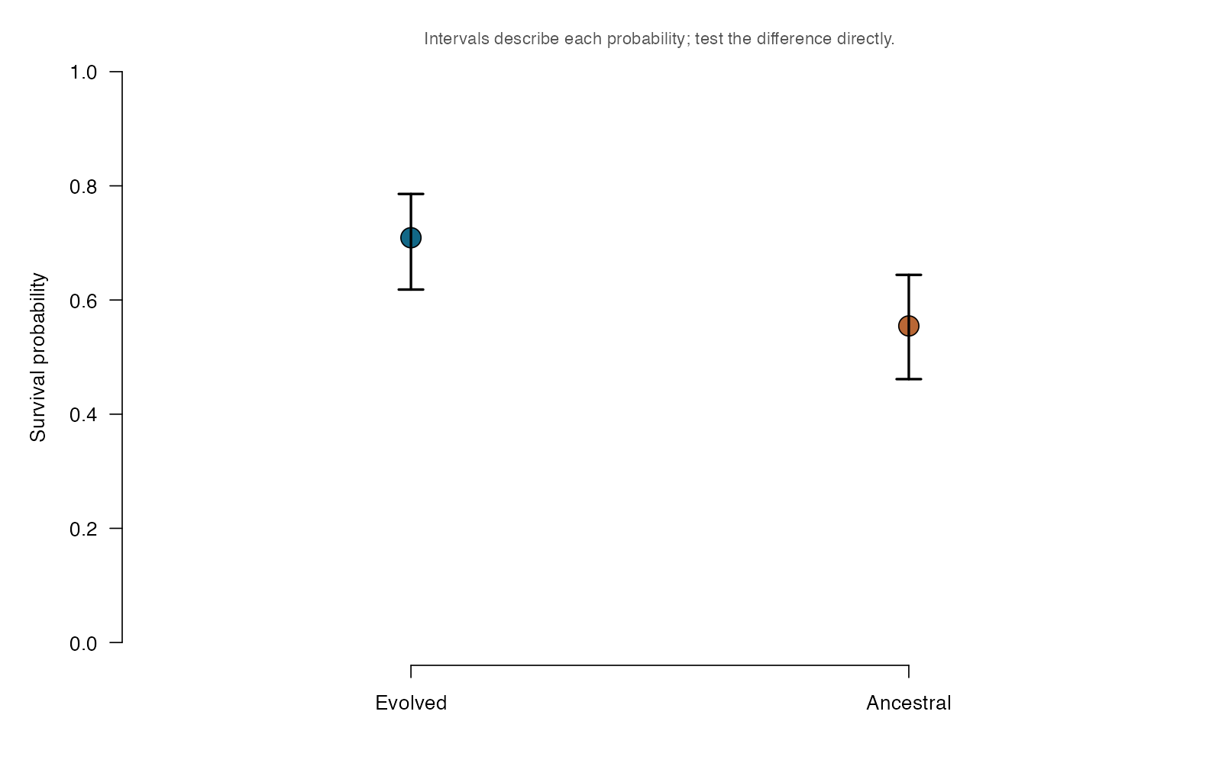
Two proportions: see the data
base R arguments
ylim — Display probabilities on 0–1.
axis — Keep the explicit group order.
arrows — Show separate 95% probability intervals.
pch / bg — Use filled symbols and restrained group colors.
Two-proportion test — simulated biological data
Notes:
This figure is generated from the saved CSV by modules/two_proportions/analysis.R. Keep group order explicit: the contrast is evolved minus ancestral, and its confidence interval addresses the actual comparison.

Slide 271
Two proportions: plot code
par(mar = c(4, 5, 2, 1), las = 1)
plot(1:2, estimate, xlim = c(.5, 2.5), ylim = c(0, 1),
xaxt = "n", xlab = "", ylab = "Survival probability", bty = "n",
pch = 21, bg = c("#126887", "#b96735"), cex = 2.2)
arrows(1:2, group_ci[1, ], 1:2, group_ci[2, ],
code = 3, angle = 90, length = .1, lwd = 2)
axis(1, 1:2, groups)
mtext("Intervals describe each probability; test the difference directly.", 3,
cex = .85, col = "#555555")
Arguments to change
ylim — Display probabilities on 0–1.
axis — Keep the explicit group order.
arrows — Show separate 95% probability intervals.
pch / bg — Use filled symbols and restrained group colors.
Notes:
This is an exact excerpt from analysis.R. Any preparation referenced by the excerpt appears in the complete companion script. The script opens a ragg PNG device before these lines and closes it afterward.

Slide 272
Two proportions: question and null
Scientific question
Does survival probability differ between evolved and ancestral yeast?
Null / estimation target
Evolved and ancestral cultures have equal survival probabilities.
Relevant options
List successes and totals in the same group order.
correct = FALSE uses the uncorrected large-sample test.
The CI follows the first-minus-second group order.
Notes:
Ask whether rejecting this null, or estimating this target, answers the biological question. Keep group order explicit: the contrast is evolved minus ancestral, and its confidence interval addresses the actual comparison.

Slide 273
Two proportions: assumptions
What matters here
Cultures are independent.
Expected cell counts support the large-sample approximation.
Use trials, not percentages without denominators.
Parametric responses
Use logistic regression to adjust for temperature or batch.
Use a binomial mixed model when cultures share batches.
Nonparametric responses
Use Fisher exact inference for sparse 2 × 2 tables.
Permutation of group labels requires exchangeable independent cultures.
Notes:
Begin with the design. A model change should address a specific issue and preserve the scientific target where possible. A rank or permutation alternative has its own assumptions and may change the null; do not choose it solely from a normality-test p-value.

Slide 274
Two proportions: run and read
groups <- c("Evolved", "Ancestral")
x <- sapply(groups, function(g) sum(d$survived[d$group == g]))
n <- sapply(groups, function(g) sum(d$group == g))
fit <- prop.test(x, n, correct = FALSE)
estimate <- x / n
difference <- estimate[1] - estimate[2]
ci <- fit$conf.int
group_ci <- sapply(1:2, function(i) prop.test(x[i], n[i],
correct = FALSE)$conf.int)
Generated results
Evolved: 78 / 110; ancestral: 61 / 110
Difference (evolved − ancestral): 0.155
95% CI for difference: 0.029 to 0.280
Two-sided p = 0.01748
Notes:
Full executed model/test output:
2-sample test for equality of proportions without continuity correction
data: x out of n
X-squared = 5.647, df = 1, p-value = 0.01748
alternative hypothesis: two.sided
95 percent confidence interval:
0.02872612 0.28036479
sample estimates:
prop 1 prop 2
0.7090909 0.5545455

Slide 275
Two proportions: interpret
Evolved minus ancestral survival was 15.5 percentage points (95% CI 2.9 to 28.0; p = 0.0175). The interval for this difference answers the comparison directly.
Discuss: If the groups contain 20 and 200 cultures, why are their denominators essential?
Notes:
Teaching point: Keep group order explicit: the contrast is evolved minus ancestral, and its confidence interval addresses the actual comparison.
Instructor comparison with the simulated population: Evolved minus ancestral survival probability is 0.20, so the equal-probabilities null is false. The corresponding population odds ratio is approximately 2.37.
The reported estimate and p-value are calculated from this realized dataset; they need not exactly match the known population effect.

Slide 276
Chi-square goodness-of-fit: the data
Segregation in an F2 cross
One categorical response with three mutually exclusive outcomes
Observed counts, not percentages
Prespecified Mendelian probabilities: 1/4, 1/2, 1/4
Other data like these
Flower morph ratios
Habitat use versus availability
Mutation classes versus a predicted spectrum
Notes:
Chi-square goodness-of-fit
Each offspring is assigned to one of three genotypes.
offspring: Unique independent offspring identifier (none)
genotype: AA, Aa, or aa genotype category (none)

Slide 277
Chi-square goodness-of-fit: simulate and save
set.seed(3104)
d <- data.frame(offspring = 1:240,
genotype = sample(c("AA", "Aa", "aa"), 240, replace = TRUE,
prob = c(.18, .54, .28)))
write.csv(d, file.path(out_dir, "data.csv"), row.names = FALSE)
First saved row
offspring: 1
genotype: aa
Notes:
Seed: 3104
Generating model: Independently sample 240 offspring genotypes with probabilities AA = 0.18, Aa = 0.54, aa = 0.28. Test against the fixed Mendelian probabilities 0.25, 0.50, 0.25; no probabilities are estimated for the null.
Population truth: The simulated probabilities differ from 1:2:1 by -0.07, +0.04, and +0.03. The goodness-of-fit null is false.
The script writes data.csv before reading it for analysis. output_dir or out_dir is the folder supplied to the standalone script.
Original saved-data preview:
1 | aa
2 | aa
3 | Aa
4 | AA
5 | Aa

Slide 278
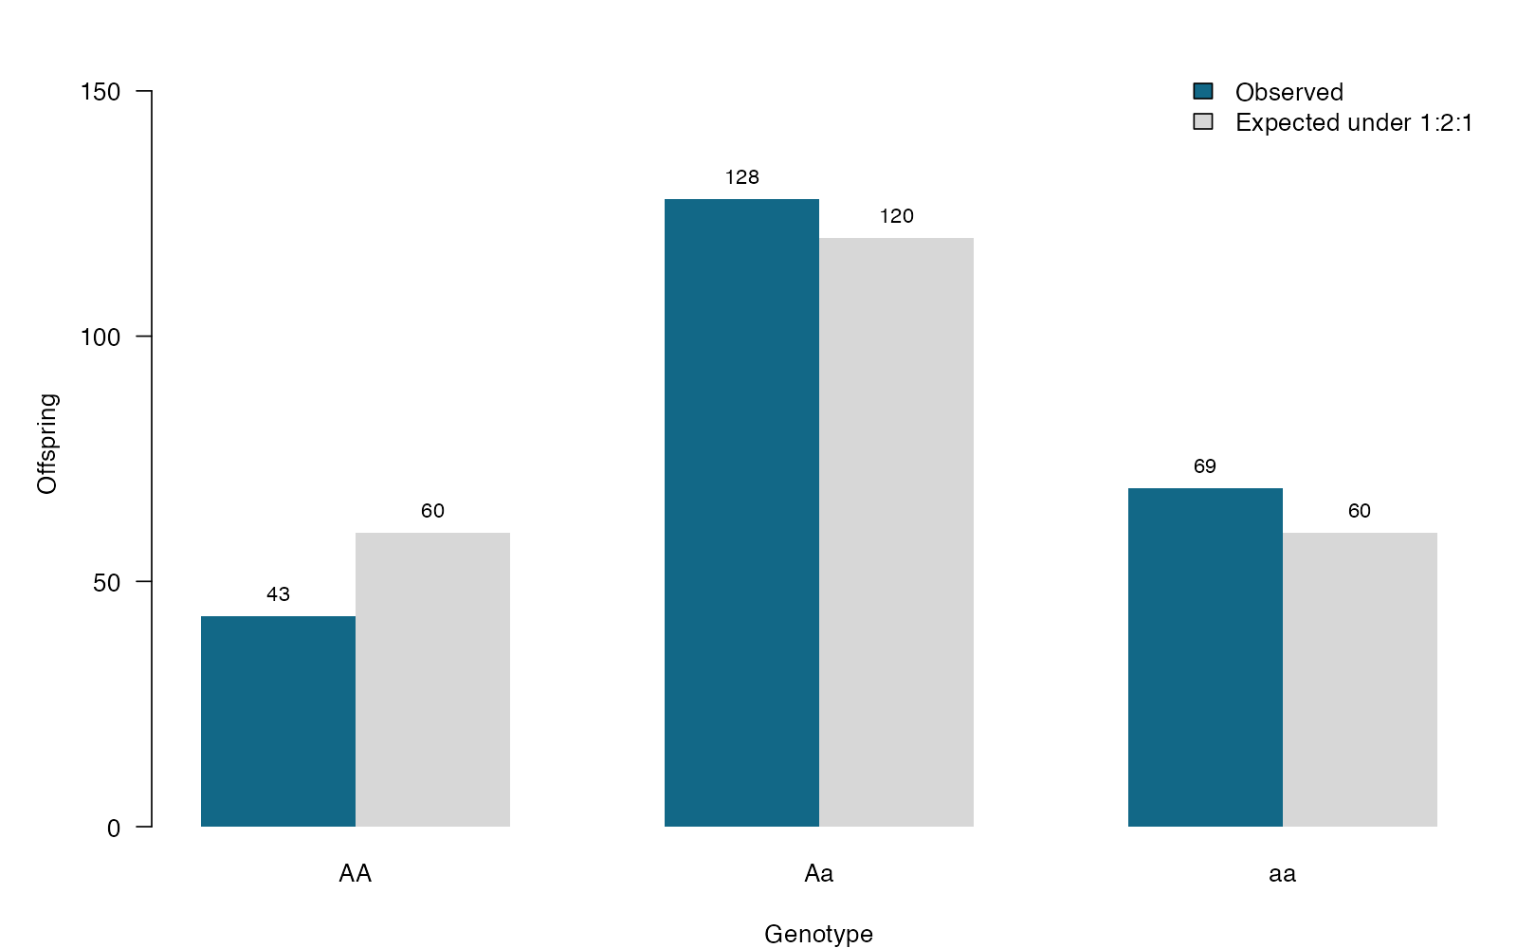
Chi-square goodness-of-fit: see the data
base R arguments
beside = TRUE — Compare observed and expected counts side by side.
names.arg — Label the genotype categories.
legend — Identify observed versus expected bars.
ylim — Leave room for bar labels.
Chi-square goodness-of-fit — simulated biological data
Notes:
This figure is generated from the saved CSV by modules/chi_gof/analysis.R. Expected counts encode the biological hypothesis. Equal expected counts would test a different hypothesis.

Slide 279
Chi-square goodness-of-fit: plot code
par(mar = c(4, 5, 2, 1), las = 1)
bars <- barplot(rbind(Observed = observed, Expected = expected),
beside = TRUE, col = c("#126887", "#d7d7d7"), border = NA,
ylim = c(0, max(observed, expected) * 1.22),
names.arg = names(observed), ylab = "Offspring", xlab = "Genotype")
text(bars, rbind(observed, expected), labels = c(rbind(observed, expected)),
pos = 3, cex = .85)
legend("topright", c("Observed", "Expected under 1:2:1"),
fill = c("#126887", "#d7d7d7"), bty = "n")
Arguments to change
beside = TRUE — Compare observed and expected counts side by side.
names.arg — Label the genotype categories.
legend — Identify observed versus expected bars.
ylim — Leave room for bar labels.
Notes:
This is an exact excerpt from analysis.R. Any preparation referenced by the excerpt appears in the complete companion script. The script opens a ragg PNG device before these lines and closes it afterward.

Slide 280
Chi-square goodness-of-fit: question and null
Scientific question
Do the genotype frequencies follow the expected 1:2:1 segregation ratio?
Null / estimation target
Genotype probabilities are AA = 0.25, Aa = 0.50, and aa = 0.25.
Relevant options
Supply p in exactly the table’s category order.
Use counts as the first argument.
simulate.p.value = TRUE can calibrate sparse multinomial counts.
Notes:
Ask whether rejecting this null, or estimating this target, answers the biological question. Expected counts encode the biological hypothesis. Equal expected counts would test a different hypothesis.

Slide 281
Chi-square goodness-of-fit: assumptions
What matters here
Offspring are independent for the intended model.
Categories are exhaustive and mutually exclusive.
Expected counts support the chi-square approximation.
Parametric responses
Use a multinomial model when probabilities depend on predictors.
If null probabilities were estimated, account for fitted parameters.
Nonparametric responses
Use Monte Carlo multinomial null simulation for sparse counts.
For only two outcomes, use an exact binomial test.
Notes:
Begin with the design. A model change should address a specific issue and preserve the scientific target where possible. A rank or permutation alternative has its own assumptions and may change the null; do not choose it solely from a normality-test p-value.

Slide 282
Chi-square goodness-of-fit: run and read
observed <- table(factor(d$genotype, levels = c("AA", "Aa", "aa")))
fit <- chisq.test(observed, p = c(.25, .50, .25))
expected <- as.numeric(fit$expected)
departures <- observed / sum(observed) - c(.25, .50, .25)
Generated results
Observed: 43, 128, 69
Expected: 60, 120, 60
Chi-square = 6.700; df = 2
p = 0.03508
Notes:
Full executed model/test output:
Chi-squared test for given probabilities
data: observed
X-squared = 6.7, df = 2, p-value = 0.03508

Slide 283
Chi-square goodness-of-fit: interpret
Observed genotype proportions were 0.179, 0.533, 0.287. The goodness-of-fit test gives chi-square(2) = 6.70, p = 0.0351 against the prespecified 1:2:1 ratio; the test does not identify a biological mechanism for the departure.
Discuss: Would equal expected counts answer the same question as a 1:2:1 expected ratio?
Notes:
Teaching point: Expected counts encode the biological hypothesis. Equal expected counts would test a different hypothesis.
Instructor comparison with the simulated population: The simulated probabilities differ from 1:2:1 by -0.07, +0.04, and +0.03. The goodness-of-fit null is false.
The reported estimate and p-value are calculated from this realized dataset; they need not exactly match the known population effect.

Slide 284
Chi-square independence: the data
Infection across three lizard habitats
Two categorical variables: habitat and infection
Counts in a 3 × 2 contingency table
The target is an association between the variables
Other data like these
Phenotype versus treatment
Flower color versus pollinator class
Genotype category versus disease status
Notes:
Chi-square test of independence
Independent lizards sampled once in one of three habitats.
habitat: Sampling habitat: Forest, Grassland, or Urban (none)
infection: Infected or Uninfected status (none)

Slide 285
Chi-square independence: simulate and save
set.seed(3105)
d <- data.frame(habitat = rep(c("Forest", "Grassland", "Urban"), each = 90))
d$infection <- ifelse(rbinom(270, 1, rep(c(.25, .42, .55), each = 90)),
"Infected", "Uninfected")
write.csv(d, file.path(out_dir, "data.csv"), row.names = FALSE)
First saved row
habitat: Forest
infection: Uninfected
Notes:
Seed: 3105
Generating model: Generate 90 independent lizards from each of Forest, Grassland, and Urban habitats. Infection is Bernoulli with probabilities 0.25, 0.42, and 0.55, respectively. No site-level clustering is simulated.
Population truth: Infection probability depends on habitat, so the independence null is false. Urban minus forest infection probability is 0.30; the simulation does not assign causality to habitat.
The script writes data.csv before reading it for analysis. output_dir or out_dir is the folder supplied to the standalone script.
Original saved-data preview:
Forest | Uninfected
Forest | Uninfected
Forest | Uninfected
Forest | Uninfected
Forest | Infected

Slide 286
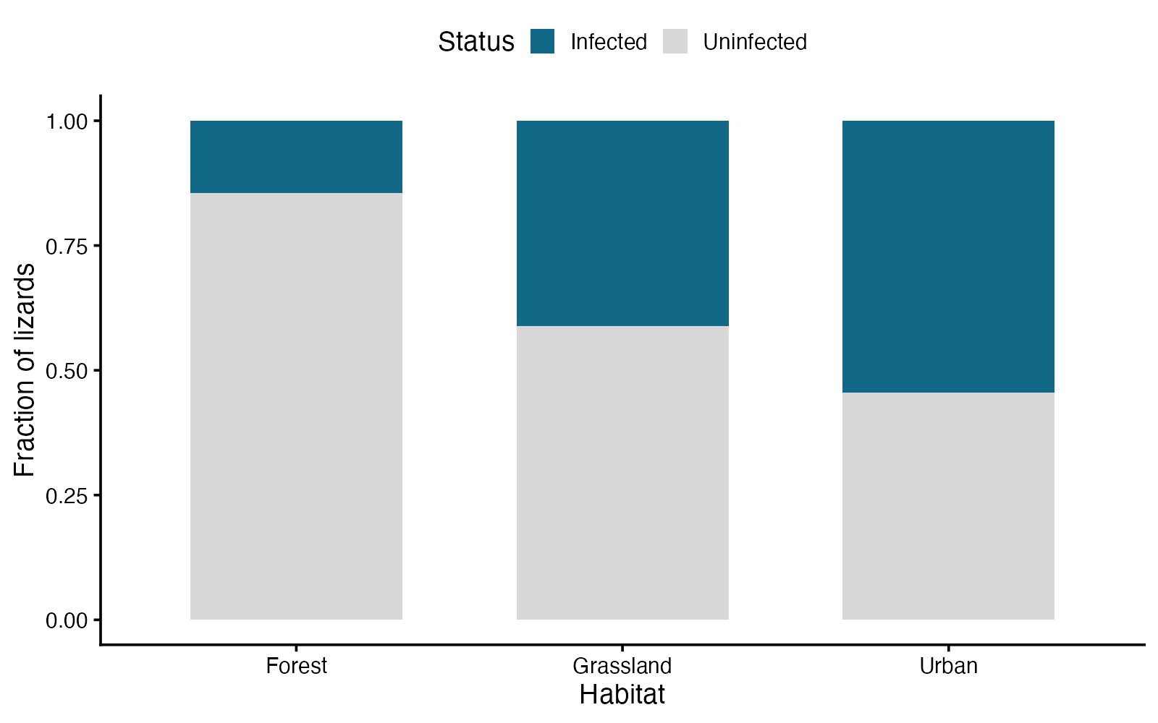
Chi-square independence: see the data
ggplot2 arguments
position = “fill” — Each habitat bar sums to one.
scale_fill_manual — Use the same outcome colors throughout.
scale_y_continuous — Label the axis as a probability.
theme_classic — Keep a clean background.
Chi-square test of independence — simulated biological data
Notes:
This figure is generated from the saved CSV by modules/chi_independence/analysis.R. A significant omnibus association does not establish a causal habitat effect or identify every differing pair.

Slide 287
Chi-square independence: plot code
p <- ggplot2::ggplot(d, ggplot2::aes(habitat, fill = infection)) +
ggplot2::geom_bar(position = "fill", width = .65) +
ggplot2::scale_fill_manual(values = c(Infected = "#126887", Uninfected = "#d8d8d8")) +
ggplot2::scale_y_continuous(limits = c(0, 1)) +
ggplot2::labs(x = "Habitat", y = "Fraction of lizards", fill = "Status") +
ggplot2::theme_classic(base_size = 17) +
ggplot2::theme(legend.position = "top")
print(p)
Arguments to change
position = “fill” — Each habitat bar sums to one.
scale_fill_manual — Use the same outcome colors throughout.
scale_y_continuous — Label the axis as a probability.
theme_classic — Keep a clean background.
Notes:
This is an exact excerpt from analysis.R. Any preparation referenced by the excerpt appears in the complete companion script. The script opens a ragg PNG device before these lines and closes it afterward.

Slide 288
Chi-square independence: question and null
Scientific question
Is infection status associated with habitat?
Null / estimation target
Infection status and habitat are independent; infection probabilities are equal across habitats.
Relevant options
Construct a table from paired categories on each lizard.
correct = FALSE is explicit; Yates correction only applies to 2 × 2.
Inspect expected counts, not only observed counts.
Notes:
Ask whether rejecting this null, or estimating this target, answers the biological question. A significant omnibus association does not establish a causal habitat effect or identify every differing pair.

Slide 289
Chi-square independence: assumptions
What matters here
Lizards are independent.
Each lizard contributes to one table cell.
Expected counts support the chi-square approximation.
Parametric responses
Use logistic regression for infection with covariates.
Use a mixed logistic model if lizards share sampling sites.
Nonparametric responses
Use a Monte Carlo conditional test for sparse larger tables.
Fisher exact inference is an option for sparse tables.
Notes:
Begin with the design. A model change should address a specific issue and preserve the scientific target where possible. A rank or permutation alternative has its own assumptions and may change the null; do not choose it solely from a normality-test p-value.

Slide 290
Chi-square independence: run and read
tab <- table(d$habitat, d$infection)
fit <- chisq.test(tab, correct = FALSE)
cramers_v <- sqrt(as.numeric(fit$statistic) /
(sum(tab) * min(nrow(tab)-1, ncol(tab)-1)))
rates <- prop.table(tab, 1)[, "Infected"]
Generated results
Infection probabilities: Forest 0.14; Grassland 0.41; Urban 0.54
Minimum expected count: 33.0
Chi-square(2) = 32.153
p = 1.042e-07; Cramer V = 0.345
Notes:
Full executed model/test output:
Pearson's Chi-squared test
data: tab
X-squared = 32.153, df = 2, p-value = 1.042e-07

Slide 291
Chi-square independence: interpret
Infection probabilities differed descriptively across habitats (Forest 14%, Grassland 41%, Urban 54%). The independence test gives chi-square(2) = 32.15, p = 1.04e-07; Cramer V = 0.35. This observational association does not establish a habitat effect.
Discuss: Why would treating several lizards from one cage as independent change the analysis?
Notes:
Teaching point: A significant omnibus association does not establish a causal habitat effect or identify every differing pair.
Instructor comparison with the simulated population: Infection probability depends on habitat, so the independence null is false. Urban minus forest infection probability is 0.30; the simulation does not assign causality to habitat.
The reported estimate and p-value are calculated from this realized dataset; they need not exactly match the known population effect.

Slide 292
Fisher exact: the data
Survival of rare resistant and susceptible clones
Two categorical variables in a 2 × 2 table
Small counts, including possibly empty cells
The target is an association, expressed as an odds ratio
Other data like these
Rare infection in two hosts
Mutation presence in two strains
Hatching in small captive crosses
Notes:
Fisher exact test
Two small independent clone groups; binary survival after exposure.
clone: Unique independent clone identifier (none)
type: Susceptible or Resistant clone type (none)
survived: 1 = survived exposure; 0 = died (binary)

Slide 293
Fisher exact: simulate and save
set.seed(3106)
d <- data.frame(clone = 1:24,
type = rep(c("Susceptible", "Resistant"), each = 12))
d$survived <- rbinom(24, 1, rep(c(.20, .65), each = 12))
write.csv(d, file.path(out_dir, "data.csv"), row.names = FALSE)
First saved row
clone: 1
type: Susceptible
survived: 0
Notes:
Seed: 3106
Generating model: Generate 12 independent susceptible clones with survival probability 0.20 and 12 independent resistant clones with probability 0.65. Each contributes one Bernoulli outcome; small table cells are intentional.
Population truth: The resistant-to-susceptible population survival odds ratio is (0.65/0.35)/(0.20/0.80), approximately 7.43. The odds-ratio-one null is false.
The script writes data.csv before reading it for analysis. output_dir or out_dir is the folder supplied to the standalone script.
Original saved-data preview:
1 | Susceptible | 0
2 | Susceptible | 0
3 | Susceptible | 0
4 | Susceptible | 1
5 | Susceptible | 0

Slide 294
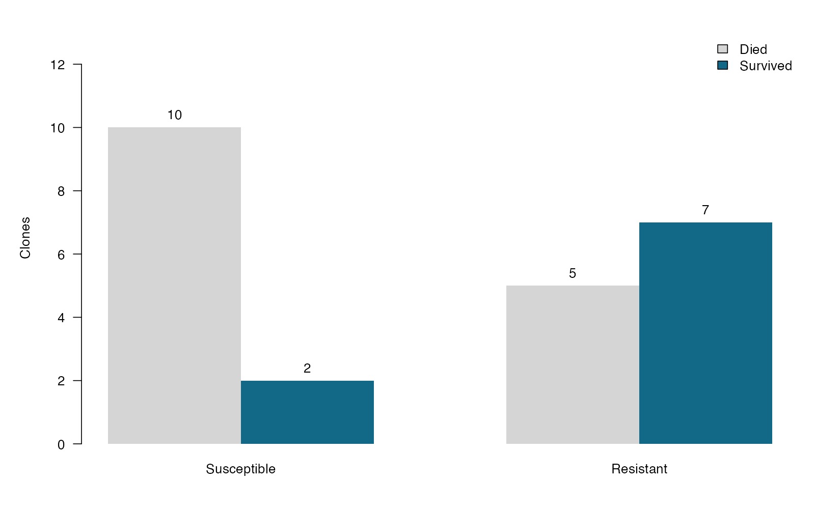
Fisher exact: see the data
base R arguments
beside = TRUE — Show each group’s two outcome counts.
col — Link outcome colors to the legend.
text — Put small counts directly on the bars.
ylim — Leave label space above the bars.
Fisher exact test — simulated biological data
Notes:
This figure is generated from the saved CSV by modules/fisher_exact/analysis.R. Exact inference handles sparse counts, but it cannot create the precision missing from a small sample.

Slide 295
Fisher exact: plot code
par(mar = c(4, 5, 2, 1), las = 1)
bars <- barplot(t(tab), beside = TRUE, border = NA,
col = c("#d5d5d5", "#126887"), ylim = c(0, max(tab) + 3),
names.arg = rownames(tab), ylab = "Clones")
text(bars, t(tab), labels = c(t(tab)), pos = 3)
legend("topright", c("Died", "Survived"),
fill = c("#d5d5d5", "#126887"), bty = "n")
Arguments to change
beside = TRUE — Show each group’s two outcome counts.
col — Link outcome colors to the legend.
text — Put small counts directly on the bars.
ylim — Leave label space above the bars.
Notes:
This is an exact excerpt from analysis.R. Any preparation referenced by the excerpt appears in the complete companion script. The script opens a ragg PNG device before these lines and closes it afterward.

Slide 296
Fisher exact: question and null
Scientific question
Are survival odds associated with clone type?
Null / estimation target
The population odds ratio for clone type and survival is 1.
Relevant options
Check the row and column order before interpreting the odds ratio.
alternative = “two.sided” tests association in either direction.
The confidence interval is for the odds ratio.
Notes:
Ask whether rejecting this null, or estimating this target, answers the biological question. Exact inference handles sparse counts, but it cannot create the precision missing from a small sample.

Slide 297
Fisher exact: assumptions
What matters here
Each clone contributes one independent observation.
Outcomes belong to exactly one table cell.
Use an appropriate paired analysis for matched clones.
Parametric responses
Logistic regression can add predictors; sparse-data methods may be needed.
More observations improve precision when the interval is wide.
Nonparametric responses
Fisher’s test already provides exact conditional inference.
Use an exact paired test for discordant matched pairs.
Notes:
Begin with the design. A model change should address a specific issue and preserve the scientific target where possible. A rank or permutation alternative has its own assumptions and may change the null; do not choose it solely from a normality-test p-value.

Slide 298
Fisher exact: run and read
tab <- table(factor(d$type, levels = c("Susceptible", "Resistant")),
factor(d$survived, levels = c(0, 1)))
fit <- fisher.test(tab, alternative = "two.sided")
odds_ratio <- unname(fit$estimate)
ci <- fit$conf.int
Generated results
Survivors: susceptible 2/12; resistant 7/12
Survival odds ratio (resistant / susceptible): 6.395
95% exact CI: 0.810 to 85.671
Two-sided exact p = 0.08938
Notes:
Full executed model/test output:
Fisher's Exact Test for Count Data
data: tab
p-value = 0.08938
alternative hypothesis: true odds ratio is not equal to 1
95 percent confidence interval:
0.8098091 85.6709653
sample estimates:
odds ratio
6.394505

Slide 299
Fisher exact: interpret
The resistant-to-susceptible survival odds ratio was 6.39 (95% exact CI 0.81–85.67; p = 0.0894). A wide interval reflects limited information from these small groups; odds are not probabilities.
Discuss: Why is an odds ratio of 3 not the same as a threefold survival probability?
Notes:
Teaching point: Exact inference handles sparse counts, but it cannot create the precision missing from a small sample.
Instructor comparison with the simulated population: The resistant-to-susceptible population survival odds ratio is (0.65/0.35)/(0.20/0.80), approximately 7.43. The odds-ratio-one null is false.
The reported estimate and p-value are calculated from this realized dataset; they need not exactly match the known population effect.

Slide 300
McNemar: the data
Antibody detection before and after an exposure season
A binary response at two times
Each mouse supplies a matched pair
Discordant pairs determine evidence for a change
Other data like these
Diagnostic results from two assays
Presence before and after treatment
Two yes/no preferences from each animal
Notes:
McNemar test
The same 80 wild mice are sampled twice.
mouse: Matched mouse identifier (none)
before: Antibody detected at the first visit (1 = yes) (binary)
after: Antibody detected at the second visit (1 = yes) (binary)

Slide 301
McNemar: simulate and save
set.seed(3107)
d <- data.frame(mouse = 1:80, before = rbinom(80, 1, .45))
d$after <- rbinom(80, 1, ifelse(d$before == 1, .85, .35))
write.csv(d, file.path(out_dir, "data.csv"), row.names = FALSE)
First saved row
mouse: 1
before: 1
after: 1
Notes:
Seed: 3107
Generating model: Generate 80 independent mice. Before status is Bernoulli(0.45). Conditional after positivity is 0.85 for a previously positive mouse and 0.35 for a previously negative mouse, producing correlated within-mouse measurements.
Population truth: Marginal after positivity is 0.45×0.85 + 0.55×0.35 = 0.575, a +0.125 change from before. Population gain and loss probabilities are 0.1925 and 0.0675, so the McNemar null is false.
The script writes data.csv before reading it for analysis. output_dir or out_dir is the folder supplied to the standalone script.
Original saved-data preview:
1 | 1 | 1
2 | 1 | 1
3 | 1 | 0
4 | 1 | 0
5 | 0 | 0

Slide 302
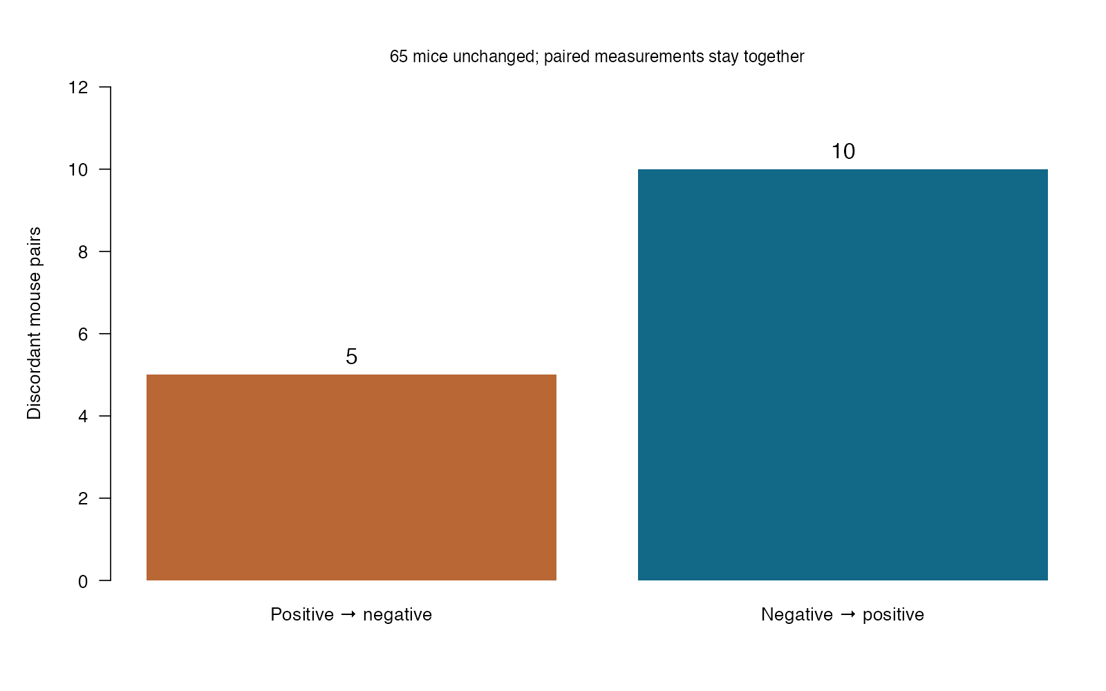
McNemar: see the data
base R arguments
barplot — Focus on the discordant pairs that drive the test.
names.arg — Describe the direction of change.
text — Label the observed transition counts.
mtext — Report the number of unchanged pairs.
McNemar test — simulated biological data
Notes:
This figure is generated from the saved CSV by modules/mcnemar/analysis.R. The information about a change is in discordant pairs. Keeping the mouse identity changes the appropriate test.

Slide 303
McNemar: plot code
par(mar = c(5, 5, 3, 1), las = 1)
counts <- c("Positive → negative" = lost, "Negative → positive" = gained)
bars <- barplot(counts, col = c("#b96735", "#126887"), border = NA,
ylim = c(0, max(counts) * 1.25), ylab = "Discordant mouse pairs")
text(bars, counts, labels = counts, pos = 3, cex = 1.2)
mtext(paste(sum(diag(tab)), "mice unchanged; paired measurements stay together"),
side = 3, cex = .9)
Arguments to change
barplot — Focus on the discordant pairs that drive the test.
names.arg — Describe the direction of change.
text — Label the observed transition counts.
mtext — Report the number of unchanged pairs.
Notes:
This is an exact excerpt from analysis.R. Any preparation referenced by the excerpt appears in the complete companion script. The script opens a ragg PNG device before these lines and closes it afterward.

Slide 304
McNemar: question and null
Scientific question
Does the marginal probability of antibody detection change between visits?
Null / estimation target
The probability of changing from negative to positive equals that of changing from positive to negative.
Relevant options
Build a paired 2 × 2 table: before by after.
correct = FALSE uses the uncorrected approximation.
Use binom.test on discordant pairs for an exact version.
Notes:
Ask whether rejecting this null, or estimating this target, answers the biological question. The information about a change is in discordant pairs. Keeping the mouse identity changes the appropriate test.

Slide 305
McNemar: assumptions
What matters here
Pairs are independent across mice.
Measurements are correctly matched within mice.
The asymptotic test needs enough discordant pairs.
Parametric responses
Use a repeated-measures logistic model for predictors or more times.
Use GEE when a population-average effect is the target.
Nonparametric responses
Use the exact binomial test on discordant pairs when counts are small.
A two-proportion test would discard the pairing.
Notes:
Begin with the design. A model change should address a specific issue and preserve the scientific target where possible. A rank or permutation alternative has its own assumptions and may change the null; do not choose it solely from a normality-test p-value.

Slide 306
McNemar: run and read
tab <- table(factor(d$before, levels = 0:1),
factor(d$after, levels = 0:1))
fit <- mcnemar.test(tab, correct = FALSE)
gained <- tab[1, 2]
lost <- tab[2, 1]
exact <- binom.test(gained, gained + lost, p = .5)
change <- mean(d$after) - mean(d$before)
Generated results
Gained detection: 10; lost detection: 5
Before: 0.438; after: 0.500
Change: 0.062
McNemar p = 0.1967; exact paired p = 0.3018
Notes:
Full executed model/test output:
$McNemar
McNemar's Chi-squared test
data: tab
McNemar's chi-squared = 1.6667, df = 1, p-value = 0.1967
$exact_discordant_pairs
Exact binomial test
data: gained and gained + lost
number of successes = 10, number of trials = 15, p-value = 0.3018
alternative hypothesis: true probability of success is not equal to 0.5
95 percent confidence interval:
0.3838037 0.8817589
sample estimates:
probability of success
0.6666667

Slide 307
McNemar: interpret
Detection changed from 43.8% to 50.0% (change 6.2 percentage points). There were 10 gains and 5 losses; McNemar p = 0.197 and exact paired p = 0.302. The comparison preserves mouse identity.
Discuss: Which two cells would be exchanged if the visits were reversed, and would a two-sided p-value change?
Notes:
Teaching point: The information about a change is in discordant pairs. Keeping the mouse identity changes the appropriate test.
Instructor comparison with the simulated population: Marginal after positivity is 0.45×0.85 + 0.55×0.35 = 0.575, a +0.125 change from before. Population gain and loss probabilities are 0.1925 and 0.0675, so the McNemar null is false.
The reported estimate and p-value are calculated from this realized dataset; they need not exactly match the known population effect.

Slide 308
Cochran Q: the data
Bee visits to three floral odors
Binary visit/no visit response
Three matched conditions for every bee
Independent bees; repeated responses within a bee
Other data like these
Three diagnostic assays per sample
Detection under three protocols
Presence across three paired surveys
Notes:
Cochran’s Q test
Each bee experiences all odors in randomized sessions with a washout.
bee: Independent bee and repeated-measures identifier (none)
odor: Repeated odor condition: A, B, or C (none)
visit: 1 = visit; 0 = no visit (binary)

Slide 309
Cochran Q: simulate and save
set.seed(3108)
bee_effect <- rnorm(60, 0, .8)
d <- data.frame(bee = rep(1:60, each = 3),
odor = rep(c("A", "B", "C"), 60))
d$visit <- rbinom(180, 1,
plogis(-.7 + rep(bee_effect, each = 3) + rep(c(0, .5, 1), 60)))
write.csv(d, file.path(out_dir, "data.csv"), row.names = FALSE)
First saved row
bee: 1
odor: A
visit: 0
Notes:
Seed: 3108
Generating model: Generate 60 independent bees, each with a Normal(0, 0.8²) latent effect. Each bee encounters odors A, B, and C. Visit logits are -0.7 + bee effect + odor effect, with odor effects 0, 0.5, and 1. Outcomes are independent conditional on the bee effect but correlated within a bee marginally.
Population truth: Increasing odor effects produce strictly increasing marginal visit probabilities across A, B, and C. The equal-probabilities null is false; the latent log-odds differences are not themselves the marginal probability differences.
The script writes data.csv before reading it for analysis. output_dir or out_dir is the folder supplied to the standalone script.
Original saved-data preview:
1 | A | 0
1 | B | 1
1 | C | 1
2 | A | 0
2 | B | 1

Slide 310
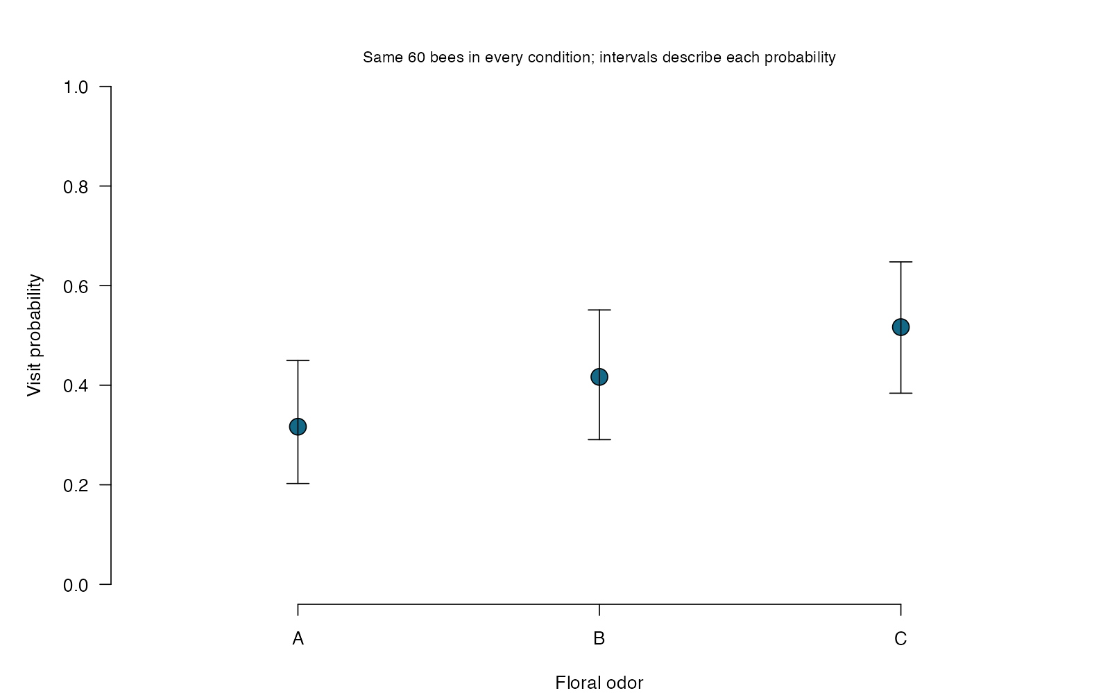
Cochran Q: see the data
base R arguments
arrows — Show separate probability intervals for each odor.
ylim — Use the full 0–1 scale.
axis — Name the repeated conditions.
mtext — Remind the reader that all conditions use the same bees.
Cochran’s Q test — simulated biological data
Notes:
This figure is generated from the saved CSV by modules/cochran_q/analysis.R. A matched omnibus binary test uses complete sets of responses; a significant result does not identify which conditions differ.

Slide 311
Cochran Q: plot code
par(mar = c(4, 5, 3, 1), las = 1)
plot(1:k, rates, xlim = c(.5, k + .5), ylim = c(0, 1),
xaxt = "n", xlab = "Floral odor", ylab = "Visit probability", bty = "n",
pch = 21, bg = "#126887", cex = 2)
arrows(1:k, ci[1, ], 1:k, ci[2, ], code = 3, angle = 90, length = .1)
axis(1, 1:k, colnames(wide))
mtext("Same 60 bees in every condition; intervals describe each probability",
side = 3, cex = .85)
Arguments to change
arrows — Show separate probability intervals for each odor.
ylim — Use the full 0–1 scale.
axis — Name the repeated conditions.
mtext — Remind the reader that all conditions use the same bees.
Notes:
This is an exact excerpt from analysis.R. Any preparation referenced by the excerpt appears in the complete companion script. The script opens a ragg PNG device before these lines and closes it afterward.

Slide 312
Cochran Q: question and null
Scientific question
Are marginal visit probabilities equal for all three odors?
Null / estimation target
The three odor conditions have equal marginal probabilities of a visit.
Relevant options
Keep one row per bee in the matched outcome matrix.
Q uses a chi-square reference with k − 1 degrees of freedom.
An omnibus result needs planned or adjusted follow-up comparisons.
Notes:
Ask whether rejecting this null, or estimating this target, answers the biological question. A matched omnibus binary test uses complete sets of responses; a significant result does not identify which conditions differ.

Slide 313
Cochran Q: assumptions
What matters here
Bees are independent of one another.
Each bee has a complete matched set.
Condition order and carryover are addressed by the design.
Parametric responses
Use repeated-measures logistic regression to model predictors.
Use binary GEE for population-average comparisons.
Nonparametric responses
Q is a nonparametric matched binary test.
Within-bee randomization can be used if justified by the design.
Notes:
Begin with the design. A model change should address a specific issue and preserve the scientific target where possible. A rank or permutation alternative has its own assumptions and may change the null; do not choose it solely from a normality-test p-value.

Slide 314
Cochran Q: run and read
wide <- xtabs(visit ~ bee + odor, data = d)
k <- ncol(wide)
C <- colSums(wide)
R <- rowSums(wide)
Q <- (k - 1) * (k * sum(C^2) - sum(C)^2) /
(k * sum(R) - sum(R^2))
p_value <- pchisq(Q, df = k - 1, lower.tail = FALSE)
rates <- C / nrow(wide)
ci <- sapply(1:k, function(j) binom.test(C[j], nrow(wide))$conf.int)
Generated results
Matched bees: 60; conditions: 3
Visit probabilities: 0.317, 0.417, 0.517
Q = 5.143; df = 2
Omnibus p = 0.07643
Notes:
Full executed model/test output:
$statistic
[1] 5.142857
$df
[1] 2
$p.value
[1] 0.07642629
$visit_probabilities
A B C
0.3166667 0.4166667 0.5166667

Slide 315
Cochran Q: interpret
Visit probabilities were 31.7%, 41.7%, 51.7%. Cochran Q(2) = 5.14, p = 0.0764 tests equality across all odors while retaining matching. It does not identify which odor pairs differ.
Discuss: Why is an ordinary independence chi-square test inappropriate for these repeated visits?
Notes:
Teaching point: A matched omnibus binary test uses complete sets of responses; a significant result does not identify which conditions differ.
Instructor comparison with the simulated population: Increasing odor effects produce strictly increasing marginal visit probabilities across A, B, and C. The equal-probabilities null is false; the latent log-odds differences are not themselves the marginal probability differences.
The reported estimate and p-value are calculated from this realized dataset; they need not exactly match the known population effect.

Slide 316
Logistic regression: the data
Hybrid viability across parental divergence
Binary viability outcome
Continuous predictor: parental divergence (%)
Model a probability through log odds
Other data like these
Infection versus dose
Germination versus temperature
Marker expression versus concentration
Notes:
Logistic regression
One independent hybrid offspring per cross.
cross: Unique independent cross identifier (none)
divergence: Parental divergence (percentage points)
viable: 1 = viable hybrid; 0 = nonviable (binary)

Slide 317
Logistic regression: simulate and save
set.seed(3110)
d <- data.frame(cross = 1:160, divergence = runif(160, 0, 8))
d$viable <- rbinom(160, 1, plogis(1.9 - .5 * d$divergence))
write.csv(d, file.path(out_dir, "data.csv"), row.names = FALSE)
First saved row
cross: 1
divergence: 5.034
viable: 0
Notes:
Seed: 3110
Generating model: Generate 160 independent crosses with divergence Uniform(0,8) percentage points. One hybrid viability outcome per cross is Bernoulli with probability plogis(1.9 - 0.5 × divergence). Predictors are not rounded.
Population truth: The true divergence coefficient is -0.5; viability odds are multiplied by exp(-0.5) ≈ 0.607 per divergence percentage point. The zero-slope null is false. The probability decline is nonlinear.
The script writes data.csv before reading it for analysis. output_dir or out_dir is the folder supplied to the standalone script.
Original saved-data preview:
1 | 5.03366027772427 | 0
2 | 4.56829151697457 | 0
3 | 6.65665970183909 | 0
4 | 5.46810280717909 | 0
5 | 7.20037802867591 | 0

Slide 318
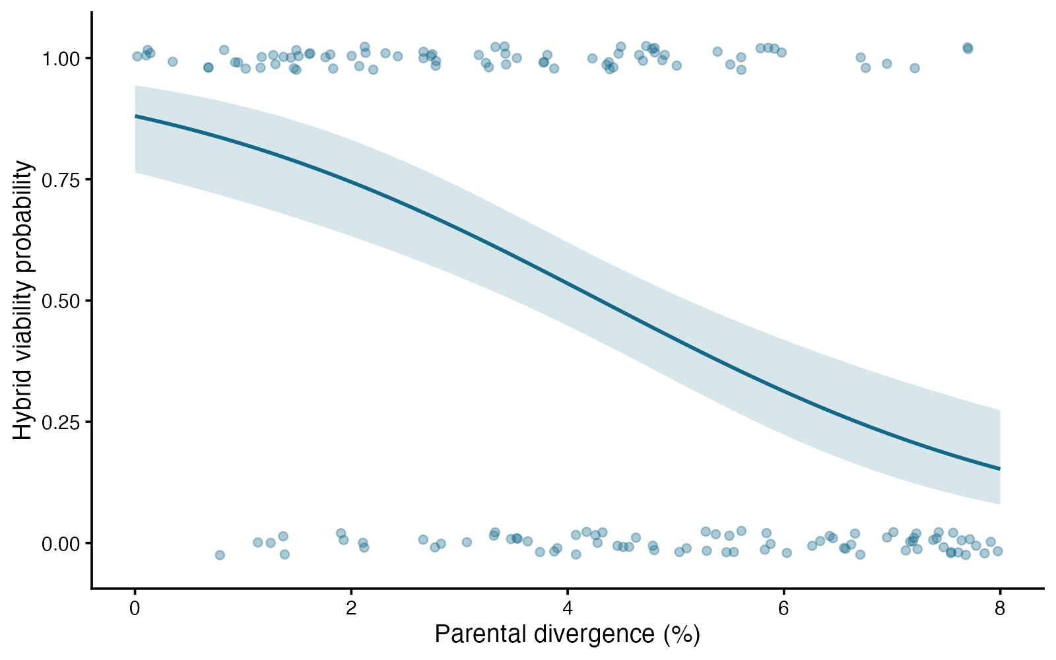
Logistic regression: see the data
ggplot2 arguments
geom_jitter(height) — Separate overlapping binary outcomes slightly.
geom_ribbon — Display a confidence band for the modeled probability.
type = “link” — Compute intervals on the logit scale, then transform.
coord_cartesian — Keep the probability display near 0–1.
Logistic regression — simulated biological data
Notes:
This figure is generated from the saved CSV by modules/logistic/analysis.R. A coefficient describes log odds; translate to odds ratios or plotted probabilities to answer the biological question.

Slide 319
Logistic regression: plot code
p <- ggplot2::ggplot(d, ggplot2::aes(divergence, viable)) +
ggplot2::geom_jitter(width = 0, height = .025, alpha = .35, color = "#126887") +
ggplot2::geom_ribbon(data = grid, ggplot2::aes(x = divergence, ymin = lower,
ymax = upper), inherit.aes = FALSE, fill = "#126887", alpha = .17) +
ggplot2::geom_line(data = grid, ggplot2::aes(y = probability),
color = "#126887", linewidth = 1.2) +
ggplot2::coord_cartesian(ylim = c(-.04, 1.04)) +
ggplot2::labs(x = "Parental divergence (%)", y = "Hybrid viability probability") +
ggplot2::theme_classic(base_size = 17)
print(p)
Arguments to change
geom_jitter(height) — Separate overlapping binary outcomes slightly.
geom_ribbon — Display a confidence band for the modeled probability.
type = “link” — Compute intervals on the logit scale, then transform.
coord_cartesian — Keep the probability display near 0–1.
Notes:
This is an exact excerpt from analysis.R. Any preparation referenced by the excerpt appears in the complete companion script. The script opens a ragg PNG device before these lines and closes it afterward.

Slide 320
Logistic regression: question and null
Scientific question
Does viability probability change with parental divergence?
Null / estimation target
The divergence coefficient is zero: modeled viability odds do not change with divergence.
Relevant options
family = binomial(link = “logit”)
A 1-unit coefficient is a log odds change, not a probability change.
predict(…, type = “response”) returns probabilities.
Notes:
Ask whether rejecting this null, or estimating this target, answers the biological question. A coefficient describes log odds; translate to odds ratios or plotted probabilities to answer the biological question.

Slide 321
Logistic regression: assumptions
What matters here
Offspring are independent in this simulation.
The specified predictor relationship is linear on the logit scale.
Separation or sparse outcomes can destabilize estimates.
Parametric responses
Add a justified nonlinear term if the logit relationship bends.
Use a mixed logistic model for several offspring per cross.
Nonparametric responses
A suitable randomization test must preserve the assignment structure.
There is no rank-test substitute that keeps this probability model and question.
Notes:
Begin with the design. A model change should address a specific issue and preserve the scientific target where possible. A rank or permutation alternative has its own assumptions and may change the null; do not choose it solely from a normality-test p-value.

Slide 322
Logistic regression: run and read
fit <- glm(viable ~ divergence, data = d, family = binomial)
test <- drop1(fit, test = "Chisq")
p_value <- test["divergence", "Pr(>Chi)"]
b <- coef(fit)["divergence"]
se <- sqrt(vcov(fit)["divergence", "divergence"])
odds_ratio <- exp(b)
ci <- exp(b + c(-1, 1) * 1.96 * se)
Generated results
Divergence coefficient: -0.464
Odds ratio per percentage point: 0.629
95% Wald CI for odds ratio: 0.528 to 0.749
Likelihood-ratio p = 6.573e-09
Notes:
Full executed model/test output:
Call:
glm(formula = viable ~ divergence, family = binomial, data = d)
Coefficients:
Estimate Std. Error z value Pr(>|z|)
(Intercept) 1.99600 0.41934 4.760 1.94e-06 ***
divergence -0.46382 0.08915 -5.203 1.96e-07 ***
---
Signif. codes: 0 ‘***’ 0.001 ‘**’ 0.01 ‘*’ 0.05 ‘.’ 0.1 ‘ ’ 1
(Dispersion parameter for binomial family taken to be 1)
Null deviance: 221.78 on 159 degrees of freedom
Residual deviance: 188.12 on 158 degrees of freedom
AIC: 192.12
Number of Fisher Scoring iterations: 4

Slide 323
Logistic regression: interpret
Each additional percentage point of divergence multiplied modeled viability odds by 0.63 (95% Wald CI 0.53–0.75; likelihood-ratio p = 6.57e-09). The curve translates odds into probabilities; this association alone does not establish causation.
Discuss: If several offspring came from each cross, what independent unit would the current analysis ignore?
Notes:
Teaching point: A coefficient describes log odds; translate to odds ratios or plotted probabilities to answer the biological question.
Instructor comparison with the simulated population: The true divergence coefficient is -0.5; viability odds are multiplied by exp(-0.5) ≈ 0.607 per divergence percentage point. The zero-slope null is false. The probability decline is nonlinear.
The reported estimate and p-value are calculated from this realized dataset; they need not exactly match the known population effect.

Slide 324
Multinomial regression: the data
Fish use of three unordered feeding microhabitats
One unordered outcome with three categories
Two independent food-availability groups
Model all category probabilities jointly
Other data like these
Colony morphology classes
Host species choice
Unordered cell fates
Notes:
Multinomial logistic regression
Independent fish encounter either low or high food availability.
food: Low or High food availability (none)
choice: Open, Shelter, or Surface microhabitat (none)

Slide 325
Multinomial regression: simulate and save
set.seed(3114)
d <- data.frame(food = rep(c("Low", "High"), each = 120))
d$choice <- c(sample(c("Open", "Shelter", "Surface"), 120, TRUE,
prob = c(.25, .50, .25)),
sample(c("Open", "Shelter", "Surface"), 120, TRUE,
prob = c(.50, .30, .20)))
write.csv(d, file.path(out_dir, "data.csv"), row.names = FALSE)
First saved row
food: Low
choice: Surface
Notes:
Seed: 3114
Generating model: Generate 120 independent fish choices under Low food with Open/Shelter/Surface probabilities 0.25/0.50/0.25 and 120 under High food with probabilities 0.50/0.30/0.20. Choices are unordered, mutually exclusive, and independent.
Population truth: The outcome distributions differ, so the joint no-food-effect null is false. Relative to Open, the food coefficients are log(0.30/0.50)-log(0.50/0.25) ≈ -1.204 for Shelter and log(0.20/0.50)-log(0.25/0.25) ≈ -0.916 for Surface.
The script writes data.csv before reading it for analysis. output_dir or out_dir is the folder supplied to the standalone script.
Original saved-data preview:
Low | Surface
Low | Shelter
Low | Shelter
Low | Shelter
Low | Surface

Slide 326
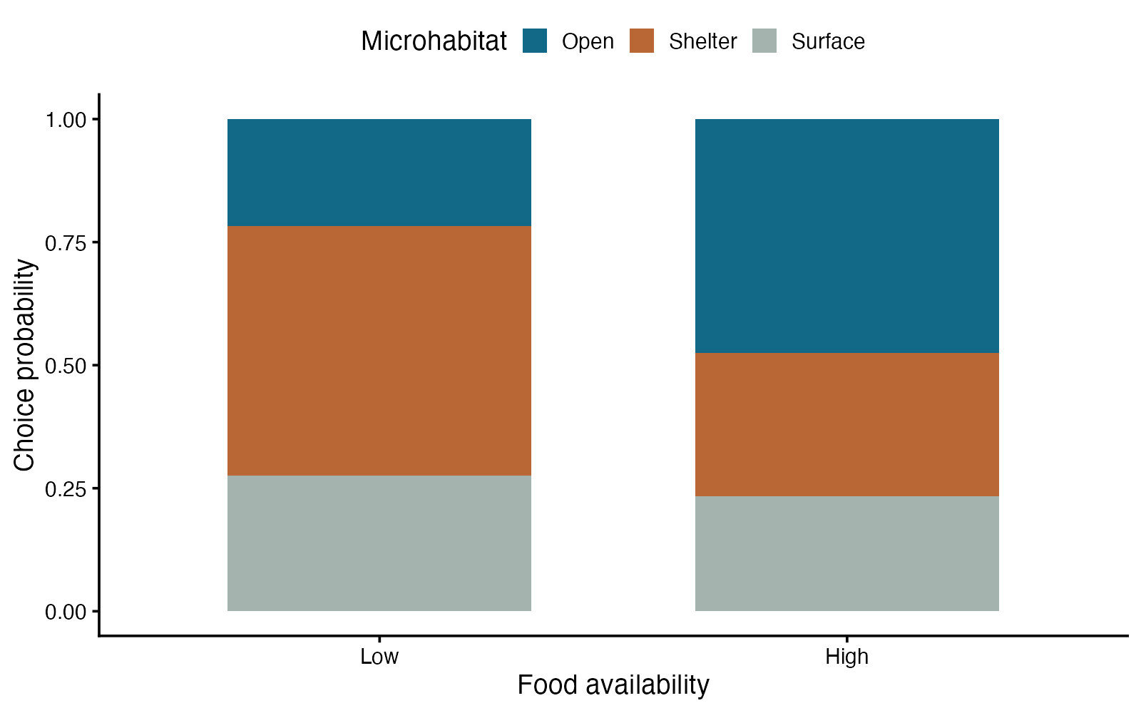
Multinomial regression: see the data
ggplot2 arguments
position = “fill” — Compare distributions of choices.
scale_fill_manual — Use distinct, consistent category colors.
labs(fill) — Name the biological response in the legend.
width — Leave breathing room between bars.
Multinomial logistic regression — simulated biological data
Notes:
This figure is generated from the saved CSV by modules/multinomial/analysis.R. A categorical response with more than two levels requires a joint question across several coefficients.

Slide 327
Multinomial regression: plot code
p <- ggplot2::ggplot(d, ggplot2::aes(food, fill = choice)) +
ggplot2::geom_bar(position = "fill", width = .65) +
ggplot2::scale_fill_manual(values = c(Open = "#126887", Shelter = "#b96735",
Surface = "#a4b3ad")) +
ggplot2::labs(x = "Food availability", y = "Choice probability", fill = "Microhabitat") +
ggplot2::theme_classic(base_size = 17) +
ggplot2::theme(legend.position = "top")
print(p)
Arguments to change
position = “fill” — Compare distributions of choices.
scale_fill_manual — Use distinct, consistent category colors.
labs(fill) — Name the biological response in the legend.
width — Leave breathing room between bars.
Notes:
This is an exact excerpt from analysis.R. Any preparation referenced by the excerpt appears in the complete companion script. The script opens a ragg PNG device before these lines and closes it afterward.

Slide 328
Multinomial regression: question and null
Scientific question
Does food availability change the distribution of feeding microhabitat choices?
Null / estimation target
All nonreference food coefficients are zero; microhabitat probabilities are the same under low and high food.
Relevant options
Choose the outcome reference category deliberately.
Fit the same data for the full and null models.
Use a joint likelihood-ratio test for the multi-coefficient predictor.
Notes:
Ask whether rejecting this null, or estimating this target, answers the biological question. A categorical response with more than two levels requires a joint question across several coefficients.

Slide 329
Multinomial regression: assumptions
What matters here
Fish contribute independent choices.
Categories are mutually exclusive and sufficiently populated.
The multinomial model’s relative-odds structure is appropriate.
Parametric responses
Use a richer multinomial model for additional predictors.
Use a model for dependent choices when observations repeat.
Nonparametric responses
A contingency-table test answers the same no-association question with one categorical predictor.
A randomization test must follow the food-assignment design.
Notes:
Begin with the design. A model change should address a specific issue and preserve the scientific target where possible. A rank or permutation alternative has its own assumptions and may change the null; do not choose it solely from a normality-test p-value.

Slide 330
Multinomial regression: run and read
d$food <- factor(d$food, levels = c("Low", "High"))
d$choice <- factor(d$choice, levels = c("Open", "Shelter", "Surface"))
fit <- nnet::multinom(choice ~ food, data = d, trace = FALSE)
fit0 <- nnet::multinom(choice ~ 1, data = d, trace = FALSE)
LR <- 2 * as.numeric(logLik(fit) - logLik(fit0))
df <- attr(logLik(fit), "df") - attr(logLik(fit0), "df")
p_value <- pchisq(LR, df, lower.tail = FALSE)
Generated results
Low-food probabilities: 0.217, 0.508, 0.275
High-food probabilities: 0.475, 0.292, 0.233
Likelihood ratio = 19.404; df = 2
Joint p = 6.115e-05
Notes:
Full executed model/test output:
Call:
nnet::multinom(formula = choice ~ food, data = d, trace = FALSE)
Coefficients:
(Intercept) foodHigh
Shelter 0.8527665 -1.3404733
Surface 0.2384121 -0.9492706
Std. Errors:
(Intercept) foodHigh
Shelter 0.2342112 0.3177579
Surface 0.2622292 0.3493172
Residual Deviance: 499.8932
AIC: 507.8932

Slide 331
Multinomial regression: interpret
Predicted probabilities for open/shelter/surface were 0.22/0.51/0.28 under low food and 0.48/0.29/0.23 under high food. The joint likelihood-ratio test gives chi-square(2) = 19.40, p = 6.11e-05; it tests the whole distribution of choices.
Discuss: Why does one food predictor require two coefficients when the response has three unordered categories?
Notes:
Teaching point: A categorical response with more than two levels requires a joint question across several coefficients.
Instructor comparison with the simulated population: The outcome distributions differ, so the joint no-food-effect null is false. Relative to Open, the food coefficients are log(0.30/0.50)-log(0.50/0.25) ≈ -1.204 for Shelter and log(0.20/0.50)-log(0.25/0.25) ≈ -0.916 for Surface.
The reported estimate and p-value are calculated from this realized dataset; they need not exactly match the known population effect.

Slide 332
Ordinal regression: the data
Coral bleaching severity along a temperature gradient
Ordered categories: none, mild, moderate, severe
Continuous temperature predictor
Distances between score levels are not assumed equal
Other data like these
Ordered disease grades
Behavioral response intensity classes
Developmental stage ratings
Notes:
Ordinal logistic regression
Independent coral fragments are assigned a four-level ordered bleaching score.
fragment: Unique independent coral fragment identifier (none)
temperature: Experimental temperature (°C)
severity: Ordered bleaching level: None < Mild < Moderate < Severe (none)

Slide 333
Ordinal regression: simulate and save
set.seed(3115)
d <- data.frame(fragment = 1:180, temperature = runif(180, 26, 32))
latent <- .8 * (d$temperature - 28) + rlogis(180)
d$severity <- cut(latent, c(-Inf, -1, .7, 2.2, Inf),
labels = c("None", "Mild", "Moderate", "Severe"))
write.csv(d, file.path(out_dir, "data.csv"), row.names = FALSE)
First saved row
fragment: 1
temperature: 28.15
severity: Moderate
Notes:
Seed: 3115
Generating model: Generate 180 independent fragments with temperature Uniform(26,32) °C. Latent severity is 0.8 × (temperature - 28) plus a standard logistic error. Cut at -1, 0.7, and 2.2 to obtain None, Mild, Moderate, Severe. Do not treat category spacing as numeric distance.
Population truth: The common temperature coefficient is 0.8, so each °C multiplies odds of higher versus lower severity by exp(0.8) ≈ 2.226 at every cumulative threshold. The zero-effect null is false and proportional odds holds by construction.
The script writes data.csv before reading it for analysis. output_dir or out_dir is the folder supplied to the standalone script.
Original saved-data preview:
1 | 28.15313 | Moderate
2 | 28.30287 | None
3 | 27.62607 | None
4 | 27.56123 | Mild
5 | 31.16458 | Moderate

Slide 334
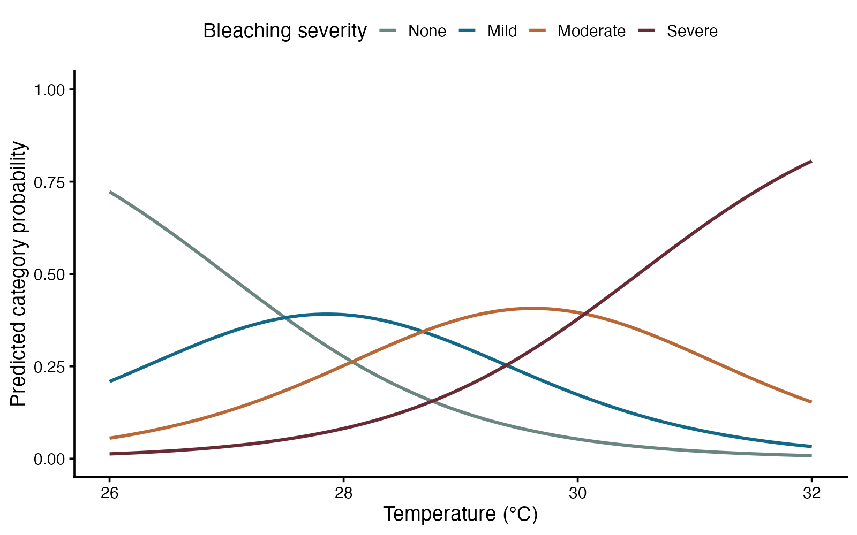
Ordinal regression: see the data
ggplot2 arguments
color = severity — Track each ordered category’s probability.
geom_line — Show probabilities across the temperature gradient.
scale_color_manual — Use an ordered color progression.
ylim(0, 1) — Keep probabilities on their natural scale.
Ordinal logistic regression — simulated biological data
Notes:
This figure is generated from the saved CSV by modules/ordinal_logistic/analysis.R. Ordering carries information without assuming equal distances; the common effect across thresholds is the key model assumption.

Slide 335
Ordinal regression: plot code
p <- ggplot2::ggplot(plot_data, ggplot2::aes(temperature, probability,
color = severity)) +
ggplot2::geom_line(linewidth = 1.3) +
ggplot2::scale_color_manual(values = c(None = "#6b8581", Mild = "#126887",
Moderate = "#b96735", Severe = "#682b35")) +
ggplot2::ylim(0, 1) +
ggplot2::labs(x = "Temperature (°C)", y = "Predicted category probability",
color = "Bleaching severity") +
ggplot2::theme_classic(base_size = 17) +
ggplot2::theme(legend.position = "top")
print(p)
Arguments to change
color = severity — Track each ordered category’s probability.
geom_line — Show probabilities across the temperature gradient.
scale_color_manual — Use an ordered color progression.
ylim(0, 1) — Keep probabilities on their natural scale.
Notes:
This is an exact excerpt from analysis.R. Any preparation referenced by the excerpt appears in the complete companion script. The script opens a ragg PNG device before these lines and closes it afterward.

Slide 336
Ordinal regression: question and null
Scientific question
Does temperature shift bleaching severity toward higher ordered categories?
Null / estimation target
The common temperature coefficient is zero; the modeled severity distribution does not change with temperature.
Relevant options
Mark the response as ordered in the correct direction.
link = “logit” fits cumulative proportional odds.
exp(coefficient) compares odds of higher versus lower severity.
Notes:
Ask whether rejecting this null, or estimating this target, answers the biological question. Ordering carries information without assuming equal distances; the common effect across thresholds is the key model assumption.

Slide 337
Ordinal regression: assumptions
What matters here
Coral fragments are independent.
A common temperature effect across cumulative thresholds is plausible.
The predictor relationship on the logit scale is appropriate.
Parametric responses
Use partial proportional-odds or multinomial models if the common effect fails.
Use an ordinal mixed model for clustered fragments.
Nonparametric responses
Spearman association can address monotonic ordering with a different null.
A design-based permutation test must preserve the treatment structure.
Notes:
Begin with the design. A model change should address a specific issue and preserve the scientific target where possible. A rank or permutation alternative has its own assumptions and may change the null; do not choose it solely from a normality-test p-value.

Slide 338
Ordinal regression: run and read
d$severity <- ordered(d$severity, levels = c("None", "Mild", "Moderate", "Severe"))
fit <- ordinal::clm(severity ~ temperature, data = d, link = "logit")
fit0 <- ordinal::clm(severity ~ 1, data = d, link = "logit")
LR <- 2 * as.numeric(logLik(fit) - logLik(fit0))
p_value <- pchisq(LR, df = 1, lower.tail = FALSE)
b <- fit$beta["temperature"]
se <- sqrt(vcov(fit)["temperature", "temperature"])
odds_ratio <- exp(b)
ci <- exp(b + c(-1, 1) * 1.96 * se)
Generated results
Common odds ratio per 1°C: 2.613
95% Wald CI: 2.105 to 3.244
Likelihood ratio = 97.836; df = 1
p = 4.544e-23
Notes:
Full executed model/test output:
formula: severity ~ temperature
data: d
link threshold nobs logLik AIC niter max.grad cond.H
logit flexible 180 -200.34 408.69 5(0) 2.85e-11 1.3e+06
Coefficients:
Estimate Std. Error z value Pr(>|z|)
temperature 0.9606 0.1103 8.71 <2e-16 ***
---
Signif. codes: 0 ‘***’ 0.001 ‘**’ 0.01 ‘*’ 0.05 ‘.’ 0.1 ‘ ’ 1
Threshold coefficients:
Estimate Std. Error z value
None|Mild 25.935 3.098 8.373
Mild|Moderate 27.589 3.178 8.682
Moderate|Severe 29.316 3.273 8.957

Slide 339
Ordinal regression: interpret
Each 1°C increase multiplied the modeled odds of higher rather than lower bleaching severity by 2.61 (95% Wald CI 2.11–3.24; likelihood-ratio p = 4.54e-23), assuming the same temperature effect across thresholds.
Discuss: Why would treating none/mild/moderate/severe as equally spaced numbers add an assumption?
Notes:
Teaching point: Ordering carries information without assuming equal distances; the common effect across thresholds is the key model assumption.
Instructor comparison with the simulated population: The common temperature coefficient is 0.8, so each °C multiplies odds of higher versus lower severity by exp(0.8) ≈ 2.226 at every cumulative threshold. The zero-effect null is false and proportional odds holds by construction.
The reported estimate and p-value are calculated from this realized dataset; they need not exactly match the known population effect.

Slide 340
Exact Poisson: the data
De novo mutations in sequenced microbial lineages
Nonnegative mutation counts
Known exposure: callable megabases
Target: mutations per megabase, compared with a benchmark
Other data like these
Colonies per milliliter
Rare events per observation hour
Parasites per surveyed area
Notes:
Exact Poisson rate test
Independent lineages have different amounts of callable sequence.
lineage: Unique independent microbial lineage (none)
megabases: Callable sequence exposure (Mb)
mutations: Observed de novo mutations (count)

Slide 341
Exact Poisson: simulate and save
set.seed(3109)
d <- data.frame(lineage = 1:60, megabases = runif(60, 8, 20))
d$mutations <- rpois(60, .40 * d$megabases)
write.csv(d, file.path(out_dir, "data.csv"), row.names = FALSE)
First saved row
lineage: 1
megabases: 14.79
mutations: 7
Notes:
Seed: 3109
Generating model: Generate 60 independent lineages with callable sequence Uniform(8,20) megabases. Each count is Poisson with mean 0.40 × callable megabases. The population rate is constant across lineages and exposure is unrounded.
Population truth: The true rate is 0.40 mutations/Mb rather than the null rate 0.25/Mb. The population rate ratio to the null is 1.6.
The script writes data.csv before reading it for analysis. output_dir or out_dir is the folder supplied to the standalone script.
Original saved-data preview:
1 | 14.7936320584267 | 7
2 | 19.4386634835973 | 6
3 | 19.1721002459526 | 3
4 | 12.0031125238165 | 4
5 | 18.0816876189783 | 5

Slide 342
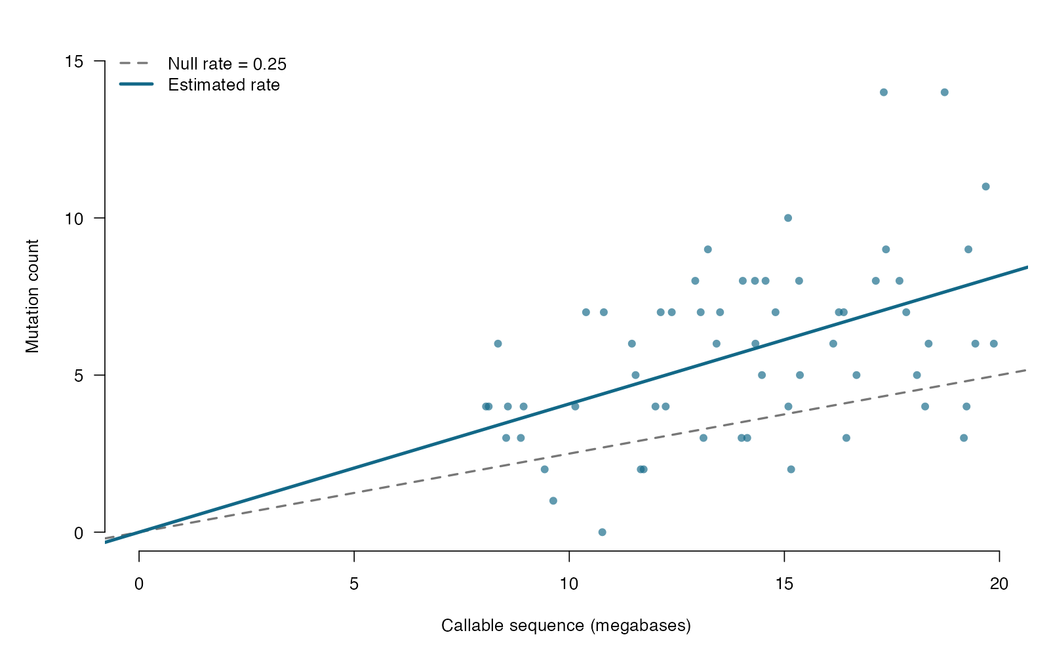
Exact Poisson: see the data
base R arguments
abline(a = 0, b = rate) — A rate becomes a count-versus-exposure slope.
pch / col — Use readable points with modest transparency.
legend — Distinguish the null and estimated rates.
xlab — Show exposure units explicitly.
Exact Poisson rate test — simulated biological data
Notes:
This figure is generated from the saved CSV by modules/poisson_exact/analysis.R. A count becomes a rate only after the exposure and its units are supplied.

Slide 343
Exact Poisson: plot code
par(mar = c(5, 5, 2, 1), las = 1)
plot(d$megabases, d$mutations, pch = 16, col = "#126887AA", bty = "n",
xlab = "Callable sequence (megabases)", ylab = "Mutation count",
xlim = c(0, max(d$megabases)), ylim = c(0, max(d$mutations) + 1))
abline(a = 0, b = .25, lty = 2, col = "#777777", lwd = 2)
abline(a = 0, b = rate, col = "#126887", lwd = 3)
legend("topleft", c("Null rate = 0.25", "Estimated rate"),
lty = c(2, 1), lwd = c(2, 3), col = c("#777777", "#126887"), bty = "n")
Arguments to change
abline(a = 0, b = rate) — A rate becomes a count-versus-exposure slope.
pch / col — Use readable points with modest transparency.
legend — Distinguish the null and estimated rates.
xlab — Show exposure units explicitly.
Notes:
This is an exact excerpt from analysis.R. Any preparation referenced by the excerpt appears in the complete companion script. The script opens a ragg PNG device before these lines and closes it afterward.

Slide 344
Exact Poisson: question and null
Scientific question
Does the mutation rate differ from 0.25 mutations per callable megabase?
Null / estimation target
The common mutation rate is 0.25 per callable megabase.
Relevant options
x = total events; T = total exposure
r = the null rate in the same exposure units
alternative = “two.sided” compares either direction
Notes:
Ask whether rejecting this null, or estimating this target, answers the biological question. A count becomes a rate only after the exposure and its units are supplied.

Slide 345
Exact Poisson: assumptions
What matters here
Events follow a Poisson process at a common rate.
Lineages contribute independent counts.
Exposure is measured correctly; extra heterogeneity can inflate variance.
Parametric responses
Use a Poisson GLM with log-exposure offset for predictors.
Use negative binomial or quasi-Poisson for extra variation.
Nonparametric responses
A lineage-level bootstrap can estimate rate uncertainty with many lineages.
A count rank test does not automatically compare rates when exposures differ.
Notes:
Begin with the design. A model change should address a specific issue and preserve the scientific target where possible. A rank or permutation alternative has its own assumptions and may change the null; do not choose it solely from a normality-test p-value.

Slide 346
Exact Poisson: run and read
fit <- poisson.test(sum(d$mutations), T = sum(d$megabases),
r = .25, alternative = "two.sided")
rate <- sum(d$mutations) / sum(d$megabases)
ci <- fit$conf.int
Generated results
Events: 345; exposure: 845.0 Mb
Rate: 0.408 mutations/Mb
95% exact CI: 0.366 to 0.454
Exact p = 3.246e-17
Notes:
Full executed model/test output:
Exact Poisson test
data: sum(d$mutations) time base: sum(d$megabases)
number of events = 345, time base = 844.99, p-value < 2.2e-16
alternative hypothesis: true event rate is not equal to 0.25
95 percent confidence interval:
0.3663373 0.4537273
sample estimates:
event rate
0.4082887

Slide 347
Exact Poisson: interpret
The mutation rate was 0.408 per callable Mb (95% exact CI 0.366–0.454; p = 3.25e-17 against 0.25/Mb). Pooling counts is justified here by the common-rate Poisson model.
Discuss: How would the estimated rate and its units change if exposure were entered in kilobases?
Notes:
Teaching point: A count becomes a rate only after the exposure and its units are supplied.
Instructor comparison with the simulated population: The true rate is 0.40 mutations/Mb rather than the null rate 0.25/Mb. The population rate ratio to the null is 1.6.
The reported estimate and p-value are calculated from this realized dataset; they need not exactly match the known population effect.

Slide 348
Poisson regression: the data
Coral recruit counts and live coral cover
Nonnegative counts per transect
Known area exposure in square meters
Continuous predictor: live coral cover (%)
Other data like these
Mutations per callable base
Colonies per volume of medium
Encounters per hour of observation
Notes:
Poisson regression
Independent transects differ in surveyed area and live coral cover.
transect: Unique independent transect identifier (none)
cover: Live coral cover (percentage points)
area: Surveyed transect area (m²)
recruits: Observed coral recruits (count)

Slide 349
Poisson regression: simulate and save
set.seed(3111)
d <- data.frame(transect = 1:120, cover = runif(120, 0, 80),
area = runif(120, 2, 8))
d$recruits <- rpois(120, d$area * exp(-.5 + .016 * d$cover))
write.csv(d, file.path(out_dir, "data.csv"), row.names = FALSE)
First saved row
transect: 1
cover: 56.65
area: 7.215
recruits: 15
Notes:
Seed: 3111
Generating model: Generate 120 independent transects. Cover is Uniform(0,80) percentage points and area is independently Uniform(2,8) square meters. Recruit counts are Poisson(area × exp(-0.5 + 0.016 × cover)). No clustering or rounding is introduced.
Population truth: The true cover coefficient is 0.016. A 10-point cover increase multiplies recruit density by exp(0.16) ≈ 1.174. The zero-slope null is false, and the exposure coefficient is fixed at one.
The script writes data.csv before reading it for analysis. output_dir or out_dir is the folder supplied to the standalone script.
Original saved-data preview:
1 | 56.6454520076513 | 7.21462797746062 | 15
2 | 58.0549041554332 | 6.60326516302302 | 9
3 | 23.0353081598878 | 7.21808331925422 | 5
4 | 9.47735395282507 | 4.16359867714345 | 3
5 | 75.7575953565538 | 6.12687354674563 | 12

Slide 350
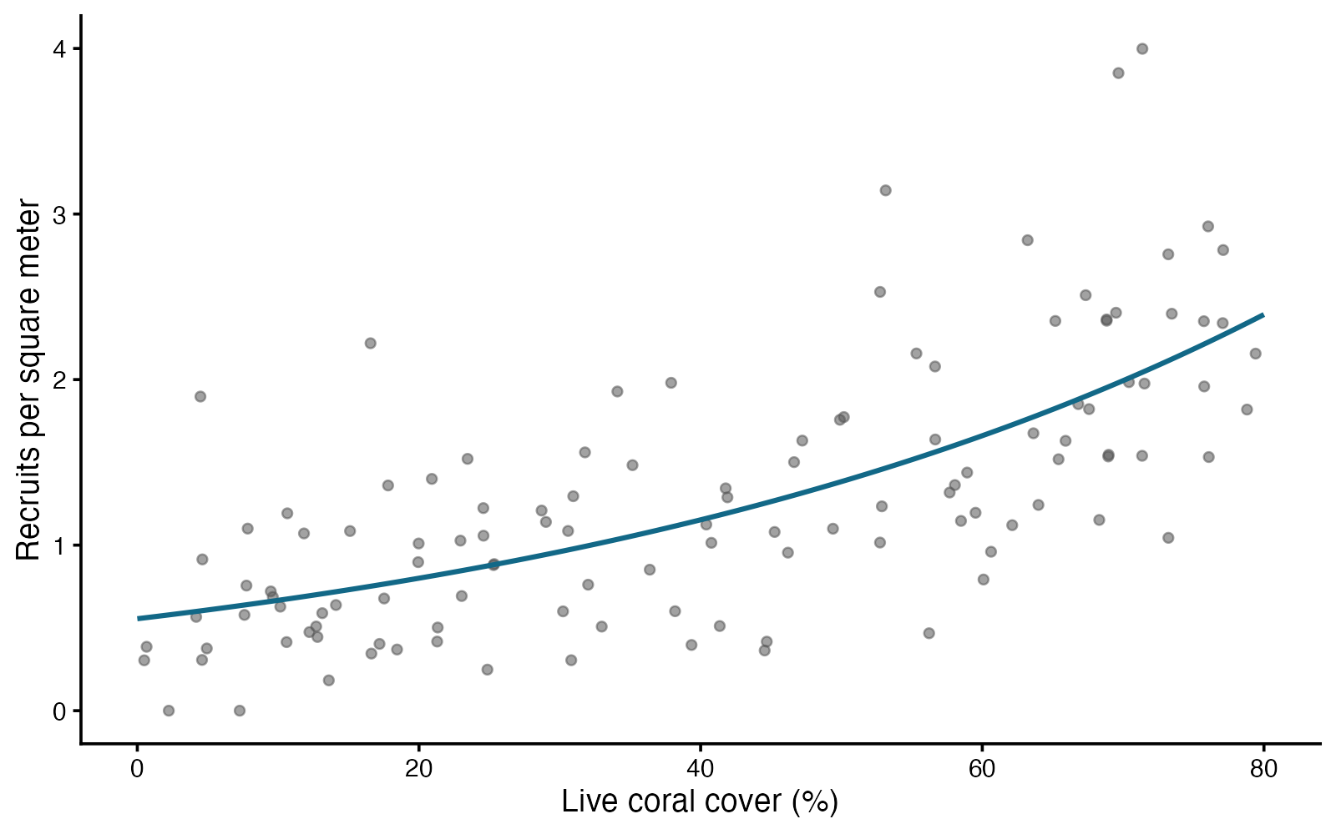
Poisson regression: see the data
ggplot2 arguments
count / area — Plot observed rates when exposures differ.
geom_point(alpha) — Reveal dense observations without hiding spread.
geom_line — Show the modeled rate at one unit of exposure.
linewidth — Make the fitted relationship easy to see.
Poisson regression — simulated biological data
Notes:
This figure is generated from the saved CSV by modules/poisson_glm/analysis.R. The exposure offset separates a biological density difference from simply looking over a larger area.

Slide 351
Poisson regression: plot code
p <- ggplot2::ggplot(d, ggplot2::aes(cover, recruits / area)) +
ggplot2::geom_point(alpha = .55, size = 2, color = "#555555") +
ggplot2::geom_line(data = grid, ggplot2::aes(y = rate),
color = "#126887", linewidth = 1.3) +
ggplot2::labs(x = "Live coral cover (%)", y = "Recruits per square meter") +
ggplot2::theme_classic(base_size = 17)
print(p)
Arguments to change
count / area — Plot observed rates when exposures differ.
geom_point(alpha) — Reveal dense observations without hiding spread.
geom_line — Show the modeled rate at one unit of exposure.
linewidth — Make the fitted relationship easy to see.
Notes:
This is an exact excerpt from analysis.R. Any preparation referenced by the excerpt appears in the complete companion script. The script opens a ragg PNG device before these lines and closes it afterward.

Slide 352
Poisson regression: question and null
Scientific question
Does recruit density change with live coral cover after accounting for surveyed area?
Null / estimation target
The coral-cover coefficient is zero: recruit rate per square meter is unrelated to cover in this model.
Relevant options
family = poisson(link = “log”)
offset(log(area)) fixes the exposure coefficient at 1.
exp(10 * coefficient) is the rate ratio per 10 cover percentage points.
Notes:
Ask whether rejecting this null, or estimating this target, answers the biological question. The exposure offset separates a biological density difference from simply looking over a larger area.

Slide 353
Poisson regression: assumptions
What matters here
Transect counts are independent.
The mean rate has the specified log-linear relationship.
Conditional count variance is approximately the conditional mean.
Parametric responses
Use negative binomial or quasi-Poisson for overdispersion.
Add site effects or use a mixed count model for clustered transects.
Nonparametric responses
A bootstrap should resample independent transects or sites.
A rank test on raw counts does not adjust for unequal areas.
Notes:
Begin with the design. A model change should address a specific issue and preserve the scientific target where possible. A rank or permutation alternative has its own assumptions and may change the null; do not choose it solely from a normality-test p-value.

Slide 354
Poisson regression: run and read
fit <- glm(recruits ~ cover + offset(log(area)), data = d,
family = poisson)
p_value <- drop1(fit, test = "Chisq")["cover", "Pr(>Chi)"]
b <- coef(fit)["cover"]
se <- sqrt(vcov(fit)["cover", "cover"])
rate_ratio <- exp(10 * b)
ci <- exp(10 * (b + c(-1, 1) * 1.96 * se))
dispersion <- sum(residuals(fit, type = "pearson")^2) / df.residual(fit)
Generated results
Rate ratio per 10 cover points: 1.200
95% Wald CI: 1.162 to 1.240
Likelihood-ratio p = 2.64e-30
Pearson dispersion diagnostic: 1.111
Notes:
Full executed model/test output:
Call:
glm(formula = recruits ~ cover + offset(log(area)), family = poisson,
data = d)
Coefficients:
Estimate Std. Error z value Pr(>|z|)
(Intercept) -0.587917 0.092543 -6.353 2.11e-10 ***
cover 0.018256 0.001649 11.071 < 2e-16 ***
---
Signif. codes: 0 ‘***’ 0.001 ‘**’ 0.01 ‘*’ 0.05 ‘.’ 0.1 ‘ ’ 1
(Dispersion parameter for poisson family taken to be 1)
Null deviance: 258.31 on 119 degrees of freedom
Residual deviance: 127.43 on 118 degrees of freedom
AIC: 541.72
Number of Fisher Scoring iterations: 4

Slide 355
Poisson regression: interpret
A 10-percentage-point increase in coral cover multiplied modeled recruit density by 1.20 (95% Wald CI 1.16–1.24; p = 2.64e-30). Area is handled as exposure; the observational association is not a causal effect.
Discuss: Why should log(area) be an offset rather than an ordinary estimated slope when area is exposure?
Notes:
Teaching point: The exposure offset separates a biological density difference from simply looking over a larger area.
Instructor comparison with the simulated population: The true cover coefficient is 0.016. A 10-point cover increase multiplies recruit density by exp(0.16) ≈ 1.174. The zero-slope null is false, and the exposure coefficient is fixed at one.
The reported estimate and p-value are calculated from this realized dataset; they need not exactly match the known population effect.

Slide 356
Quasi-Poisson: the data
Bacterial colony counts with clumping
Nonnegative colony counts with extra-Poisson spread
Exposure: plated volume in milliliters
Mean rate differs between low- and high-nutrient medium
Other data like these
Counts with unmodeled clumping
Offspring counts with overdispersion
Encounters with extra variability
Notes:
Quasi-Poisson regression
Independent plated samples vary in medium and plated volume.
medium: Low or High nutrient medium (none)
volume_ml: Plated volume exposure (ml)
colonies: Observed colony count after clumping (count)

Slide 357
Quasi-Poisson: simulate and save
set.seed(3113)
d <- data.frame(medium = rep(c("Low", "High"), each = 60),
volume_ml = runif(120, .7, 1.3))
mu <- d$volume_ml * exp(2.4 + .5 * (d$medium == "High"))
clumps <- rpois(120, mu / 3)
d$colonies <- rpois(120, 3 * clumps)
write.csv(d, file.path(out_dir, "data.csv"), row.names = FALSE)
First saved row
medium: Low
volume_ml: 1.184
colonies: 7
Notes:
Seed: 3113
Generating model: Generate 60 low-medium and 60 high-medium independent plates, with volume Uniform(0.7,1.3) ml. Set mean count μ = volume × exp(2.4 + 0.5 × high). Generate clumps ~ Poisson(μ/3), then colonies ~ Poisson(3 × clumps). Marginal mean is μ and variance is 4μ.
Population truth: High medium multiplies mean colony density by exp(0.5) ≈ 1.649; the equal-rate null is false. The true dispersion multiplier is 4, so Poisson uncertainty would be too small.
The script writes data.csv before reading it for analysis. output_dir or out_dir is the folder supplied to the standalone script.
Original saved-data preview:
Low | 1.1841021 | 7
Low | 0.7388036 | 13
Low | 0.8322714 | 8
Low | 0.9698467 | 13
Low | 0.7744541 | 10

Slide 358
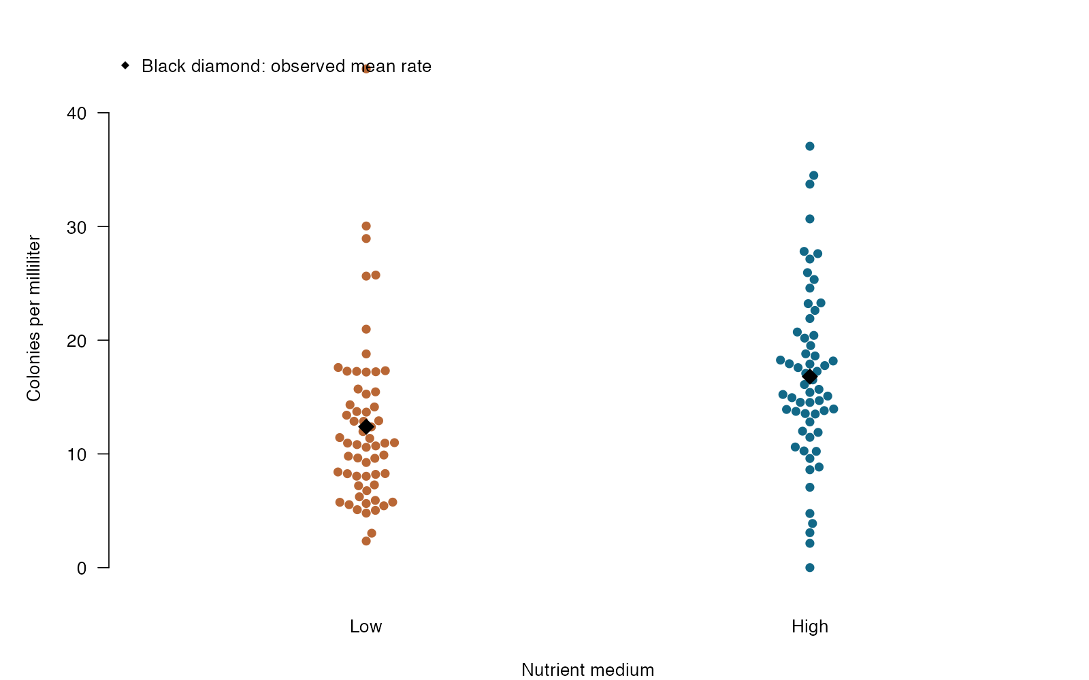
Quasi-Poisson: see the data
beeswarm arguments
pch — Filled points keep individual plates visible.
col — Match medium colors to group labels.
method = “swarm” — Spread points to avoid overlap.
cex — Balance visibility with crowding.
Quasi-Poisson regression — simulated biological data
Notes:
This figure is generated from the saved CSV by modules/quasipoisson/analysis.R. Quasi-Poisson retains the log-mean question while changing the uncertainty model; ordinary likelihood AIC is unavailable.

Slide 359
Quasi-Poisson: plot code
par(mar = c(4, 5, 2, 1), las = 1)
beeswarm::beeswarm(colonies / volume_ml ~ medium, data = d,
method = "swarm", pch = 16, cex = 1.1, col = c("#b96735", "#126887"),
xlab = "Nutrient medium", ylab = "Colonies per milliliter", bty = "n")
group_means <- tapply(d$colonies / d$volume_ml, d$medium, mean)
points(1:2, group_means, pch = 18, cex = 2)
legend("topleft", "Black diamond: observed mean rate", pch = 18, bty = "n")
Arguments to change
pch — Filled points keep individual plates visible.
col — Match medium colors to group labels.
method = “swarm” — Spread points to avoid overlap.
cex — Balance visibility with crowding.
Notes:
This is an exact excerpt from analysis.R. Any preparation referenced by the excerpt appears in the complete companion script. The script opens a ragg PNG device before these lines and closes it afterward.

Slide 360
Quasi-Poisson: question and null
Scientific question
Does mean colony density differ between media after accounting for plated volume?
Null / estimation target
The high-medium coefficient is zero: mean colony rates are equal between media.
Relevant options
family = quasipoisson estimates a dispersion multiplier.
Use t/F-based inference for the fitted dispersion.
Quasi-likelihood does not provide ordinary likelihood AIC.
Notes:
Ask whether rejecting this null, or estimating this target, answers the biological question. Quasi-Poisson retains the log-mean question while changing the uncertainty model; ordinary likelihood AIC is unavailable.

Slide 361
Quasi-Poisson: assumptions
What matters here
Plated samples are independent.
The specified log-mean model is appropriate.
Variance is approximately a common multiple of the mean.
Parametric responses
Negative binomial regression supplies an alternative variance relationship.
Use a mixed model when plates share biological cultures.
Nonparametric responses
A cluster-aware bootstrap can assess uncertainty.
A rank-sum test on rates would target a different distributional question.
Notes:
Begin with the design. A model change should address a specific issue and preserve the scientific target where possible. A rank or permutation alternative has its own assumptions and may change the null; do not choose it solely from a normality-test p-value.

Slide 362
Quasi-Poisson: run and read
d$medium <- factor(d$medium, levels = c("Low", "High"))
fit <- glm(colonies ~ medium + offset(log(volume_ml)),
data = d, family = quasipoisson)
b <- coef(fit)["mediumHigh"]
se <- sqrt(vcov(fit)["mediumHigh", "mediumHigh"])
critical <- qt(.975, df.residual(fit))
rate_ratio <- exp(b)
ci <- exp(b + c(-1, 1) * critical * se)
p_value <- summary(fit)$coefficients["mediumHigh", "Pr(>|t|)"]
Generated results
High / low mean rate ratio: 1.351
95% t-based CI: 1.117 to 1.633
Dispersion multiplier: 3.953
Quasi-Poisson t-test p = 0.002166
Notes:
Full executed model/test output:
Call:
glm(formula = colonies ~ medium + offset(log(volume_ml)), family = quasipoisson,
data = d)
Coefficients:
Estimate Std. Error t value Pr(>|t|)
(Intercept) 2.52196 0.07284 34.622 < 2e-16 ***
mediumHigh 0.30075 0.09592 3.135 0.00217 **
---
Signif. codes: 0 ‘***’ 0.001 ‘**’ 0.01 ‘*’ 0.05 ‘.’ 0.1 ‘ ’ 1
(Dispersion parameter for quasipoisson family taken to be 3.953259)
Null deviance: 489.45 on 119 degrees of freedom
Residual deviance: 450.13 on 118 degrees of freedom
AIC: NA
Number of Fisher Scoring iterations: 4

Slide 363
Quasi-Poisson: interpret
High-nutrient medium had 1.35 times the modeled colony rate of low-nutrient medium (95% t-based CI 1.12–1.63; p = 0.00217). Estimated dispersion 3.95 adjusts uncertainty for extra-Poisson variation.
Discuss: Why should a Poisson likelihood-ratio test or ordinary AIC not be copied directly into this quasi-Poisson analysis?
Notes:
Teaching point: Quasi-Poisson retains the log-mean question while changing the uncertainty model; ordinary likelihood AIC is unavailable.
Instructor comparison with the simulated population: High medium multiplies mean colony density by exp(0.5) ≈ 1.649; the equal-rate null is false. The true dispersion multiplier is 4, so Poisson uncertainty would be too small.
The reported estimate and p-value are calculated from this realized dataset; they need not exactly match the known population effect.

Slide 364
Negative binomial: the data
Parasite abundance and fish body length
Nonnegative parasite counts
Continuous length predictor in centimeters
Conditional variance can exceed the conditional mean
Other data like these
Overdispersed offspring counts
RNA-seq counts with suitable normalization
Microbial colony counts with heterogeneous rates
Notes:
Negative binomial regression
Independent fish vary in body length; parasite burdens are highly variable.
fish: Unique independent fish identifier (none)
length_cm: Fish body length (cm)
parasites: Observed parasite burden (count)

Slide 365
Negative binomial: simulate and save
set.seed(3112)
d <- data.frame(fish = 1:130, length_cm = runif(130, 18, 42))
mu <- exp(-.2 + .085 * d$length_cm)
d$parasites <- rnbinom(130, mu = mu, size = 2)
write.csv(d, file.path(out_dir, "data.csv"), row.names = FALSE)
First saved row
fish: 1
length_cm: 27.86
parasites: 7
Notes:
Seed: 3112
Generating model: Generate 130 independent fish with length Uniform(18,42) cm. Parasite count follows a negative binomial with mean exp(-0.2 + 0.085 × length) and size/theta 2. Conditional variance is mean + mean²/2.
Population truth: The length coefficient is 0.085, so 5 cm multiplies expected parasite abundance by exp(0.425) ≈ 1.530. The slope-zero null is false; the Poisson variance assumption is intentionally violated.
The script writes data.csv before reading it for analysis. output_dir or out_dir is the folder supplied to the standalone script.
Original saved-data preview:
1 | 27.863254705444 | 7
2 | 27.5214403253049 | 1
3 | 29.7717737685889 | 4
4 | 20.5594320036471 | 2
5 | 21.0298875980079 | 2

Slide 366
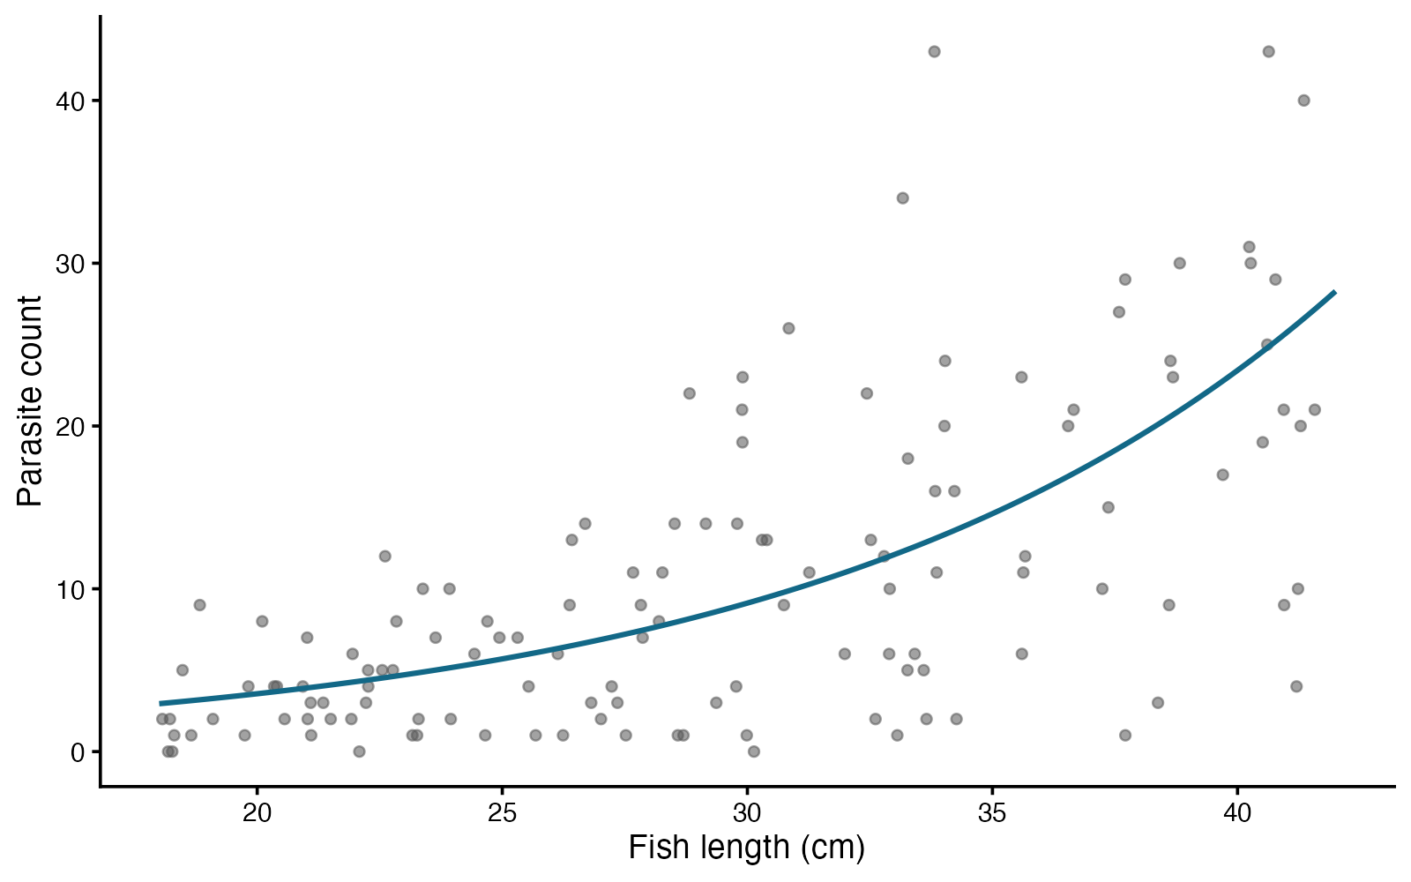
Negative binomial: see the data
ggplot2 arguments
geom_point(alpha) — Keep high variability visible.
geom_line — Show the conditional mean, not an individual prediction.
scale_y_continuous — Keep the count scale interpretable.
labs — Include length units in the axis.
Negative binomial regression — simulated biological data
Notes:
This figure is generated from the saved CSV by modules/negbin_glm/analysis.R. Overdispersion can be addressed with a parametric count model; it does not automatically require replacing the scientific question with a rank test.

Slide 367
Negative binomial: plot code
p <- ggplot2::ggplot(d, ggplot2::aes(length_cm, parasites)) +
ggplot2::geom_point(alpha = .55, size = 2, color = "#555555") +
ggplot2::geom_line(data = grid, ggplot2::aes(y = mean_count),
color = "#126887", linewidth = 1.3) +
ggplot2::labs(x = "Fish length (cm)", y = "Parasite count") +
ggplot2::theme_classic(base_size = 17)
print(p)
Arguments to change
geom_point(alpha) — Keep high variability visible.
geom_line — Show the conditional mean, not an individual prediction.
scale_y_continuous — Keep the count scale interpretable.
labs — Include length units in the axis.
Notes:
This is an exact excerpt from analysis.R. Any preparation referenced by the excerpt appears in the complete companion script. The script opens a ragg PNG device before these lines and closes it afterward.

Slide 368
Negative binomial: question and null
Scientific question
Does expected parasite burden change with fish length?
Null / estimation target
The length coefficient is zero: expected parasite abundance does not change with length in this model.
Relevant options
MASS::glm.nb estimates extra-Poisson variation.
The default link is log.
Exponentiate a scaled coefficient to report a meaningful rate ratio.
Notes:
Ask whether rejecting this null, or estimating this target, answers the biological question. Overdispersion can be addressed with a parametric count model; it does not automatically require replacing the scientific question with a rank test.

Slide 369
Negative binomial: assumptions
What matters here
Fish are independent.
The log mean is modeled appropriately.
A negative binomial mean–variance pattern is plausible.
Parametric responses
Compare residual patterns with Poisson and quasi-Poisson alternatives.
Use a mixed negative binomial model for fish clustered by site.
Nonparametric responses
Bootstrap independent fish or sites for uncertainty.
A rank-based association test asks a different question from a count-model slope.
Notes:
Begin with the design. A model change should address a specific issue and preserve the scientific target where possible. A rank or permutation alternative has its own assumptions and may change the null; do not choose it solely from a normality-test p-value.

Slide 370
Negative binomial: run and read
fit <- MASS::glm.nb(parasites ~ length_cm, data = d)
b <- coef(fit)["length_cm"]
se <- sqrt(vcov(fit)["length_cm", "length_cm"])
p_value <- summary(fit)$coefficients["length_cm", "Pr(>|z|)"]
rate_ratio <- exp(5 * b)
ci <- exp(5 * (b + c(-1, 1) * 1.96 * se))
Generated results
Mean count ratio per 5 cm: 1.602
95% Wald CI: 1.458 to 1.761
Wald p = 1.634e-22
Estimated negative-binomial theta: 2.292
Notes:
Full executed model/test output:
Call:
MASS::glm.nb(formula = parasites ~ length_cm, data = d, init.theta = 2.292042228,
link = log)
Coefficients:
Estimate Std. Error z value Pr(>|z|)
(Intercept) -0.617706 0.299553 -2.062 0.0392 *
length_cm 0.094281 0.009658 9.762 <2e-16 ***
---
Signif. codes: 0 ‘***’ 0.001 ‘**’ 0.01 ‘*’ 0.05 ‘.’ 0.1 ‘ ’ 1
(Dispersion parameter for Negative Binomial(2.292) family taken to be 1)
Null deviance: 234.38 on 129 degrees of freedom
Residual deviance: 140.90 on 128 degrees of freedom
AIC: 814.62
Number of Fisher Scoring iterations: 1
Theta: 2.292
Std. Err.: 0.374
2 x log-likelihood: -808.615

Slide 371
Negative binomial: interpret
A 5-cm increase in fish length multiplied expected parasite count by 1.60 (95% Wald CI 1.46–1.76; Wald p = 1.63e-22). Negative binomial variation allows more spread than a Poisson model.
Discuss: If variance still increases faster than the fitted model predicts, what should you inspect before interpreting its p-value?
Notes:
Teaching point: Overdispersion can be addressed with a parametric count model; it does not automatically require replacing the scientific question with a rank test.
Instructor comparison with the simulated population: The length coefficient is 0.085, so 5 cm multiplies expected parasite abundance by exp(0.425) ≈ 1.530. The slope-zero null is false; the Poisson variance assumption is intentionally violated.
The reported estimate and p-value are calculated from this realized dataset; they need not exactly match the known population effect.

Slide 372
Linear mixed model: the data
Evolutionary biologists follow larval growth under two diets.
Continuous repeated response
Larva IDs define dependence
Individual starting masses and slopes
Other data like these
Repeated plant growth
Hormone trajectories within animals
Fitness measurements within populations
Notes:
Linear mixed model
36 larvae measured at weeks 0–3; diet assigned to larvae.
week: Time since baseline (week)
larva: Repeated biological individual (ID)
treatment: Control or enriched diet (category)
mass: Larval mass (mg)

Slide 373
Linear mixed model: simulate and save
set.seed(2106)
d <- expand.grid(week = 0:3, larva = 1:36)
d$treatment <- rep(rep(c("Control", "Enriched"), each = 18), each = 4)
intercepts <- rnorm(36, 0, 2.3); slopes <- rnorm(36, 0, .7)
d$mass <- 12 + 2 * d$week + .8 * (d$treatment == "Enriched") +
.9 * d$week * (d$treatment == "Enriched") + intercepts[d$larva] +
slopes[d$larva] * d$week + rnorm(nrow(d), 0, 1.1)
write.csv(d, file.path(output_dir, "data.csv"), row.names = FALSE)
First saved row
week: 0
larva: 1
treatment: Control
mass: 11.1
Notes:
Seed: 2106
Generating model: 36 larvae (18 per diet) are measured at weeks 0–3. Mass = 12 + 2 × week + 0.8 if enriched + 0.9 × week if enriched + a larval Normal(0, 2.3²) intercept + a larval Normal(0, 0.7²) slope × week + independent Normal(0, 1.1²) error. Simulated intercepts and slopes are independent. Repeated values share both effects; no rounding.
Population truth: The control slope is 2 mg/week; enrichment adds 0.9 mg/week. The diet-by-week null is false. Simulated random-intercept and slope SDs are 2.3 mg and 0.7 mg/week.
The script writes data.csv before reading it for analysis. output_dir or out_dir is the folder supplied to the standalone script.
Original saved-data preview:
week larva treatment mass
0 1 Control 11.10276
1 1 Control 11.94295
2 1 Control 15.19498
3 1 Control 16.07766

Slide 374
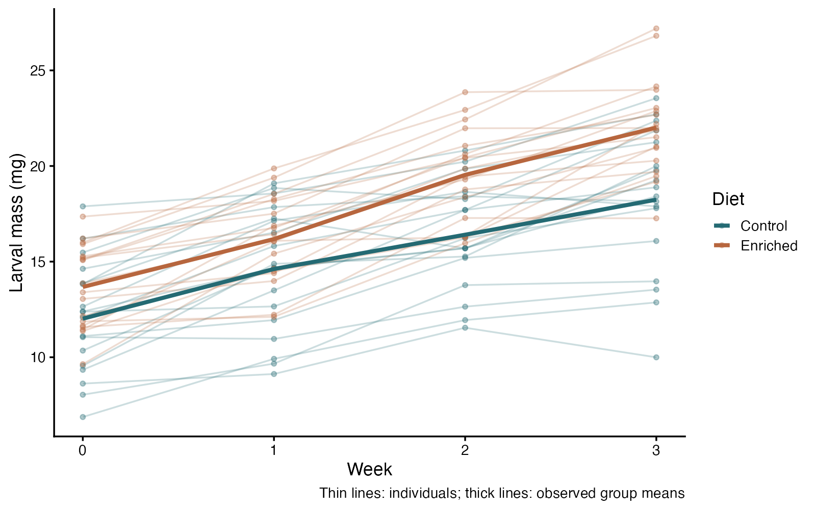
Linear mixed model: see the data
ggplot2 arguments
group = larva — Preserve individual trajectories
alpha — Keep repeated lines unobtrusive
stat_summary — Show observed diet means
linewidth — Separate summary from individual lines
Linear mixed model — simulated biological data
Notes:
This figure is generated from the saved CSV by modules/linear_mixed/analysis.R. Random intercepts describe starting differences; random slopes describe trajectory differences.

Slide 375
Linear mixed model: plot code
p <- ggplot(d, aes(week, mass, color = treatment)) +
geom_line(aes(group = larva), alpha = .23) +
geom_point(alpha = .35, size = 1.6) +
stat_summary(fun = mean, geom = "line", linewidth = 1.7) +
scale_color_manual(values = c("#246A73", "#B7663E")) +
scale_x_continuous(breaks = 0:3) +
labs(x = "Week", y = "Larval mass (mg)", color = "Diet",
caption = "Thin lines: individuals; thick lines: observed group means") +
theme_classic(base_size = 16)
print(p)
Arguments to change
group = larva — Preserve individual trajectories
alpha — Keep repeated lines unobtrusive
stat_summary — Show observed diet means
linewidth — Separate summary from individual lines
Notes:
This is an exact excerpt from analysis.R. Any preparation referenced by the excerpt appears in the complete companion script. The script opens a ragg PNG device before these lines and closes it afterward.

Slide 376
Linear mixed model: question and null
Scientific question
Does diet change the mean growth slope?
Null / estimation target
The population growth-slope difference between diets is zero.
Relevant options
(week | larva) fits larval intercepts and slopes
treatment * week tests different diet trajectories
lmerTest uses Satterthwaite degrees of freedom here
Notes:
Ask whether rejecting this null, or estimating this target, answers the biological question. Random intercepts describe starting differences; random slopes describe trajectory differences.

Slide 377
Linear mixed model: assumptions
What matters here
Independent larvae
Suitable random-effect and residual structure
Enough subjects; inspect convergence and singular fits
Parametric responses
Model residual variance or time correlation when needed
Use ML for likelihood comparisons of different fixed-effect models
Nonparametric responses
A cluster bootstrap resamples whole larvae
Friedman would answer a simpler complete-block rank question
Notes:
Begin with the design. A model change should address a specific issue and preserve the scientific target where possible. A rank or permutation alternative has its own assumptions and may change the null; do not choose it solely from a normality-test p-value.

Slide 378
Linear mixed model: run and read
fit <- lmerTest::lmer(mass ~ treatment * week + (week | larva), data = d)
summary(fit, ddf = "Satterthwaite")
trend_ci <- confint(fit, parm = "treatmentEnriched:week", method = "Wald")
Generated results
Growth-slope difference = 0.79 mg/week
Approximate 95% Wald CI 0.31 to 1.27
Satterthwaite df = 34.0; t = 3.20; p = 0.002966
36 larvae; 144 rows; singular fit: FALSE
Notes:
Full executed model/test output:
Linear mixed model fit by REML. t-tests use Satterthwaite's method [
lmerModLmerTest]
Formula: mass ~ treatment * week + (week | larva)
Data: d
REML criterion at convergence: 570
Scaled residuals:
Min 1Q Median 3Q Max
-1.64582 -0.56247 0.05774 0.54128 1.60492
Random effects:
Groups Name Variance Std.Dev. Corr
larva (Intercept) 5.7165 2.3909
week 0.3129 0.5594 -0.01
Residual 1.1701 1.0817
Number of obs: 144, groups: larva, 36
Fixed effects:
Estimate Std. Error df t value Pr(>|t|)
(Intercept) 12.2501 0.6026 33.9995 20.330 < 2e-16 ***
treatmentEnriched 1.3465 0.8522 33.9995 1.580 0.12335
week 2.0463 0.1743 34.0002 11.740 1.65e-13 ***
treatmentEnriched:week 0.7891 0.2465 34.0002 3.201 0.00297 **
---
Signif. codes: 0 ‘***’ 0.001 ‘**’ 0.01 ‘*’ 0.05 ‘.’ 0.1 ‘ ’ 1
Correlation of Fixed Effects:
(Intr) trtmnE week
trtmntEnrch -0.707
week -0.193 0.137
trtmntEnrc: 0.137 -0.193 -0.707

Slide 379
Linear mixed model: interpret
Enrichment increased the fitted growth slope by 0.79 mg/week (approximate 95% Wald CI 0.31 to 1.27; Satterthwaite t with 34.0 df, p = 0.002966). Individual intercepts and slopes model repeated larvae; 144 rows do not represent 144 independent animals.
Discuss: What does the random slope add beyond a random intercept?
Notes:
Teaching point: Random intercepts describe starting differences; random slopes describe trajectory differences.
Instructor comparison with the simulated population: The control slope is 2 mg/week; enrichment adds 0.9 mg/week. The diet-by-week null is false. Simulated random-intercept and slope SDs are 2.3 mg and 0.7 mg/week.
The reported estimate and p-value are calculated from this realized dataset; they need not exactly match the known population effect.

Slide 380
Binary mixed model: the data
Immunologists record repeated infection outcomes in vaccinated and control hosts.
Binary outcome
Treatment plus time
Repeated host ID
Other data like these
Repeated mating success
Seed germination within trays
Infection among individuals in populations
Notes:
Binary mixed model
72 hosts with four weekly binary responses.
week: Scheduled visit relative to baseline (week)
host: Repeated host identifier (ID)
treatment: Control or vaccine assignment (category)
infected: Infection outcome: 1 infected, 0 not infected (binary)

Slide 381
Binary mixed model: simulate and save
set.seed(2107)
d <- expand.grid(week = 0:3, host = 1:72)
d$treatment <- rep(rep(c("Control", "Vaccine"), each = 36), each = 4)
individual <- rnorm(72, 0, .8)
d$probability <- plogis(-.4 + .25 * d$week -
1.0 * (d$treatment == "Vaccine") + individual[d$host])
d$infected <- rbinom(nrow(d), 1, d$probability)
d$probability <- NULL
write.csv(d, file.path(output_dir, "data.csv"), row.names = FALSE)
First saved row
week: 0
host: 1
treatment: Control
infected: 1
Notes:
Seed: 2107
Generating model: 72 hosts (36 per group) are scored at weeks 0–3. Host intercepts are Normal(0, 0.8²). The infection log odds equal −0.4 + 0.25 × week − 1.0 if vaccinated + host intercept. Independent Bernoulli outcomes are sampled conditional on those probabilities. Host intercepts create dependence across visits; latent probabilities are removed from the saved student dataset.
Population truth: The conditional vaccine odds ratio is exp(−1) ≈ 0.368; the week odds ratio is exp(0.25) ≈ 1.284. The vaccine null is false. These are conditional effects, not population-average odds ratios.
The script writes data.csv before reading it for analysis. output_dir or out_dir is the folder supplied to the standalone script.
Original saved-data preview:
week host treatment infected
0 1 Control 1
1 1 Control 1
2 1 Control 1
3 1 Control 1

Slide 382
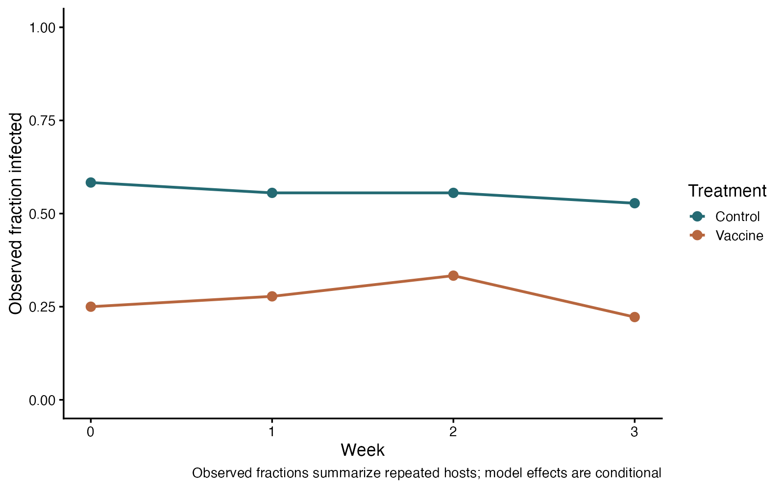
Binary mixed model: see the data
ggplot2 arguments
stat_summary(fun = mean) — The mean of 0/1 data is a proportion
color — Separate treatments
limits = c(0,1) — Use the full probability scale
breaks — Show scheduled visits
Binary mixed model — simulated biological data
Notes:
This figure is generated from the saved CSV by modules/binary_glmm/analysis.R. Repeated binary outcomes need both a response distribution and a dependence model.

Slide 383
Binary mixed model: plot code
p <- ggplot(d, aes(week, infected, color = treatment)) +
stat_summary(fun = mean, geom = "line", linewidth = 1.2) +
stat_summary(fun = mean, geom = "point", size = 3.5) +
scale_color_manual(values = c("#246A73", "#B7663E")) +
scale_x_continuous(breaks = 0:3) +
scale_y_continuous(limits = c(0, 1), breaks = seq(0, 1, .25)) +
labs(x = "Week", y = "Observed fraction infected", color = "Treatment",
caption = "Observed fractions summarize repeated hosts; model effects are conditional") +
theme_classic(base_size = 16)
print(p)
Arguments to change
stat_summary(fun = mean) — The mean of 0/1 data is a proportion
color — Separate treatments
limits = c(0,1) — Use the full probability scale
breaks — Show scheduled visits
Notes:
This is an exact excerpt from analysis.R. Any preparation referenced by the excerpt appears in the complete companion script. The script opens a ragg PNG device before these lines and closes it afterward.

Slide 384
Binary mixed model: question and null
Scientific question
Does vaccination affect infection odds while accounting for repeated hosts?
Null / estimation target
The vaccination coefficient is zero: its conditional odds ratio is one.
Relevant options
family = binomial specifies a binary response
(1 | host) models shared host tendency
Wald intervals and z tests are approximate
Notes:
Ask whether rejecting this null, or estimating this target, answers the biological question. Repeated binary outcomes need both a response distribution and a dependence model.

Slide 385
Binary mixed model: assumptions
What matters here
Independent hosts; dependence modeled within host
Suitable log-odds and random-effect model
Check convergence, separation, and remaining dependence
Parametric responses
Add justified time effects or random slopes
GEE targets population-average effects instead
Nonparametric responses
McNemar suits two paired binary measurements
Cochran’s Q suits simpler complete repeated conditions
Notes:
Begin with the design. A model change should address a specific issue and preserve the scientific target where possible. A rank or permutation alternative has its own assumptions and may change the null; do not choose it solely from a normality-test p-value.

Slide 386
Binary mixed model: run and read
fit <- lme4::glmer(infected ~ treatment + week + (1 | host),
family = binomial, data = d,
control = lme4::glmerControl(optimizer = "bobyqa"))
summary(fit)
log_or_ci <- confint(fit, parm = "treatmentVaccine", method = "Wald")
Generated results
Conditional vaccine odds ratio = 0.24
Approximate 95% CI 0.12 to 0.48
Wald z = -3.99; p = 6.63e-05
72 independent hosts; four repeated observations each
Notes:
Full executed model/test output:
Generalized linear mixed model fit by maximum likelihood (Laplace
Approximation) [glmerMod]
Family: binomial ( logit )
Formula: infected ~ treatment + week + (1 | host)
Data: d
Control: lme4::glmerControl(optimizer = "bobyqa")
AIC BIC logLik -2*log(L) df.resid
366.0 380.7 -179.0 358.0 284
Scaled residuals:
Min 1Q Median 3Q Max
-1.4049 -0.6888 -0.4268 0.7494 1.8362
Random effects:
Groups Name Variance Std.Dev.
host (Intercept) 0.8177 0.9043
Number of obs: 288, groups: host, 72
Fixed effects:
Estimate Std. Error z value Pr(>|z|)
(Intercept) 0.34030 0.29953 1.136 0.256
treatmentVaccine -1.42502 0.35722 -3.989 6.63e-05 ***
week -0.05141 0.12047 -0.427 0.670
---
Signif. codes: 0 ‘***’ 0.001 ‘**’ 0.01 ‘*’ 0.05 ‘.’ 0.1 ‘ ’ 1
Correlation of Fixed Effects:
(Intr) trtmnV
tretmntVccn -0.550
week -0.607 0.016

Slide 387
Binary mixed model: interpret
At the same week and host random effect, vaccination multiplied infection odds by 0.24 (approximate 95% Wald CI 0.12 to 0.48; p = 6.63e-05). This is a conditional odds ratio, not a probability ratio or the population-average odds ratio estimated by a GEE.
Discuss: Why is exp(coefficient) an odds ratio rather than a probability difference?
Notes:
Teaching point: Repeated binary outcomes need both a response distribution and a dependence model.
Instructor comparison with the simulated population: The conditional vaccine odds ratio is exp(−1) ≈ 0.368; the week odds ratio is exp(0.25) ≈ 1.284. The vaccine null is false. These are conditional effects, not population-average odds ratios.
The reported estimate and p-value are calculated from this realized dataset; they need not exactly match the known population effect.

Slide 388
Binary GEE: the data
Repeated infection screening after vaccination
Binary outcome measured repeatedly
Rows within an animal are correlated
Target: population-average vaccination association, adjusted for week
Other data like these
Repeated diagnostic positivity
Longitudinal presence/absence
Repeated binary behavior scores
Notes:
Binary generalized estimating equations
80 independent animals are screened at four scheduled visits.
animal: Independent animal and clustering identifier (none)
week: Scheduled visit time (weeks)
vaccine: Control or Vaccinated group (none)
infected: 1 = infection detected; 0 = not detected (binary)

Slide 389
Binary GEE: simulate and save
set.seed(3116)
shared <- rep(rnorm(80), each = 4)
d <- data.frame(animal = rep(1:80, each = 4),
week = rep(0:3, 80), vaccine = rep(rep(c("Control", "Vaccinated"), each = 40), each = 4))
z <- sqrt(.3) * shared + sqrt(.7) * rnorm(320)
p <- plogis(-.6 + .35 * d$week - .9 * (d$vaccine == "Vaccinated"))
d$infected <- as.integer(pnorm(z) < p)
write.csv(d, file.path(out_dir, "data.csv"), row.names = FALSE)
First saved row
animal: 1
week: 0
vaccine: Control
infected: 0
Notes:
Seed: 3116
Generating model: Generate 80 independent animals, 40 per vaccination group, measured at weeks 0,1,2,3. Set the marginal infection probability to plogis(-0.6 + 0.35 × week - 0.9 × vaccinated). For each row, z = sqrt(0.3) × shared animal Normal(0,1) + sqrt(0.7) × independent Normal(0,1). Because each z is standard normal, pnorm(z) is marginally uniform. Infection is 1 when pnorm(z) is below the specified probability. The shared component creates dependence while preserving the exact marginal probabilities.
Population truth: The true population-average vaccination coefficient is -0.9 and odds ratio exp(-0.9) ≈ 0.407, adjusted for week. The no-group-effect null is false. The true marginal week coefficient is 0.35. A working exchangeable correlation is an approximation, while the marginal mean model is exact.
The script writes data.csv before reading it for analysis. output_dir or out_dir is the folder supplied to the standalone script.
Original saved-data preview:
1 | 0 | Control | 0
1 | 1 | Control | 0
1 | 2 | Control | 0
1 | 3 | Control | 1
2 | 0 | Control | 0

Slide 390
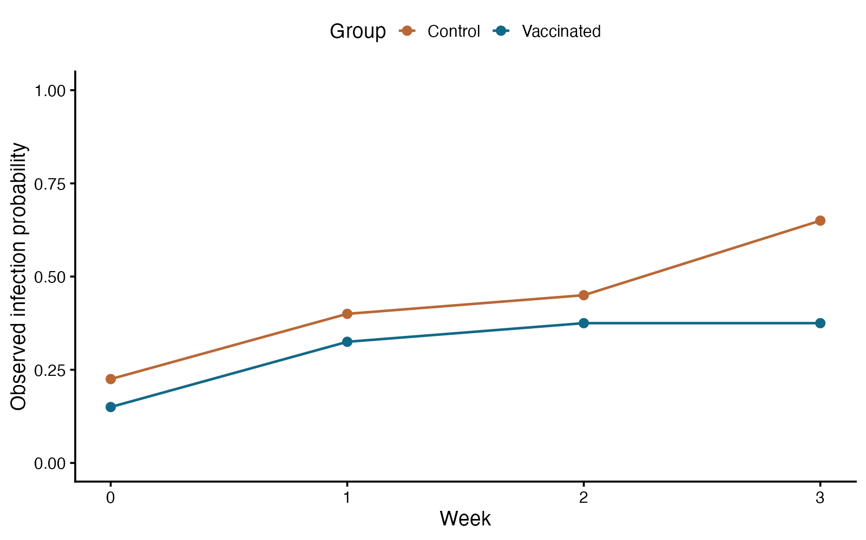
Binary GEE: see the data
ggplot2 arguments
group = vaccine — Connect the visits within each treatment group.
geom_point — Show observed visit-specific proportions.
geom_line — Show the population pattern across visits.
scale_y_continuous — Keep the full probability scale.
Binary generalized estimating equations — simulated biological data
Notes:
This figure is generated from the saved CSV by modules/binary_gee/analysis.R. Choose between a population-average question and an individual-conditional question; repeated rows are not independent animals.

Slide 391
Binary GEE: plot code
p <- ggplot2::ggplot(observed, ggplot2::aes(week, infected,
color = vaccine, group = vaccine)) +
ggplot2::geom_line(linewidth = 1) + ggplot2::geom_point(size = 3) +
ggplot2::scale_color_manual(values = c(Control = "#b96735", Vaccinated = "#126887")) +
ggplot2::scale_y_continuous(limits = c(0, 1)) +
ggplot2::scale_x_continuous(breaks = 0:3) +
ggplot2::labs(x = "Week", y = "Observed infection probability", color = "Group") +
ggplot2::theme_classic(base_size = 17) +
ggplot2::theme(legend.position = "top")
print(p)
Arguments to change
group = vaccine — Connect the visits within each treatment group.
geom_point — Show observed visit-specific proportions.
geom_line — Show the population pattern across visits.
scale_y_continuous — Keep the full probability scale.
Notes:
This is an exact excerpt from analysis.R. Any preparation referenced by the excerpt appears in the complete companion script. The script opens a ragg PNG device before these lines and closes it afterward.

Slide 392
Binary GEE: question and null
Scientific question
Does population-average infection probability differ by vaccination after accounting for week?
Null / estimation target
The population-average vaccination coefficient is zero, adjusting for week.
Relevant options
id identifies the independent animal; sort rows by animal.
corstr = “exchangeable” specifies a working within-animal correlation.
Use robust sandwich uncertainty from the GEE fit.
Notes:
Ask whether rejecting this null, or estimating this target, answers the biological question. Choose between a population-average question and an individual-conditional question; repeated rows are not independent animals.

Slide 393
Binary GEE: assumptions
What matters here
Animals are independent of one another.
The marginal mean model and observation process are appropriate.
Enough independent animals are available for robust inference.
Parametric responses
A mixed logistic model estimates a conditional effect instead.
Revise the time trend or working correlation if the design suggests it.
Nonparametric responses
A cluster bootstrap must resample whole animals.
Use a simple paired binary test only when its design and question match.
Notes:
Begin with the design. A model change should address a specific issue and preserve the scientific target where possible. A rank or permutation alternative has its own assumptions and may change the null; do not choose it solely from a normality-test p-value.

Slide 394
Binary GEE: run and read
d$vaccine <- factor(d$vaccine, levels = c("Control", "Vaccinated"))
d <- d[order(d$animal, d$week), ]
fit <- geepack::geeglm(infected ~ vaccine + week, id = animal,
data = d, family = binomial, corstr = "exchangeable")
b <- coef(fit)["vaccineVaccinated"]
se <- sqrt(vcov(fit)["vaccineVaccinated", "vaccineVaccinated"])
odds_ratio <- exp(b)
ci <- exp(b + c(-1, 1) * 1.96 * se)
p_value <- 2 * pnorm(abs(b / se), lower.tail = FALSE)
Generated results
Independent animals: 80; observations: 320
Marginal vaccination odds ratio: 0.555
95% robust CI: 0.294 to 1.046
Robust Wald p = 0.06864
Working correlation estimate: 0.265
Notes:
Full executed model/test output:
Call:
geepack::geeglm(formula = infected ~ vaccine + week, family = binomial,
data = d, id = animal, corstr = "exchangeable")
Coefficients:
Estimate Std.err Wald Pr(>|W|)
(Intercept) -0.98785 0.25570 14.926 0.000112 ***
vaccineVaccinated -0.58896 0.32346 3.315 0.068637 .
week 0.46535 0.08719 28.486 9.44e-08 ***
---
Signif. codes: 0 ‘***’ 0.001 ‘**’ 0.01 ‘*’ 0.05 ‘.’ 0.1 ‘ ’ 1
Correlation structure = exchangeable
Estimated Scale Parameters:
Estimate Std.err
(Intercept) 1 0.08157
Link = identity
Estimated Correlation Parameters:
Estimate Std.err
alpha 0.2655 0.0796
Number of clusters: 80 Maximum cluster size: 4

Slide 395
Binary GEE: interpret
The estimated population-average infection odds ratio for vaccination was 0.55 (95% robust CI 0.29–1.05; Wald p = 0.0686), adjusted for week. The model treats 80 animals, rather than 320 rows, as independent units.
Discuss: Would a mixed logistic model necessarily report the same vaccination odds ratio as this population-average model?
Notes:
Teaching point: Choose between a population-average question and an individual-conditional question; repeated rows are not independent animals.
Instructor comparison with the simulated population: The true population-average vaccination coefficient is -0.9 and odds ratio exp(-0.9) ≈ 0.407, adjusted for week. The no-group-effect null is false. The true marginal week coefficient is 0.35. A working exchangeable correlation is an approximation, while the marginal mean model is exact.
The reported estimate and p-value are calculated from this realized dataset; they need not exactly match the known population effect.

Slide 396
Count GEE: the data
Microbial ecologists count bacterial colonies in repeated water samples from experimental pond mesocosms.
A count response with measured exposure
Repeated samples within independent mesocosms
A population-average mean-rate comparison
Other data like these
Repeated parasite egg counts per gram of feces
Mutation counts per callable base across clustered samples
Repeated insect captures per trap-hour within sites
Notes:
Count and rate GEE
Ninety independent mesocosms, 45 per temperature treatment, are sampled at weeks 0–3. Each sample has a known plated volume.
mesocosm: Independent experimental mesocosm and repeated-sample cluster (ID)
week: Sampling time since experiment began (week)
treatment: Assigned ambient or warmed temperature (category)
volume_ml: Sampled/plated water volume: the count exposure (mL)
colonies: Observed colony count in the plated sample (count)

Slide 397
Count GEE: simulate and save
set.seed(1401)
mesocosm <- rep(1:90, each = 4)
week <- rep(0:3, 90)
treatment <- rep(rep(c("Ambient", "Warm"), each = 45), each = 4)
volume_ml <- runif(360, .5, 1.5)
shared_rate <- rgamma(90, shape = 2, rate = 2)
mu <- volume_ml * exp(2.2 + .45 * (treatment == "Warm") + .1 * week)
colonies <- rpois(360, mu * shared_rate[mesocosm])
d <- data.frame(mesocosm, week, treatment, volume_ml, colonies)
write.csv(d, file.path(output_dir, "data.csv"), row.names = FALSE)
First saved row
mesocosm: 1
week: 0
treatment: Ambient
volume_ml: 1.28
colonies: 9
Notes:
Seed: 1401
Generating model: Ninety independent mesocosms (45 Ambient, 45 Warm) are sampled at weeks 0, 1, 2, and 3. Each volume is Uniform(0.5, 1.5) mL. The marginal expected count is mu = volume × exp(2.2 + 0.45 × Warm + 0.1 × week). Each mesocosm has one independent Gamma(shape 2, rate 2) multiplier, with mean 1 and variance 0.5. Conditional counts are independent Poisson(mu × multiplier), so repeated observations share the multiplier. No rounding or censoring is added.
Population truth: The exact population-average Warm / Ambient rate ratio is exp(0.45), approximately 1.568; the equal-rate null is false. Each week multiplies the marginal rate by exp(0.1), approximately 1.105. Marginal count variance is mu + 0.5 × mu squared. The working exchangeable correlation is approximate, while the specified marginal mean is exact.
The script writes data.csv before reading it for analysis. output_dir or out_dir is the folder supplied to the standalone script.
Original saved-data preview:
mesocosm week treatment volume_ml colonies
1 0 Ambient 1.2803623 9
1 1 Ambient 0.9959790 8
1 2 Ambient 1.1585612 21
1 3 Ambient 0.5922451 5

Slide 398
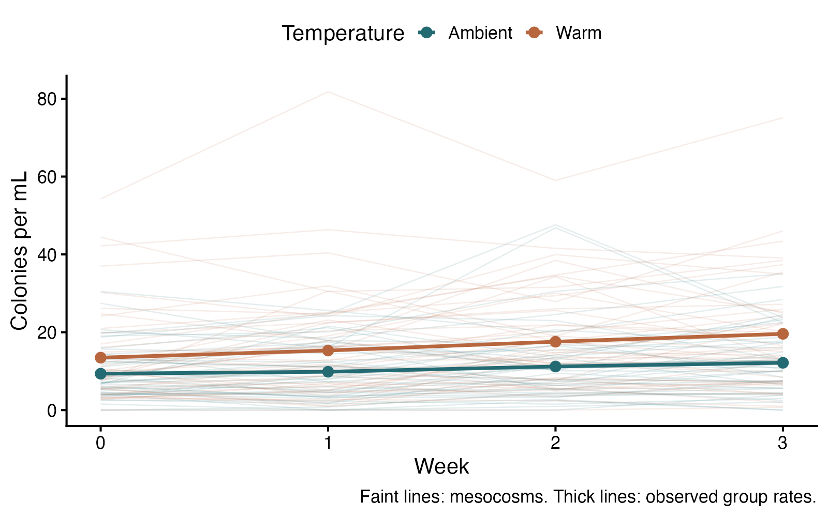
Count GEE: see the data
ggplot2 arguments
aes(group = mesocosm) — Connect repeated samples from the same mesocosm
alpha / linewidth — Keep individual trajectories faint behind group trends
data = observed — Overlay observed group rates from total counts / total volume
scale_color_manual — Use stable colors for ambient and warmed conditions
Count and rate GEE — simulated biological data
Notes:
This figure is generated from the saved CSV by modules/count_gee/analysis.R. GEE estimates a population-average rate ratio and uses mesocosms as independent units. The offset accounts for exposure; robust uncertainty accommodates the extra variation and repeated observations.

Slide 399
Count GEE: plot code
observed <- aggregate(cbind(colonies, volume_ml) ~ treatment + week, d, sum)
observed$rate <- observed$colonies / observed$volume_ml
p <- ggplot(d, aes(week, colonies / volume_ml, color = treatment)) +
geom_line(aes(group = mesocosm), alpha = .12, linewidth = .5) +
geom_line(data = observed, aes(y = rate, group = treatment), linewidth = 1.4) +
geom_point(data = observed, aes(y = rate), size = 3.4) +
scale_color_manual(values = c(Ambient = "#246A73", Warm = "#B7663E")) +
scale_x_continuous(breaks = 0:3) +
labs(x = "Week", y = "Colonies per mL", color = "Temperature",
caption = "Faint lines: mesocosms. Thick lines: observed group rates.") +
theme_classic(base_size = 18) + theme(legend.position = "top")
print(p)
Arguments to change
aes(group = mesocosm) — Connect repeated samples from the same mesocosm
alpha / linewidth — Keep individual trajectories faint behind group trends
data = observed — Overlay observed group rates from total counts / total volume
scale_color_manual — Use stable colors for ambient and warmed conditions
Notes:
This is an exact excerpt from analysis.R. Any preparation referenced by the excerpt appears in the complete companion script. The script opens a ragg PNG device before these lines and closes it afterward.

Slide 400
Count GEE: question and null
Scientific question
Does warming change the population-average colony rate after accounting for week and sampled volume?
Null / estimation target
The warming coefficient is zero: population-average colony rates are equal at the same week and exposure.
Relevant options
id identifies mesocosms; keep their rows together
offset(log(volume_ml)) converts a count model to a rate comparison
Choose corstr; std.err = “san.se” uses robust sandwich uncertainty
Notes:
Ask whether rejecting this null, or estimating this target, answers the biological question. GEE estimates a population-average rate ratio and uses mesocosms as independent units. The offset accounts for exposure; robust uncertainty accommodates the extra variation and repeated observations.

Slide 401
Count GEE: assumptions
What matters here
Mesocosms are independent; repeated samples are dependent
The marginal log-mean model and exposure are appropriate
Robust inference needs enough independent mesocosms
Parametric responses
Change the time trend or working correlation to fit the design
A count GLMM models rates conditional on a cluster random effect
Nonparametric responses
A cluster bootstrap resamples whole mesocosms
Rank methods answer a different ordering question; they do not replace this adjusted mean-rate model
Notes:
Begin with the design. A model change should address a specific issue and preserve the scientific target where possible. A rank or permutation alternative has its own assumptions and may change the null; do not choose it solely from a normality-test p-value.

Slide 402
Count GEE: run and read
d$treatment <- factor(d$treatment, levels = c("Ambient", "Warm"))
d <- d[order(d$mesocosm, d$week), ]
fit <- geepack::geeglm(colonies ~ treatment + week + offset(log(volume_ml)),
id = mesocosm, data = d, family = poisson(link = "log"),
corstr = "exchangeable", std.err = "san.se")
b <- coef(fit)["treatmentWarm"]
se <- sqrt(vcov(fit)["treatmentWarm", "treatmentWarm"])
rate_ratio <- exp(b)
ci <- exp(b + c(-1, 1) * 1.96 * se)
p_value <- 2 * pnorm(abs(b / se), lower.tail = FALSE)
Generated results
Independent mesocosms: 90; observations: 360
Population-average Warm / Ambient rate ratio = 1.580
95% robust CI: 1.175 to 2.123
Robust Wald p = 0.00243
Working correlation estimate = 0.816
Notes:
Full executed model/test output:
Call:
geepack::geeglm(formula = colonies ~ treatment + week + offset(log(volume_ml)),
family = poisson(link = "log"), data = d, id = mesocosm,
corstr = "exchangeable", std.err = "san.se")
Coefficients:
Estimate Std.err Wald Pr(>|W|)
(Intercept) 2.20660 0.10491 442.355 < 2e-16 ***
treatmentWarm 0.45715 0.15078 9.193 0.00243 **
week 0.10817 0.01322 66.937 3.33e-16 ***
---
Signif. codes: 0 ‘***’ 0.001 ‘**’ 0.01 ‘*’ 0.05 ‘.’ 0.1 ‘ ’ 1
Correlation structure = exchangeable
Estimated Scale Parameters:
Estimate Std.err
(Intercept) 7.602 1.51
Link = identity
Estimated Correlation Parameters:
Estimate Std.err
alpha 0.8161 0.04783
Number of clusters: 90 Maximum cluster size: 4

Slide 403
Count GEE: interpret
The population-average colony rate in warmed mesocosms was 1.58 times the ambient rate (95% robust CI 1.18 to 2.12; Wald p = 0.00243), adjusting for week and sampled volume. The 90 mesocosms are the independent units; the model accounts for their repeated samples.
Discuss: If sampled volume differs among visits, why should the model include an exposure offset instead of comparing raw counts?
Notes:
Teaching point: GEE estimates a population-average rate ratio and uses mesocosms as independent units. The offset accounts for exposure; robust uncertainty accommodates the extra variation and repeated observations.
Instructor comparison with the simulated population: The exact population-average Warm / Ambient rate ratio is exp(0.45), approximately 1.568; the equal-rate null is false. Each week multiplies the marginal rate by exp(0.1), approximately 1.105. Marginal count variance is mu + 0.5 × mu squared. The working exchangeable correlation is approximate, while the specified marginal mean is exact.
The reported estimate and p-value are calculated from this realized dataset; they need not exactly match the known population effect.

Slide 404
Count mixed model: the data
Pollinator visits are repeatedly counted on plants in two habitats.
Nonnegative event counts
Exposure in minutes
Repeated plant IDs
Other data like these
Parasites counted repeatedly in hosts
Mutations across repeated cell lines
Calls recorded repeatedly from territories
Notes:
Count mixed model: Poisson and negative binomial
48 plants observed on four days with unequal observation durations.
day: Observation day (day)
plant: Repeated plant identifier (ID)
habitat: Open or sheltered habitat (category)
minutes: Observation exposure (minute)
visits: Number of pollinator visits (count)

Slide 405
Count mixed model: simulate and save
set.seed(2114)
d <- expand.grid(day = 1:4, plant = 1:48)
d$habitat <- rep(rep(c("Open", "Sheltered"), each = 24), each = 4)
d$minutes <- sample(20:60, nrow(d), replace = TRUE)
individual <- rnorm(48, 0, .45)
rate <- exp(-2.0 + .55 * (d$habitat == "Sheltered") +
.06 * d$day + individual[d$plant])
d$visits <- rnbinom(nrow(d), mu = d$minutes * rate, size = 5)
write.csv(d, file.path(output_dir, "data.csv"), row.names = FALSE)
First saved row
day: 1
plant: 1
habitat: Open
minutes: 32
visits: 22
Notes:
Seed: 2114
Generating model: 48 plants (24 per habitat) are observed on days 1–4. Observation duration is sampled uniformly from the integers 20–60 minutes. Plant intercepts are Normal(0, 0.45²). Log rate = −2 + 0.55 if sheltered + 0.06 × day + plant intercept. Counts are negative binomial with mean = minutes × rate and size = 5; conditional variance is mean + mean²/5. Repeated plants share the intercept.
Population truth: The conditional sheltered/open rate ratio is exp(0.55) ≈ 1.733; the habitat null is false. The generating distribution has extra variation beyond Poisson even after conditioning on the plant intercept.
The script writes data.csv before reading it for analysis. output_dir or out_dir is the folder supplied to the standalone script.
Original saved-data preview:
day plant habitat minutes visits
1 1 Open 32 22
2 1 Open 58 10
3 1 Open 25 9
4 1 Open 48 23

Slide 406
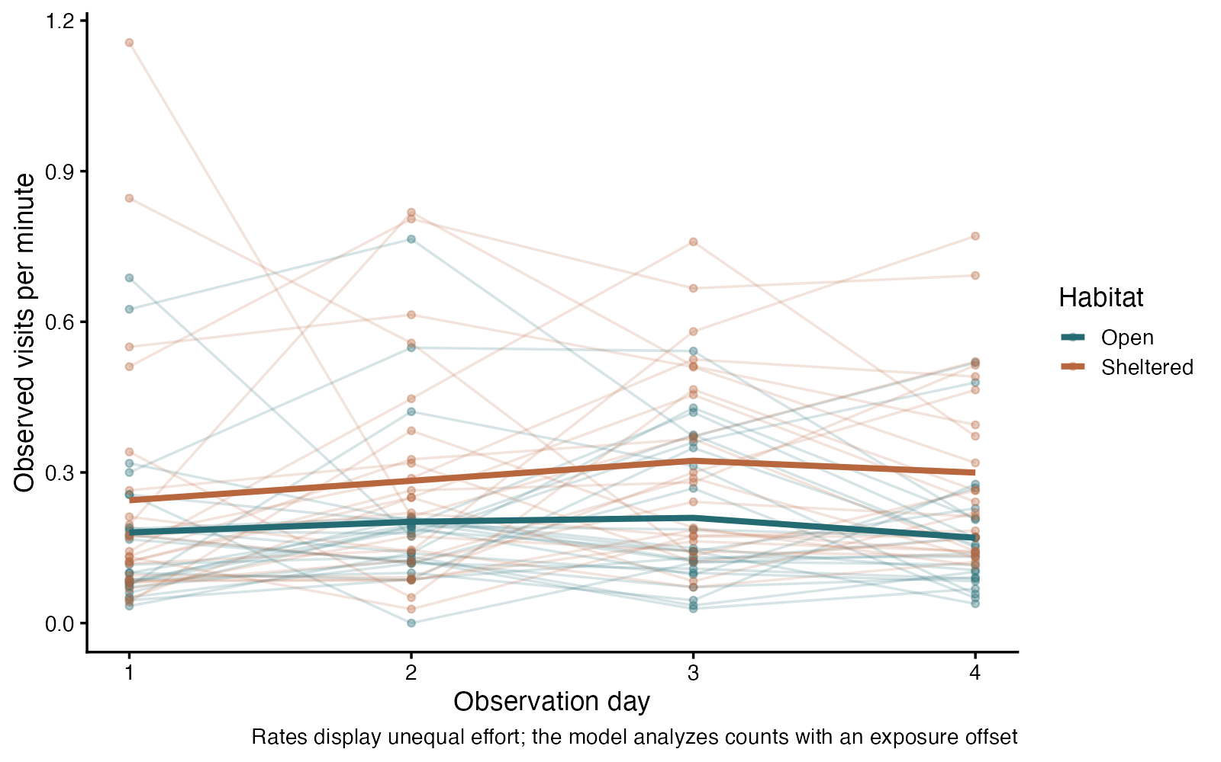
Count mixed model: see the data
ggplot2 arguments
visits / minutes — Plot rates for unequal effort
group = plant — Preserve repeated units
alpha — Reduce overlap
stat_summary — Show observed habitat means
Count mixed model: Poisson and negative binomial — simulated biological data
Notes:
This figure is generated from the saved CSV by modules/count_glmm/analysis.R. Offsets retain count information while accounting for exposure; negative binomial and random effects address different variation sources.

Slide 407
Count mixed model: plot code
p <- ggplot(d, aes(day, visits / minutes, color = habitat)) +
geom_line(aes(group = plant), alpha = .18) +
geom_point(alpha = .35, size = 1.6) +
stat_summary(fun = mean, geom = "line", linewidth = 1.7) +
scale_color_manual(values = c("#246A73", "#B7663E")) +
scale_x_continuous(breaks = 1:4) +
labs(x = "Observation day", y = "Observed visits per minute", color = "Habitat",
caption = "Rates display unequal effort; the model analyzes counts with an exposure offset") +
theme_classic(base_size = 16)
print(p)
Arguments to change
visits / minutes — Plot rates for unequal effort
group = plant — Preserve repeated units
alpha — Reduce overlap
stat_summary — Show observed habitat means
Notes:
This is an exact excerpt from analysis.R. Any preparation referenced by the excerpt appears in the complete companion script. The script opens a ragg PNG device before these lines and closes it afterward.

Slide 408
Count mixed model: question and null
Scientific question
Does habitat change visit rate while accounting for repeated plants?
Null / estimation target
The habitat coefficient is zero: its conditional visit-rate ratio is one.
Relevant options
offset(log(minutes)) accounts for exposure
(1 | plant) models shared plant tendency
glmer.nb adds negative-binomial conditional variation
Notes:
Ask whether rejecting this null, or estimating this target, answers the biological question. Offsets retain count information while accounting for exposure; negative binomial and random effects address different variation sources.

Slide 409
Count mixed model: assumptions
What matters here
Independent plants
Suitable conditional count and random-effect model
Exposure is measured and mean count scales with it
Parametric responses
Check Poisson versus negative-binomial conditional variation
Add justified dependence or a biologically supported zero process
Nonparametric responses
A valid cluster permutation keeps repeated plants together
Ranks discard the modeled mean-rate question
Notes:
Begin with the design. A model change should address a specific issue and preserve the scientific target where possible. A rank or permutation alternative has its own assumptions and may change the null; do not choose it solely from a normality-test p-value.

Slide 410
Count mixed model: run and read
poisson_fit <- lme4::glmer(visits ~ habitat + day +
offset(log(minutes)) + (1 | plant), family = poisson, data = d,
control = lme4::glmerControl(optimizer = "bobyqa"))
fit <- lme4::glmer.nb(visits ~ habitat + day +
offset(log(minutes)) + (1 | plant), data = d,
control = lme4::glmerControl(optimizer = "bobyqa"))
summary(fit)
log_ratio_ci <- confint(fit, parm = "habitatSheltered", method = "Wald")
Generated results
Conditional sheltered/open rate ratio = 1.50
Approximate 95% CI 1.11 to 2.02
Wald z = 2.62; p = 0.008759
Poisson AIC 1281.6; negative-binomial AIC 1165.5
Notes:
Full executed model/test output:
Generalized linear mixed model fit by maximum likelihood (Laplace
Approximation) [glmerMod]
Family: Negative Binomial(5.8365) ( log )
Formula: visits ~ habitat + day + offset(log(minutes)) + (1 | plant)
Data: d
Control: lme4::glmerControl(optimizer = "bobyqa")
AIC BIC logLik -2*log(L) df.resid
1165.5 1181.8 -577.8 1155.5 187
Scaled residuals:
Min 1Q Median 3Q Max
-1.6584 -0.6798 -0.1409 0.4246 3.2452
Random effects:
Groups Name Variance Std.Dev.
plant (Intercept) 0.2057 0.4536
Number of obs: 192, groups: plant, 48
Fixed effects:
Estimate Std. Error z value Pr(>|z|)
(Intercept) -1.90884 0.14304 -13.345 < 2e-16 ***
habitatSheltered 0.40249 0.15355 2.621 0.00876 **
day 0.05234 0.03605 1.452 0.14658
---
Signif. codes: 0 ‘***’ 0.001 ‘**’ 0.01 ‘*’ 0.05 ‘.’ 0.1 ‘ ’ 1
Correlation of Fixed Effects:
(Intr) hbttSh
habttShltrd -0.547
day -0.638 -0.005
Generalized linear mixed model fit by maximum likelihood (Laplace
Approximation) [glmerMod]
Family: poisson ( log )
Formula: visits ~ habitat + day + offset(log(minutes)) + (1 | plant)
Data: d
Control: lme4::glmerControl(optimizer = "bobyqa")
AIC BIC logLik -2*log(L) df.resid
1281.6 1294.7 -636.8 1273.6 188
Scaled residuals:
Min 1Q Median 3Q Max
-3.0928 -0.9462 -0.1606 0.6940 5.4685
Random effects:
Groups Name Variance Std.Dev.
plant (Intercept) 0.2447 0.4947
Number of obs: 192, groups: plant, 48
Fixed effects:
Estimate Std. Error z value Pr(>|z|)
(Intercept) -1.90548 0.12177 -15.649 <2e-16 ***
habitatSheltered 0.40022 0.15209 2.631 0.0085 **
day 0.04840 0.02086 2.321 0.0203 *
---
Signif. codes: 0 ‘***’ 0.001 ‘**’ 0.01 ‘*’ 0.05 ‘.’ 0.1 ‘ ’ 1
Correlation of Fixed Effects:
(Intr) hbttSh
habttShltrd -0.644
day -0.447 0.011

Slide 411
Count mixed model: interpret
In the negative-binomial mixed model, sheltered plants had 1.50 times the visit rate of open plants at the same day and random effect (approximate 95% Wald CI 1.11 to 2.02; p = 0.008759). Minutes are an exposure offset; plant intercepts model repeated observations. Extra conditional variation motivates checking the negative-binomial variant, not automatically selecting it from a single cutoff.
Discuss: Why do we model counts with an offset instead of fitting a Poisson model to rates?
Notes:
Teaching point: Offsets retain count information while accounting for exposure; negative binomial and random effects address different variation sources.
Instructor comparison with the simulated population: The conditional sheltered/open rate ratio is exp(0.55) ≈ 1.733; the habitat null is false. The generating distribution has extra variation beyond Poisson even after conditioning on the plant intercept.
The reported estimate and p-value are calculated from this realized dataset; they need not exactly match the known population effect.

Slide 412
Ordinal mixed model: the data
Fish behavior is scored repeatedly using ordered stress categories.
Ordered categories
Repeated fish IDs
Treatment plus visit
Other data like these
Repeated disease severity
Damage scores within plant lines
Behavior scores within individuals
Notes:
Ordinal mixed model
70 fish measured at three visits; treatment assigned between fish.
visit: Scheduled repeated assessment (visit)
fish: Repeated fish identifier (ID)
treatment: Control or stress assignment (category)
score: Ordered behavior severity (ordered category)

Slide 413
Ordinal mixed model: simulate and save
set.seed(2109)
d <- expand.grid(visit = 1:3, fish = 1:70)
d$treatment <- rep(rep(c("Control", "Stress"), each = 35), each = 3)
individual <- rnorm(70, 0, .8)
latent <- .8 * (d$treatment == "Stress") + .15 * d$visit +
individual[d$fish] + rlogis(nrow(d))
d$score <- cut(latent, c(-Inf, -.8, .3, 1.3, Inf),
labels = c("None", "Mild", "Moderate", "High"))
write.csv(d, file.path(output_dir, "data.csv"), row.names = FALSE)
First saved row
visit: 1
fish: 1
treatment: Control
score: Mild
Notes:
Seed: 2109
Generating model: 70 fish (35 per treatment) are scored at visits 1–3. Fish intercepts are Normal(0, 0.8²). Latent severity = 0.8 if stressed + 0.15 × visit + fish intercept + standard logistic error. Thresholds −0.8, 0.3 and 1.3 produce None, Mild, Moderate and High. The latent score is not saved; repeated scores share the fish intercept.
Population truth: The conditional common odds ratio for a higher score under stress is exp(0.8) ≈ 2.226. The treatment null is false. The simulated thresholds obey proportional odds.
The script writes data.csv before reading it for analysis. output_dir or out_dir is the folder supplied to the standalone script.
Original saved-data preview:
visit fish treatment score
1 1 Control Mild
2 1 Control Mild
3 1 Control High
1 2 Control None

Slide 414
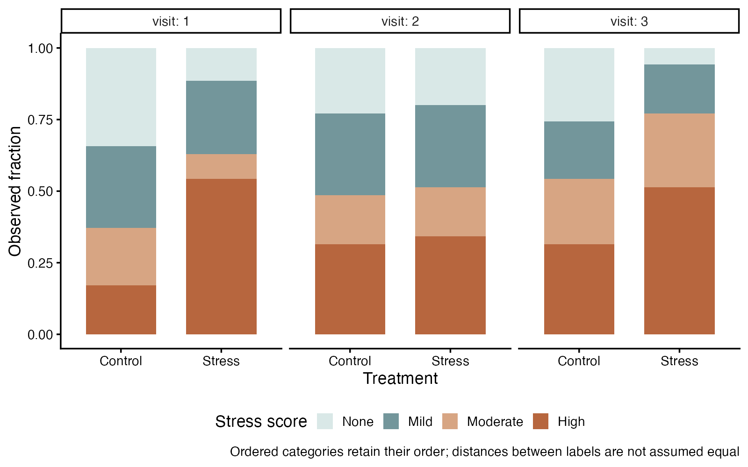
Ordinal mixed model: see the data
ggplot2 arguments
position = “fill” — Show proportions within each group
facet_wrap — Separate visits
scale_fill_manual — Keep category colors consistent
ordered factor — Keep severity in biological order
Ordinal mixed model — simulated biological data
Notes:
This figure is generated from the saved CSV by modules/ordinal_mixed/analysis.R. Use ordered category probabilities; arbitrary numerical category spacings are unnecessary.

Slide 415
Ordinal mixed model: plot code
p <- ggplot(d, aes(treatment, fill = score)) +
geom_bar(position = "fill", width = .7) +
facet_wrap(~ visit, labeller = label_both) +
scale_fill_manual(values = c("#D9E8E7", "#73969B", "#D7A583", "#B7663E"),
drop = FALSE) +
labs(x = "Treatment", y = "Observed fraction", fill = "Stress score",
caption = "Ordered categories retain their order; distances between labels are not assumed equal") +
theme_classic(base_size = 16) + theme(legend.position = "bottom")
print(p)
Arguments to change
position = “fill” — Show proportions within each group
facet_wrap — Separate visits
scale_fill_manual — Keep category colors consistent
ordered factor — Keep severity in biological order
Notes:
This is an exact excerpt from analysis.R. Any preparation referenced by the excerpt appears in the complete companion script. The script opens a ragg PNG device before these lines and closes it afterward.

Slide 416
Ordinal mixed model: question and null
Scientific question
Does treatment shift repeated scores toward higher categories?
Null / estimation target
The treatment coefficient is zero: its conditional cumulative odds ratio is one.
Relevant options
ordered() defines the category sequence
link = “logit” gives proportional odds
(1 | fish) accounts for repeated fish
Notes:
Ask whether rejecting this null, or estimating this target, answers the biological question. Use ordered category probabilities; arbitrary numerical category spacings are unnecessary.

Slide 417
Ordinal mixed model: assumptions
What matters here
Independent fish
A common treatment odds effect across thresholds
Suitable random effects and converged estimation
Parametric responses
Use a more flexible ordinal model if threshold effects differ
Retain the response order when scientifically meaningful
Nonparametric responses
Friedman suits complete within-fish condition comparisons
A sign test asks only about paired change direction
Notes:
Begin with the design. A model change should address a specific issue and preserve the scientific target where possible. A rank or permutation alternative has its own assumptions and may change the null; do not choose it solely from a normality-test p-value.

Slide 418
Ordinal mixed model: run and read
fit <- ordinal::clmm(score ~ treatment + visit + (1 | fish),
data = d, link = "logit", Hess = TRUE)
summary(fit)
b <- coef(summary(fit))["treatmentStress", ]
log_or_ci <- b[1] + c(-1, 1) * qnorm(.975) * b[2]
Generated results
Conditional higher-score odds ratio = 2.51
Approximate 95% CI 1.31 to 4.82
Wald z = 2.78; p = 0.005491
70 fish; three repeated ordinal scores each
Notes:
Full executed model/test output:
Cumulative Link Mixed Model fitted with the Laplace approximation
formula: score ~ treatment + visit + (1 | fish)
data: d
link threshold nobs logLik AIC niter max.grad cond.H
logit flexible 210 -274.11 560.22 240(723) 5.81e-05 1.0e+02
Random effects:
Groups Name Variance Std.Dev.
fish (Intercept) 0.6701 0.8186
Number of groups: fish 70
Coefficients:
Estimate Std. Error z value Pr(>|z|)
treatmentStress 0.9221 0.3321 2.777 0.00549 **
visit 0.2399 0.1608 1.492 0.13578
---
Signif. codes: 0 ‘***’ 0.001 ‘**’ 0.01 ‘*’ 0.05 ‘.’ 0.1 ‘ ’ 1
Threshold coefficients:
Estimate Std. Error z value
None|Mild -0.6966 0.4029 -1.729
Mild|Moderate 0.6908 0.4025 1.716
Moderate|High 1.5974 0.4207 3.797

Slide 419
Ordinal mixed model: interpret
At the same visit and fish random effect, stress treatment multiplied the odds of being above any score threshold by 2.51 (approximate 95% Wald CI 1.31 to 4.82; p = 0.005491). The proportional-odds model uses a common effect across thresholds; category labels are ordered, not equally spaced measurements.
Discuss: Why is subtracting the category codes not the same as measuring a change?
Notes:
Teaching point: Use ordered category probabilities; arbitrary numerical category spacings are unnecessary.
Instructor comparison with the simulated population: The conditional common odds ratio for a higher score under stress is exp(0.8) ≈ 2.226. The treatment null is false. The simulated thresholds obey proportional odds.
The reported estimate and p-value are calculated from this realized dataset; they need not exactly match the known population effect.

Slide 420
Kaplan–Meier: the data
Ecologists follow seedling survival until death or final observation.
Event time in days
event = 1 death; 0 right-censored
Independent individuals
Other data like these
Time to germination
Time to infection
Time to pupation
Notes:
Kaplan–Meier survival estimation
120 independent seedlings; follow-up ends at different times.
seedling: Independent seedling identifier (ID)
days: Observed event or censoring time (day)
event: 1 death; 0 right-censored (binary)

Slide 421
Kaplan–Meier: simulate and save
set.seed(2110)
d <- data.frame(seedling = 1:120)
event_time <- rexp(120, rate = .018)
follow_up <- runif(120, 35, 100)
d$days <- pmin(event_time, follow_up)
d$event <- as.integer(event_time <= follow_up)
write.csv(d, file.path(output_dir, "data.csv"), row.names = FALSE)
First saved row
seedling: 1
days: 48.03
event: 1
Notes:
Seed: 2110
Generating model: 120 independent event times are drawn from an exponential distribution with death rate 0.018/day. Each independent final follow-up time is Uniform(35, 100) days. Observed days = minimum(event time, follow-up); event = 1 when the event occurs by follow-up and 0 otherwise. Times remain unrounded. Censoring is independent by construction.
Population truth: The population survival function is exp(−0.018 × days); true day-40 survival is exp(−0.72) ≈ 0.487. This is an estimation target, not a null hypothesis.
The script writes data.csv before reading it for analysis. output_dir or out_dir is the folder supplied to the standalone script.
Original saved-data preview:
seedling days event
1 48.03005 1
2 77.73765 0
3 12.86731 1
4 43.82996 0

Slide 422
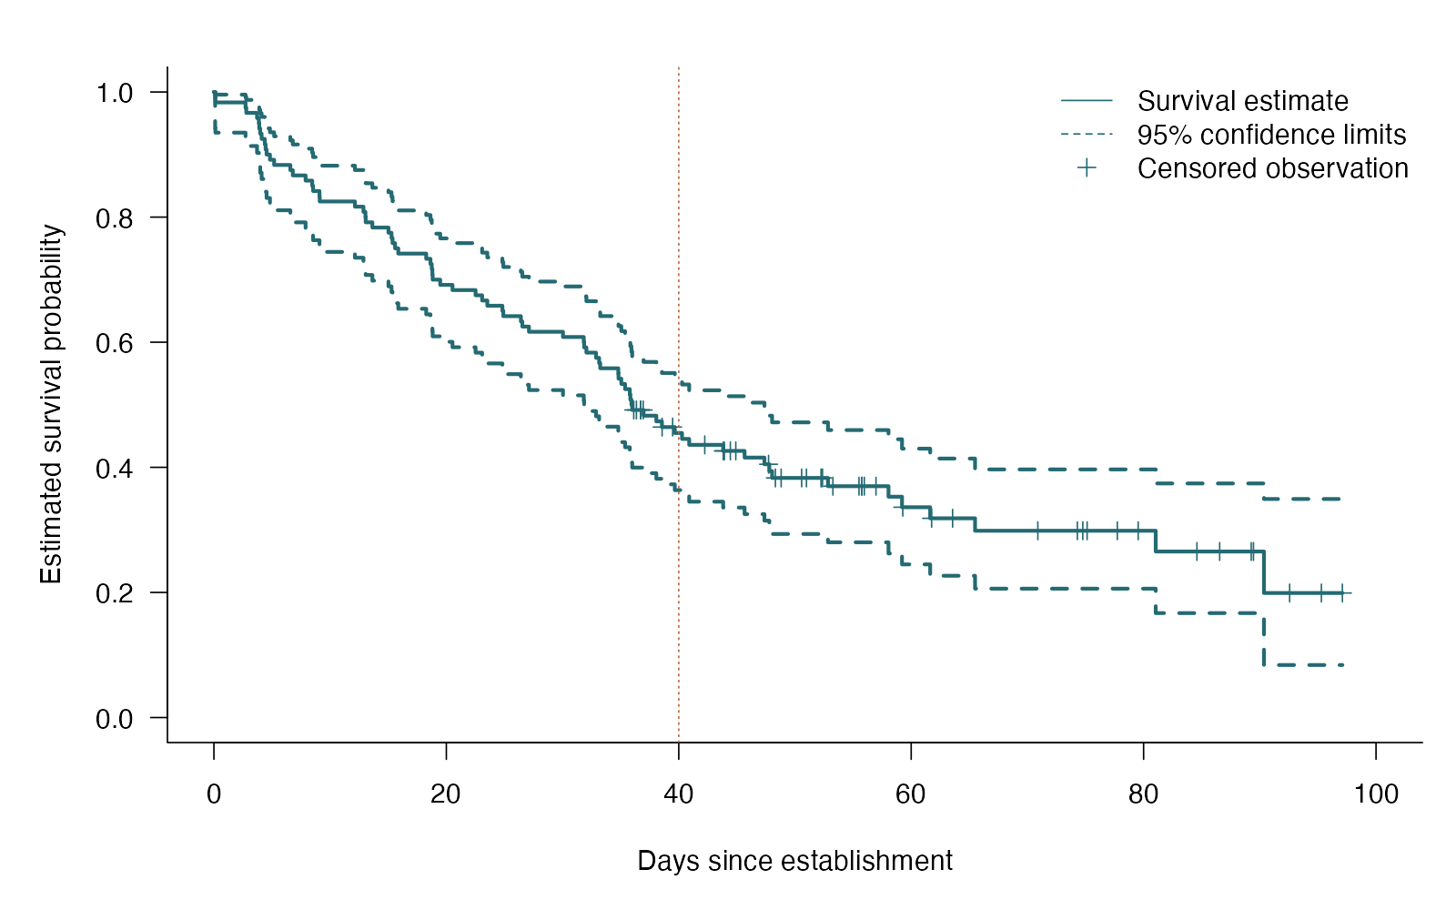
Kaplan–Meier: see the data
base R arguments
mark.time — Mark censored observations
conf.int — Draw uncertainty limits
xlim — Show the follow-up period
abline(v=40) — Highlight the requested time
Kaplan–Meier survival estimation — simulated biological data
Notes:
This figure is generated from the saved CSV by modules/kaplan_meier/analysis.R. Censored observations contribute until follow-up ends; no invented p-value is needed for estimation.

Slide 423
Kaplan–Meier: plot code
par(mar = c(5, 5, 2, 1), las = 1, bty = "l", cex = 1.15)
plot(fit, col = "#246A73", lwd = 2.5, conf.int = TRUE,
mark.time = TRUE, xlab = "Days since establishment",
ylab = "Estimated survival probability", xlim = c(0, 100))
abline(v = 40, lty = 3, col = "#B7663E")
legend("topright", c("Survival estimate", "95% confidence limits", "Censored observation"),
col = c("#246A73", "#246A73", "#246A73"),
lty = c(1, 2, NA), pch = c(NA, NA, 3), bty = "n")
Arguments to change
mark.time — Mark censored observations
conf.int — Draw uncertainty limits
xlim — Show the follow-up period
abline(v=40) — Highlight the requested time
Notes:
This is an exact excerpt from analysis.R. Any preparation referenced by the excerpt appears in the complete companion script. The script opens a ragg PNG device before these lines and closes it afterward.

Slide 424
Kaplan–Meier: question and null
Scientific question
What fraction of seedlings remain alive at day 40?
Null / estimation target
No null hypothesis: the target is the survival probability over time.
Relevant options
Surv(days, event) retains censoring
conf.type = “log-log” constructs bounded intervals
times = 40 requests a biologically meaningful time
Notes:
Ask whether rejecting this null, or estimating this target, answers the biological question. Censored observations contribute until follow-up ends; no invented p-value is needed for estimation.

Slide 425
Kaplan–Meier: assumptions
What matters here
Independent seedlings
Censoring is unrelated to future survival within the population
Correct event and follow-up recording
Parametric responses
A parametric survival model estimates a smooth curve if its distribution fits
Nonparametric responses
Kaplan–Meier is already nonparametric
Log-rank adds a group-comparison question
Notes:
Begin with the design. A model change should address a specific issue and preserve the scientific target where possible. A rank or permutation alternative has its own assumptions and may change the null; do not choose it solely from a normality-test p-value.

Slide 426
Kaplan–Meier: run and read
fit <- survival::survfit(survival::Surv(days, event) ~ 1,
data = d, conf.type = "log-log")
at_day40 <- summary(fit, times = 40)
print(at_day40)
Generated results
120 seedlings; 79 events; 41 censored
Estimated survival at day 40 = 0.455
95% CI 0.364 to 0.542
Still at risk at day 40: 48
Notes:
Full executed model/test output:
Call: survfit(formula = survival::Surv(days, event) ~ 1, data = d,
conf.type = "log-log")
time n.risk n.event survival std.err lower 95% CI upper 95% CI
0.106 120 1 0.992 0.0083 0.942 0.999
0.126 119 1 0.983 0.0117 0.935 0.996
2.720 118 1 0.975 0.0143 0.925 0.992
2.786 117 1 0.967 0.0164 0.914 0.987
3.710 116 1 0.958 0.0182 0.903 0.982
3.869 115 1 0.950 0.0199 0.892 0.977
3.900 114 1 0.942 0.0214 0.882 0.972
3.983 113 1 0.933 0.0228 0.871 0.966
4.104 112 1 0.925 0.0240 0.861 0.960
4.377 111 1 0.917 0.0252 0.851 0.954
4.446 110 1 0.908 0.0263 0.841 0.948
4.531 109 1 0.900 0.0274 0.831 0.942
4.822 108 1 0.892 0.0284 0.821 0.936
5.181 107 1 0.883 0.0293 0.811 0.929
6.574 106 1 0.875 0.0302 0.801 0.923
6.788 105 1 0.867 0.0310 0.792 0.916
7.888 104 1 0.858 0.0318 0.782 0.909
8.457 103 1 0.850 0.0326 0.773 0.903
8.532 102 1 0.842 0.0333 0.763 0.896
9.082 101 1 0.833 0.0340 0.754 0.889
9.103 100 1 0.825 0.0347 0.744 0.882
12.133 99 1 0.817 0.0353 0.735 0.875
12.867 98 1 0.808 0.0359 0.726 0.868
13.038 97 1 0.800 0.0365 0.717 0.861
13.059 96 1 0.792 0.0371 0.707 0.854
13.633 95 1 0.783 0.0376 0.698 0.847
15.020 94 1 0.775 0.0381 0.689 0.840
15.281 93 1 0.767 0.0386 0.680 0.833
15.370 92 1 0.758 0.0391 0.671 0.825
15.590 91 1 0.750 0.0395 0.662 0.818
15.865 90 1 0.742 0.0400 0.653 0.811
18.267 89 1 0.733 0.0404 0.645 0.803
18.634 88 1 0.725 0.0408 0.636 0.796
18.744 87 1 0.717 0.0411 0.627 0.788
18.800 86 1 0.708 0.0415 0.618 0.781
18.822 85 1 0.700 0.0418 0.609 0.773
19.473 84 1 0.692 0.0422 0.601 0.766
20.529 83 1 0.683 0.0425 0.592 0.758
22.516 82 1 0.675 0.0428 0.583 0.751
23.080 81 1 0.667 0.0430 0.575 0.743
23.526 80 1 0.658 0.0433 0.566 0.736
24.822 79 1 0.650 0.0435 0.558 0.728
24.903 78 1 0.642 0.0438 0.549 0.720
26.414 77 1 0.633 0.0440 0.540 0.712
26.537 76 1 0.625 0.0442 0.532 0.705
27.108 75 1 0.617 0.0444 0.523 0.697
30.038 74 1 0.608 0.0446 0.515 0.689
31.827 73 1 0.600 0.0447 0.507 0.681
31.855 72 1 0.592 0.0449 0.498 0.673
32.051 71 1 0.583 0.0450 0.490 0.666
32.881 70 1 0.575 0.0451 0.482 0.658
33.146 69 1 0.567 0.0452 0.473 0.650
33.241 68 1 0.558 0.0453 0.465 0.642
34.796 67 1 0.550 0.0454 0.457 0.634
34.815 66 1 0.542 0.0455 0.448 0.626
35.056 65 1 0.533 0.0455 0.440 0.618
35.379 64 1 0.525 0.0456 0.432 0.610
35.787 63 1 0.517 0.0456 0.424 0.602
35.834 62 1 0.508 0.0456 0.416 0.594
35.927 61 1 0.500 0.0456 0.408 0.585
35.995 60 1 0.492 0.0456 0.400 0.577
36.970 54 1 0.483 0.0457 0.391 0.568
38.069 53 1 0.473 0.0457 0.382 0.560
38.550 52 1 0.464 0.0457 0.373 0.551
39.659 49 1 0.455 0.0458 0.364 0.542
40.280 48 1 0.445 0.0458 0.354 0.532
40.896 47 1 0.436 0.0458 0.345 0.523
43.820 45 1 0.426 0.0458 0.336 0.514
45.663 40 1 0.416 0.0459 0.325 0.503
47.372 39 1 0.405 0.0459 0.315 0.493
47.792 37 1 0.394 0.0460 0.304 0.483
48.030 36 1 0.383 0.0460 0.293 0.472
52.841 29 1 0.370 0.0462 0.280 0.460
58.048 22 1 0.353 0.0471 0.262 0.445
59.211 21 1 0.336 0.0478 0.245 0.430
61.635 19 1 0.319 0.0484 0.227 0.414
65.496 16 1 0.299 0.0493 0.206 0.397
81.042 9 1 0.265 0.0538 0.167 0.374
90.357 4 1 0.199 0.0702 0.084 0.349

Slide 427
Kaplan–Meier: interpret
Estimated day-40 survival was 45.5% (95% CI 36.4% to 54.2%), with 48 seedlings still at risk. Kaplan–Meier estimates survival rather than testing a null. Censored seedlings contribute information until their final follow-up; they are not assumed to survive forever.
Discuss: What information does a censored seedling contribute?
Notes:
Teaching point: Censored observations contribute until follow-up ends; no invented p-value is needed for estimation.
Instructor comparison with the simulated population: The population survival function is exp(−0.018 × days); true day-40 survival is exp(−0.72) ≈ 0.487. This is an estimation target, not a null hypothesis.
The reported estimate and p-value are calculated from this realized dataset; they need not exactly match the known population effect.

Slide 428
Log-rank: the data
Plant pathologists compare time to infection under three protective treatments.
Time plus event indicator
Two or more independent groups
Right-censored observations retained
Other data like these
Longevity across diets
Germination timing across treatments
Time to metamorphosis across environments
Notes:
Log-rank survival comparison
50 independent plants per treatment; some plants remain uninfected at final follow-up.
plant: Independent plant identifier (ID)
treatment: Protective treatment level (category)
days: Time to infection or last follow-up (day)
event: 1 infection; 0 right-censored (binary)

Slide 429
Log-rank: simulate and save
set.seed(2111)
d <- data.frame(plant = 1:150,
treatment = rep(c("Control", "Low", "High"), each = 50))
event_time <- rexp(150, rate = rep(c(.045, .03, .018), each = 50))
follow_up <- runif(150, 40, 80)
d$days <- pmin(event_time, follow_up)
d$event <- as.integer(event_time <= follow_up)
write.csv(d, file.path(output_dir, "data.csv"), row.names = FALSE)
First saved row
plant: 1
treatment: Control
days: 33.27
event: 1
Notes:
Seed: 2111
Generating model: 50 independent plants per group have exponential infection times with rates 0.045, 0.030 and 0.018/day in Control, Low and High treatment. Independent follow-up is Uniform(40, 80) days. Save the minimum time and an event indicator; no rounding. The construction gives proportional hazards and noninformative censoring.
Population truth: Equal survival is false: day-30 infection-free probabilities are exp(−1.35) ≈ 0.259, exp(−0.9) ≈ 0.407 and exp(−0.54) ≈ 0.583. The high/control hazard ratio is 0.4, though the log-rank test itself does not estimate it.
The script writes data.csv before reading it for analysis. output_dir or out_dir is the folder supplied to the standalone script.
Original saved-data preview:
plant treatment days event
1 Control 33.273930 1
2 Control 15.453446 1
3 Control 9.159049 1
4 Control 65.398373 0

Slide 430
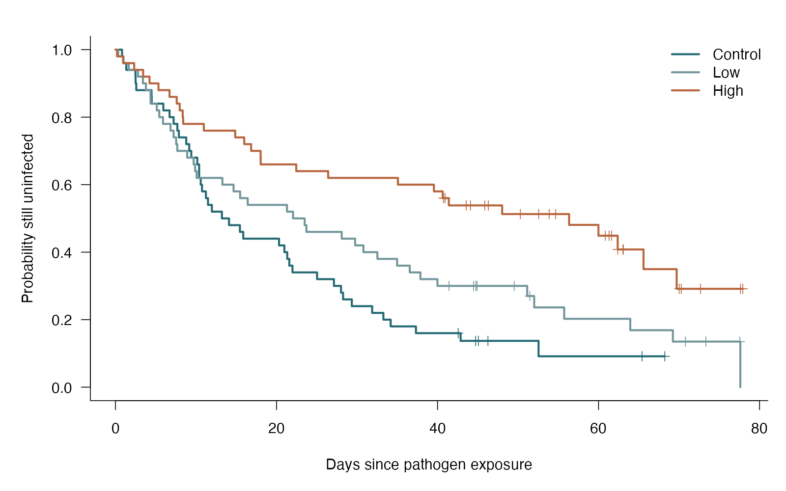
Log-rank: see the data
base R arguments
mark.time — Show censored observations
conf.int = FALSE — Keep three curves readable
col — Match group colors and legend
lwd — Make step curves visible
Log-rank survival comparison — simulated biological data
Notes:
This figure is generated from the saved CSV by modules/log_rank/analysis.R. An omnibus survival comparison is not a pairwise effect estimate.

Slide 431
Log-rank: plot code
par(mar = c(5, 5, 2, 1), las = 1, bty = "l", cex = 1.15)
plot(fit, col = c("#246A73", "#73969B", "#B7663E"), lwd = 2.5,
mark.time = TRUE, conf.int = FALSE,
xlab = "Days since pathogen exposure", ylab = "Probability still uninfected")
legend("topright", levels(d$treatment), lty = 1, lwd = 2.5,
col = c("#246A73", "#73969B", "#B7663E"), bty = "n")
Arguments to change
mark.time — Show censored observations
conf.int = FALSE — Keep three curves readable
col — Match group colors and legend
lwd — Make step curves visible
Notes:
This is an exact excerpt from analysis.R. Any preparation referenced by the excerpt appears in the complete companion script. The script opens a ragg PNG device before these lines and closes it afterward.

Slide 432
Log-rank: question and null
Scientific question
Are the infection-free survival curves equal across treatments?
Null / estimation target
The groups have the same survival function over follow-up.
Relevant options
rho = 0 requests the ordinary log-rank test
The same function handles two or more groups
Use a justified contrast procedure for specific follow-ups
Notes:
Ask whether rejecting this null, or estimating this target, answers the biological question. An omnibus survival comparison is not a pairwise effect estimate.

Slide 433
Log-rank: assumptions
What matters here
Independent plants
Noninformative censoring within each group
Crossing curves may make this comparison insensitive
Parametric responses
Cox regression adds predictors
Time-varying effects or an AFT model may fit a different scientific target
Nonparametric responses
Log-rank is already a nonparametric comparison
A fixed-time or restricted-mean comparison can ask a different prespecified question
Notes:
Begin with the design. A model change should address a specific issue and preserve the scientific target where possible. A rank or permutation alternative has its own assumptions and may change the null; do not choose it solely from a normality-test p-value.

Slide 434
Log-rank: run and read
test <- survival::survdiff(survival::Surv(days, event) ~ treatment,
data = d, rho = 0)
fit <- survival::survfit(survival::Surv(days, event) ~ treatment, data = d)
p_value <- pchisq(test$chisq, df = length(test$n) - 1, lower.tail = FALSE)
Generated results
Log-rank chi-square(2) = 17.18
Omnibus p = 0.0001863
Control day-30 survival 0.24 (95% CI 0.15–0.39)
High day-30 survival 0.62 (95% CI 0.50–0.77)
Notes:
Full executed model/test output:
Call: survfit(formula = survival::Surv(days, event) ~ treatment, data = d)
treatment=Control
time n.risk n.event survival std.err lower 95% CI upper 95% CI
0.813 50 1 0.9800 0.0198 0.9420 1.000
0.992 49 1 0.9600 0.0277 0.9072 1.000
1.344 48 1 0.9400 0.0336 0.8764 1.000
2.481 47 1 0.9200 0.0384 0.8478 0.998
2.498 46 1 0.9000 0.0424 0.8206 0.987
2.584 45 1 0.8800 0.0460 0.7944 0.975
4.478 44 1 0.8600 0.0491 0.7690 0.962
4.495 43 1 0.8400 0.0518 0.7443 0.948
5.943 42 1 0.8200 0.0543 0.7201 0.934
6.715 41 1 0.8000 0.0566 0.6965 0.919
7.222 40 1 0.7800 0.0586 0.6732 0.904
7.687 39 1 0.7600 0.0604 0.6504 0.888
7.875 38 1 0.7400 0.0620 0.6279 0.872
8.784 37 1 0.7200 0.0635 0.6057 0.856
9.159 36 1 0.7000 0.0648 0.5838 0.839
9.416 35 1 0.6800 0.0660 0.5623 0.822
10.160 34 1 0.6600 0.0670 0.5409 0.805
10.390 33 1 0.6400 0.0679 0.5199 0.788
10.392 32 1 0.6200 0.0686 0.4991 0.770
10.587 31 1 0.6000 0.0693 0.4785 0.752
10.749 30 1 0.5800 0.0698 0.4581 0.734
11.233 29 1 0.5600 0.0702 0.4380 0.716
11.492 28 1 0.5400 0.0705 0.4181 0.697
11.969 27 1 0.5200 0.0707 0.3984 0.679
13.215 26 1 0.5000 0.0707 0.3790 0.660
14.101 25 1 0.4800 0.0707 0.3597 0.641
15.453 24 1 0.4600 0.0705 0.3407 0.621
15.867 23 1 0.4400 0.0702 0.3218 0.602
20.316 22 1 0.4200 0.0698 0.3032 0.582
20.978 21 1 0.4000 0.0693 0.2849 0.562
21.332 20 1 0.3800 0.0686 0.2667 0.541
21.591 19 1 0.3600 0.0679 0.2488 0.521
21.986 18 1 0.3400 0.0670 0.2311 0.500
25.038 17 1 0.3200 0.0660 0.2136 0.479
27.135 16 1 0.3000 0.0648 0.1964 0.458
28.011 15 1 0.2800 0.0635 0.1795 0.437
28.269 14 1 0.2600 0.0620 0.1629 0.415
29.354 13 1 0.2400 0.0604 0.1466 0.393
31.881 12 1 0.2200 0.0586 0.1305 0.371
33.274 11 1 0.2000 0.0566 0.1149 0.348
34.181 10 1 0.1800 0.0543 0.0996 0.325
37.319 9 1 0.1600 0.0518 0.0848 0.302
42.870 7 1 0.1371 0.0492 0.0679 0.277
52.549 3 1 0.0914 0.0497 0.0315 0.265
treatment=Low
time n.risk n.event survival std.err lower 95% CI upper 95% CI
0.336 50 1 0.980 0.0198 0.9420 1.000
0.962 49 1 0.960 0.0277 0.9072 1.000
1.650 48 1 0.940 0.0336 0.8764 1.000
2.796 47 1 0.920 0.0384 0.8478 0.998
3.411 46 1 0.900 0.0424 0.8206 0.987
3.787 45 1 0.880 0.0460 0.7944 0.975
4.355 44 1 0.860 0.0491 0.7690 0.962
4.363 43 1 0.840 0.0518 0.7443 0.948
5.133 42 1 0.820 0.0543 0.7201 0.934
5.437 41 1 0.800 0.0566 0.6965 0.919
5.899 40 1 0.780 0.0586 0.6732 0.904
6.838 39 1 0.760 0.0604 0.6504 0.888
7.224 38 1 0.740 0.0620 0.6279 0.872
7.538 37 1 0.720 0.0635 0.6057 0.856
7.675 36 1 0.700 0.0648 0.5838 0.839
8.909 35 1 0.680 0.0660 0.5623 0.822
9.707 34 1 0.660 0.0670 0.5409 0.805
9.890 33 1 0.640 0.0679 0.5199 0.788
10.080 32 1 0.620 0.0686 0.4991 0.770
13.278 31 1 0.600 0.0693 0.4785 0.752
14.667 30 1 0.580 0.0698 0.4581 0.734
15.481 29 1 0.560 0.0702 0.4380 0.716
16.421 28 1 0.540 0.0705 0.4181 0.697
21.299 27 1 0.520 0.0707 0.3984 0.679
22.051 26 1 0.500 0.0707 0.3790 0.660
23.496 25 1 0.480 0.0707 0.3597 0.641
23.714 24 1 0.460 0.0705 0.3407 0.621
28.097 23 1 0.440 0.0702 0.3218 0.602
29.766 22 1 0.420 0.0698 0.3032 0.582
30.795 21 1 0.400 0.0693 0.2849 0.562
32.531 20 1 0.380 0.0686 0.2667 0.541
34.979 19 1 0.360 0.0679 0.2488 0.521
36.550 18 1 0.340 0.0670 0.2311 0.500
37.875 17 1 0.320 0.0660 0.2136 0.479
39.991 16 1 0.300 0.0648 0.1964 0.458
51.134 10 1 0.270 0.0649 0.1686 0.432
52.005 8 1 0.236 0.0650 0.1378 0.405
55.730 7 1 0.202 0.0639 0.1091 0.376
63.940 6 1 0.169 0.0615 0.0826 0.345
69.234 5 1 0.135 0.0577 0.0584 0.312
77.609 1 1 0.000 NaN NA NA
treatment=High
time n.risk n.event survival std.err lower 95% CI upper 95% CI
0.198 50 1 0.980 0.0198 0.942 1.000
0.954 49 1 0.960 0.0277 0.907 1.000
2.322 48 1 0.940 0.0336 0.876 1.000
3.432 47 1 0.920 0.0384 0.848 0.998
4.231 46 1 0.900 0.0424 0.821 0.987
5.337 45 1 0.880 0.0460 0.794 0.975
6.714 44 1 0.860 0.0491 0.769 0.962
7.608 43 1 0.840 0.0518 0.744 0.948
7.978 42 1 0.820 0.0543 0.720 0.934
8.346 41 1 0.800 0.0566 0.696 0.919
8.408 40 1 0.780 0.0586 0.673 0.904
10.973 39 1 0.760 0.0604 0.650 0.888
14.870 38 1 0.740 0.0620 0.628 0.872
15.989 37 1 0.720 0.0635 0.606 0.856
16.848 36 1 0.700 0.0648 0.584 0.839
18.024 35 1 0.680 0.0660 0.562 0.822
18.038 34 1 0.660 0.0670 0.541 0.805
22.455 33 1 0.640 0.0679 0.520 0.788
26.415 32 1 0.620 0.0686 0.499 0.770
35.083 31 1 0.600 0.0693 0.478 0.752
39.551 30 1 0.580 0.0698 0.458 0.734
40.646 29 1 0.560 0.0702 0.438 0.716
41.403 26 1 0.538 0.0707 0.416 0.697
48.025 21 1 0.513 0.0719 0.390 0.675
56.342 16 1 0.481 0.0742 0.355 0.651
59.986 15 1 0.449 0.0758 0.322 0.625
62.376 11 1 0.408 0.0792 0.279 0.597
65.583 7 1 0.350 0.0867 0.215 0.568
69.705 6 1 0.291 0.0897 0.159 0.533
Call:
survival::survdiff(formula = survival::Surv(days, event) ~ treatment,
data = d, rho = 0)
N Observed Expected (O-E)^2/E (O-E)^2/V
treatment=Control 50 44 28.8 8.000 11.16
treatment=Low 50 41 36.7 0.515 0.76
treatment=High 50 29 48.5 7.857 14.15
Chisq= 17.2 on 2 degrees of freedom, p= 2e-04

Slide 435
Log-rank: interpret
The three infection-free survival curves differed (log-rank chi-square(2) = 17.18, p = 0.0001863). Estimated day-30 infection-free fractions were 0.24 in control and 0.62 in high treatment. The omnibus test does not identify each differing pair and does not estimate a hazard ratio.
Discuss: Why does a significant omnibus result not tell us every pair differs?
Notes:
Teaching point: An omnibus survival comparison is not a pairwise effect estimate.
Instructor comparison with the simulated population: Equal survival is false: day-30 infection-free probabilities are exp(−1.35) ≈ 0.259, exp(−0.9) ≈ 0.407 and exp(−0.54) ≈ 0.583. The high/control hazard ratio is 0.4, though the log-rank test itself does not estimate it.
The reported estimate and p-value are calculated from this realized dataset; they need not exactly match the known population effect.

Slide 436
Stratified log-rank: the data
Larval survival under stress is compared within 12 rearing blocks.
Time plus event indicator
Two treatments in every block
Compare treatments within blocks
Other data like these
Germination by collection site
Infection by matched host cohort
Survival by experimental batch
Notes:
Stratified log-rank test
Independent larvae within known rearing blocks; administrative censoring at day 30.
stratum: Rearing block (ID)
treatment: Assigned condition (category)
time: Observed event or censoring time (days)
event: Event observed by day 30 (TRUE/FALSE)

Slide 437
Stratified log-rank: simulate and save
set.seed(240501)
stratum <- rep(1:12, each=10)
treatment <- rep(rep(c("Control", "Stress"), each=5), 12)
rate <- rep(seq(.025, .08, length.out=12), each=10)
event_time <- rexp(120, rate * ifelse(treatment=="Stress", 1.6, 1))
d <- data.frame(stratum, treatment, time=pmin(event_time, 30), event=event_time<=30)
write.csv(d, file.path(out_dir, "data.csv"), row.names = FALSE)
First saved row
stratum: 1
treatment: Control
time: 30
event: FALSE
Notes:
Seed: 240501
Generating model: 120 independent exponential event times conditional on 12 fixed block rates evenly spaced from 0.025 to 0.08 per day. Stress multiplies every block rate by 1.6. Follow-up stops at 30 days.
Population truth: Stress has a true hazard ratio of 1.6 within each block; the within-block equality null is false.
The script writes data.csv before reading it for analysis. output_dir or out_dir is the folder supplied to the standalone script.
Original saved-data preview:
stratum treatment time event
1 Control 30.000000 FALSE
1 Control 27.462231 TRUE
1 Control 30.000000 FALSE
1 Control 3.618851 TRUE

Slide 438
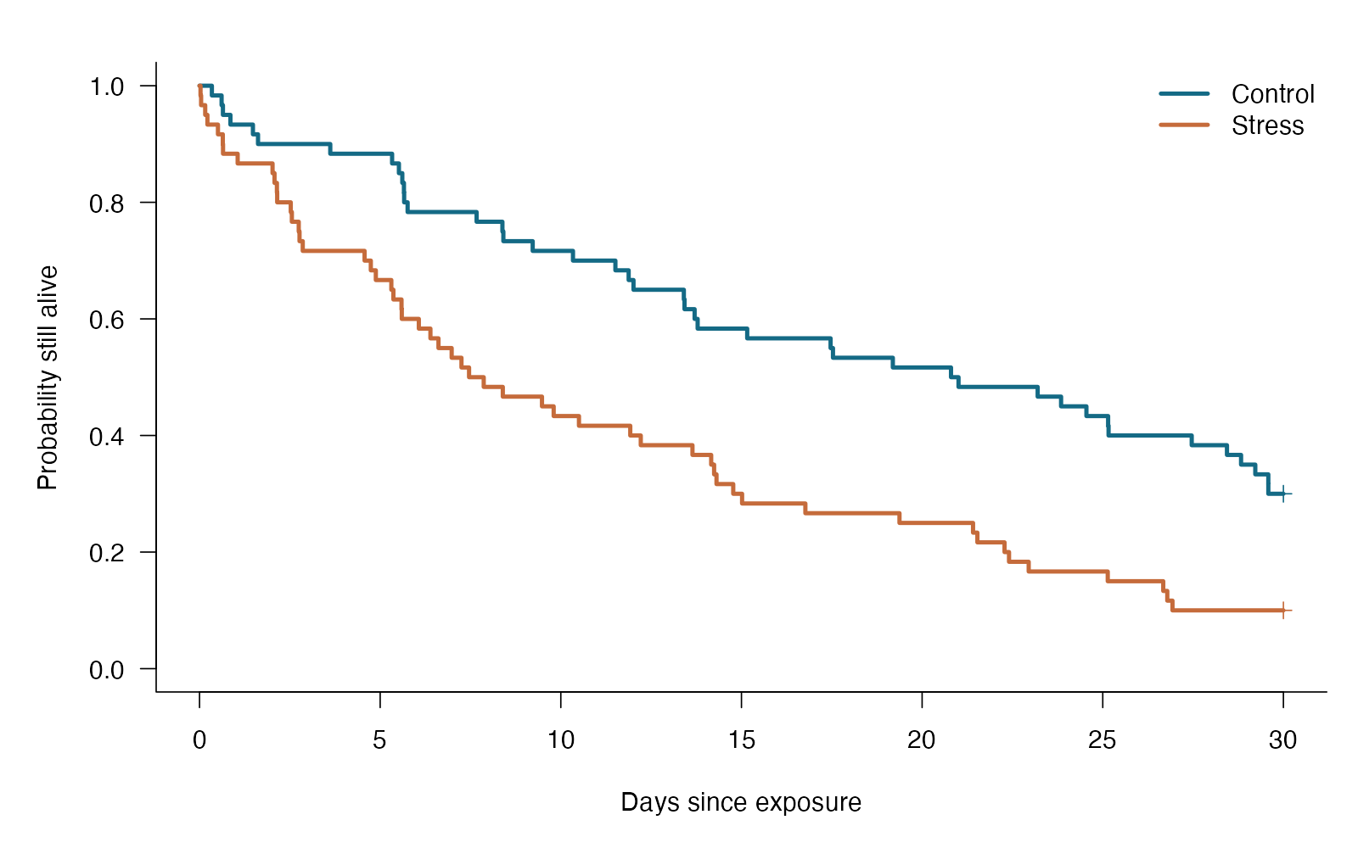
Stratified log-rank: see the data
base R arguments
mark.time=TRUE — Marks censoring times
conf.int=FALSE — Keeps this teaching plot uncluttered
col / lwd — Matches treatment colors and line widths
Stratified log-rank test — simulated biological data
Notes:
This figure is generated from the saved CSV by modules/stratified_logrank/analysis.R. Stratification permits different baseline survival across known blocks.

Slide 439
Stratified log-rank: plot code
fit <- survival::survfit(survival::Surv(time, event) ~ treatment, data=d)
plot(fit, col=c("#146A85", "#C56B3B"), lwd=3, conf.int=FALSE,
xlab="Days since exposure", ylab="Probability still alive", mark.time=TRUE)
legend("topright", c("Control", "Stress"), col=c("#146A85", "#C56B3B"), lwd=3, bty="n")
Arguments to change
mark.time=TRUE — Marks censoring times
conf.int=FALSE — Keeps this teaching plot uncluttered
col / lwd — Matches treatment colors and line widths
Notes:
This is an exact excerpt from analysis.R. Any preparation referenced by the excerpt appears in the complete companion script. The script opens a ragg PNG device before these lines and closes it afterward.

Slide 440
Stratified log-rank: question and null
Scientific question
Do matched groups differ in survival after accounting for the matching strata?
Null / estimation target
Within the specified strata, groups have the same survival function.
Relevant options
survival::survdiff(Surv(time, event) ~ group + strata(match), data = d, rho = 0)
Notes:
Ask whether rejecting this null, or estimating this target, answers the biological question. Stratification permits different baseline survival across known blocks.

Slide 441
Stratified log-rank: assumptions
What matters here
Matching/strata are defined by design; meaningful group comparisons occur within strata.
Appropriate censoring and independence between matched sets.
Parametric responses
Stratified Cox allows additional predictors and separate baseline hazards for strata.
Nonparametric responses
Already a stratified nonparametric comparison; a permutation must honor matching and the event/censoring design.
Notes:
Begin with the design. A model change should address a specific issue and preserve the scientific target where possible. A rank or permutation alternative has its own assumptions and may change the null; do not choose it solely from a normality-test p-value.

Slide 442
Stratified log-rank: run and read
result <- survival::survdiff(survival::Surv(time, event) ~ treatment + strata(stratum), data=d)
p_value <- pchisq(result$chisq, df=1, lower.tail=FALSE)
Generated results
Stratified chi-square = 13.433
p = 0.0002472
12 rearing blocks; 120 larvae
Notes:
Full executed model/test output:
Call:
survival::survdiff(formula = survival::Surv(time, event) ~ treatment +
strata(stratum), data = d)
N Observed Expected (O-E)^2/E (O-E)^2/V
treatment=Control 60 42 58.5 4.64 13.4
treatment=Stress 60 54 37.5 7.23 13.4
Chisq= 13.4 on 1 degrees of freedom, p= 2e-04

Slide 443
Stratified log-rank: interpret
After comparison within rearing blocks, chi-square = 13.43 (1 df), p = 0.000247. The test compares survival; estimate the direction and magnitude with survival curves or a suitable model.
Discuss: What biological variation does stratification account for here?
Notes:
Teaching point: Stratification permits different baseline survival across known blocks.
Instructor comparison with the simulated population: Stress has a true hazard ratio of 1.6 within each block; the within-block equality null is false.
The reported estimate and p-value are calculated from this realized dataset; they need not exactly match the known population effect.

Slide 444
Cox regression: the data
Seedling death times are related to protective dose and temperature.
Event time plus censor indicator
Quantitative dose and temperature
Conditional hazard comparison
Other data like these
Dose effects on time to infection
Body size effects on longevity
Habitat effects on germination hazard
Notes:
Cox proportional-hazards regression
180 independent seedlings with right-censoring.
seedling: Independent seedling identifier (ID)
dose: Protective dose (dose unit)
temperature: Rearing temperature (°C)
days: Observed death or censoring time (day)
event: 1 death; 0 right-censored (binary)

Slide 445
Cox regression: simulate and save
set.seed(2112)
d <- data.frame(seedling = 1:180, dose = runif(180, 0, 3),
temperature = rnorm(180, 25, 2))
rate <- exp(log(.035) - .45 * d$dose + .12 * (d$temperature - 25))
event_time <- rexp(180, rate = rate)
follow_up <- runif(180, 45, 100)
d$days <- pmin(event_time, follow_up)
d$event <- as.integer(event_time <= follow_up)
write.csv(d, file.path(output_dir, "data.csv"), row.names = FALSE)
First saved row
seedling: 1
dose: 2.467
temperature: 23.63
days: 86.63
event: 0
Notes:
Seed: 2112
Generating model: 180 seedlings have dose Uniform(0, 3) and temperature Normal(25, 2²)°C. Conditional event times are exponential with rate exp(log(0.035) − 0.45 × dose + 0.12 × (temperature − 25)). Independent censoring times are Uniform(45, 100) days. Save the minimum time and event indicator without rounding.
Population truth: The adjusted hazard ratio per dose unit is exp(−0.45) ≈ 0.638; per °C it is exp(0.12) ≈ 1.127. The dose null is false and proportional hazards holds in the generating model.
The script writes data.csv before reading it for analysis. output_dir or out_dir is the folder supplied to the standalone script.
Original saved-data preview:
seedling dose temperature days event
1 2.4670338 23.63476 86.62669 0
2 1.4318536 27.56345 33.04450 1
3 1.1376910 24.91264 62.69940 0
4 0.7997489 22.42051 15.39509 1

Slide 446

Cox regression: see the data
base R arguments
newdata — Hold temperature fixed while varying dose
conf.int — Choose whether uncertainty bands are drawn
col — Distinguish predictor scenarios
mtext — State what is held constant
Cox proportional-hazards regression — simulated biological data
Notes:
This figure is generated from the saved CSV by modules/cox_ph/analysis.R. A hazard ratio compares instantaneous event risk among individuals still at risk.

Slide 447
Cox regression: plot code
par(mar = c(5, 5, 2, 1), las = 1, bty = "l", cex = 1.15)
plot(curves, col = c("#246A73", "#73969B", "#B7663E"), lwd = 2.5,
conf.int = FALSE, xlab = "Days since exposure",
ylab = "Fitted survival probability")
legend("topright", c("Dose 0", "Dose 1.5", "Dose 3"), lty = 1, lwd = 2.5,
col = c("#246A73", "#73969B", "#B7663E"), bty = "n")
mtext("Fitted curves at 25°C", side = 3, line = .1, adj = 0)
Arguments to change
newdata — Hold temperature fixed while varying dose
conf.int — Choose whether uncertainty bands are drawn
col — Distinguish predictor scenarios
mtext — State what is held constant
Notes:
This is an exact excerpt from analysis.R. Any preparation referenced by the excerpt appears in the complete companion script. The script opens a ragg PNG device before these lines and closes it afterward.

Slide 448
Cox regression: question and null
Scientific question
Does dose alter death hazard after accounting for temperature?
Null / estimation target
The dose coefficient is zero: the adjusted hazard ratio per dose unit is one.
Relevant options
Surv(days, event) preserves censoring
dose + temperature adjusts for temperature
cox.zph examines the proportional-hazards structure
Notes:
Ask whether rejecting this null, or estimating this target, answers the biological question. A hazard ratio compares instantaneous event risk among individuals still at risk.

Slide 449
Cox regression: assumptions
What matters here
Suitable covariate effects and censoring mechanism
A constant hazard ratio for ordinary coefficients
Independent seedlings; model dependence if present
Parametric responses
Allow time-varying effects or justified strata
An AFT model targets a survival-time ratio
Nonparametric responses
Cox leaves the baseline hazard unspecified
Log-rank supports a simpler group comparison
Notes:
Begin with the design. A model change should address a specific issue and preserve the scientific target where possible. A rank or permutation alternative has its own assumptions and may change the null; do not choose it solely from a normality-test p-value.

Slide 450
Cox regression: run and read
fit <- survival::coxph(survival::Surv(days, event) ~ dose + temperature,
data = d, x = TRUE)
summary(fit)
ph_check <- survival::cox.zph(fit)
hazard_ci <- exp(confint(fit)["dose", ])
Generated results
Dose hazard ratio per unit = 0.69
95% CI 0.56 to 0.84
Wald z = -3.72; p = 0.0001969
PH diagnostic global p = 0.01934
Notes:
Full executed model/test output:
Call:
survival::coxph(formula = survival::Surv(days, event) ~ dose +
temperature, data = d, x = TRUE)
n= 180, number of events= 126
coef exp(coef) se(coef) z Pr(>|z|)
dose -0.37705 0.68588 0.10128 -3.723 0.000197 ***
temperature 0.16013 1.17367 0.04852 3.300 0.000966 ***
---
Signif. codes: 0 ‘***’ 0.001 ‘**’ 0.01 ‘*’ 0.05 ‘.’ 0.1 ‘ ’ 1
exp(coef) exp(-coef) lower .95 upper .95
dose 0.6859 1.458 0.5624 0.8365
temperature 1.1737 0.852 1.0672 1.2908
Concordance= 0.628 (se = 0.027 )
Likelihood ratio test= 21.6 on 2 df, p=2e-05
Wald test = 21.43 on 2 df, p=2e-05
Score (logrank) test = 21.27 on 2 df, p=2e-05
chisq df p
dose 7.726 1 0.0054
temperature 0.942 1 0.3317
GLOBAL 7.891 2 0.0193

Slide 451
Cox regression: interpret
Each dose unit multiplied the death hazard by 0.69 at the same temperature (95% CI 0.56 to 0.84; Wald p = 0.0001969). This is an instantaneous-risk comparison among seedlings still alive, not a survival probability ratio. The fitted constant hazard ratio must be checked over time.
Discuss: Explain why a hazard ratio of 0.6 does not mean 60% as many seedlings survive.
Notes:
Teaching point: A hazard ratio compares instantaneous event risk among individuals still at risk.
Instructor comparison with the simulated population: The adjusted hazard ratio per dose unit is exp(−0.45) ≈ 0.638; per °C it is exp(0.12) ≈ 1.127. The dose null is false and proportional hazards holds in the generating model.
The reported estimate and p-value are calculated from this realized dataset; they need not exactly match the known population effect.

Slide 452
Parametric survival: the data
Botanists compare germination timing after control or cold treatment.
Positive event time
Right-censoring
A time-ratio scientific target
Other data like these
Developmental time under temperature
Time to infection under treatment
Longevity under different diets
Notes:
Parametric survival: accelerated failure time
140 independent seeds; some remain ungerminated at final follow-up.
seed: Independent seed identifier (ID)
treatment: Control or cold pretreatment (category)
days: Observed germination or censoring time (day)
event: 1 germinated; 0 right-censored (binary)

Slide 453
Parametric survival: simulate and save
set.seed(2113)
d <- data.frame(seed = 1:140,
treatment = rep(c("Control", "Cold"), each = 70))
log_scale <- log(20) + .4 * (d$treatment == "Cold")
event_time <- rweibull(140, shape = 1.8, scale = exp(log_scale))
follow_up <- runif(140, 22, 50)
d$days <- pmin(event_time, follow_up)
d$event <- as.integer(event_time <= follow_up)
write.csv(d, file.path(output_dir, "data.csv"), row.names = FALSE)
First saved row
seed: 1
treatment: Control
days: 11.06
event: 1
Notes:
Seed: 2113
Generating model: 140 independent seeds (70 per group) have Weibull germination times with shape 1.8 and scale exp(log(20) + 0.4 if Cold). Thus control scale is 20 days and cold scale is about 29.84 days. Independent censoring times are Uniform(22, 50) days. Save minimum time and event indicator without rounding.
Population truth: The population cold/control time ratio is exp(0.4) ≈ 1.492, so the equal-time null is false. The generating Weibull distribution matches the fitted AFT family.
The script writes data.csv before reading it for analysis. output_dir or out_dir is the folder supplied to the standalone script.
Original saved-data preview:
seed treatment days event
1 Control 11.058162 1
2 Control 26.148082 1
3 Control 5.194153 1
4 Control 22.392917 0

Slide 454

Parametric survival: see the data
base R arguments
lty — Separate empirical steps from model curves
lines — Overlay fitted survival curves
mark.time — Keep censoring visible
legend — Name both groups and line meanings
Parametric survival: accelerated failure time — simulated biological data
Notes:
This figure is generated from the saved CSV by modules/parametric_survival/analysis.R. An AFT coefficient becomes a time ratio; it is not interpreted as a Cox hazard ratio.

Slide 455
Parametric survival: plot code
par(mar = c(5, 5, 2, 1), las = 1, bty = "l", cex = 1.15)
plot(km, col = c("#246A73", "#B7663E"), lty = 2, lwd = 1.4,
conf.int = FALSE, mark.time = TRUE, xlim = c(0, 60),
xlab = "Days since sowing", ylab = "Probability not yet germinated")
lines(time_grid, survival_control, col = "#246A73", lwd = 2.5)
lines(time_grid, survival_cold, col = "#B7663E", lwd = 2.5)
legend("topright", c("Control", "Cold", "Weibull model", "Kaplan–Meier"),
col = c("#246A73", "#B7663E", "#172D34", "#172D34"),
lty = c(1, 1, 1, 2), lwd = c(2.5, 2.5, 2.5, 1.4), bty = "n")
Arguments to change
lty — Separate empirical steps from model curves
lines — Overlay fitted survival curves
mark.time — Keep censoring visible
legend — Name both groups and line meanings
Notes:
This is an exact excerpt from analysis.R. Any preparation referenced by the excerpt appears in the complete companion script. The script opens a ragg PNG device before these lines and closes it afterward.

Slide 456
Parametric survival: question and null
Scientific question
Does cold treatment stretch the germination-time distribution?
Null / estimation target
The treatment coefficient is zero: the cold/control time ratio is one.
Relevant options
dist = “weibull” chooses the event-time family
exp(coefficient) gives the AFT time ratio
Surv retains seeds that are right-censored
Notes:
Ask whether rejecting this null, or estimating this target, answers the biological question. An AFT coefficient becomes a time ratio; it is not interpreted as a Cox hazard ratio.

Slide 457
Parametric survival: assumptions
What matters here
Independent seeds and appropriate censoring
A suitable Weibull time distribution
A common acceleration factor for treatment
Parametric responses
Check other justified parametric time distributions
Cox changes the effect scale to a hazard ratio
Nonparametric responses
Kaplan–Meier estimates survival without a time distribution
Log-rank tests equal survival curves
Notes:
Begin with the design. A model change should address a specific issue and preserve the scientific target where possible. A rank or permutation alternative has its own assumptions and may change the null; do not choose it solely from a normality-test p-value.

Slide 458
Parametric survival: run and read
fit <- survival::survreg(survival::Surv(days, event) ~ treatment,
data = d, dist = "weibull")
summary(fit)
time_ci <- exp(confint(fit)["treatmentCold", ])
Generated results
Cold/control time ratio = 1.70
95% CI 1.35 to 2.13
Wald z = 4.54; p = 5.745e-06
Fitted Weibull shape = 1.64
Notes:
Full executed model/test output:
Call:
survival::survreg(formula = survival::Surv(days, event) ~ treatment,
data = d, dist = "weibull")
Value Std. Error z p
(Intercept) 2.8854 0.0773 37.32 < 2e-16
treatmentCold 0.5288 0.1166 4.54 5.7e-06
Log(scale) -0.4935 0.0759 -6.50 8.1e-11
Scale= 0.61
Weibull distribution
Loglik(model)= -454.6 Loglik(intercept only)= -465
Chisq= 20.72 on 1 degrees of freedom, p= 5.3e-06
Number of Newton-Raphson Iterations: 5
n= 140

Slide 459
Parametric survival: interpret
Under the Weibull accelerated-failure-time model, cold-treated seeds had 1.70 times the germination time of controls (95% CI 1.35 to 2.13; p = 5.745e-06). This is a time ratio, not a Cox hazard ratio. The distributional fit and censoring assumptions remain part of the interpretation.
Discuss: Would an AFT time ratio above one speed up or delay germination?
Notes:
Teaching point: An AFT coefficient becomes a time ratio; it is not interpreted as a Cox hazard ratio.
Instructor comparison with the simulated population: The population cold/control time ratio is exp(0.4) ≈ 1.492, so the equal-time null is false. The generating Weibull distribution matches the fitted AFT family.
The reported estimate and p-value are calculated from this realized dataset; they need not exactly match the known population effect.

Slide 460
Shared frailty: the data
Larvae from 24 populations experience a control or stress condition.
Cluster ID retained
Time and censor indicator
Conditional treatment effect
Other data like these
Animals within colonies
Plants within populations
Patients within centers
Notes:
Shared-frailty survival model
Larvae share an unobserved population risk; time-to-death is censored at day 35.
population: Shared risk group (ID)
stress: Control=0, stress=1 (indicator)
time: Observed follow-up (days)
event: Death observed (TRUE/FALSE)

Slide 461
Shared frailty: simulate and save
set.seed(240502)
population <- rep(1:24, each=10)
stress <- rep(rep(0:1, each=5), 24)
frailty <- rgamma(24, shape=2, rate=2)
event_time <- rexp(240, .04 * frailty[population] * exp(.5*stress))
d <- data.frame(population, stress, time=pmin(event_time, 35), event=event_time<=35)
write.csv(d, file.path(out_dir, "data.csv"), row.names = FALSE)
First saved row
population: 1
stress: 0
time: 35
event: FALSE
Notes:
Seed: 240502
Generating model: 24 population frailties follow Gamma(shape=2, rate=2), mean 1. Conditional event times are exponential with rate 0.04 × frailty × exp(0.5 × stress). Ten larvae per population; censoring at 35 days.
Population truth: The conditional stress hazard ratio is exp(0.5) ≈ 1.65; shared population variance is 0.5.
The script writes data.csv before reading it for analysis. output_dir or out_dir is the folder supplied to the standalone script.
Original saved-data preview:
population stress time event
1 0 35.00000 FALSE
1 0 35.00000 FALSE
1 0 35.00000 FALSE
1 0 33.92861 TRUE

Slide 462

Shared frailty: see the data
base R arguments
Surv(time,event) — Uses follow-up and event status together
mark.time — Shows right-censored observations
conf.int — Controls interval display
Shared-frailty survival model — simulated biological data
Notes:
This figure is generated from the saved CSV by modules/shared_frailty/analysis.R. Frailty accounts for shared latent risk; it is different from giving each stratum its own baseline curve.

Slide 463
Shared frailty: plot code
fit <- survival::survfit(survival::Surv(time, event) ~ stress, data=d)
plot(fit, col=c("#146A85", "#C56B3B"), lwd=3, conf.int=FALSE,
xlab="Days since exposure", ylab="Probability still alive", mark.time=TRUE)
legend("topright", c("Control", "Stress"), col=c("#146A85", "#C56B3B"), lwd=3, bty="n")
Arguments to change
Surv(time,event) — Uses follow-up and event status together
mark.time — Shows right-censored observations
conf.int — Controls interval display
Notes:
This is an exact excerpt from analysis.R. Any preparation referenced by the excerpt appears in the complete companion script. The script opens a ragg PNG device before these lines and closes it afterward.

Slide 464
Shared frailty: question and null
Scientific question
Does stress change larval death hazard after accounting for shared population conditions?
Null / estimation target
The stress coefficient is zero: the hazard ratio conditional on population frailty is one.
Relevant options
survival::coxph(Surv(time, event) ~ x + frailty(cluster_id), data = d)
Specify a plausible frailty distribution; inspect convergence and the cluster structure.
Notes:
Ask whether rejecting this null, or estimating this target, answers the biological question. Frailty accounts for shared latent risk; it is different from giving each stratum its own baseline curve.

Slide 465
Shared frailty: assumptions
What matters here
Independent clusters; a suitable shared-frailty structure and conditional proportional hazards.
Appropriate censoring; enough independent clusters.
Parametric responses
Stratified Cox allows separate baseline hazards; cluster-robust uncertainty adjusts precision without fitting a frailty distribution.
Nonparametric responses
Cluster-level resampling may assess uncertainty; simple rank tests discard the survival and clustering structure.
Notes:
Begin with the design. A model change should address a specific issue and preserve the scientific target where possible. A rank or permutation alternative has its own assumptions and may change the null; do not choose it solely from a normality-test p-value.

Slide 466
Shared frailty: run and read
result <- survival::coxph(survival::Surv(time, event) ~ stress + frailty(population), data=d)
b <- coef(result)["stress"]
se <- sqrt(vcov(result)["stress", "stress"])
hr <- exp(b); ci <- exp(b+c(-1,1)*1.96*se)
p_value <- 2*pnorm(-abs(b/se))
Generated results
Conditional hazard ratio = 1.61
Wald 95% CI 1.18 to 2.18
Wald p = 0.002373
Notes:
Full executed model/test output:
Call:
survival::coxph(formula = survival::Surv(time, event) ~ stress +
frailty(population), data = d)
coef se(coef) se2 Chisq DF p
stress 0.475 0.156 0.155 9.236 1.0 0.0024
frailty(population) 55.288 17.2 6.8e-06
Iterations: 8 outer, 31 Newton-Raphson
Variance of random effect= 0.337 I-likelihood = -848
Degrees of freedom for terms= 1.0 17.2
Likelihood ratio test=82.8 on 18.1 df, p=3e-10
n= 240, number of events= 174

Slide 467
Shared frailty: interpret
Stress has an estimated hazard ratio of 1.61 conditional on population frailty (95% Wald CI 1.18 to 2.18; p = 0.00237). Population frailty represents shared differences in baseline risk.
Discuss: Why do 240 larvae not provide 240 independent population replicates?
Notes:
Teaching point: Frailty accounts for shared latent risk; it is different from giving each stratum its own baseline curve.
Instructor comparison with the simulated population: The conditional stress hazard ratio is exp(0.5) ≈ 1.65; shared population variance is 0.5.
The reported estimate and p-value are calculated from this realized dataset; they need not exactly match the known population effect.

Slide 468
Bonferroni: the data
Compare gene expression between two conditions across 40 genes.
Many related hypotheses
One prespecified family of 40 tests
Effect sizes remain interpretable per gene
Other data like these
Multiple candidate traits
Several planned endpoints
Many microbial taxa
Notes:
Bonferroni correction
Each gene comparison uses 12 independent samples per condition; simulation uses independent genes.
gene: Gene comparison (ID)
treated: Control=0, treated=1 (indicator)
expression: Expression measurement (log2 units)

Slide 469
Bonferroni: simulate and save
set.seed(240508)
gene <- rep(1:40, each=24)
treated <- rep(rep(0:1, each=12), 40)
effect <- rep(c(rep(1.1,8), rep(0,32)), each=24)
d <- data.frame(gene, treated, expression=rnorm(960, 6+effect*treated, 1))
write.csv(d, file.path(out_dir, "data.csv"), row.names = FALSE)
First saved row
gene: 1
treated: 0
expression: 9.308
Notes:
Seed: 240508
Generating model: 40 genes, each with 12 control and 12 treated independent Normal observations, SD=1 log2 unit. Controls have mean 6; the first 8 genes have treatment shift 1.1; the other 32 have shift 0. Genes are independent in this simulation.
Population truth: The first eight genes have true mean effects of 1.1 log2 units; the other 32 nulls are true.
The script writes data.csv before reading it for analysis. output_dir or out_dir is the folder supplied to the standalone script.
Original saved-data preview:
gene treated expression
1 0 9.307887
1 0 5.031719
1 0 4.517621
1 0 4.356985

Slide 470

Bonferroni: see the data
base R arguments
-log10(p_value) — Makes smaller p-values appear higher
bg=ifelse(…) — Colors by the adjusted decision
abline(v=0) — Marks zero expression difference
Bonferroni correction — simulated biological data
Notes:
This figure is generated from the saved CSV by modules/bonferroni/analysis.R. Bonferroni controls the chance of at least one false positive in the declared family; retain the gene effect sizes when interpreting discoveries.

Slide 471
Bonferroni: plot code
plot(difference, -log10(p_value), pch=21,
bg=ifelse(adjusted<.05, "#C56B3B", "#A7B6BD"),
xlab="Treatment − control (log2 expression)", ylab="−log10(unadjusted p)")
abline(v=0, lty=2, col="gray60")
legend("topleft", c("Passes adjustment", "Does not pass"),
pch=21, pt.bg=c("#C56B3B", "#A7B6BD"), bty="n")
Arguments to change
-log10(p_value) — Makes smaller p-values appear higher
bg=ifelse(…) — Colors by the adjusted decision
abline(v=0) — Marks zero expression difference
Notes:
This is an exact excerpt from analysis.R. Any preparation referenced by the excerpt appears in the complete companion script. The script opens a ragg PNG device before these lines and closes it afterward.

Slide 472
Bonferroni: question and null
Scientific question
Which gene differences are supported while controlling the chance of any false positive across the 40 comparisons?
Null / estimation target
For each gene, the treatment and control population means are equal. The adjustment changes the error criterion, not those individual nulls.
Relevant options
p.adjust(p_value, method=“bonferroni”)
Define the family before viewing results
At adjusted p < .05, control familywise error at 5%
Notes:
Ask whether rejecting this null, or estimating this target, answers the biological question. Bonferroni controls the chance of at least one false positive in the declared family; retain the gene effect sizes when interpreting discoveries.

Slide 473
Bonferroni: assumptions
What matters here
Each input p-value is valid for its own null.
The family and error criterion match the scientific aim.
Parametric responses
Adjust valid p-values from the selected parametric tests.
Nonparametric responses
The same adjustment can be applied to valid rank-test or permutation p-values.
Notes:
Begin with the design. A model change should address a specific issue and preserve the scientific target where possible. A rank or permutation alternative has its own assumptions and may change the null; do not choose it solely from a normality-test p-value.

Slide 474
Bonferroni: run and read
p_value <- difference <- numeric(40)
for (i in 1:40) {
x <- d$expression[d$gene==i & d$treated==1]
y <- d$expression[d$gene==i & d$treated==0]
p_value[i] <- t.test(x,y)$p.value
difference[i] <- mean(x)-mean(y)
}
adjusted <- p.adjust(p_value, method="bonferroni")
result <- data.frame(gene=1:40, difference, p_value, adjusted)
Generated results
Unadjusted p<.05: 8 genes
Adjusted p<.05: 2 genes
One declared family of 40 gene comparisons
Notes:
Full executed model/test output:
gene difference p_value adjusted
1 1 1.356069983 2.431656e-02 0.972662302
2 2 1.820104702 3.547859e-03 0.141914361
3 3 0.845346076 1.950008e-02 0.780003216
4 4 1.601922131 2.962924e-04 0.011851697
5 5 0.875891097 1.213253e-02 0.485301058
6 6 0.687357661 7.714434e-02 1.000000000
7 7 1.845249234 9.557971e-05 0.003823188
8 8 1.105882290 1.875913e-02 0.750365364
9 9 0.141888955 7.029532e-01 1.000000000
10 10 -0.525492608 1.433129e-01 1.000000000
11 11 -0.111584860 7.609645e-01 1.000000000
12 12 -0.500318535 1.802215e-01 1.000000000
13 13 -0.174194669 6.714101e-01 1.000000000
14 14 -0.442811468 3.442297e-01 1.000000000
15 15 -0.237449722 4.772690e-01 1.000000000
16 16 0.070743474 8.445295e-01 1.000000000
17 17 1.038355354 2.150182e-02 0.860072962
18 18 -0.478127932 2.694789e-01 1.000000000
19 19 -0.695425512 7.735015e-02 1.000000000
20 20 0.295473084 5.001759e-01 1.000000000
21 21 -0.255778461 5.105560e-01 1.000000000
22 22 -0.052458354 8.819974e-01 1.000000000
23 23 0.019658817 9.659932e-01 1.000000000
24 24 0.428118427 2.948827e-01 1.000000000
25 25 0.078072139 8.409584e-01 1.000000000
26 26 0.329322315 4.137296e-01 1.000000000
27 27 0.115868310 7.837690e-01 1.000000000
28 28 -0.128556430 7.479098e-01 1.000000000
29 29 -0.244565960 5.393038e-01 1.000000000
30 30 -0.444446000 3.158609e-01 1.000000000
31 31 -0.110704620 8.086996e-01 1.000000000
32 32 -0.163111825 7.039041e-01 1.000000000
33 33 -0.460802842 3.168194e-01 1.000000000
34 34 -0.288218696 5.228287e-01 1.000000000
35 35 0.312361668 4.543604e-01 1.000000000
36 36 -0.439299699 3.246300e-01 1.000000000
37 37 -0.001465637 9.964233e-01 1.000000000
38 38 0.588926287 2.193949e-01 1.000000000
39 39 -0.165987262 6.396148e-01 1.000000000
40 40 0.585516005 1.799847e-01 1.000000000

Slide 475
Bonferroni: interpret
Of 40 gene comparisons, 2 have Bonferroni-adjusted p-values below 0.05. With valid input tests, this rule controls the probability of at least one false positive in the family at 5%. Interpret the gene effect sizes alongside the adjusted evidence.
Discuss: Does a gene with a small adjusted p-value necessarily have a biologically large effect?
Notes:
Teaching point: Bonferroni controls the chance of at least one false positive in the declared family; retain the gene effect sizes when interpreting discoveries.
Instructor comparison with the simulated population: The first eight genes have true mean effects of 1.1 log2 units; the other 32 nulls are true.
The reported estimate and p-value are calculated from this realized dataset; they need not exactly match the known population effect.

Slide 476
Benjamini–Hochberg FDR: the data
Compare gene expression between two conditions across 40 genes.
Many related hypotheses
One prespecified family of 40 tests
Effect sizes remain interpretable per gene
Other data like these
Multiple candidate traits
Several planned endpoints
Many microbial taxa
Notes:
Benjamini–Hochberg FDR
Each gene comparison uses 12 independent samples per condition; simulation uses independent genes.
gene: Gene comparison (ID)
treated: Control=0, treated=1 (indicator)
expression: Expression measurement (log2 units)

Slide 477
Benjamini–Hochberg FDR: simulate and save
set.seed(240509)
gene <- rep(1:40, each=24)
treated <- rep(rep(0:1, each=12), 40)
effect <- rep(c(rep(1.1,8), rep(0,32)), each=24)
d <- data.frame(gene, treated, expression=rnorm(960, 6+effect*treated, 1))
write.csv(d, file.path(out_dir, "data.csv"), row.names = FALSE)
First saved row
gene: 1
treated: 0
expression: 5.778
Notes:
Seed: 240509
Generating model: 40 genes, each with 12 control and 12 treated independent Normal observations, SD=1 log2 unit. Controls have mean 6; the first 8 genes have treatment shift 1.1; the other 32 have shift 0. Genes are independent in this simulation.
Population truth: The first eight genes have true mean effects of 1.1 log2 units; the other 32 nulls are true.
The script writes data.csv before reading it for analysis. output_dir or out_dir is the folder supplied to the standalone script.
Original saved-data preview:
gene treated expression
1 0 5.777521
1 0 6.305479
1 0 5.978374
1 0 5.551299

Slide 478

Benjamini–Hochberg FDR: see the data
base R arguments
-log10(p_value) — Makes smaller p-values appear higher
bg=ifelse(…) — Colors by the adjusted decision
abline(v=0) — Marks zero expression difference
Benjamini–Hochberg FDR — simulated biological data
Notes:
This figure is generated from the saved CSV by modules/fdr/analysis.R. BH controls the expected false-discovery proportion among selected genes under its assumptions; the fraction in one particular selected set can differ.

Slide 479
Benjamini–Hochberg FDR: plot code
plot(difference, -log10(p_value), pch=21,
bg=ifelse(adjusted<.05, "#C56B3B", "#A7B6BD"),
xlab="Treatment − control (log2 expression)", ylab="−log10(unadjusted p)")
abline(v=0, lty=2, col="gray60")
legend("topleft", c("Passes adjustment", "Does not pass"),
pch=21, pt.bg=c("#C56B3B", "#A7B6BD"), bty="n")
Arguments to change
-log10(p_value) — Makes smaller p-values appear higher
bg=ifelse(…) — Colors by the adjusted decision
abline(v=0) — Marks zero expression difference
Notes:
This is an exact excerpt from analysis.R. Any preparation referenced by the excerpt appears in the complete companion script. The script opens a ragg PNG device before these lines and closes it afterward.

Slide 480
Benjamini–Hochberg FDR: question and null
Scientific question
Which gene differences are supported while controlling the expected fraction of false discoveries among selected genes?
Null / estimation target
For each gene, the treatment and control population means are equal. The adjustment changes the error criterion, not those individual nulls.
Relevant options
p.adjust(p_value, method=“BH”)
Define the family before viewing results
At adjusted p < .05, target a 5% false-discovery rate
Notes:
Ask whether rejecting this null, or estimating this target, answers the biological question. BH controls the expected false-discovery proportion among selected genes under its assumptions; the fraction in one particular selected set can differ.

Slide 481
Benjamini–Hochberg FDR: assumptions
What matters here
Each input p-value is valid for its own null.
The family and error criterion match the scientific aim.
BH needs independence or suitable positive dependence for its usual guarantee.
Parametric responses
Adjust valid p-values from the selected parametric tests.
Nonparametric responses
The same adjustment can be applied to valid rank-test or permutation p-values.
Notes:
Begin with the design. A model change should address a specific issue and preserve the scientific target where possible. A rank or permutation alternative has its own assumptions and may change the null; do not choose it solely from a normality-test p-value.

Slide 482
Benjamini–Hochberg FDR: run and read
p_value <- difference <- numeric(40)
for (i in 1:40) {
x <- d$expression[d$gene==i & d$treated==1]
y <- d$expression[d$gene==i & d$treated==0]
p_value[i] <- t.test(x,y)$p.value
difference[i] <- mean(x)-mean(y)
}
adjusted <- p.adjust(p_value, method="BH")
result <- data.frame(gene=1:40, difference, p_value, adjusted)
Generated results
Unadjusted p<.05: 7 genes
Adjusted p<.05: 3 genes
One declared family of 40 gene comparisons
Notes:
Full executed model/test output:
gene difference p_value adjusted
1 1 0.74361874 0.1104543621 0.40165223
2 2 1.13993835 0.0030532767 0.04071036
3 3 0.63303366 0.1567432146 0.44783776
4 4 1.14326813 0.0073476739 0.06095345
5 5 0.96736406 0.0305870454 0.17478312
6 6 1.09236913 0.0076191816 0.06095345
7 7 1.48722039 0.0005346944 0.02138778
8 8 0.98760270 0.0091921923 0.06128128
9 9 0.51837432 0.1388609646 0.42726451
10 10 -0.14223887 0.7992511250 0.89242739
11 11 0.51406450 0.1902207102 0.50725523
12 12 0.70940140 0.1049898188 0.40165223
13 13 -0.30250964 0.4092528380 0.71174407
14 14 0.42126908 0.2268777905 0.53383010
15 15 0.61198019 0.1050522464 0.40165223
16 16 0.20888941 0.5939132343 0.84844748
17 17 -0.65242027 0.1298588176 0.42726451
18 18 -0.01411687 0.9796145857 0.97961459
19 19 0.24030316 0.6422998740 0.88593086
20 20 -0.64493323 0.1016113193 0.40165223
21 21 0.07513899 0.8145615887 0.89242739
22 22 -0.47464912 0.2974303246 0.66095628
23 23 0.02363298 0.9466910092 0.97096514
24 24 1.02654327 0.0014177568 0.02835514
25 25 -0.29191394 0.4709077705 0.75345243
26 26 -0.10301348 0.8478060177 0.89242739
27 27 0.18143797 0.6983414710 0.89242739
28 28 -0.18717039 0.6687974584 0.89172994
29 29 0.33171934 0.3389648607 0.67310147
30 30 0.15073943 0.7246670673 0.89242739
31 31 0.51380224 0.2236912675 0.53383010
32 32 -0.08888316 0.8389536027 0.89242739
33 33 0.26256464 0.4695329863 0.75345243
34 34 -0.15063432 0.7623551098 0.89242739
35 35 -0.36171374 0.3702058103 0.67310147
36 36 0.45507254 0.3293200199 0.67310147
37 37 -0.33460383 0.5022342610 0.77266809
38 38 0.24260469 0.5607670894 0.83076606
39 39 0.48258110 0.3672953546 0.67310147
40 40 0.10560952 0.7943725893 0.89242739

Slide 483
Benjamini–Hochberg FDR: interpret
Of 40 gene comparisons, 3 have BH-adjusted p-values below 0.05. Under its assumptions, this rule controls the expected false-discovery proportion among selected genes at 5%. Interpret the gene effect sizes alongside the adjusted evidence.
Discuss: Does a gene with a small adjusted p-value necessarily have a biologically large effect?
Notes:
Teaching point: BH controls the expected false-discovery proportion among selected genes under its assumptions; the fraction in one particular selected set can differ.
Instructor comparison with the simulated population: The first eight genes have true mean effects of 1.1 log2 units; the other 32 nulls are true.
The reported estimate and p-value are calculated from this realized dataset; they need not exactly match the known population effect.

Slide 484
Monte Carlo test: the data
Test whether candidate sex-determination genes are unusually concentrated on the X chromosome.
One binary chromosome class per gene
Explicit null opportunity: 20%
Test statistic: deviation in number on X
Other data like these
Mutations in genomic compartments
Colonization among equal-access patches
Offspring under a specified segregation model
Notes:
Monte Carlo null-model test
A teaching null assigns independent genes to X with probability equal to its opportunity share.
gene: Candidate gene (ID)
on_X: X chromosome=1, other=0 (indicator)

Slide 485
Monte Carlo test: simulate and save
set.seed(240505)
d <- data.frame(gene=1:80, on_X=rbinom(80, 1, .32))
write.csv(d, file.path(out_dir, "data.csv"), row.names = FALSE)
First saved row
gene: 1
on_X: 0
Notes:
Seed: 240505
Generating model: 80 independent Bernoulli indicators with true X probability 0.32. The tested null probability is 0.20; null simulation uses 9999 binomial draws.
Population truth: The true occupancy probability is 0.32, so the tested 0.20 null is false.
The script writes data.csv before reading it for analysis. output_dir or out_dir is the folder supplied to the standalone script.
Original saved-data preview:
gene on_X
1 0
2 0
3 1
4 0

Slide 486

Monte Carlo test: see the data
base R arguments
names.arg — Names chromosome categories
col — Highlights X against autosomes
border=NA — Removes unnecessary bar outlines
Monte Carlo null-model test — simulated biological data
Notes:
This figure is generated from the saved CSV by modules/monte_carlo/analysis.R. A simulation test is only as useful as its biological null model.

Slide 487
Monte Carlo test: plot code
barplot(c(sum(d$on_X==0),sum(d$on_X==1)), names.arg=c("Autosomes", "X chromosome"),
col=c("#9AA6AC","#146A85"), border=NA, ylab="Candidate genes")
Arguments to change
names.arg — Names chromosome categories
col — Highlights X against autosomes
border=NA — Removes unnecessary bar outlines
Notes:
This is an exact excerpt from analysis.R. Any preparation referenced by the excerpt appears in the complete companion script. The script opens a ragg PNG device before these lines and closes it afterward.

Slide 488
Monte Carlo test: question and null
Scientific question
Is chromosome occupancy inconsistent with the specified opportunity model?
Null / estimation target
Each independent candidate gene has probability 0.20 of being on X.
Relevant options
Specify the biological null model before simulation.
Choose the statistic and one- or two-sided extremeness rule.
Increase B for finer Monte Carlo precision.
Notes:
Ask whether rejecting this null, or estimating this target, answers the biological question. A simulation test is only as useful as its biological null model.

Slide 489
Monte Carlo test: assumptions
What matters here
The null opportunity model is biologically appropriate.
The simulation captures dependence; this simple example assumes independent genes.
Parametric responses
For independent binary assignments, compare with an exact binomial test.
Nonparametric responses
Randomize gene labels across eligible genomic positions when that matches the null.
Notes:
Begin with the design. A model change should address a specific issue and preserve the scientific target where possible. A rank or permutation alternative has its own assumptions and may change the null; do not choose it solely from a normality-test p-value.

Slide 490
Monte Carlo test: run and read
observed <- sum(d$on_X)
p0 <- .20; n <- nrow(d); B <- 9999
null <- rbinom(B, size=n, prob=p0)
p_value <- (1+sum(abs(null-n*p0)>=abs(observed-n*p0)))/(B+1)
result <- data.frame(observed_X=observed, expected_X=n*p0, monte_carlo_p=p_value)
Generated results
Observed on X: 32 of 80
Expected under null: 16.0
Two-sided Monte Carlo p = 0.0002
Notes:
Full executed model/test output:
observed_X expected_X monte_carlo_p
1 32 16 2e-04

Slide 491
Monte Carlo test: interpret
32 of 80 genes were on X, compared with null expectation 16.0. The absolute count-deviation Monte Carlo test gives p = 0.0002. Here the null assigns each independent gene probability 0.20 of being on X.
Discuss: How would linked genes change the null simulation?
Notes:
Teaching point: A simulation test is only as useful as its biological null model.
Instructor comparison with the simulated population: The true occupancy probability is 0.32, so the tested 0.20 null is false.
The reported estimate and p-value are calculated from this realized dataset; they need not exactly match the known population effect.

Slide 492
Bootstrap interval: the data
Estimate average biomass from independent bacterial colonies with a right-skewed distribution.
Positive continuous measurements
Independent sampling units
Mean is the scientific target
Other data like these
Fruit mass
Enzyme activity
Parasite biomass
Notes:
Bootstrap confidence interval
One biomass measurement per independent colony.
colony: Independent colony (ID)
biomass_mg: Measured biomass (mg)

Slide 493
Bootstrap interval: simulate and save
set.seed(240507)
d <- data.frame(colony=1:40, biomass_mg=rlnorm(40, log(12), .45))
write.csv(d, file.path(out_dir, "data.csv"), row.names = FALSE)
First saved row
colony: 1
biomass_mg: 5.622
Notes:
Seed: 240507
Generating model: 40 independent Lognormal(meanlog=log(12), sdlog=0.45) colony biomasses. The generating arithmetic mean is exp(log(12)+0.45^2/2), approximately 13.28 mg.
Population truth: The population arithmetic mean is approximately 13.28 mg; the interval may or may not cover it in one sample.
The script writes data.csv before reading it for analysis. output_dir or out_dir is the folder supplied to the standalone script.
Original saved-data preview:
colony biomass_mg
1 5.622015
2 12.481955
3 11.103281
4 10.549377

Slide 494

Bootstrap interval: see the data
base R arguments
method=“stack” — Stacks nearby observations without hiding them
pch=21 / bg — Outlined filled symbols
abline(v=mean(…)) — Marks the arithmetic mean
Bootstrap confidence interval — simulated biological data
Notes:
This figure is generated from the saved CSV by modules/bootstrap/analysis.R. Resampling changes the computational procedure, not what counts as an independent replicate.

Slide 495
Bootstrap interval: plot code
stripchart(d$biomass_mg, method="stack", pch=21, bg="#146A85",
xlab="Colony biomass (mg)", main="Independent bacterial colonies")
abline(v=mean(d$biomass_mg), col="#C56B3B", lwd=2)
Arguments to change
method=“stack” — Stacks nearby observations without hiding them
pch=21 / bg — Outlined filled symbols
abline(v=mean(…)) — Marks the arithmetic mean
Notes:
This is an exact excerpt from analysis.R. Any preparation referenced by the excerpt appears in the complete companion script. The script opens a ragg PNG device before these lines and closes it afterward.

Slide 496
Bootstrap interval: question and null
Scientific question
How uncertain is the estimated mean biomass?
Null / estimation target
No null is required for this confidence interval; the target is the population mean.
Relevant options
Resample entire independent units with replacement.
Choose statistic, B and interval method explicitly.
Percentile is illustrated; it is not universally the best bootstrap interval.
Notes:
Ask whether rejecting this null, or estimating this target, answers the biological question. Resampling changes the computational procedure, not what counts as an independent replicate.

Slide 497
Bootstrap interval: assumptions
What matters here
The sample represents the population of interest.
Rows are independent units; cluster resampling is needed for clustered data.
Small or unrepresentative samples limit bootstrap performance.
Parametric responses
Use a suitable response model or a t interval when appropriate.
Nonparametric responses
Resample independent colonies; resample clusters or pairs intact when needed.
Notes:
Begin with the design. A model change should address a specific issue and preserve the scientific target where possible. A rank or permutation alternative has its own assumptions and may change the null; do not choose it solely from a normality-test p-value.

Slide 498
Bootstrap interval: run and read
B <- 4999
boot_mean <- numeric(B)
for (i in 1:B) boot_mean[i] <- mean(sample(d$biomass_mg, replace=TRUE))
ci <- quantile(boot_mean, c(.025,.975))
result <- data.frame(mean=mean(d$biomass_mg), lower=ci[1], upper=ci[2])
Generated results
Sample mean = 11.54 mg
Percentile 95% CI = 10.15 to 13.07 mg
4999 resamples of independent colonies
Notes:
Full executed model/test output:
mean lower upper
2.5% 11.53829 10.14616 13.06527

Slide 499
Bootstrap interval: interpret
Mean colony biomass is 11.54 mg, with a percentile bootstrap 95% interval of 10.15 to 13.07 mg. The interval estimates uncertainty in the mean, not the spread of individual colonies.
Discuss: Would resampling individual cells be appropriate if biomass was measured on whole colonies?
Notes:
Teaching point: Resampling changes the computational procedure, not what counts as an independent replicate.
Instructor comparison with the simulated population: The population arithmetic mean is approximately 13.28 mg; the interval may or may not cover it in one sample.
The reported estimate and p-value are calculated from this realized dataset; they need not exactly match the known population effect.

Slide 500
Sampling and CI coverage: the data
Independent cell cultures differ in the waiting time to a developmental transition.
Positive, right-skewed waiting times
25 independent observations per experiment
Simulation replicates are repeated experiments
Other data like these
Waiting time to colonization
Cell-cycle transition timing
Latency to a behavior
Notes:
Sampling variation and CI coverage
Repeat a 25-cell sampling experiment 1000 times from a known population.
experiment: Repeated simulated sample (ID)
waiting_days: Time to transition (days)

Slide 501
Sampling and CI coverage: simulate and save
set.seed(240506)
d <- data.frame(experiment=rep(1:1000, each=25),
waiting_days=rexp(25000, rate=.2))
write.csv(d, file.path(out_dir, "data.csv"), row.names = FALSE)
First saved row
experiment: 1
waiting_days: 8.527
Notes:
Seed: 240506
Generating model: 1000 samples of 25 independent Exponential(rate=0.2/day) observations. Every sample uses a conventional two-sided 95% t interval for its mean.
Population truth: The population mean is exactly 5 days; nominal 95% coverage is a procedure property to evaluate, not an imposed simulation result.
The script writes data.csv before reading it for analysis. output_dir or out_dir is the folder supplied to the standalone script.
Original saved-data preview:
experiment waiting_days
1 8.526990
1 3.750089
1 6.877382
1 8.813151

Slide 502

Sampling and CI coverage: see the data
base R arguments
segments — Draws each confidence interval
abline(v=5) — Marks the known population mean
ifelse(covered,…) — Colors intervals by whether they contain the truth
Sampling variation and CI coverage — simulated biological data
Notes:
This figure is generated from the saved CSV by modules/sampling_coverage/analysis.R. Larger B stabilizes the estimated coverage; larger n changes the experiment.

Slide 503
Sampling and CI coverage: plot code
plot(NA, xlim=range(c(low[1:60], high[1:60])), ylim=c(1,60),
xlab="Mean waiting time and 95% t interval (days)", ylab="Simulated experiment")
abline(v=5, lty=2, lwd=2)
segments(low[1:60], 1:60, high[1:60], 1:60,
col=ifelse(covered[1:60], "#146A85", "#C56B3B"), lwd=2)
points(estimate[1:60], 1:60, pch=16, cex=.5)
Arguments to change
segments — Draws each confidence interval
abline(v=5) — Marks the known population mean
ifelse(covered,…) — Colors intervals by whether they contain the truth
Notes:
This is an exact excerpt from analysis.R. Any preparation referenced by the excerpt appears in the complete companion script. The script opens a ragg PNG device before these lines and closes it afterward.

Slide 504
Sampling and CI coverage: question and null
Scientific question
How often does a stated interval procedure cover the true population mean?
Null / estimation target
This is a performance simulation, not a single hypothesis test. The known population mean is 5 days.
Relevant options
Choose sample size n independently of simulation count B.
Evaluate the same interval procedure in every experiment.
Check coverage against the fixed generating parameter.
Notes:
Ask whether rejecting this null, or estimating this target, answers the biological question. Larger B stabilizes the estimated coverage; larger n changes the experiment.

Slide 505
Sampling and CI coverage: assumptions
What matters here
The simulated population reflects the scenario of interest.
Results describe this population, design and sample size.
Parametric responses
Change n or the population distribution to examine the t interval.
Nonparametric responses
Compare a bootstrap interval by repeating the entire sampling experiment.
Notes:
Begin with the design. A model change should address a specific issue and preserve the scientific target where possible. A rank or permutation alternative has its own assumptions and may change the null; do not choose it solely from a normality-test p-value.

Slide 506
Sampling and CI coverage: run and read
low <- high <- estimate <- numeric(1000)
for (i in 1:1000) {
x <- d$waiting_days[d$experiment==i]
estimate[i] <- mean(x)
margin <- qt(.975, length(x)-1)*sd(x)/sqrt(length(x))
low[i] <- mean(x)-margin; high[i] <- mean(x)+margin
}
covered <- low<=5 & high>=5
result <- data.frame(experiment=1:1000, estimate, low, high, covered)
Generated results
Mean estimated waiting time: 5.03 days
Observed 95% t-interval coverage: 92.6%
True population mean: 5 days
Notes:
Full executed model/test output:
experiment estimate low high covered
1 1 5.522029 4.072284 6.971773 TRUE
2 2 5.204283 2.985148 7.423418 TRUE
3 3 4.368782 2.517560 6.220003 TRUE
4 4 5.642785 3.234415 8.051154 TRUE
5 5 4.238518 2.021749 6.455288 TRUE
6 6 5.643793 2.979302 8.308284 TRUE
7 7 5.469335 3.573552 7.365119 TRUE
8 8 5.008316 3.136312 6.880320 TRUE
9 9 7.688537 4.535211 10.841862 TRUE
10 10 4.479982 2.489549 6.470416 TRUE
11 11 5.263651 1.711425 8.815877 TRUE
12 12 3.318445 1.975755 4.661135 FALSE
13 13 5.013864 2.746185 7.281543 TRUE
14 14 5.850578 3.541759 8.159396 TRUE
15 15 4.512140 2.771186 6.253094 TRUE
16 16 5.354784 3.188556 7.521012 TRUE
17 17 6.757512 3.640167 9.874857 TRUE
18 18 4.132858 2.769656 5.496059 TRUE
19 19 5.497705 3.455908 7.539502 TRUE
20 20 6.413697 4.247548 8.579845 TRUE
21 21 4.688334 3.063164 6.313503 TRUE
22 22 5.239921 3.067297 7.412546 TRUE
23 23 6.752626 3.853531 9.651721 TRUE
24 24 4.809608 3.067157 6.552059 TRUE
25 25 5.655483 4.247544 7.063422 TRUE
26 26 5.876048 3.895268 7.856828 TRUE
27 27 4.618555 2.384767 6.852343 TRUE
28 28 3.658729 2.417663 4.899794 FALSE
29 29 4.338001 2.857263 5.818739 TRUE
30 30 5.506953 3.072848 7.941058 TRUE
31 31 5.687501 3.054839 8.320163 TRUE
32 32 5.066542 3.191820 6.941265 TRUE
33 33 4.692163 2.311953 7.072373 TRUE
34 34 4.805327 3.165974 6.444680 TRUE
35 35 5.233745 3.158254 7.309237 TRUE
36 36 4.789032 3.003878 6.574186 TRUE
37 37 4.012812 1.996415 6.029208 TRUE
38 38 4.326758 2.382734 6.270782 TRUE
39 39 3.964481 2.574601 5.354360 TRUE
40 40 6.382165 4.232534 8.531796 TRUE
41 41 3.434084 1.829988 5.038180 TRUE
42 42 5.814381 3.787407 7.841355 TRUE
43 43 6.348211 4.113734 8.582688 TRUE
44 44 6.842268 4.091238 9.593298 TRUE
45 45 5.445202 2.970798 7.919606 TRUE
46 46 4.089058 2.582495 5.595621 TRUE
47 47 6.638345 4.348471 8.928219 TRUE
48 48 4.803594 2.537863 7.069326 TRUE
49 49 4.649075 2.458765 6.839386 TRUE
50 50 6.536089 4.425454 8.646724 TRUE
51 51 4.634365 2.627069 6.641661 TRUE
52 52 4.411398 3.077791 5.745006 TRUE
53 53 3.947442 2.577601 5.317284 TRUE
54 54 5.809957 3.245246 8.374669 TRUE
55 55 4.911161 2.853966 6.968356 TRUE
56 56 2.839206 1.888804 3.789608 FALSE
57 57 4.344700 3.039214 5.650185 TRUE
58 58 4.519626 2.867844 6.171408 TRUE
59 59 5.930605 2.995504 8.865706 TRUE
60 60 4.083792 2.659315 5.508269 TRUE
61 61 4.400565 2.899233 5.901897 TRUE
62 62 4.608569 3.206468 6.010671 TRUE
63 63 6.122087 3.529017 8.715158 TRUE
64 64 4.017382 2.632192 5.402571 TRUE
65 65 3.818379 2.364116 5.272641 TRUE
66 66 3.765858 2.317919 5.213796 TRUE
67 67 4.754093 2.844543 6.663642 TRUE
68 68 6.341148 3.941493 8.740803 TRUE
69 69 4.799054 2.697553 6.900555 TRUE
70 70 3.796780 2.443970 5.149590 TRUE
71 71 4.136329 2.731771 5.540887 TRUE
72 72 4.030844 2.327800 5.733889 TRUE
73 73 6.796037 4.119067 9.473006 TRUE
74 74 5.556472 2.973111 8.139833 TRUE
75 75 6.207926 3.910795 8.505058 TRUE
76 76 4.107061 2.152500 6.061622 TRUE
77 77 4.753323 3.124626 6.382020 TRUE
78 78 2.794476 1.369826 4.219126 FALSE
79 79 4.566371 2.837708 6.295035 TRUE
80 80 5.894649 3.659524 8.129775 TRUE
81 81 4.690335 2.896712 6.483958 TRUE
82 82 4.491655 2.640704 6.342605 TRUE
83 83 5.663687 3.229420 8.097953 TRUE
84 84 4.115975 2.707549 5.524400 TRUE
85 85 5.732207 3.571358 7.893057 TRUE
86 86 4.876916 2.965229 6.788603 TRUE
87 87 5.618509 4.067509 7.169509 TRUE
88 88 4.811652 3.344971 6.278334 TRUE
89 89 3.998192 2.273287 5.723097 TRUE
90 90 4.719024 2.958358 6.479690 TRUE
91 91 3.695699 2.389634 5.001764 TRUE
92 92 5.504377 3.267597 7.741157 TRUE
93 93 4.458405 2.330069 6.586741 TRUE
94 94 3.596332 2.582829 4.609835 FALSE
95 95 3.905252 2.464322 5.346181 TRUE
96 96 4.234980 2.561521 5.908438 TRUE
97 97 5.397633 3.101522 7.693744 TRUE
98 98 3.804190 2.235648 5.372732 TRUE
99 99 4.555470 2.447108 6.663832 TRUE
100 100 3.965643 1.957545 5.973742 TRUE
101 101 3.936298 2.425014 5.447583 TRUE
102 102 4.434617 2.475259 6.393976 TRUE
103 103 5.100318 3.290936 6.909700 TRUE
104 104 4.067811 2.542494 5.593129 TRUE
105 105 3.317712 1.908598 4.726826 FALSE
106 106 6.516611 4.021650 9.011571 TRUE
107 107 4.493778 3.003852 5.983703 TRUE
108 108 3.950111 2.552436 5.347785 TRUE
109 109 5.101214 3.126121 7.076308 TRUE
110 110 5.391561 3.582766 7.200356 TRUE
111 111 5.672264 2.436146 8.908382 TRUE
112 112 5.308363 3.405103 7.211624 TRUE
113 113 4.648292 3.070992 6.225592 TRUE
114 114 4.833650 2.986126 6.681173 TRUE
115 115 6.413949 3.788569 9.039328 TRUE
116 116 3.755544 2.547431 4.963657 FALSE
117 117 5.953093 4.095236 7.810951 TRUE
118 118 5.423245 2.814981 8.031510 TRUE
119 119 8.026679 5.101515 10.951842 FALSE
120 120 4.622307 2.434032 6.810582 TRUE
121 121 4.080753 2.700272 5.461233 TRUE
122 122 4.235137 2.645343 5.824930 TRUE
123 123 5.288931 2.278319 8.299543 TRUE
124 124 5.873955 3.016026 8.731884 TRUE
125 125 5.171276 3.380162 6.962391 TRUE
126 126 3.250377 1.489852 5.010902 TRUE
127 127 4.191097 2.668626 5.713568 TRUE
128 128 6.754089 3.601342 9.906836 TRUE
129 129 4.793879 3.097612 6.490145 TRUE
130 130 6.746923 3.533661 9.960186 TRUE
131 131 6.187196 3.894694 8.479698 TRUE
132 132 4.224100 2.524231 5.923970 TRUE
133 133 3.434999 2.221782 4.648216 FALSE
134 134 6.834802 4.139378 9.530226 TRUE
135 135 4.191357 2.319007 6.063707 TRUE
136 136 3.151103 2.060237 4.241968 FALSE
137 137 5.026459 3.169689 6.883229 TRUE
138 138 3.577657 2.528884 4.626430 FALSE
139 139 3.687805 1.994784 5.380827 TRUE
140 140 5.351641 3.422936 7.280347 TRUE
141 141 3.879084 2.304154 5.454013 TRUE
142 142 5.286025 3.516029 7.056022 TRUE
143 143 4.693587 3.300891 6.086283 TRUE
144 144 5.109116 2.401925 7.816308 TRUE
145 145 5.089690 3.333748 6.845632 TRUE
146 146 5.430569 3.870811 6.990327 TRUE
147 147 6.782960 4.339468 9.226452 TRUE
148 148 5.823611 3.331024 8.316199 TRUE
149 149 4.366575 2.390465 6.342684 TRUE
150 150 4.184145 2.110662 6.257627 TRUE
151 151 7.730201 4.354545 11.105856 TRUE
152 152 6.140021 3.348536 8.931505 TRUE
153 153 4.117216 2.409964 5.824468 TRUE
154 154 4.398973 1.430581 7.367365 TRUE
155 155 4.508656 2.892396 6.124916 TRUE
156 156 4.142960 2.664366 5.621555 TRUE
157 157 5.245062 3.098888 7.391237 TRUE
158 158 5.040628 3.008546 7.072711 TRUE
159 159 4.218798 2.480088 5.957507 TRUE
160 160 5.347144 3.433166 7.261123 TRUE
161 161 6.686552 3.977025 9.396078 TRUE
162 162 4.142875 3.147446 5.138305 TRUE
163 163 3.269228 1.170891 5.367566 TRUE
164 164 4.955636 2.996825 6.914446 TRUE
165 165 4.556690 2.991951 6.121429 TRUE
166 166 5.400123 2.910192 7.890054 TRUE
167 167 4.277913 2.393319 6.162508 TRUE
168 168 3.254105 2.029229 4.478981 FALSE
169 169 4.566055 3.025270 6.106840 TRUE
170 170 5.348849 3.080346 7.617352 TRUE
171 171 2.395981 1.556685 3.235278 FALSE
172 172 4.640689 2.748807 6.532571 TRUE
173 173 3.508499 2.009903 5.007095 TRUE
174 174 5.225143 2.841299 7.608988 TRUE
175 175 4.983477 2.784035 7.182919 TRUE
176 176 3.795989 1.917545 5.674432 TRUE
177 177 5.690686 3.581406 7.799967 TRUE
178 178 4.848927 2.914100 6.783754 TRUE
179 179 5.374085 2.260090 8.488080 TRUE
180 180 6.475772 3.811408 9.140136 TRUE
181 181 4.741831 2.402756 7.080906 TRUE
182 182 5.321358 3.240530 7.402186 TRUE
183 183 5.191675 1.921541 8.461809 TRUE
184 184 4.658280 2.766932 6.549628 TRUE
185 185 5.753889 4.188246 7.319532 TRUE
186 186 6.257938 3.073481 9.442395 TRUE
187 187 5.566719 3.929474 7.203964 TRUE
188 188 2.465539 1.547398 3.383681 FALSE
189 189 4.206448 2.561935 5.850961 TRUE
190 190 3.479337 1.933332 5.025342 TRUE
191 191 3.463501 2.085828 4.841174 FALSE
192 192 3.727588 2.093795 5.361380 TRUE
193 193 6.847350 3.846342 9.848358 TRUE
194 194 5.713059 3.598224 7.827895 TRUE
195 195 3.507900 2.070407 4.945393 FALSE
196 196 6.905772 3.535558 10.275986 TRUE
197 197 7.418474 4.791591 10.045357 TRUE
198 198 5.314492 3.311919 7.317065 TRUE
199 199 5.561324 3.223291 7.899358 TRUE
200 200 5.457266 3.586288 7.328244 TRUE
201 201 5.989511 3.791370 8.187652 TRUE
202 202 3.913985 2.508346 5.319624 TRUE
203 203 5.290439 3.427504 7.153373 TRUE
204 204 4.686989 2.752241 6.621737 TRUE
205 205 4.463568 2.682710 6.244426 TRUE
206 206 5.165704 3.407387 6.924021 TRUE
207 207 5.076360 2.702550 7.450170 TRUE
208 208 6.213807 2.760825 9.666789 TRUE
209 209 4.867417 3.309513 6.425321 TRUE
210 210 3.577422 1.434624 5.720220 TRUE
211 211 5.894050 3.514567 8.273532 TRUE
212 212 4.338063 2.560657 6.115469 TRUE
213 213 6.143999 3.323829 8.964169 TRUE
214 214 5.598588 3.768305 7.428870 TRUE
215 215 6.272771 3.983205 8.562336 TRUE
216 216 7.138216 4.579673 9.696759 TRUE
217 217 6.026648 4.078599 7.974697 TRUE
218 218 3.850279 2.341270 5.359289 TRUE
219 219 4.487893 2.978306 5.997479 TRUE
220 220 5.245262 3.003950 7.486574 TRUE
221 221 4.822648 2.948739 6.696558 TRUE
222 222 8.021933 4.637147 11.406719 TRUE
223 223 5.935316 3.847466 8.023167 TRUE
224 224 4.980738 2.542093 7.419382 TRUE
225 225 4.281605 2.961476 5.601734 TRUE
226 226 5.418768 2.691508 8.146029 TRUE
227 227 4.427298 2.528119 6.326477 TRUE
228 228 6.569612 4.002026 9.137198 TRUE
229 229 5.126956 3.152984 7.100928 TRUE
230 230 3.853325 2.401367 5.305283 TRUE
231 231 4.502664 2.540948 6.464380 TRUE
232 232 3.975073 2.580084 5.370062 TRUE
233 233 3.434649 2.342173 4.527125 FALSE
234 234 5.400147 2.760415 8.039879 TRUE
235 235 4.140376 2.134298 6.146454 TRUE
236 236 5.589214 4.041403 7.137025 TRUE
237 237 3.532313 2.393871 4.670754 FALSE
238 238 4.704814 2.780582 6.629047 TRUE
239 239 6.548639 3.403325 9.693952 TRUE
240 240 6.697136 4.277313 9.116959 TRUE
241 241 6.611054 3.033616 10.188492 TRUE
242 242 3.994481 2.210885 5.778078 TRUE
243 243 4.509383 3.090736 5.928030 TRUE
244 244 5.026530 3.017718 7.035342 TRUE
245 245 4.815224 3.105586 6.524861 TRUE
246 246 5.571338 2.475466 8.667209 TRUE
247 247 3.350048 2.078539 4.621557 FALSE
248 248 4.217988 2.648283 5.787692 TRUE
249 249 4.310275 2.014899 6.605652 TRUE
250 250 4.440112 2.616232 6.263992 TRUE
251 251 3.553821 2.381495 4.726146 FALSE
252 252 5.472761 3.405546 7.539975 TRUE
253 253 4.248571 2.281546 6.215597 TRUE
254 254 5.081565 3.002994 7.160135 TRUE
255 255 7.247705 3.855316 10.640094 TRUE
256 256 6.569047 4.377447 8.760647 TRUE
257 257 7.361497 5.158275 9.564720 FALSE
258 258 4.632382 2.402952 6.861812 TRUE
259 259 4.290517 2.594137 5.986896 TRUE
260 260 6.130597 3.595685 8.665509 TRUE
261 261 6.192151 4.400440 7.983862 TRUE
262 262 3.833823 2.241736 5.425911 TRUE
263 263 5.779415 3.498400 8.060429 TRUE
264 264 4.294562 2.340403 6.248721 TRUE
265 265 5.183574 1.892786 8.474362 TRUE
266 266 4.889187 2.752254 7.026119 TRUE
267 267 5.756816 2.918858 8.594774 TRUE
268 268 6.884198 4.169422 9.598975 TRUE
269 269 4.989537 2.320946 7.658129 TRUE
270 270 5.013138 2.522201 7.504074 TRUE
271 271 6.021809 3.395412 8.648207 TRUE
272 272 5.107057 2.865401 7.348712 TRUE
273 273 4.792391 3.209370 6.375412 TRUE
274 274 4.249709 2.221006 6.278412 TRUE
275 275 5.170267 3.380168 6.960365 TRUE
276 276 5.768764 3.080663 8.456865 TRUE
277 277 6.234953 3.083420 9.386486 TRUE
278 278 5.028424 2.781633 7.275215 TRUE
279 279 5.616455 3.487074 7.745837 TRUE
280 280 6.236102 3.960979 8.511224 TRUE
281 281 4.983969 2.177201 7.790738 TRUE
282 282 4.940238 2.891489 6.988987 TRUE
283 283 5.390487 3.274993 7.505981 TRUE
284 284 3.381895 2.098824 4.664966 FALSE
285 285 5.791524 2.618764 8.964283 TRUE
286 286 4.716518 3.311282 6.121754 TRUE
287 287 4.849553 2.268082 7.431024 TRUE
288 288 6.041211 3.583686 8.498735 TRUE
289 289 5.229720 3.264473 7.194968 TRUE
290 290 7.439641 4.404122 10.475160 TRUE
291 291 6.378421 3.828685 8.928157 TRUE
292 292 4.015060 2.681271 5.348850 TRUE
293 293 4.837685 2.984054 6.691316 TRUE
294 294 4.038949 2.735889 5.342009 TRUE
295 295 5.393227 2.732074 8.054380 TRUE
296 296 3.603210 1.905268 5.301151 TRUE
297 297 4.987438 2.865588 7.109287 TRUE
298 298 3.485912 2.313194 4.658630 FALSE
299 299 5.140612 2.954029 7.327194 TRUE
300 300 3.477965 2.236296 4.719633 FALSE
301 301 4.838179 2.666346 7.010013 TRUE
302 302 4.378519 2.904589 5.852448 TRUE
303 303 6.498538 4.652734 8.344341 TRUE
304 304 7.888626 4.962471 10.814781 TRUE
305 305 5.866072 2.703398 9.028746 TRUE
306 306 4.548210 2.879283 6.217138 TRUE
307 307 5.812011 3.232438 8.391584 TRUE
308 308 4.729734 1.924979 7.534489 TRUE
309 309 4.724547 3.012132 6.436962 TRUE
310 310 5.509638 3.535638 7.483638 TRUE
311 311 4.860572 3.116204 6.604940 TRUE
312 312 6.229047 3.491158 8.966936 TRUE
313 313 7.803910 4.373291 11.234530 TRUE
314 314 4.172664 2.392126 5.953202 TRUE
315 315 5.385459 2.042203 8.728715 TRUE
316 316 7.443384 5.117284 9.769484 FALSE
317 317 3.497343 2.049574 4.945112 FALSE
318 318 4.548129 2.747034 6.349224 TRUE
319 319 3.575881 2.061335 5.090426 TRUE
320 320 4.249734 2.824205 5.675263 TRUE
321 321 5.766841 2.901673 8.632008 TRUE
322 322 4.483690 2.292183 6.675196 TRUE
323 323 3.693372 2.348145 5.038599 TRUE
324 324 5.790088 3.547823 8.032353 TRUE
325 325 4.373371 2.672825 6.073916 TRUE
326 326 5.636814 3.126611 8.147018 TRUE
327 327 5.688598 3.445629 7.931566 TRUE
328 328 5.319054 3.285915 7.352192 TRUE
329 329 5.880438 3.824059 7.936816 TRUE
330 330 6.465134 4.247065 8.683202 TRUE
331 331 4.969131 3.396605 6.541658 TRUE
332 332 4.901981 2.672084 7.131878 TRUE
333 333 6.226111 3.711165 8.741058 TRUE
334 334 5.408684 3.786308 7.031060 TRUE
335 335 5.770414 3.100292 8.440535 TRUE
336 336 5.913838 3.614729 8.212947 TRUE
337 337 6.188054 3.866605 8.509502 TRUE
338 338 6.786741 3.736639 9.836843 TRUE
339 339 4.129207 2.361370 5.897044 TRUE
340 340 3.032454 1.717065 4.347843 FALSE
341 341 6.702018 4.001909 9.402128 TRUE
342 342 3.289385 2.287299 4.291471 FALSE
343 343 5.397701 3.036290 7.759112 TRUE
344 344 4.690581 3.338412 6.042750 TRUE
345 345 4.252300 2.408449 6.096151 TRUE
346 346 5.537847 3.517280 7.558414 TRUE
347 347 3.990287 2.845479 5.135095 TRUE
348 348 4.802474 3.107818 6.497130 TRUE
349 349 6.350321 3.977693 8.722949 TRUE
350 350 6.287531 4.145984 8.429079 TRUE
351 351 4.684363 3.022354 6.346373 TRUE
352 352 5.005328 2.055718 7.954937 TRUE
353 353 3.922937 2.744968 5.100905 TRUE
354 354 4.216767 2.555903 5.877632 TRUE
355 355 4.126480 2.520638 5.732323 TRUE
356 356 5.396866 2.614256 8.179475 TRUE
357 357 4.115359 2.418793 5.811926 TRUE
358 358 5.467963 2.648544 8.287381 TRUE
359 359 5.545995 3.918816 7.173173 TRUE
360 360 6.629963 4.361714 8.898212 TRUE
361 361 7.464774 5.190105 9.739443 FALSE
362 362 3.893538 2.313191 5.473885 TRUE
363 363 5.586150 3.581217 7.591083 TRUE
364 364 4.350802 2.798264 5.903340 TRUE
365 365 5.533744 3.580420 7.487067 TRUE
366 366 6.533713 4.433862 8.633563 TRUE
367 367 4.034656 2.408537 5.660776 TRUE
368 368 5.677861 3.199031 8.156691 TRUE
369 369 3.745753 2.345502 5.146004 TRUE
370 370 3.867365 2.604430 5.130300 TRUE
371 371 5.009786 2.314848 7.704724 TRUE
372 372 4.201901 2.228387 6.175415 TRUE
373 373 3.932006 2.575756 5.288256 TRUE
374 374 3.104887 1.706235 4.503538 FALSE
375 375 4.994901 2.689743 7.300058 TRUE
376 376 5.675704 3.555901 7.795507 TRUE
377 377 4.893366 2.777931 7.008801 TRUE
378 378 5.703625 2.303286 9.103965 TRUE
379 379 5.642371 3.428647 7.856096 TRUE
380 380 7.575066 5.039821 10.110312 FALSE
381 381 3.417589 2.028577 4.806602 FALSE
382 382 5.147397 3.561781 6.733013 TRUE
383 383 4.267169 2.690513 5.843826 TRUE
384 384 5.132687 2.856936 7.408438 TRUE
385 385 5.545660 3.562714 7.528607 TRUE
386 386 3.425808 2.099023 4.752593 FALSE
387 387 5.174324 3.301461 7.047187 TRUE
388 388 5.020330 3.321982 6.718679 TRUE
389 389 4.562946 2.850898 6.274993 TRUE
390 390 3.781244 2.000282 5.562206 TRUE
391 391 3.662179 2.277420 5.046939 TRUE
392 392 5.832291 4.107676 7.556906 TRUE
393 393 5.176855 3.283717 7.069992 TRUE
394 394 7.517398 4.950500 10.084297 TRUE
395 395 5.804012 2.897819 8.710204 TRUE
396 396 3.914535 2.172928 5.656142 TRUE
397 397 5.414024 3.584665 7.243382 TRUE
398 398 3.202148 2.113354 4.290942 FALSE
399 399 4.430965 2.894375 5.967554 TRUE
400 400 3.133685 1.751089 4.516282 FALSE
401 401 3.731211 2.333027 5.129395 TRUE
402 402 5.155056 3.787554 6.522558 TRUE
403 403 3.895069 2.278757 5.511381 TRUE
404 404 4.308242 2.671849 5.944635 TRUE
405 405 5.545011 3.640552 7.449471 TRUE
406 406 3.800447 2.172081 5.428814 TRUE
407 407 3.895227 2.253468 5.536986 TRUE
408 408 5.532700 3.108258 7.957141 TRUE
409 409 5.482474 3.738025 7.226924 TRUE
410 410 5.629247 3.284370 7.974123 TRUE
411 411 4.820694 3.525997 6.115392 TRUE
412 412 5.405898 3.392313 7.419482 TRUE
413 413 5.924852 3.558685 8.291019 TRUE
414 414 5.066681 2.698632 7.434731 TRUE
415 415 4.915435 2.597853 7.233018 TRUE
416 416 6.138261 4.025465 8.251057 TRUE
417 417 4.877111 3.117194 6.637028 TRUE
418 418 5.834988 2.396679 9.273298 TRUE
419 419 7.812349 4.063134 11.561563 TRUE
420 420 6.486590 4.386750 8.586430 TRUE
421 421 6.325887 3.357138 9.294636 TRUE
422 422 5.206549 2.964874 7.448224 TRUE
423 423 4.811876 3.037972 6.585780 TRUE
424 424 5.355761 2.933215 7.778307 TRUE
425 425 6.081486 3.339819 8.823154 TRUE
426 426 6.265863 2.865016 9.666710 TRUE
427 427 4.625853 2.737395 6.514311 TRUE
428 428 5.197927 3.146977 7.248877 TRUE
429 429 4.732570 3.269087 6.196053 TRUE
430 430 6.153467 4.165308 8.141627 TRUE
431 431 4.545992 2.966141 6.125843 TRUE
432 432 3.845872 1.825047 5.866698 TRUE
433 433 4.784515 1.561578 8.007452 TRUE
434 434 5.243350 3.809553 6.677147 TRUE
435 435 5.335282 3.136412 7.534152 TRUE
436 436 4.855157 2.751246 6.959068 TRUE
437 437 5.913499 4.139509 7.687488 TRUE
438 438 6.951797 4.302247 9.601348 TRUE
439 439 5.709046 3.266752 8.151339 TRUE
440 440 4.525120 2.870263 6.179977 TRUE
441 441 4.098103 2.578728 5.617479 TRUE
442 442 5.239271 3.167073 7.311469 TRUE
443 443 5.141058 3.113897 7.168219 TRUE
444 444 4.434291 3.173190 5.695392 TRUE
445 445 4.125902 2.820920 5.430885 TRUE
446 446 5.357395 3.573233 7.141557 TRUE
447 447 5.593451 3.763647 7.423255 TRUE
448 448 3.817898 2.268593 5.367203 TRUE
449 449 4.815512 2.684623 6.946401 TRUE
450 450 5.075280 3.195076 6.955485 TRUE
451 451 4.465869 2.509297 6.422441 TRUE
452 452 5.133483 3.387658 6.879308 TRUE
453 453 5.250172 3.365547 7.134797 TRUE
454 454 4.551341 2.794505 6.308177 TRUE
455 455 3.788567 2.101412 5.475722 TRUE
456 456 5.771946 3.838096 7.705795 TRUE
457 457 5.513785 2.757240 8.270329 TRUE
458 458 5.634396 3.680767 7.588025 TRUE
459 459 4.098808 2.385325 5.812291 TRUE
460 460 5.369949 3.464645 7.275253 TRUE
461 461 4.972874 2.843550 7.102199 TRUE
462 462 5.224391 3.741785 6.706997 TRUE
463 463 3.838537 2.873653 4.803420 FALSE
464 464 4.712739 2.809141 6.616336 TRUE
465 465 6.831285 4.291093 9.371476 TRUE
466 466 5.033021 3.556764 6.509277 TRUE
467 467 4.002367 2.515297 5.489437 TRUE
468 468 4.851197 3.666983 6.035412 TRUE
469 469 4.094786 2.827846 5.361726 TRUE
470 470 4.879996 2.572024 7.187969 TRUE
471 471 6.921330 4.548232 9.294428 TRUE
472 472 6.766903 4.540315 8.993491 TRUE
473 473 4.724773 3.070959 6.378586 TRUE
474 474 4.481435 3.368199 5.594671 TRUE
475 475 5.230887 3.399876 7.061898 TRUE
476 476 6.801320 2.780041 10.822598 TRUE
477 477 4.671635 3.068472 6.274797 TRUE
478 478 5.167384 3.358241 6.976527 TRUE
479 479 3.805892 2.357575 5.254210 TRUE
480 480 5.981513 3.344232 8.618795 TRUE
481 481 3.366190 1.806807 4.925573 FALSE
482 482 3.128616 1.971421 4.285810 FALSE
483 483 4.399658 2.702270 6.097047 TRUE
484 484 6.140888 4.227038 8.054739 TRUE
485 485 6.727461 3.094195 10.360727 TRUE
486 486 6.193597 3.172880 9.214314 TRUE
487 487 6.151937 3.274387 9.029488 TRUE
488 488 5.466977 3.527447 7.406507 TRUE
489 489 4.694192 2.815471 6.572913 TRUE
490 490 5.873051 3.451248 8.294855 TRUE
491 491 5.908998 3.965276 7.852719 TRUE
492 492 4.837721 2.613303 7.062138 TRUE
493 493 4.003946 2.581327 5.426564 TRUE
494 494 5.644872 2.630181 8.659564 TRUE
495 495 5.516786 3.692707 7.340864 TRUE
496 496 6.565423 2.813723 10.317122 TRUE
497 497 5.232838 2.903357 7.562318 TRUE
498 498 5.182276 3.119214 7.245338 TRUE
499 499 4.730740 2.797385 6.664095 TRUE
500 500 6.125210 3.327403 8.923016 TRUE
501 501 5.296794 3.353180 7.240408 TRUE
502 502 5.212718 3.182777 7.242658 TRUE
503 503 5.858924 3.543789 8.174060 TRUE
504 504 7.430133 3.953359 10.906907 TRUE
505 505 4.339081 2.530808 6.147353 TRUE
506 506 5.639081 3.791919 7.486242 TRUE
507 507 4.461407 3.297367 5.625447 TRUE
508 508 4.455286 2.598152 6.312419 TRUE
509 509 4.540664 3.197714 5.883614 TRUE
510 510 3.765878 2.107360 5.424395 TRUE
511 511 4.565119 2.932153 6.198085 TRUE
512 512 5.009326 3.243633 6.775019 TRUE
513 513 5.062506 3.405402 6.719610 TRUE
514 514 3.794507 2.226344 5.362670 TRUE
515 515 5.201223 3.131053 7.271392 TRUE
516 516 4.519861 2.985177 6.054545 TRUE
517 517 3.943825 2.759921 5.127730 TRUE
518 518 4.120684 2.659027 5.582341 TRUE
519 519 4.741021 3.122028 6.360014 TRUE
520 520 5.153431 3.205458 7.101404 TRUE
521 521 4.483928 2.592569 6.375287 TRUE
522 522 4.834770 2.971241 6.698299 TRUE
523 523 5.621305 3.600492 7.642119 TRUE
524 524 5.162748 3.525299 6.800197 TRUE
525 525 4.626029 3.090010 6.162048 TRUE
526 526 4.881417 2.752002 7.010831 TRUE
527 527 7.183870 4.845098 9.522642 TRUE
528 528 6.023974 3.736834 8.311115 TRUE
529 529 5.231664 3.392156 7.071173 TRUE
530 530 5.968391 3.353934 8.582847 TRUE
531 531 5.251931 3.107945 7.395916 TRUE
532 532 4.558820 2.607283 6.510358 TRUE
533 533 3.626828 2.339777 4.913879 FALSE
534 534 4.789747 3.267055 6.312440 TRUE
535 535 5.442687 2.925027 7.960348 TRUE
536 536 4.642890 2.618750 6.667029 TRUE
537 537 3.892448 2.495351 5.289545 TRUE
538 538 4.395484 2.095739 6.695229 TRUE
539 539 6.297636 3.923211 8.672062 TRUE
540 540 3.933338 2.241742 5.624934 TRUE
541 541 4.433064 2.035389 6.830740 TRUE
542 542 6.900332 3.714216 10.086448 TRUE
543 543 4.928259 2.540913 7.315605 TRUE
544 544 7.116895 4.652474 9.581316 TRUE
545 545 4.682426 3.045381 6.319471 TRUE
546 546 5.042526 3.450488 6.634565 TRUE
547 547 3.322409 2.187334 4.457483 FALSE
548 548 4.419000 2.878159 5.959840 TRUE
549 549 4.735999 2.732477 6.739520 TRUE
550 550 3.770235 2.569520 4.970950 FALSE
551 551 4.449977 2.332116 6.567837 TRUE
552 552 5.364129 2.517983 8.210275 TRUE
553 553 5.784248 3.054308 8.514188 TRUE
554 554 3.905277 2.604360 5.206193 TRUE
555 555 4.015880 2.675371 5.356389 TRUE
556 556 5.254450 3.536556 6.972344 TRUE
557 557 5.077611 2.934500 7.220722 TRUE
558 558 5.560871 3.617405 7.504336 TRUE
559 559 5.520867 3.433108 7.608627 TRUE
560 560 7.118458 3.988488 10.248428 TRUE
561 561 5.027113 3.362989 6.691236 TRUE
562 562 4.927540 2.580129 7.274952 TRUE
563 563 3.376468 1.704337 5.048599 TRUE
564 564 7.146564 4.949120 9.344007 TRUE
565 565 5.597253 2.713778 8.480729 TRUE
566 566 4.358790 2.997476 5.720103 TRUE
567 567 6.158183 3.117841 9.198524 TRUE
568 568 6.361814 4.589695 8.133932 TRUE
569 569 5.238995 3.380084 7.097906 TRUE
570 570 5.318172 3.252804 7.383539 TRUE
571 571 5.420861 3.185164 7.656559 TRUE
572 572 5.640545 3.908785 7.372304 TRUE
573 573 5.018300 2.858205 7.178396 TRUE
574 574 4.855283 3.159766 6.550800 TRUE
575 575 5.523746 2.999026 8.048465 TRUE
576 576 3.614069 2.456335 4.771803 FALSE
577 577 5.382685 3.717046 7.048323 TRUE
578 578 5.286303 2.850322 7.722283 TRUE
579 579 5.850556 3.601187 8.099924 TRUE
580 580 3.901438 2.261854 5.541021 TRUE
581 581 4.710187 2.913014 6.507359 TRUE
582 582 3.404412 1.809784 4.999041 FALSE
583 583 4.707936 2.493442 6.922431 TRUE
584 584 7.724015 4.300094 11.147936 TRUE
585 585 6.617400 3.081913 10.152887 TRUE
586 586 4.290836 2.727766 5.853906 TRUE
587 587 4.077177 2.768886 5.385468 TRUE
588 588 4.726618 2.763738 6.689497 TRUE
589 589 4.186182 2.746722 5.625642 TRUE
590 590 3.764223 1.265970 6.262477 TRUE
591 591 4.141476 2.246423 6.036530 TRUE
592 592 4.713677 3.131934 6.295419 TRUE
593 593 8.315554 5.266436 11.364672 FALSE
594 594 4.769037 2.725478 6.812597 TRUE
595 595 4.665730 3.411253 5.920207 TRUE
596 596 5.104662 2.562745 7.646579 TRUE
597 597 4.618102 2.898966 6.337239 TRUE
598 598 3.363085 2.113797 4.612373 FALSE
599 599 4.409113 3.290124 5.528101 TRUE
600 600 5.507062 3.328157 7.685966 TRUE
601 601 4.047800 3.045832 5.049769 TRUE
602 602 4.680106 2.362362 6.997850 TRUE
603 603 5.829014 3.915152 7.742876 TRUE
604 604 5.047798 3.264911 6.830686 TRUE
605 605 4.821044 2.985016 6.657072 TRUE
606 606 6.232595 4.174096 8.291093 TRUE
607 607 6.603795 3.185208 10.022382 TRUE
608 608 4.222902 1.919405 6.526399 TRUE
609 609 4.840775 3.090607 6.590943 TRUE
610 610 4.559219 3.161071 5.957368 TRUE
611 611 4.914736 3.171554 6.657917 TRUE
612 612 7.178296 4.213571 10.143022 TRUE
613 613 4.119775 2.165562 6.073988 TRUE
614 614 5.617246 3.262465 7.972028 TRUE
615 615 3.982396 2.455665 5.509128 TRUE
616 616 5.410101 2.720863 8.099339 TRUE
617 617 3.580421 2.339151 4.821691 FALSE
618 618 5.648987 3.857257 7.440718 TRUE
619 619 6.567629 3.555800 9.579459 TRUE
620 620 4.825538 3.300359 6.350717 TRUE
621 621 6.407025 4.085413 8.728636 TRUE
622 622 5.260382 3.354144 7.166620 TRUE
623 623 4.324717 2.893232 5.756201 TRUE
624 624 4.330775 2.603968 6.057582 TRUE
625 625 4.482748 2.831404 6.134091 TRUE
626 626 4.911338 3.151228 6.671448 TRUE
627 627 6.717525 3.848416 9.586635 TRUE
628 628 3.795103 2.106430 5.483776 TRUE
629 629 5.037149 2.979511 7.094788 TRUE
630 630 4.617378 1.986142 7.248613 TRUE
631 631 4.890553 2.441352 7.339753 TRUE
632 632 6.865302 4.336777 9.393828 TRUE
633 633 4.195107 2.824754 5.565460 TRUE
634 634 4.985863 2.949944 7.021782 TRUE
635 635 6.013759 3.508814 8.518705 TRUE
636 636 5.039251 3.242784 6.835718 TRUE
637 637 4.890446 2.636844 7.144048 TRUE
638 638 5.820160 3.179330 8.460991 TRUE
639 639 5.720414 3.566226 7.874602 TRUE
640 640 4.134422 2.285240 5.983603 TRUE
641 641 4.846078 3.208933 6.483223 TRUE
642 642 4.748944 3.312102 6.185786 TRUE
643 643 7.253654 4.830611 9.676698 TRUE
644 644 5.580492 3.365478 7.795506 TRUE
645 645 4.972327 3.213344 6.731311 TRUE
646 646 4.201401 2.614518 5.788283 TRUE
647 647 3.668279 1.898330 5.438228 TRUE
648 648 3.772814 2.210868 5.334760 TRUE
649 649 4.220621 2.673001 5.768242 TRUE
650 650 5.133508 2.960103 7.306914 TRUE
651 651 4.210159 2.541548 5.878769 TRUE
652 652 4.145103 2.543053 5.747154 TRUE
653 653 5.131459 2.875607 7.387311 TRUE
654 654 5.537918 3.799652 7.276183 TRUE
655 655 4.413059 2.570227 6.255891 TRUE
656 656 5.142701 3.046226 7.239175 TRUE
657 657 4.762951 2.968477 6.557426 TRUE
658 658 5.244548 3.512986 6.976109 TRUE
659 659 4.351468 2.301470 6.401466 TRUE
660 660 3.399293 1.526015 5.272571 TRUE
661 661 4.648068 2.839789 6.456347 TRUE
662 662 3.656324 2.316670 4.995979 FALSE
663 663 3.639481 2.131687 5.147275 TRUE
664 664 3.619674 1.697044 5.542305 TRUE
665 665 7.902260 4.892733 10.911786 TRUE
666 666 5.749114 3.412851 8.085378 TRUE
667 667 5.802268 3.256608 8.347928 TRUE
668 668 3.768605 2.249720 5.287490 TRUE
669 669 3.289854 2.132925 4.446784 FALSE
670 670 5.027536 3.286523 6.768548 TRUE
671 671 7.091174 4.357877 9.824471 TRUE
672 672 6.284777 4.023185 8.546369 TRUE
673 673 4.770851 2.469841 7.071861 TRUE
674 674 5.206206 3.297008 7.115404 TRUE
675 675 6.360203 4.503567 8.216838 TRUE
676 676 4.008653 2.405287 5.612020 TRUE
677 677 6.516809 2.474882 10.558736 TRUE
678 678 5.183937 3.107967 7.259906 TRUE
679 679 5.218020 3.179566 7.256474 TRUE
680 680 5.219067 2.677387 7.760747 TRUE
681 681 5.414683 3.369254 7.460112 TRUE
682 682 5.144505 2.901081 7.387930 TRUE
683 683 4.670895 2.430325 6.911464 TRUE
684 684 4.455078 2.713660 6.196496 TRUE
685 685 4.392574 3.216750 5.568398 TRUE
686 686 7.168245 4.367240 9.969249 TRUE
687 687 5.007352 2.420989 7.593715 TRUE
688 688 5.439679 3.534588 7.344769 TRUE
689 689 4.565341 2.383238 6.747444 TRUE
690 690 5.210984 3.140538 7.281430 TRUE
691 691 6.369395 3.714549 9.024242 TRUE
692 692 4.796377 2.911562 6.681192 TRUE
693 693 7.166511 3.473505 10.859517 TRUE
694 694 3.737361 2.370923 5.103799 TRUE
695 695 4.946349 2.374817 7.517881 TRUE
696 696 5.439459 3.581471 7.297447 TRUE
697 697 5.315822 3.447856 7.183788 TRUE
698 698 3.741409 2.290181 5.192637 TRUE
699 699 4.774971 3.073936 6.476006 TRUE
700 700 3.402316 2.136310 4.668323 FALSE
701 701 6.020801 3.099626 8.941975 TRUE
702 702 4.449331 1.966136 6.932527 TRUE
703 703 5.102650 2.891447 7.313854 TRUE
704 704 6.881138 2.040926 11.721351 TRUE
705 705 3.850459 2.259788 5.441130 TRUE
706 706 4.413014 2.002804 6.823224 TRUE
707 707 6.850892 4.650988 9.050796 TRUE
708 708 4.725583 3.138983 6.312183 TRUE
709 709 4.881814 3.193956 6.569672 TRUE
710 710 3.611745 2.037187 5.186303 TRUE
711 711 3.327933 1.994595 4.661271 FALSE
712 712 6.106955 3.311340 8.902570 TRUE
713 713 3.416288 2.020751 4.811825 FALSE
714 714 4.884710 2.936531 6.832889 TRUE
715 715 5.180604 2.607237 7.753971 TRUE
716 716 5.281995 2.733991 7.830000 TRUE
717 717 4.175568 2.081826 6.269309 TRUE
718 718 5.017237 2.621908 7.412565 TRUE
719 719 5.467241 3.864656 7.069826 TRUE
720 720 3.153686 1.932826 4.374546 FALSE
721 721 7.155385 4.427355 9.883415 TRUE
722 722 4.341135 2.774704 5.907567 TRUE
723 723 3.037412 1.669276 4.405547 FALSE
724 724 5.474374 3.772444 7.176304 TRUE
725 725 6.450400 3.799504 9.101295 TRUE
726 726 6.750764 3.514467 9.987061 TRUE
727 727 6.845386 4.481699 9.209074 TRUE
728 728 4.667582 2.473775 6.861389 TRUE
729 729 3.362999 1.530116 5.195882 TRUE
730 730 5.378504 3.487381 7.269627 TRUE
731 731 5.766296 3.740023 7.792570 TRUE
732 732 4.098024 2.725293 5.470754 TRUE
733 733 4.005968 2.481660 5.530277 TRUE
734 734 5.245817 2.606822 7.884813 TRUE
735 735 4.533103 2.987374 6.078832 TRUE
736 736 5.538313 3.563316 7.513309 TRUE
737 737 4.860992 3.043456 6.678529 TRUE
738 738 6.143755 3.583157 8.704353 TRUE
739 739 4.551941 2.655501 6.448382 TRUE
740 740 4.473198 2.789070 6.157327 TRUE
741 741 5.453317 2.970865 7.935769 TRUE
742 742 4.773511 3.273516 6.273505 TRUE
743 743 4.269461 2.958314 5.580608 TRUE
744 744 3.756605 2.266408 5.246802 TRUE
745 745 5.240357 3.412053 7.068661 TRUE
746 746 5.540027 3.514813 7.565241 TRUE
747 747 6.274828 2.552602 9.997053 TRUE
748 748 5.829695 3.977654 7.681736 TRUE
749 749 6.163465 3.715670 8.611259 TRUE
750 750 6.687634 4.175748 9.199520 TRUE
751 751 5.688588 3.342611 8.034566 TRUE
752 752 5.748188 4.057759 7.438617 TRUE
753 753 5.199793 3.391007 7.008579 TRUE
754 754 4.378812 2.994439 5.763185 TRUE
755 755 3.754616 2.704143 4.805090 FALSE
756 756 4.932217 2.380414 7.484020 TRUE
757 757 4.050452 2.442749 5.658155 TRUE
758 758 6.332122 3.545771 9.118473 TRUE
759 759 4.303519 2.527341 6.079696 TRUE
760 760 2.960447 2.094130 3.826763 FALSE
761 761 5.997577 3.645953 8.349201 TRUE
762 762 3.706199 1.912164 5.500233 TRUE
763 763 4.375903 2.424948 6.326859 TRUE
764 764 5.380407 2.557484 8.203330 TRUE
765 765 4.623833 2.975591 6.272076 TRUE
766 766 5.731270 3.832596 7.629945 TRUE
767 767 3.936541 1.520358 6.352724 TRUE
768 768 5.630331 3.625201 7.635460 TRUE
769 769 4.858964 3.136736 6.581192 TRUE
770 770 4.676496 3.058747 6.294244 TRUE
771 771 4.408279 2.590964 6.225594 TRUE
772 772 4.756400 2.692028 6.820773 TRUE
773 773 6.340416 4.269570 8.411262 TRUE
774 774 4.193975 2.424266 5.963684 TRUE
775 775 3.795168 2.251851 5.338484 TRUE
776 776 5.300706 3.510871 7.090542 TRUE
777 777 4.364782 3.042306 5.687257 TRUE
778 778 6.294204 3.516965 9.071443 TRUE
779 779 5.999043 3.449786 8.548300 TRUE
780 780 6.136780 3.655391 8.618169 TRUE
781 781 7.005303 4.334360 9.676245 TRUE
782 782 3.163227 1.703438 4.623016 FALSE
783 783 4.364169 2.640040 6.088298 TRUE
784 784 4.599123 3.042723 6.155522 TRUE
785 785 3.837009 2.050359 5.623659 TRUE
786 786 5.653517 3.040694 8.266340 TRUE
787 787 6.824836 4.443580 9.206093 TRUE
788 788 5.531718 3.731936 7.331501 TRUE
789 789 3.376157 2.149207 4.603107 FALSE
790 790 5.154140 3.051966 7.256315 TRUE
791 791 3.730045 2.337028 5.123063 TRUE
792 792 5.159005 2.997285 7.320726 TRUE
793 793 6.109767 3.730349 8.489185 TRUE
794 794 5.310507 1.937030 8.683984 TRUE
795 795 3.821305 2.450911 5.191699 TRUE
796 796 4.503406 2.751958 6.254855 TRUE
797 797 6.215615 3.772428 8.658803 TRUE
798 798 5.963003 4.186761 7.739245 TRUE
799 799 4.547936 2.966518 6.129353 TRUE
800 800 5.935948 3.831795 8.040100 TRUE
801 801 4.580775 3.262942 5.898609 TRUE
802 802 5.288510 3.293573 7.283447 TRUE
803 803 4.003014 2.249933 5.756094 TRUE
804 804 4.578937 2.767465 6.390409 TRUE
805 805 5.208572 2.679992 7.737152 TRUE
806 806 4.510099 2.834455 6.185742 TRUE
807 807 5.541238 3.028892 8.053584 TRUE
808 808 5.587650 3.922296 7.253003 TRUE
809 809 5.868813 3.030253 8.707373 TRUE
810 810 6.811166 3.956606 9.665726 TRUE
811 811 4.709316 2.678808 6.739824 TRUE
812 812 4.609925 2.372038 6.847812 TRUE
813 813 4.616457 2.873843 6.359071 TRUE
814 814 6.079642 3.810205 8.349078 TRUE
815 815 4.919606 3.317186 6.522027 TRUE
816 816 4.729133 2.687433 6.770834 TRUE
817 817 4.503897 2.746692 6.261102 TRUE
818 818 4.966847 2.799646 7.134048 TRUE
819 819 4.129039 2.239144 6.018934 TRUE
820 820 6.426912 3.939504 8.914320 TRUE
821 821 4.147807 2.227563 6.068051 TRUE
822 822 4.291451 2.683235 5.899667 TRUE
823 823 4.312255 2.782270 5.842240 TRUE
824 824 5.449740 3.637872 7.261609 TRUE
825 825 5.059137 3.375397 6.742877 TRUE
826 826 5.734931 2.777250 8.692611 TRUE
827 827 3.832671 1.863564 5.801779 TRUE
828 828 5.752577 3.043486 8.461667 TRUE
829 829 4.141864 2.360535 5.923192 TRUE
830 830 7.076177 4.395425 9.756928 TRUE
831 831 3.144744 2.211525 4.077963 FALSE
832 832 5.077636 3.190094 6.965177 TRUE
833 833 3.399460 2.176792 4.622129 FALSE
834 834 3.481387 2.116464 4.846311 FALSE
835 835 4.274422 2.708855 5.839988 TRUE
836 836 4.662463 3.128964 6.195962 TRUE
837 837 3.014837 1.529162 4.500511 FALSE
838 838 4.790803 2.854306 6.727300 TRUE
839 839 4.339132 2.613838 6.064426 TRUE
840 840 3.702371 2.466085 4.938657 FALSE
841 841 4.896887 2.952496 6.841277 TRUE
842 842 6.039827 3.678936 8.400717 TRUE
843 843 3.734504 1.991932 5.477075 TRUE
844 844 4.153317 1.642083 6.664552 TRUE
845 845 4.611843 2.374738 6.848947 TRUE
846 846 4.794271 3.111052 6.477490 TRUE
847 847 7.798794 3.923451 11.674137 TRUE
848 848 6.130638 3.656101 8.605176 TRUE
849 849 4.226358 2.782900 5.669816 TRUE
850 850 4.228714 3.036633 5.420794 TRUE
851 851 4.464075 3.111874 5.816277 TRUE
852 852 4.676103 2.719248 6.632958 TRUE
853 853 4.480655 2.820526 6.140784 TRUE
854 854 4.470416 2.921734 6.019097 TRUE
855 855 3.911622 2.537023 5.286222 TRUE
856 856 3.940003 2.787154 5.092851 TRUE
857 857 6.795089 3.883985 9.706194 TRUE
858 858 4.961688 3.646689 6.276688 TRUE
859 859 5.467941 3.495495 7.440387 TRUE
860 860 5.532097 2.580928 8.483267 TRUE
861 861 4.301249 3.162170 5.440327 TRUE
862 862 4.519407 2.838443 6.200371 TRUE
863 863 4.562370 3.423932 5.700807 TRUE
864 864 7.015168 5.088167 8.942168 FALSE
865 865 4.450826 3.122603 5.779050 TRUE
866 866 5.715641 3.350611 8.080670 TRUE
867 867 4.443041 2.631183 6.254898 TRUE
868 868 4.290362 2.808323 5.772401 TRUE
869 869 7.454553 4.734805 10.174301 TRUE
870 870 4.640577 2.597255 6.683899 TRUE
871 871 5.670020 3.387079 7.952961 TRUE
872 872 5.482412 3.268457 7.696367 TRUE
873 873 5.342856 3.574643 7.111070 TRUE
874 874 4.285617 2.414433 6.156801 TRUE
875 875 5.142422 3.373784 6.911060 TRUE
876 876 4.420942 2.992030 5.849854 TRUE
877 877 3.598424 2.205445 4.991404 FALSE
878 878 4.806463 3.012270 6.600656 TRUE
879 879 4.783824 2.845521 6.722126 TRUE
880 880 5.191992 2.880083 7.503901 TRUE
881 881 3.418037 2.118500 4.717574 FALSE
882 882 4.897953 2.848338 6.947568 TRUE
883 883 3.398464 1.997536 4.799392 FALSE
884 884 3.386818 2.177829 4.595807 FALSE
885 885 4.340401 2.150313 6.530490 TRUE
886 886 4.118217 2.760658 5.475777 TRUE
887 887 5.153575 2.984333 7.322817 TRUE
888 888 5.510811 3.769060 7.252561 TRUE
889 889 4.602609 2.855847 6.349372 TRUE
890 890 3.905941 2.291495 5.520388 TRUE
891 891 6.774256 4.306045 9.242467 TRUE
892 892 4.317355 2.024624 6.610086 TRUE
893 893 4.723483 2.979927 6.467039 TRUE
894 894 4.097961 2.764166 5.431756 TRUE
895 895 3.331095 2.104561 4.557629 FALSE
896 896 3.764747 2.597417 4.932077 FALSE
897 897 5.044357 2.025798 8.062916 TRUE
898 898 5.104493 2.976858 7.232128 TRUE
899 899 3.882643 2.367587 5.397699 TRUE
900 900 4.726397 3.083887 6.368907 TRUE
901 901 5.481720 2.834072 8.129368 TRUE
902 902 4.482242 2.335264 6.629221 TRUE
903 903 4.535109 1.822728 7.247490 TRUE
904 904 5.196180 2.692429 7.699932 TRUE
905 905 4.492009 2.163685 6.820334 TRUE
906 906 6.678821 3.784831 9.572811 TRUE
907 907 5.884205 3.473011 8.295398 TRUE
908 908 5.687094 2.991138 8.383051 TRUE
909 909 7.412439 4.708236 10.116642 TRUE
910 910 4.303710 2.809604 5.797816 TRUE
911 911 4.964240 2.453755 7.474724 TRUE
912 912 5.801719 3.462369 8.141068 TRUE
913 913 4.950980 3.050451 6.851509 TRUE
914 914 6.001761 3.774318 8.229205 TRUE
915 915 6.528805 3.491221 9.566389 TRUE
916 916 4.288220 2.089472 6.486969 TRUE
917 917 4.956680 3.180271 6.733090 TRUE
918 918 7.170421 3.982702 10.358140 TRUE
919 919 5.185765 3.480158 6.891373 TRUE
920 920 6.595852 3.893265 9.298440 TRUE
921 921 7.114845 4.448619 9.781071 TRUE
922 922 3.623587 1.952435 5.294738 TRUE
923 923 4.543857 2.465439 6.622275 TRUE
924 924 3.258461 1.851580 4.665342 FALSE
925 925 4.014023 2.668096 5.359949 TRUE
926 926 4.276813 2.510167 6.043460 TRUE
927 927 6.814491 3.751824 9.877159 TRUE
928 928 5.772787 3.231194 8.314380 TRUE
929 929 5.447037 2.751048 8.143025 TRUE
930 930 5.931869 2.980780 8.882958 TRUE
931 931 4.041626 1.958424 6.124829 TRUE
932 932 5.316973 3.323518 7.310427 TRUE
933 933 4.688817 2.673399 6.704235 TRUE
934 934 7.467652 4.695951 10.239353 TRUE
935 935 5.564227 2.907007 8.221446 TRUE
936 936 3.423039 2.226523 4.619555 FALSE
937 937 5.734565 3.254354 8.214775 TRUE
938 938 5.020510 2.869966 7.171054 TRUE
939 939 5.100959 3.294427 6.907491 TRUE
940 940 5.657519 3.319490 7.995548 TRUE
941 941 5.606712 2.617362 8.596062 TRUE
942 942 5.931564 3.878500 7.984629 TRUE
943 943 7.327035 4.398522 10.255548 TRUE
944 944 5.762697 3.368771 8.156623 TRUE
945 945 4.435359 2.549444 6.321275 TRUE
946 946 3.444544 2.051309 4.837780 FALSE
947 947 4.634854 2.194194 7.075514 TRUE
948 948 5.300417 3.013622 7.587212 TRUE
949 949 3.831749 2.413875 5.249622 TRUE
950 950 7.433438 4.760416 10.106460 TRUE
951 951 4.202738 2.386948 6.018529 TRUE
952 952 5.257739 3.429020 7.086458 TRUE
953 953 4.035664 2.651484 5.419843 TRUE
954 954 4.220258 2.506679 5.933838 TRUE
955 955 4.543337 3.332731 5.753943 TRUE
956 956 6.475770 4.153527 8.798013 TRUE
957 957 4.484203 2.645032 6.323374 TRUE
958 958 4.818013 2.538188 7.097838 TRUE
959 959 5.850119 3.954613 7.745626 TRUE
960 960 5.065497 3.364905 6.766089 TRUE
961 961 5.269891 2.878345

Slide 507
Sampling and CI coverage: interpret
Across 1000 experiments of 25 cells, 92.6% of nominal 95% t intervals contain the true mean of 5 days. Coverage is evaluated against that truth, not each interval’s own sample mean.
Discuss: Would increasing the number of simulations give an individual experiment more biological replication?
Notes:
Teaching point: Larger B stabilizes the estimated coverage; larger n changes the experiment.
Instructor comparison with the simulated population: The population mean is exactly 5 days; nominal 95% coverage is a procedure property to evaluate, not an imposed simulation result.
The reported estimate and p-value are calculated from this realized dataset; they need not exactly match the known population effect.

Slide 508
PCA: the data
Four correlated morphological traits are measured in beetles from three ecotypes.
Several quantitative variables per individual
Correlated traits with different scales
Ecotype labels are known
Other data like these
Plant functional traits
Metabolite profiles
Multivariate physiology
Notes:
Principal component analysis
25 independent beetles per ecotype; four traits on each individual.
ecotype: Known source habitat (category)
body_mm: body (mm)
wing_mm: wing (mm)
femur_mm: femur (mm)
antenna_mm: antenna (mm)

Slide 509
PCA: simulate and save
set.seed(240510)
ecotype <- rep(c("Forest", "Grassland", "Dune"), each=25)
size <- rnorm(75, rep(c(12,14,13),each=25), 1.2)
d <- data.frame(ecotype, body_mm=size,
wing_mm=1.3*size+rnorm(75,0,1), femur_mm=.45*size+rnorm(75,0,.4),
antenna_mm=.7*size+rep(c(0,1,-1),each=25)+rnorm(75,0,.5))
write.csv(d, file.path(out_dir, "data.csv"), row.names = FALSE)
First saved row
ecotype: Forest
body_mm: 11.26
wing_mm: 15.47
femur_mm: 6.018
antenna_mm: 7.573
Notes:
Seed: 240510
Generating model: 75 beetles: 25 per ecotype. Body size is Normal(mean 12,14,13 mm by Forest,Grassland,Dune; SD 1.2). Wing=1.3×size+Normal(0,1); femur=0.45×size+Normal(0,0.4); antenna=0.7×size+ecotype shift(0,1,−1)+Normal(0,0.5). All errors independent.
Population truth: Groups differ in body-size means and antenna shifts; all traits share a common body-size component.
The script writes data.csv before reading it for analysis. output_dir or out_dir is the folder supplied to the standalone script.
Original saved-data preview:
ecotype body_mm wing_mm femur_mm antenna_mm
Forest 11.26475 15.47408 6.017827 7.573212
Forest 12.29596 13.71508 6.000100 8.864468
Forest 10.58483 13.48461 5.152304 7.897169
Forest 12.05559 17.34693 5.790201 8.476954

Slide 510

PCA: see the data
base R arguments
pch=21 / bg — Shows known ecotypes with outlined colors
xlab / ylab — Names the coordinates actually plotted
legend — Keeps ecotype labels explicit
Principal component analysis — simulated biological data
Notes:
This figure is generated from the saved CSV by modules/pca/analysis.R. PCA uses the measurements, not class labels, to construct the axes.

Slide 511
PCA: plot code
coordinates <- result$x[,1:2]
colours <- c("#146A85", "#C56B3B", "#5B8266")[match(d$ecotype,c("Forest","Grassland","Dune"))]
plot(coordinates, pch=21, bg=colours, cex=1.1,
xlab="PC1", ylab="PC2")
legend("topright", c("Forest","Grassland","Dune"), pch=21,
pt.bg=c("#146A85", "#C56B3B", "#5B8266"), bty="n")
Arguments to change
pch=21 / bg — Shows known ecotypes with outlined colors
xlab / ylab — Names the coordinates actually plotted
legend — Keeps ecotype labels explicit
Notes:
This is an exact excerpt from analysis.R. Any preparation referenced by the excerpt appears in the complete companion script. The script opens a ragg PNG device before these lines and closes it afterward.

Slide 512
PCA: question and null
Scientific question
Which combinations of traits summarize the most variation?
Null / estimation target
The target is a set of linear trait combinations that explain the most variance; PCA itself does not test a null hypothesis.
Relevant options
prcomp(…, center=TRUE, scale.=TRUE)
Scaling gives traits comparable weight.
Inspect scores, loadings and variance explained.
Notes:
Ask whether rejecting this null, or estimating this target, answers the biological question. PCA uses the measurements, not class labels, to construct the axes.

Slide 513
PCA: assumptions
What matters here
Rows are comparable observations.
Scaling and linear combinations suit the question.
Parametric responses
Use a model that directly tests the biological group contrast if inference is the aim.
Nonparametric responses
Consider rank- or distance-based approaches when their target matches the question.
Notes:
Begin with the design. A model change should address a specific issue and preserve the scientific target where possible. A rank or permutation alternative has its own assumptions and may change the null; do not choose it solely from a normality-test p-value.

Slide 514
PCA: run and read
z <- d[c("body_mm","wing_mm","femur_mm","antenna_mm")]
result <- prcomp(z, center=TRUE, scale.=TRUE)
variance <- result$sdev^2/sum(result$sdev^2)
Generated results
PC1 accounts for 84.3% of variance
PC2 accounts for 8.6%
Variables centered and scaled
Notes:
Full executed model/test output:
Standard deviations (1, .., p=4):
[1] 1.8360217 0.5857306 0.4563007 0.2788073
Rotation (n x k) = (4 x 4):
PC1 PC2 PC3 PC4
body_mm 0.5283830 -0.09689995 0.05098935 -0.8419156
wing_mm 0.4805746 -0.77094271 -0.17456589 0.3797659
femur_mm 0.5007526 0.30369527 0.74286006 0.3243069
antenna_mm 0.4889849 0.55138637 -0.64427150 0.2044041

Slide 515
PCA: interpret
The first two principal components account for 92.9% of the standardized trait variance. Separation is descriptive; PCA does not test a population difference.
Discuss: What biological claim would this plot alone fail to establish?
Notes:
Teaching point: PCA uses the measurements, not class labels, to construct the axes.
Instructor comparison with the simulated population: Groups differ in body-size means and antenna shifts; all traits share a common body-size component.
The reported estimate and p-value are calculated from this realized dataset; they need not exactly match the known population effect.

Slide 516
MDS: the data
Four correlated morphological traits are measured in beetles from three ecotypes.
Several quantitative variables per individual
Correlated traits with different scales
Ecotype labels are known
Other data like these
Plant functional traits
Metabolite profiles
Multivariate physiology
Notes:
Classical multidimensional scaling
25 independent beetles per ecotype; four traits on each individual.
ecotype: Known source habitat (category)
body_mm: body (mm)
wing_mm: wing (mm)
femur_mm: femur (mm)
antenna_mm: antenna (mm)

Slide 517
MDS: simulate and save
set.seed(240511)
ecotype <- rep(c("Forest", "Grassland", "Dune"), each=25)
size <- rnorm(75, rep(c(12,14,13),each=25), 1.2)
d <- data.frame(ecotype, body_mm=size,
wing_mm=1.3*size+rnorm(75,0,1), femur_mm=.45*size+rnorm(75,0,.4),
antenna_mm=.7*size+rep(c(0,1,-1),each=25)+rnorm(75,0,.5))
write.csv(d, file.path(out_dir, "data.csv"), row.names = FALSE)
First saved row
ecotype: Forest
body_mm: 13.79
wing_mm: 17.49
femur_mm: 6.58
antenna_mm: 9.902
Notes:
Seed: 240511
Generating model: 75 beetles: 25 per ecotype. Body size is Normal(mean 12,14,13 mm by Forest,Grassland,Dune; SD 1.2). Wing=1.3×size+Normal(0,1); femur=0.45×size+Normal(0,0.4); antenna=0.7×size+ecotype shift(0,1,−1)+Normal(0,0.5). All errors independent.
Population truth: Groups differ in body-size means and antenna shifts; all traits share a common body-size component.
The script writes data.csv before reading it for analysis. output_dir or out_dir is the folder supplied to the standalone script.
Original saved-data preview:
ecotype body_mm wing_mm femur_mm antenna_mm
Forest 13.793539 17.49224 6.579655 9.902124
Forest 9.759031 11.67429 4.754731 5.610025
Forest 11.629775 16.06503 5.934906 7.928403
Forest 11.563274 15.86861 4.898189 8.768995

Slide 518

MDS: see the data
base R arguments
pch=21 / bg — Shows known ecotypes with outlined colors
xlab / ylab — Names the coordinates actually plotted
legend — Keeps ecotype labels explicit
asp=1 — Keeps one coordinate unit the same size on both axes
Classical multidimensional scaling — simulated biological data
Notes:
This figure is generated from the saved CSV by modules/mds/analysis.R. Distance choice defines what counts as similar.

Slide 519
MDS: plot code
coordinates <- result$points
colours <- c("#146A85", "#C56B3B", "#5B8266")[match(d$ecotype,c("Forest","Grassland","Dune"))]
plot(coordinates, pch=21, bg=colours, cex=1.1, asp=1,
xlab="Dimension 1", ylab="Dimension 2")
legend("topright", c("Forest","Grassland","Dune"), pch=21,
pt.bg=c("#146A85", "#C56B3B", "#5B8266"), bty="n")
Arguments to change
pch=21 / bg — Shows known ecotypes with outlined colors
xlab / ylab — Names the coordinates actually plotted
legend — Keeps ecotype labels explicit
asp=1 — Keeps one coordinate unit the same size on both axes
Notes:
This is an exact excerpt from analysis.R. Any preparation referenced by the excerpt appears in the complete companion script. The script opens a ragg PNG device before these lines and closes it afterward.

Slide 520
MDS: question and null
Scientific question
Can a low-dimensional map preserve the chosen between-individual distances?
Null / estimation target
The target is a low-dimensional configuration that preserves the chosen distances; this map is not itself a hypothesis test.
Relevant options
Choose and justify the distance measure.
cmdscale(distance, k=2, eig=TRUE)
Inspect representation quality, not just separation.
Notes:
Ask whether rejecting this null, or estimating this target, answers the biological question. Distance choice defines what counts as similar.

Slide 521
MDS: assumptions
What matters here
The chosen distance represents biological similarity.
A 2D view may distort higher-dimensional distances.
Parametric responses
Use a model that directly tests the biological group contrast if inference is the aim.
Nonparametric responses
Consider rank- or distance-based approaches when their target matches the question.
Notes:
Begin with the design. A model change should address a specific issue and preserve the scientific target where possible. A rank or permutation alternative has its own assumptions and may change the null; do not choose it solely from a normality-test p-value.

Slide 522
MDS: run and read
z <- scale(d[c("body_mm","wing_mm","femur_mm","antenna_mm")])
distance <- dist(z)
result <- cmdscale(distance, k=2, eig=TRUE)
Generated results
Two-dimensional goodness of fit: 0.920
Euclidean distances between standardized traits
Closer points have more similar trait combinations
Notes:
Full executed model/test output:
$points
[,1] [,2]
[1,] 0.97540338 0.007130556
[2,] -4.46130829 0.469609156
[3,] -1.24571197 0.497452164
[4,] -1.72828046 -0.597133304
[5,] -2.74594570 0.122395278
[6,] -2.26815563 -0.447789896
[7,] -1.12397958 -0.107186606
[8,] -2.29155329 -0.726311080
[9,] -1.80227000 -0.471975030
[10,] -0.56171783 -0.334092884
[11,] -1.18275802 0.653631090
[12,] -1.48299577 0.317510437
[13,] -1.62765057 -0.078355363
[14,] -2.98896933 -0.208697033
[15,] -1.52757541 -0.363367937
[16,] -1.24637429 -0.557080003
[17,] -1.68366709 -0.860288254
[18,] 0.75666938 1.285941982
[19,] -2.29549992 -0.667152081
[20,] -2.66289688 0.118922324
[21,] 3.10082130 -0.156332459
[22,] -1.82282364 -0.059656139
[23,] 0.40921175 0.416657106
[24,] -1.32552072 -0.761149165
[25,] 0.44845870 0.200823791
[26,] 0.10324130 -0.589977555
[27,] 1.19923123 0.134419369
[28,] 3.96984785 -0.172448876
[29,] 2.27126118 -0.066311361
[30,] 1.91711754 -0.430709984
[31,] 0.89544237 -0.462383205
[32,] -0.78009775 -0.819192745
[33,] 1.95641125 -0.909672844
[34,] -0.79468191 -0.922655152
[35,] -0.05522046 -0.365612822
[36,] 1.91428844 0.226624485
[37,] 3.20090994 -0.459201925
[38,] 0.21205988 -0.380048608
[39,] 1.02003356 -1.362147284
[40,] 1.24568281 -0.502301932
[41,] 1.57679589 -0.872085050
[42,] 1.81592643 -0.316351601
[43,] -0.27934197 -0.941706918
[44,] 0.71348105 -0.759967619
[45,] 0.38942396 -0.801572292
[46,] 4.47393929 -0.264713577
[47,] 1.98517161 -0.021157208
[48,] 0.36349297 -1.335409653
[49,] 1.15444022 -0.482976416
[50,] 3.46599888 -0.175119031
[51,] -1.53157106 -0.074276676
[52,] 0.78199752 0.930207230
[53,] 1.93515071 0.509660813
[54,] -0.70579706 0.859092352
[55,] 1.93518403 0.658875892
[56,] 0.67278208 0.218760206
[57,] 2.31127845 1.656886824
[58,] 1.38891081 0.771957279
[59,] -3.12887039 0.673693604
[60,] 0.20500793 0.590338474
[61,] 1.08079324 0.219675988
[62,] -1.65195396 0.345045343
[63,] -0.23402694 0.866576022
[64,] 0.63783338 0.691868939
[65,] 0.03377474 0.685551771
[66,] -0.73276347 0.993763279
[67,] 0.38852270 0.645752563
[68,] 1.00849774 0.539426058
[69,] -1.10164072 0.394921013
[70,] -2.75230520 0.157078109
[71,] -1.89821525 0.185367845
[72,] 1.02526505 0.481524596
[73,] -0.55076836 0.062510038
[74,] 0.79132930 1.044617787
[75,] -1.45818095 1.250297811
$eig
[1] 2.415403e+02 3.065253e+01 1.922729e+01 4.579862e+00 9.815933e-15
[6] 7.269084e-15 6.521041e-15 6.457920e-15 5.351543e-15 5.024629e-15
[11] 3.536685e-15 3.224538e-15 3.067886e-15 2.784960e-15 2.781320e-15
[16] 2.715877e-15 2.455016e-15 2.311272e-15 2.161329e-15 1.958721e-15
[21] 1.911807e-15 1.878351e-15 1.848735e-15 1.841280e-15 1.815672e-15
[26] 1.404475e-15 1.240902e-15 1.143682e-15 8.747429e-16 6.569501e-16
[31] 5.432930e-16 5.345057e-16 3.332429e-16 2.448202e-16 2.198298e-16
[36] 1.350057e-16 1.320982e-16 7.297038e-17 6.174247e-18 -1.292171e-16
[41] -2.390654e-16 -3.186937e-16 -3.438659e-16 -3.717135e-16 -4.448662e-16
[46] -4.953244e-16 -5.242173e-16 -5.484482e-16 -5.981108e-16 -6.448906e-16
[51] -6.998647e-16 -7.125050e-16 -7.285133e-16 -8.590374e-16 -9.645182e-16
[56] -9.755598e-16 -1.171510e-15 -1.301264e-15 -1.519557e-15 -1.560846e-15
[61] -2.906036e-15 -3.566509e-15 -3.793373e-15 -4.033947e-15 -4.147306e-15
[66] -4.299794e-15 -6.382293e-15 -6.885932e-15 -6.931247e-15 -7.223042e-15
[71] -7.241831e-15 -1.007704e-14 -1.271357e-14 -1.335275e-14 -5.515095e-14
$x
NULL
$ac
[1] 0
$GOF
[1] 0.9195704 0.9195704

Slide 523
MDS: interpret
The two-dimensional configuration has a goodness-of-fit measure of 0.920 for the supplied distances. Its axes summarize distances; their signs and orientation have no fixed biological meaning.
Discuss: What biological claim would this plot alone fail to establish?
Notes:
Teaching point: Distance choice defines what counts as similar.
Instructor comparison with the simulated population: Groups differ in body-size means and antenna shifts; all traits share a common body-size component.
The reported estimate and p-value are calculated from this realized dataset; they need not exactly match the known population effect.

Slide 524
Discriminant analysis: the data
Four correlated morphological traits are measured in beetles from three ecotypes.
Several quantitative variables per individual
Correlated traits with different scales
Ecotype labels are known
Other data like these
Plant functional traits
Metabolite profiles
Multivariate physiology
Notes:
Linear discriminant analysis
25 independent beetles per ecotype; four traits on each individual.
ecotype: Known source habitat (category)
body_mm: body (mm)
wing_mm: wing (mm)
femur_mm: femur (mm)
antenna_mm: antenna (mm)

Slide 525
Discriminant analysis: simulate and save
set.seed(240512)
ecotype <- rep(c("Forest", "Grassland", "Dune"), each=25)
size <- rnorm(75, rep(c(12,14,13),each=25), 1.2)
d <- data.frame(ecotype, body_mm=size,
wing_mm=1.3*size+rnorm(75,0,1), femur_mm=.45*size+rnorm(75,0,.4),
antenna_mm=.7*size+rep(c(0,1,-1),each=25)+rnorm(75,0,.5))
write.csv(d, file.path(out_dir, "data.csv"), row.names = FALSE)
First saved row
ecotype: Forest
body_mm: 11.35
wing_mm: 13.06
femur_mm: 5.641
antenna_mm: 7.476
Notes:
Seed: 240512
Generating model: 75 beetles: 25 per ecotype. Body size is Normal(mean 12,14,13 mm by Forest,Grassland,Dune; SD 1.2). Wing=1.3×size+Normal(0,1); femur=0.45×size+Normal(0,0.4); antenna=0.7×size+ecotype shift(0,1,−1)+Normal(0,0.5). All errors independent.
Population truth: Groups differ in body-size means and antenna shifts; all traits share a common body-size component.
The script writes data.csv before reading it for analysis. output_dir or out_dir is the folder supplied to the standalone script.
Original saved-data preview:
ecotype body_mm wing_mm femur_mm antenna_mm
Forest 11.346715 13.06098 5.640757 7.475622
Forest 9.949277 14.98767 4.180859 7.395974
Forest 13.155070 19.23823 5.574966 9.558507
Forest 12.155492 15.55765 5.688317 8.910027

Slide 526

Discriminant analysis: see the data
base R arguments
pch=21 / bg — Shows known ecotypes with outlined colors
xlab / ylab — Names the coordinates actually plotted
legend — Keeps ecotype labels explicit
Linear discriminant analysis — simulated biological data
Notes:
This figure is generated from the saved CSV by modules/lda/analysis.R. LDA uses the labels to find discrimination; separation on training data is not validation.

Slide 527
Discriminant analysis: plot code
coordinates <- predict(result)$x[,1:2]
colours <- c("#146A85", "#C56B3B", "#5B8266")[match(d$ecotype,c("Forest","Grassland","Dune"))]
plot(coordinates, pch=21, bg=colours, cex=1.1,
xlab="LD1", ylab="LD2")
legend("topright", c("Forest","Grassland","Dune"), pch=21,
pt.bg=c("#146A85", "#C56B3B", "#5B8266"), bty="n")
Arguments to change
pch=21 / bg — Shows known ecotypes with outlined colors
xlab / ylab — Names the coordinates actually plotted
legend — Keeps ecotype labels explicit
Notes:
This is an exact excerpt from analysis.R. Any preparation referenced by the excerpt appears in the complete companion script. The script opens a ragg PNG device before these lines and closes it afterward.

Slide 528
Discriminant analysis: question and null
Scientific question
How well can measured traits predict known group membership?
Null / estimation target
The target is predictive classification of known ecotypes; this example estimates validation accuracy rather than testing a null hypothesis.
Relevant options
Specify the class label and predictors.
Use validation such as CV=TRUE.
Class priors affect classification.
Notes:
Ask whether rejecting this null, or estimating this target, answers the biological question. LDA uses the labels to find discrimination; separation on training data is not validation.

Slide 529
Discriminant analysis: assumptions
What matters here
Classes have approximately multivariate-normal predictors and a common covariance for the classical model.
Validation samples must be independent of model fitting.
Parametric responses
Use a model that directly tests the biological group contrast if inference is the aim.
Nonparametric responses
Consider rank- or distance-based approaches when their target matches the question.
Notes:
Begin with the design. A model change should address a specific issue and preserve the scientific target where possible. A rank or permutation alternative has its own assumptions and may change the null; do not choose it solely from a normality-test p-value.

Slide 530
Discriminant analysis: run and read
result <- MASS::lda(ecotype ~ body_mm + wing_mm + femur_mm + antenna_mm, data=d)
cv <- MASS::lda(ecotype ~ body_mm + wing_mm + femur_mm + antenna_mm, data=d, CV=TRUE)
accuracy <- mean(cv$class==d$ecotype)
Generated results
Leave-one-out classification accuracy: 82.7%
Three known ecotype labels used during training
Equal group sizes in this example
Notes:
Full executed model/test output:
Call:
lda(ecotype ~ body_mm + wing_mm + femur_mm + antenna_mm, data = d)
Prior probabilities of groups:
Dune Forest Grassland
0.3333333 0.3333333 0.3333333
Group means:
body_mm wing_mm femur_mm antenna_mm
Dune 12.70929 17.02713 5.706581 7.915556
Forest 11.99869 15.71095 5.328634 8.397726
Grassland 13.90283 17.92353 6.288135 10.870551
Coefficients of linear discriminants:
LD1 LD2
body_mm 1.01499407 -0.78013116
wing_mm 0.10976514 -0.43360845
femur_mm 0.09092525 -0.08365976
antenna_mm -1.89182813 0.50613401
Proportion of trace:
LD1 LD2
0.8823 0.1177

Slide 531
Discriminant analysis: interpret
Leave-one-out classification accuracy is 82.7% for these three ecotypes. This is a prediction exercise using known class labels, not an unsupervised discovery or a significance test.
Discuss: What biological claim would this plot alone fail to establish?
Notes:
Teaching point: LDA uses the labels to find discrimination; separation on training data is not validation.
Instructor comparison with the simulated population: Groups differ in body-size means and antenna shifts; all traits share a common body-size component.
The reported estimate and p-value are calculated from this realized dataset; they need not exactly match the known population effect.

Slide 532
Midterm plan

