Slide 1
Continuous Variables
Biology 683
Heath Blackmon
Coding Session: Saturday 14
9-12 BSBE 115
Size is often exponentially distributed in populations. Imagine that you sample a population and get the mean size in your sample. You then repeat this process many times; what will the distribution of your means look like?
What is the definition of a p-value?

Slide 2
Today
Comparing means
  One sample t-test
  Two sample t-test
  Paired value t-test
Comparing Variances
  Levene’s test
Assumptions
Transformations
Non-parametric tests
  Sign test
  Mann-Whitney / Wilcoxon Rank
  Permutation test

Slide 3
Continuous Data (more or less)
Many datasets are technically categorical but can be treated as continuous.
- count data
chromosomes
offspring
species
gene copy number

Slide 4
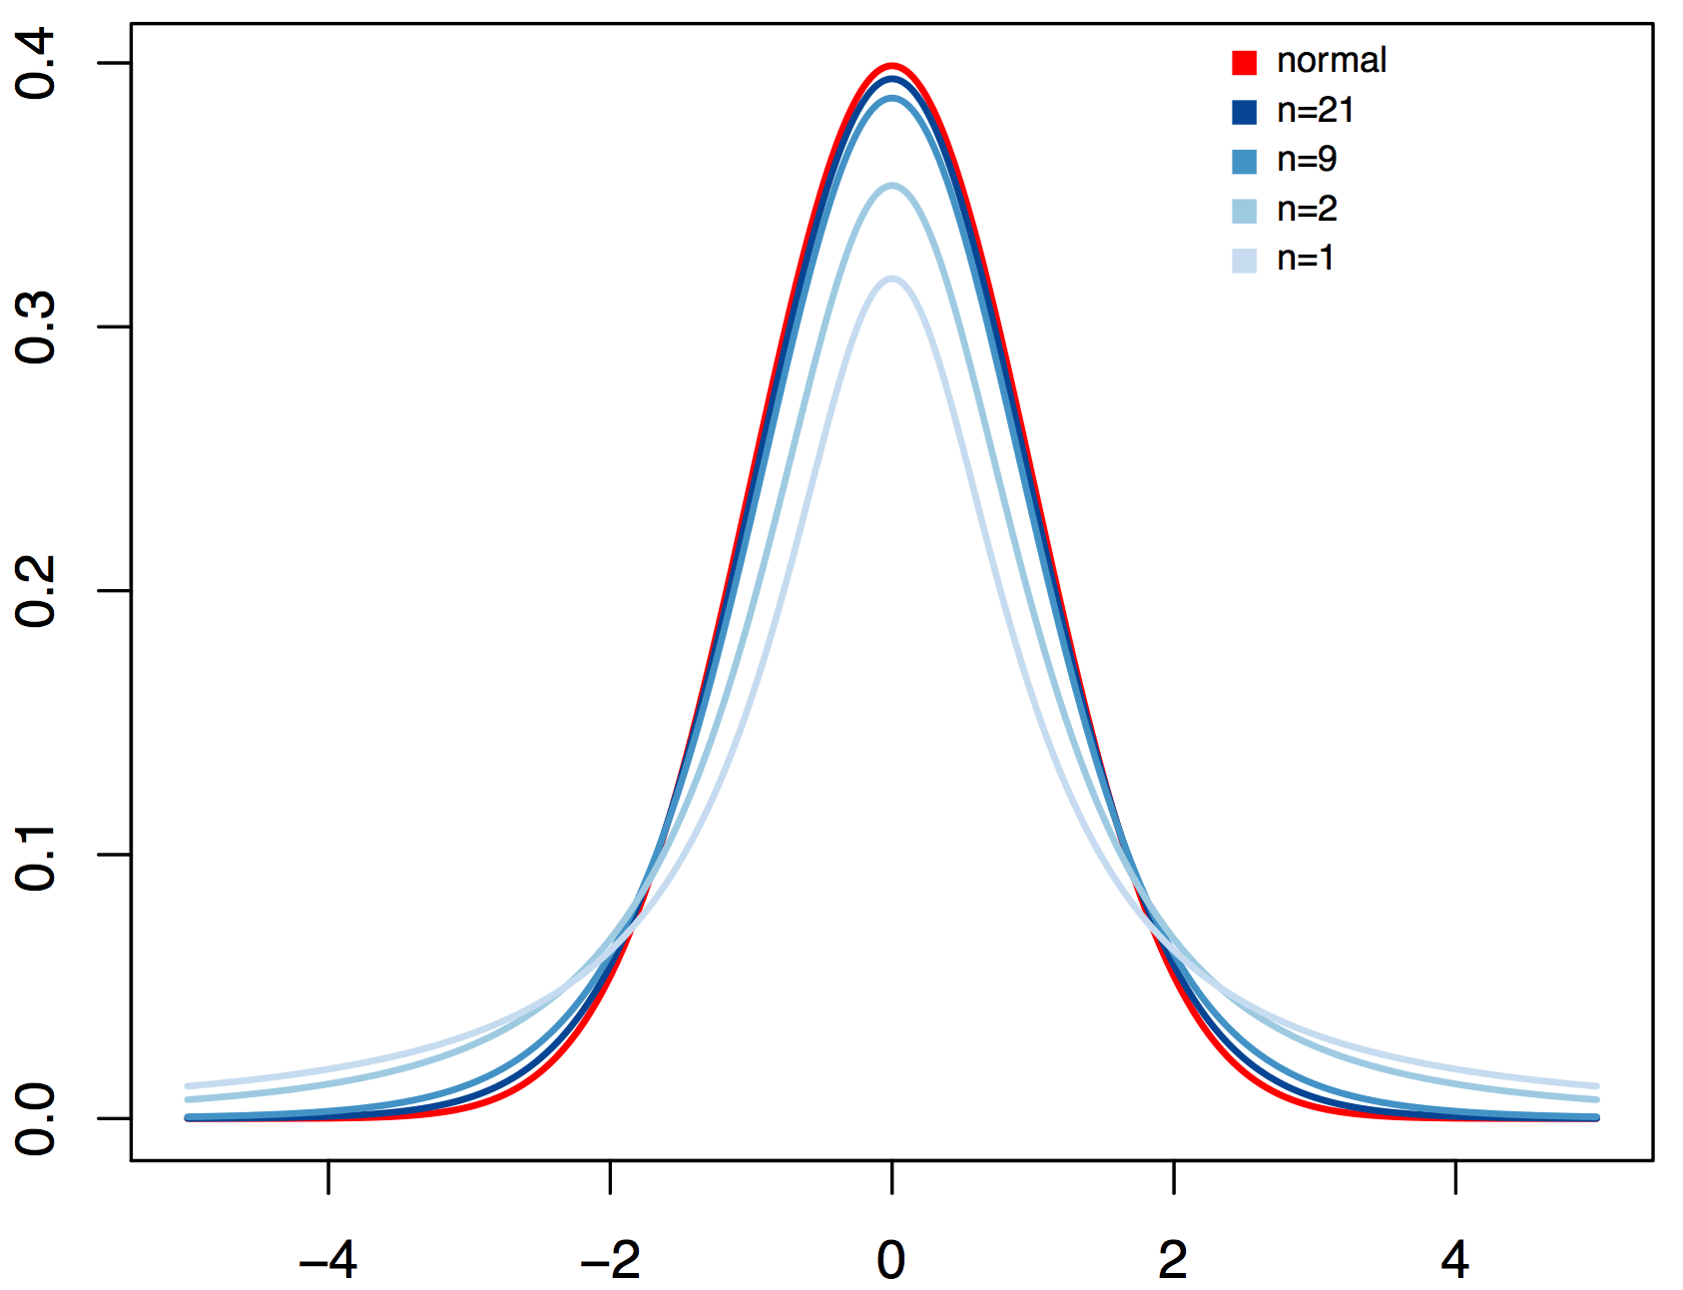
T distribution
Power increases dramatically for the first few samples

Slide 5
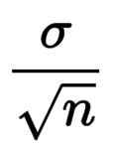
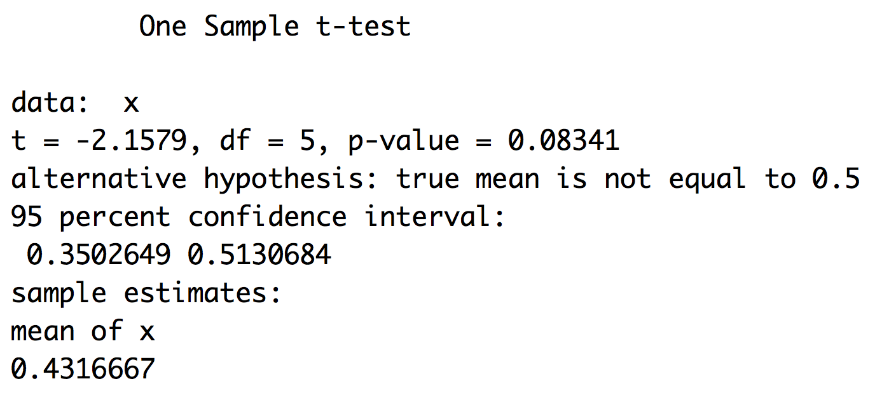
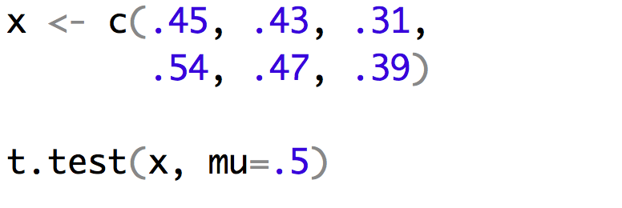
One-sample t-test
The one sample T-test compares a sample to a hypothesis
Assumptions:
The variable is normally distributed in the population
Implementation
$$t=\frac{\left(\overline{Y}−μ\right)}{SEM}$$

Slide 6
One-sample t-test
The one sample T-test compares a sample to a hypothesis
Assumptions:
The variable is normally distributed in the population
Implementation
$$t=\frac{\left(\overline{Y}−μ\right)}{SEM}$$

Slide 7
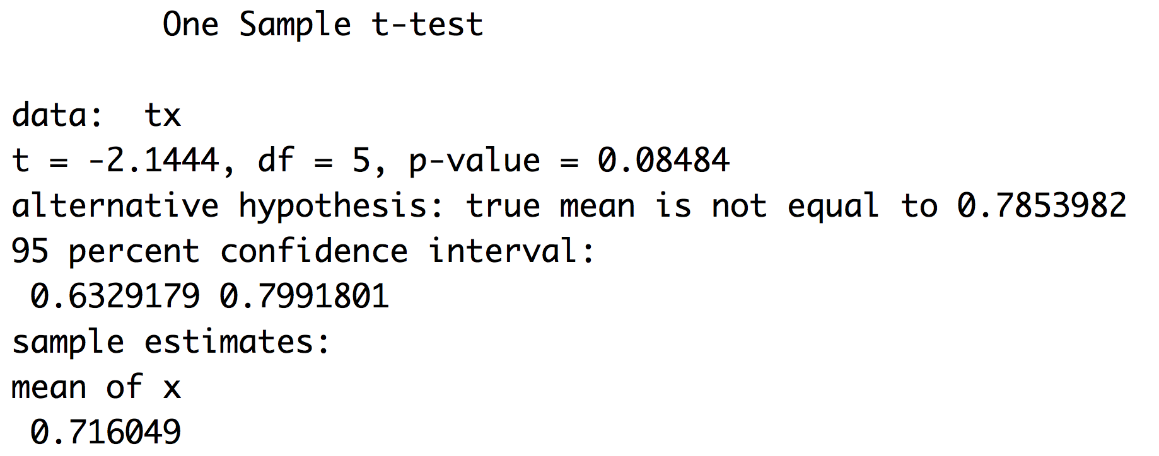
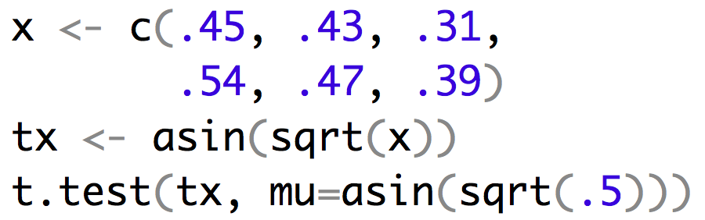
One-sample t-test
$$t=\frac{\left(\overline{Y}−μ\right)}{SEM}$$
Arcsine is the standard transformation for proportion data. Lets see how our answer changes.

Slide 8
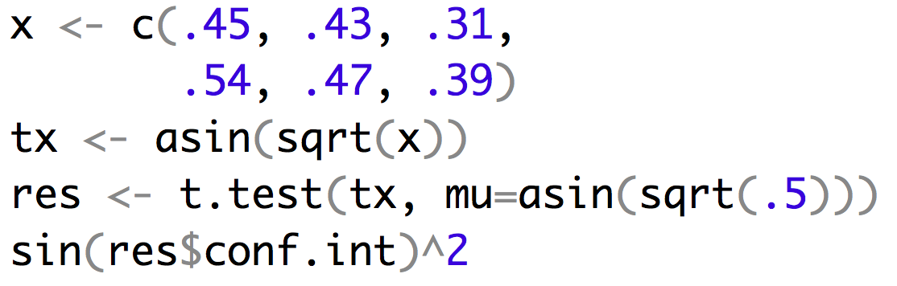

If you transform don’t forget to back transform

Slide 9
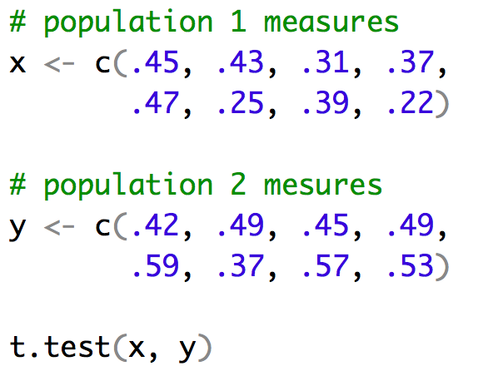
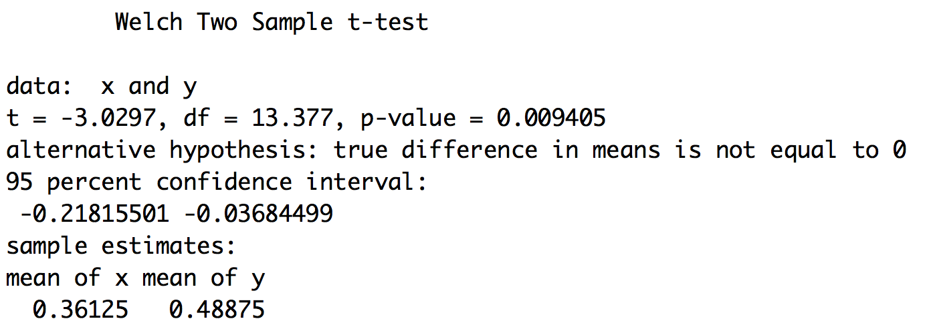
Two-sample t-test
Many times we will want to compare two populations strains or treatments and see if their means differ.
Implementation
$$t=\frac{\left({\overline{Y}}_{a}−{\overline{Y}}_{b}\right)}{\sqrt{\frac{s_{a}^{2}}{n_{a}}+\frac{s_{b}^{2}}{n_{b}}}}$$

Slide 10
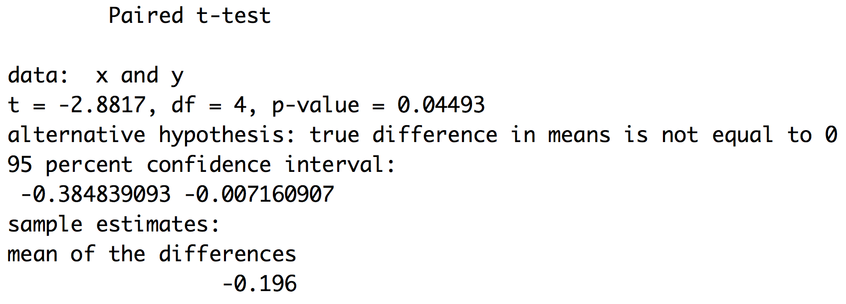
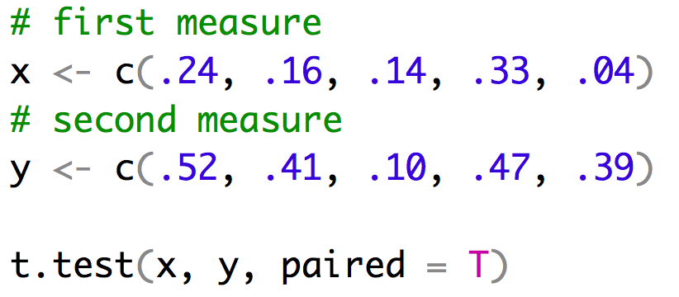
Paired-sample t-test
In some experiments you measure individuals before and after a manipulation. These values can be analyzed with the paired-sample t-test.
Implementation
$$t=\frac{\overline{d}}{{SE}_{d}}$$
$$\overline{d}=\frac{\sum_{i=1}^{n}{y_{ai}−y_{bi}}}{n}$$

Slide 11
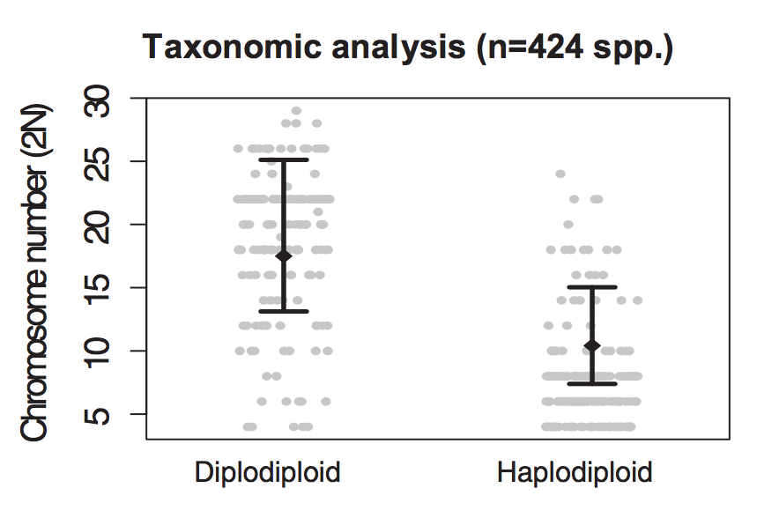
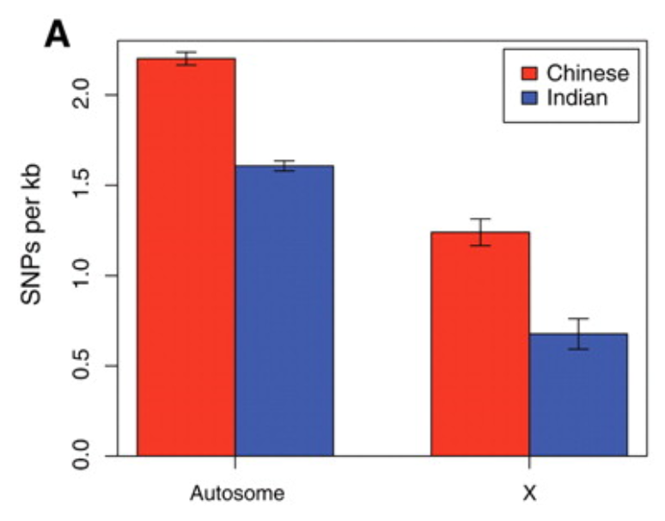
Confidence Intervals and t-tests
If two 95% confidence intervals don’t overlap then the values are significantly different at the α = 0.05 level.
If there is overlap in the CI then you can’t conclude anything.

Slide 12
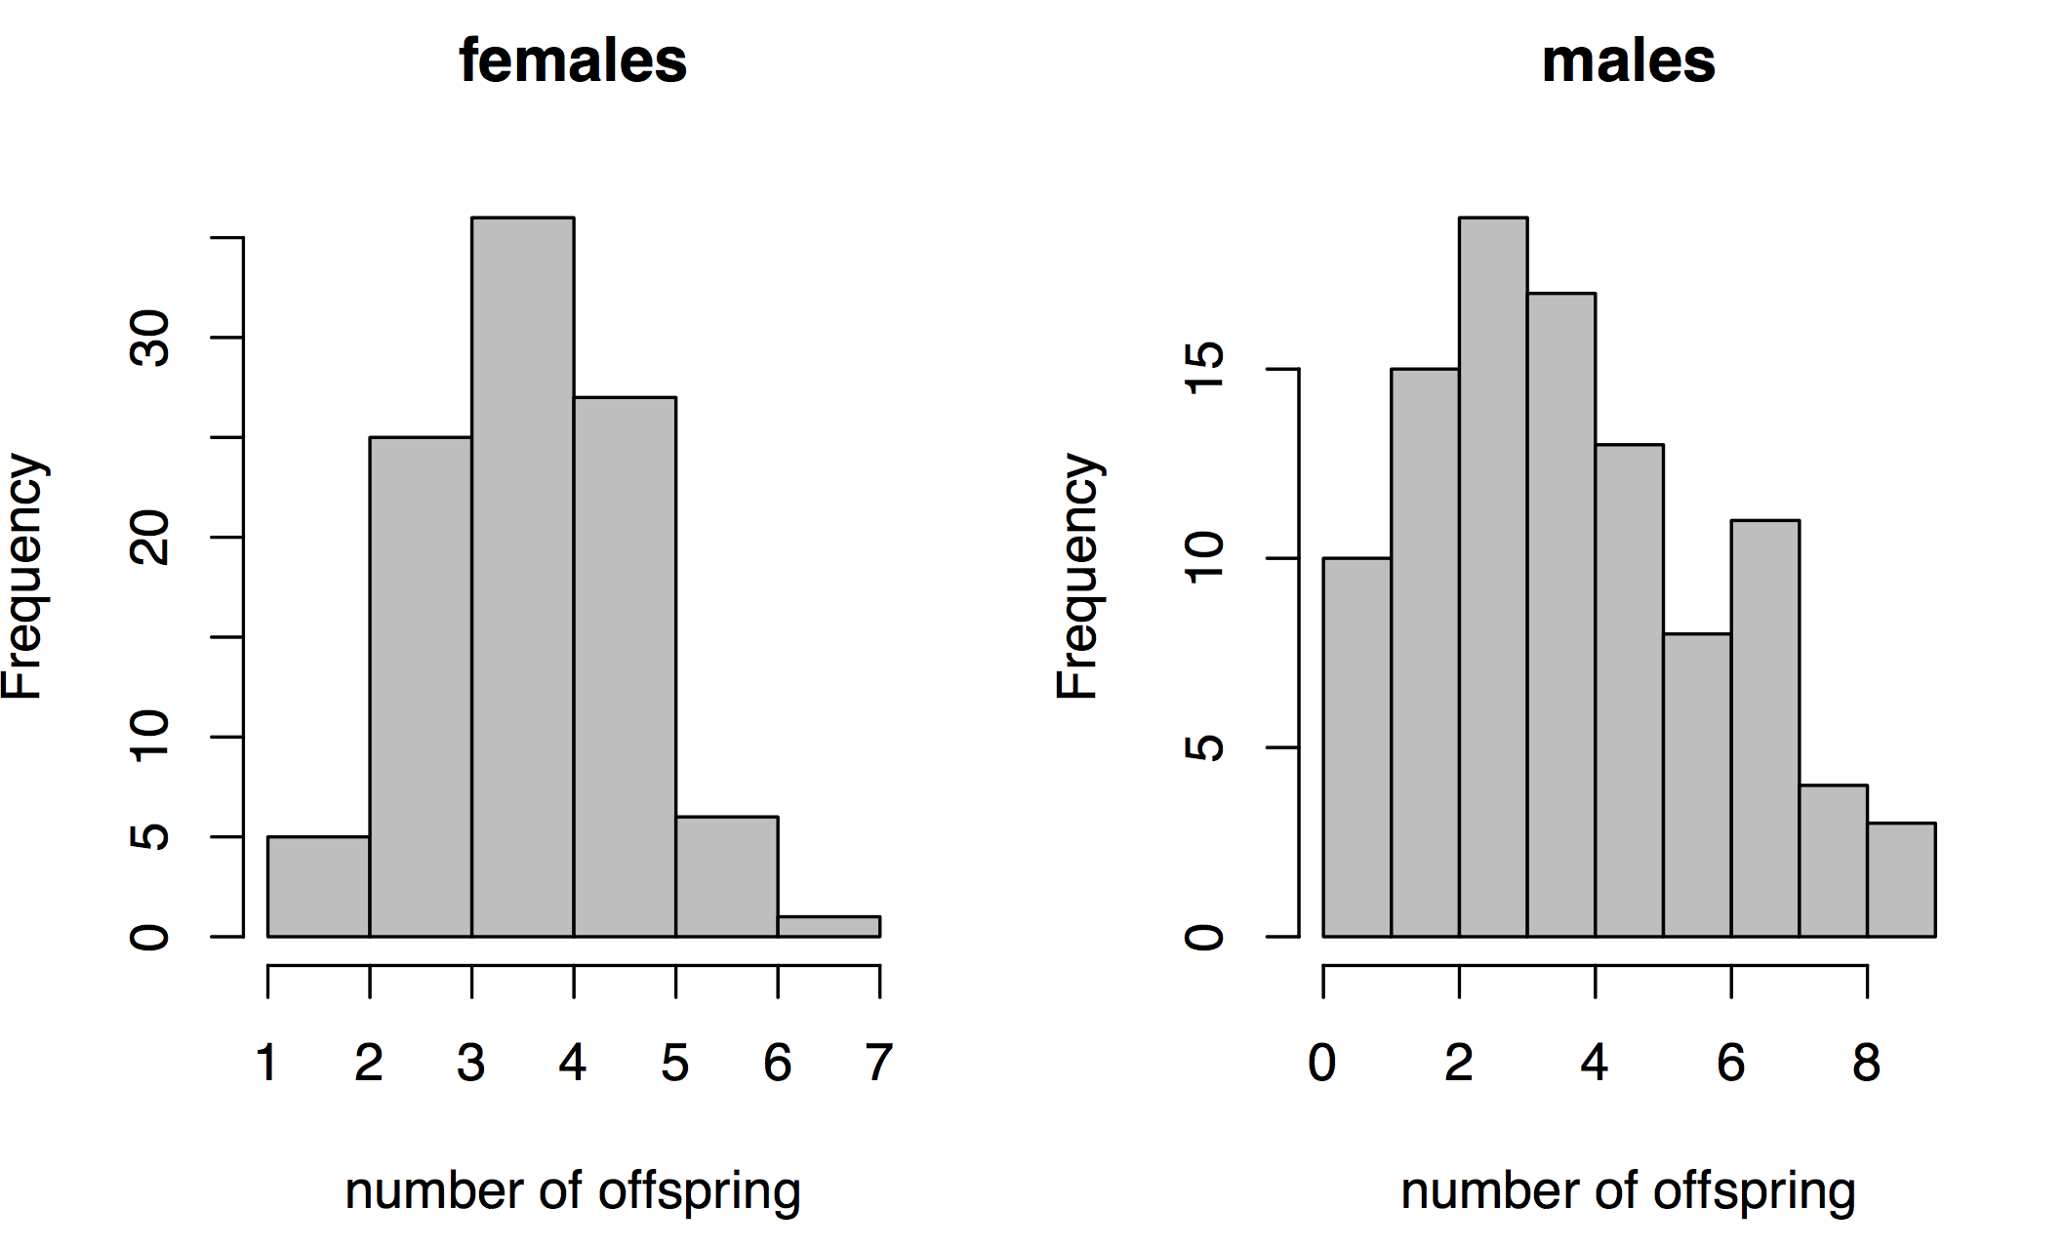
Comparing variances
Some experiments might focus on differences in variance. Think about how sexual selection works with regard to number offspring.
Two most common tests are the F-test and Levine’s test. F-test assumes that the variable is normally distributed in the population and is sensitive to violations of this assumption.
For this reason we will focus on Levine’s test which assumes the variables have roughly symmetrical distributions and is furthermore quite robust to violations of this assumption.

Slide 13
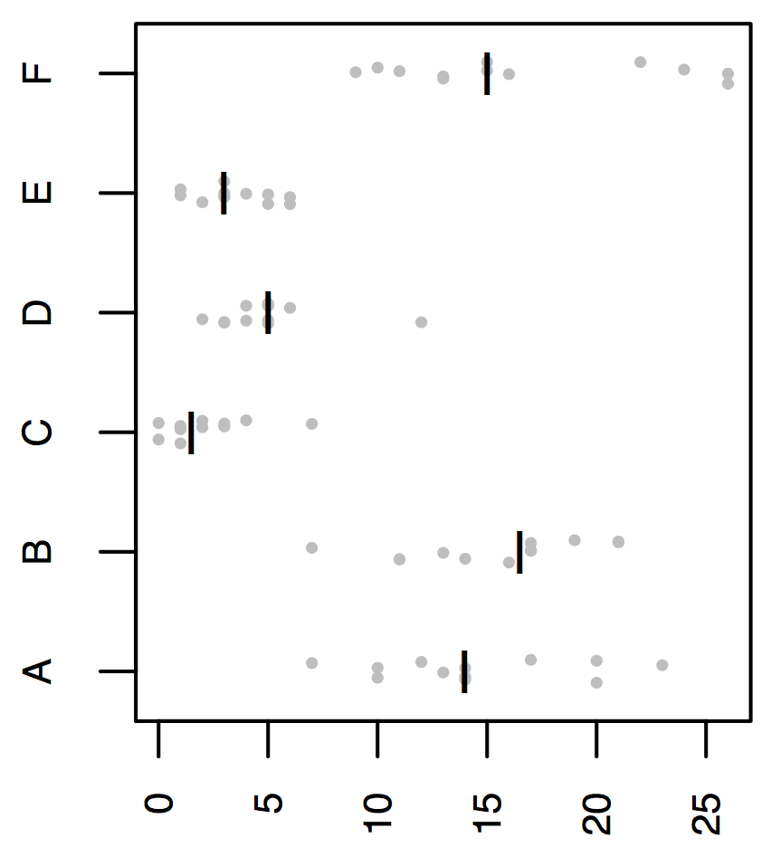
Levene’s test
R insect spray data
Levene’s test works by calculating a central value for each group and then comparing the deviations of individuals in each group from these to calculate a W statistic.
Compared to a F distribution
Spray code
Number of pests after spraying

Slide 14
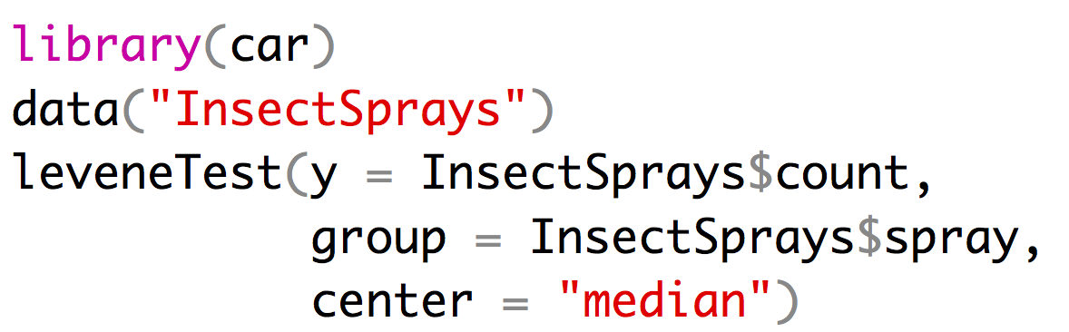
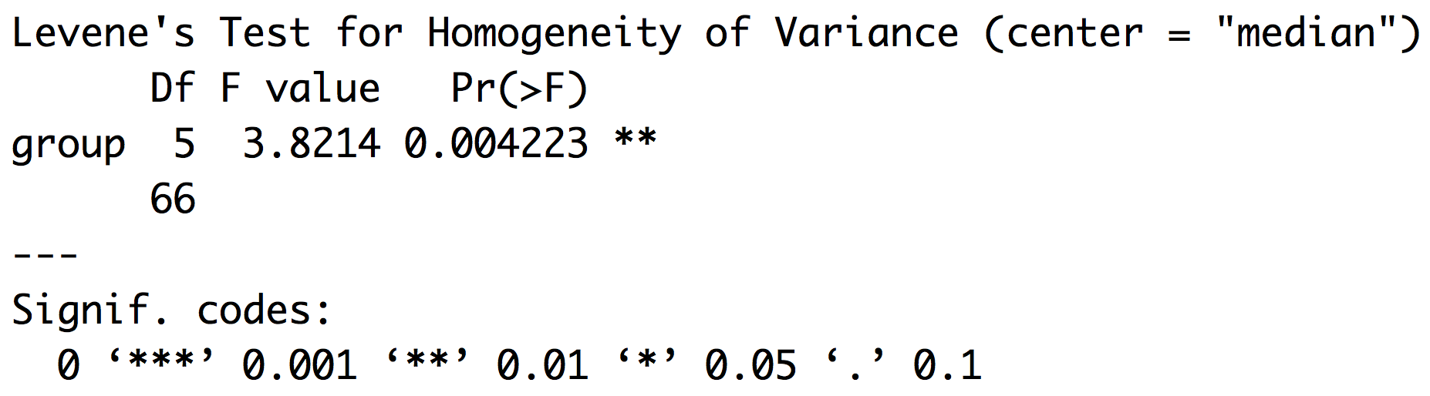
Levene’s test
R insect spray data
Spray code
Number of pests after spraying

Slide 15
Assumptions
  One-sample T-test
    The variable is normally distributed in the population
  Two-sample T-test
      The variable is normally distributed in the population
    unequal variance ok
  Paired-sample T-test
    Differences are normally distributed
  Levine’s test
    Distributions are roughly symmetrical

Slide 16
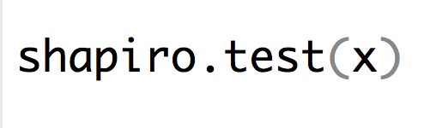
Assumptions
Many tests are quite robust to minor violations of assumptions.
Tests of normality (Shapiro-Wilks) are not terribly useful.
  Small sample size have little power
  Large sample size reject with even minor deviations from normality
Often most important to simply visualize distributions
  histograms
  qqplots

Slide 17
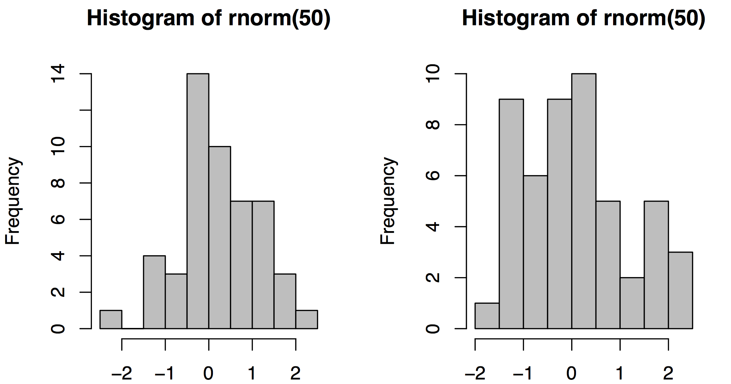
histograms
You don’t need or even expect a perfect bell curve from a finite sample of a population.

Slide 18
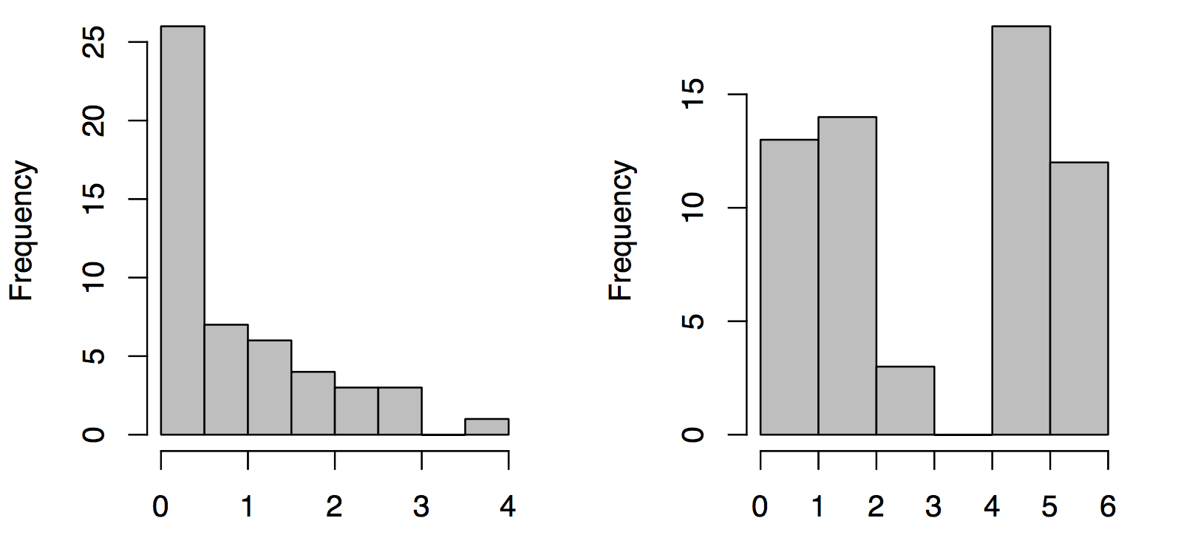
histograms
You should be worried if the histogram suggests a different distribution

Slide 19

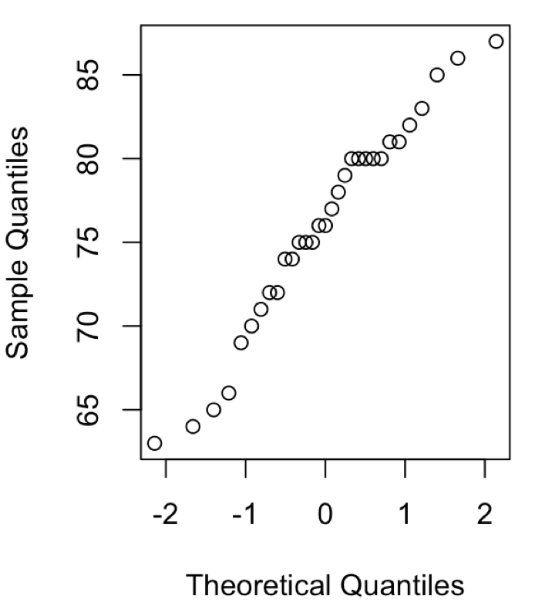
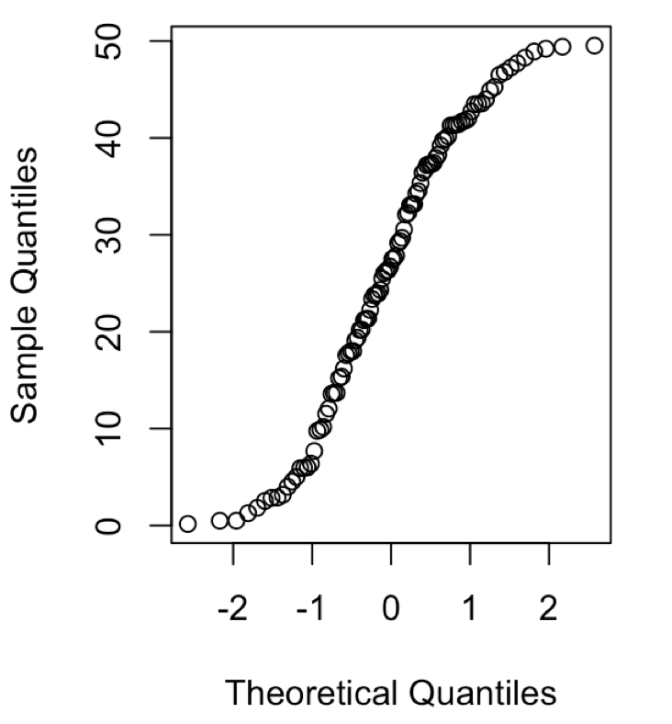
qqplots
normal
Too many extreme values
The time when you should be most hesitant is when your biological knowledge tells you that you don’t expect a variable to have a normal distribution!

Slide 20
Data really isn’t close to normal
First, be sure that the statistical test actually requires normality as an assumption – this constraint isn’t universal (e.g., Levene’s test merely requires symmetry)
Second, try to transform the variable to make it roughly normal
Third, as a last resort, use a non-parametric test

Slide 21
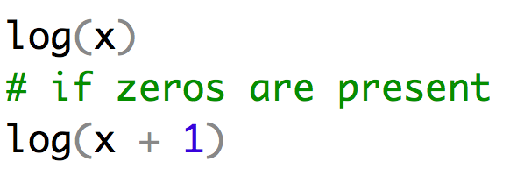
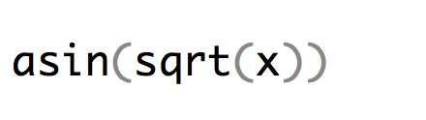
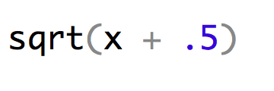
Transformations
Log transformation
Take the natural log of every observation
Especially for right-skewed data.
Arcsine transformation
Take the arcsine of the square root of each observation
Used mainly for proportions
Square-root transformation
Add 0.5 and take the square root
Solves similar problems to the log transformation
For other transformations, see p. 381 in Whitlock and Schluter

Slide 22
Don’t P-hack
Try different transformations to see which improve normality or homoscedasticity not to see which one gives the lowest p-value.
If you use a transformation that is not standard in your field or for the data type you will often need to justify it in the text of your paper or to the reviewers of your work
Best case scenario is when you can take two routes and show the same result.
  The number of genes in the P53 network that showed signs of selection were positively correlated with the maximum life span of taxa (B = 2.5, R2 = .26, p = .024). Analysis of square root transformed gene count data produced qualitatively similar results.
  A Welch’s two sample t-test showed that the two populations had significantly different mean body size. However despite log transformation of body size both populations failed a Shapiro-Wilks test of normality. Therefor we also performed a Mann-Whitney U-test which also showed that population A was significantly larger than population B.

Slide 23
Non-parametric tests
  Non-parametric tests still have assumptions but fewer.
  You lose a lot of power when you switch from parametric to non-parametric.

Slide 24
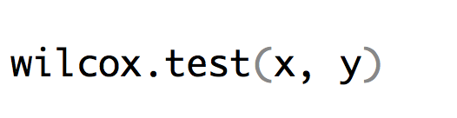
Mann-Whitney / Wilcoxon Rank
Replaces two sample t-test
Tests the hypothesis based upon a ranked list
The tests are done on the ranks rather than the actual values
Implementation:
Assumptions:
  The distribution of measurements is symmetrical
  Distributions of the two variables must have the same shape
  A significant result implies that the two variables have different distributions (possibly due to different means but also possibly due to variances or skewness)

Slide 25
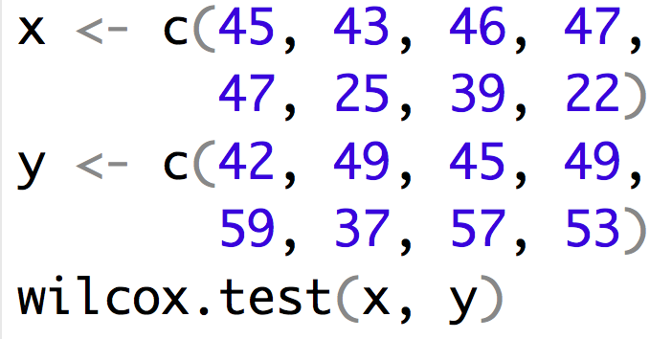
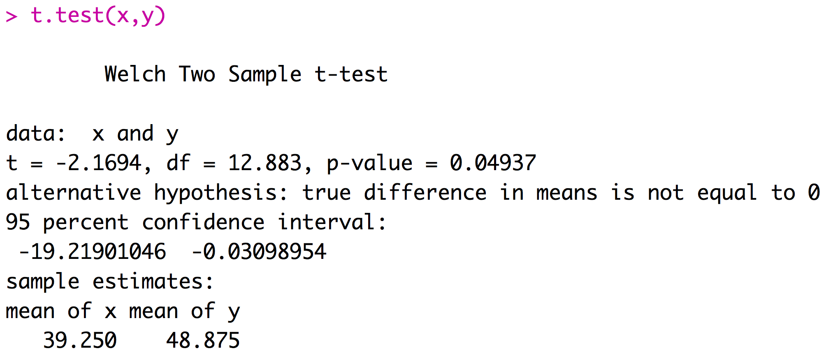
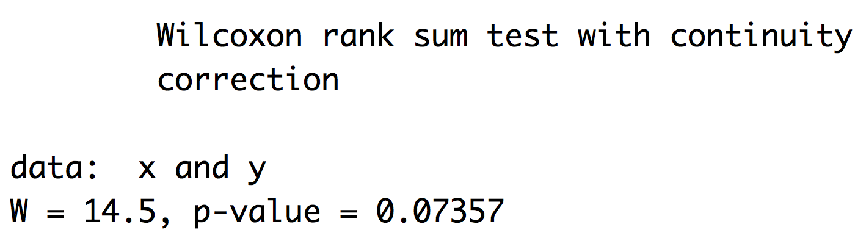
Doing a Mann-Whitney / Wilcoxon Rank in R

Slide 26
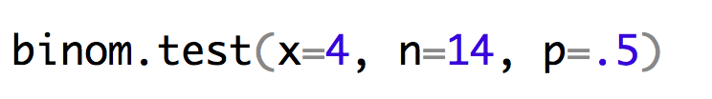
Sign test
Replaces one-sample or paired-sample t-test
Convert the data to a score (+ or -)
  One-sample: whether the value is above or below the hypothesized value.
  Paired-sample: whether the second value is higher or lower
Under the null hypothesis, the number of +’s should equal the number of –’s, so this test boils down to a binomial test
Obviously, it’s throwing away a lot of information
Implementation:

Slide 27
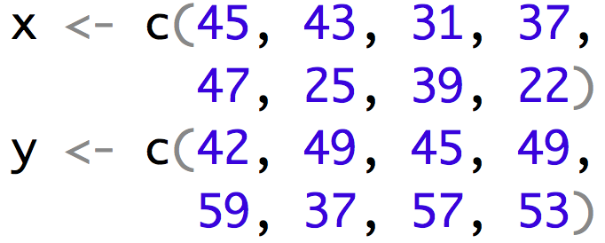

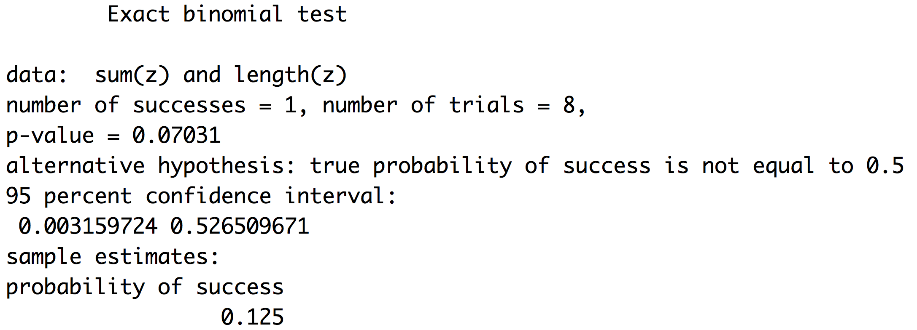
Doing sign test in R
Implementation:
Test | P-value
T-test | 0.049
Wilcox rank test | 0.074
Sign test | 0.125

Slide 28
Permutation test
Makes almost no assumptions about the underlying data and allow very specific questions to be asked.
Under the null hypothesis, the two groups are drawn from identical distributions (they are from identical populations)
By randomizing the observations between groups, an expected distribution under the null hypothesis can be generated
If we are interested in differences between the mean, then we might choose mean 1-mean 2 as our test statistic

Slide 29
Permutation test
Step 1: Create a permuted set of data in which the values of the response variable are randomly reordered
Step 2: Calculate the test statistic from the randomly reordered groups
Step 3: Repeat Steps 1 and 2 thousands of times
Step 4: Compare the actual value of the test statistic from the original data to the distribution of values from the permutation steps

Slide 30
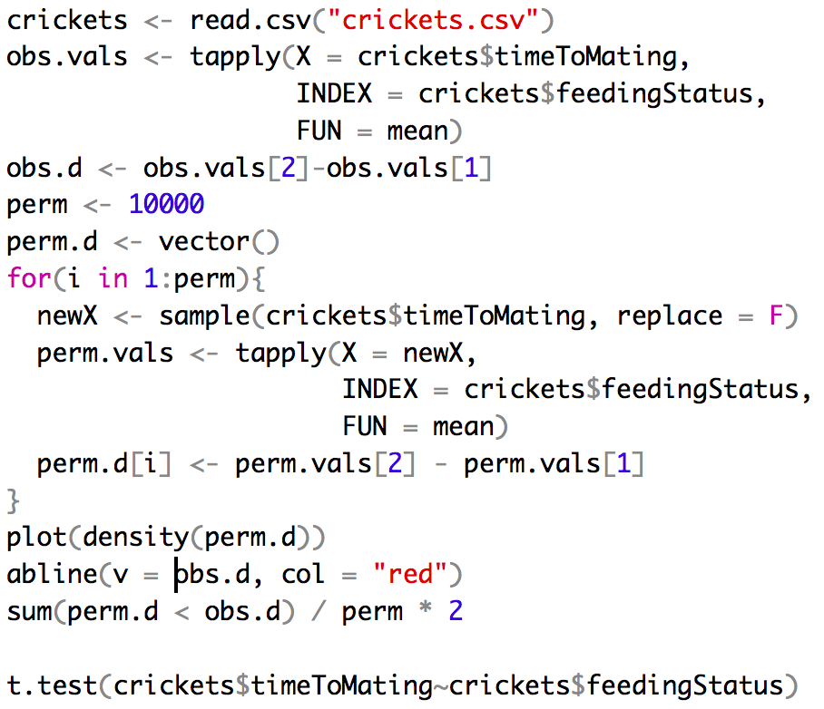
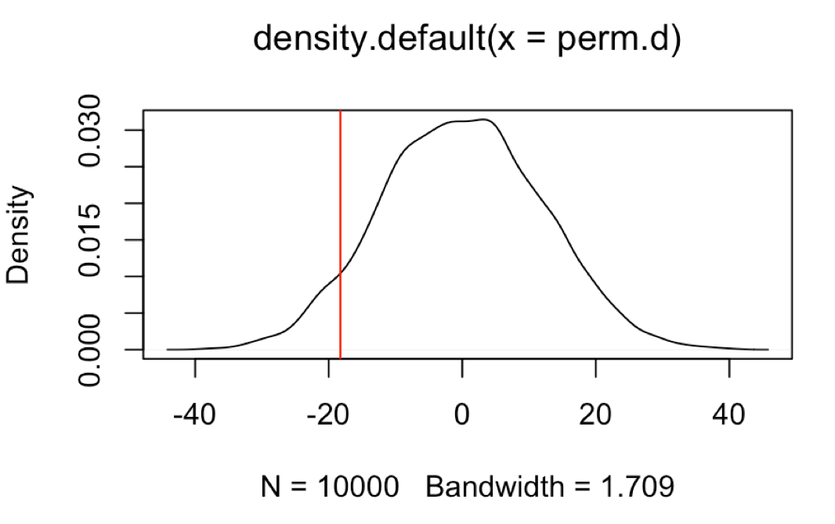
Permutation test

Slide 31
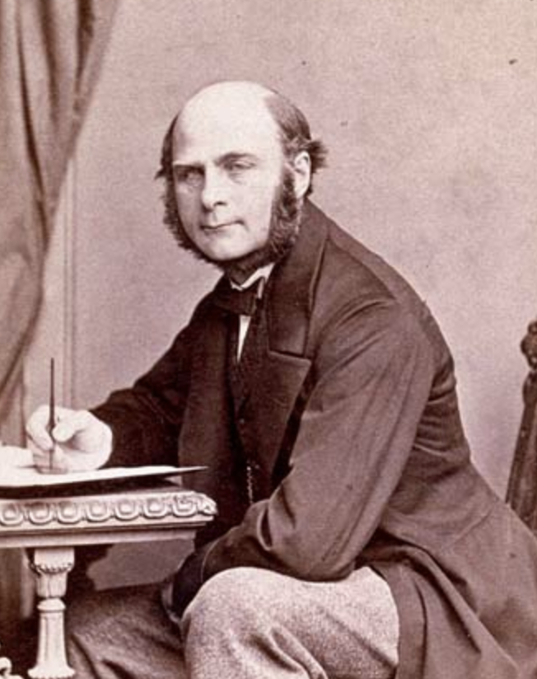
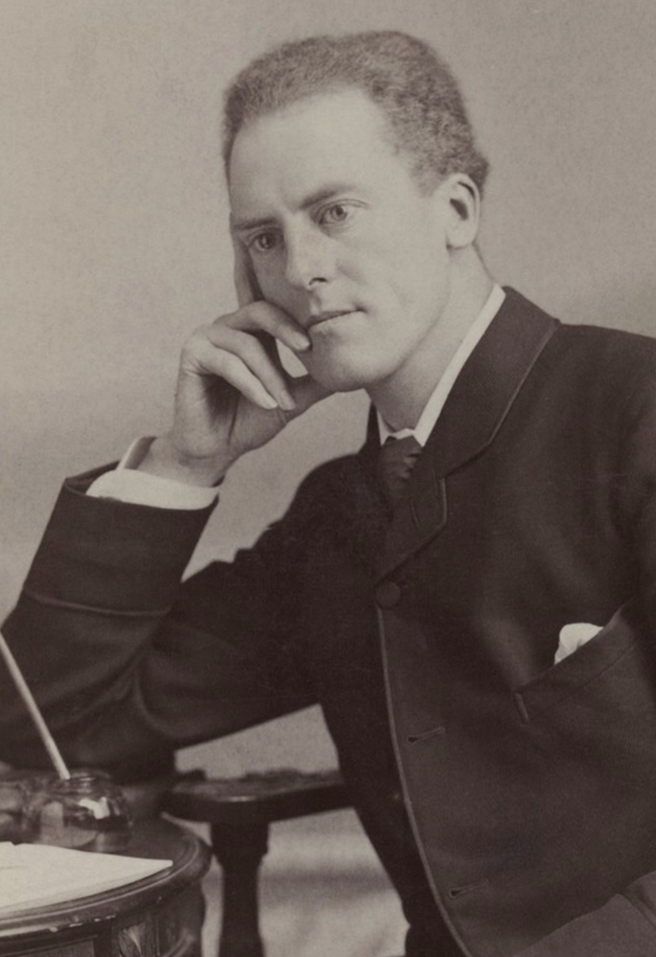
Correlation and Causation
The correlation is a foundational concept in the biological sciences
Pearson’s correlation coefficient:
$$r\left(X,Y\right)=\frac{cov(X,Y)}{s_{x}s_{y}}$$
Francis Galton
1822 - 1911
Karl Pearson
1857 - 1936
$$cov\left(X,Y\right)=\frac{\sum_{i=1}^{n}{\left(X_{i}−\overline{X}\right)\left(Y_{i}−\overline{Y}\right)}}{n−1}$$
Notes:
Galton invented term eugenics cousins with darwin mention regression to the mean
Pearson invented modern concept of and widely applied to r. Also eugenicist and racist

Slide 32
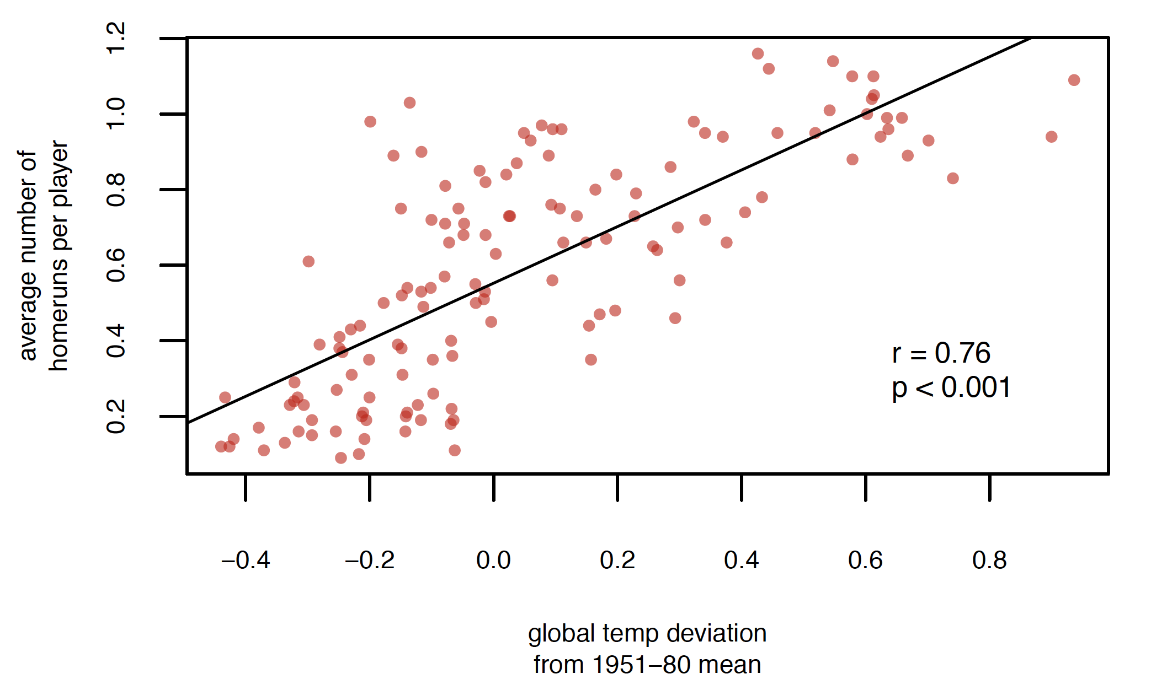
Interpret with caution

Slide 33
Obviously these covary with time
Average number of
home runs per game

Slide 34
Pearson’s Correlation Coefficient
Assumes that the data are roughly from a bivariate normal distribution
Would not be appropriate when:
Relationship is non-linear (possible solutions?)
Dataset contains extreme outliers (evaluate leverage)
Data are in multiple distinct clouds of points (what could cause this?)

Slide 35
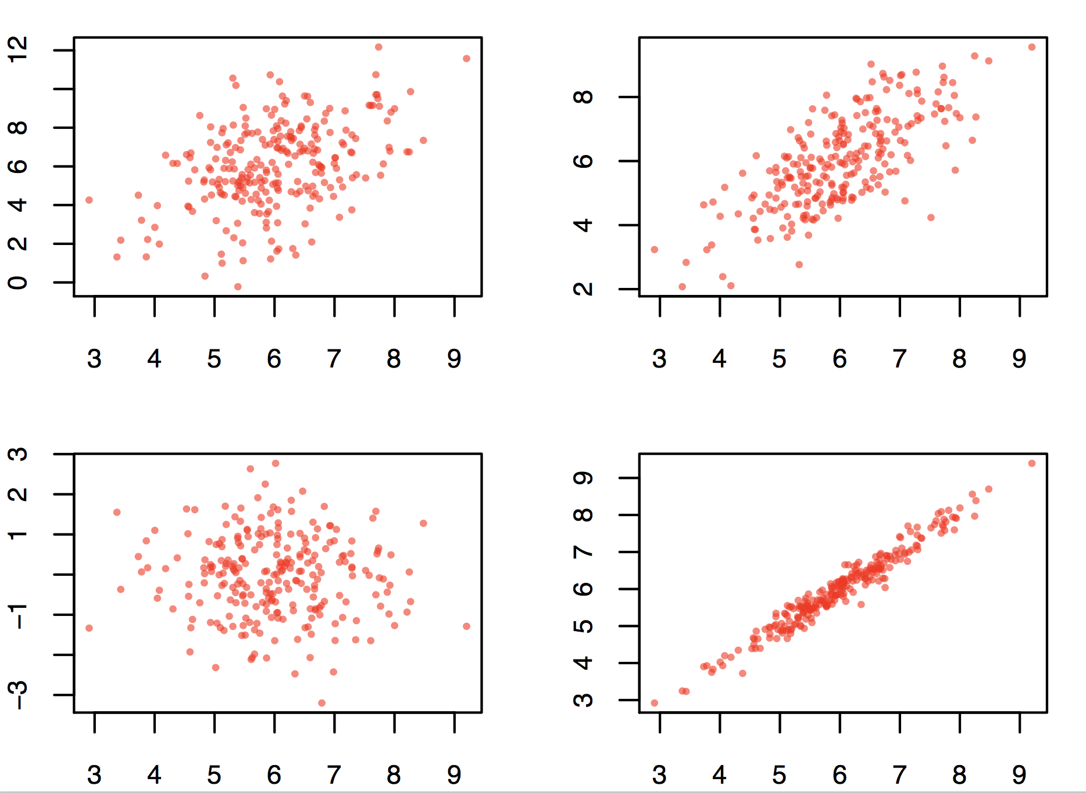
Good data

Slide 36
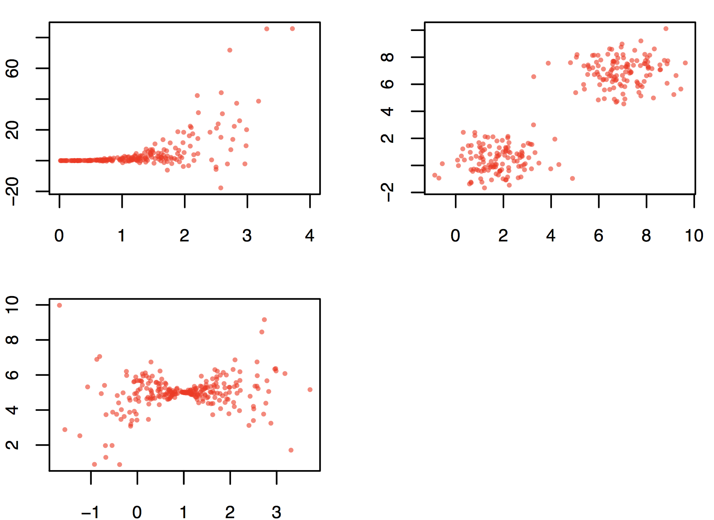
Bad data
Correlation simulator

Slide 37
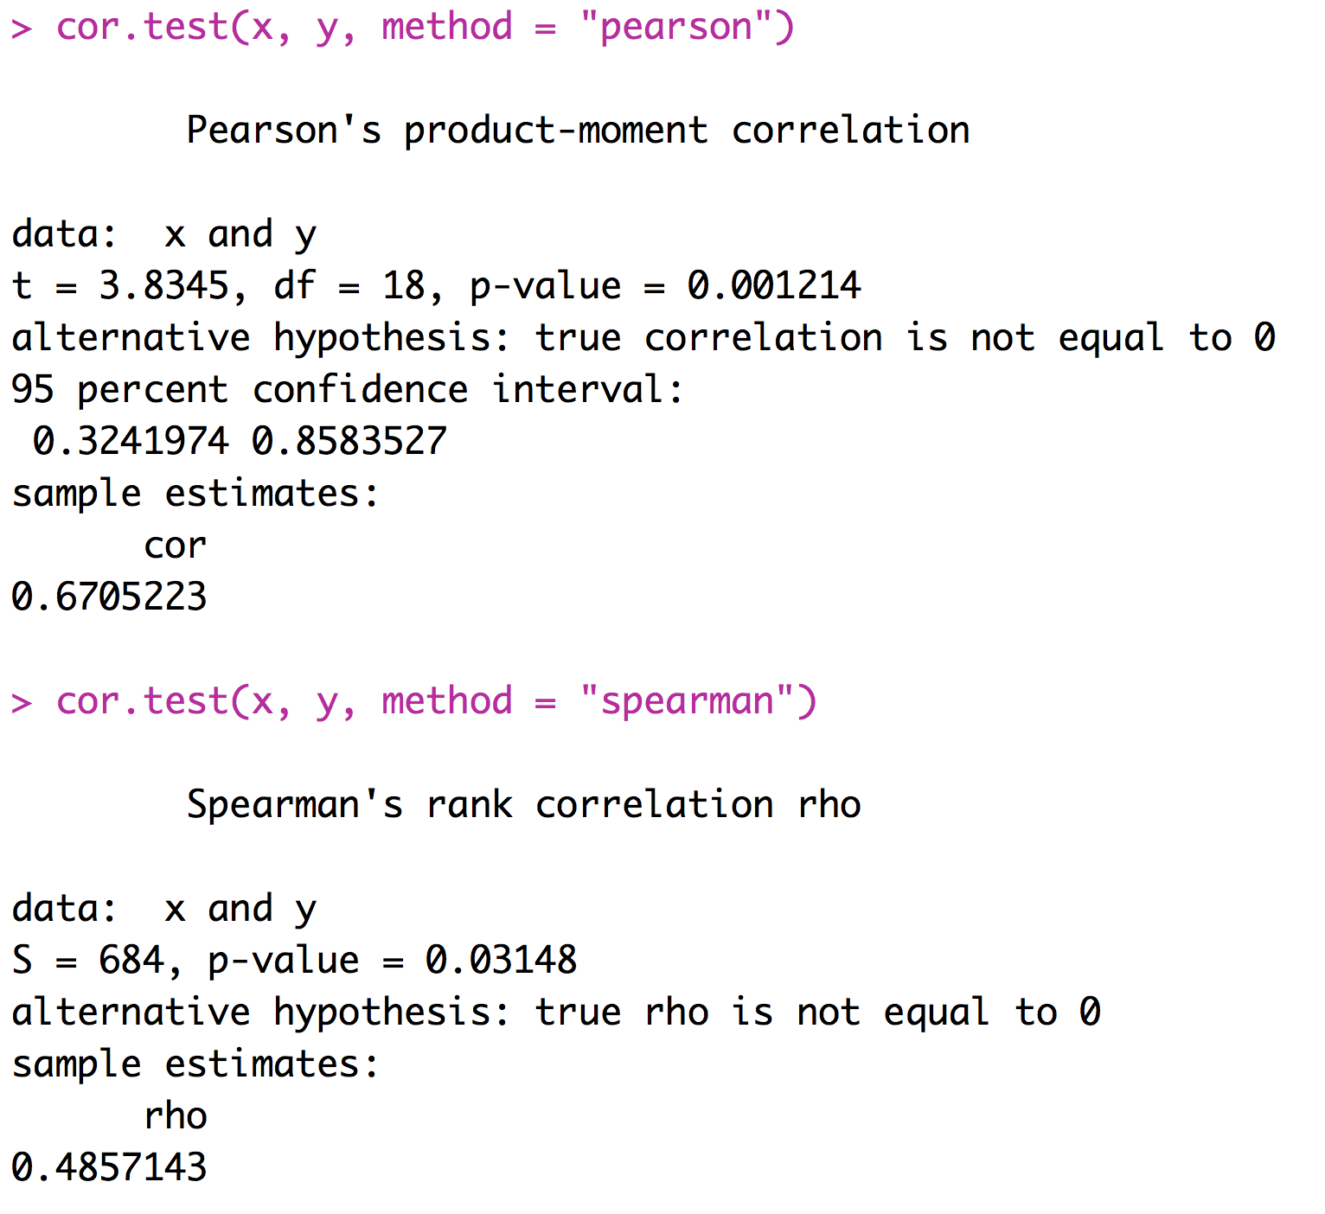
Spearman’s Rank Correlation
An alternative to Pearson’s correlation coefficient for data that depart substantially from bivariate normality
Based on ranks

Slide 38
Correlation Summary
Correlations are very important
We are interested in correlations between values of treatments and response variables
We are interested in correlations between various factors that could affect the response variable
We need to think about correlations between explanatory variables and potentially confounding variables
Many types of experiments call for the calculation and consideration of correlation coefficients

Slide 39
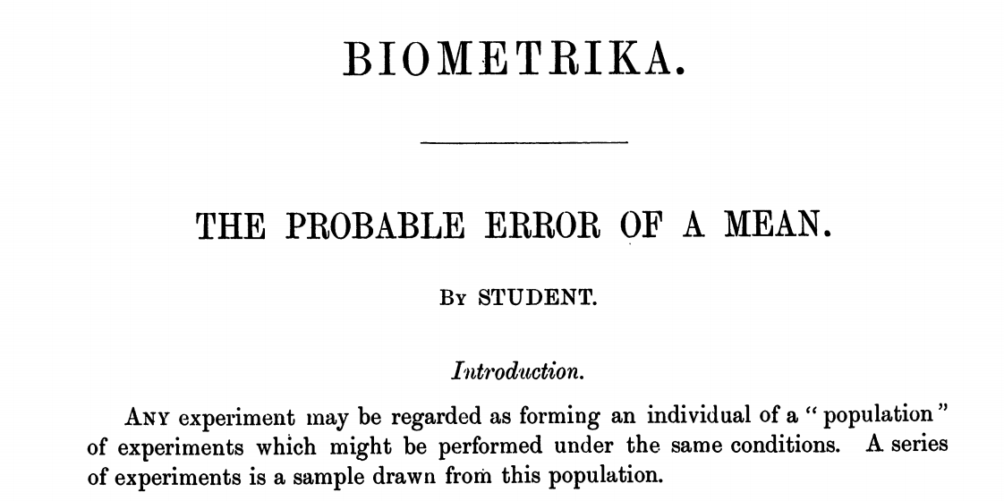
t tests - history
Based on the t-distribution, which is similar to a normal distribution, except it takes into account the fact that we don’t know the population standard deviation with certainty. Published by Gosset in 1908 under the pseudonym Student because he was employed by Guinness brewery.
Since we only know the sample standard deviation, instead of the population standard deviation, we have some additional uncertainty regarding the possible values of the mean
Consequently, the t-distribution is wider than the normal distribution, and the t-distribution actually yields a more exact estimate of the confidence interval for the mean

