Slide 1
Reading for Tuesdays discussion is posted on course website.
One of the central challenges of studying genomes is the extreme difficulty in assembling large contiguous stretches of DNA. Specifically large portions of the genome are made up of highly repetitive DNA that is dispersed across the genome. This has led to most genomes actually being made up of 1000s of small scaffolds whose position on chromosomes is unknown.
Hi-C DNA sequencing provides a transformative solution to this problem.

Slide 2
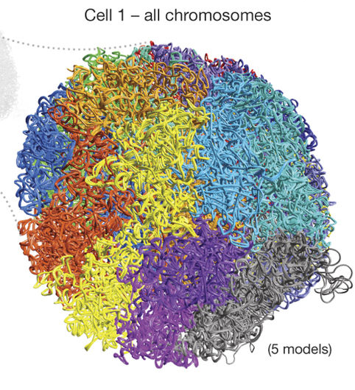

Slide 3
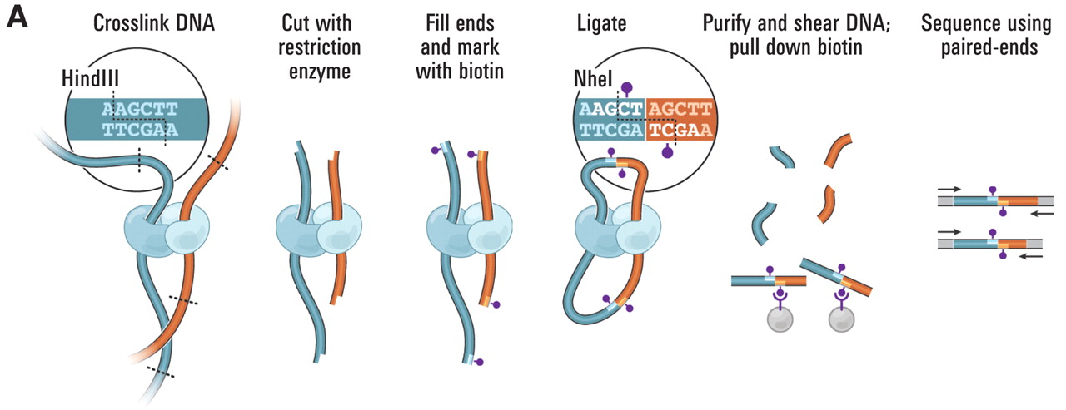

Slide 4
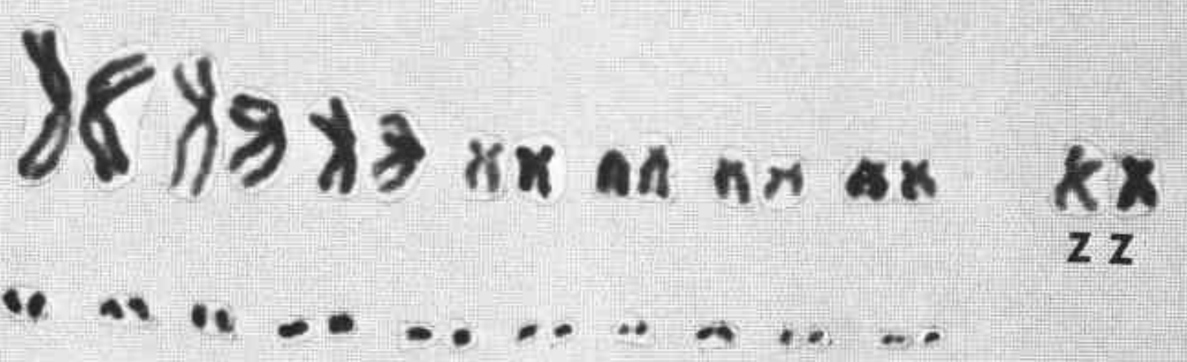

Slide 7
Challenge for today come up with a linear model that explains the frequency of crosslinks among and within chromosomes.
Do michrochromosomes have more links between them than we expect?
Install.packages(“nlme”)
lme
lm
Glm
Data is on website

