Slide 1
Describing biological data
Experimental Design
Heath Blackmon
Tuesday, September 15 & Thursday, September 17, 2026
01
Notes:
Tuesday: 1 minutes (0–1 minutes).
Tuesday: slides 1–20, 75 minutes. Thursday: slides 21–40, 75 minutes. Slides 41 onward provide optional paired and permutation lessons for later. Introduce SD, SE and tests as new topics. Keep foundations.R and the course CSV in the working directory. All biological framing for the course CSV is an illustrative scenario using simulated values.
Sources
https://coleoguy.github.io/subpages/teaching/expdes/datasets.html

Slide 2

The disgraceful history of biostatistics
Much of statistics was developed with the idea of showing that we could measure, scientifically analyze, and improve the “quality” of humans.
The majority of geneticists and statisticians in the early 1900s were proponents of eugenics.

Slide 3
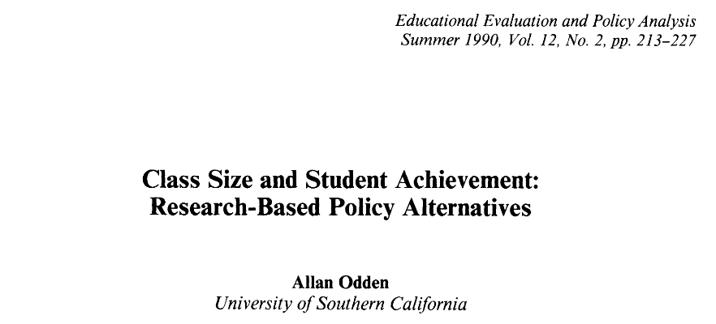
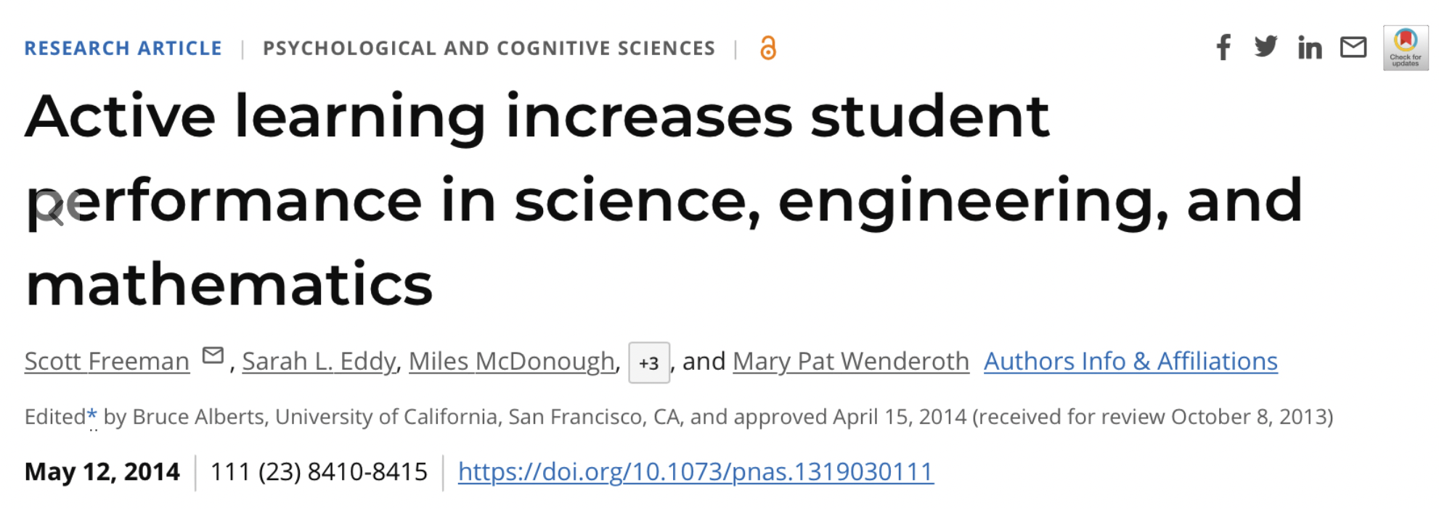
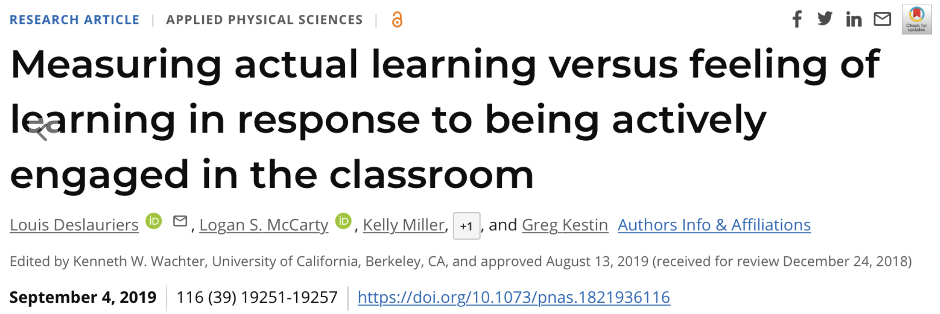
01
Notes:
Tuesday: 1 minutes (0–1 minutes).
Tuesday: slides 1–20, 75 minutes. Thursday: slides 21–40, 75 minutes. Slides 41 onward provide optional paired and permutation lessons for later. Introduce SD, SE and tests as new topics. Keep foundations.R and the course CSV in the working directory. All biological framing for the course CSV is an illustrative scenario using simulated values.
Sources
https://coleoguy.github.io/subpages/teaching/expdes/datasets.html

Slide 4
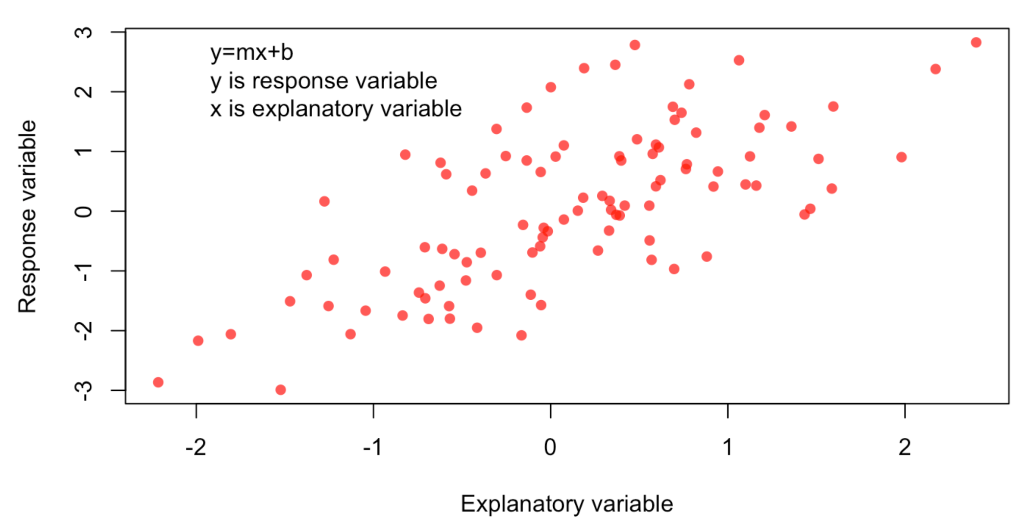
Explanatory and Response Variables

Slide 5
Population, sample, parameter, statistic
Term | In our example
Population | All organisms in the defined target culture
Sample | The 30 organisms measured
Parameter | The population mean growth, μ
Statistic | The sample mean growth, x̄
Which quantity could change if we collected another sample?
04
Notes:
Tuesday: 4 minutes (7–11 minutes).
Recall population versus sample and introduce/revisit parameter/statistic explicitly. Target population might be all organisms in a defined culture under specified conditions. Sample is the 30 measured organisms. A parameter describes that population; a statistic is calculated from this sample. The parameter can remain fixed while statistics change across samples. Use words before symbols.

Slide 6
A distribution describes possible values
Where are the values concentrated?
How widely do they vary?
Is the shape symmetric?
05
Notes:
Tuesday: 3 minutes (11–14 minutes).
A data distribution shows which observed values occur and how frequently. A probability distribution is a model for possible values and their probabilities. This histogram uses all 30 control values with width-one bins. It is an empirical distribution, not a claim that a named model is true. Ask about location, spread and shape in ordinary language before formulas.
Sources
https://coleoguy.github.io/subpages/teaching/expdes/data/t_test_data.csv

Slide 7
Some common probability distributions
Normal
t
Poisson
mean 0, SD 1
3 degrees of freedom
mean count 3
Exponential
Uniform
Binomial
rate 1
minimum 0, maximum 1
10 trials, success chance 0.5
Bars show probability at an integer. Curves show density over a continuous range.
06
Notes:
Tuesday: 6 minutes (14–20 minutes).
Six illustrative theoretical distributions, with the specified parameters rather than fitted course data. Continuous panels plot density; discrete panels plot probability mass. Normal: mean 0, SD 1. The t distribution has 3 degrees of freedom and heavier tails than the standard normal; later it will model a standardized statistic. Poisson: counts per fixed exposure, mean 3, nonnegative integers with no finite upper bound. Exponential: waiting time at constant event rate 1, for x ≥ 0. Uniform: density 1 on [0, 1], zero elsewhere. Binomial: successes in 10 independent trials, each with success probability 0.5. Name and compare shapes without requiring formulas or parameter mastery. Visible ranges truncate normal, t, Poisson, and exponential tails.
Sources
https://stat.ethz.ch/R-manual/R-devel/library/stats/html/Distributions.html

Slide 8
Probability and density
Discrete values: add probabilities for the values of interest.
Continuous values: probability is area across an interval.
Uniform from 0 to 1: the interval 0.2 to 0.4 has probability 0.2.
07
Notes:
Tuesday: 4 minutes (20–24 minutes).
For discrete X, a bar can represent P(X=3). For continuous X, probability is area over an interval, not the curve height at one point. Under an ideal continuous model a single exact value has probability zero, although recorded measurements have finite precision. Equal-length intervals under a uniform distribution on0–1 have equal probabilities; P(.2≤X≤.4)=.2. Explain relative frequency intuitively. Density may exceed1 when a distribution is concentrated over a narrow range.
Sources
https://stat.ethz.ch/R-manual/R-devel/library/stats/html/Distributions.html

Slide 9
The measurement helps suggest a model
Quantity | Possible model
Germinated seeds out of 10 planted | Binomial
Events in a fixed observation period | Poisson
Waiting time at a constant event rate | Exponential
Equally likely positions along an interval | Uniform
Roughly symmetric measurement errors | Normal
The shape alone cannot establish the model’s assumptions.
08
Notes:
Tuesday: 4 minutes (24–28 minutes).
Ask students to identify possible values before naming a distribution. These are candidate models whose assumptions require checking. Binomial requires a fixed trial count, independent trials, and a shared probability. Poisson assumes an appropriate constant-rate independent-event count model; clumping can violate it. Exponential has constant hazard. Normal is unbounded and only approximates positive measurements when negative probability is negligible. The t distribution is the reference for a standardized statistic here, not a default biological response model.
Sources
https://stat.ethz.ch/R-manual/R-devel/library/stats/html/Distributions.html

Slide 10
The measurement helps suggest a model
Quantity | Possible model
Germinated seeds out of 10 planted | Binomial
Events in a fixed observation period | Poisson
Waiting time at a constant event rate | Exponential
Equally likely positions along an interval | Uniform
Roughly symmetric measurement errors | Normal
The shape alone cannot establish the model’s assumptions.
08
Notes:
Tuesday: 4 minutes (24–28 minutes).
Ask students to identify possible values before naming a distribution. These are candidate models whose assumptions require checking. Binomial requires a fixed trial count, independent trials, and a shared probability. Poisson assumes an appropriate constant-rate independent-event count model; clumping can violate it. Exponential has constant hazard. Normal is unbounded and only approximates positive measurements when negative probability is negligible. The t distribution is the reference for a standardized statistic here, not a default biological response model.
Sources
https://stat.ethz.ch/R-manual/R-devel/library/stats/html/Distributions.html

Slide 11
Observations, variables and units
An observation is one recorded case, such as an organism.
A variable is a recorded attribute, such as growth or group.
The experimental unit receives an independent treatment assignment.
Would 25 beetles sharing one treated vial give 25 independent treatment replicates?
03
Notes:
Tuesday: 3 minutes (4–7 minutes).
Distinguish the response unit of measurement from the experimental unit. Here a row is one observation; growth is a quantitative variable; group is categorical. For this exercise we assume independent organisms. If treatment was assigned by vial, vial would be the experimental unit and beetles subsamples. Independence comes from design records, not a column count.
Sources
https://coleoguy.github.io/subpages/teaching/expdes/data/t_test_data.csv

Slide 12

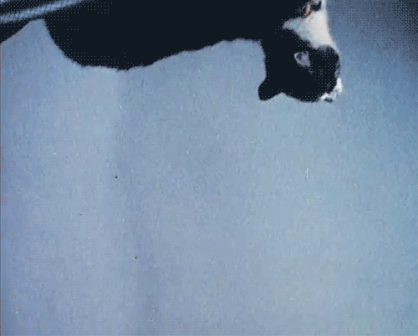

Falling Cats
Thinking about sampling
In the period between January 1, 1998 and December 12, 2001 at the Clinic of Surgery, Orthopedics and Ophthalmology of the Veterinary Faculty, 119 cats were treated after a fall or jump from a balcony or window, where the owners saw the fall, or where there was a reasonable suspicion that a fall had occurred. Only those cats that fell from the second or higher stories were included. The owners brought the cats for treatment within varying periods of time after the fall (from 30 min to over a month).
Vnuk, et al. "Feline high-rise syndrome: 119 cases (1998–2001).
Journal of Feline Medicine & Surgery 6.5 (2004): 305-312.

Slide 13
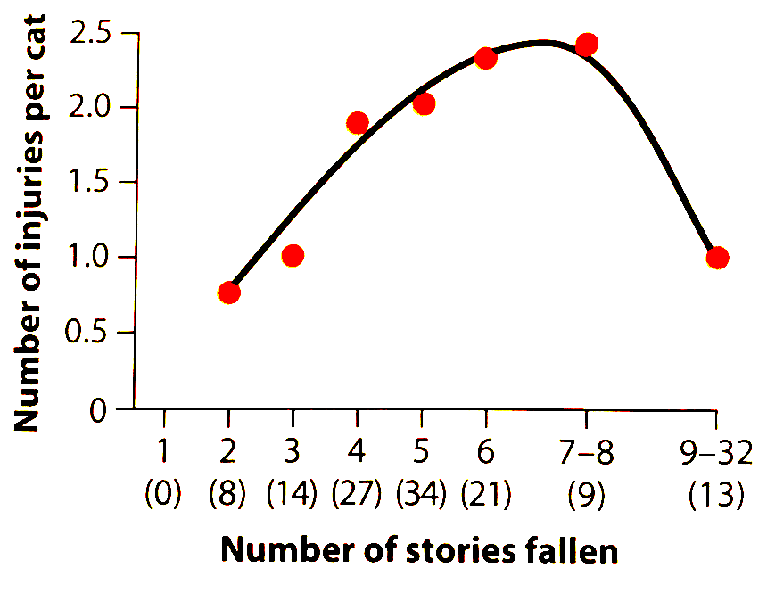
What is the population?
What is your interpretation of the results from this study?

Slide 14
Our dataset: growth measurements
Row | Group | Growth
1 | Control | 10.609
2 | Control | 7.920
3 | Control | 11.501
4 | Control | 11.881
5 | Control | 6.098
6 | Control | 7.396
30 simulated observations
What would you want to know about these values?
02
Notes:
Tuesday: 3 minutes (1–4 minutes).
Open the course t_test_data.csv. Use Control rows first. These are simulated responses with generic units. Imagine growth measured on independently sampled organisms. Show the first six records, but emphasize the full control dataset contains 30 observations. Ask what one row represents. Do not introduce the test yet.
Sources
https://coleoguy.github.io/subpages/teaching/expdes/datasets.html
https://coleoguy.github.io/subpages/teaching/expdes/data/t_test_data.csv

Slide 15
Mean and median describe location
Example values: 2, 4, 4, 6
Mean = sum / number of values = 16 / 4 = 4
Median = middle value after sorting = 4
Replace 6 with 18. What happens to each summary?
09
Notes:
Tuesday: 4 minutes (28–32 minutes).
Constructed miniature growth dataset, separate from the course CSV. Sum: 2 + 4 + 4 + 6 = 16; mean: 4. The median is the average of the middle two values, 4 and 4, so it is also 4. Replacing 6 with 18 gives mean 7 and median 4. Have students calculate both, then discuss why reporting only one summary can hide asymmetry or outliers. No single summary is universally best.

Slide 16
The same mean can hide different variation
Sample | Values | Mean | Range
A | 3, 4, 4, 5 | 4 | 2
B | 0, 4, 4, 8 | 4 | 8
Which sample would you describe as more variable? What does the mean omit?
10
Notes:
Tuesday: 3 minutes (32–35 minutes).
Constructed samples A: 3, 4, 4, 5 and B: 0, 4, 4, 8 both have mean 4. Ask which has greater variation without calculating. Equal means do not imply equivalent distributions. Range is maximum minus minimum: 2 and 8, respectively. We will develop variance and SD as additional spread summaries next.

Slide 17
Deviations from the mean
Value | Value − mean | Squared deviation
2 | −2 | 4
4 | 0 | 0
4 | 0 | 0
6 | 2 | 4
Why would adding the signed deviations give a poor measure of spread?
11
Notes:
Tuesday: 3 minutes (35–38 minutes).
Return to the constructed values 2, 4, 4, 6, whose mean is 4. Subtract the mean from each value. Signed deviations sum to zero because negative and positive deviations balance. This makes the mean signed deviation unsuitable as a spread measure. Squaring avoids cancellation; absolute deviation is another approach, but we focus on variance today.

Slide 18
Sample variance
Variance = sum of squared deviations / (n − 1)
For 2, 4, 4, 6: s² = 8 / 3 = 2.667
Squaring changes the units.
If growth is measured in mm, variance is measured in mm².
n is the number of independent observations in this example.
12
Notes:
Tuesday: 4 minutes (38–42 minutes).
Define sample variance before its abbreviation. The sum of squared deviations is 8, and the denominator is n − 1 = 3, giving s² = 8/3 = 2.6667. Estimating the mean from the same sample constrains the deviations to sum to zero, leaving n − 1 free deviations. Under independent, identically distributed sampling, this denominator makes sample variance unbiased for population variance. Keep the proof optional. If measurements are in mm, variance is in mm².
Sources
https://stat.ethz.ch/R-manual/R-devel/library/stats/html/sd.html

Slide 19
Standard deviation
SD = √variance
s = √2.667 = 1.633 growth units
SD describes spread among observations.
It uses the same units as the original measurements.
A larger SD can reflect biological variation, measurement error, or both.
13
Notes:
Tuesday: 4 minutes (42–46 minutes).
Standard deviation is the square root of sample variance. For the constructed values 2, 4, 4, 6, it is sqrt(8/3) = 1.632993. Describe the typical scale of deviation from the mean, not the mean absolute deviation. SD uses the original measurement units. A larger SD means greater spread, but it need not indicate measurement error: real biological variation also contributes.
Sources
https://stat.ethz.ch/R-manual/R-devel/library/stats/html/sd.html

Slide 20
Describing the course data in R
dat <- read.csv("t_test_data.csv")
x <- dat$value[dat$group == "Control"]
length(x)
mean(x)
median(x)
var(x)
sd(x)
Which line keeps only the control observations? Which output describes spread?
14
Notes:
Tuesday: 6 minutes (46–52 minutes).
Live coding. Explain <- assignment, $ column selection, == comparison, and [] selection. Read the CSV and select Control rows. Predict outputs, then run. There are 30 observations, mean 10.0336333, and sample SD 1.5535056. The script also computes the median and variance. Have students verify that sd(x)^2 equals var(x). Explain that sqrt computes a square root and length counts values. Do not use SE until later.
Sources
https://stat.ethz.ch/R-manual/R-devel/library/stats/html/sd.html
https://coleoguy.github.io/subpages/teaching/expdes/data/t_test_data.csv

Slide 21
SD and the normal distribution
For a normal population
About 68% of values lie within 1 SD of the mean.
About 95% lie within approximately 2 SDs (1.96).
These percentages depend on the distribution’s shape.
This describes individual values in a normal population.
15
Notes:
Tuesday: 3 minutes (52–55 minutes).
For a normal population, about 68% of values lie within 1 population SD of its mean, and about 95% lie within 1.96 population SDs. The common 2-SD shorthand is approximate. These statements describe individual values under a normal model, not confidence in an estimated mean. Strongly skewed distributions do not obey the 68–95 rule. Population notation μ and σ differs from sample notation x̄ and s.
Sources
https://stat.ethz.ch/R-manual/R-devel/library/stats/html/Distributions.html

Slide 22
Another sample gives another mean
Sample | Four observed values | Sample mean
1 | 8, 9, 11, 12 | 10
2 | 9, 10, 12, 13 | 11
3 | 7, 8, 10, 11 | 9
Could all three samples come from the same population?
16
Notes:
Tuesday: 4 minutes (55–59 minutes).
Introduce sampling variation with constructed examples. Samples drawn from same population can give different means even if study design and measurement protocol are identical. Distinguish two sources of variation: individuals within samples, and estimated means across samples. We do not usually have many real samples, but a simulation lets us see the idea.

Slide 23
Simulating repeated sampling
set.seed(683)
one_sample <- rnorm(30, mean = 10, sd = 1.5)
mean(one_sample)
means <- replicate(10000,
mean(rnorm(30, mean = 10, sd = 1.5)))
hist(means)
How many organisms are in each sample? How many sample means do we calculate?
17
Notes:
Tuesday: 5 minutes (59–64 minutes).
Unpack each line of this new code. set.seed fixes a reproducible random-number sequence. rnorm generates 30 values from a normal population with mean 10 and SD 1.5. mean summarizes one sample. replicate repeats that expression 10,000 times, returning 10,000 means. hist plots their distribution. The number of simulation repetitions differs from the number of organisms per sample. Ask students to identify both before running the code.
Sources
https://stat.ethz.ch/R-manual/R-devel/library/stats/html/Distributions.html

Slide 24
START HERE
Standard error of the mean
SE describes variation among sample means.
SE = s / √n
Course data:
1.554 / √30 = 0.284
18
Notes:
Tuesday: 4 minutes (64–68 minutes).
Standard error is the SD of an estimator across repeated samples. This histogram uses 10,000 simulated means, each based on 30 independent normal observations with population SD 1.5. The true SE is 1.5/sqrt(30) = 0.273861. For real data with unknown population SD, estimate SE as s/sqrt(n). For the Control data, this is 1.5535056/sqrt(30) = 0.283630. This formula assumes independent, identically distributed observations. The displayed histogram was generated in NumPy; R uses a different generator and will vary slightly.
Sources
https://stat.ethz.ch/R-manual/R-devel/library/stats/html/sd.html
https://stat.ethz.ch/R-manual/R-devel/library/stats/html/Distributions.html

Slide 25
SD and SE answer different questions
Summary | Question | Course data
SD | How variable are the observations? | 1.554
SE of mean | How variable is the estimated mean across repeated samples? | 0.284
An error bar must say whether it shows SD, SE, or something else.
19
Notes:
Tuesday: 4 minutes (68–72 minutes).
Use the same sample to distinguish spread from sampling uncertainty. SD = 1.554 describes variation among individual Control observations. Estimated SE = 0.284 describes sampling uncertainty in the estimated population mean. Both use the original response units. Ask whether a plot should emphasize organism variation or uncertainty in a mean. Error bars need labels: do not infer their meaning from appearance.

Slide 26
Tuesday’s exit questions
What is the difference between a parameter and a statistic?
Which describes variation among organisms: SD or SE?
Does simulating 10,000 sample means add biological replicates?
20
Notes:
Tuesday: 3 minutes (72–75 minutes).
Collect brief answers. (1) The population parameter is fixed in the model; a sample statistic changes across samples. (2) SD measures spread among observations; estimated SE describes uncertainty in the sample mean. (3) The 10,000 simulated means represent repeated hypothetical samples, not additional biological replication. If students cannot explain answer 2, begin Thursday by revisiting raw values versus sample means. Tuesday totals 75 minutes.

Slide 27
Sampling uncertainty and our first tests
Thursday, September 17
What do SD and SE each describe?
21
Notes:
Thursday: 3 minutes (0–3 minutes).
Begin Thursday with retrieval. Let students explain SD and SE without notes. x̄ is the sample mean, s is sample SD, and n counts independent observations. Today introduces confidence intervals and two mean comparisons. Paired and permutation material remains optional after slide 40. Thursday timing starts here.

Slide 28
Sample size and standard error
Independent n | SD held at 2 | SE = 2 / √n
25 | 2 | 0.40
100 | 2 | 0.20
400 | 2 | 0.10
Four times as many independent observations gives half the SE.
22
Notes:
Thursday: 4 minutes (3–7 minutes).
Hold population spread at SD 2. Use s = 2 for the illustrative SE calculations: n = 25 gives SE 0.4; n = 100 gives 0.2; n = 400 gives 0.1. Quadrupling independent sample size halves SE. Individual spread does not systematically shrink as n increases; sample SD becomes a more stable estimate. If observations share treated vials, adding rows may not add independent replicates.

Slide 29
The central limit theorem
With independent sampling and finite variance, sample means approach normality as n grows.
The individual observations can remain strongly skewed.
The approximation depends on the population and the sample size.
Does a large sample size make the original observations normal?
23
Notes:
Thursday: 5 minutes (7–12 minutes).
Introduce the CLT without assuming prior teaching. Under independent, identically distributed sampling with finite variance, the standardized mean approaches a normal distribution as n grows. This does not make raw data normal. There is no universal n = 30 guarantee; skewness and heavy tails affect convergence. Use rexp in foundations.R with sample sizes 1, 5, and 30 to compare means drawn from a strongly skewed exponential population with mean 1. Give students two minutes to predict before showing histograms.
Sources
https://stat.ethz.ch/R-manual/R-devel/library/stats/html/Distributions.html

Slide 30
A confidence interval for a mean
Estimate ± multiplier × standard error
10.034 ± 2.045 × 0.284
95% confidence interval: 9.454 to 10.614
Across repeated samples, about 95% of such intervals cover the true mean.
24
Notes:
Thursday: 5 minutes (12–17 minutes).
Define interval estimate and confidence level before using R output. Under independent normal sampling, the interval is x̄ ± t-critical × s/sqrt(n), with n − 1 degrees of freedom. We will explain t shortly; for n = 30, the 95% multiplier 2.045 comes from a reference-distribution lookup. The course interval is 10.0336 ± 2.04523 × 0.28363, or 9.4535 to 10.6137. The 95% describes long-run procedure coverage under the assumptions, not 95% of organisms and not a frequentist probability for a fixed parameter after observing data.
Sources
https://stat.ethz.ch/R-manual/R-devel/library/stats/html/t.test.html

Slide 31
Confidence intervals across repeated samples
Generate 30 values from a population whose mean is 10.
Calculate a mean and its 95% confidence interval.
Repeat, then count how often the interval includes 10.
Would every interval include 10? Would every sample give the same interval?
25
Notes:
Thursday: 5 minutes (17–22 minutes).
Live coding with foundations.R. Use a known normal population with mean 10 and SD 1.5, and independent samples of size 30. Each sample gets its own t interval. Repeat 1,000 times and count the fraction containing 10. Expect near 0.95, not exactly 0.95. Show the code in R and discuss it in chunks. qt(0.975, df = 29) supplies the two-sided 95% multiplier. More Monte Carlo repetitions stabilize estimated coverage without adding real organisms. Do not imply that every realized interval has 95% posterior probability.
Sources
https://stat.ethz.ch/R-manual/R-devel/library/stats/html/t.test.html

Slide 32
Our data and a fixed benchmark
30 control observations
Mean = 10.034
Fixed target = 10
How surprising is this departure?
26
Notes:
Thursday: 3 minutes (22–25 minutes).
Introduce the dataset before the one-sample method. Return to the original 30 Control values. The teaching benchmark of 10 is a fixed stipulated target, not an estimate from another sample. Ask whether the population mean is compatible with 10 under the model. Raw values help assess spread and unusual observations. The observed mean is 10.0336, a departure of 0.0336. Introduce the test later.
Sources
https://coleoguy.github.io/subpages/teaching/expdes/data/t_test_data.csv

Slide 33
The design and model come first
Independent observations supported by the sampling design
A quantitative response and a meaningful population mean
A reasonably suitable model for the distribution of values
Which assumption could you check from the dataset alone? Which needs study records?
27
Notes:
Thursday: 3 minutes (25–28 minutes).
Exact one-sample t inference assumes independent normal observations with common population variance; approximate inference can be reasonable otherwise. Show the course histogram if needed and ask about severe skew or unusual points. A graph cannot prove independence or normality. Population inference depends on sampling; causal claims depend on design. Avoid pretesting normality to select a test mechanically.
Sources
https://stat.ethz.ch/R-manual/R-devel/library/stats/html/t.test.html

Slide 34
Null and alternative hypotheses
Null hypothesis: the population mean equals 10.
Alternative hypothesis: the population mean differs from 10.
Observed departure: 10.034 − 10 = 0.034.
Would the null require every organism to have a value of exactly 10?
28
Notes:
Thursday: 3 minutes (28–31 minutes).
Define the null as population mean 10 and the alternative as a mean different from 10. Two-sided means that either direction counts as evidence against the null. Specify the question before inspecting significance. Rejecting or failing to reject follows a decision rule; it does not prove a hypothesis true or false. This null concerns the population mean, not every observation equaling 10.

Slide 35
The one-sample t statistic
t = (sample mean − null mean) / estimated SE
t = (10.034 − 10) / 0.284 = 0.119
The observed mean is about 0.12 standard errors
from the benchmark.
29
Notes:
Thursday: 4 minutes (31–35 minutes).
Define a test statistic as a summary used to compare observed data with a null reference. Here t = (x̄ − μ₀)/(s/sqrt(n)). The result is t = 0.1185817 with 29 degrees of freedom; reuse the estimated SE of 0.28363. The statistic is dimensionless and expresses how many estimated SEs separate the observed mean from the null value. Degrees of freedom n − 1 connect to the estimated-mean constraint in Tuesday’s variance calculation. The dataset, hypothesis, and model have preceded the method.
Sources
https://stat.ethz.ch/R-manual/R-devel/library/stats/html/t.test.html

Slide 36
The t distribution is a reference
Degrees of freedom:
30 − 1 = 29
The reference describes the statistic under the null.
30
Notes:
Thursday: 3 minutes (35–38 minutes).
Return to the early distribution gallery. Under the null and independent normal sampling, the statistic follows a t distribution with n − 1 degrees of freedom. Estimating the unknown population SD leads to a reference with heavier tails than the standard normal, especially at small degrees of freedom. With more degrees of freedom it approaches the standard normal. Raw measurements need not have a t distribution. The confidence-interval multiplier is qt(0.975, 29) = 2.04523.
Sources
https://stat.ethz.ch/R-manual/R-devel/library/stats/html/t.test.html
https://stat.ethz.ch/R-manual/R-devel/library/stats/html/Distributions.html

Slide 37
The p-value
Assuming the null and model are correct:
How often would we get a statistic at least
as extreme as the one observed?
Our example: p = 0.906
A large p-value does not establish that the null hypothesis is true.
31
Notes:
Thursday: 4 minutes (38–42 minutes).
A p-value is the probability, under the null and statistical model, of a statistic at least as extreme as observed. For the two-sided t-test, count both tails outside ±|t-observed|. Here p = 0.906424: the statistic is near zero and unsurprising under the null. This is not the posterior probability of the null, the chance that randomness caused the result, or an effect magnitude. Explain that larger absolute t-values give smaller tail areas without introducing another formula.
Sources
https://stat.ethz.ch/R-manual/R-devel/library/stats/html/t.test.html

Slide 38
The one-sample test in R
dat <- read.csv("t_test_data.csv")
x <- dat$value[dat$group == "Control"]
one <- t.test(x, mu = 10)
one
one$conf.int
Where are the estimate, interval, test statistic and p-value in the output?
32
Notes:
Thursday: 5 minutes (42–47 minutes).
Live coding. Select x as on Tuesday, run t.test(x, mu = 10), store the result, and print it. Locate the estimate, confidence interval, statistic, degrees of freedom, and p-value. This call performs a two-sided one-sample test and gives a 95% confidence interval by default. Students annotate the output in their scripts. $conf.int accesses a component of the returned list.
Sources
https://stat.ethz.ch/R-manual/R-devel/library/stats/html/t.test.html
https://coleoguy.github.io/subpages/teaching/expdes/data/t_test_data.csv

Slide 39
Interpreting the first test
Estimated mean = 10.034
95% CI: 9.454 to 10.614 p = 0.906
The data do not provide evidence that the population mean
differs from the stipulated target of 10.
How is “no evidence of a difference” different from “the means are equal”?
33
Notes:
Thursday: 3 minutes (47–50 minutes).
The estimated mean is 10.0336, the 95% interval is 9.4535 to 10.6137, and p = 0.9064. The data do not provide evidence of a difference from 10 under the model. Do not claim equivalence, no effect, or a range containing 95% of individuals. Whether a departure is smaller than a biologically meaningful threshold is a separate, explicitly defined question; it cannot be inferred from nonsignificance. These are simulated data.
Sources
https://stat.ethz.ch/R-manual/R-devel/library/stats/html/t.test.html

Slide 40
A second dataset question: two groups
Control | Treatment
10.609 | 15.783
7.920 | 10.687
11.501 | 10.476
11.881 | 9.872
30 control organisms
28 treatment organisms
Does mean growth differ
between the groups?
Assume independent assignment.
Both group means now have sampling uncertainty.
34
Notes:
Thursday: 3 minutes (50–53 minutes).
Introduce the data question before Welch’s method. The same CSV now contributes both groups: 30 Control and 28 Treatment observations. The illustrative scenario assumes independently assigned organisms and uses simulated responses in generic growth units. The question concerns two population means. Both group means are estimated; the Control mean is not a fixed known benchmark. Ask whether equal row counts would imply pairing. They would not.
Sources
https://coleoguy.github.io/subpages/teaching/expdes/datasets.html
https://coleoguy.github.io/subpages/teaching/expdes/data/t_test_data.csv

Slide 41
The observed difference in means
Control mean: 10.034
Treatment mean: 11.736
Difference: +1.703
What uncertainty comes from estimating both means?
35
Notes:
Thursday: 4 minutes (53–57 minutes).
Use all 58 points. Treatment mean 11.7364286 minus Control mean 10.0336333 gives 1.7027952. Horizontal jitter separates points; it is not a biological measurement. Keep the direction Treatment minus Control consistent. Independent groups matter. The distributions overlap despite their mean difference: every individual need not be separated. After discussion, mention the group SD estimates of 1.591 and 1.554.
Sources
https://coleoguy.github.io/subpages/teaching/expdes/data/t_test_data.csv

Slide 42
Welch’s two-sample t-test
SE of difference = √(varianceT / nT + varianceC / nC)
t = (1.703 − 0) / 0.413 = 4.119
Welch’s method allows unequal population variances.
The observations in the two groups must be independent.
Null: equal population means. Alternative: population means differ.
36
Notes:
Thursday: 4 minutes (57–61 minutes).
Introduce Welch’s test after the question and observed data. For independent groups, estimated SE of the difference is sqrt(sT²/nT + sC²/nC) = 0.4133549. The null difference is zero; the two-sided alternative allows either direction. The statistic is 4.119451 with approximately 55.5082 degrees of freedom, calculated from the variance contributions. Welch does not require equal population variances, but independence and suitable sampling distributions remain necessary. Avoid a Levene pretest and a pooled-variance test. Students need not memorize the more complicated degrees-of-freedom formula. Build on uncertainty rather than deriving every algebraic step.
Sources
https://stat.ethz.ch/R-manual/R-devel/library/stats/html/t.test.html

Slide 43
The group comparison in R
control <- dat$value[dat$group == "Control"]
treatment <- dat$value[dat$group == "Treatment"]
welch <- t.test(treatment, control,
var.equal = FALSE)
welch
How does this call differ from comparing one sample with a fixed target?
37
Notes:
Thursday: 5 minutes (61–66 minutes).
Live coding. Choose Treatment and Control explicitly to establish the positive direction. var.equal = FALSE is the default, written explicitly for clarity. With two numeric vectors, t.test performs an independent Welch comparison unless paired = TRUE. Print the estimate, confidence interval, and p-value. Before running, ask what changed from the one-sample call. Both mean estimates now contribute uncertainty. Do not pair observations based on row order.
Sources
https://stat.ethz.ch/R-manual/R-devel/library/stats/html/t.test.html

Slide 44
The size of the difference matters
Treatment − Control = +1.703
95% CI: +0.875 to +2.531 p = 0.000128
The estimated mean is higher in the treatment group.
Its biological importance depends on the response and context.
38
Notes:
Thursday: 3 minutes (66–69 minutes).
The mean difference is 1.702795, its 95% interval is 0.874584 to 2.531006, and p = 0.0001275808. These are simulated course measurements, not findings from a real study. Distinguish evidence of a mean difference from its biological importance. A causal interpretation relies on the hypothetical randomization and appropriate controls, not on a small p-value. The interval quantifies sampling uncertainty conditional on the model and design.
Sources
https://stat.ethz.ch/R-manual/R-devel/library/stats/html/t.test.html
https://coleoguy.github.io/subpages/teaching/expdes/data/t_test_data.csv

Slide 45
Three claims to examine
“A small SD means our population mean is precisely estimated.”
“p = 0.000128 is the probability that the null is true.”
“There are 58 rows, so there must be 58 independent replicates.”
What additional information or correction does each claim need?
39
Notes:
Thursday: 4 minutes (69–73 minutes).
Discuss three intentionally incomplete or incorrect statements in pairs. (1) SD describes variation among individuals; precision of the mean also depends on independent sample size. (2) A p-value is a tail probability under the null and model, not the probability that the null is true. (3) Row counts alone cannot establish independent replication. Ask students to repair each claim in a sentence using Tuesday’s terminology and the study design. If time is tight, prioritize the first two.

Slide 46
Thursday’s exit questions
When does the comparison require uncertainty from two means?
What does a confidence interval add to a p-value?
What design problem could make a correctly executed test misleading?
40
Notes:
Thursday: 2 minutes (73–75 minutes).
Answers: a one-sample test compares a mean with a fixed target; Welch compares the means of two independent groups. SD describes individual spread, SE describes variation in an estimator across samples, a confidence interval supplies an interval estimate with a coverage interpretation, and a p-value quantifies extremeness under the null and model. Greenhouse or vial grouping can invalidate independence even when R runs correctly. Thursday totals 75 minutes. Optional follow-on slides are outside this pacing.

Slide 47
Optional follow-on lessons
Paired observations and permutation tests
41
Notes:
Optional: 0 minutes (0–0 minutes).
These slides are for a later session or extension. They are not included in the two 75-minute plans. Paired and permutation methods each begin with their dataset before method explanation and application.

Slide 48
Response across repeated visits
Subject | T2 | T3
1 | 12.336 | 12.987
2 | 10.378 | 10.191
3 | 9.587 | 10.677
4 | 10.570 | 11.328
5 | 9.550 | 11.241
6 | 11.048 | 11.899
15 simulated subjects
3 recorded visits
Our planned question:
What is the mean change from T2 to T3?
Two measurements on one organism form one pair.
42
Notes:
Optional: 0 minutes (0–0 minutes).
Introduce repeated_measures.csv before naming the paired test. It contains 15 subjects and three visits. For this exercise, define the comparison of interest as the final interval, T3 minus T2. The table shows the two focal visits for six subjects, so students see the longitudinal structure and the deliberate contrast. Do not interpret the selected contrast as an analysis of the entire trajectory or search all pairs for significance. Values are simulated and units generic.
Sources
https://coleoguy.github.io/subpages/teaching/expdes/datasets.html
https://coleoguy.github.io/subpages/teaching/expdes/data/repeated_measures.csv

Slide 49
The paired structure is visible
Each line is one organism.
The analysis follows change within organisms.
How many independent changes do we have?
43
Notes:
Optional: 0 minutes (0–0 minutes).
Connect each subject’s T2 and T3 values. The display makes the within-subject changes visible. Explain that baseline differences among organisms are not the target here. Ask which subject declined and whether an unpaired group summary communicates the same information. There are 15 independent differences under the exercise’s independence assumption, not 30 independent organisms.
Sources
https://coleoguy.github.io/subpages/teaching/expdes/data/repeated_measures.csv

Slide 50
One change per organism
d = T3 − T2
Mean change
+0.708 units
SD of changes
0.485 units
44
Notes:
Optional: 0 minutes (0–0 minutes).
Show each difference T3 minus T2. Red line is zero. Have students compute the first difference by hand: 12.987−12.336=.651. The observed mean change is .7079333. The differences include a small negative value, so a mean increase does not imply every individual increases. Discuss why variation among differences is the relevant source of uncertainty.
Sources
https://coleoguy.github.io/subpages/teaching/expdes/data/repeated_measures.csv

Slide 51
The paired t-test
Reduce each pair to a difference.
Test whether the population mean difference is zero.
t = 0.708 / (0.485 / √15) = 5.658
The standard error comes from the 15 differences.
45
Notes:
Optional: 0 minutes (0–0 minutes).
A paired t-test is a one-sample t-test on the within-pair differences. The null is mean difference zero. Use the actual SD .484560 approximately and SE .1251128, not either visit’s SD. This is not a choice dictated by equal vector lengths. Pairing is a design property. The df is 14. The test’s exact small-sample reference assumes normally distributed independent differences.
Sources
https://stat.ethz.ch/R-manual/R-devel/library/stats/html/t.test.html

Slide 52
The distribution of the differences
Independent subjects
Meaningful pairing
A suitable sampling model for the differences
No extreme value driving the conclusion
46
Notes:
Optional: 0 minutes (0–0 minutes).
Inspect the difference distribution, not only the two marginal measurement distributions. The QQ plot shows finite-sample variation including two larger positive changes. Ask students to locate any influential points and explain why 15 is a modest sample. The paired t result is conditional on a reasonably suitable difference distribution and independent subjects. If the distribution were strongly skewed or heavy-tailed, reconsider the model and question rather than automatically transforming for significance.
Sources
https://coleoguy.github.io/subpages/teaching/expdes/data/repeated_measures.csv

Slide 53
Pair by identity in R
rm <- read.csv("repeated_measures.csv")
wide <- reshape(rm, idvar = "subject",
timevar = "time", direction = "wide")
paired <- t.test(wide$response.T3, wide$response.T2,
paired = TRUE)
paired
Match records by subject ID, never by accidental row order.
47
Notes:
Optional: 0 minutes (0–0 minutes).
Live coding block D. Use reshape with subject as ID and time as time variable. Pairing through IDs avoids reliance on the arbitrary row order of a long data frame. Run the paired t-test on T3,T2 and confirm it matches t.test(T3−T2,mu=0). The complete script checks missing values and duplicate subject/visit records before reshaping. Let students locate their chosen subject in the reshaped table.
Sources
https://stat.ethz.ch/R-manual/R-devel/library/stats/html/t.test.html
https://coleoguy.github.io/subpages/teaching/expdes/data/repeated_measures.csv

Slide 54
Mean change and causal explanation
Mean change = +0.708 units
95% CI: +0.440 to +0.976 p = 0.0000590
The response increased on average between T2 and T3.
Time, development or other changes could explain that increase.
A paired analysis does not by itself establish a treatment effect.
48
Notes:
Optional: 0 minutes (0–0 minutes).
Answer key for T3−T2: mean=.7079333, t=5.6583603, df=14, p=.0000590378, CI [.4395931,.9762736]. The data support a mean increase over this interval under the model. A before-after contrast by itself cannot isolate a treatment effect from development, temporal change, measurement drift or other factors. These records are simulated and have no documented intervention or untreated comparison.
Sources
https://coleoguy.github.io/subpages/teaching/expdes/data/repeated_measures.csv
https://stat.ethz.ch/R-manual/R-devel/library/stats/html/t.test.html

Slide 55
What would break this analysis?
An AI sorts T2 and T3 separately, then pairs rows.
A spreadsheet counts 30 measurements as 30 organisms.
Ten organisms share a cage that received the treatment.
Which dependence does each analysis ignore?
49
Notes:
Optional: 0 minutes (0–0 minutes).
Quick diagnostic discussion. Answer 1: sorting each visit independently destroys pairs. Answer 2: pretending two measurements are two independent organisms ignores repeated observations. Answer 3: assigning treatment to a whole cage makes cage the relevant randomization unit; subject independence may fail. Ask students to name a pairing example from their own research. Keep this to three minutes.

Slide 56
The original treatment comparison
30 control
28 treatment
Observed difference
+1.703 units
Could random assignment alone produce this contrast?
50
Notes:
Optional: 0 minutes (0–0 minutes).
Dataset first for the fourth test. Return to the complete t_test_data.csv with 30 control and 28 treatment rows. The question is again a treatment-associated change in response. Retain the same observed mean difference. Tell students we will now build a reference distribution through permitted relabeling, before giving the formal method name.
Sources
https://coleoguy.github.io/subpages/teaching/expdes/data/t_test_data.csv

Slide 57
A six-organism thought experiment
Original control | Original treatment
8 | 11
10 | 13
12 | 15
Constructed example
Control mean = 10
Treatment mean = 13
Observed difference = 3
Keep the six responses fixed. Reassign three treatment labels.
51
Notes:
Optional: 0 minutes (0–0 minutes).
This is an explicitly constructed miniature dataset for working by hand, not a subset of the course CSV. Three organisms receive Control and three receive Treatment. Under a completely randomized design and a sharp null of no treatment effect on any organism, all 20 allocations of three treatment labels are possible. Keep the six outcomes fixed and reassign the labels. Have pairs make one new allocation and calculate its mean difference.

Slide 58
All 20 possible assignments
20 possible allocations
4 are at least as extreme
p = 4 / 20 = 0.20
Both directions count.
52
Notes:
Optional: 0 minutes (0–0 minutes).
Six choose three equals 20. The points show every possible mean difference, sorted for display. Four of the twenty have absolute difference at least 3: −3.6667,−3,+3,+3.6667. Thus the exact two-sided p-value is 4/20=.20 for this constructed example. The count includes the observed allocation. Use absolute values because the alternative includes either direction. Here exhaustive enumeration needs no Monte Carlo plus-one correction.

Slide 59
The permutation test
Choose the statistic: Treatment mean − Control mean.
Reassign labels in a way the study design permits.
Compare the observed statistic with the resulting null distribution.
The valid shuffle follows the experimental design.
53
Notes:
Optional: 0 minutes (0–0 minutes).
Now name the method. Under the specified completely randomized design, permute labels at the organism level, retaining group sizes. This provides a randomization test of the sharp null of no treatment effect on any unit. In a sampling interpretation, unrestricted label permutation relies on exchangeability under the null. Equality of means alone does not guarantee exchangeability when distributions differ. It is not an assumption-free replacement for Welch. Blocked, paired and clustered designs require restricted permutations.
Sources
https://arxiv.org/abs/1603.05766

Slide 60
One shuffle in R
difference <- function(g) {
mean(dat$value[g == "Treatment"]) -
mean(dat$value[g == "Control"])
}
obs <- difference(dat$group)
difference(sample(dat$group))
The responses stay fixed. Only treatment labels change.
54
Notes:
Optional: 0 minutes (0–0 minutes).
Live coding block E, first part. The function computes Treatment minus Control for any supplied group-label vector. sample(dat$group) permutes the observed labels without replacement, preserving 30 Control and 28 Treatment labels. Calculate obs before shuffling. Ask students to explain which object changes and which does not. Do not permute outcomes and labels together because that leaves the association unchanged. Shuffle labels on complete independent units only.
Sources
https://stat.ethz.ch/R-manual/R-devel/library/base/html/sample.html
https://coleoguy.github.io/subpages/teaching/expdes/data/t_test_data.csv

Slide 61
Many shuffles in R
set.seed(683)
B <- 99999
null <- replicate(B, difference(sample(dat$group)))
b <- sum(abs(null) >= abs(obs))
p_mc <- (b + 1) / (B + 1)
p_mc
With random permutations, zero exceedances still does not give p = 0.
55
Notes:
Optional: 0 minutes (0–0 minutes).
Live coding block E, second part. Run 9,999 permutations in class if computers are slow and discuss the resolution limit. The complete script defaults to 99,999. Count absolute differences at least as large as the observed one. Add one to numerator and denominator for random Monte Carlo permutations. More shuffles improve Monte Carlo precision but do not increase biological sample size. The exact realized count depends on the RNG and seed.
Sources
https://arxiv.org/abs/1603.05766
https://stat.ethz.ch/R-manual/R-devel/library/base/html/sample.html

Slide 62
The null distribution for our dataset
Observed: +1.703
Reference run:
13 of 99,999 shuffles
were at least as extreme.
p = 0.00014
Counts vary with the seed.
Count |permuted difference| ≥ 1.703. Shaded bins only locate the tails.
56
Notes:
Optional: 0 minutes (0–0 minutes).
The histogram contains 99,999 random label permutations of all 58 observations. Bin width .4, total plotted range −2.4 to 2.4. Observed difference=1.7027952. The reference run had 13 absolute exceedances, giving (13+1)/(99999+1)=.00014. R simulation values will vary slightly. Let students identify both extreme tails before reporting a p-value. The raw data and group sizes stay fixed for every shuffle.
Sources
https://coleoguy.github.io/subpages/teaching/expdes/data/t_test_data.csv
https://arxiv.org/abs/1603.05766

Slide 63
What the methods have in common
 | Welch analysis | Permutation analysis
Observed difference | +1.703 | +1.703
Null reference | Approximate t distribution | Permitted label assignments
p-value | 0.000128 | About 0.0001
Key requirement | Independent groups | Valid exchangeability/design
The same dataset can support related analyses with different assumptions.
57
Notes:
Optional: 0 minutes (0–0 minutes).
Both methods retain the observed difference +1.7027952 and compare a statistic with a null reference. Welch uses an approximate t reference for unequal means under independent sampling. The permutation reference here comes from unrestricted random assignment under a sharp no-effect null, or exchangeable labels in a sampling model. Numerical agreement is reassuring in this example but not proof that assumptions are satisfied. Do not choose whichever p-value is smaller. The CI reported for the mean difference is Welch’s, not a permutation CI.
Sources
https://stat.ethz.ch/R-manual/R-devel/library/stats/html/t.test.html
https://arxiv.org/abs/1603.05766

Slide 64
A flawed simulation to repair
bad_null <- replicate(9999, {
g <- sample(dat$group, replace = TRUE)
difference(g)
})
mean(bad_null >= obs)
Intentionally flawed example
What changed about the assignment? Which tail did the code count?
58
Notes:
Optional: 0 minutes (0–0 minutes).
Intentionally flawed code. Students should find three problems: replacement changes group counts and does not implement the intended random assignment; the alternative was two-sided but the tail calculation is one-sided; randomly drawn permutations use the plus-one estimate. If obs had been negative, a single upper-tail calculation would be especially misleading. Correct code appears in the preceding two code slides and complete script. Ask students to explain the design failure, not merely edit syntax.

