Slide 1
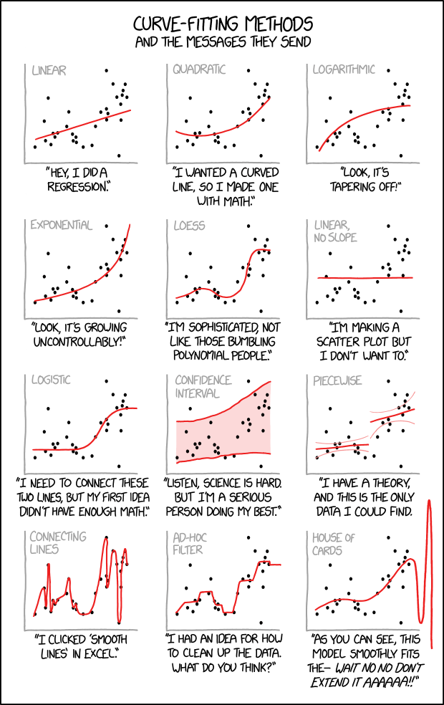
ANOVA Generalized Linear Models

Slide 2
Response = predictor variables + stochastic component

Slide 3
Analysis of Variance
Used to compare the means among more than two groups
If you are comparing three groups, for instance, you cannot just do three pair-wise t-tests – this approach would cause too many false positives
ANOVA takes into account the fact that you are comparing multiple groups and controls the false positive rate.

Slide 4
Analysis of Variance
A | B | C
2 | 5 | 7
2 | 8 | 4
3 | 8 | 5
5 | 7 | 4

Slide 5
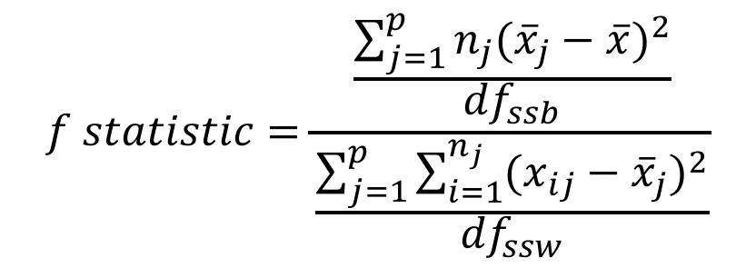
Analysis of Variance
A | B | C
2 | 5 | 7
2 | 8 | 4
3 | 8 | 5
5 | 7 | 4
$$f statistic=\frac{\frac{\sum_{j=1}^{p}{n_{j}{({\overline{x}}_{j}−\overline{x})}^{2}}}{{df}_{ssb}}}{\frac{\sum_{j=1}^{p}{\sum_{i=1}^{n_{j}}{{(x_{ij}−{\overline{x}}_{j})}^{2}}}}{{df}_{ssw}}}$$

Slide 6
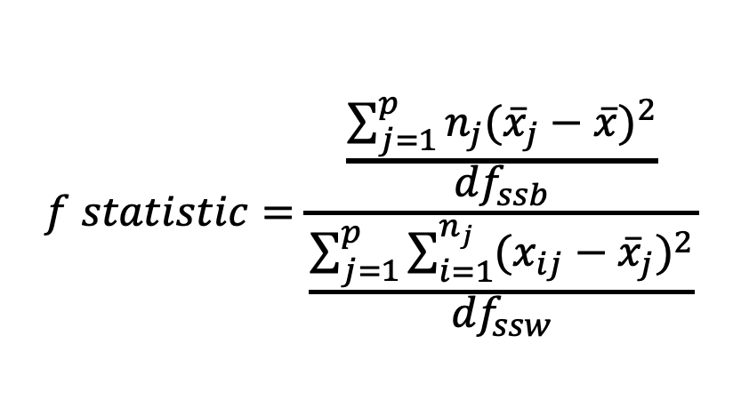
Analysis of Variance
A | B | C
2 | 5 | 7
2 | 8 | 4
3 | 8 | 5
5 | 7 | 4
$$f statistic=\frac{\frac{\sum_{j=1}^{p}{n_{j}{({\overline{x}}_{j}−\overline{x})}^{2}}}{{df}_{ssb}}}{\frac{\sum_{j=1}^{p}{\sum_{i=1}^{n_{j}}{{(x_{ij}−{\overline{x}}_{j})}^{2}}}}{{df}_{ssw}}}$$
number of groups -1
number of sample – number of groups

Slide 7
Analysis of Variance
A | B | C
2 | 5 | 7
2 | 8 | 4
3 | 8 | 5
5 | 7 | 4
$$f statistic=\frac{\frac{\sum_{j=1}^{p}{n_{j}{({\overline{x}}_{j}−\overline{x})}^{2}}}{{df}_{ssb}}}{\frac{\sum_{j=1}^{p}{\sum_{i=1}^{n_{j}}{{(x_{ij}−{\overline{x}}_{j})}^{2}}}}{{df}_{ssw}}}$$

Slide 8
Analysis of Variance
A | B | C
2 | 5 | 7
2 | 8 | 4
3 | 8 | 5
5 | 7 | 4
$$f statistic=\frac{\frac{\sum_{j=1}^{p}{n_{j}{({\overline{x}}_{j}−\overline{x})}^{2}}}{{df}_{ssb}}}{\frac{\sum_{j=1}^{p}{\sum_{i=1}^{n_{j}}{{(x_{ij}−{\overline{x}}_{j})}^{2}}}}{{df}_{ssw}}}$$

Slide 9
Analysis of Variance
A | B | C
2 | 5 | 7
2 | 8 | 4
3 | 8 | 5
5 | 7 | 4
$$f statistic=\frac{\frac{\sum_{j=1}^{p}{n_{j}{({\overline{x}}_{j}−\overline{x})}^{2}}}{{df}_{ssb}}}{\frac{\sum_{j=1}^{p}{\sum_{i=1}^{n_{j}}{{(x_{ij}−{\overline{x}}_{j})}^{2}}}}{{df}_{ssw}}}$$

Slide 10
Analysis of Variance
A | B | C
2 | 5 | 7
2 | 8 | 4
3 | 8 | 5
5 | 7 | 4
$$f statistic=\frac{\frac{\sum_{j=1}^{p}{n_{j}{({\overline{x}}_{j}−\overline{x})}^{2}}}{{df}_{ssb}}}{\frac{\sum_{j=1}^{p}{\sum_{i=1}^{n_{j}}{{(x_{ij}−{\overline{x}}_{j})}^{2}}}}{{df}_{ssw}}}$$

Slide 11
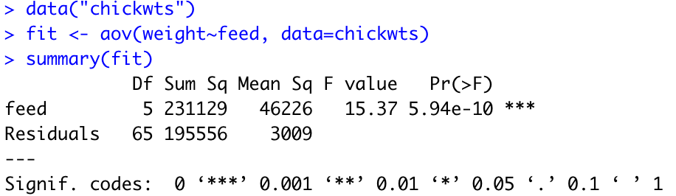
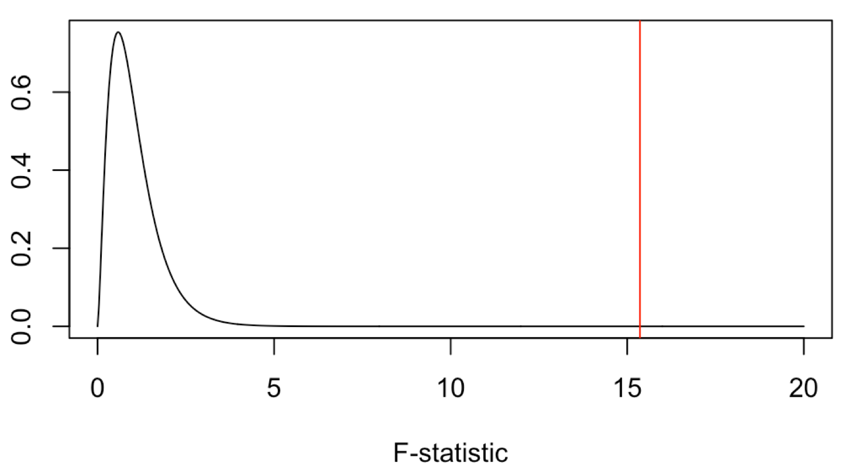
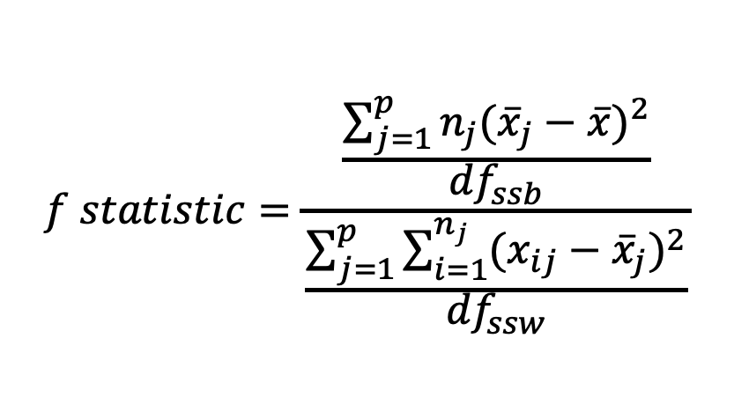
Running ANOVA in R
$$f statistic=\frac{\frac{\sum_{j=1}^{p}{n_{j}{({\overline{x}}_{j}−\overline{x})}^{2}}}{{df}_{ssb}}}{\frac{\sum_{j=1}^{p}{\sum_{i=1}^{n_{j}}{{(x_{ij}−{\overline{x}}_{j})}^{2}}}}{{df}_{ssw}}}$$
This significant result tells us that at least one of the groups of chickens have significantly different mean weights than at least one other groups. (significant ANOVA result allows us to reject the null that they are all the same)

Slide 12
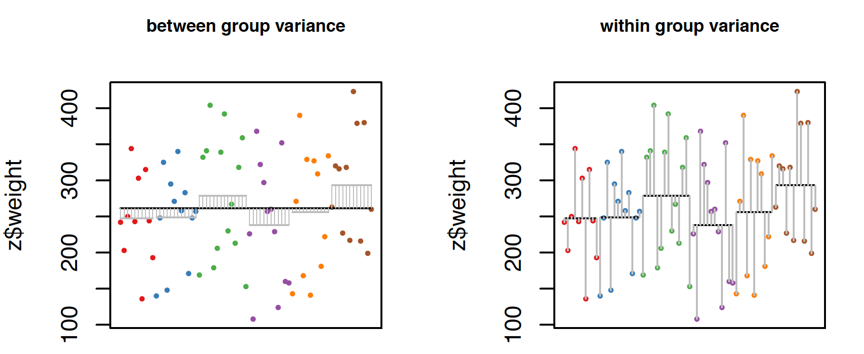
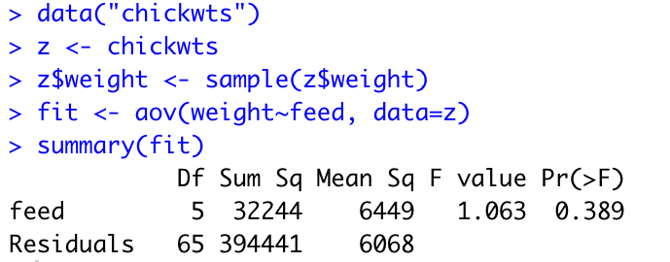
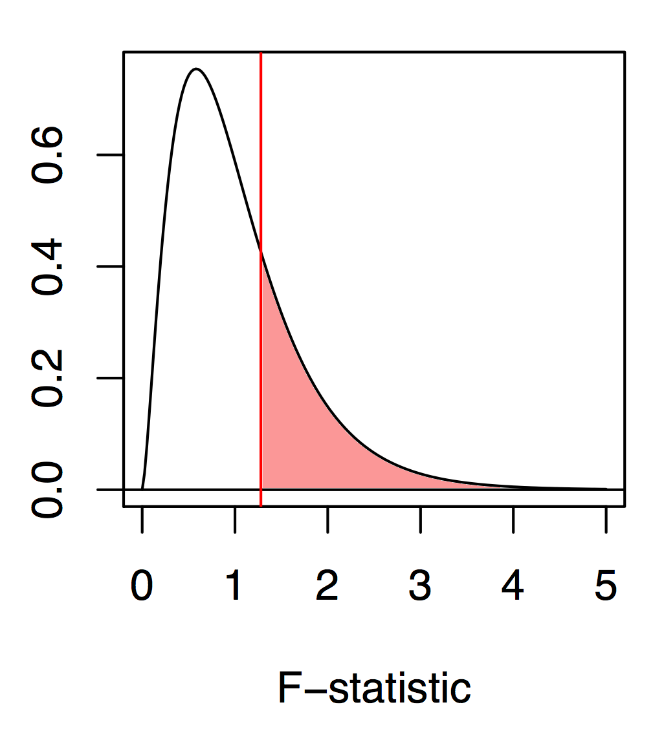
Running ANOVA in R

Slide 13
Post-hoc tests
If your ANOVA is significant, you may be interested in discovering which groups are different from one another
A variety of post-hoc comparisons of the means can be used
Fisher’s LSD
Least conservative test, basically uses t-tests to compare the means
Scheffe’s method
Performs all comparisons simultaneously, but has relatively low power
Tukey-Kramer method
A pair-wise method, like a t-test, but corrected for multiple comparisons

Slide 14
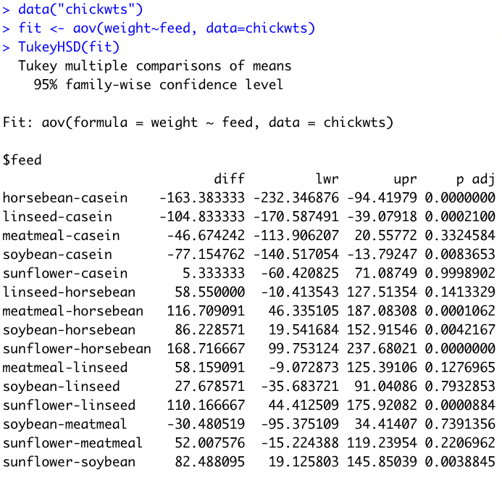
Post-hoc tests
anova and aov functions will both perform an ANOVA but the results are stored slightly differently. For this posthoc test we want the aov format

Slide 15
Interpreting post-hoc tests
When we examine all the significantly different ones we can draw several conclusions:
Chicks fed casein are significantly heavier than those fed horsebean, linseed, and soybean.
Chicks fed horsebean are significantly lighter than those fed meatmeal, soybean, and sunflower.
Chicks fed sunflower are significantly heavier than those fed linseed or soybean.

Slide 16
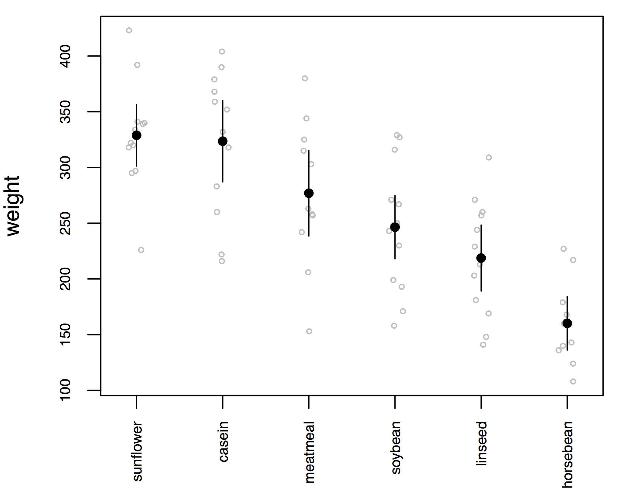
Plotting this kind of data
Our results from the ANOVA and Tukey match up pretty well with our rules of thumb about 95% CI overlaps

Slide 17
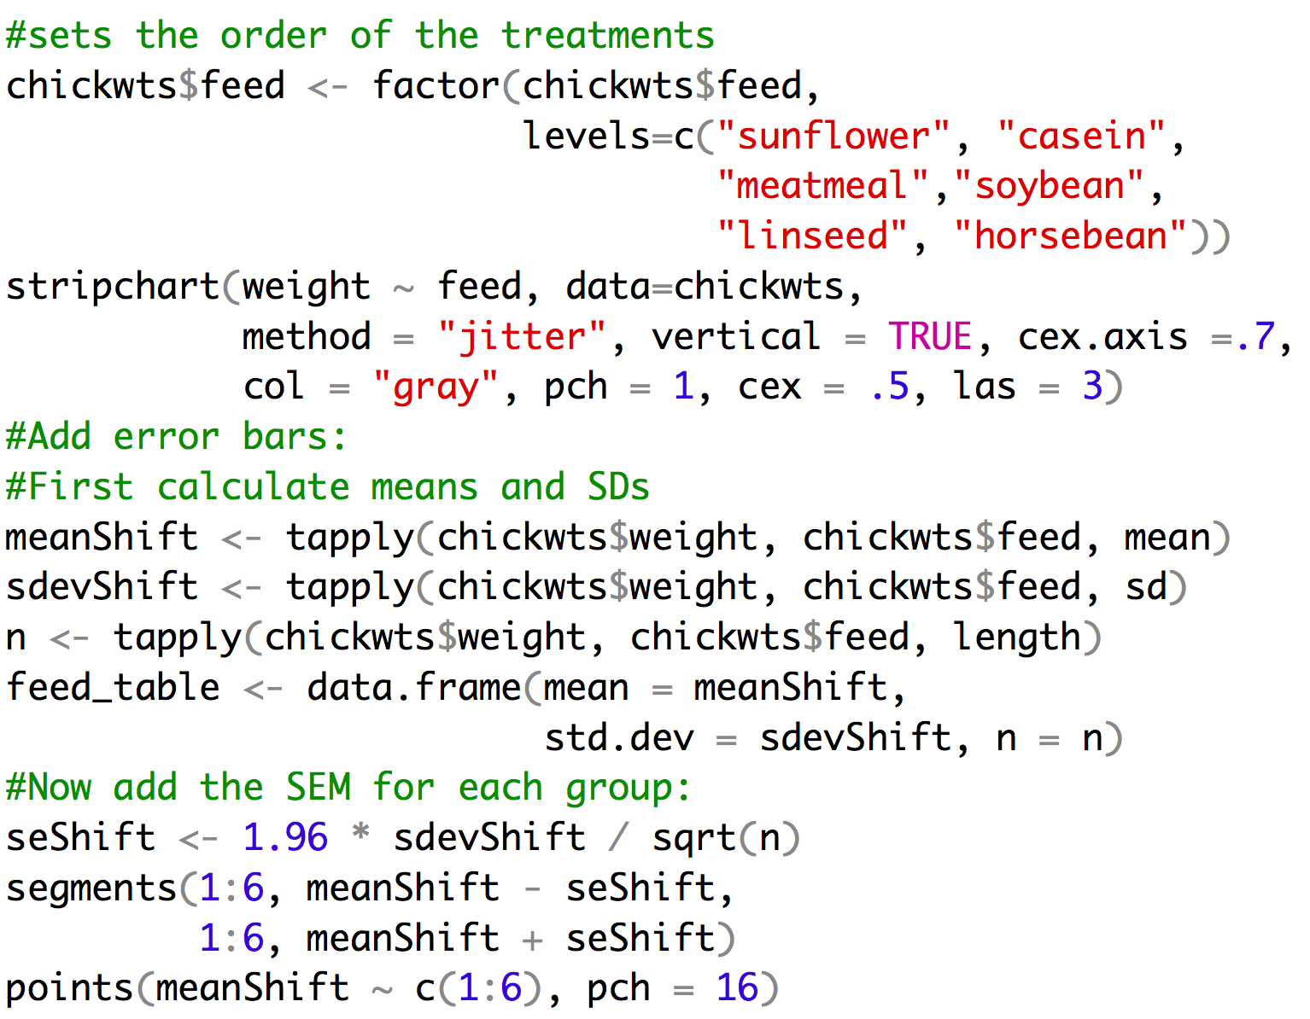
Example of code

Slide 18
Assumptions of the ANOVA
The variable is normally distributed within each group
The variance is the same in the different groups
The design is balanced – you have the same sample size for each group
But… ANOVA is fairly robust to violations of these assumptions

Slide 19
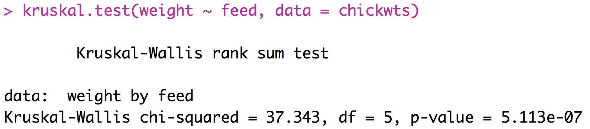
A Non-Parametric Alternative
Kruskal-Wallis Test
Based on ranks
The multiple-group version of the Mann-Whitney U-test
R-implementation:
p-value suggests this
test has lower power
than ANOVA

Slide 20
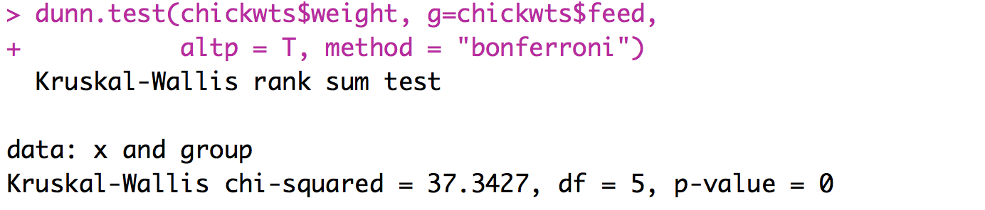
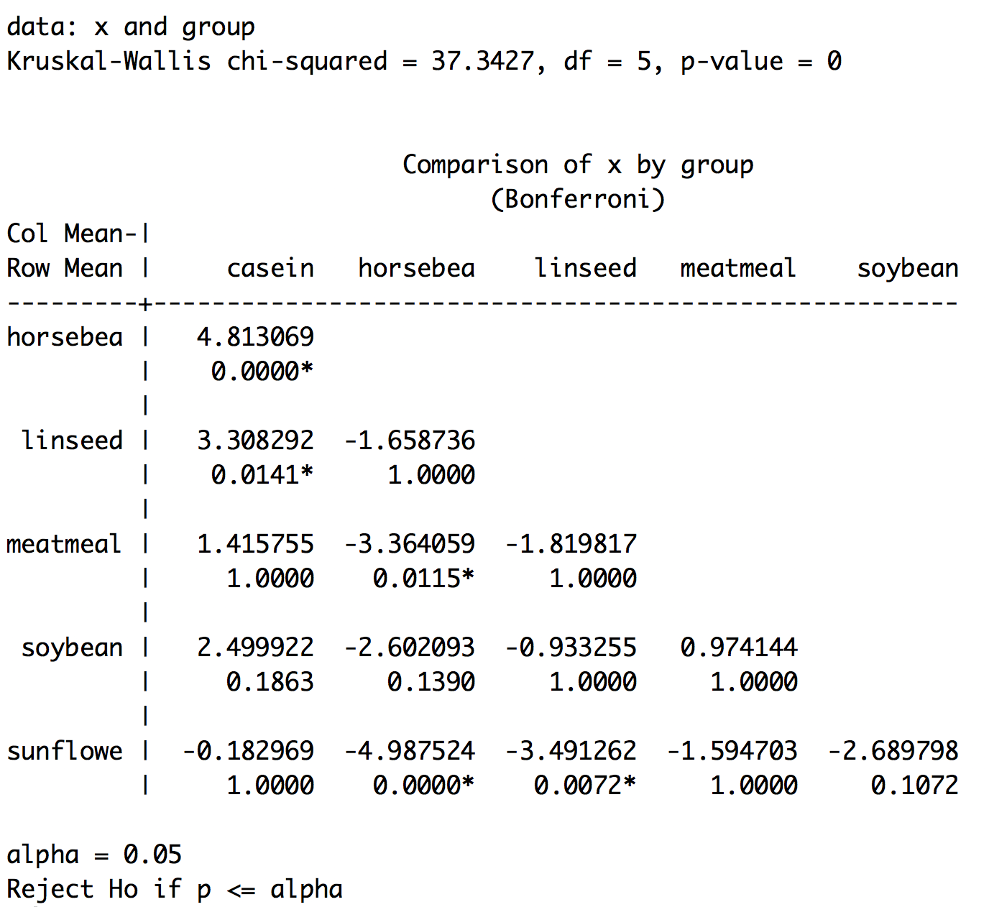
A Non-Parametric post-hoc
Dunn’s test – is the non-parametric equivalent of the Tukey
Not in base R need to install:
install.packages(“dunn.test”, dependencies=TRUE)

Slide 21
ANOVA Summary
ANOVA is the foundation of essentially all tests comparing multiple means
Don’t make it too complicated – the null hypothesis is simple: they are all the same.
Post-hoc tests are important for determining which means are the source of a significant ANOVA.
You can only justify a post-hoc test if the ANOVA is significant in the first place.
Before applying ANOVA, check that your data fit the assumptions (consider transforming the data lots of times this will be based on your biological knowledge because you will have insufficient data to say much about the observed distribution)

Slide 22
ANOVA Practice Problems
Use the chick weights dataset included in R data("chickwts"). Reduce the data down to just soybean and sunflower. Run an ANOVA and determine whether these foods lead to significant differences in weight.

Slide 23
Hypothesis testing has limits
Often times we want to say more than something has an effect. We want to understand exactly how a predictor variable impacts a response variable.
Often times we have complex relationships where several variables (continuous and discrete) impact our response variable and we need to understand how all of these things work together to determine our observations.
This is when we should think about moving to generalized linear models!

Slide 24
The Plan
Linear regression
Poisson regression
Binomial regression
GLMs with a mix of variable types
Mixed effects models

Slide 25
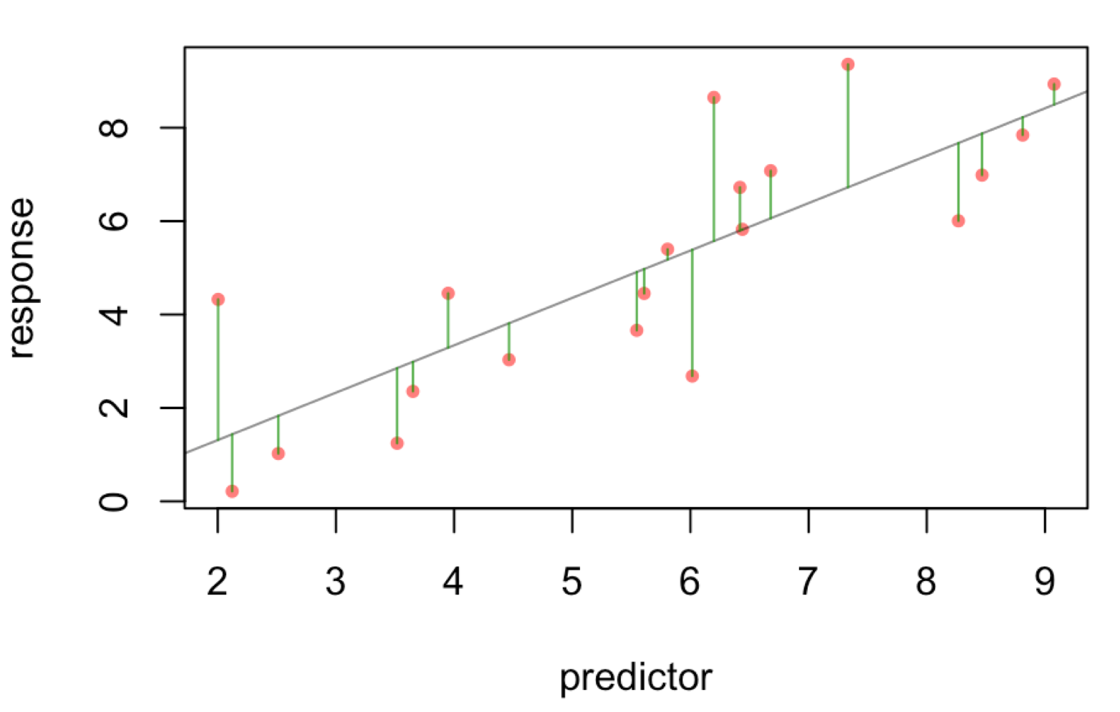
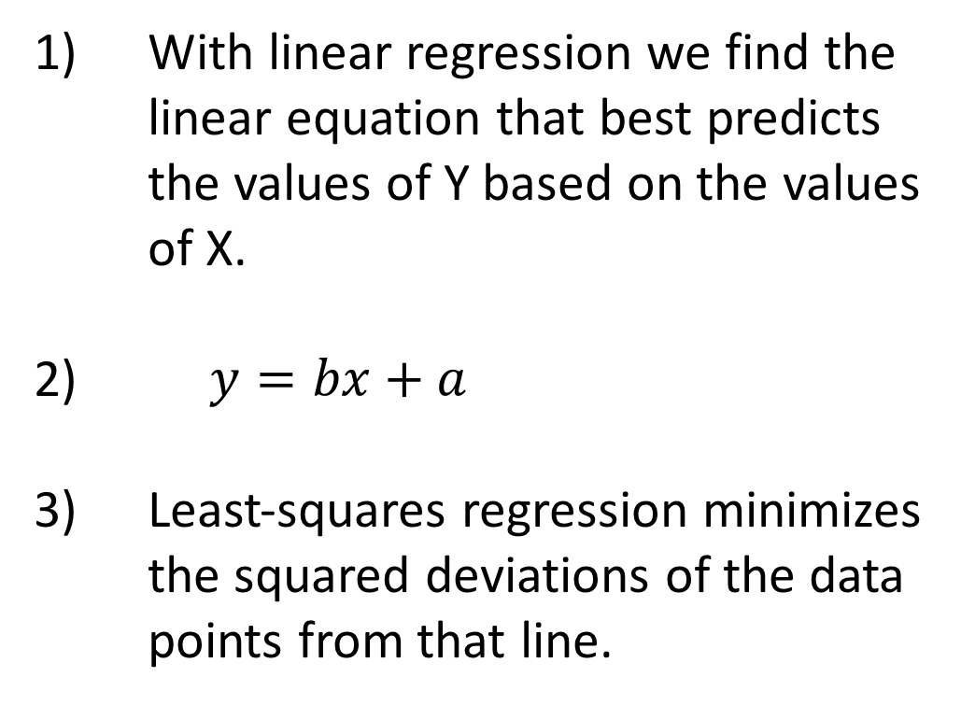
Regression in R
With linear regression we find the linear equation that best predicts the values of Y based on the values of X.
$y=bx+a$
Least-squares regression minimizes the squared deviations of the data points from that line.

Slide 26
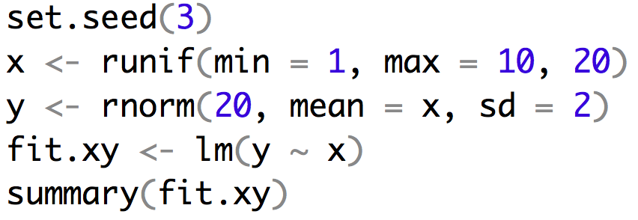
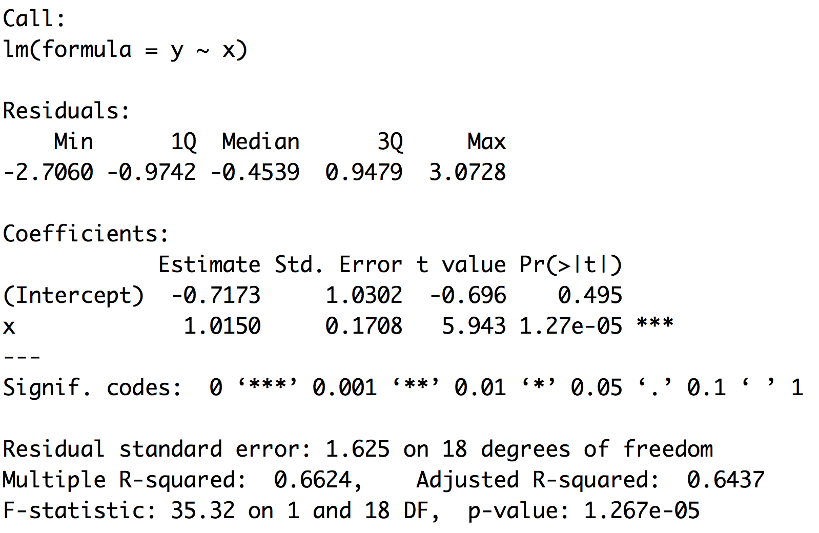
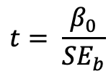

Example of regression
$$y=bx+a$$
$$t= \frac{β_{0}}{{SE}_{b}}$$

Slide 27
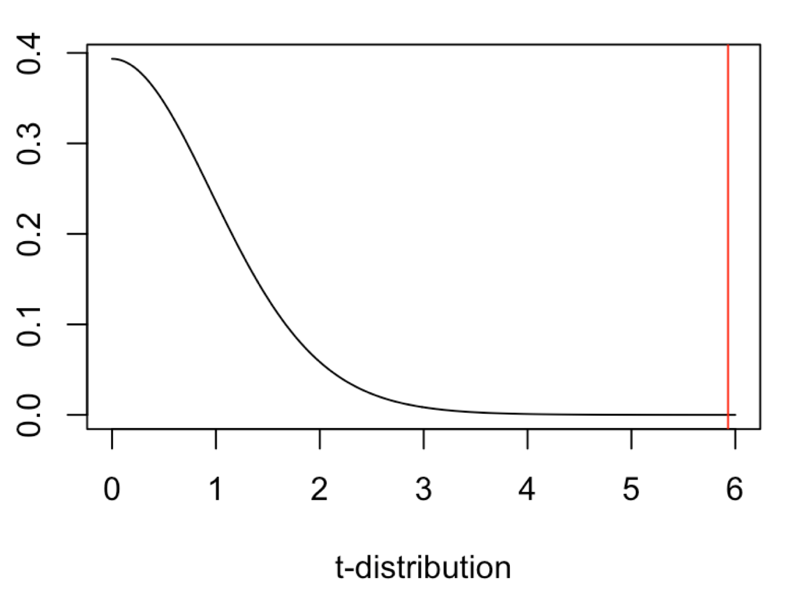
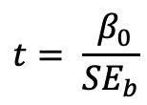
Example of regression
$$y=bx+a$$
$$t= \frac{ β_{0}}{{SE}_{b}}$$

Slide 28
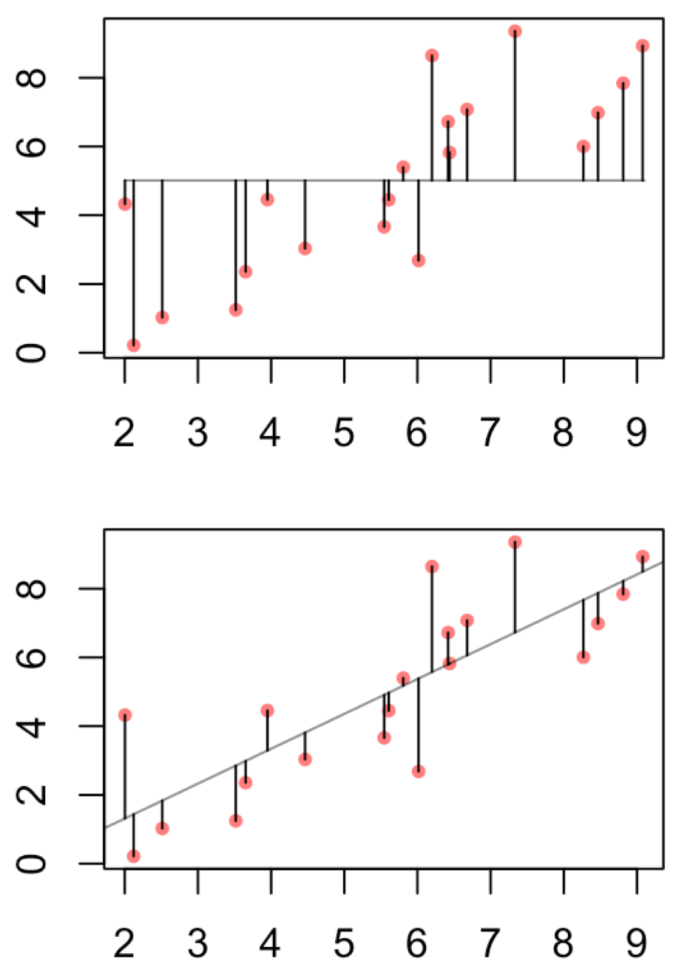
Example of regression
This can help to justify the biological importance
assuming you have a regression that is significant.
It is the proportion of total variance explained by
the regression.

Slide 29
Multiple vs Adjusted R-squared
Adjusted R-squared penalizes for additional parameters

Slide 30
Linear regression uses
Depict the relationship between two variables in an eye-catching fashion
Test the null hypothesis of no association between two variables
The test is whether or not the slope is zero
Predict the average value of variable Y for a group of individuals with a given value of variable X
variation around the line can make it very difficult to predict a value for a given individual with much confidence
Predictions outside of the range of observed data is generally discouraged
Used both for experimental and observational studies

Slide 31
What are Residuals
In general, the residual is the individual’s departure from the value predicted by the model
In this case the model is simple – the linear regression – but residuals also exist for more complex models
For a model that fits better, the residuals will be smaller on average
Residuals can be of interest in their own right, because they represent values that have been corrected for relationships that might be obscuring a pattern.

Slide 32
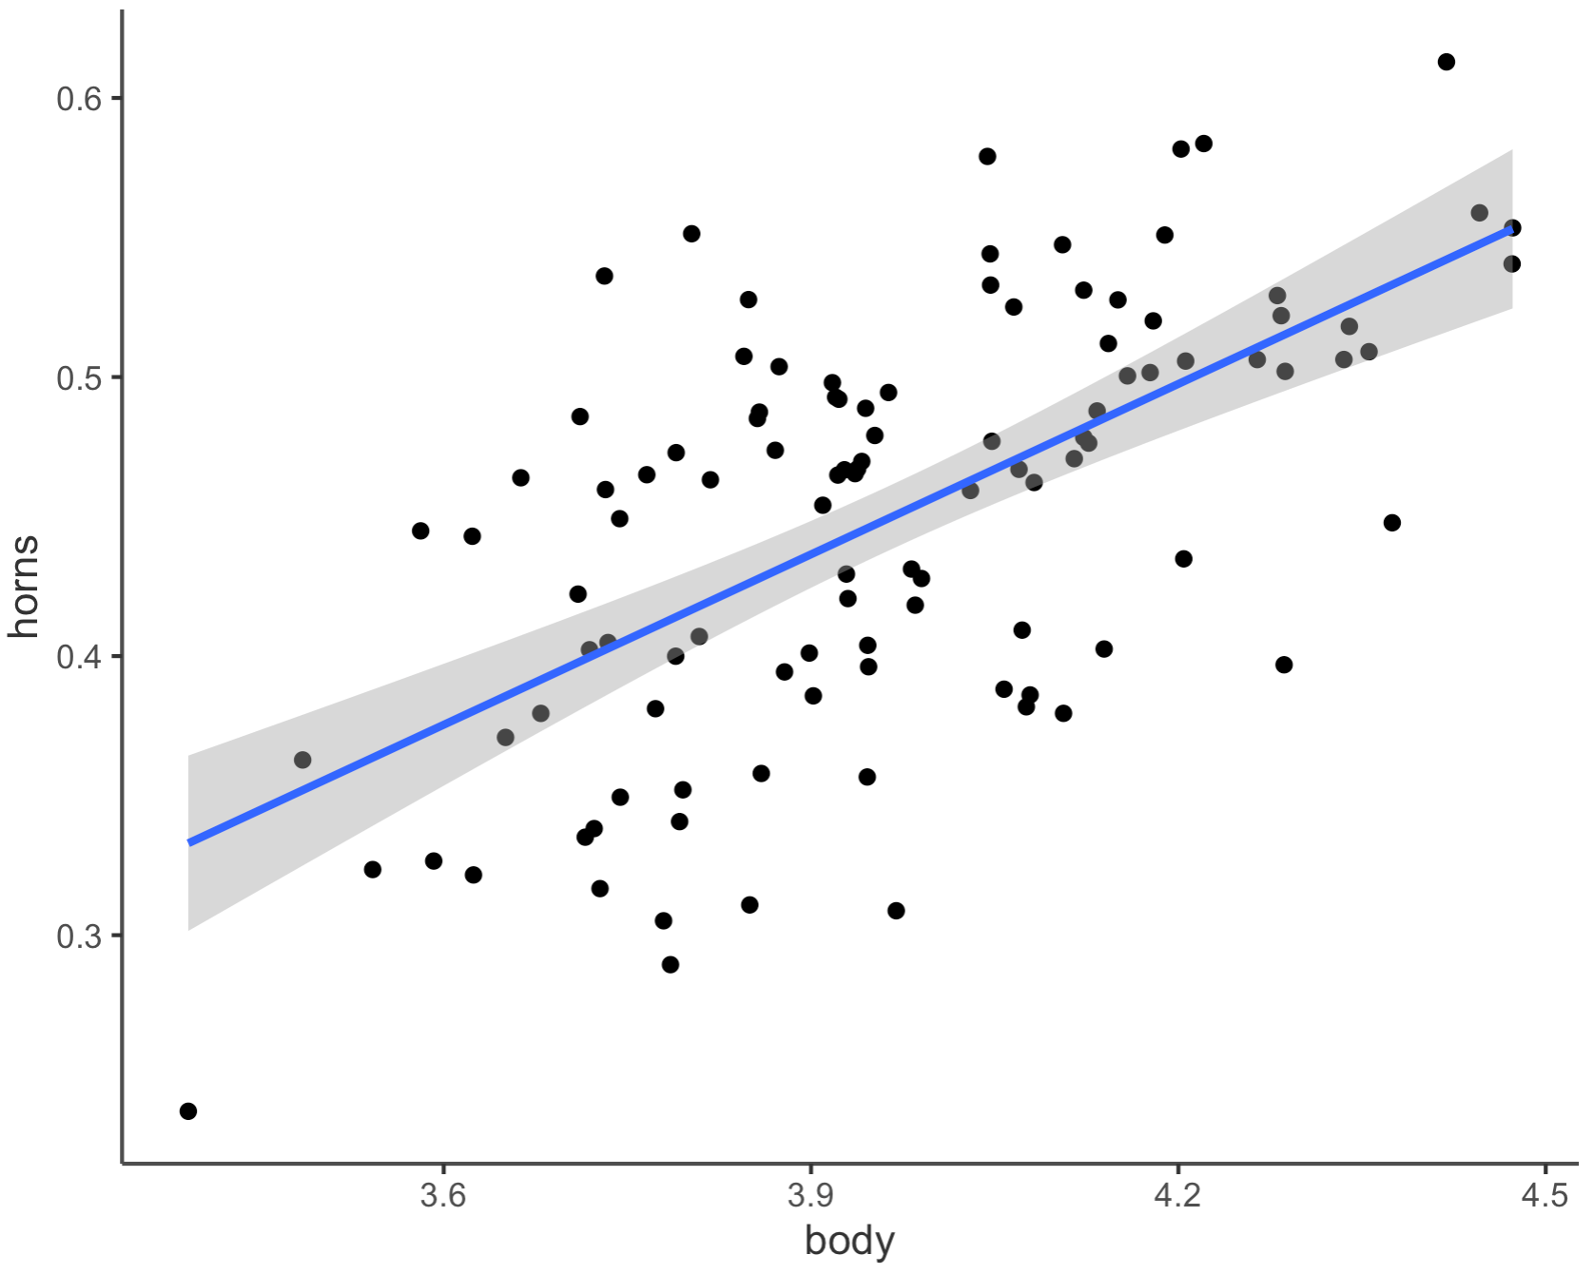

What are Residuals
Horn Size
Body Size

Slide 33
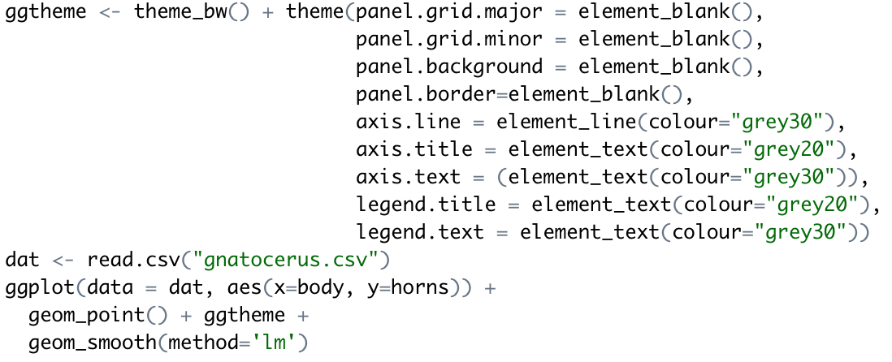
Making that plot

Slide 34
Strong Inference for Observational Studies
Noticing a pattern in the data and reporting it represents a post hoc analysis
This is not hypothesis testing
The results, while potentially important, must be interpreted cautiously
What can be done?
Based on a post-hoc observational study, construct a new hypothesis for a novel group or system that has not yet been studied

Slide 35
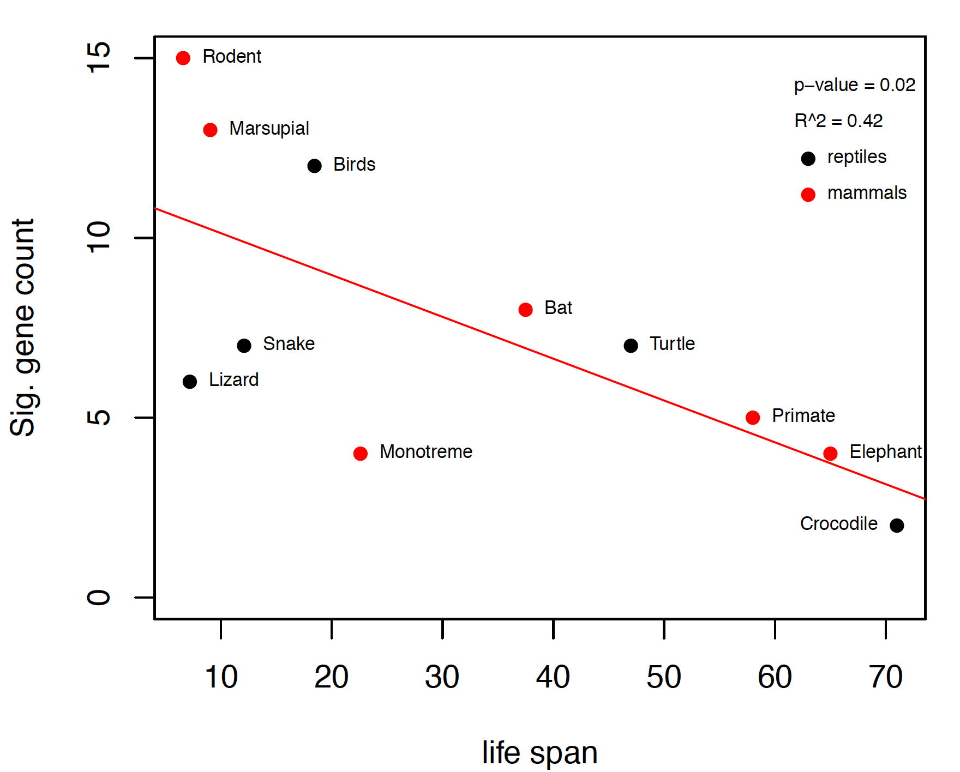
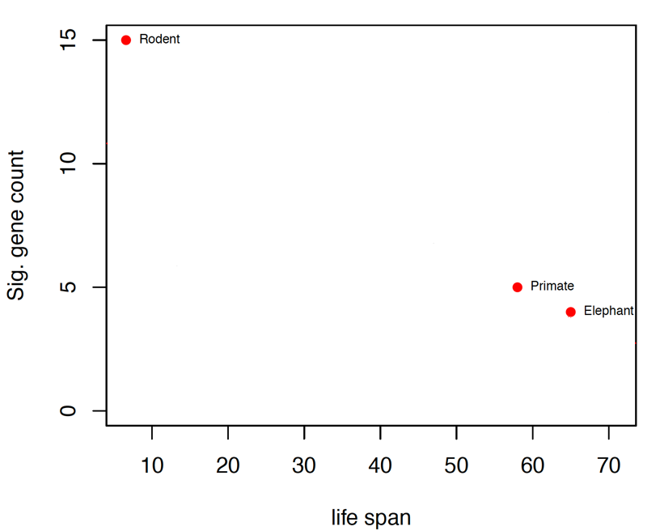
Example
We already knew that the P53 network is important in guarding against cancer in long lived species.
We also knew that primates and elephants show rather little change in this network when compared to rodents.
Collect data on many more species and test apriori hypothesis that there will be a significant and negative regression coefficient.

Slide 36
Assumptions of Linear Regression
The true relationship must be linear
At each value of X, the distribution of Y is normal (i.e., the residuals are normal)
The variance in Y is independent of the value of X
Note that there are no assumptions about the distribution of X

Slide 37
Common Problems
Outliers
Regression is extremely sensitive to outliers
The line will be drawn to outliers, especially along the x-axis
Consider performing the regression with and without outliers
Non-linearity
Best way to notice is by visually inspecting the plot and the line fit
Try a transformation to get linearity [often a log transformation]
Non-normality of residuals
Can be detected from a residual plot
Possibly solved with a transformation
Unequal variance
Usually visible from a scatterplot or from a residual plot

Slide 38
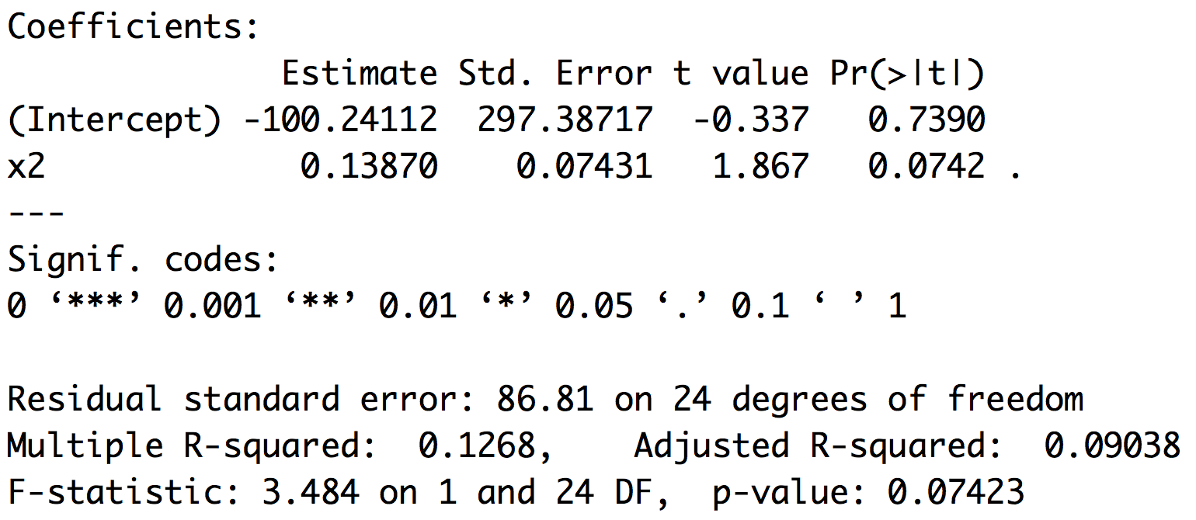
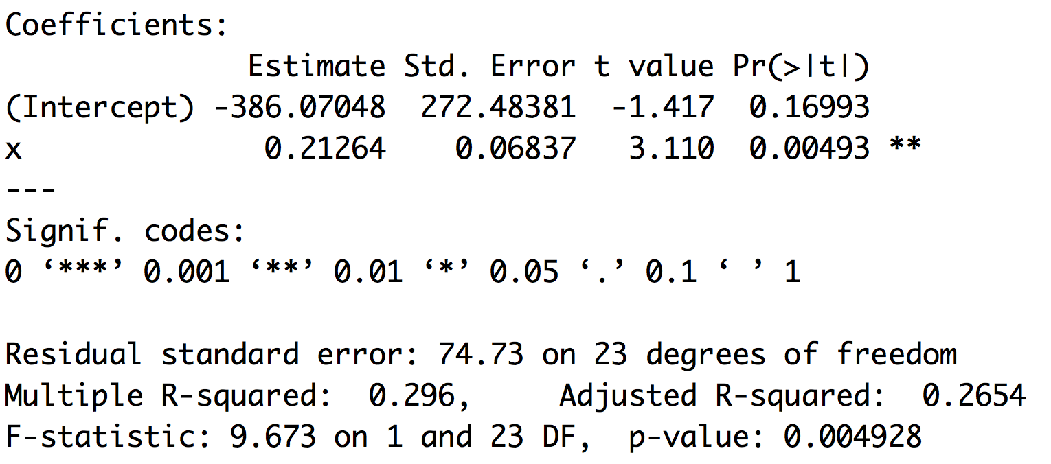
Outliers
Leverage and cooks distance
Theil–Sen estimator

Slide 39
Moving past simple models
The reason ANOVA is so widely used is that it provides a framework to simultaneously test the effects of multiple factors
ANOVA also makes it possible to detect interactions among the factors
ANOVA is a special case of a general linear model
Linear regression is a special case of a general linear model

Slide 40
GLM and LM function in R
The GLM and LM function in R takes equations that can be described with the following operators
+ +X include this variable
: X:Z include the interaction between these variables
∗ X∗Y include these variables and the interactions between them
^ (X + Z + W)^3 include these variables and all interactions up to three way

Slide 41
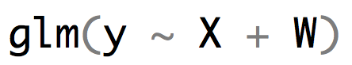


R versus the math implied
$y_{i}=β_{0}+β_{1}X_{i}+β_{2}W_{i}+ε_{i}$
$y_{i}=β_{0}+β_{1}X_{i}+β_{2}W_{i}+β_{3}{X_{i}W}_{i}+ε_{i}$

Slide 42
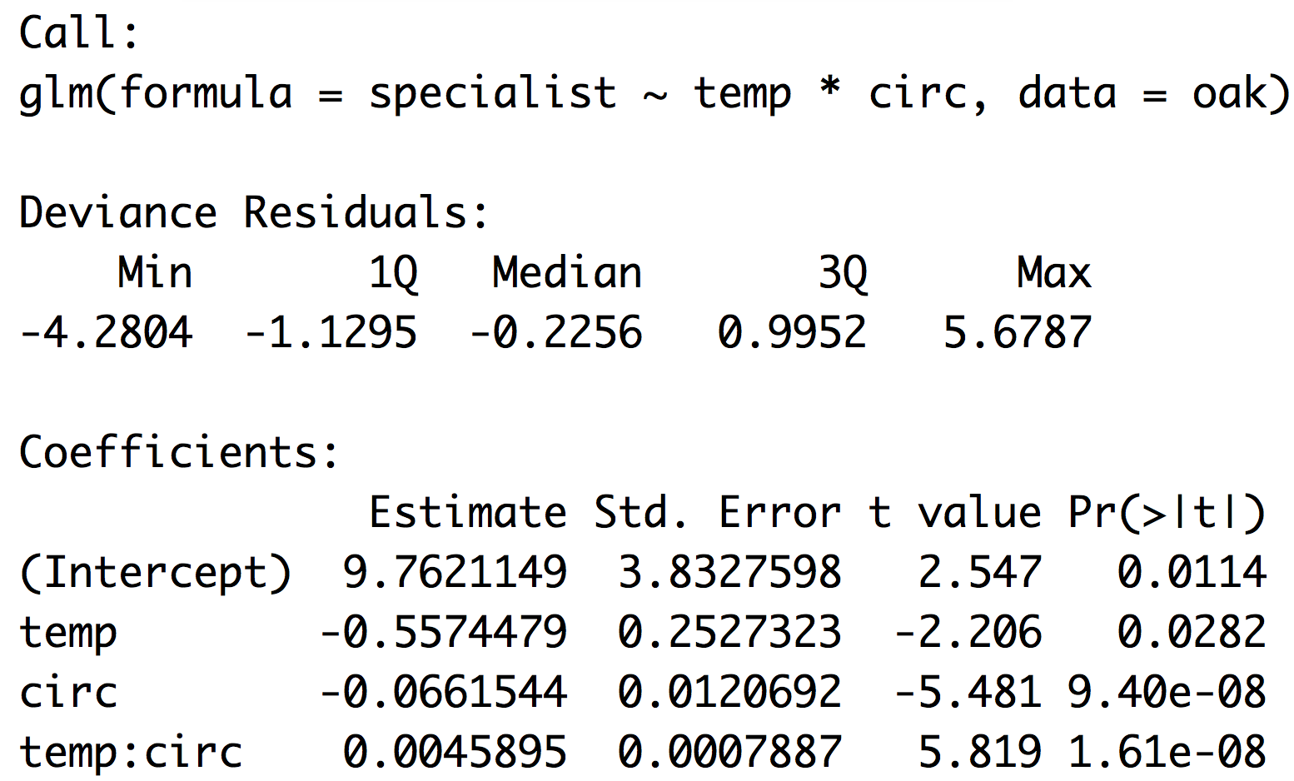
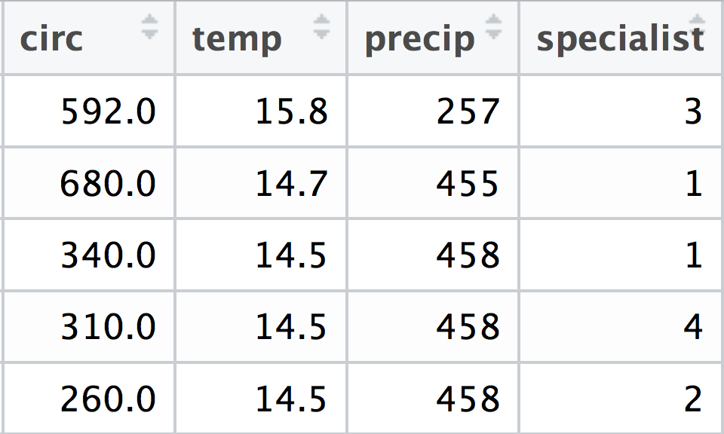
R versus the math oak example
$$y_{i}=β_{0}+β_{1}{temp}_{i}+β_{2}{circ}_{i}+β_{3}{{temp}_{i}circ}_{i}$$

Slide 43
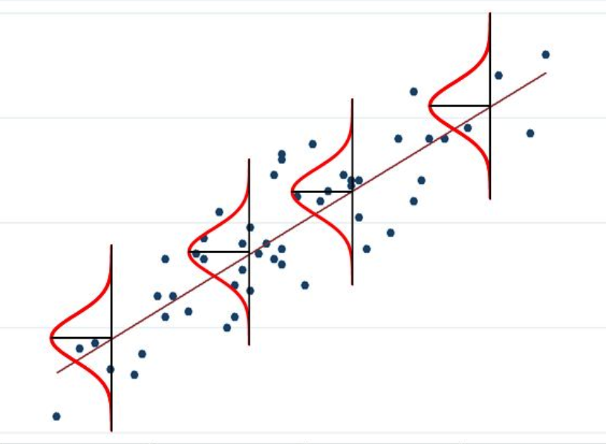
When the response variable isn’t normal

Slide 44
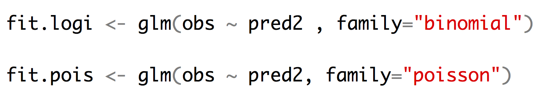
Other kinds of regression
Logistic regression allows us to fit a binary response variable (absent/present; alive/dead) with one or more categorical or continuous predictor variables.
Poisson regression allows us to fit a response variable that is Poisson distributed (number of extinctions in a unit of time, number of colonies per plate, (number of occurrences for rare events)) with one or more categorical or continuous predictor variables.

Slide 45
Likelihood and AIC model selection
Think of likelihood as how probable the observed data are under the current model. When we fit a glm we are getting the likelihood of the data assuming the best values for the parameters (beta coefficients). For any empirical dataset these will be very small numbers. It is easy for computers to store the log of very small numbers which means that log likelihoods will be negative numbers.
likelihood = .01
likelihood = .0001
ln(L) = -4.6
ln(L) = -9.2
better fit
worse fit
Adding additional predictor variables will always improve the fit of the data under the model.
R example
So we must penalize for extra parameters
R example
fit1 <- glm(y ~ a)
fit2 <- glm(y ~ a + b)
logLik(fit1)
anova(fit1, fit2, test=“LRT”)

Slide 46
Likelihood and AIC model selection
$$AIC=2k −2ln⁡(L)$$
k number of parameters
ln(L) log likelihood of the data (a big negative number)
Models with lower numbers are better (the values have no inherent meaning it is all relative)
Differences in AIC can be used to evaluate evidence for one model vs. another.
A model with a ΔAIC value within 1-2 of the best model has substantial support, and should be considered along with the best model.
A ΔAIC value within only 4-7 units of the best model has considerably less support.
A ΔAIC value > 10 indicates that the worse model has virtually no support and should not be consideration.
Burnham and Anderson 1998

Slide 47
Likelihood and AIC model selection
LRT: Does adding this predictor variable reduce the deviation from predictions more than I would expect if the predictor had no impact on the response variable (alpha = .05)
AIC: Is about comparing models and finding the model(s) that seem to match with the data we are observing.
If you are going to use AIC to choose “best” model pay attention to close seconds and whether they “tell a different story”

