Slide 1
Continuous Variables pt 2 Biology 683 Heath Blackmon Midterm next week!

Slide 2
Reading and writing data
dat <- read.csv(“filename.csv”)
write.csv(dat, file = “filename.csv”)

Slide 3
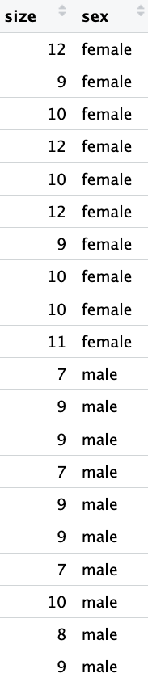
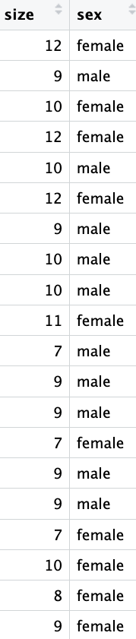
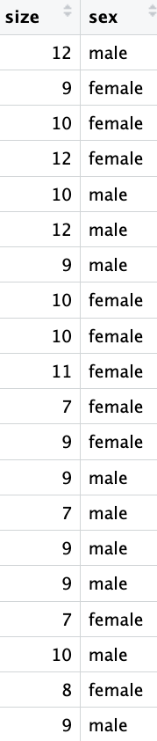
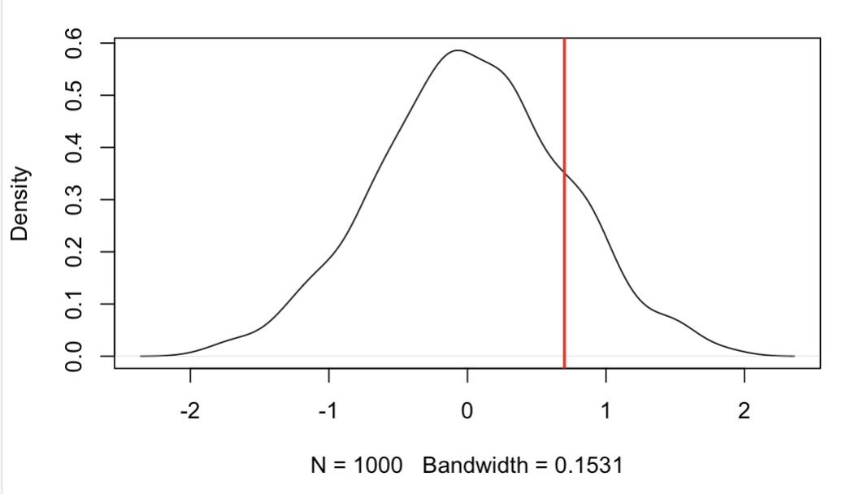
Permutation test
Pick a stat and measure it for your empirical data: mean difference = 2.1
……
Example in R
0.7
-0.3

Slide 4
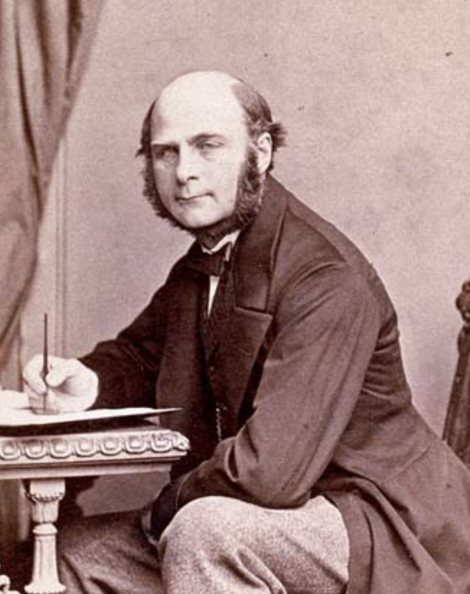
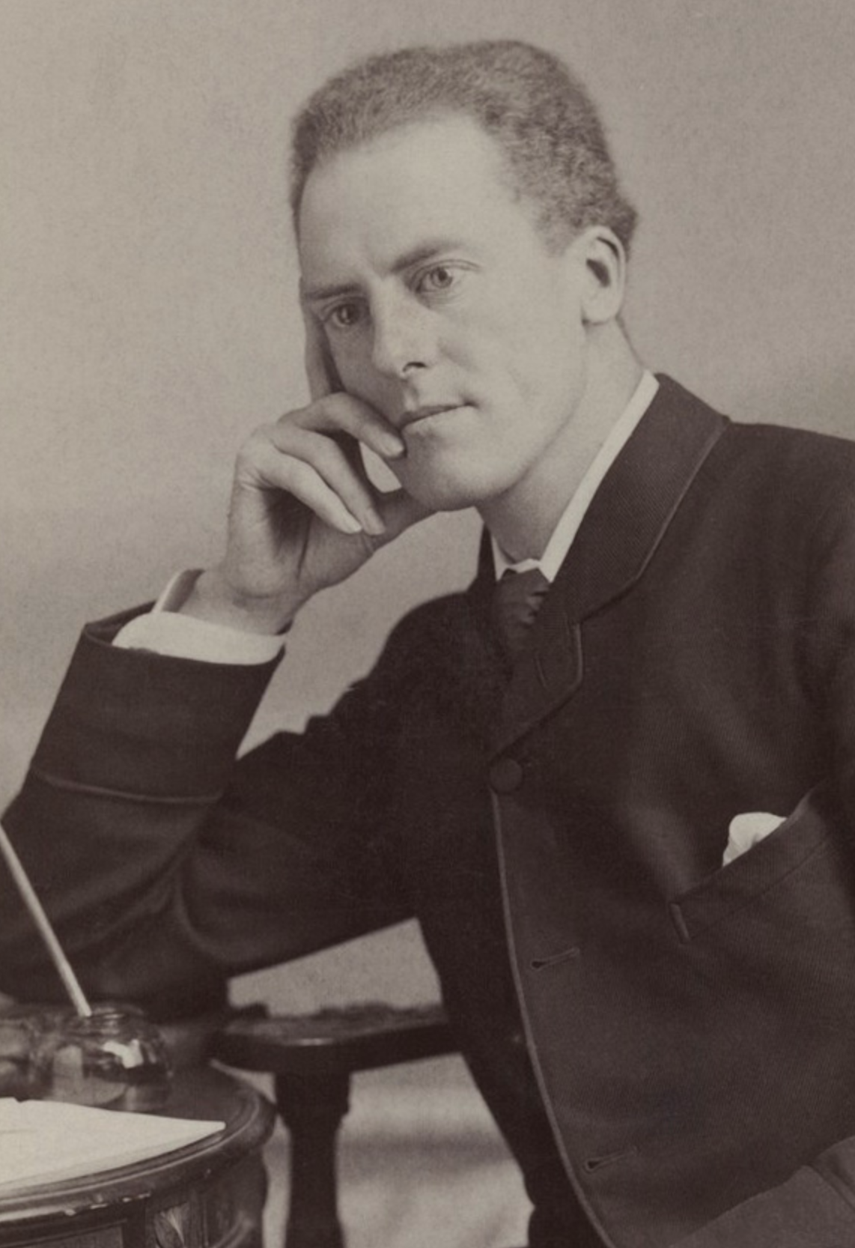
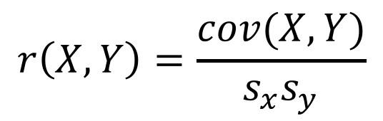
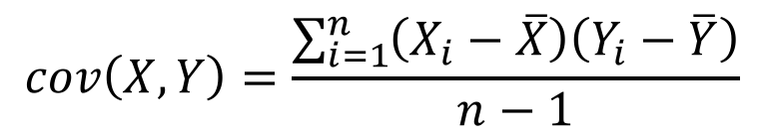
Correlation and Causation
The correlation is a foundational concept in the biological sciences
Pearson’s correlation coefficient:
$$r\left(X,Y\right)=\frac{cov(X,Y)}{s_{x}s_{y}}$$
Francis Galton
1822 - 1911
Karl Pearson
1857 - 1936
$$cov\left(X,Y\right)=\frac{\sum_{i=1}^{n}{\left(X_{i}−\overline{X}\right)\left(Y_{i}−\overline{Y}\right)}}{n−1}$$
Notes:
Galton invented term eugenics cousins with darwin mention regression to the mean
Pearson invented modern concept of and widely applied to r. Also eugenicist and racist

Slide 5
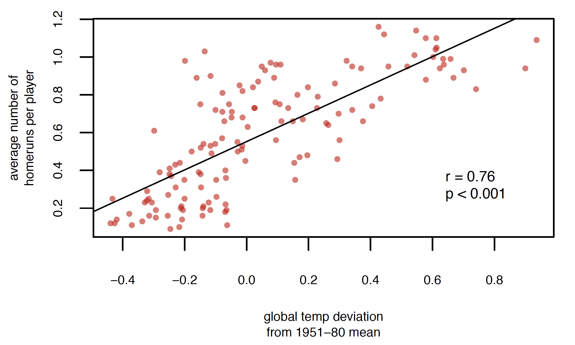
Interpret with caution

Slide 6
Obviously these covary with time
Average number of
home runs per game

Slide 7
Pearson’s Correlation Coefficient
Assumes that the data are roughly from a bivariate normal distribution
Would not be appropriate when:
Relationship is non-linear (possible solutions?)
Dataset contains extreme outliers (evaluate leverage)
Data are in multiple distinct clouds of points (what could cause this?)

Slide 8
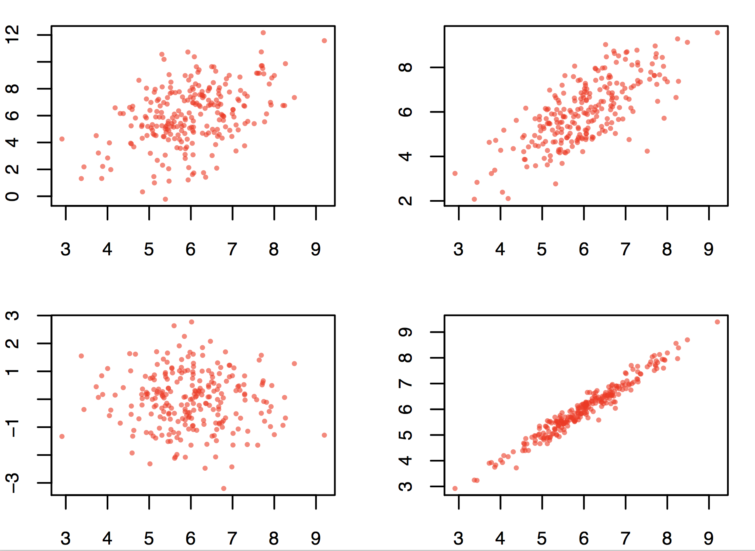
Good data

Slide 9
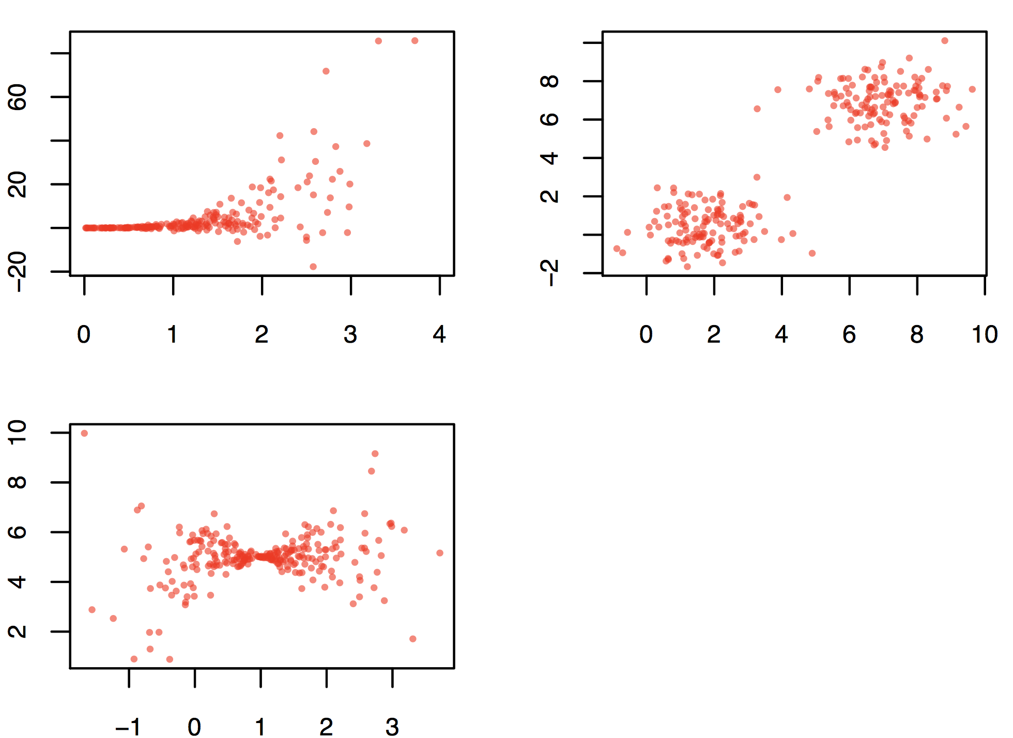
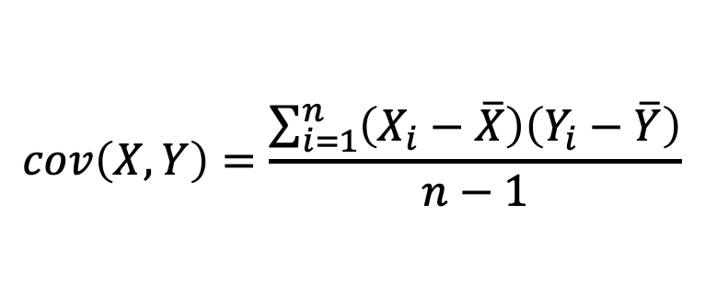
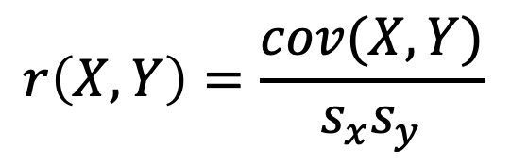
Bad data
$$r\left(X,Y\right)=\frac{cov(X,Y)}{s_{x}s_{y}}$$
$$cov\left(X,Y\right)=\frac{\sum_{i=1}^{n}{\left(X_{i}−\overline{X}\right)\left(Y_{i}−\overline{Y}\right)}}{n−1}$$
Correlation simulator

Slide 10
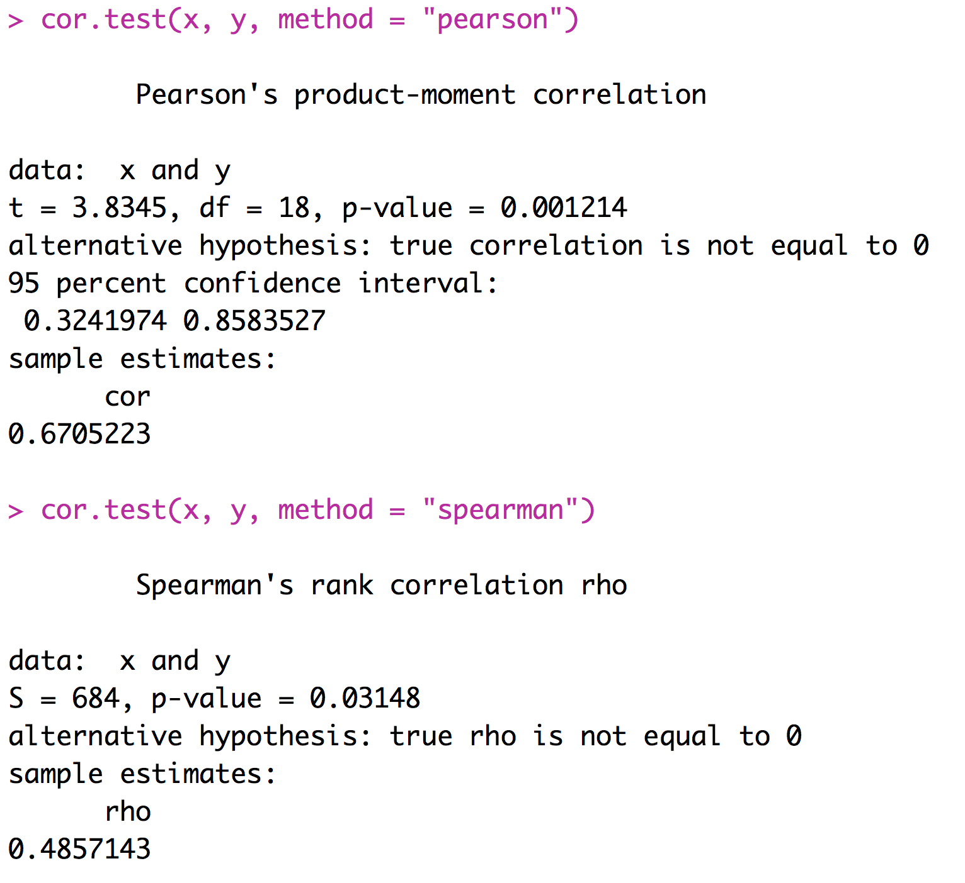
Spearman’s Rank Correlation
An alternative to Pearson’s correlation coefficient for data that depart substantially from bivariate normality
Based on ranks

Slide 11
Correlation Summary
Correlations are very important
We are interested in correlations between values of treatments and response variables
We are interested in correlations between various factors that could affect the response variable
We need to think about correlations between explanatory variables and potentially confounding variables
Many types of experiments call for the calculation and consideration of correlation coefficients

