Slide 1
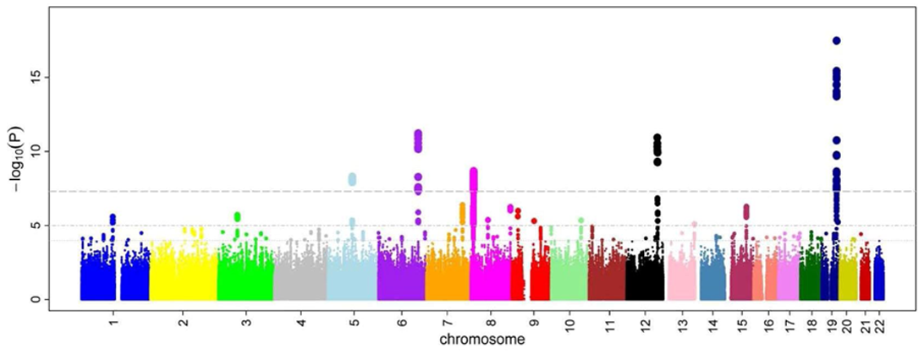
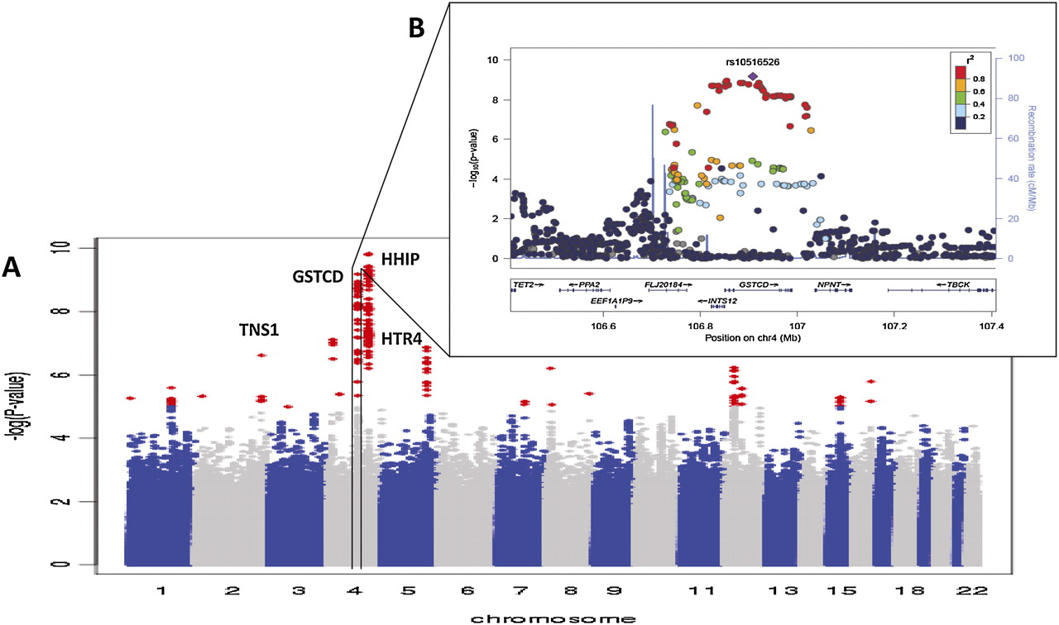
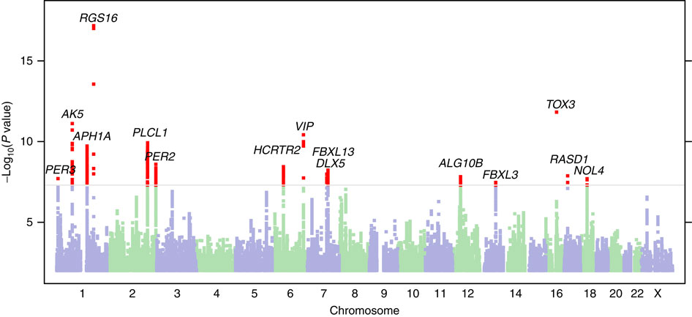
GWAS

Slide 2
GWAS
GWAS: Genome wide association study.
The goal of GWAS is to determine what genes have alleles that are responsible for a trait of interest. The trait can be any measurable trait in any organism that you wish to study. For instance, a disease in humans, an economically important trait of a crop or domestic animal, an adaptation like a certain color pattern in birds, etc.

Slide 3
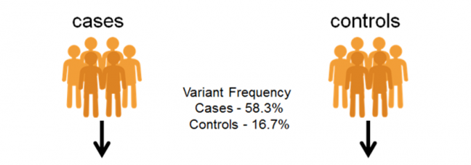
GWAS – Discrete condition (often disease)
>case 1
CATACTACTACTGAACGTTTGCTCCTGCtactatctctctctctctctctttctctctctctctctCATGC >case 2
AGTTGACTACTGCATACTCGTGCTAGCTGACTGTCGTACGTACGTAGCTAGTGATCGATCGATGCTAGCTA>case 3
CATACTACTACTGAACGTTTGCTCCTGCtactatctctctctctctctctttctctctctctctctCATGC >control 1
AGTTGACTACTGCATACTCGTGCTAGCTGACTGTCGTACGTACGTAGCTAGTGATCGATCGATGCTAGCTA>control 2
CATACTACTACTGAACGTTTGCTCCTGCtactatctctctctctctctctttctctctctctctctCATGC >control 3
AGTTGACTACTGCATACTCGTGCTAGCTGACTGTCGTACGTACGTAGCTAGTGATCGATCGATGCTAGCTA

Slide 4




GWAS – Continuous trait
>sample 1
CATACTACTACTGAACGTTTGCTCCTGCtactatctctctctctctctctttctctctctctctctCATGC >sample 2
AGTTGACTACTGCATACTCGTGCTAGCTGACTGTCGTACGTACGTAGCTAGTGATCGATCGATGCTAGCTA>sample 3
CATACTACTACTGAACGTTTGCTCCTGCtactatctctctctctctctctttctctctctctctctCATGC >sample 4
AGTTGACTACTGCATACTCGTGCTAGCTGACTGTCGTACGTACGTAGCTAGTGATCGATCGATGCTAGCTA>sample 5
CATACTACTACTGAACGTTTGCTCCTGCtactatctctctctctctctctttctctctctctctctCATGC >sample 6
AGTTGACTACTGCATACTCGTGCTAGCTGACTGTCGTACGTACGTAGCTAGTGATCGATCGATGCTAGCTA

Slide 5
GWAS – Continuous trait
AGTTGACTACTGCATACTCGT
AGTTGACTACTGCATACTCGT
AGTTGACTACTGCATACTCGT
AGTTGACTACTGCATACTCGT
TGTTGACTACTGCATACTCGT
AGTTGACTACTGCATACTCGT
TGTTGACTACTGCATACTCGT
TGTTGACTACTGCATACTCGT
AGTTGACTACTGCATACTCGT
TGTTGACTACTGCATACTCGT
TGTTGACTACTGCATACTCGT
TGTTGACTACTGCATACTCGT
coat color
Not significant
AA AT TT

Slide 6
GWAS – Continuous trait
AGTTGACTACTGCATACTCGT
AGTTGACTACTGCATACTCGT
AGTTGACTACTGCATACTCGT
AGTAGACTACTGCATACTCGT
TGTAGACTACTGCATACTCGT
AGTAGACTACTGCATACTCGT
TGTAGACTACTGCATACTCGT
TGTTGACTACTGCATACTCGT
AGTAGACTACTGCATACTCGT
TGTAGACTACTGCATACTCGT
TGTTGACTACTGCATACTCGT
TGTTGACTACTGCATACTCGT
coat color
Highly significant!
AA AT TT

Slide 7
GWAS - Problems
What is the problem with doing this across the whole genome?
Multiple tests lead to more false positives!
require a higher level of significance 5x10⁻⁸
only look at the very most significant
lots of more complicated approaches too!
What is one of the most basic requirements of almost all statistical tests?
Tests normally assume independence of the data points!
Samples from a population will be related to each other due to ancestry (trees!)
DNA sequencing is not done equally in all groups of people (western samples are usually over represented

Slide 8
GWAS - Problems
What is epistasis?
It is the case where the impact of a genotype at one locus depend on the genotype at another locus!
To find this type of effect you would need to look at all pairs of genotypes. How many tests would we need to do then?
About 6 orders of magnitude more tests would be required.
Humans have around 4,000,000 sites that are variable like this which equates to 7,999,998,000,000
GG
GT
TT
AA AT TT

Slide 9
GWAS - Problems
What about the environment?
Many diseases have a strong environmental component (heart disease, diabetes, cancer, etc.)
If these are left out of the study often what is discovered is actually genetic variation that happens to coincide with environmental factors?
If a disease is more common in Europeans than Africans or Asians but it is because of a lifestyle characteristic any genetic variation that is common in Europeans but rare in Africans and Asians could appear associated with the disease.

