Slide 1
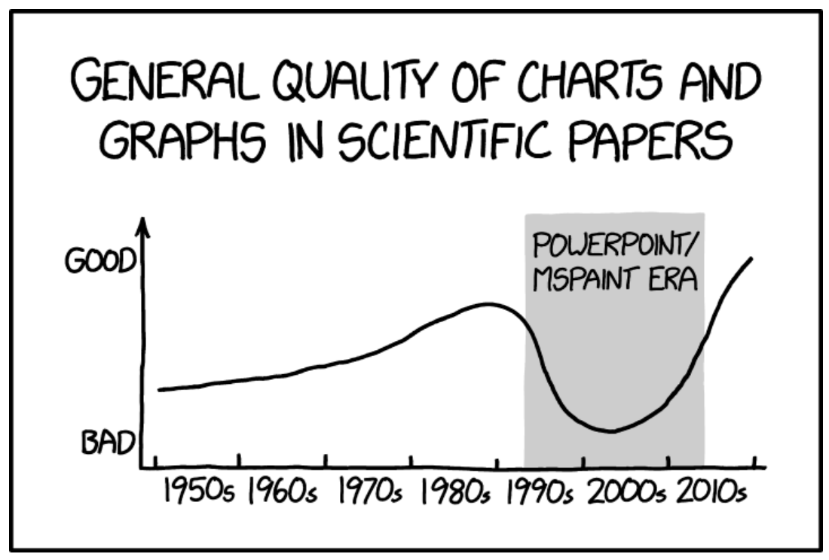
Visualizing Data Biology 683 Week 2 Heath Blackmon
What is the difference in a matrix and a dataframe?
What is a p-value
What are the types of data used in R

Slide 2
Plan for today
Importance of figures
General rules for making plots
Programs for plotting
Resources for plotting

Slide 3
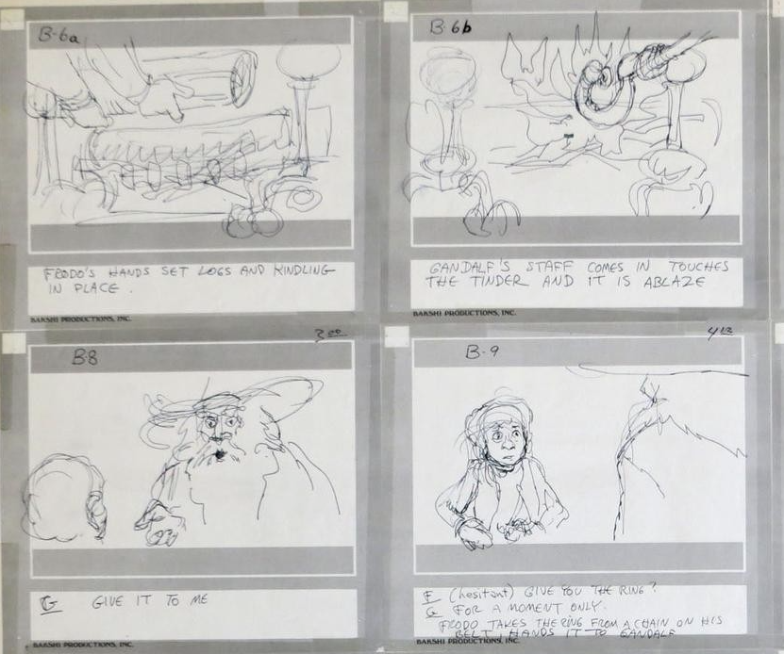
Importance of figures

Slide 4
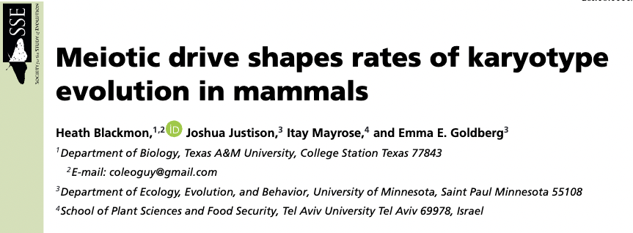
Serve a purpose

Slide 5
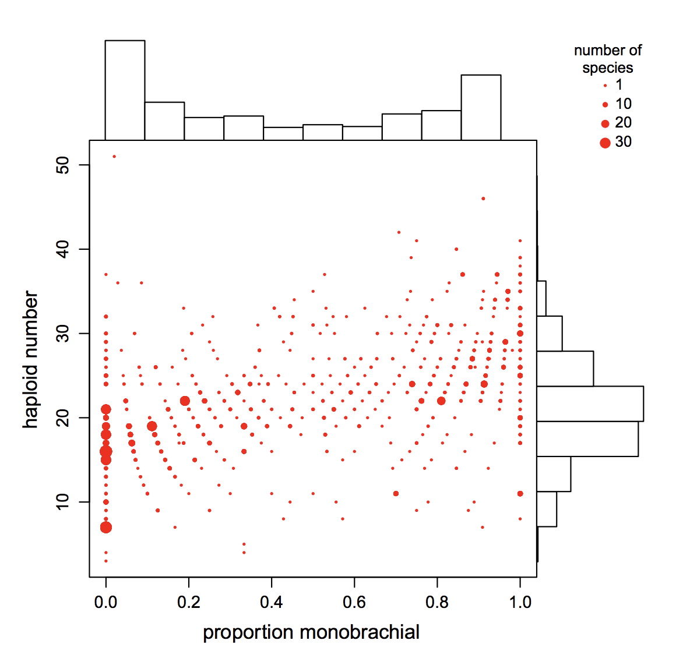
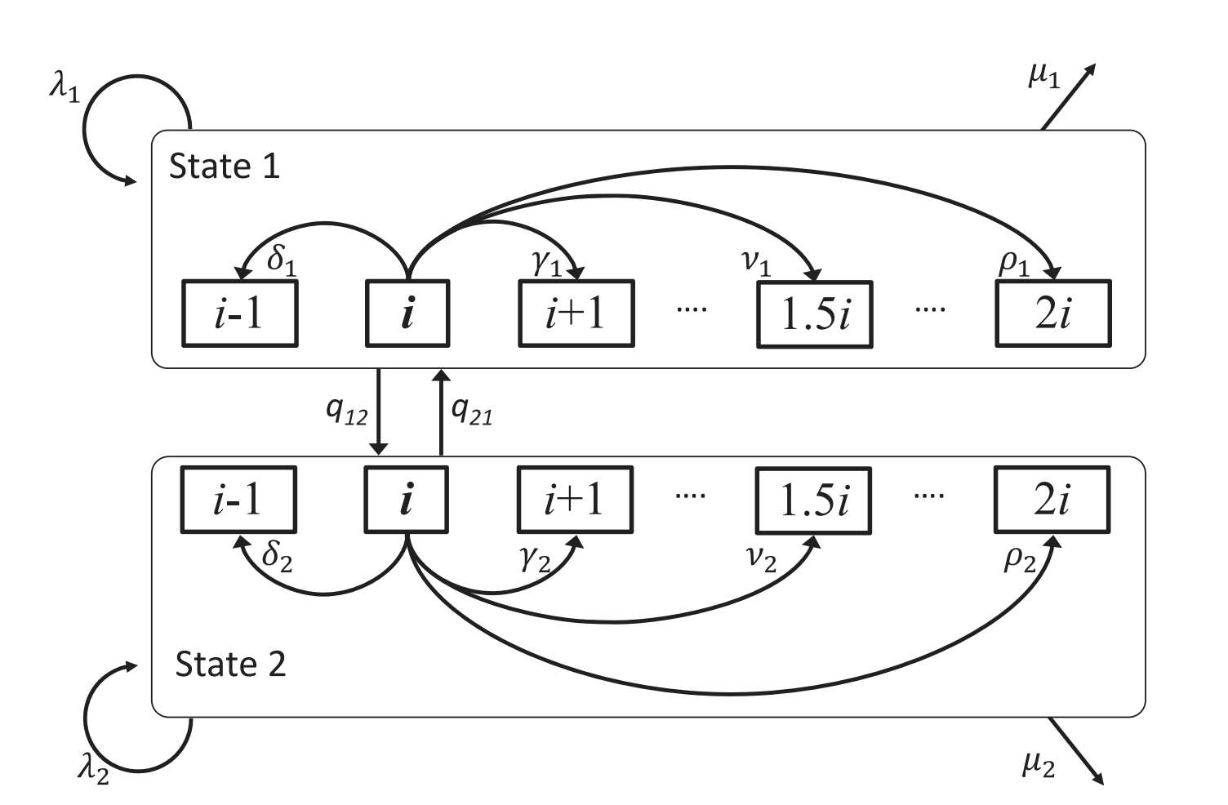
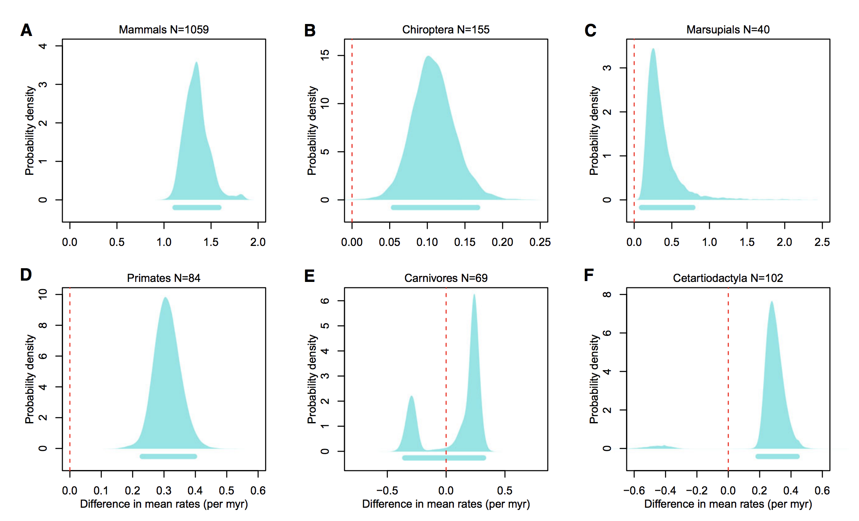
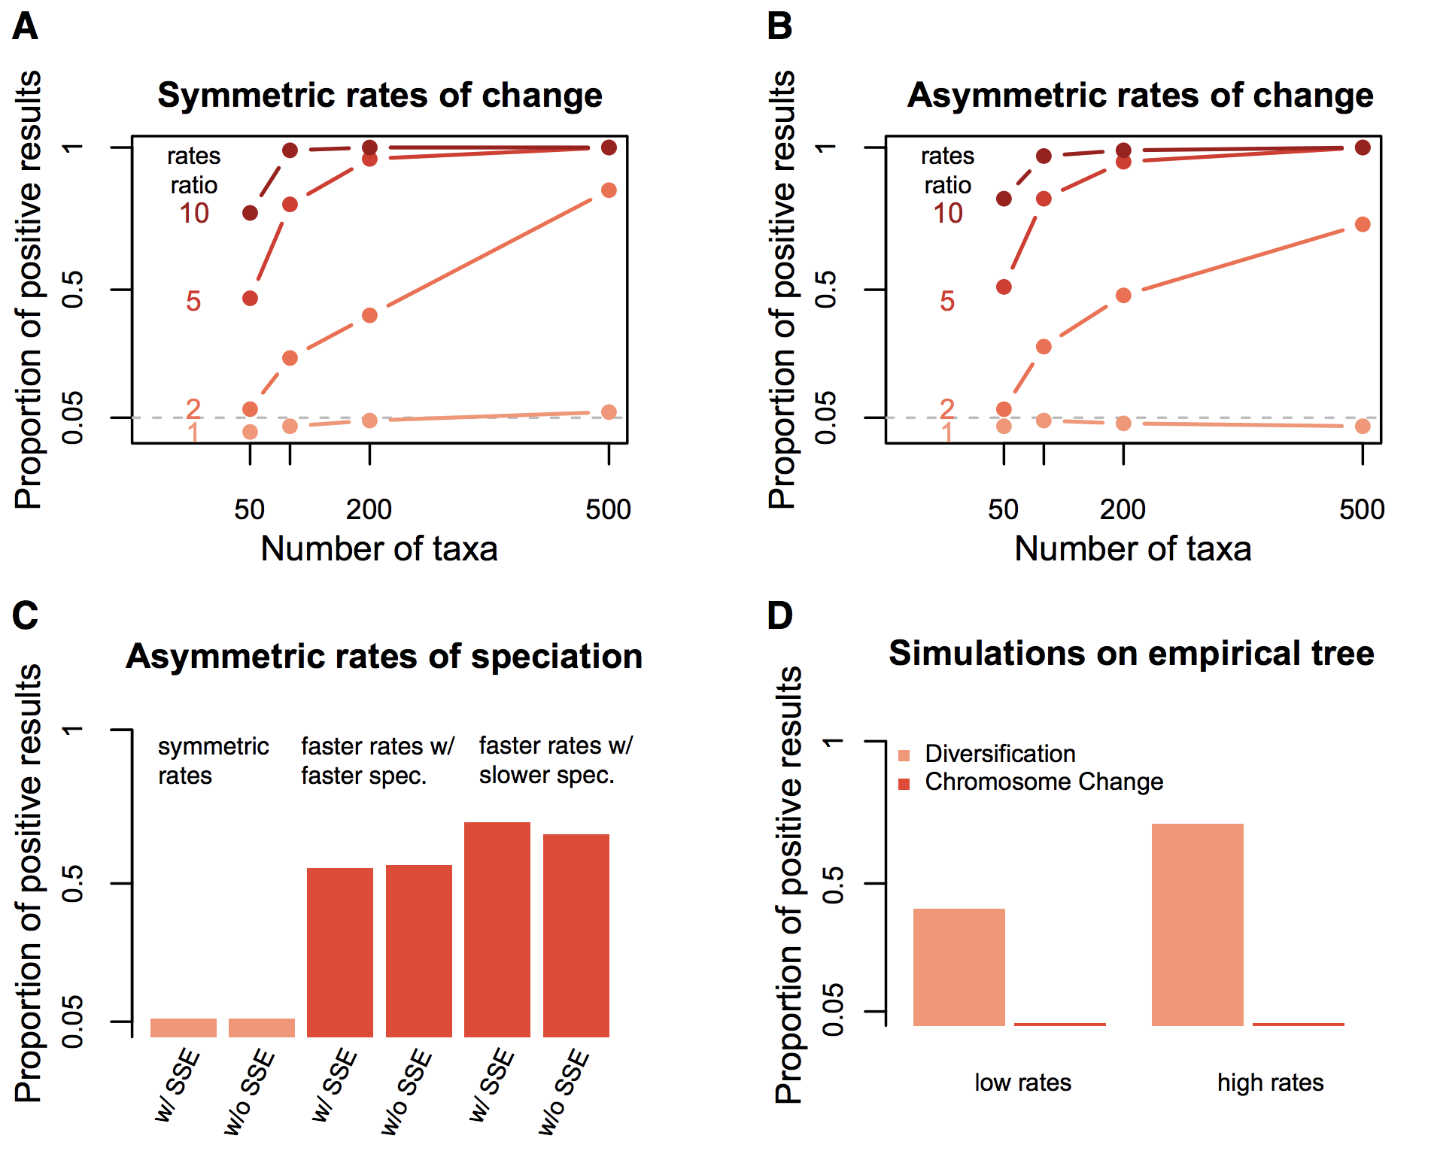
Serve a purpose
New tool and it works
The Problem/Question
The Answer
Mammals have a weird distribution of numbers and types of chromosomes
I made this new model and it can test this hypothesis and it works pretty good
For most groups of mammals I show strong support for the existing hypothesis we should assume it is right but maybe not in 1-2 groups.

Slide 6
Rules for plots
Show the data

Slide 7
Show the data

Slide 8
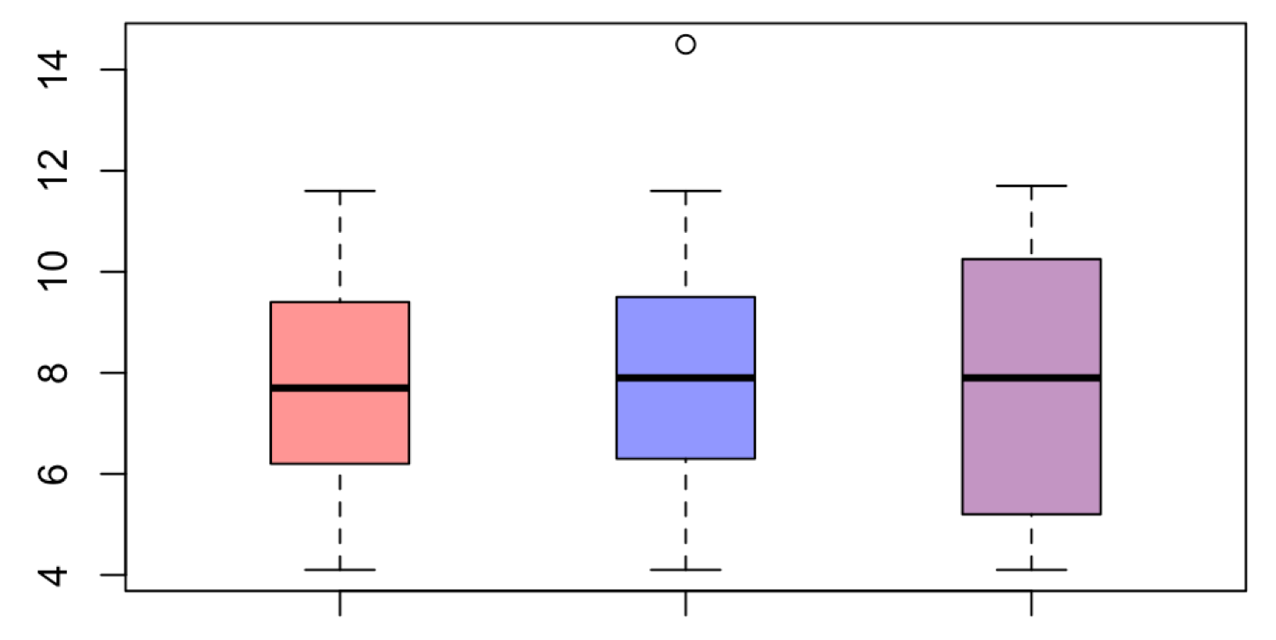
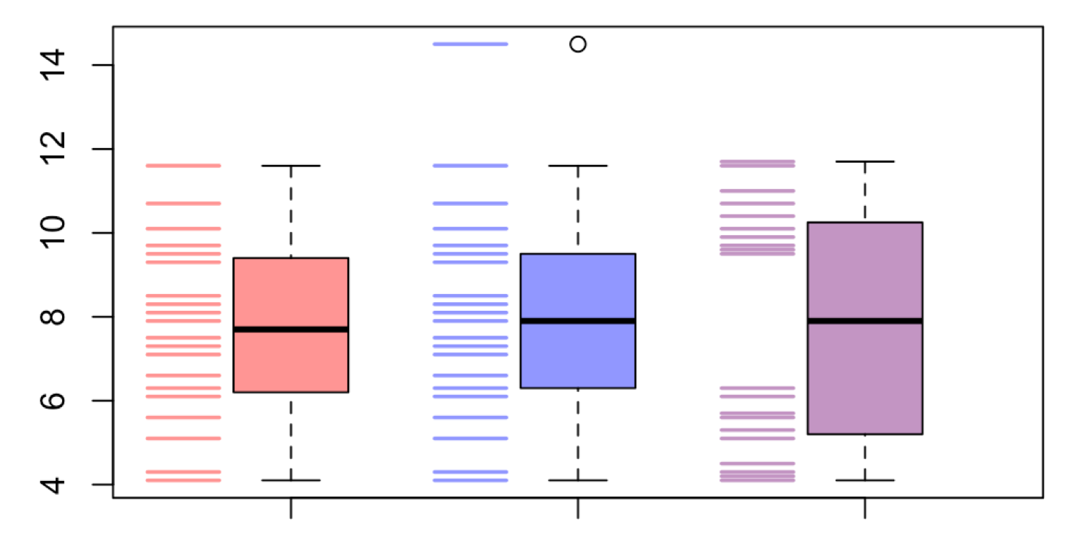
Showing the data can reveal patterns

Slide 9
Rules for plots
Show the data
Avoid distorting data

Slide 10
Avoid distorting data

Slide 11
Rules for plots
Show the data
Avoid distorting data
Avoid chart junk

Slide 12
Avoid chart junk

Slide 13
Rules for plots
Show the data
Avoid distorting data
Avoid chart junk
Maximize data:ink ratio maximize information

Slide 14
Maximize data:ink ratio maximize information

Slide 15
Rules for plots
Show the data
Avoid distorting data
Avoid chart junk
Maximize data:ink ratio maximize information
Make it accessible to all (5% color blind + BW prints).

Slide 16
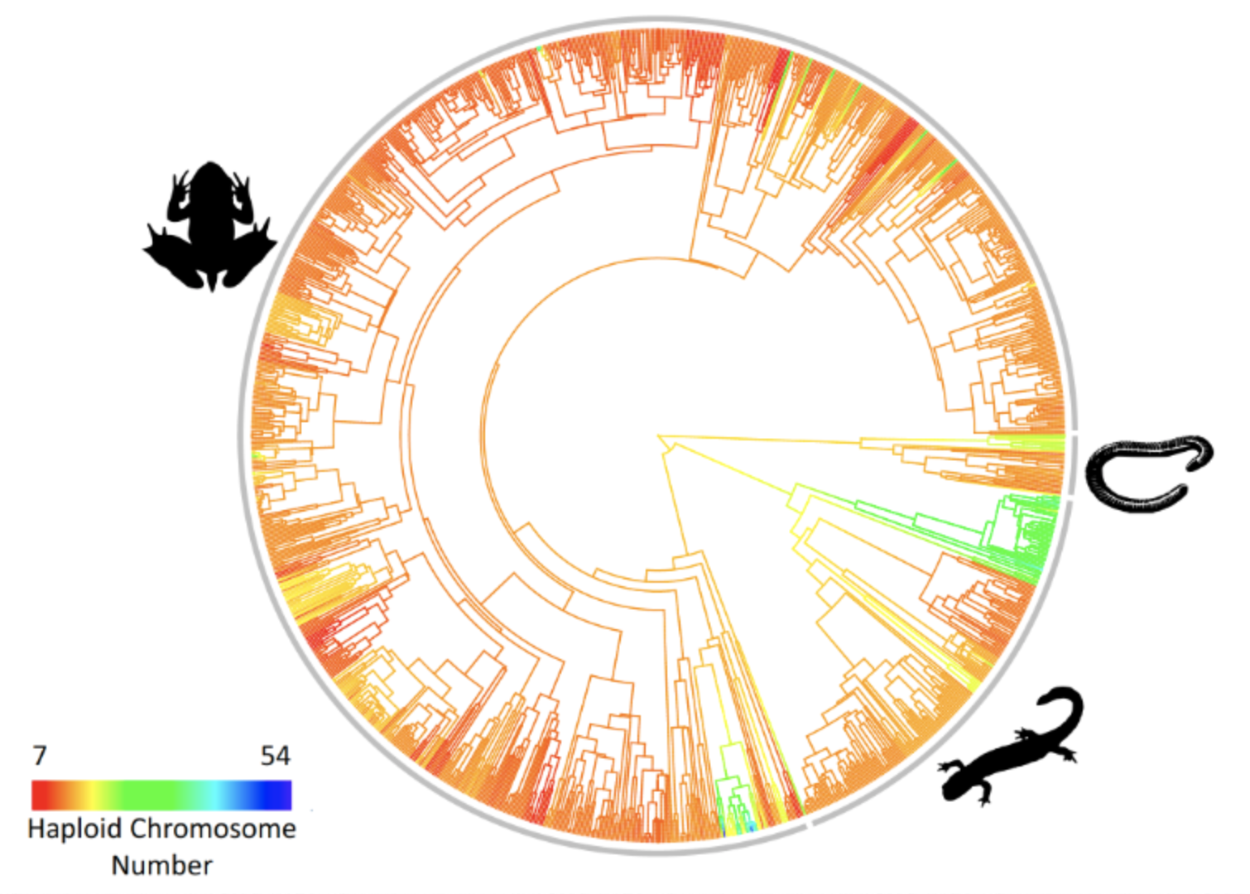
Make it accessible to all

Slide 17
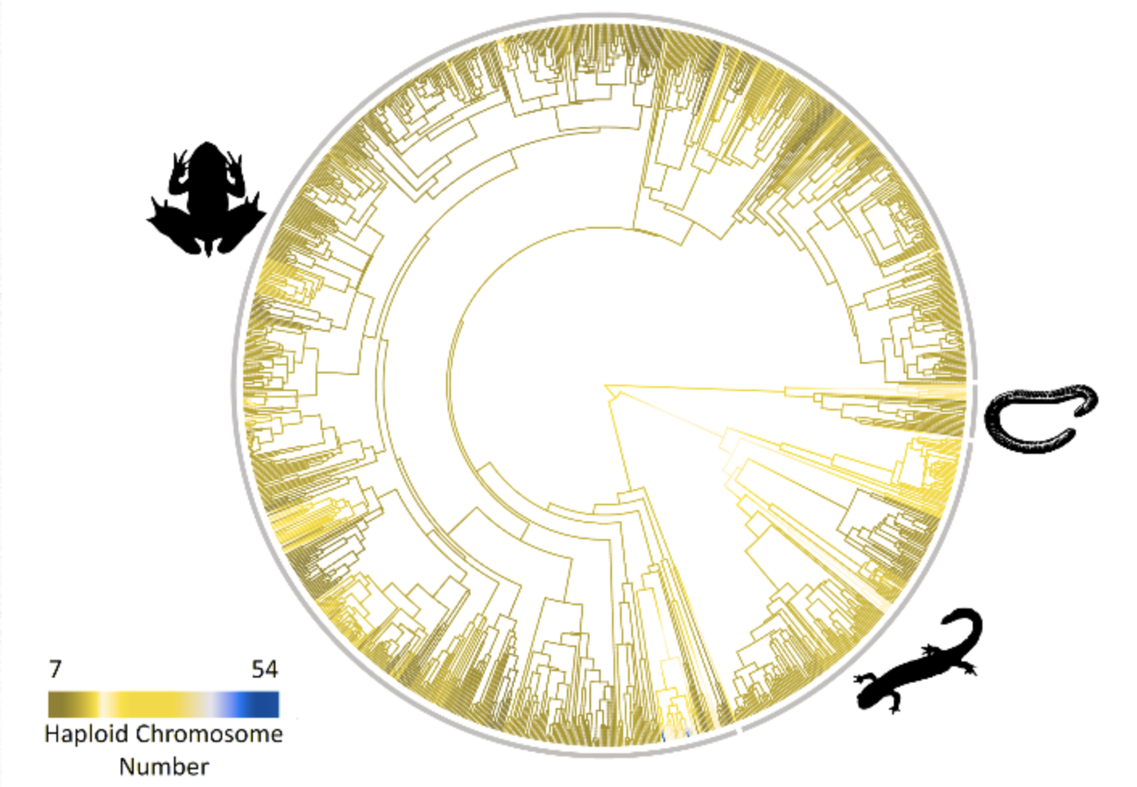
Make it accessible to all
Use the viridis color palette
Color blind simulator

Slide 18
Rules for plots
Show the data
Avoid distorting data
Avoid chart junk
Maximize data:ink ratio maximize information
Make it accessible to all (5% color blind + BW prints).
Axes and legends that are informative and useful

Slide 19
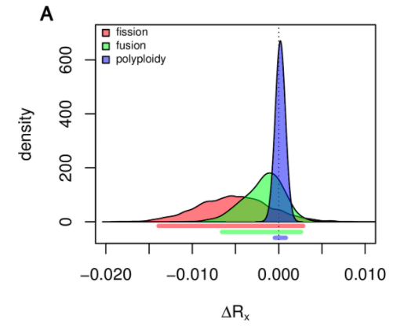
Axes and legends

Slide 20
Rules for plots
Show the data
Avoid distorting data
Avoid chart junk
Maximize data:ink ratio maximize information
Make it accessible to all (5% color blind + BW prints).
Axes and legends that are informative and useful
Use vector art when possible

Slide 21
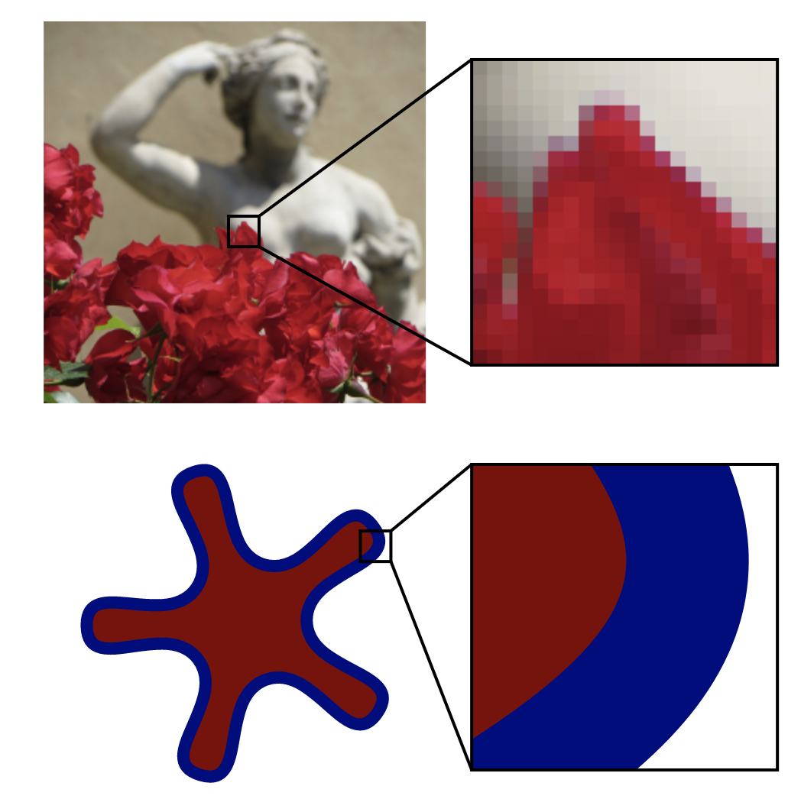
Types of images
Raster images
Vector images
Example of journal requirements
Photos (edit in Adobe photoshop; gimp)
Plots (R; edit in inkscape; Adobe illustrator)
Complex plots (PPT; Adobe illustrator)
jpg, tiff, png, bmp, raw
eps, pdf, svg

Slide 22
Rules for plots
Show the data
Avoid distorting data
Avoid chart junk
Maximize data:ink ratio maximize information
Make it accessible to all (5% color blind + BW prints).
Axes and legends that are informative and useful
Use vector art when possible
Humans aren’t good at pie charts don’t use them

Slide 23
Plots with problems!

Slide 24
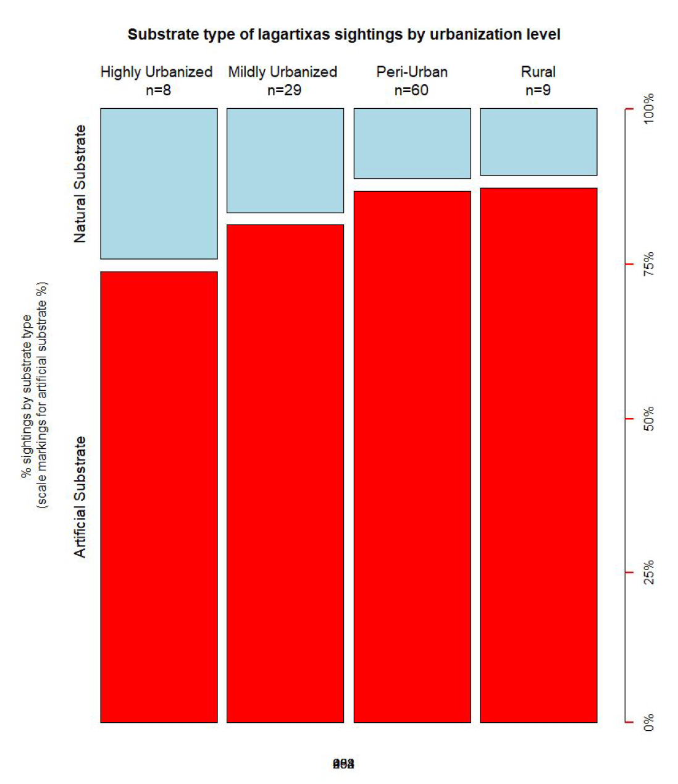
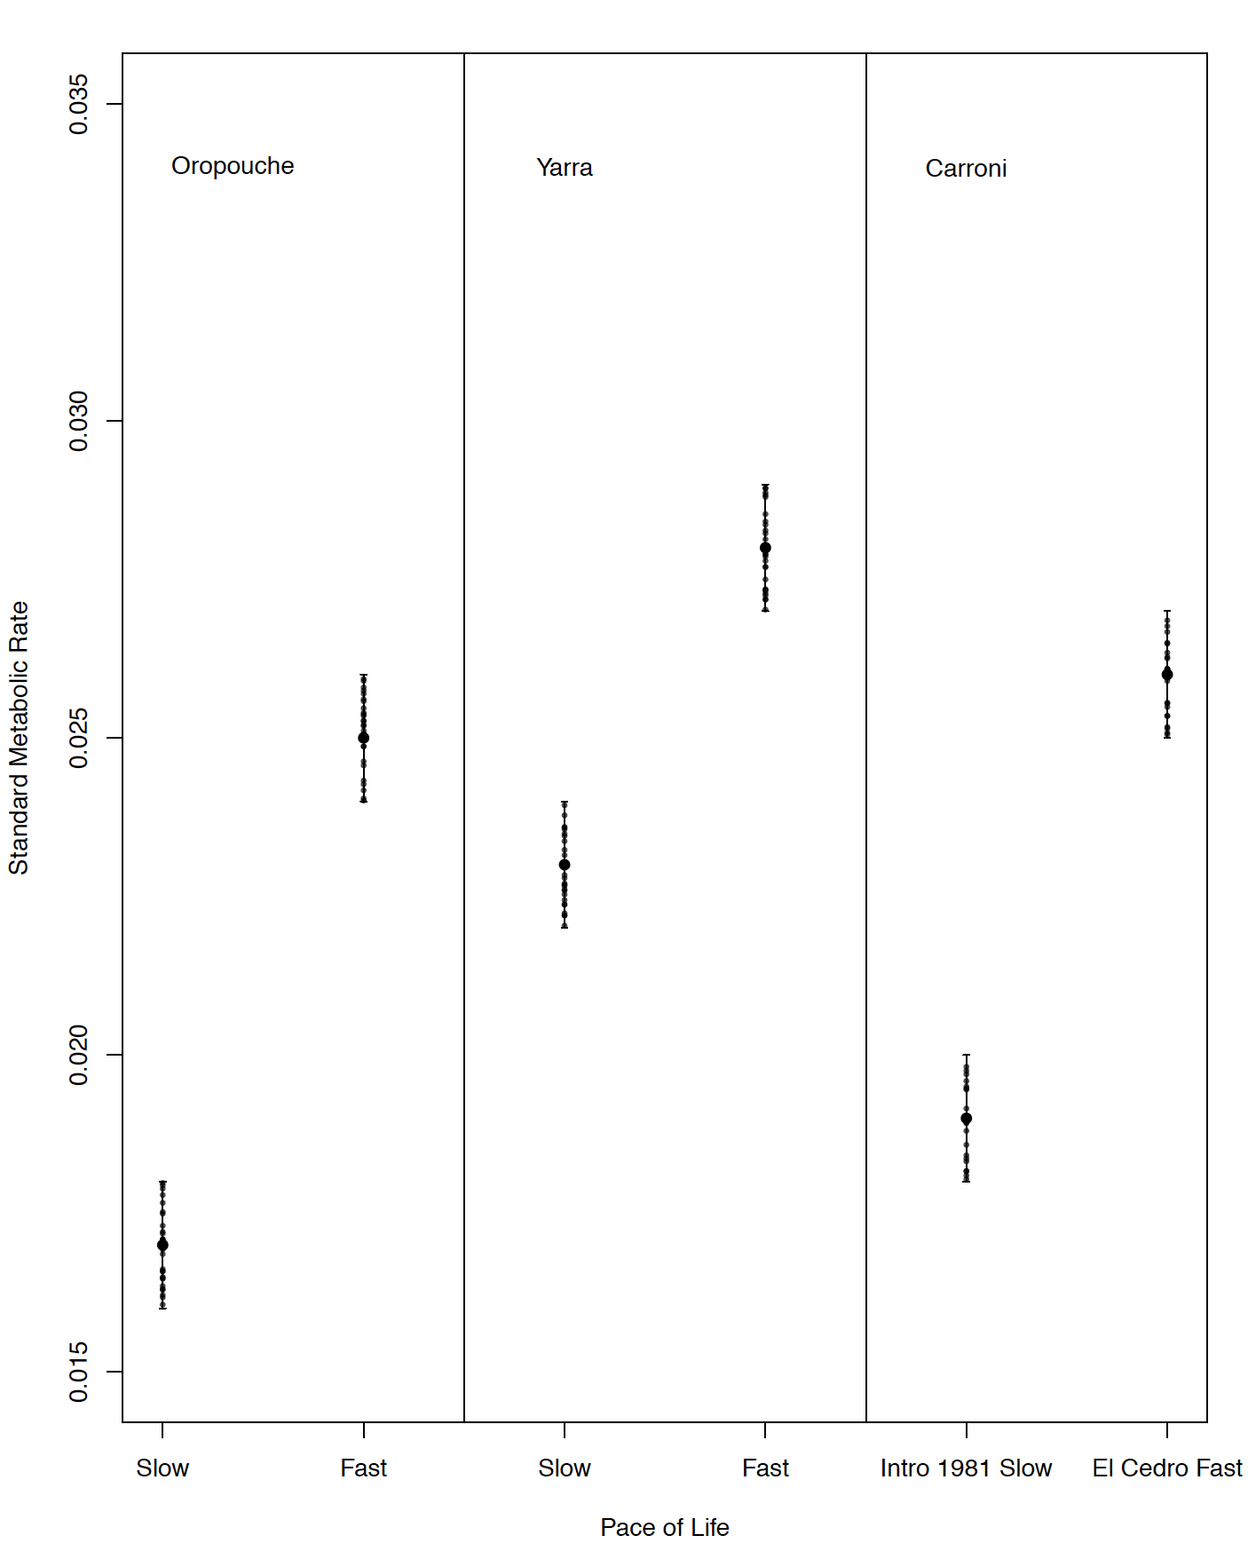

Slide 25
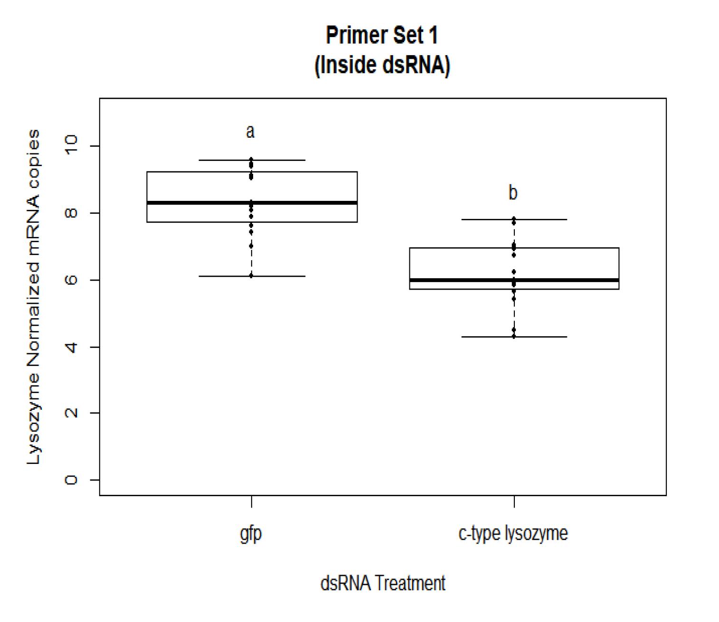
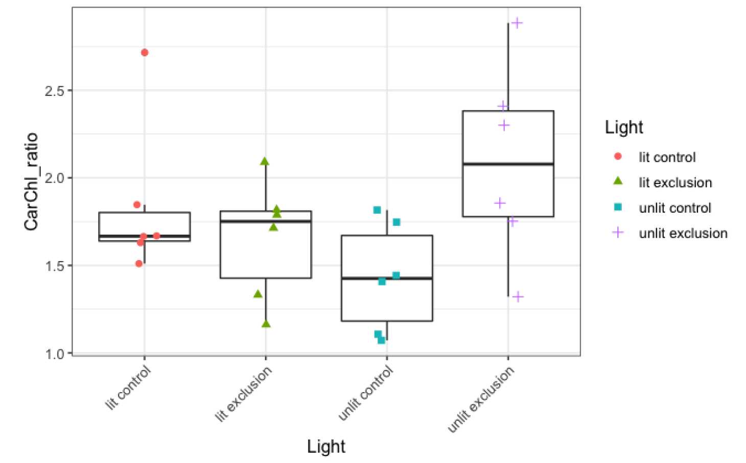

Slide 26
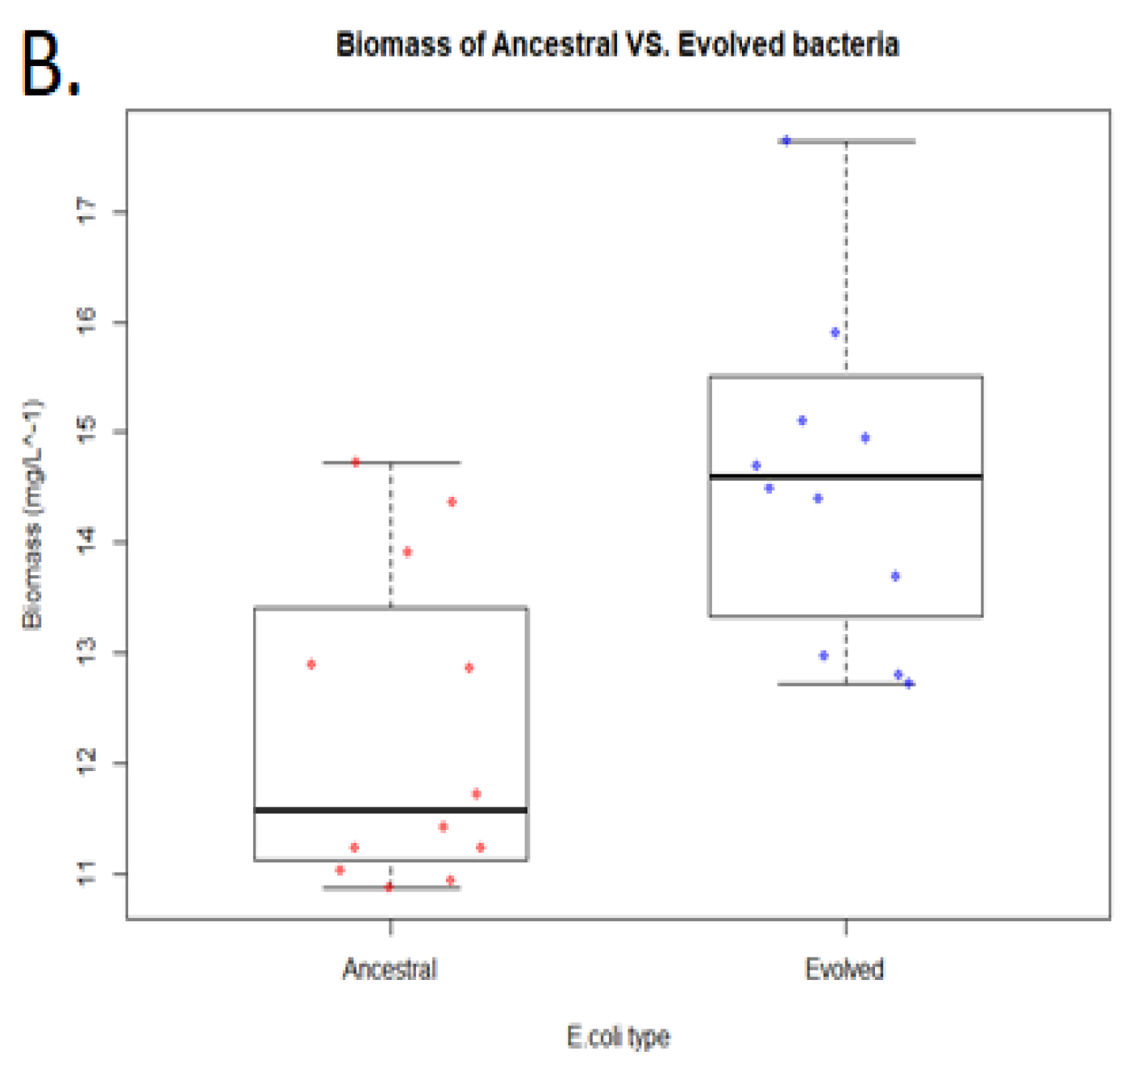
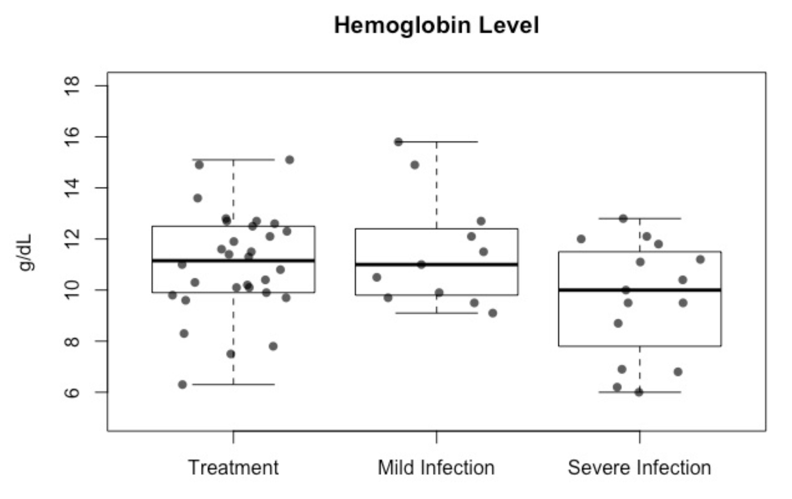

Slide 27
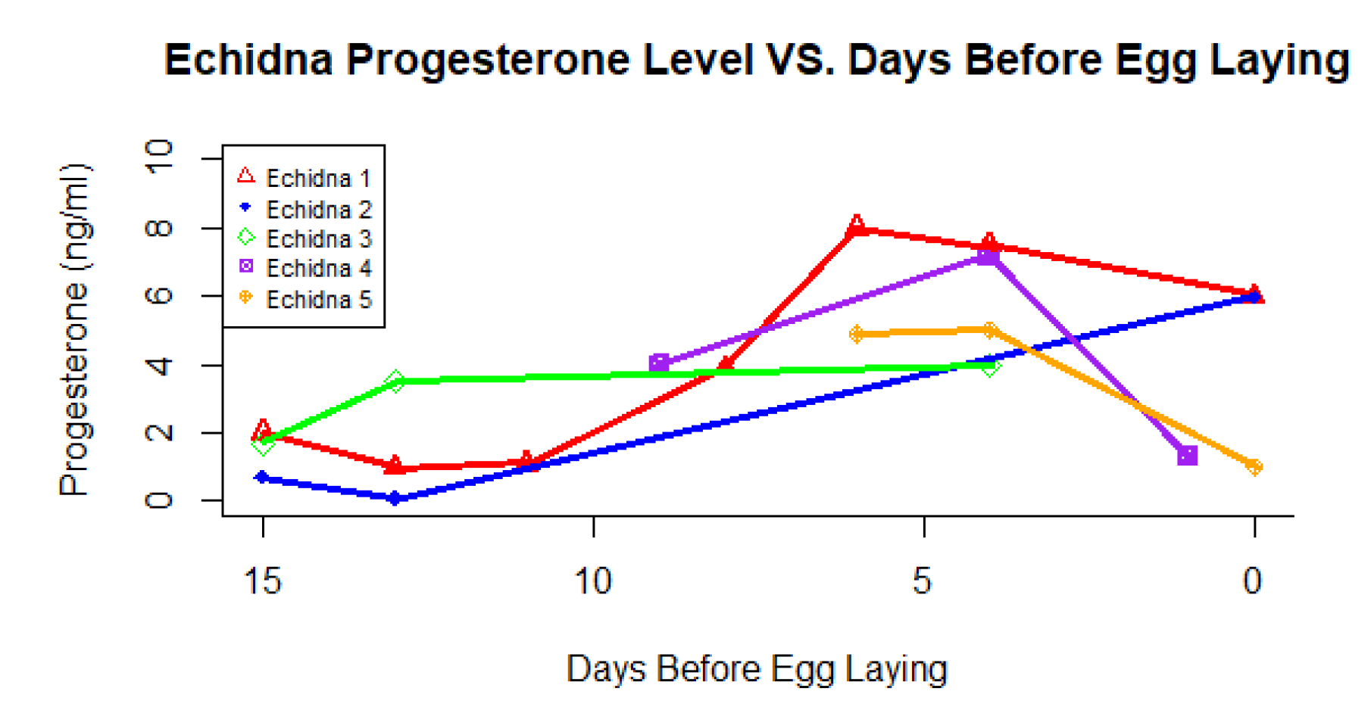

Slide 28
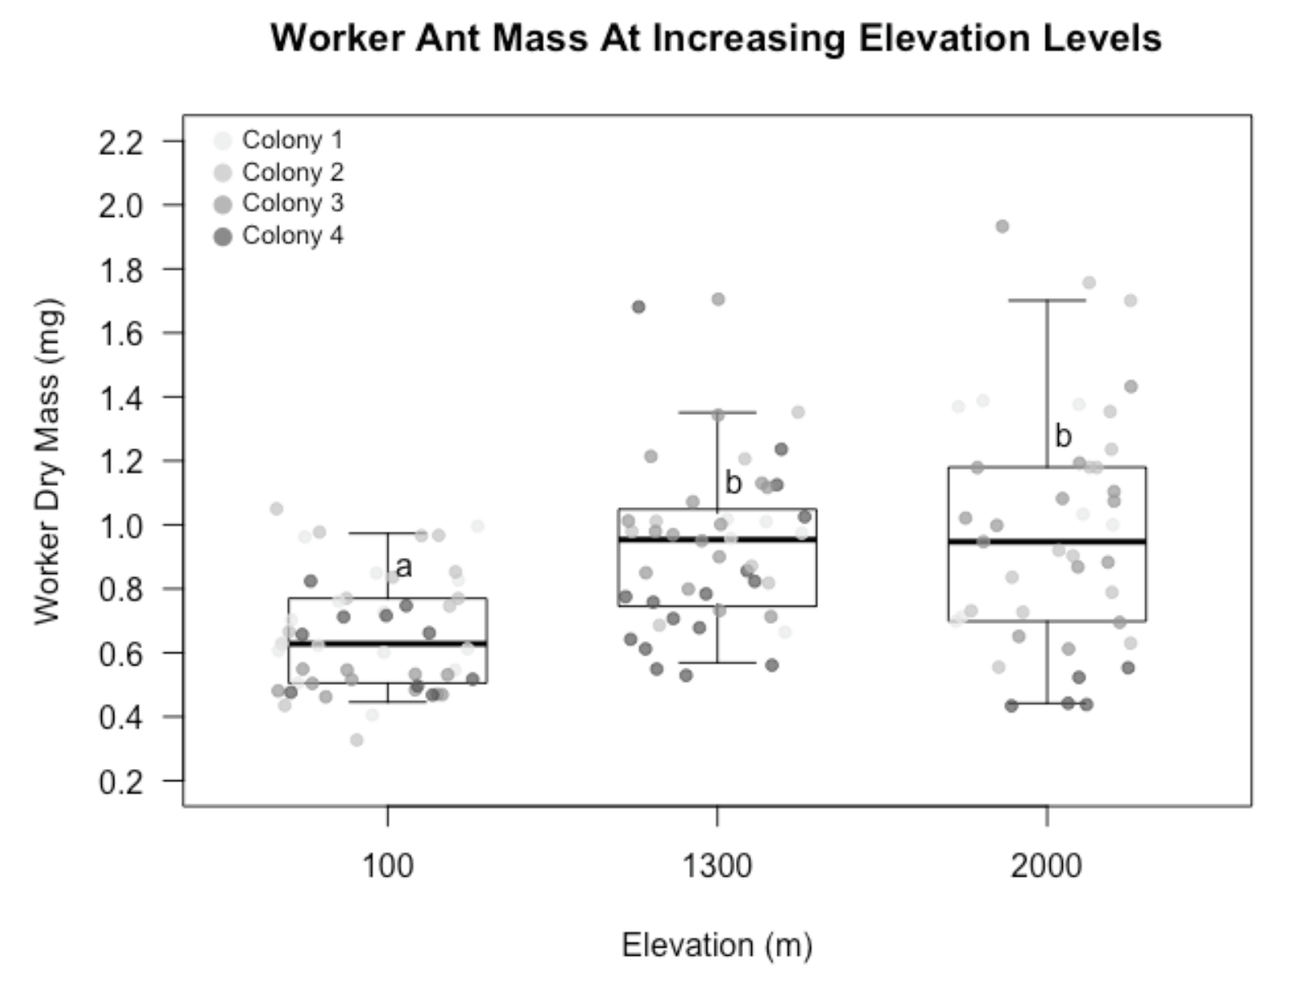

Slide 29
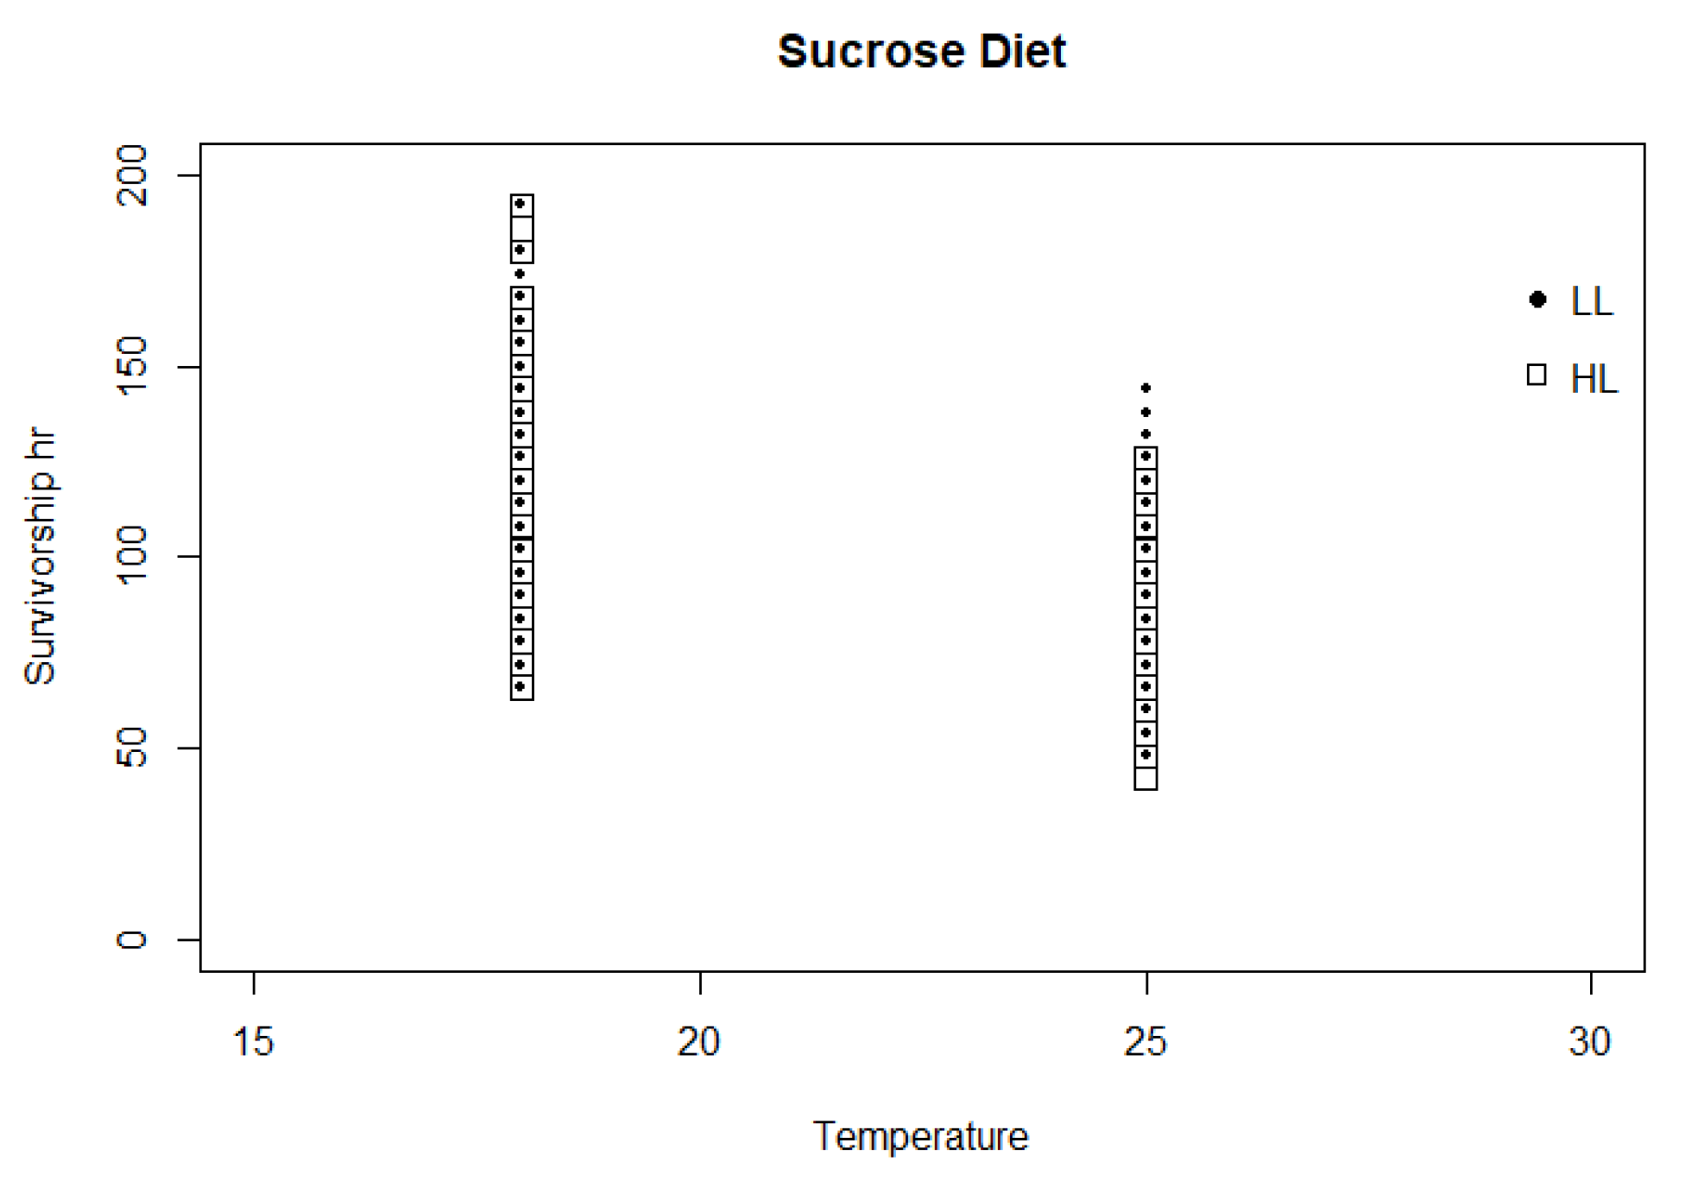

Slide 30
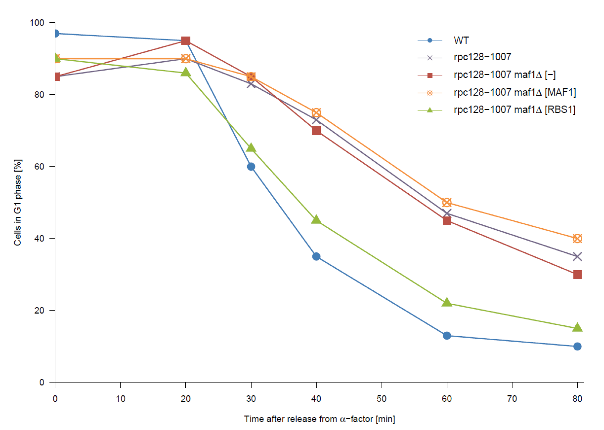

Slide 31
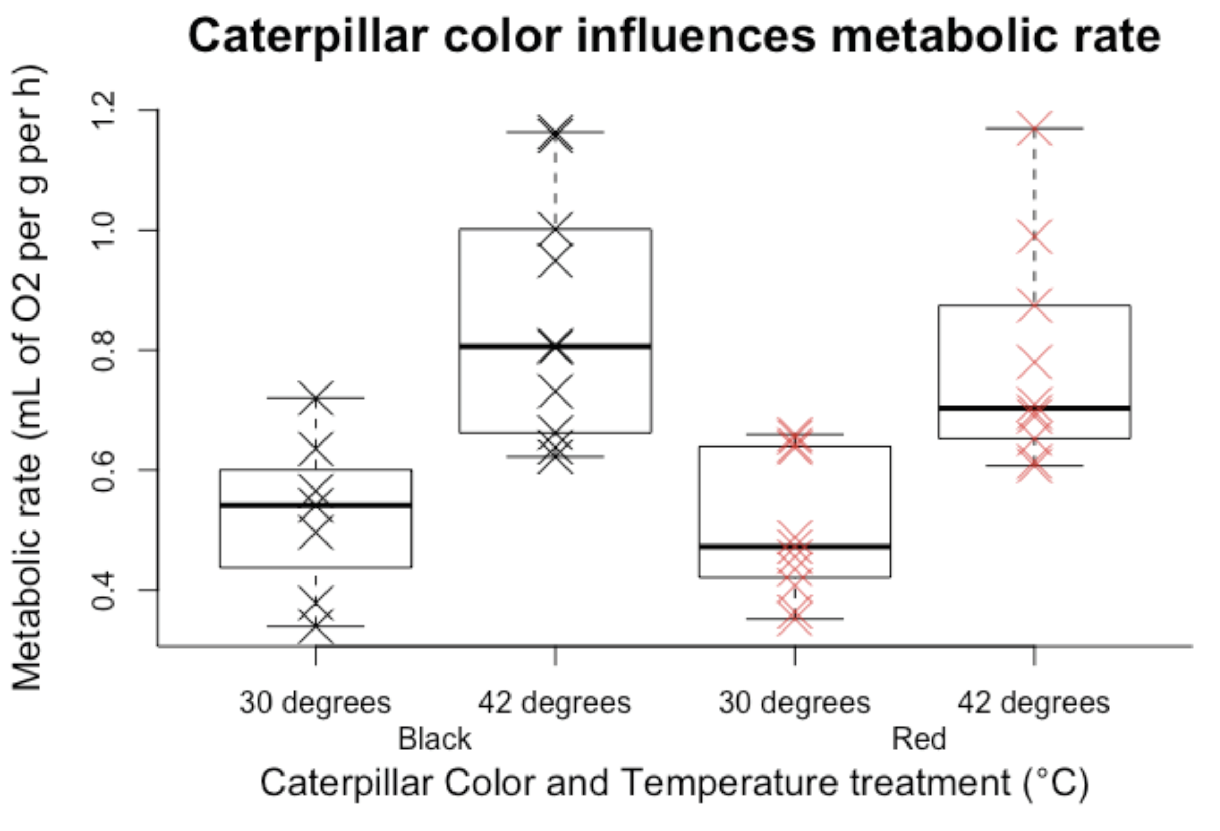

Slide 32
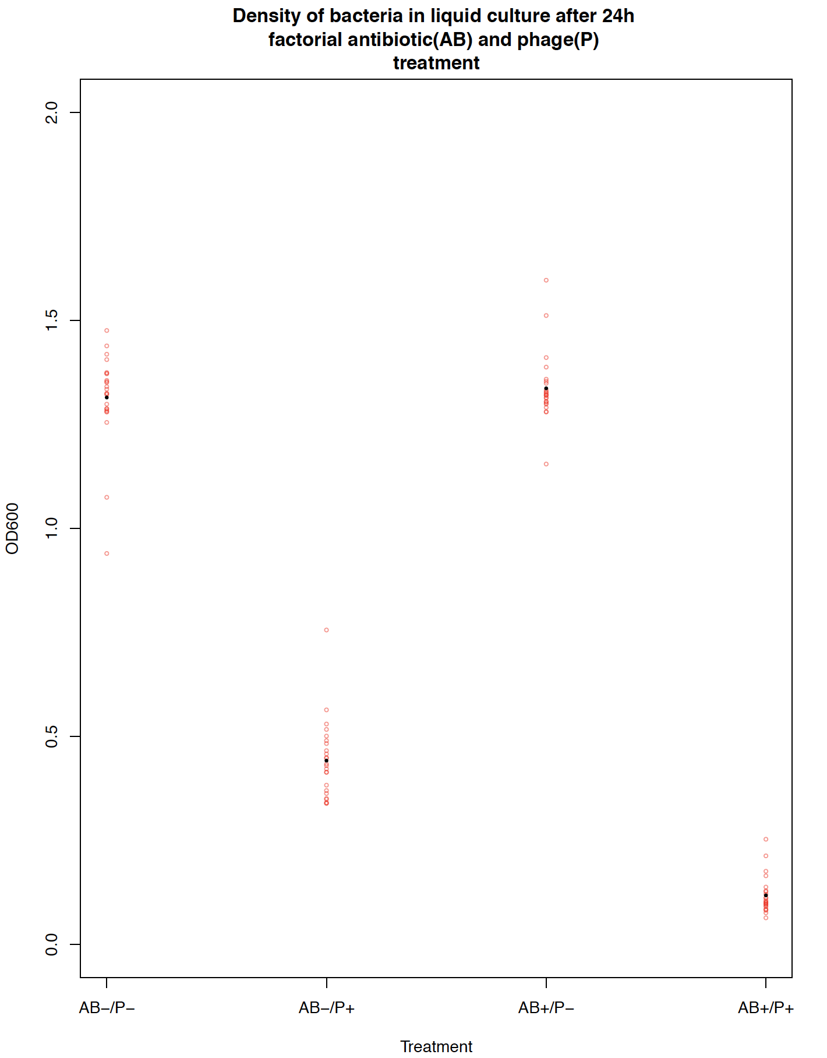
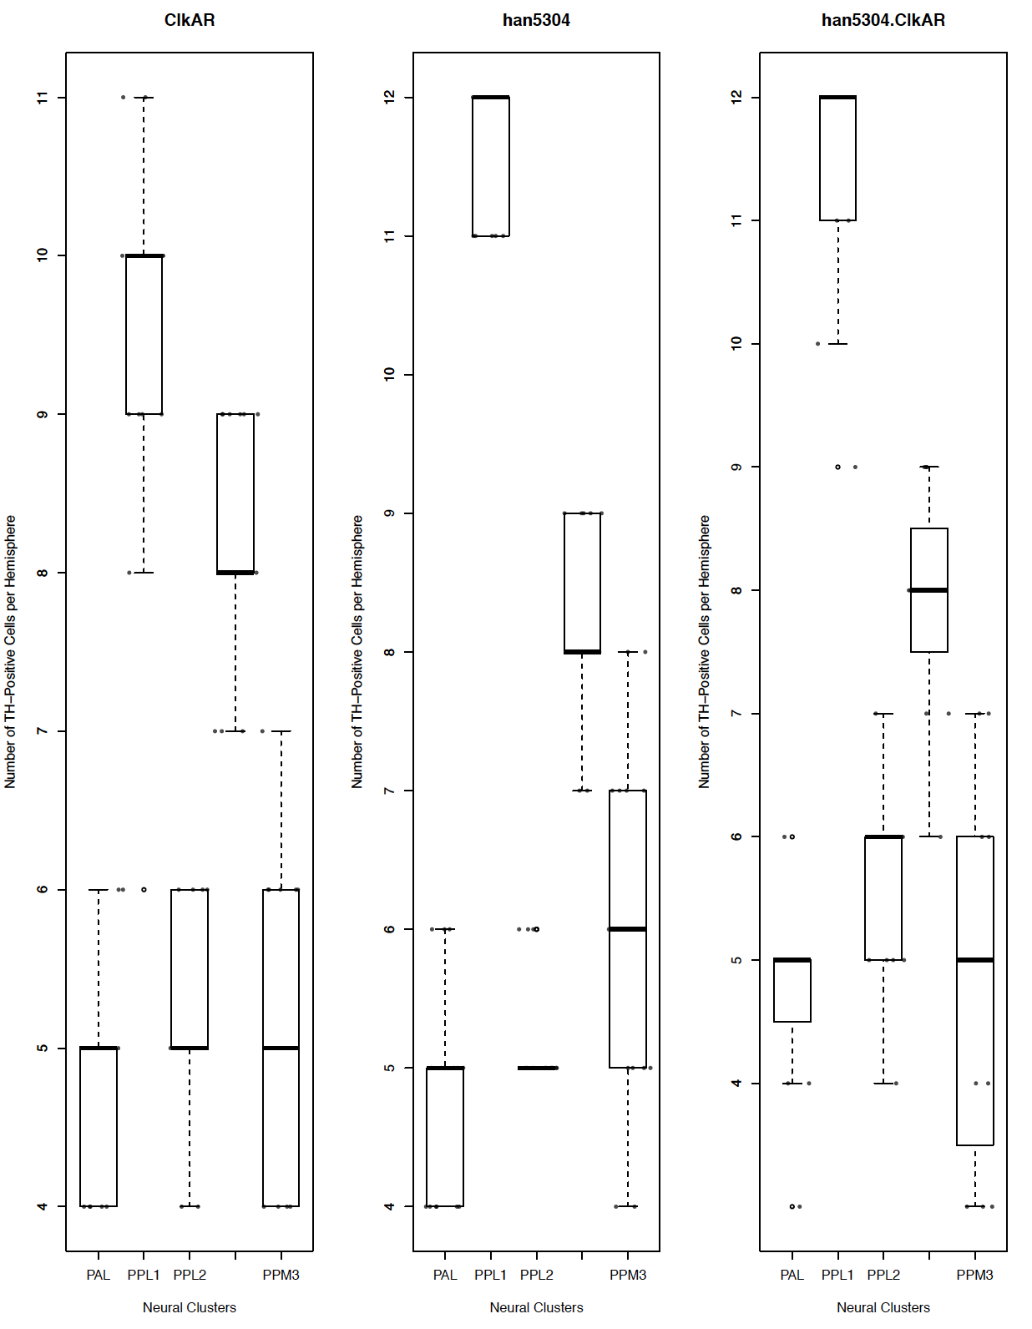

Slide 33
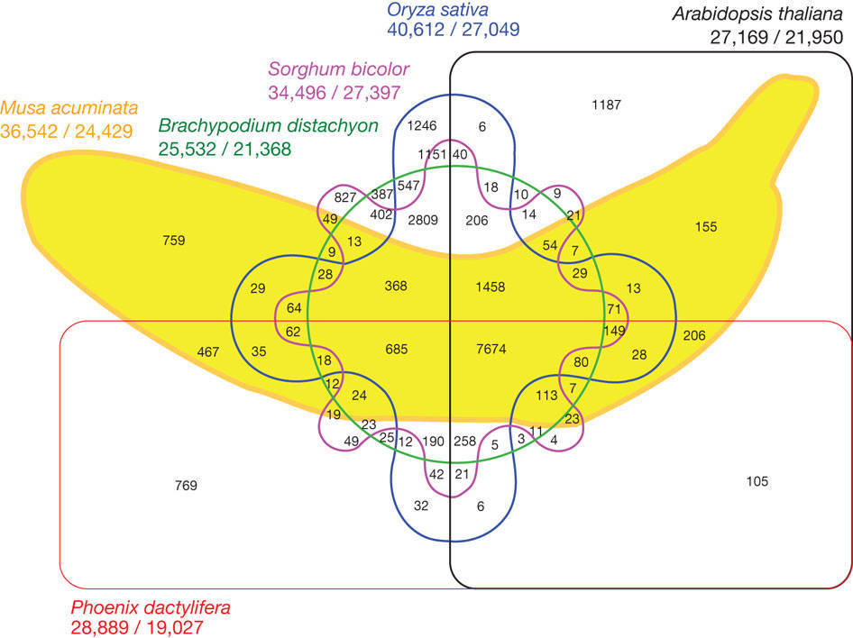

Slide 34
Use the right tool
Plotting continuous or discrete data
Matplotlib: is a python plotting library,
R: endless packages for plotting though base and ggplot2 are the most popular.
Inkscape: free vector graphics editor. Can read PDF and let you tweak things you couldn’t quite fix in your script generated version.
Circos: created plots that compare genomes but can show connections between any large datasets.
Excel: it is possible but you have very limited options and control
Adobe Illustrator: Similar to inkscape particularly useful for building complex multipart figures
Image Manipulation
GIMP: Think of it as free photoshop. Steep learning curve but can do just about whatever you want
ImageJ: Similar to GIMP but with many packages for analyses of specific image types.
Photoshop: Image manipulation steep learning curve very powerful and definitely worth learning if your research includes figures of FISH results.
General Editing
Adobe acrobat: often the easiest way to tweak something small you couldn’t get exactly right in your script.
Powerpoint: not elegant but often the easiest way to combine different elements into a single plot.
Bold = Free

Slide 35
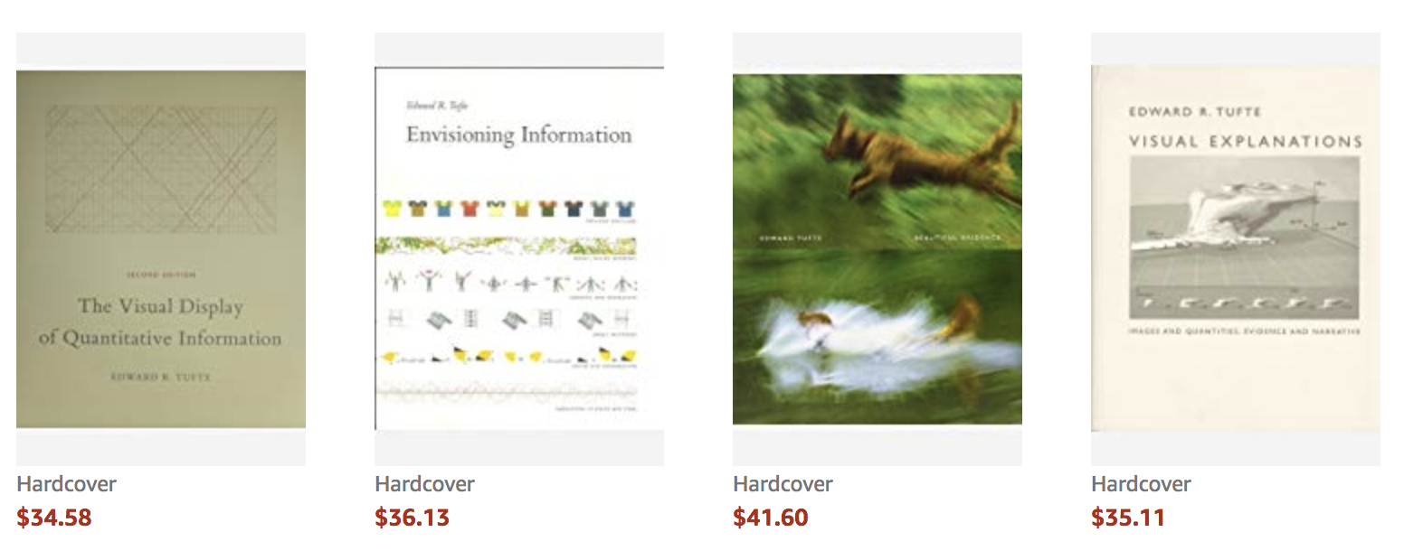
Resources
R graph gallery
Python graph gallery
Color Brewer
Plotly
Data Visualization Catalog
Philosophy of Data Visualization

Slide 36
Steps in making a great figure
Figure out the purpose of the figure. Usually you will have a sentence in the paper or a point you want to make in a talk.

Slide 37
Steps in making a great figure
Figure out the purpose of the figure. Usually you will have a sentence in the paper or a point you want to make in a talk.
Haploid chromosome number ranged from 7-50 across sample Polyneoptera species and an XO sex chromosome system was reconstructed as the most probable ancestral state for most orders.

Slide 38
Steps in making a great figure
Figure out the purpose of the figure. Usually you will have a sentence in the paper or a point you want to make in a talk.
Make a list of the data that will need to be included. Is it continuous, discrete, or more complex.
Haploid chromosome number ranged from 7-50 across sample Polyneoptera species and an XO sex chromosome system was reconstructed as the most probable ancestral state for most orders.

Slide 39
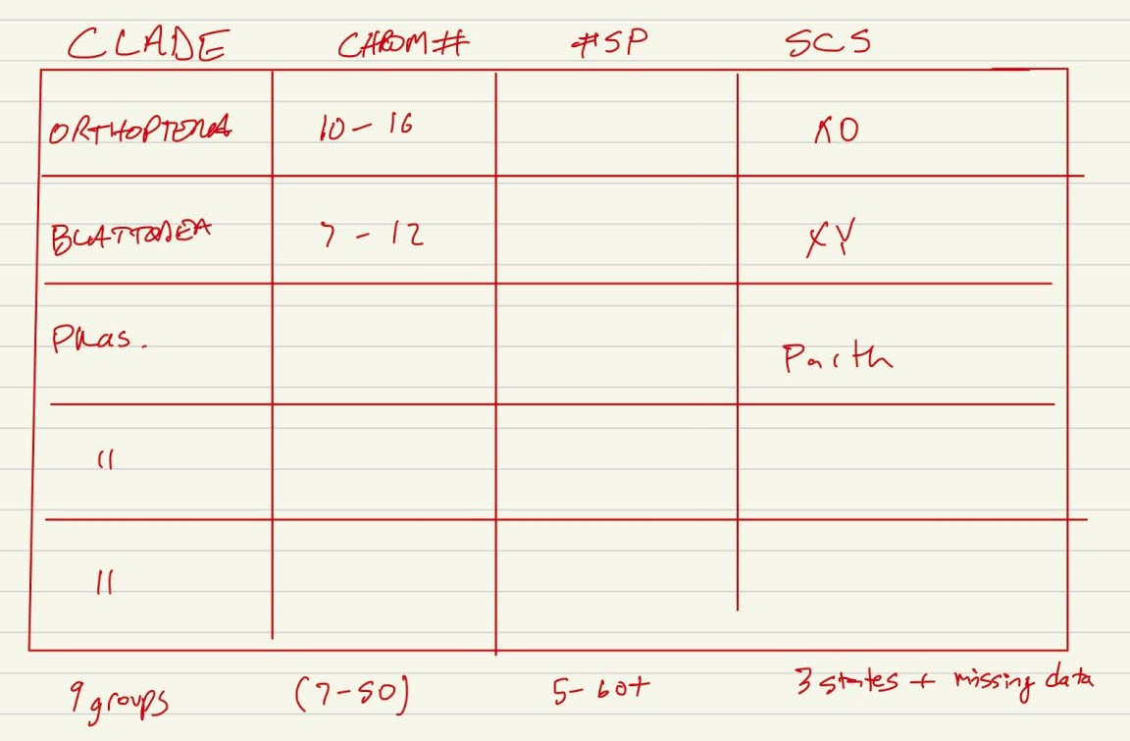
Steps in making a great figure
Figure out the purpose of the figure. Usually you will have a sentence in the paper or a point you want to make in a talk.
Make a list of the data that will need to be included. Is it continuous, discrete, or more complex.
Haploid chromosome number ranged from 7-50 across sample Polyneoptera species and an XO sex chromosome system was reconstructed as the most probable ancestral state for most orders.

Slide 40
Steps in making a great figure
Figure out the purpose of the figure. Usually you will have a sentence in the paper or a point you want to make in a talk.
Make a list of the data that will need to be included. Is it continuous, discrete, or more complex.
Sketch out what you think it will look like. Don’t waste time figuring out how to make the perfect plot in your tool until you have settled on a best approach. Check out other papers and the graph gallery for ideas.
Haploid chromosome number ranged from 7-50 across sample Polyneoptera species and an XO sex chromosome system was reconstructed as the most probable ancestral state for most orders.

Slide 41
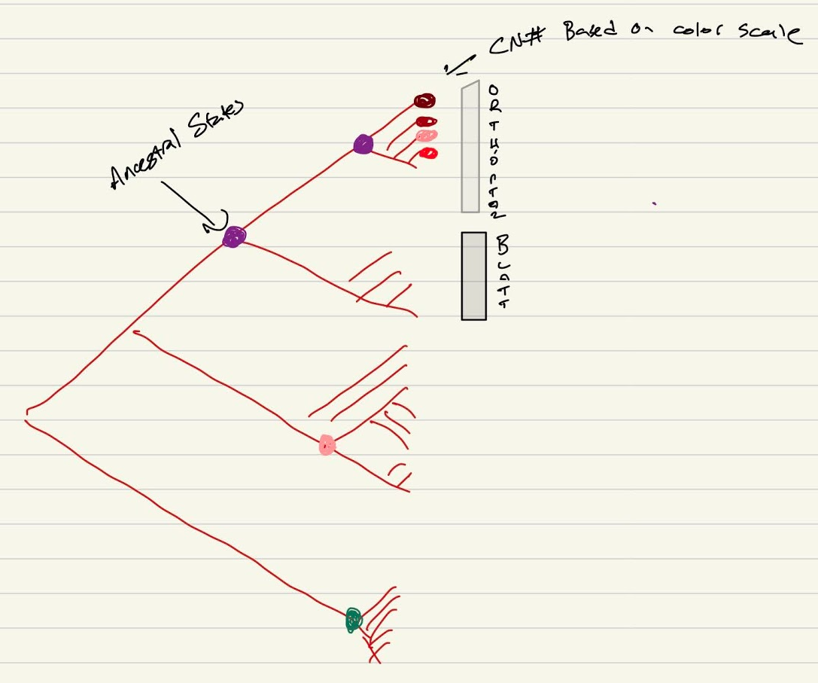
Steps in making a great figure
Figure out the purpose of the figure. Usually you will have a sentence in the paper or a point you want to make in a talk.
Make a list of the data that will need to be included. Is it continuous, discrete, or more complex.
Sketch out what you think it will look like. Don’t waste time figuring out how to make the perfect plot in your tool until you have settled on a best approach. Check out other papers and the graph gallery for ideas.
Haploid chromosome number ranged from 7-50 across sample Polyneoptera species and an XO sex chromosome system was reconstructed as the most probable ancestral state for most orders.

Slide 42
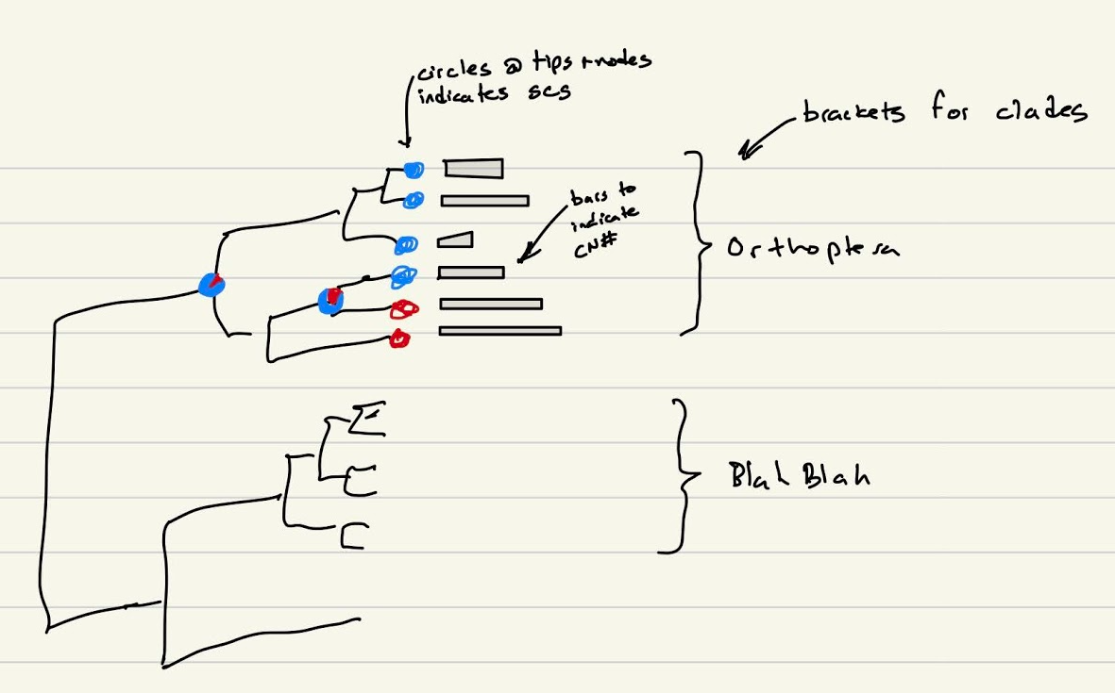
Steps in making a great figure
Figure out the purpose of the figure. Usually you will have a sentence in the paper or a point you want to make in a talk.
Make a list of the data that will need to be included. Is it continuous, discrete, or more complex.
Sketch out what you think it will look like. Don’t waste time figuring out how to make the perfect plot in your tool until you have settled on a best approach. Check out other papers and the graph gallery for ideas.
Haploid chromosome number ranged from 7-50 across sample Polyneoptera species and an XO sex chromosome system was reconstructed as the most probable ancestral state for most orders.

Slide 43
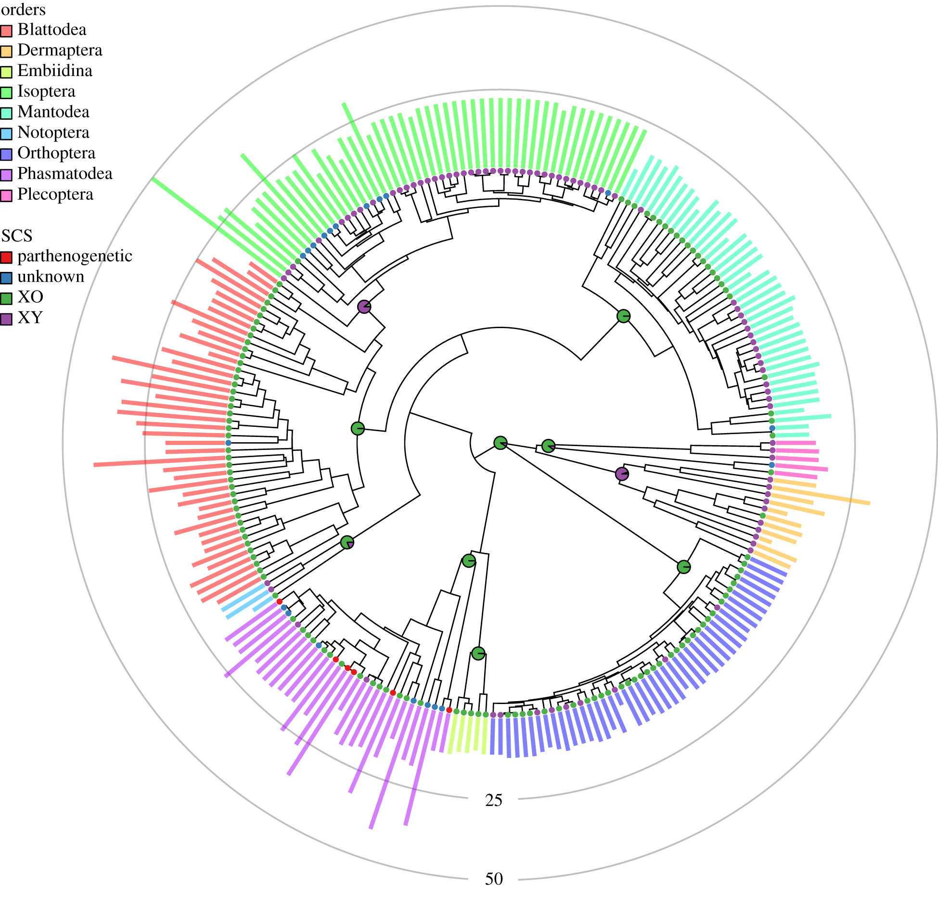
Steps in making a great figure
Figure out the purpose of the figure. Usually you will have a sentence in the paper or a point you want to make in a talk.
Make a list of the data that will need to be included. Is it continuous, discrete, or more complex.
Sketch out what you think it will look like. Don’t waste time figuring out how to make the perfect plot in your tool until you have settled on a best approach. Check out other papers and the graph gallery for ideas.
Haploid chromosome number ranged from 7-50 across sample Polyneoptera species and an XO sex chromosome system was reconstructed as the most probable ancestral state for most orders.

Slide 44
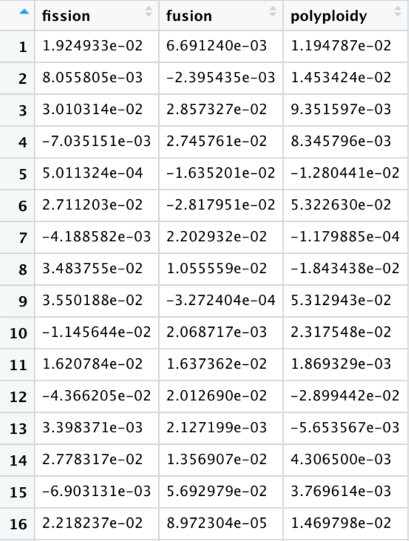
How I make a plot
1) Decide why you are making the plot. Often times you will have a sentence in your paper that demands a plot. On almost every project I’ve ever been involved in we have much more data than is ever included in a figure in the final paper.
The ΔR_{x} statistics for fusions, fissions and polyploidy had credible intervals that overlapped zero (Fig 2A).
Each curve represents the posterior distribution of the ΔR_{x} statistic, where x is either fission, fusion, or polyploidy which is indicated by the color of the fill. Below the curves the lines indicate the 95% credible interval of each statistic.
10,000 rows

Slide 45
Plotting in this class
Over the course of the semester we will plot using several approaches (base, ggplot, custom packages)
Our next topic is intro to R and then we will come back to plotting once you have some tools in your toolbox.
Show the data
Avoid distorting data
Avoid chart junk
Maximize data:ink ratio maximize information
Make it accessible to all (5% color blind + BW prints).
Axes and legends that are informative and useful
Use vector art when possible
I will evaluate all the plots you make this semester on these criteria. Can you break these? Yes but only for really good reasons!

