Slide 1
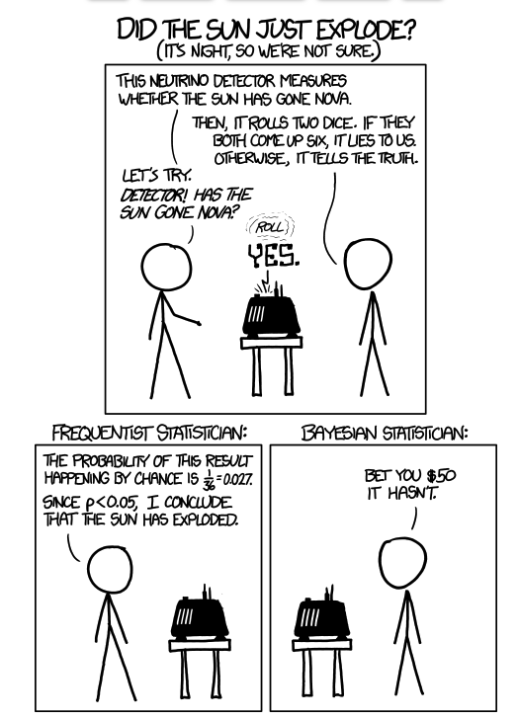
Bayesian Stats and MCMC

Slide 2
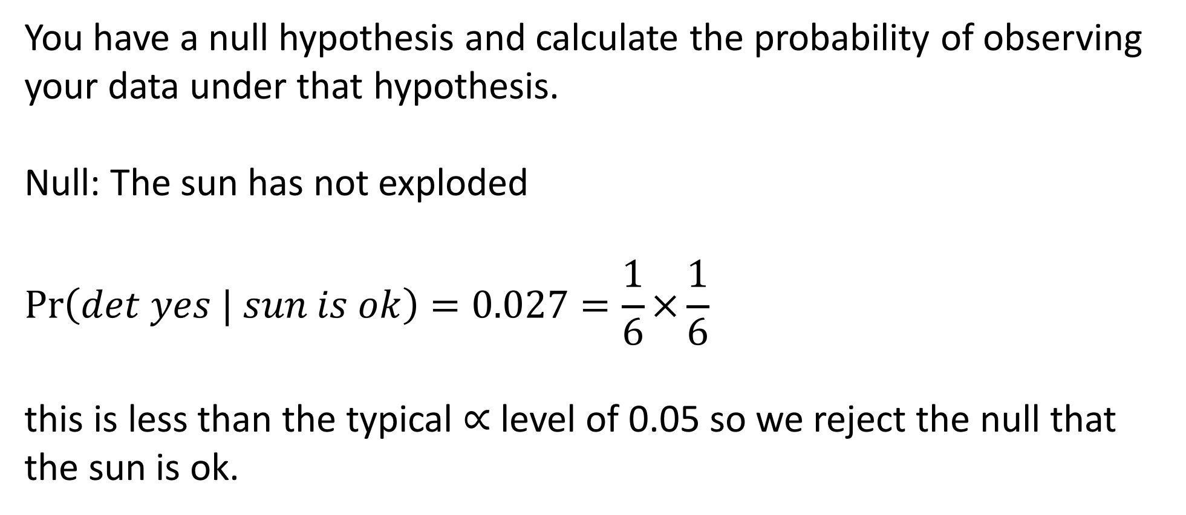
Frequentist approach
You have a null hypothesis and calculate the probability of observing your data under that hypothesis.
Null: The sun has not exploded
$$\operatorname{Pr}\left(det yes | sun is ok\right)=0.027=\frac{1}{6}×\frac{1}{6}$$
this is less than the typical $∝$ level of 0.05 so we reject the null that the sun is ok.

Slide 3
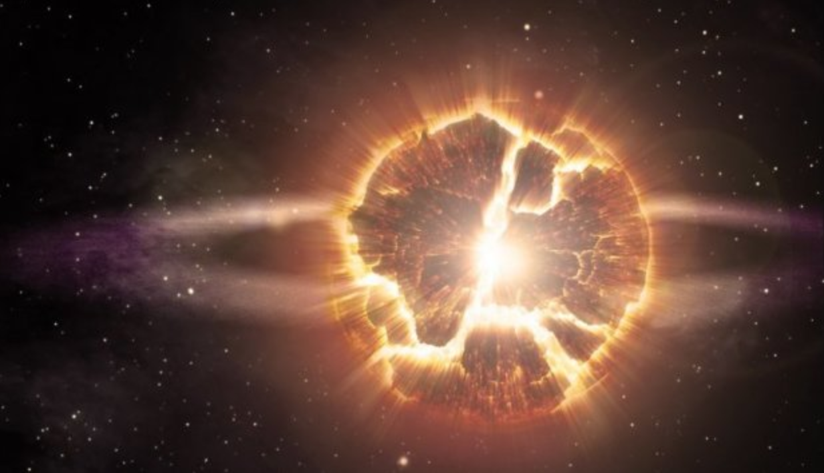
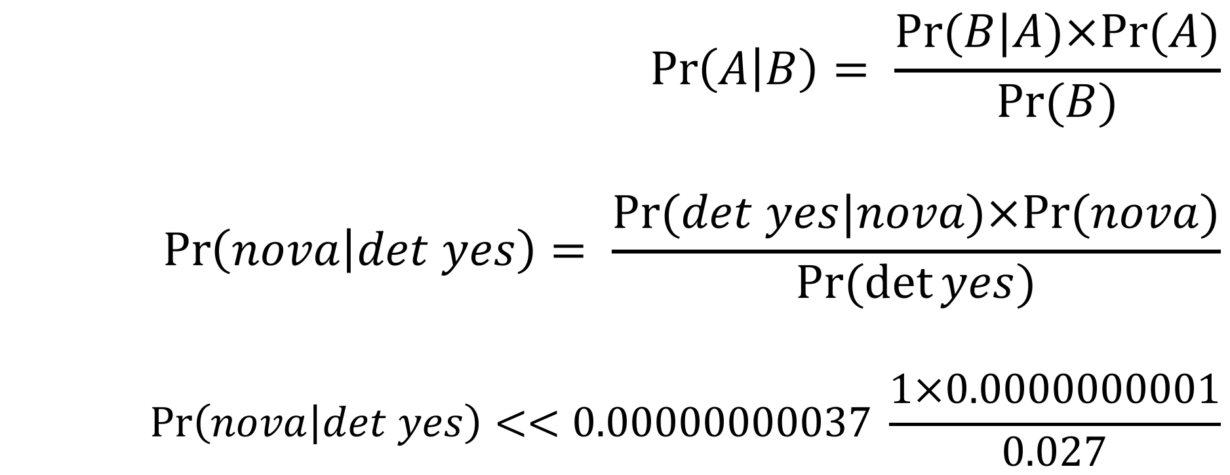
Bayesian approach
$$\operatorname{Pr}\left(A | B\right)= \frac{Pr⁡(B|A)×Pr⁡(A)}{Pr⁡(B)}$$
$$\operatorname{Pr}\left(nova | det yes\right)= \frac{Pr⁡(det yes|nova)×Pr⁡(nova)}{Pr⁡(\det{yes})}$$
$$\operatorname{Pr}\left(nova | det yes\right)<<0.00000000037 \frac{1×0.0000000001}{0.027}$$

Slide 4
Bayesian approach
Imagine a disease present in 1 person per 100,000. If you take a test that correctly returns a positive result 99.9% of the time when someone is infected but has a false positive rate of 0.5%.
How likely are you to have the disease if you test positive?
Should you be concerned if you test positive?
Bayes’ theorem provides a natural way to think about this.
Lets do this!

Slide 5
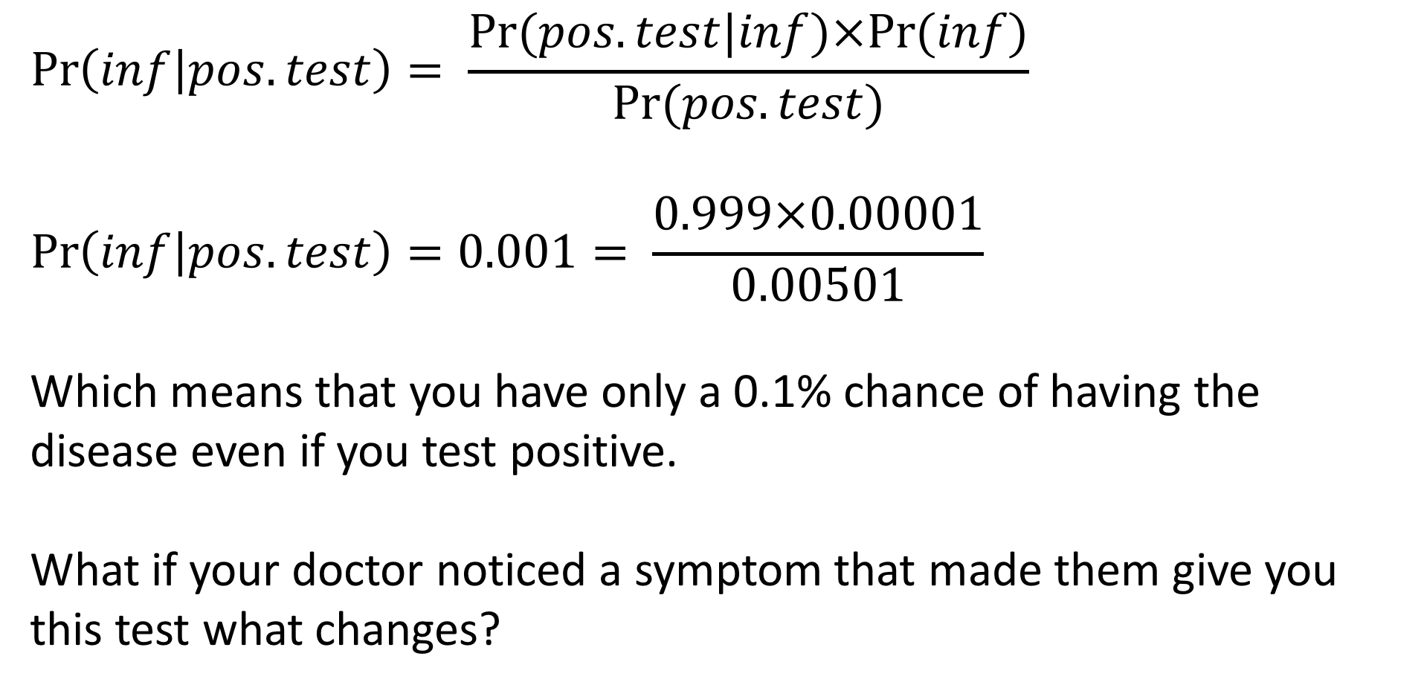
Bayesian approach
$$\operatorname{Pr}\left(inf | pos.test\right)= \frac{Pr⁡(pos.test|inf)×Pr⁡(inf)}{Pr⁡(pos.test)}$$
$$\operatorname{Pr}\left(inf | pos.test\right)=0.001= \frac{0.999×0.00001}{0.00501}$$
Which means that you have only a 0.1% chance of having the disease even if you test positive.
What if your doctor noticed a symptom that made them give you this test what changes?

Slide 6
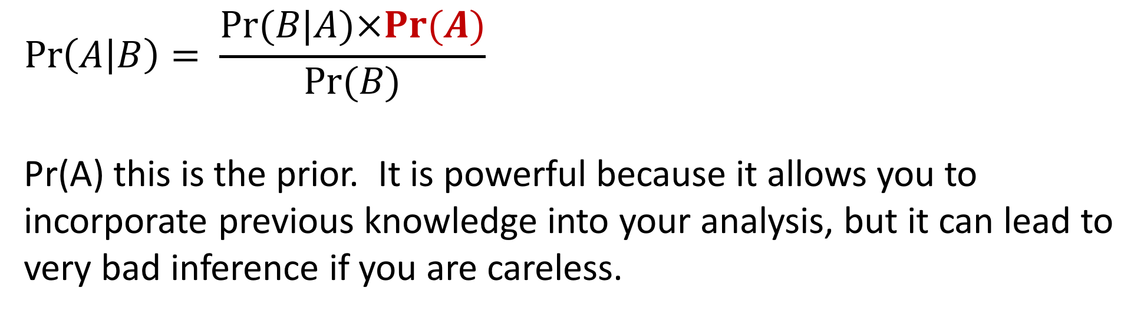
Priors
$$\operatorname{Pr}\left(A | B\right)= \frac{Pr⁡(B|A)×Pr⁡(A)}{Pr⁡(B)}$$
Pr(A) this is the prior. It is powerful because it allows you to incorporate previous knowledge into your analysis, but it can lead to very bad inference if you are careless.

Slide 7
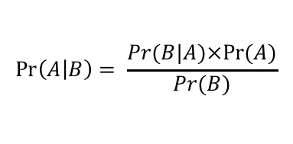
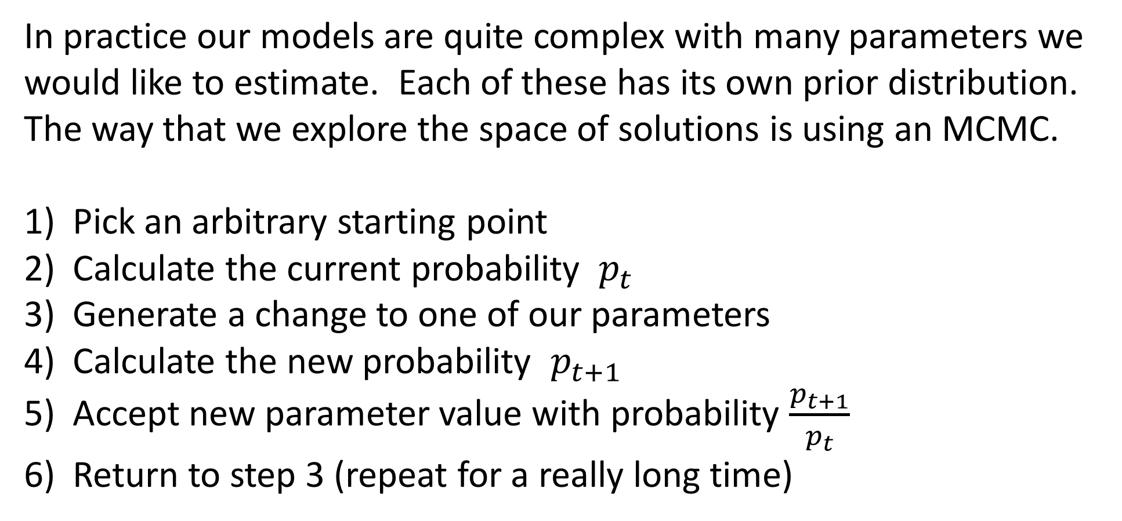
Bayesian methods in practice (MCMC)
In practice our models are quite complex with many parameters we would like to estimate. Each of these has its own prior distribution. The way that we explore the space of solutions is using an MCMC.
Pick an arbitrary starting point
Calculate the current probability $p_{t}$
Generate a change to one of our parameters
Calculate the new probability $p_{t+1}$
Accept new parameter value with probability $\frac{p_{t+1}}{p_{t}}$
Return to step 3 (repeat for a really long time)
$$\operatorname{Pr}\left(A | B\right)= \frac{Pr⁡(B|A)×Pr⁡(A)}{Pr⁡(B)}$$

Slide 8
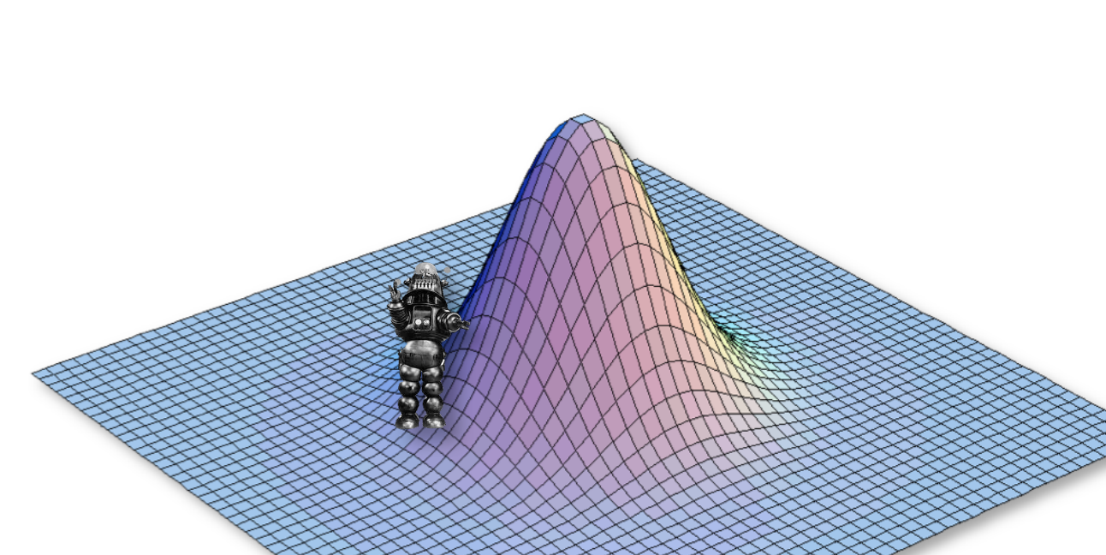
Bayesian methods in practice (MCMC)

Slide 9
Bayesian methods in practice (MCMC)

Slide 10
Bayesian methods in practice (MCMC)

Slide 11
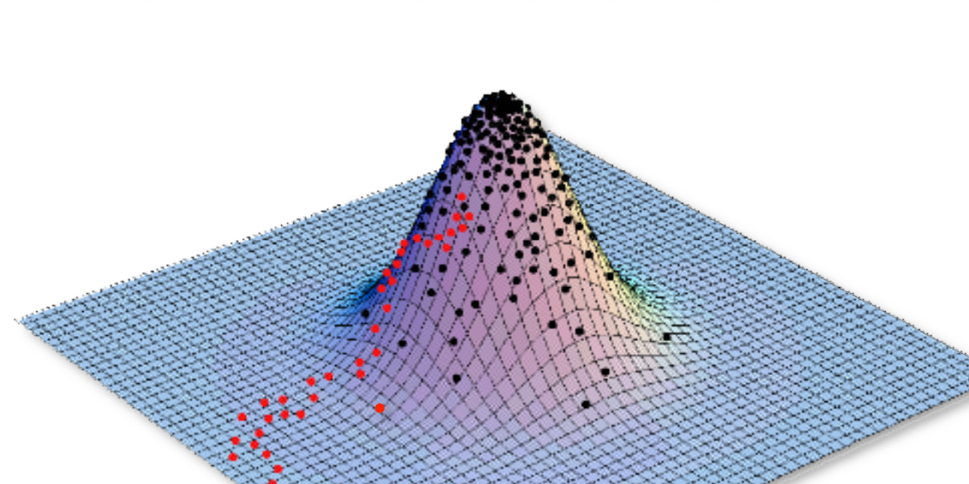
Bayesian methods in practice (MCMC)

Slide 12
Steps in a Bayesian analysis
Choose appropriate priors to use for your parameters
Run your mcmc (How long? How many times?)
Once you are confident in your run remove burn-in
Check to make sure priors didn’t determine outcome.
Make estimates of parameters based on the post burn-in results
Use summaries appropriate for Bayesian methods.

Slide 13
Assessing Convergence
R example

Slide 14
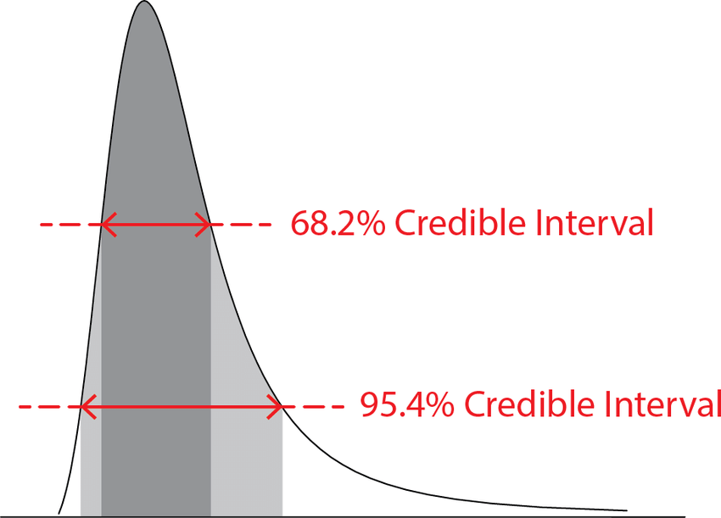
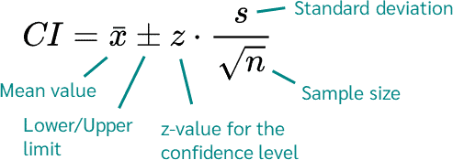
Uncertainty
Credible Interval vs Confidence Interval
R example

Slide 15
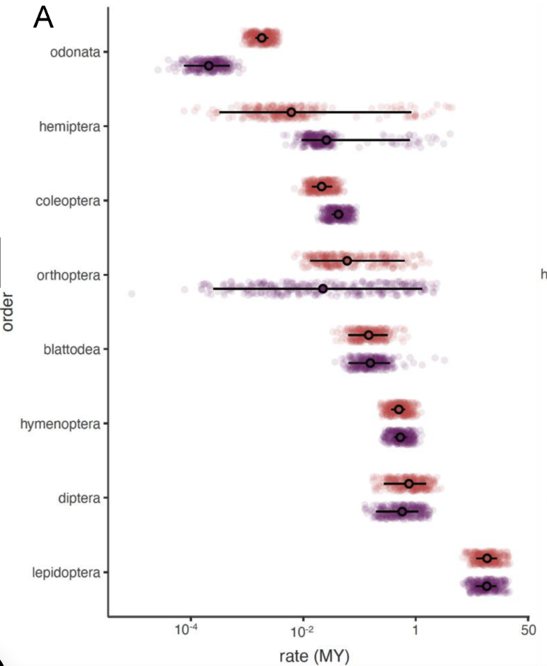
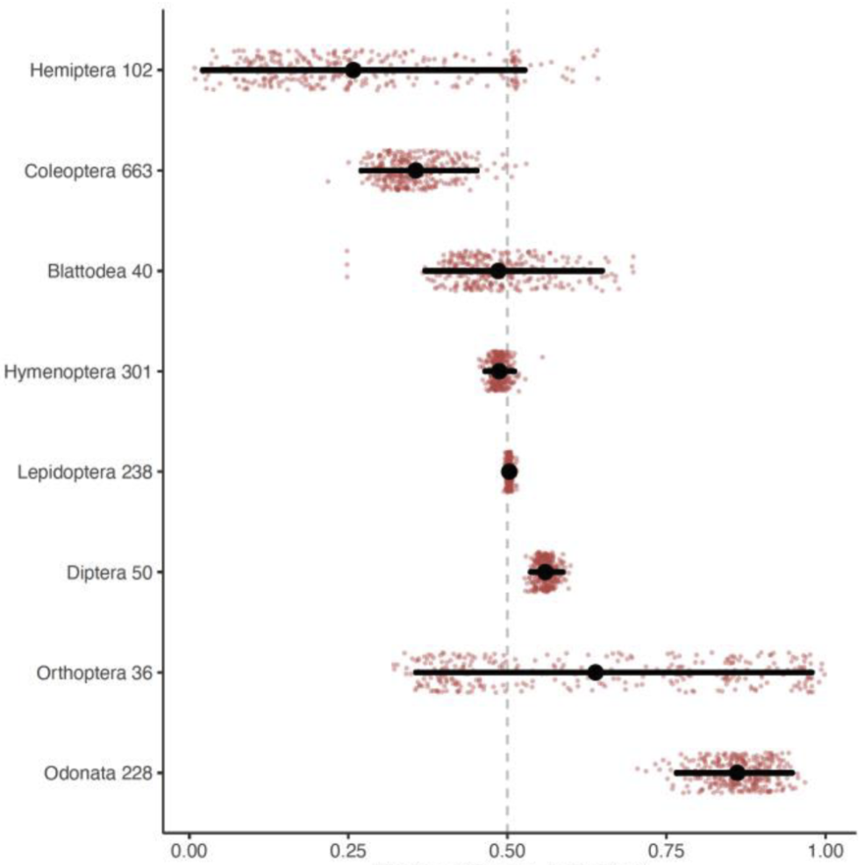
Inferences from posterior distributions

Slide 16
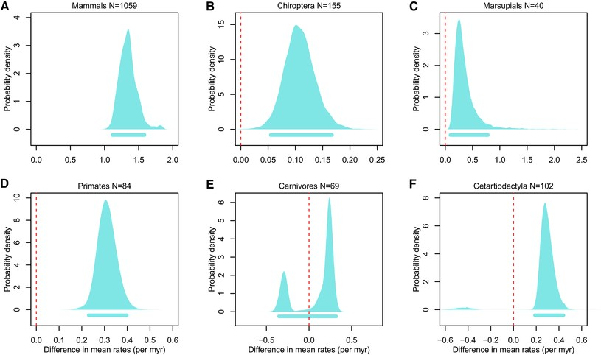
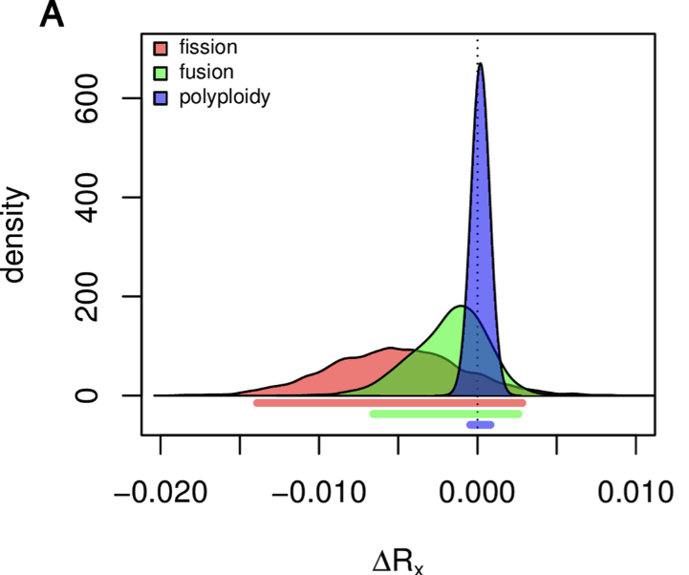
Inferences from posterior distributions

Slide 17
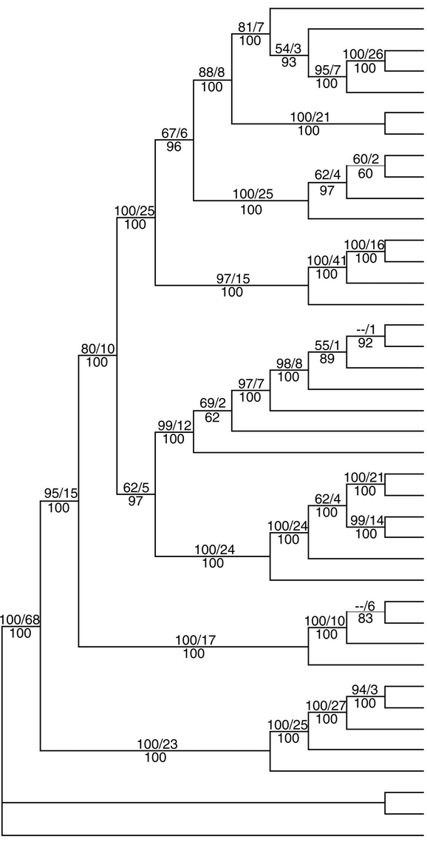
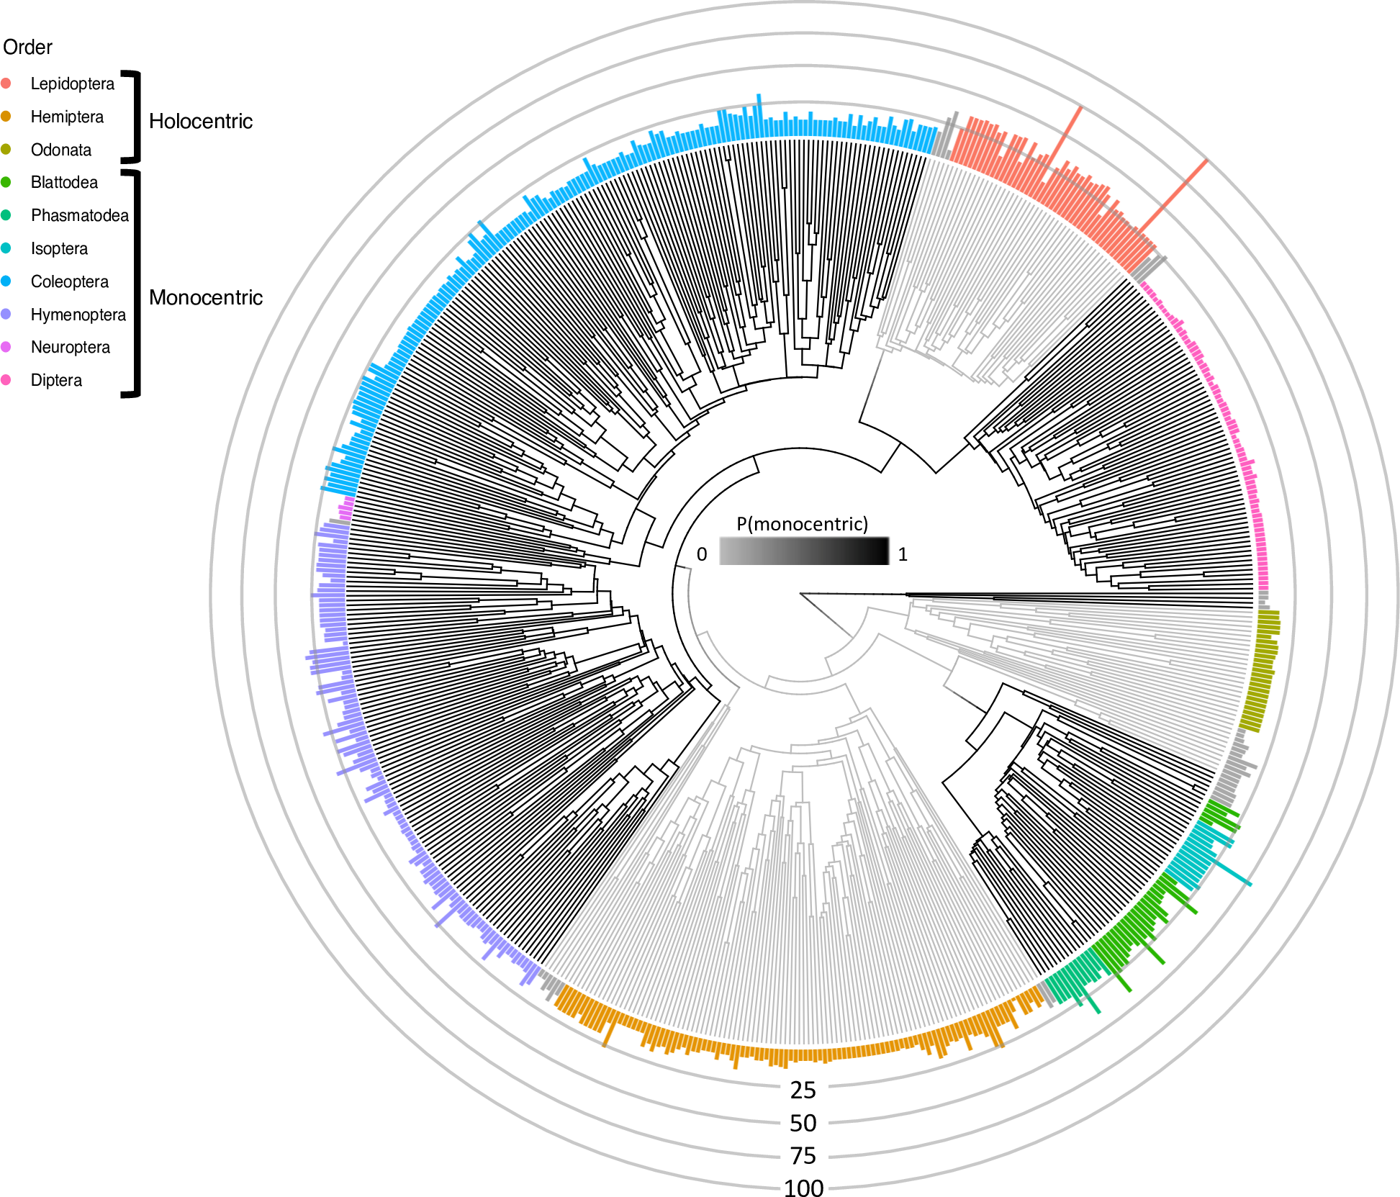
Inferences from posterior distributions

Slide 18
The power of Bayesian approaches
With a Bayesian approach we can take into account all types of uncertainty and be more conservative.
Phylogenetic
Model selection uncertainty
Parameter value uncertainty
Uncertainty in measurements

