Slide 1
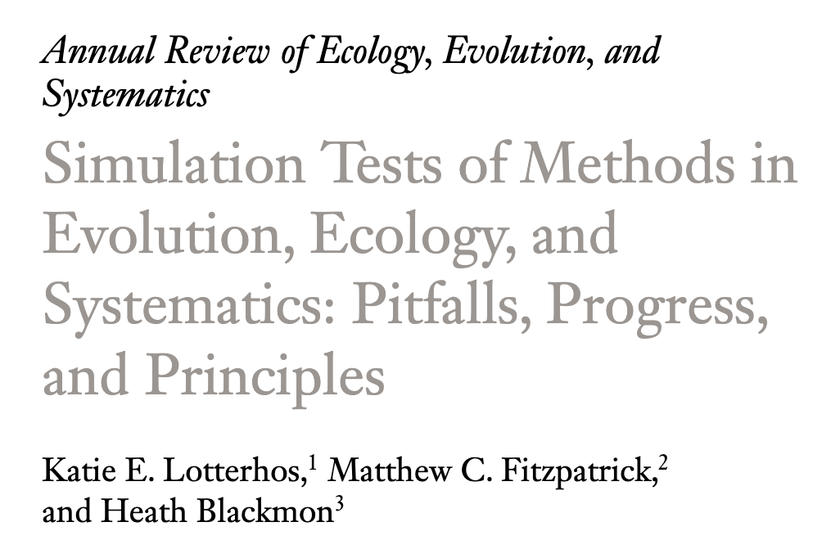
Monte Carlo and the power of simulation

Slide 2
Lets work through a challenging dataset
In insects it seems that chromosomes are often reused as sex chromosomes. A group wanted to know if some chromosomes are “better” at developing into chromosomes so they reconstructed an ancestral genome and asked if some chromosomes had more genes involved in sex determination than we would expect by chance. Their data looked like this:
Chromosome | SD Genes
1 | 24
2 | 17
3 | 18
4 | 12
X | 15
Chromosome | Gene count | Size
1 | 1202 | 42
2 | 947 | 36
3 | 678 | 34
4 | 450 | 16
X | 212 | 7
Is there other data that might be useful?

Slide 3
Lets work through a challenging dataset
Sometimes genes get transcribed into RNA then reinserted into the genome. One question we have when this happens is whether where these genes originate from (the parent gene) and where these genes get inserted into the genome (the daughter copy) are random. Are they?
Chromosome | retro Genes | Gene Number | Size
1 | 5 | 1274 | 68
2 | 4 | 1156 | 50
3 | 8 | 1078 | 56
4 | 10 | 946 | 46
5 | 12 | 978 | 36
6 | 4 | 856 | 31
7 | 6 | 860 | 25
X | 21 | 532 | 51

