Slide 1
Introduction to Phylogenetics
Heath Blackmon
19 December 2024

Slide 2
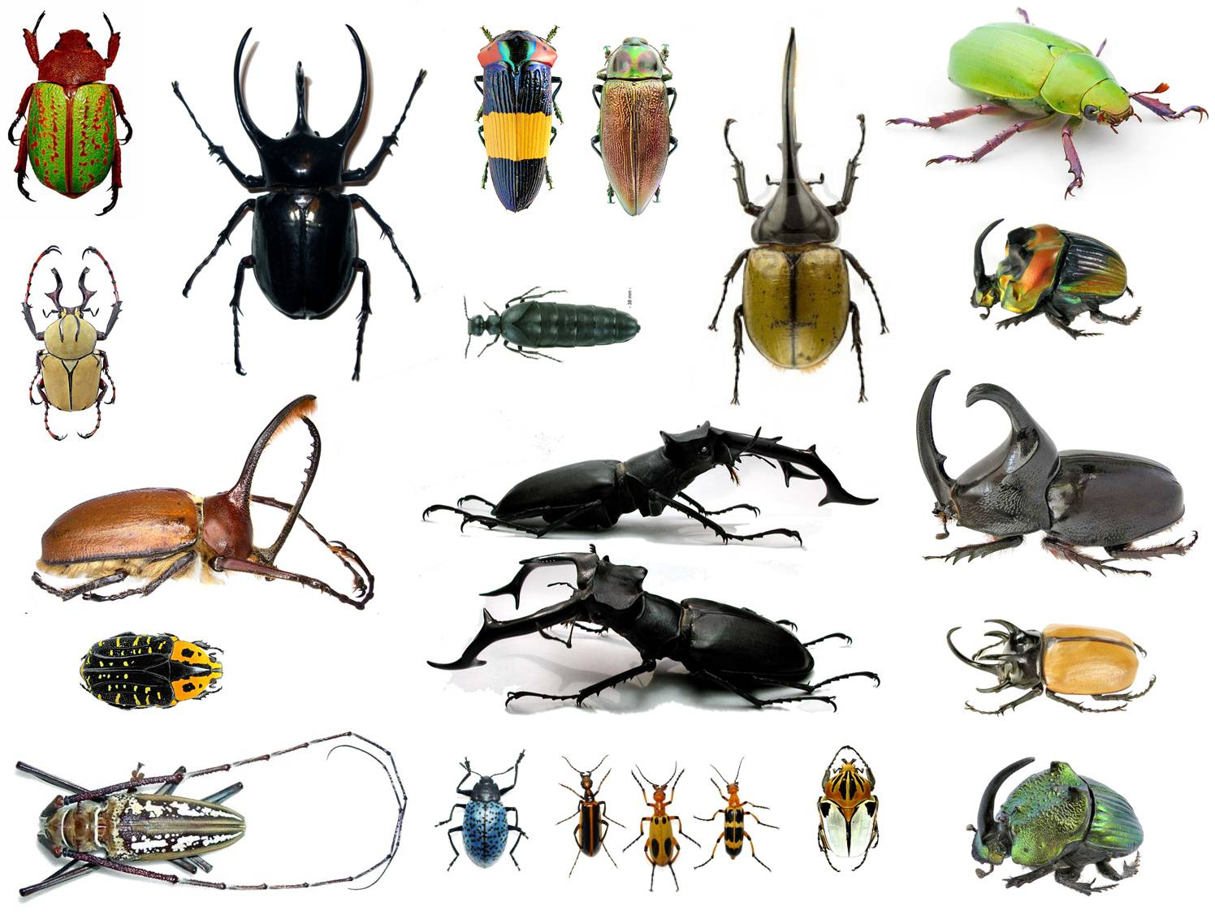
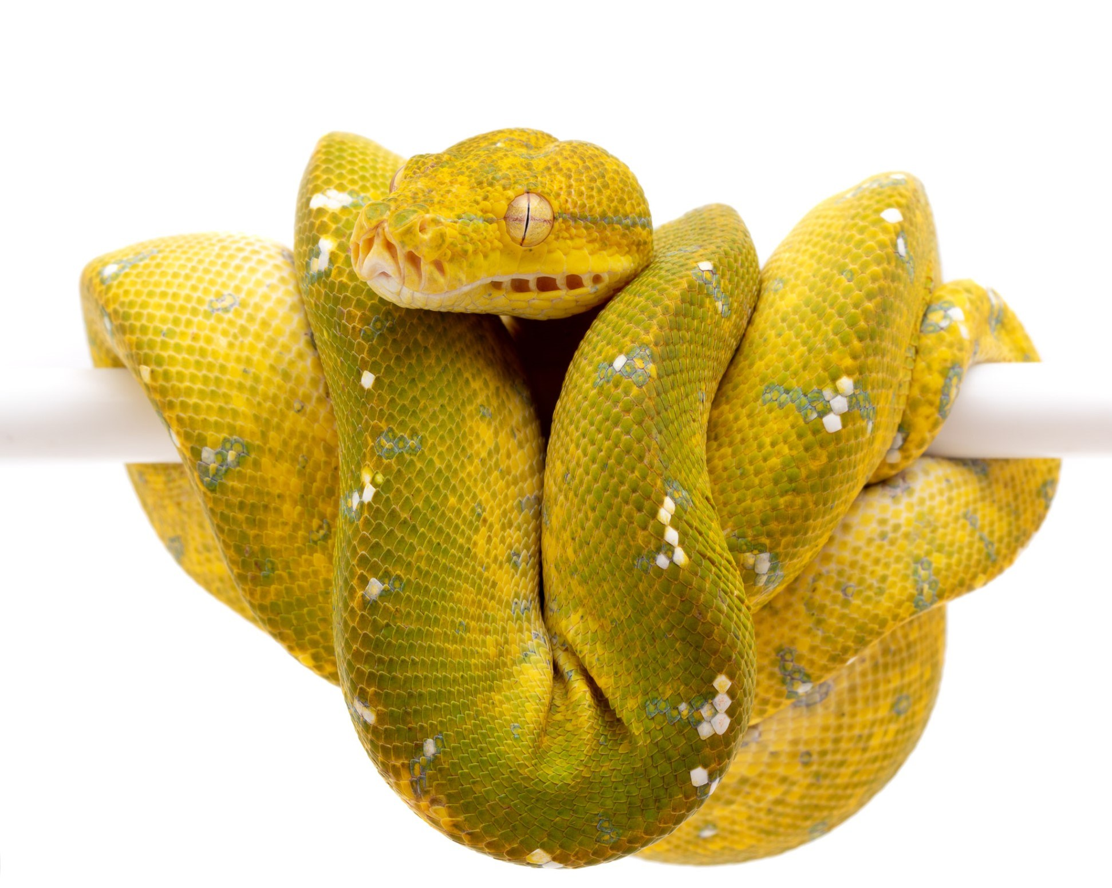
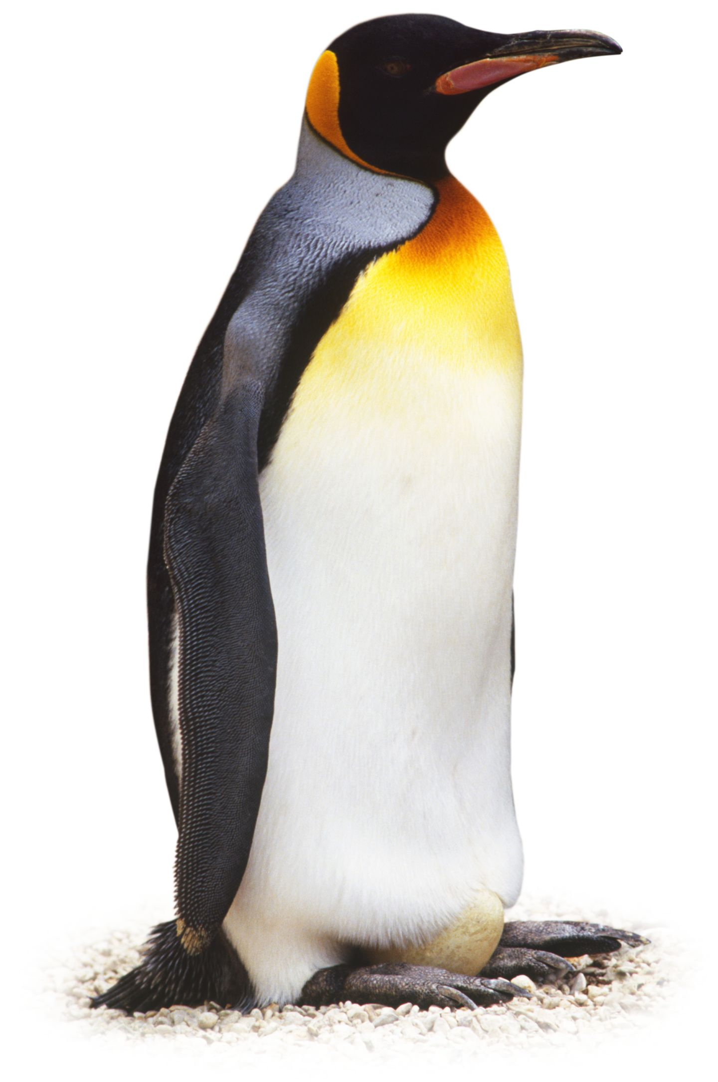

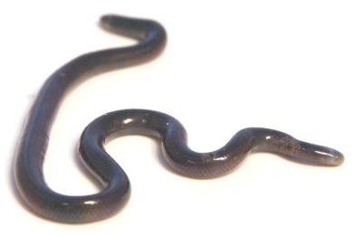
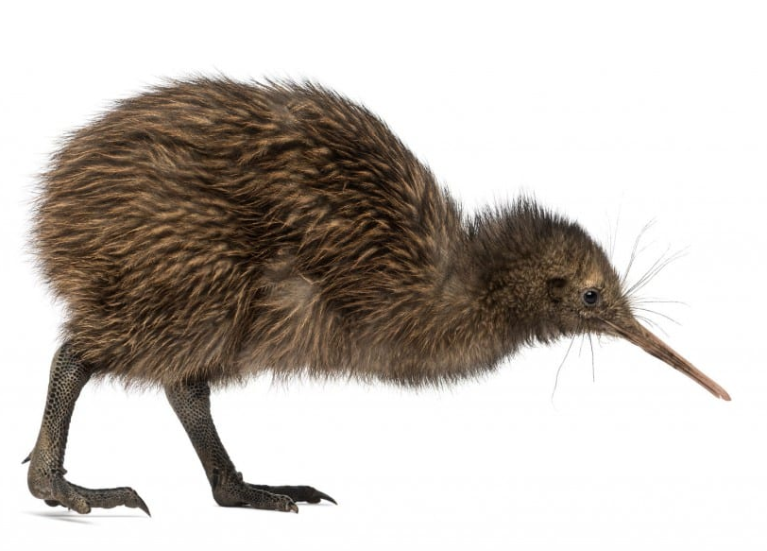
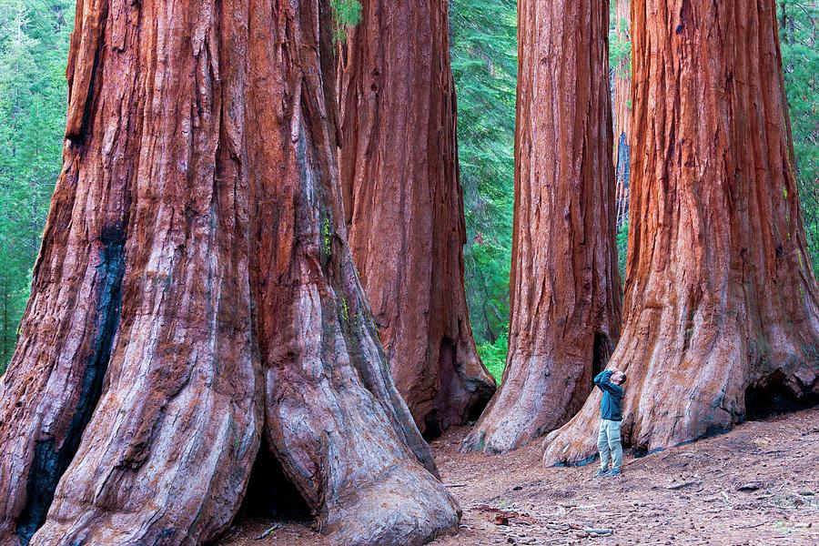

Slide 3
Conceptual Foundations 1 hour
What is a phylogeny
Why perform phylogenetic inference
Data for phylogenetics
Overview of models of evolution
Methods of inference
Interpreting trees
Hands-On Tools and Methods 1 hour
Exercise 1: Running a Simple RAxML Analysis
Exercise 2: Setting up a Basic BEAST Run
Exercise 3: Visualizing and evaluating trees in R
Mini-Project and Discussion 1 hour

Slide 4
Conceptual Foundations 1 hour
What is a phylogeny
Why perform phylogenetic inference
Data for phylogenetics
Overview of models of evolution
Methods of inference
Interpreting trees
Hands-On Tools and Methods 1 hour
Exercise 1: Running a Simple RAxML Analysis
Exercise 2: Setting up a Basic BEAST Run
Exercise 3: Visualizing and evaluating trees in R
Mini-Project and Discussion 1 hour

Slide 5
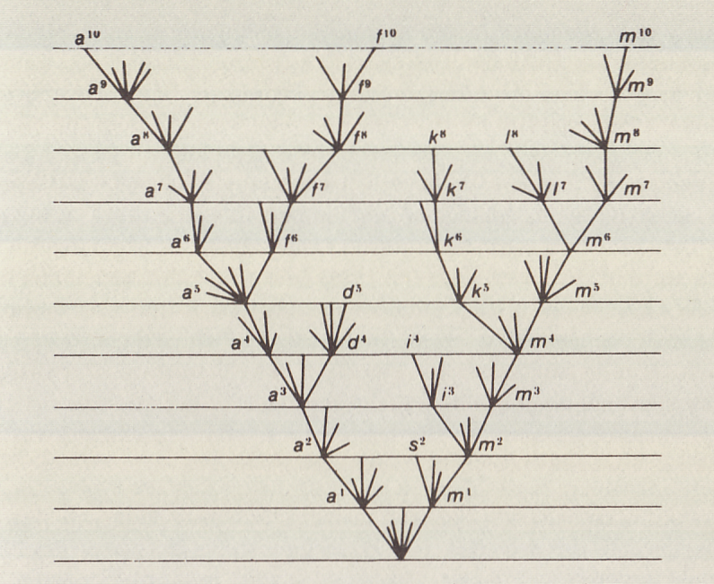
There is a beauty in phylogenies
There is grandeur in this view of life, with its several powers, having been originally breathed into a few forms or into one; and that, whilst this planet has gone cycling on according to the fixed law of gravity, from so simple a beginning endless forms most beautiful and most wonderful have been, and are being, evolved.
Darwin 1859

Slide 6
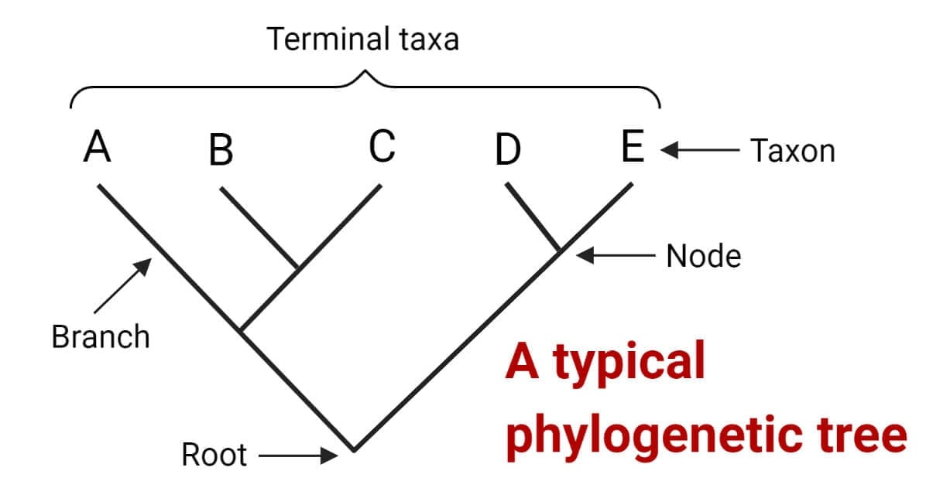
What is a phylogeny

Slide 7
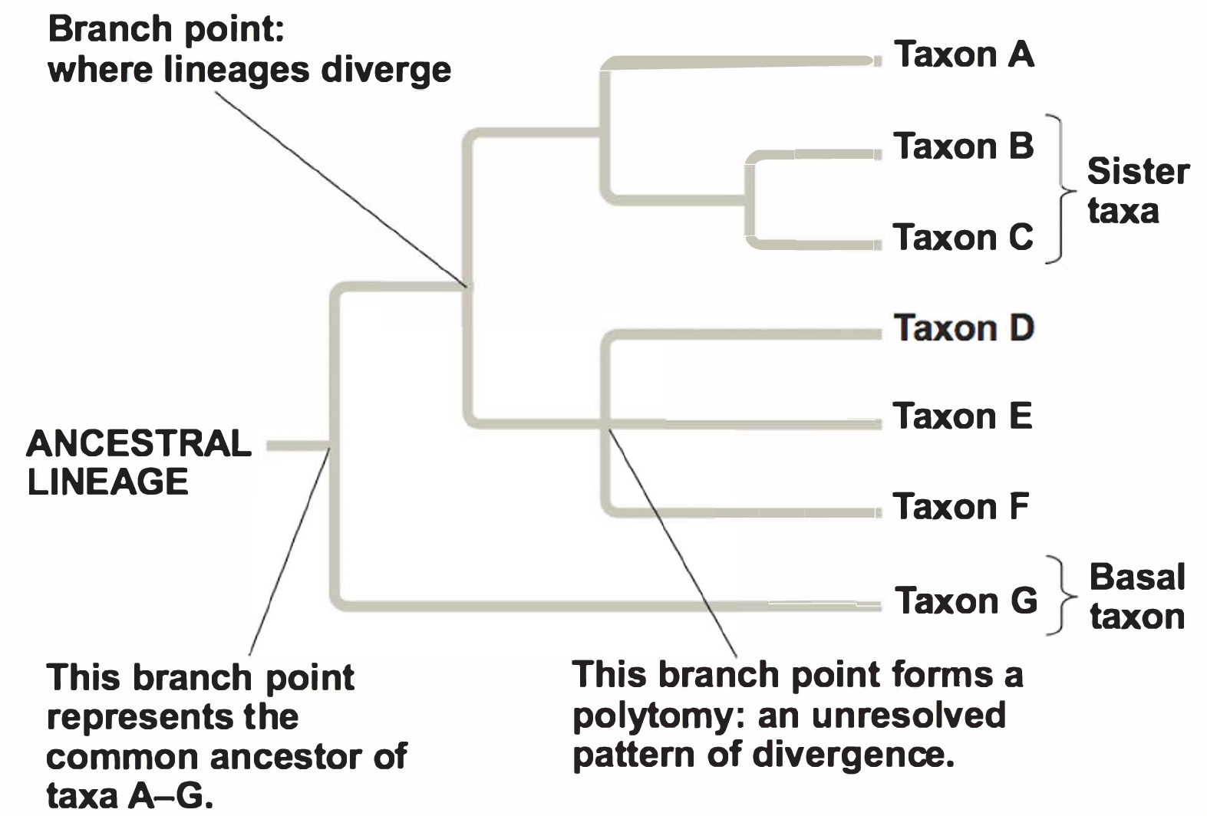
What is a phylogeny

Slide 8
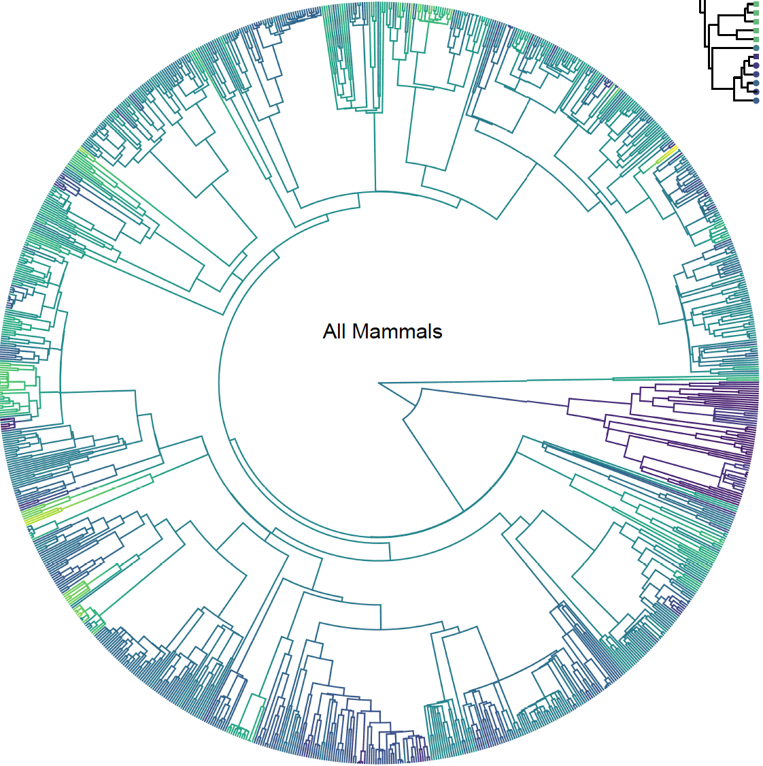
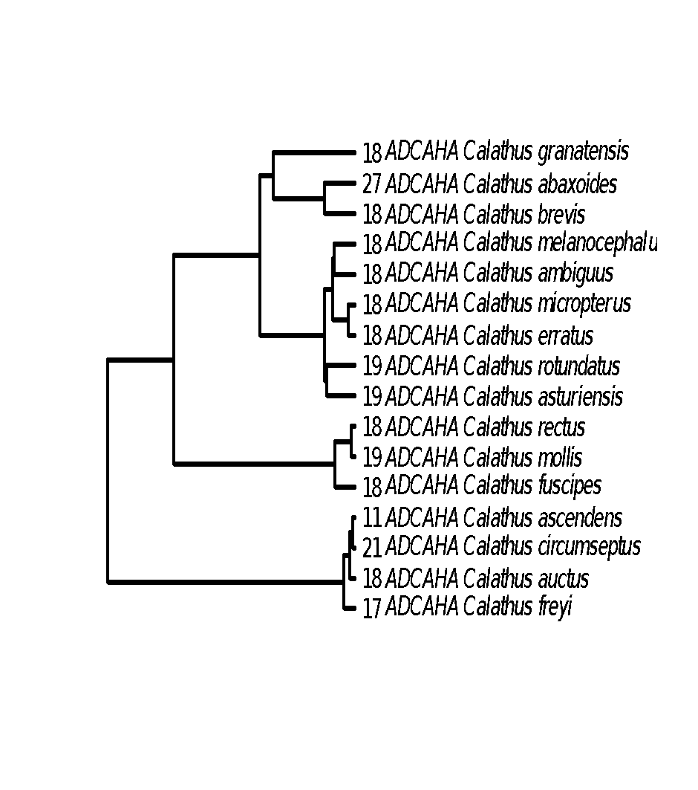
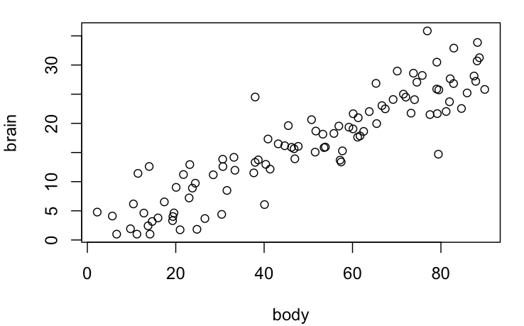
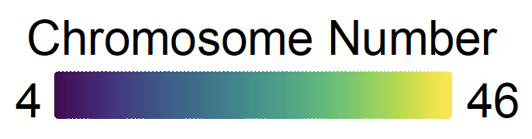
Why infer a phylogeny
Clade 1
Clade 2
Clade 3

Slide 9
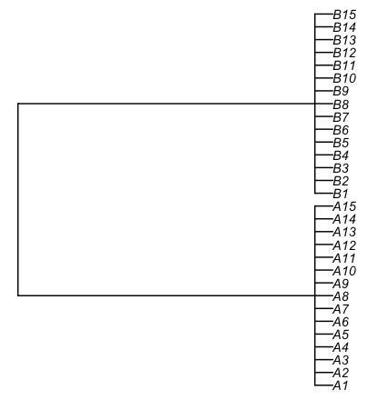
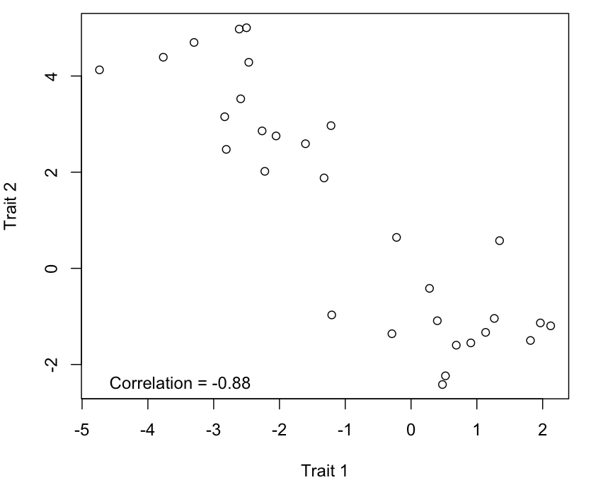
Why infer a phylogeny

Slide 10
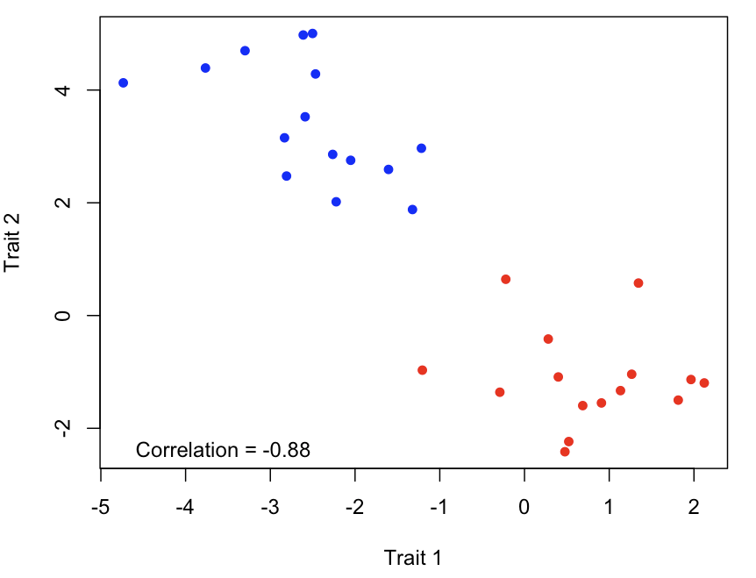
Why infer a phylogeny

Slide 11

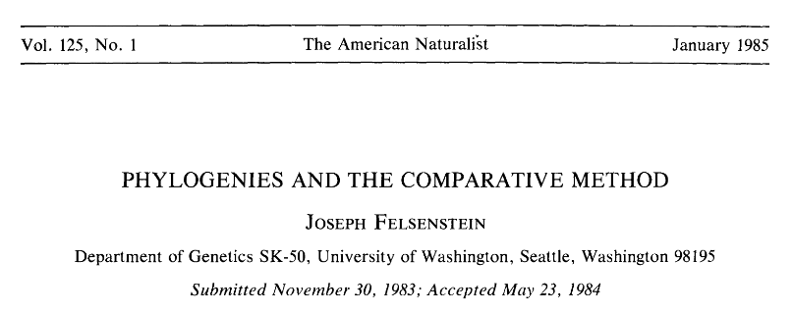
Why infer a phylogeny

Slide 12
Data to infer a phylogeny
No information
SPECIES 1
SPECIES 2
SPECIES 3
SPECIES 4
A | G | G | G | T | T | A
A | C | G | G | T | T | A
A | T | A | G | C | C | A
A | A | A | T | T | C | C

Slide 13
Data to infer a phylogeny
Allow us to cluster species
SPECIES 1
SPECIES 2
SPECIES 3
SPECIES 4
A | G | G | G | T | T | A
A | C | G | G | T | T | A
A | T | A | G | C | C | A
A | A | A | T | T | C | C

Slide 14
Data to infer a phylogeny
G | T
SPECIES 1
SPECIES 2
SPECIES 3
SPECIES 4
G | T
G | T
A | C
A | C
G | C
A | C

Slide 15
Data to infer a phylogeny
G | T
SPECIES 1
SPECIES 3
SPECIES 2
SPECIES 4
G | T
A | C
G | T
A | C
G | C
A | C
G | C
G | T
G | C
A | C

Slide 16
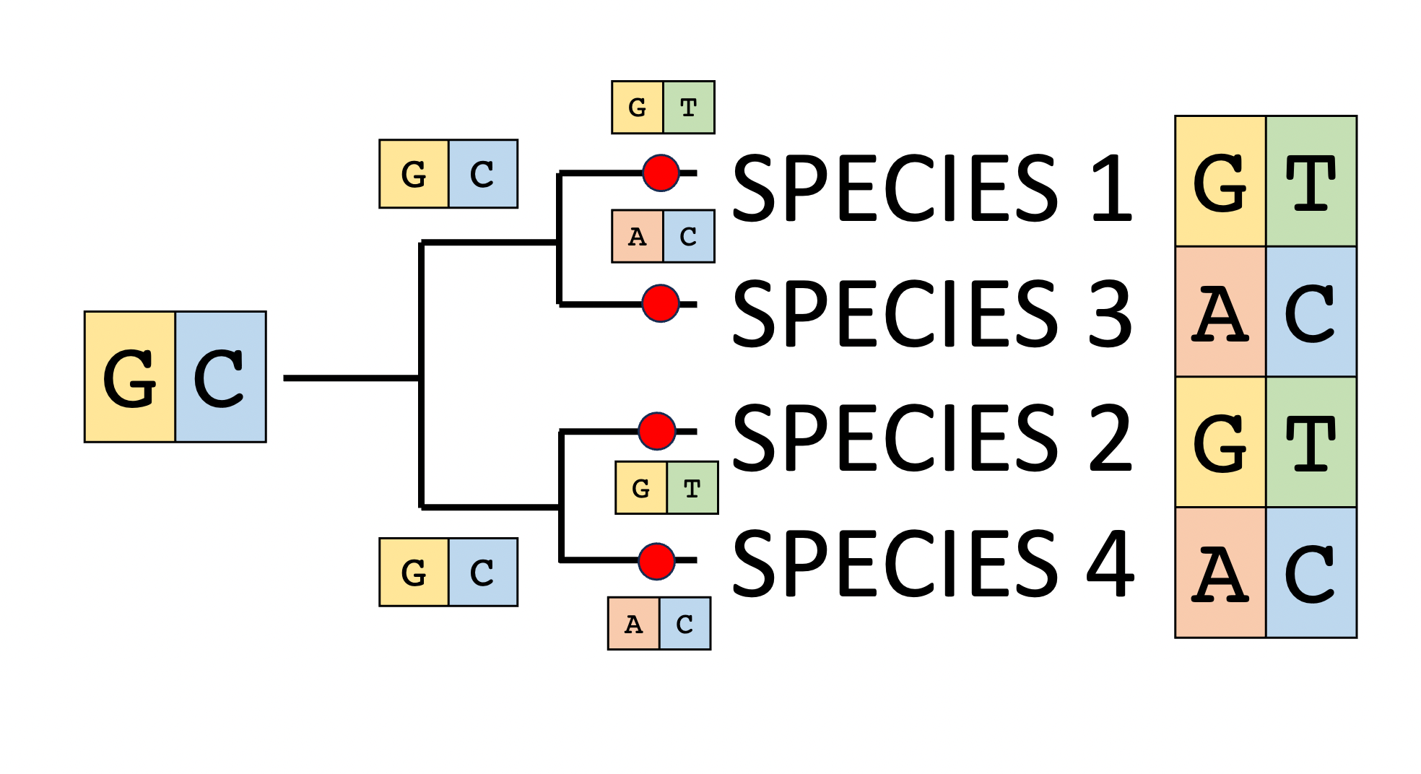
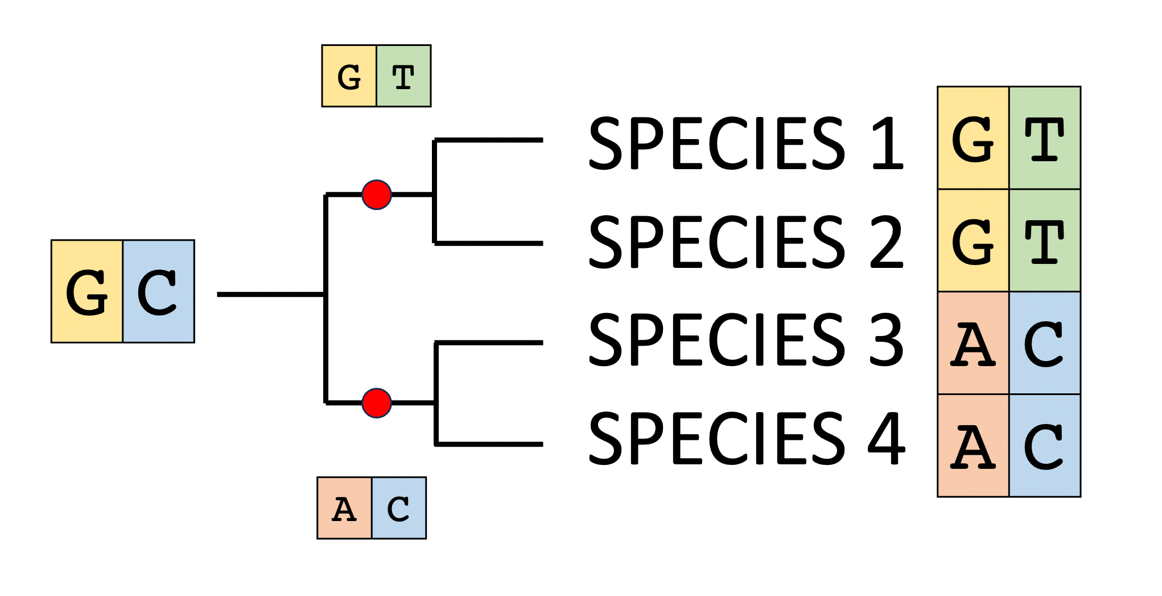
Data to infer a phylogeny

Slide 17
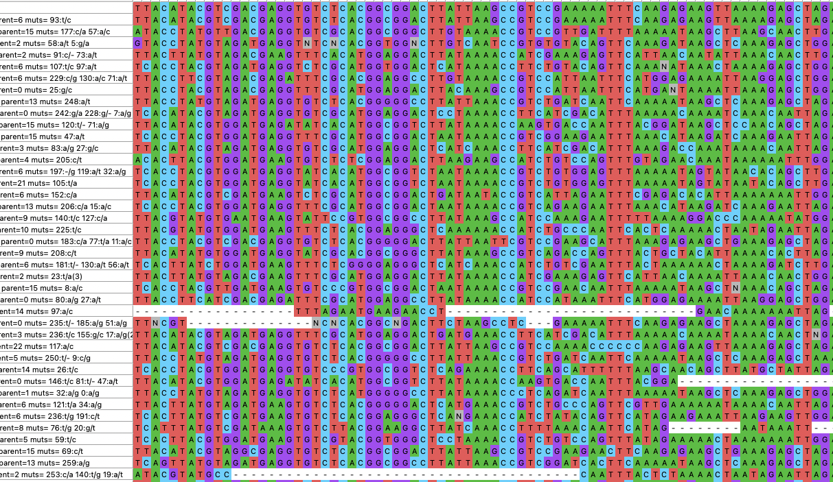
Real alignments can be messy

Slide 18
Alignments tell us a story that can span eons!

Slide 19
Real alignments can be messy
Our tree will only be as informative as our alignment and thus our alignments must be assessed/adjusted/QCd before we use them!
Alignment tool: MAFFT, T-Coffee, Clustal, Muscle, PRANK,
Assessment: Visually inspect alignments (MEGA, Geneious, Jalview, Clustal X)
Algorithmically prune sites: Gblocks, TrimAI, T-Coffee + TCS

Slide 20
Alignment Formats are Pain!
The alignments that you create can be stored in many file formats (fasta, nexus, phylip).
Packages in R like seqinr, ape, phangorn can often convert between types.

Slide 21
Models of sequence evolution describe how DNA changes?
 | A | G | C | T
A | - | α | β | β
G | α | - | β | β
C | β | β | - | α
T | β | β | α | -
Kimura’s two-parameter model
α represents transitions A<->G or C<->T (purine to purine or pyrimidine to pyrimidine)
β represents transversions transitions between purines and pyrimidines
 | A | G | C | T
A | - | r₁ | r₂ | r₃
G | r₁ | - | r₄ | r₅
C | r₂ | r₄ | - | r₆
T | r₃ | r₅ | r₆ | -
General Time Reversible Model
Each type of transition has its own rate but reverse rates equal forward rates

Slide 22
How do we handle models?
Just use GTR and forget about it.*
Pick the best model (jModel Test, Model Test NG, IQ-Tree)
Average across models based on probability (MrBayes, RevBayes)
* Abadi, S., Azouri, D., Pupko, T. and Mayrose, I., 2019. Model selection may not be a mandatory step for phylogeny reconstruction. Nature communications, 10(1), p.934.

Slide 23
How do we actually choose among trees and branch lengths
Parsimony | Maximum Likelihood | Bayesian
Simple and intuitive | Uses an explicit model of evolution | Uses an explicit model of evolution
Fast for moderate datasets | Relatively quick | Incorporates priors
Possibly more appropriate for complex morphological characters | Statistically sound and less impacted by long-branch attraction | Allows comparisons of hypotheses
Ignores some of our understanding about how sequences evolve | Requires model selection | Natural representations of uncertainty
Susceptible to long-branch attraction | Uncertainty is captured mainly by bootstrapping | Computationally intensive
 |  | Incorporates priors
 |  | Requires MCMC diagnosis

Slide 24
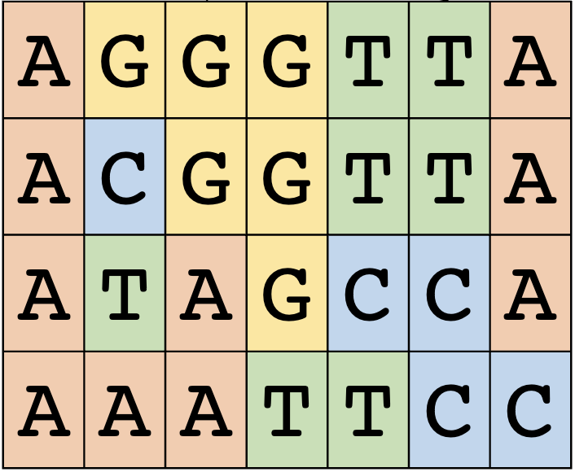
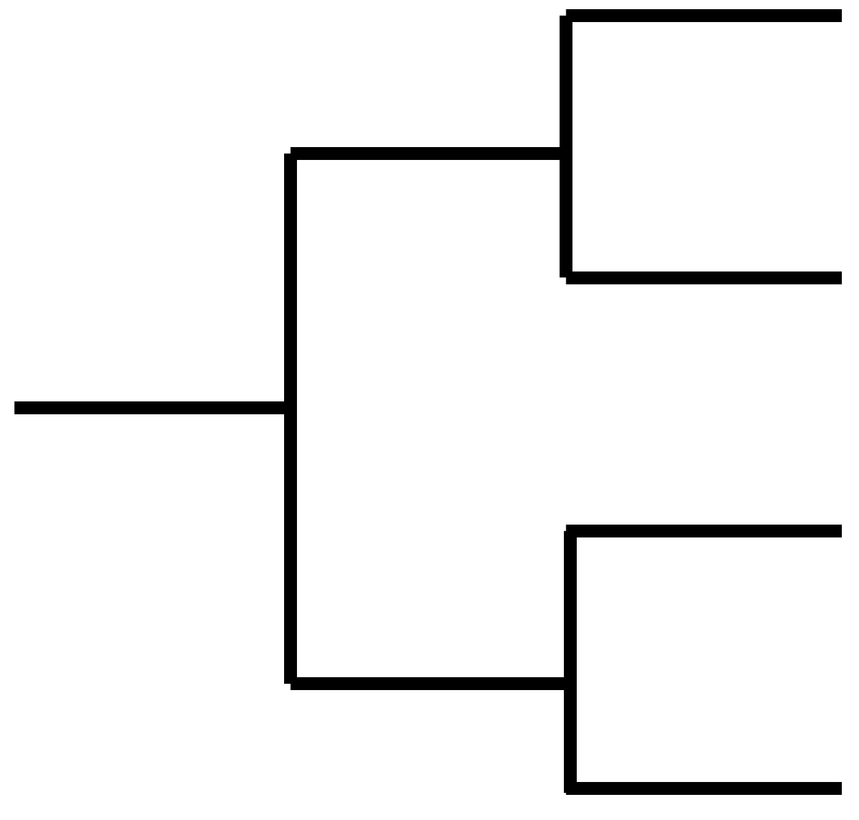
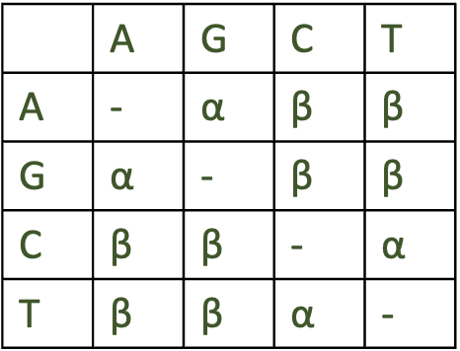

Maximum likelihood algorithm
$$P\left( | \right)$$
Pick a random starting value for all parameters
Calculate the likelihood above
Make a small change to one of the parameters
Keep that change if the likelihood of the alignment improved
Repeat until you get no further improvement in likelihood

Slide 25
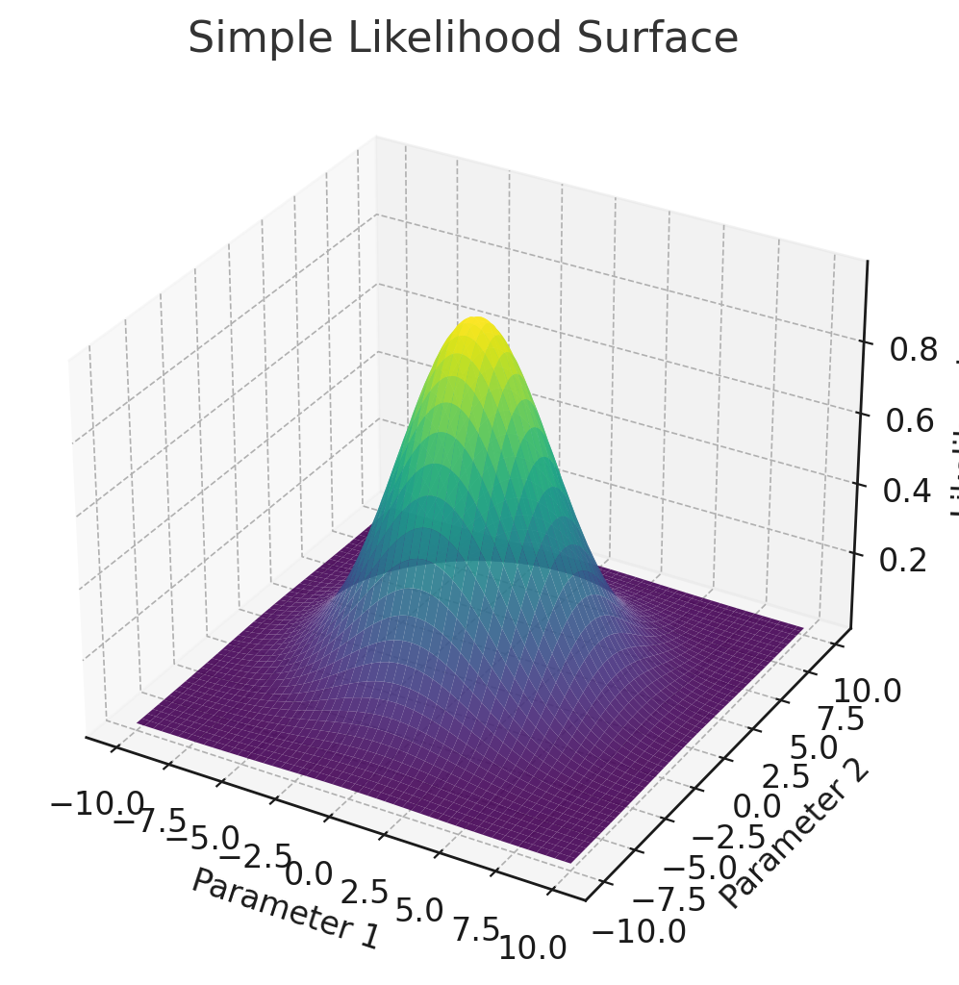
Maximum likelihood
$$P\left( | \right)$$

Slide 26
Maximum likelihood
$$P\left( | \right)$$

Slide 27
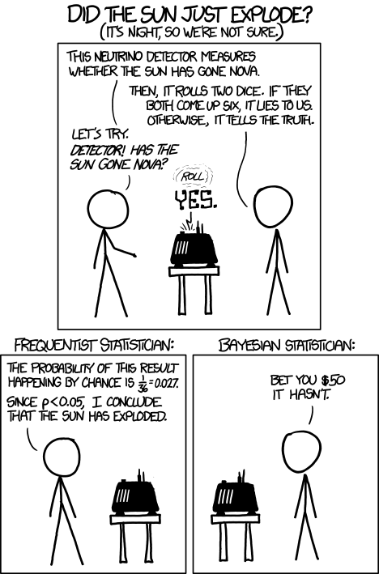
What is Bayesian Statistics?

Slide 28



Bayes’ Theorem
$P\left( | \right)$ $P( )$
$$P\left( \right)=$$
$$P( )$$
Impractical to calculate for non-trivial problems but can be avoided via MCMC
These are the priors
Reverend Thomas Bayes (1701–1761) was an English statistician, philosopher, and Presbyterian minister best known for Bayes' Theorem, which provides a mathematical framework for updating probabilities based on new evidence. His posthumously published work laid the foundation for Bayesian inference, a cornerstone of modern statistics, machine learning, and phylogenetics.

Slide 29


MCMC algorithm
$$P\left( \right)$$
Pick starting values
Calculate the probability
Make a small change to one parameter
Calculate the new probability
Accept the changed parameter with this probability
Return to step 3
Repeat steps 3-6 1,000,0000s of times
current
$$P\left( \right)$$
previous

Slide 30

MCMC Run
$$P\left( \right)$$

Slide 31
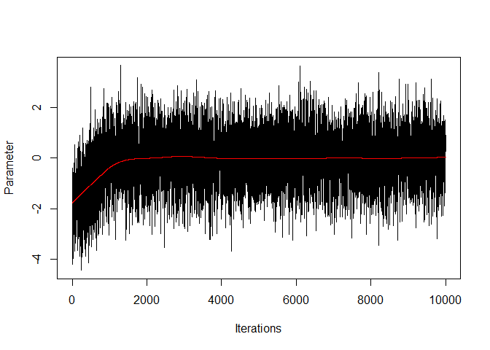
MCMC Run
This is the burnin
This is the sample of the posterior

Slide 32
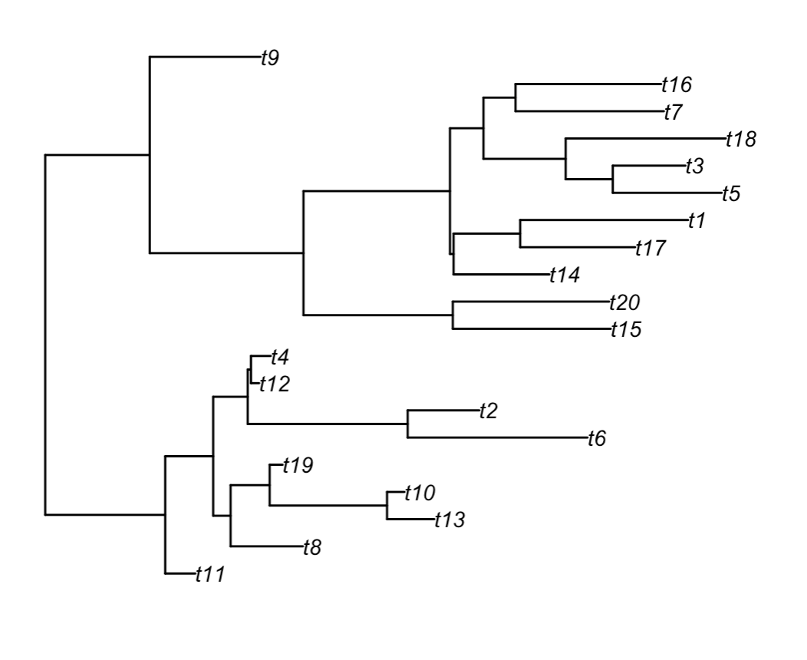
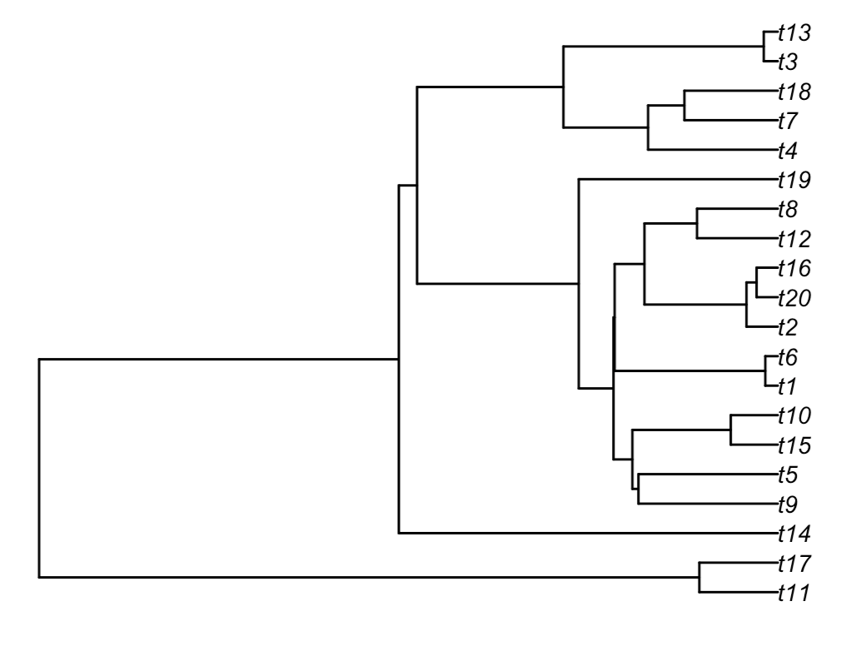
What do branch lengths mean?
Typically, branch lengths will either be expected substitutions per site or time (MY)

Slide 33
Questions
Name two species that are sister.
Which species is most closely related to t18?
What does the red dot indicate?
What are the tradeoffs between ML and Bayesian
Why do we need phylogenies?

Slide 34
If this is your future what next?
Read inferring phylogenies!
Talk to your mentors about good labs that might interest you.
As you start grad school look for workshops (MBL Mol. Evol. Course)
Amazing youtube vidoes
Some software have manuals that are very informative. For instance, the MrBayes manual is really a short course on all things Bayesian as well as how to run MrBayes.
There are also a wealth of online tutorials.

Slide 35
If this is your future what next?
Break
Guided walkthrough of running raxml / mrbayes
Visualizing trees

