Slide 1
Random vs Fixed Effects Biology 683 Lecture 8 Heath Blackmon

Slide 2
Last week
Regression
General linear model – all fixed effects

Slide 3
Today
Mixed Effects Models
Fixed vs Random
Two-factor ANOVA

Slide 4
What is a fixed effect
These are the variables whose impact we wish to determine
Characteristics of the media or habitat
Alternate medical treatments
Age groups
Time points
Conclusions that you reach are only applicable to the groups or treatments you include in the study

Slide 5
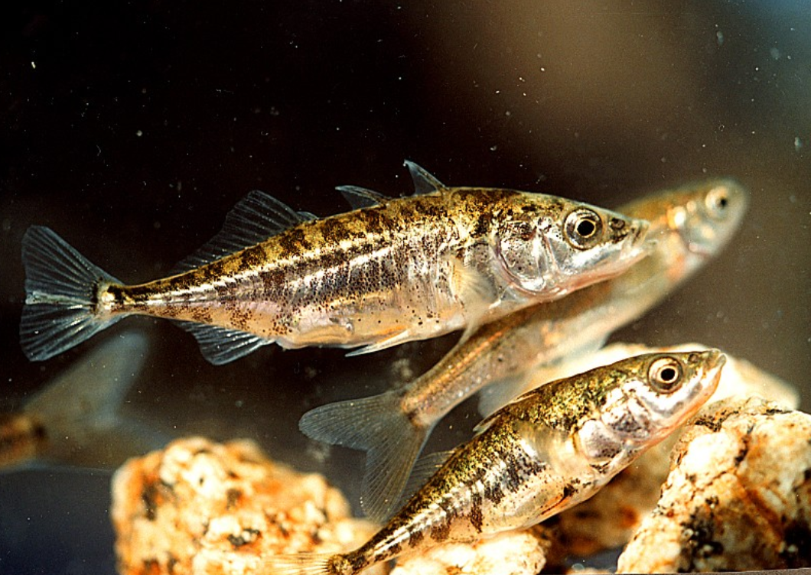
Example of fixed effects
Reciprocal relocation experiment to investigate how genotype and habitat interact to determine the fitness of stickleback fish (Rundle 2002).
 |  | Source habitat
 |  | Shallow | Deep
Test habitat | Shallow | 12 fish | 11 fish
 | Deep | 7 fish | 11 fish

Slide 6
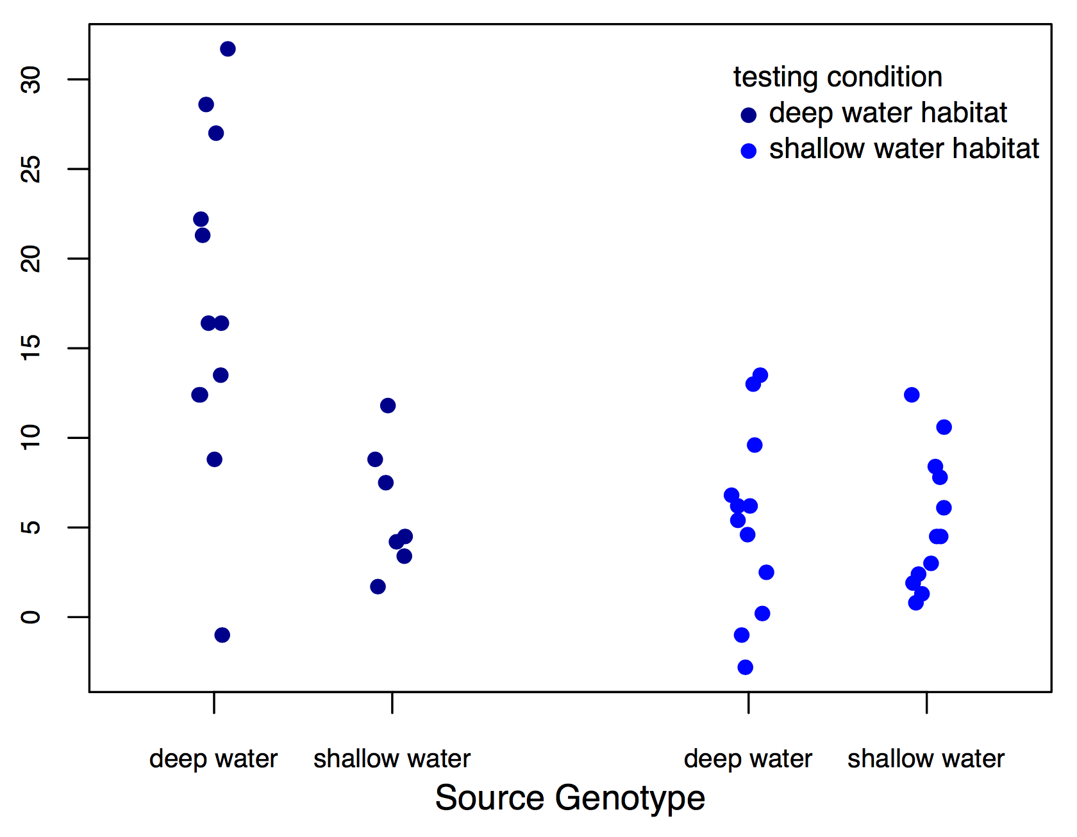
Example of fixed effects
lm(fitness ~ testing condition * genotype)
fitness

Slide 7
What is a random effect
These are randomly sampled categories of a variable that represent groups of individual measurements. Usually random effects are not repeatable.
Study sites
Environmental chambers
Families made up of siblings
Measurements within individuals
Conclusions that you reach are applicable to the population being studied

Slide 8
What is a random effect
Sometimes random effects are a nuisance
Field sites
Environmental chambers
Field plots
Repeated measures
Sometimes random effects are of great interest
Families
Transects or Sites

Slide 9
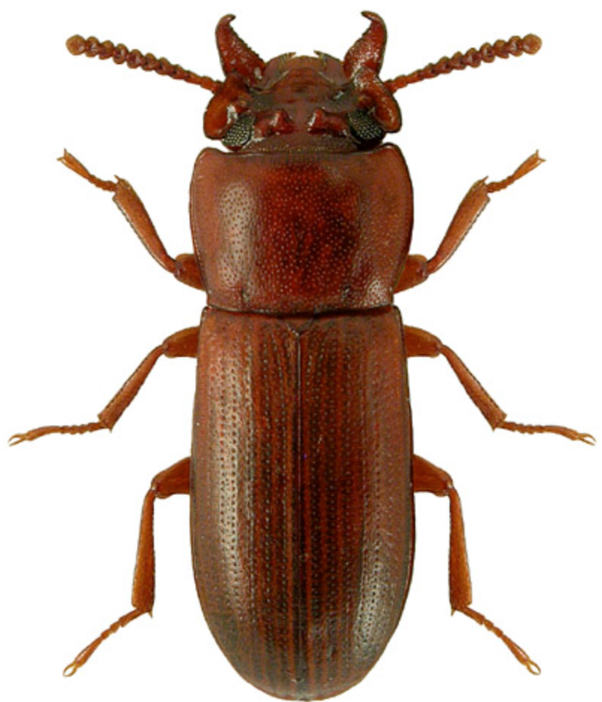
Example of random effects
Impact of selective regime on horn size. Measure both the left and right horn in 25 beetles from two different selective regimes.
Horn size | Beetle | Selective regime
256 276 321 321 423 401 381 409 | 1 1 2 2 3 3 4 4 | High High High High Low Low Low Low

Slide 10
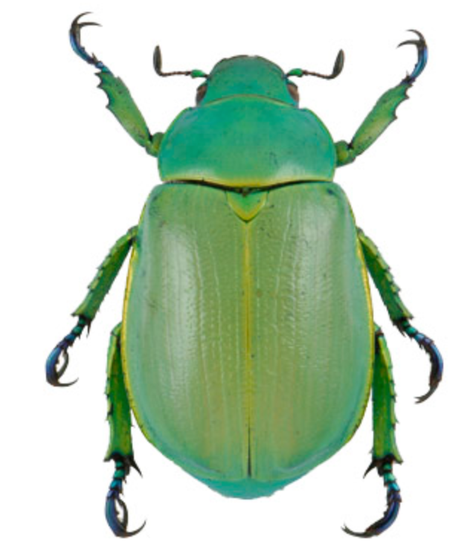
Example of random effects
Identifying the predictors for the presence or absence of Chrysina beetles.
Number collected | oak | juniper | site | date
8 2 1 5 4 6 0 7 | 1 1 0 0 1 1 1 1 | 0 1 1 1 1 0 1 1 | 21 13 31 15 21 13 31 15 | 210 210 211 212 242 242 245 245

Slide 11
Implementing a mixed effects model
Mixed effect models are fit using the LME function

Slide 12
For Thursday
Read chapter WS 17
Bring laptop to class!
Heath Blackmon
BSBW 309
coleoguy@gmail.com
@coleoguy

Slide 13
Models
"Remember that all models are wrong; the practical question is how wrong do they have to be to not be useful.”
George Box

