Slide 1
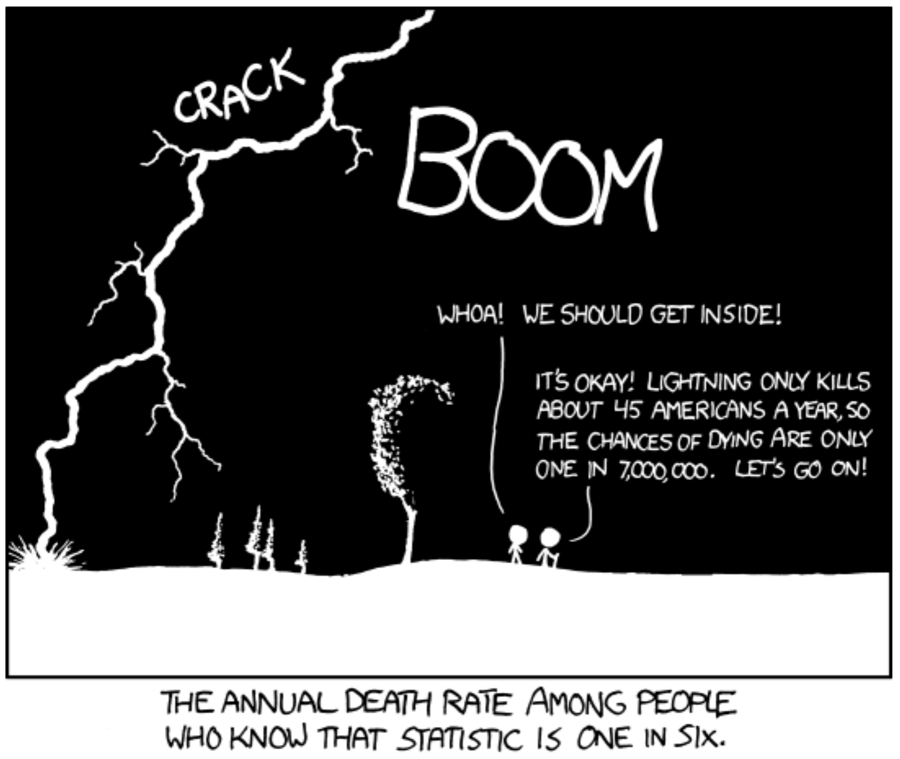
Probability and Discrete Variables Biology 683 Heath Blackmon

Slide 2
Last week
If I say the 95% CI is 1.2-1.7, what do I mean?
What is the difference in a parameter and a statistic?

Slide 3
Today
Basic experimental reminders
Basics of Probability
Binomial and Chi-square tests

Slide 4
Analyzing Proportions
Several chapters in the book deal with this topic
The experiment boils down to this:
Your subjects have some alternative outcomes
Each individual has some probability of each outcome
You are trying to find the conditions that impact that probability
When would this type of problem come up in the biological sciences?

Slide 5
Terms to know for probability
Conditional probability: The probability of being struck by lightning changes if you know the statistic about 45 American a year being killed by lightning

Slide 6
A simple example
What is the probability of drawing an ace then a king from a deck cards?
What is the sample space?
Are the events independent or dependent?
What is the probability of this event?
What is the conditional probability of drawing a king if we have already drawn an ace?
assume standard deck with no jokers

Slide 7
Binomial Test
A test to determine whether or not the observed proportion adheres to the expected proportion under the null hypothesis
Some possible uses:
Are frogs equally likely to be right or left handed?
Is the sex ratio half male and half female?
Are the offspring phenotypes a 3:1 ratio?
Do some beetles win more fights?

Slide 8
Binomial Test
As in most statistical tests, a test statistic is compared to a distribution
In this case, the test statistic is just the observed number (number of right-handed toads, number of females in the population, number of fights won)
Note that this test is only appropriate when there are two categories of individuals and your hypothesis allows you to provide a probability of the outcomes.

Slide 9
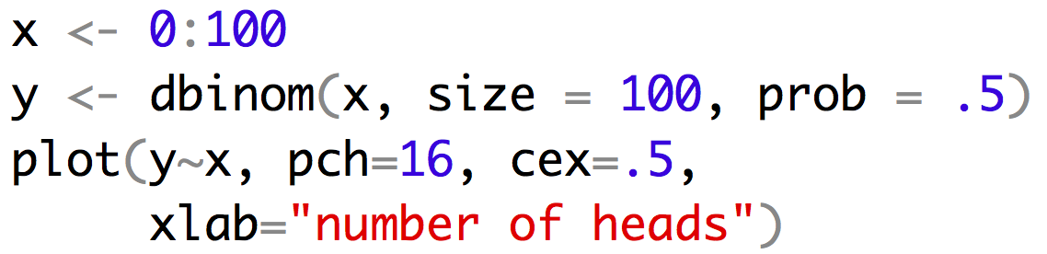
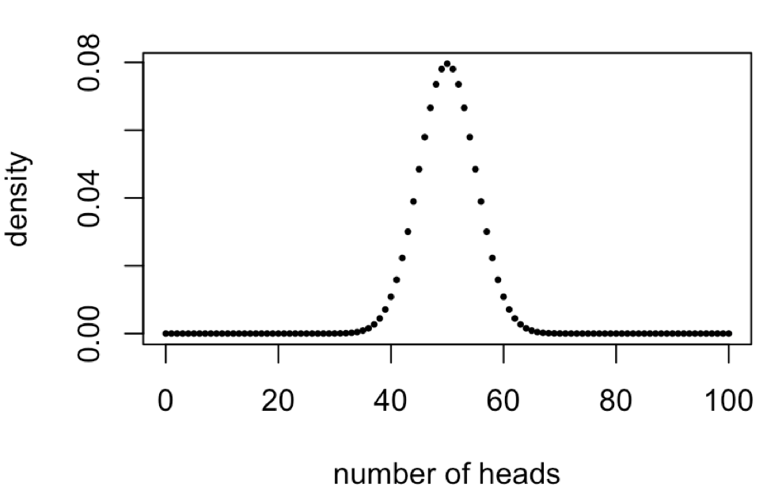
Binomial Test
With the binomial test our null hypothesis is the probability of one of the two outcomes. This probability and the number of observations defines the distribution we will compare our observation to.
Distribution when the null is 50% and we have 100 observations
use a simulation to see if you can replicate this curve

Slide 10
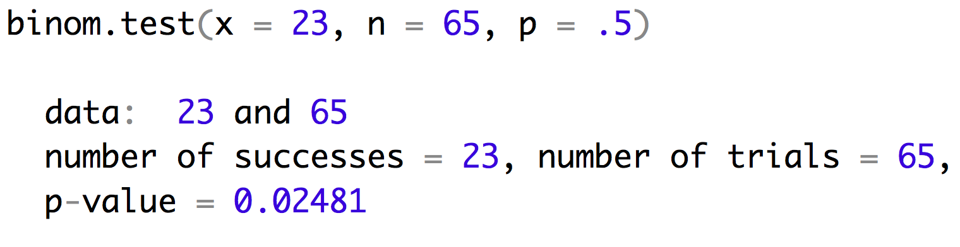
Binomial Test
Lets look at an example with sex ratio. You are hybridizing closely related species (with XY sex chromosomes) so you know Haldane’s rule states that the males might be more rare. When you survey the offspring you find 23 males out of 65 offspring. Does this result support Haldane’s rule occuring in your system?

Slide 11
Binomial Test
Lets look at an example with sex ratio. You are hybridizing closely related species (with XY sex chromosomes) so you know Haldane’s rule states that the males might be more rare. When you survey the offspring you find 23 males out of 65 offspring. Does this result support Haldane’s rule occuring in your system?

Slide 12
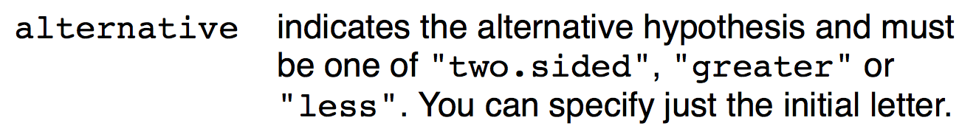
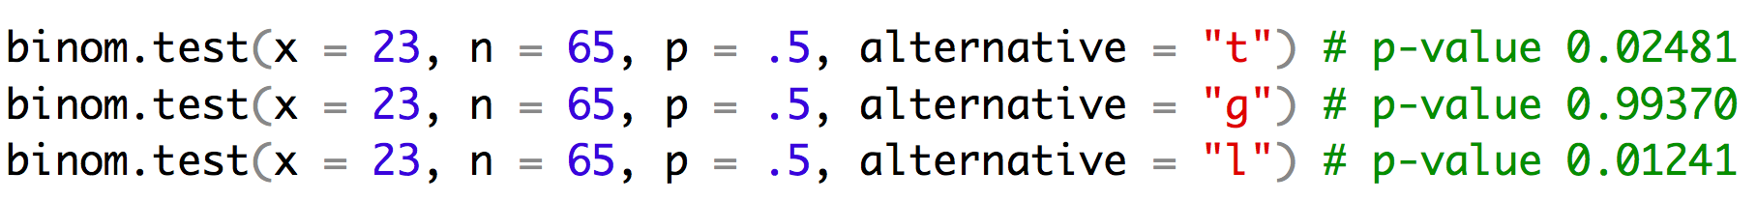
Binomial Test
binom.test has an argument alternative

Slide 13
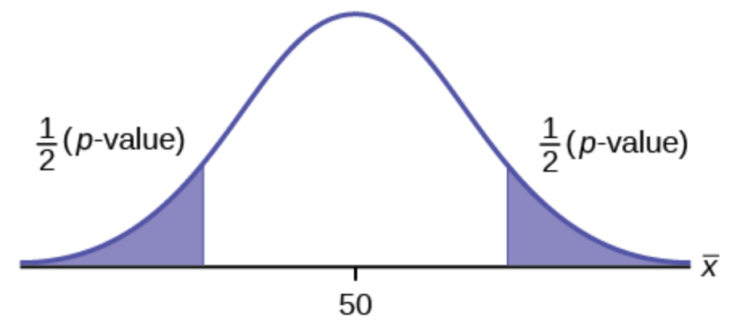
Binomial Test
Alternative = two.sided
What is the probability that I would see a skew in the sex ratio this great or greater.
In this case our observed number of males was -1.2 standard deviations from the mean. So our p-value is the area under the curves above 1.2SD and below -1.2SD.
-1.2 SD
1.2 SD

Slide 14
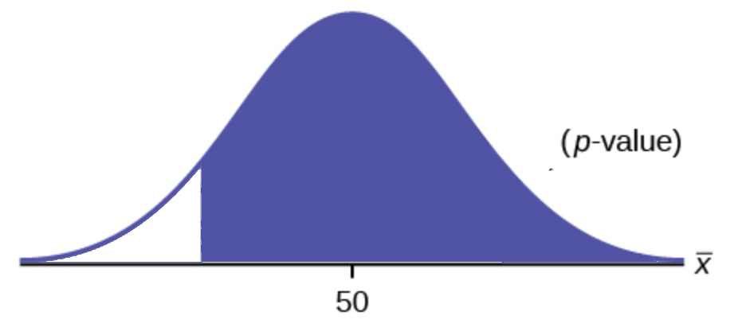
Binomial Test
Alternative = greater
What is the probability that I would see a larger number of males.
In this case our observed number of males was -1.2 standard deviations from the mean. So our p-value is the area under the curves above -1.2SD.
-1.2 SD

Slide 15
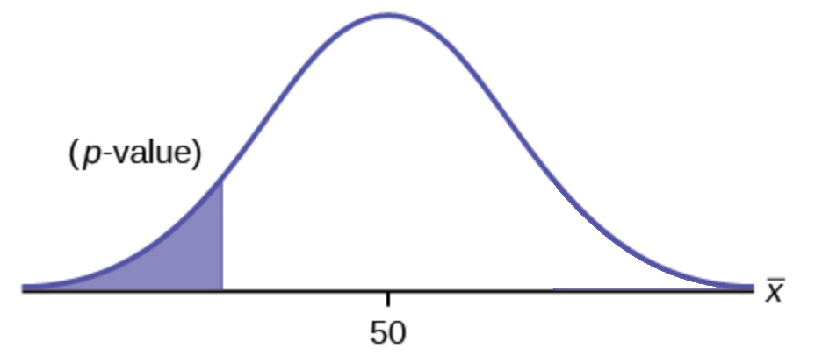
Binomial Test
Alternative = less
What is the probability that I would see this many or fewer males.
In this case our observed number of males was -1.2 standard deviations from the mean. So our p-value is the area under the curves below -1.2SD.
-1.2 SD
If before we collected this data we wanted to answer the question: “Are males more rare than females?” Then we have an apriori hypothesis that we should see fewer males than females so we could justify using this more powerful test.

Slide 16
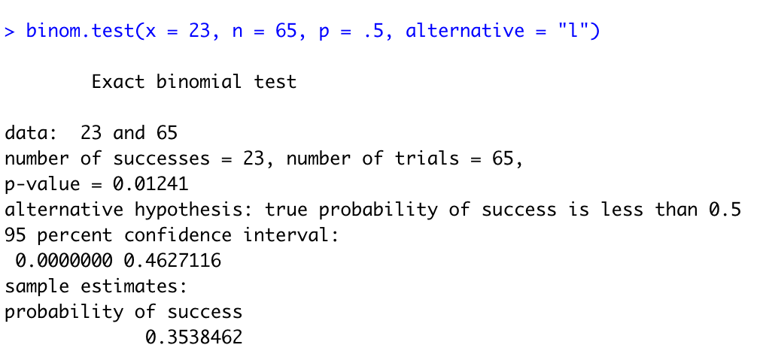
Reporting the Results
Our offspring ratio shows a significantly fewer males than would be expected under a 1:1 sex ratio (0.35, 95% CI: 0.24-0.48, binomial test, n = 65, p < 0.025).

Slide 17
Reporting the Results
This populations shows a significantly fewer males than would be expected under a 1:1 sex ration (0.35, 95% CI: 0.24-0.48, binomial test, n = 65, p < 0.025).
For very small p-values, we just say that p is very small (< 0.001 or < 0.0001).
Most journals/subdisciplines will have conventions about how certain tests are reported.
Most journals italicize mathematical variables, so n and p would be italicized. They also normally would be lower case.

Slide 18
$χ^{2}$ Test
This test compares the observed number in each category to expectations based on the null hypothesis (if there are only two categories, it approximates the binomial test with probability of 50%)
It can also be used to test for independence of two variables, and then it is called a contingency χ2-test.
We will use data from the Titanic and
see if some females were more likely to
survive than others.
Female adults on the Titanic
 | Survived | Died
1st | 140 | 4
2nd | 80 | 13
3rd | 76 | 89
Crew | 20 | 3

Slide 19
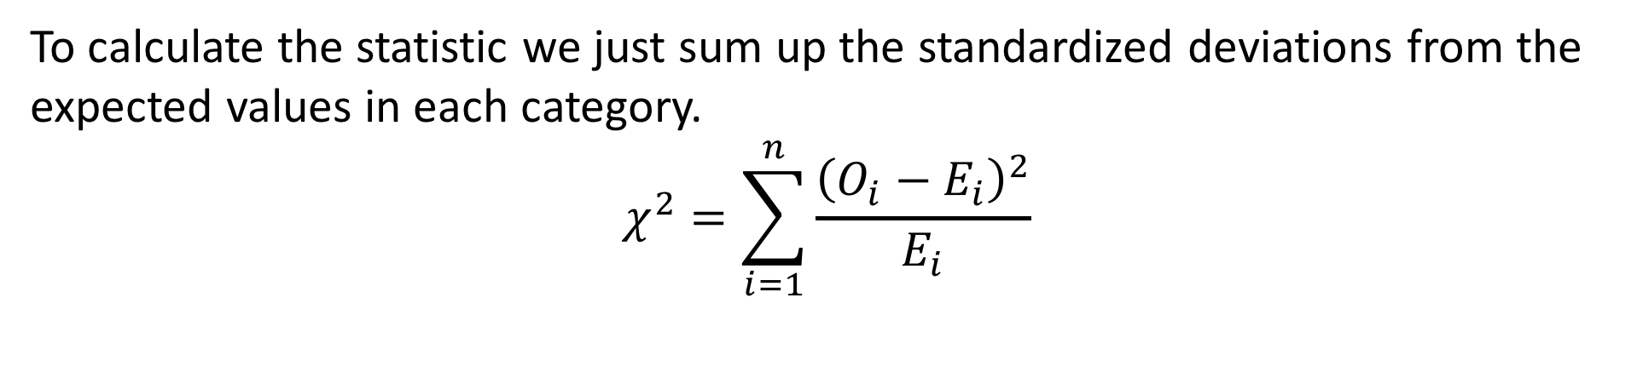
$χ^{2}$ Test
To calculate the statistic we just sum up the standardized deviations from the expected values in each category.
$$χ^{2}=\sum_{i=1}^{n}{\frac{{\left(O_{i}−E_{i}\right)}^{2}}{E_{i}}}$$

Slide 20
$χ^{2}$ Test
To calculate the statistic we just sum up the standardized deviations from the expected values in each category.
$$χ^{2}=\sum_{i=1}^{n}{\frac{{\left(O_{i}−E_{i}\right)}^{2}}{E_{i}}}$$
Female adults on the Titanic
 | Survived | Died | total
1st | 140 | 4 | 144
2nd | 80 | 13 | 93
3rd | 76 | 89 | 165
Crew | 20 | 3 | 23
total | 74.4% | 25.6%

Slide 21
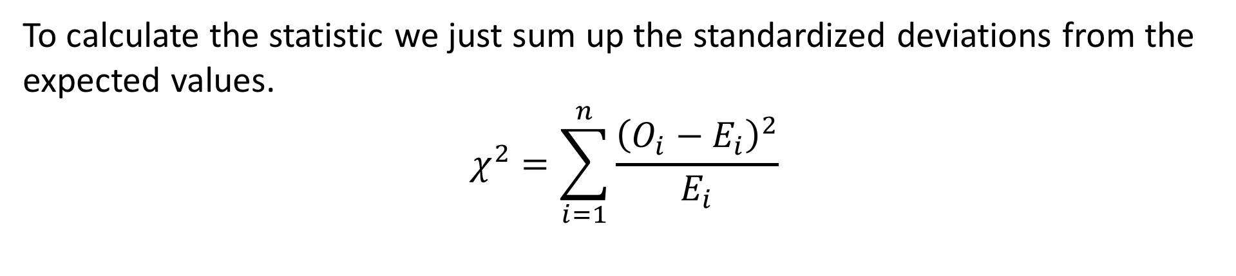
$χ^{2}$ Test
To calculate the statistic we just sum up the standardized deviations from the expected values.
$$χ^{2}=\sum_{i=1}^{n}{\frac{{\left(O_{i}−E_{i}\right)}^{2}}{E_{i}}}$$
Female adults on the Titanic
 | Survived | Died
1st | 140 | 4 | 144
2nd | 80 | 13 | 93
3rd | 76 | 89 | 165
Crew | 20 | 3 | 23
total | 74.4% | 25.6%
Expected
 | Survived | Died
1st | .744 x 144 | .256 x 144
2nd | .744 x 93 | .256 x 93
3rd | .744 x 165 | .256 x 165
Crew | .744 x 23 | .256 x 23

Slide 22
$χ^{2}$ Test
To calculate the statistic we just sum up the standardized deviations from the expected values.
$$χ^{2}=\sum_{i=1}^{n}{\frac{{\left(O_{i}−E_{i}\right)}^{2}}{E_{i}}}$$
Female adults on the Titanic
 | Survived | Died
1st | 140 | 4 | 144
2nd | 80 | 13 | 93
3rd | 76 | 89 | 165
Crew | 20 | 3 | 23
total | 74.4% | 25.6%
Expected
 | Survived | Died
1st | 107 | 37
2nd | 69 | 24
3rd | 123 | 42
Crew | 17 | 6

Slide 23
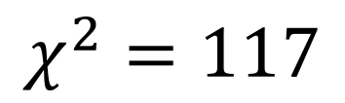
$χ^{2}$ Test
To calculate the statistic we just sum up the standardized deviations from the expected values.
$$χ^{2}=\sum_{i=1}^{n}{\frac{{\left(O_{i}−E_{i}\right)}^{2}}{E_{i}}}$$
Observed
 | Survived | Died
1st | 140 | 4
2nd | 80 | 13
3rd | 76 | 89
Crew | 20 | 3
Expected
 | Survived | Died
1st | 107 | 37
2nd | 69 | 24
3rd | 123 | 42
Crew | 17 | 6
$$χ^{2}=117$$

Slide 24
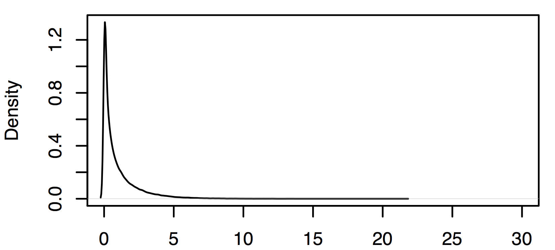
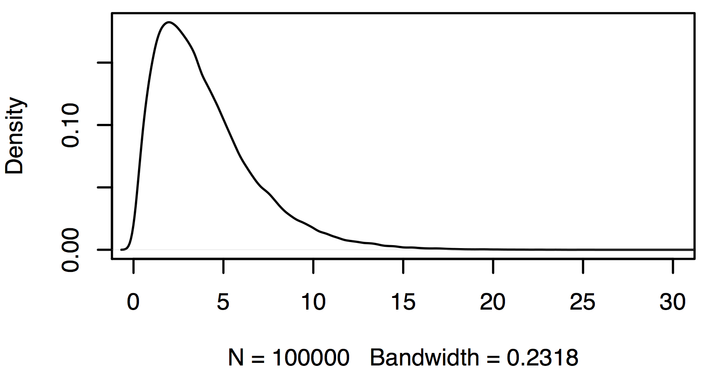
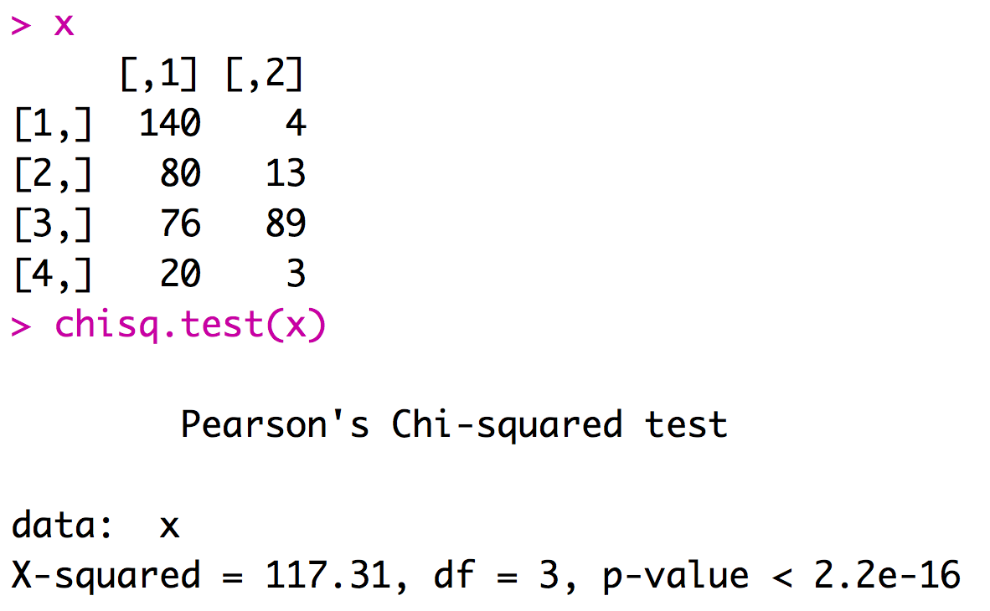
$χ^{2}$ Test
The shape of the chi square distribution depends on the degrees of freedom (df).
df = (no. rows – 1)(no. cols -1)
df = (4– 1)(2 -1)
df = 3
df=1
df=3
Female adults on the Titanic
 | Survived | Died
1st | 140 | 4
2nd | 80 | 13
3rd | 76 | 89
Crew | 20 | 3

Slide 25
My take
Much of what was presented today forms the basis of logically thinking about your experimental results. Similarly these topics are key to your ability to evaluate the evidence presented in the papers that you read. I will definitely ask you multiple questions on your midterm and final that will require you to think clearly about these topics.

Slide 26
My expectations for you
Concepts |  | R coding | Stats
Reproducibility crisis | Probability | <- [] + - / %% : == != | binom.test
Importance of stats training | Bayesian vs ML | %in% | chisq.test
Rules for plots | Null hypotheses | c, rep, data.frame, list, for,
Populations and samples | P-values | if, print, rnorm, plot, hist,
Types of data | Replicates (bio/tech) | density, names, barplot,
Data summary |  | arrows, lines, points, text,
Uncertainty |  | rgb, polygon, read.csv,

Slide 27
Thursday
Evaluate sex ratio of in two frog crosses. We cross species 1 and 2 and obtain 126 offspring 52 of them are male.
1) what is our null hypothesis going to be?
2) does this result support Haldane's rule?
3) what is the minimum number of offspring required to detect a significant deviation from our expectation under the null hypothesis?
We cross females from one strains of fish with males from another strain. A proportion of our offspring have an unusual color pattern.
1) What null might we construct for this data?
2) Can we reject this null?
3) What might we infer from this data?
 | Males | Females
Color Pattern Present | 31 | 4
Color Pattern Absent | 68 | 89

