Slide 1
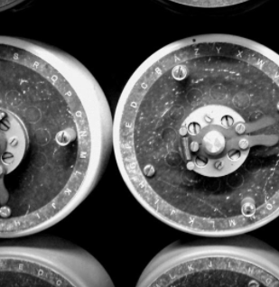
Vets who Code

Slide 2
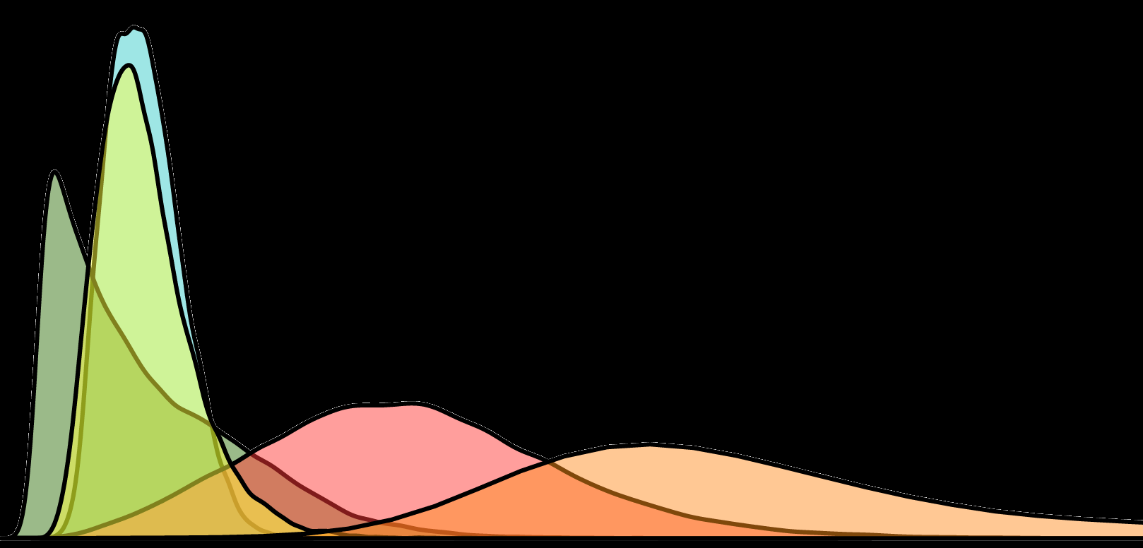
Experimental Design

Slide 3
Effective Population Size

Slide 4
TAMU Phylo
Group

