Slide 1
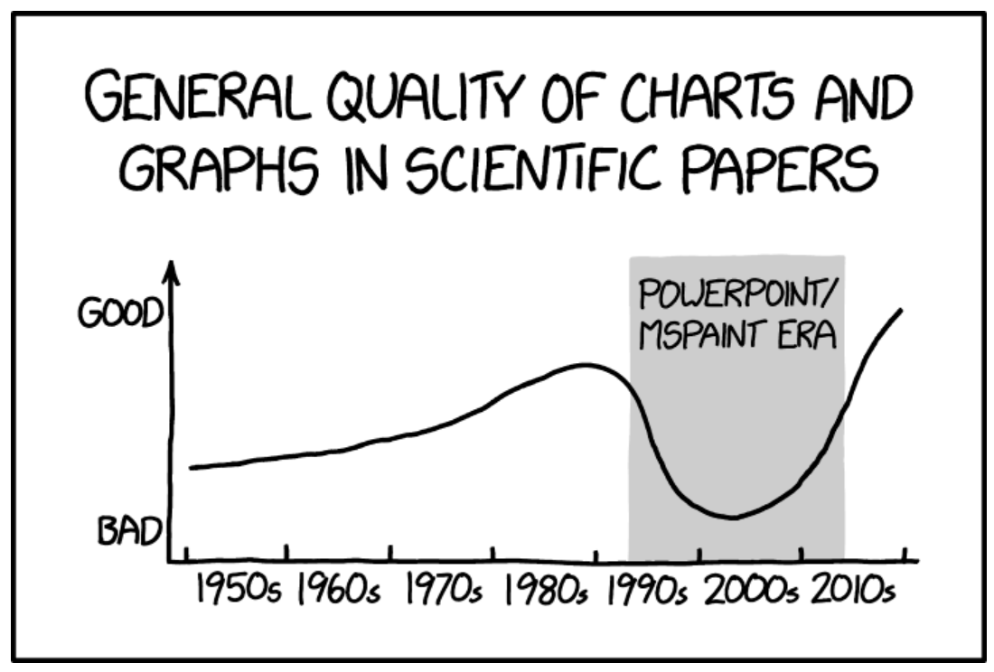
Experimental Design Biology 683 Problematic plots Heath Blackmon

Slide 2
Plan for today
Build a script that reads data and makes 6 types of plots
Histogram
Barplot
Moasaicplot
XY scatter
Boxplot
Stripchart
Find a published plot that is bad

Slide 3
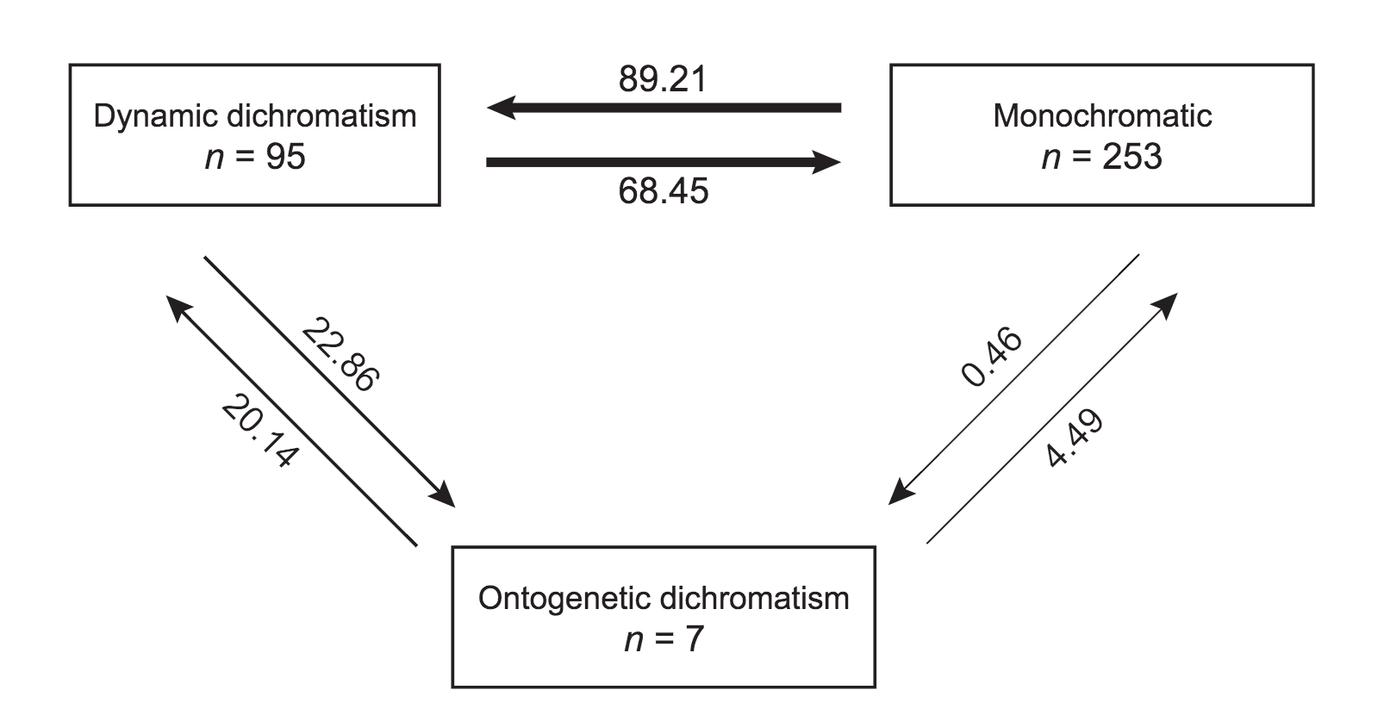
Problematic Plots

Slide 4
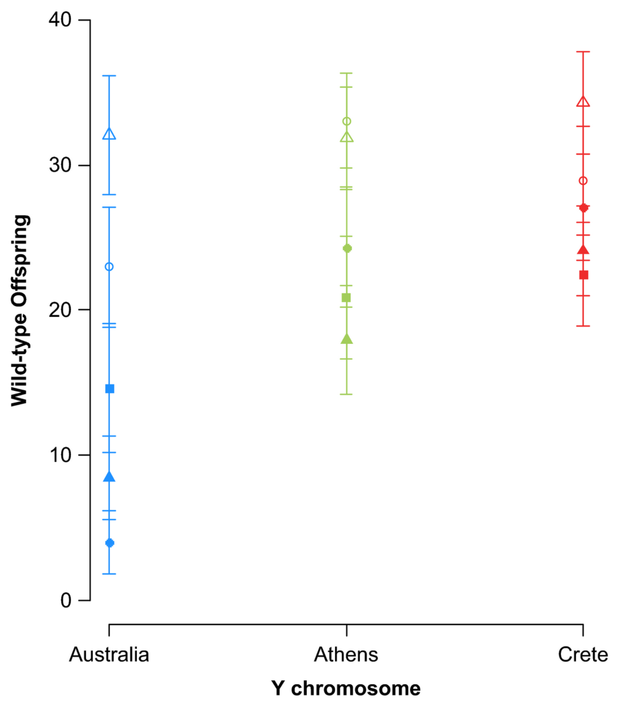
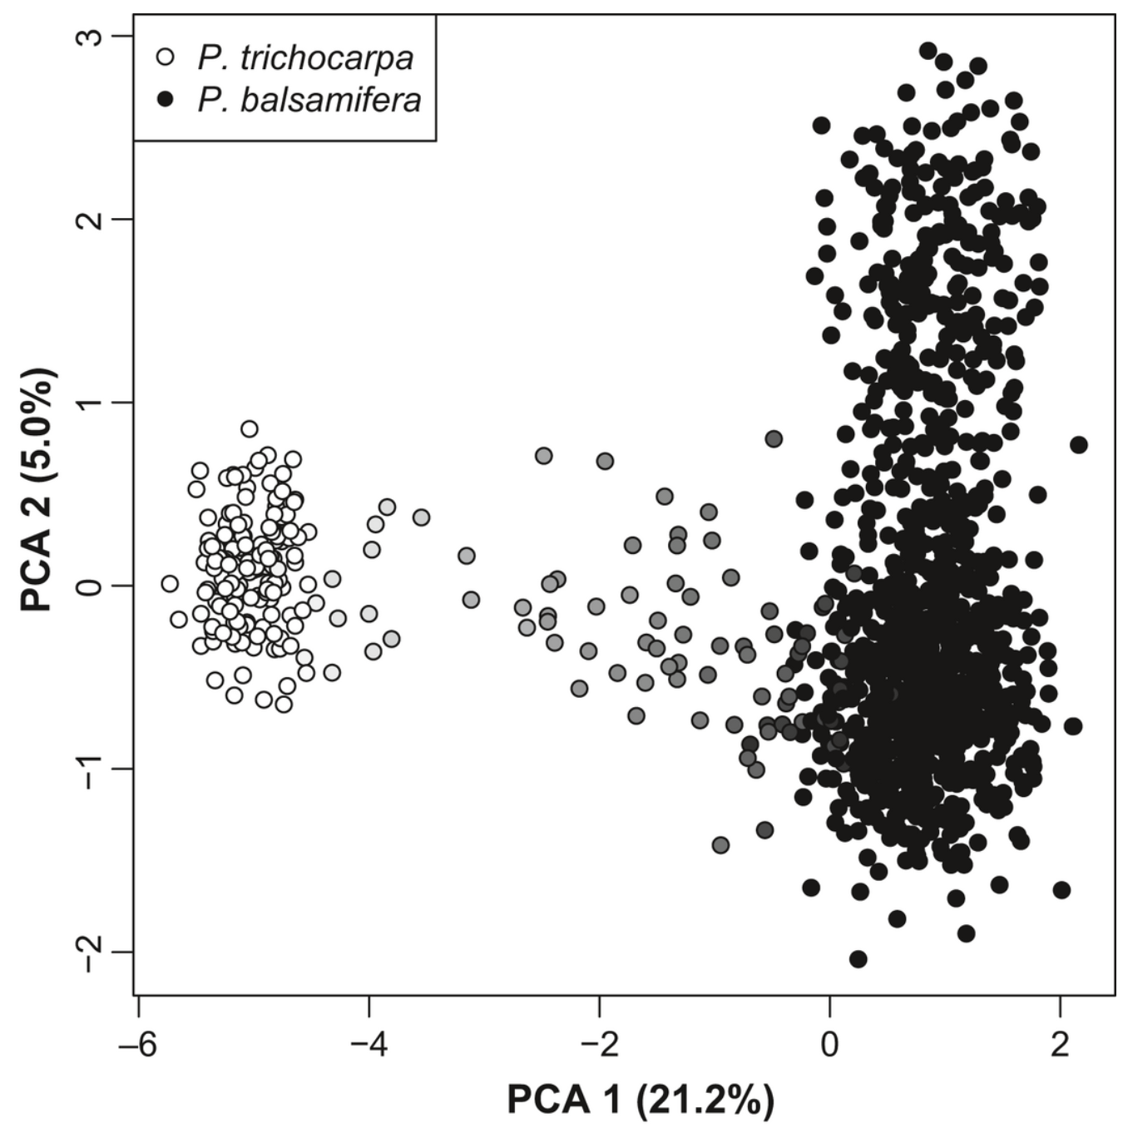
Problematic Plots

Slide 5
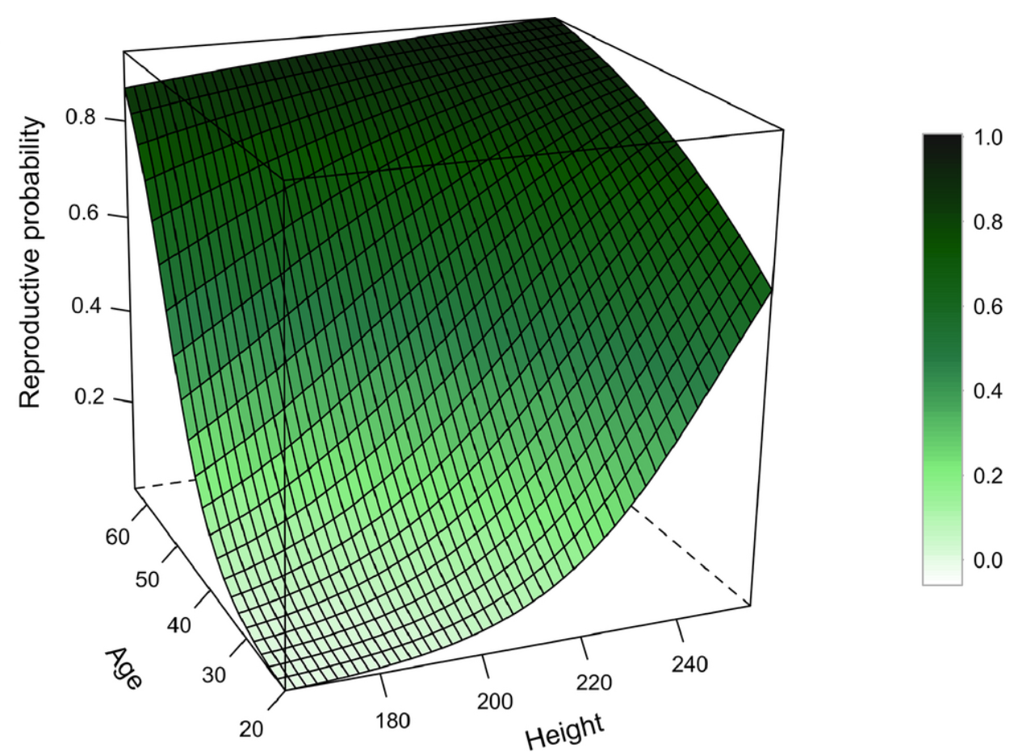
Problematic Plots

Slide 6
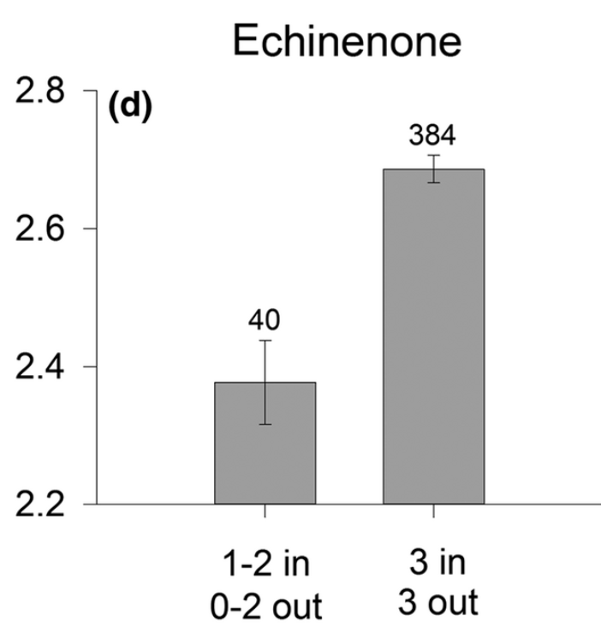
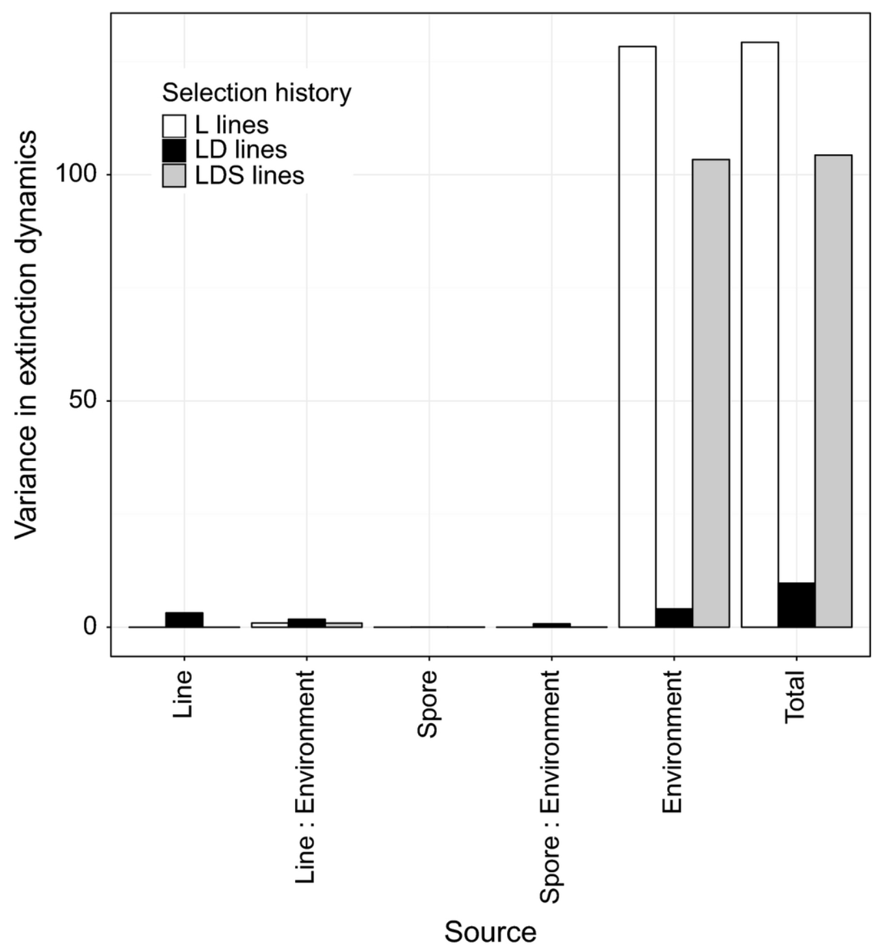
Problematic Plots

Slide 7
For Tuesday
Do homework 2

