Slide 1

Monte Carlo methods Named after the resort in Monaco well known for its casinos

Slide 2
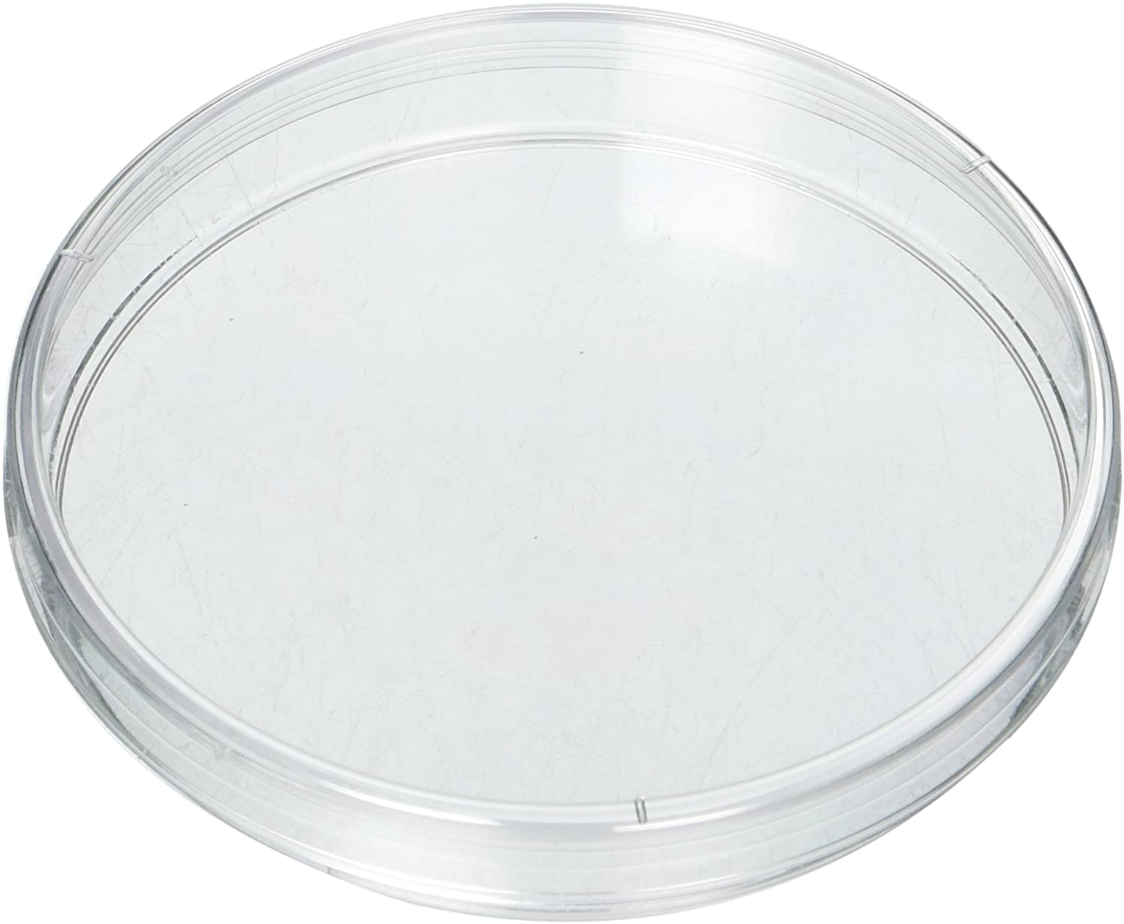
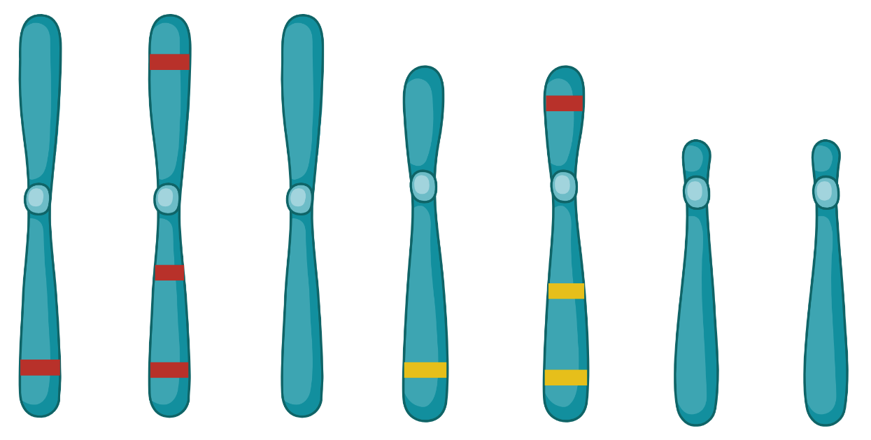
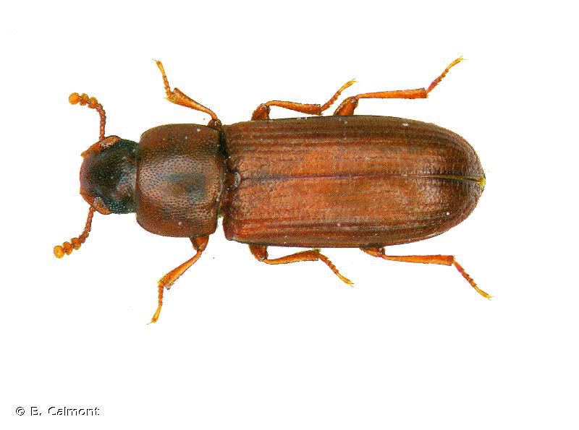
You will eventually be faced with questions where you can’t find a clear statistical test that will be appropriate to your data.
Are these beetles randomly distributed, aggregating or avoiding each other?
Does chromosome 2 have more “red” genes than I would expect by chance?

Slide 3
You will eventually be faced with questions where you can’t find a clear statistical test that will be appropriate to your data.
Monte Carlo methods are most similar to permutation methods that we have used previously. The distinction between the two is that with permutations we simply randomized data. In contrast, with Monte Carlo we will use a simulation process that represents the biology of a null hypothesis.

Slide 4
Monte Carlo methods offer an approach to answer difficult often complex questions.
Lets look at an example with retrogenes.

Slide 5
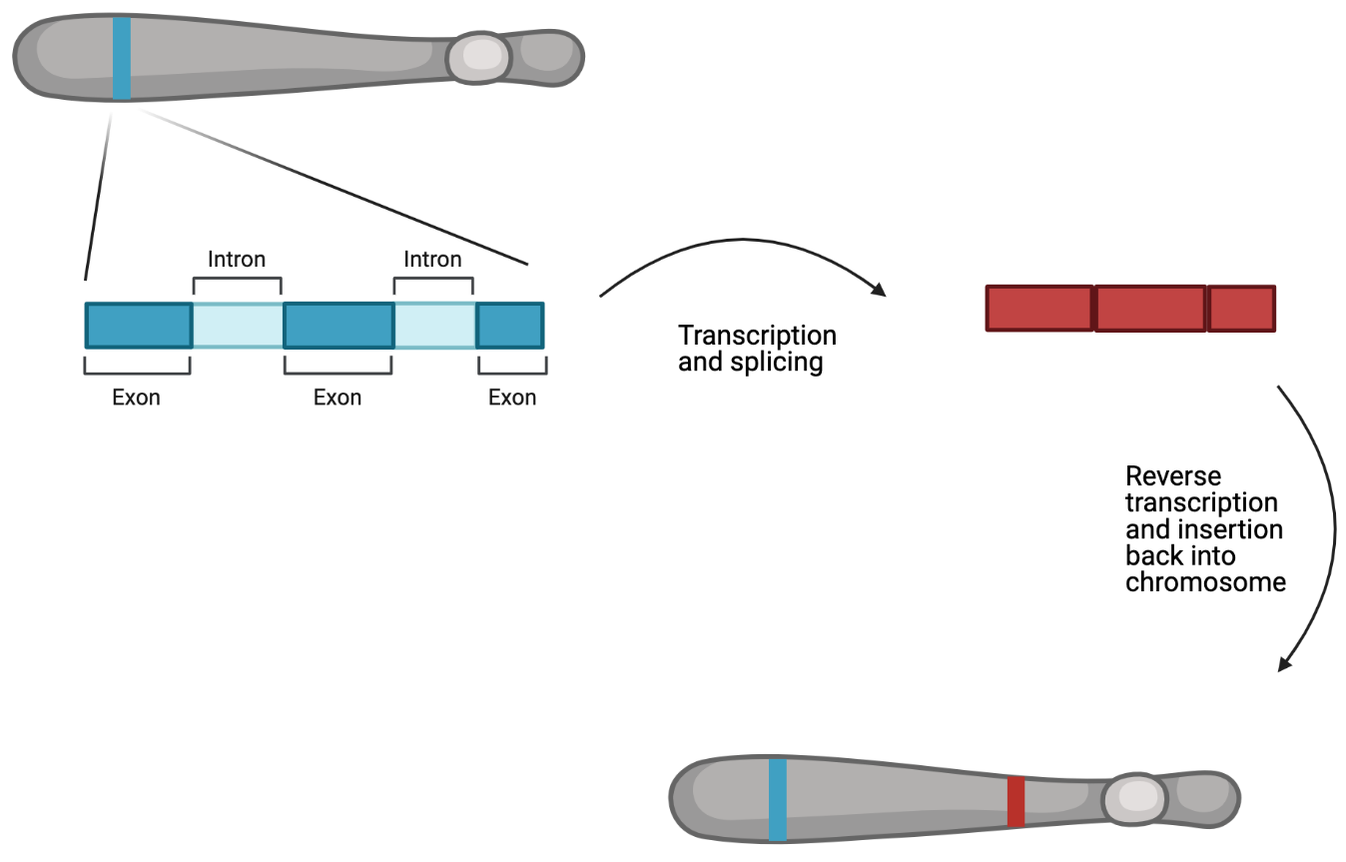
Lets look at an example with retrogenes.

Slide 6
Sexual antagonism hypothesis of retrogene distribution:
If some genes have variation that is beneficial to one sex but harmful to the other fitness could be increased in two ways.
make a duplicate of a gene and express one version in males and one in females
make a duplicate of a gene and move it from an autosome to an X or Y chromosome
Additionally in many species the sex chromosomes do not get expressed during meiosis if you have a gene that can benefit males during spermatogenesis moving this type of gene from a sex chromosome to an autosome will be beneficial.

Slide 7
From this sexual antagonism hypothesis we might expect to see more retrogenes on sex chromosomes and possibly more parental genes on sex chromosomes than we would expect by chance.

Slide 8
We identified retrogenes in a Tribolium beetle that has a recent fusion of chromosome 2 (lg2) to the sex chromosome. This means that the X in this species now include everything that is in lg2 as well as lgX.
 | lg1 | lg2 | lgX | lg4 | lg5 | lg6 | lg7 | lg8 | lg9 | lg10 | Total
GeneNumber | 3254 | 2941 | 3705 | 1507 | 1543 | 1287 | 994 | 684 | 325 | 212 | 16512
PhysicalSize | 45 | 41 | 38 | 30 | 20 | 15 | 14 | 11 | 12 | 9 | 235
Parents | 22 | 45 | 39 | 9 | 8 | 7 | 8 | 3 | 1 | 0 | 142
Daughters | 24 | 40 | 35 | 15 | 7 | 6 | 5 | 4 | 5 | 1 | 142

Slide 9
We identified retrogenes in a Tribolium beetle that has a recent fusion of chromosome 2 (lg2) to the sex chromosome. This means that the X in this species now include everything that is in lg2 as well as lgX.
 | lg1 | lg2 | lgX | lg4 | lg5 | lg6 | lg7 | lg8 | lg9 | lg10 | Total
GeneNumber | 3254 | 2941 | 3705 | 1507 | 1543 | 1287 | 994 | 684 | 325 | 212 | 16512
PhysicalSize | 45 | 41 | 38 | 30 | 20 | 15 | 14 | 11 | 12 | 9 | 235
Parents | 22 | 45 | 39 | 9 | 8 | 7 | 8 | 3 | 1 | 0 | 142
Daughters | 24 | 40 | 35 | 15 | 7 | 6 | 5 | 4 | 5 | 1 | 142
What is the probability that we would observe this many parents and daughters assuming that chromosome 2 is no different than any other chromosomes?

Slide 10
From this we might hypothesize that we should see more retrogenes on sex chromosomes and possibly more parental genes on sex chromosomes than we would expect by chance.
Size of the chromosome (determines probability of a daughter gene being on a chromosome)
Number of genes on each chromosome (determines the probability of a parent gene being on a a chromosomes)

Slide 11
First decide what we want to test
the number of parents on lg2
the number of daughters on lg2
Create an object to store a null distribution of these values
Simulate an expected number of parents and and an expected number of daughters on lg 2.
when simulating account for chromosome size and gene number
Repeat step 3 thousands of times.
Compare our observation to the null distribution to calculate a p-value for our observation.

Slide 12
R example

