Slide 1
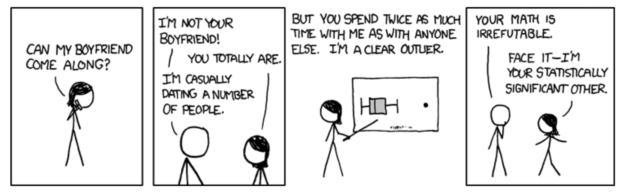

Binary Response Variables Biology 683 Heath Blackmon

Slide 2
Likelihood and AIC model selection
Think of likelihood as how probable the observed data are under the current model. When we fit a glm we are getting the likelihood of the data assuming the best values for the parameters (beta coefficients). For any empirical dataset these will be very small numbers. It is easy for computers to store the log of very small numbers which means that log likelihoods will be negative numbers.
likelihood = .01
likelihood = .0001
ln(L) = -4.6
ln(L) = -9.2
better fit
worse fit
Adding additional predictor variables will always improve the fit of the data under the model.
R example
So we must penalize for extra parameters
R example
fit1 <- glm(y ~ a)
fit2 <- glm(y ~ a + b)
logLik(fit1)
anova(fit1, fit2, test=“LRT”)

Slide 3
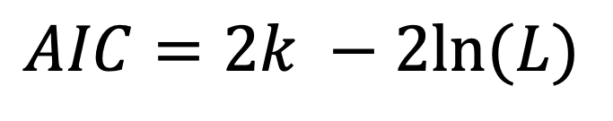
Likelihood and AIC model selection
$$AIC=2k −2ln⁡(L)$$
k number of parameters
ln(L) log likelihood of the data (a big negative number)
Models with smaller numbers are better
Differences in AIC can be used to evaluate evidence for one model vs. another.
A model with a ΔAIC value within 1-2 of the best model has substantial support, and should be considered along with the best model.
A ΔAIC value within only 4-7 units of the best model has considerably less support.
A ΔAIC value > 10 indicates that the worse model has virtually no support and should not be consideration.
Burnham and Anderson 1998

Slide 4
Likelihood and AIC model selection
LRT: Does adding this predictor variable reduce the deviation from predictions more than I would expect if the predictor had no impact on the response variable (alpha = .05)
AIC: Is about comparing models and finding the model(s) that seem to match with the data we are observing.
If you are going to use AIC to choose “best” model pay attention to close seconds and whether they “tell a different story”

Slide 5
Logistic Regression
Questions where the response variable is binary are common.
Dispersal vs Non-dispersal
Survival
Presence/Absence of a trait
Infected/uninfected

Slide 6
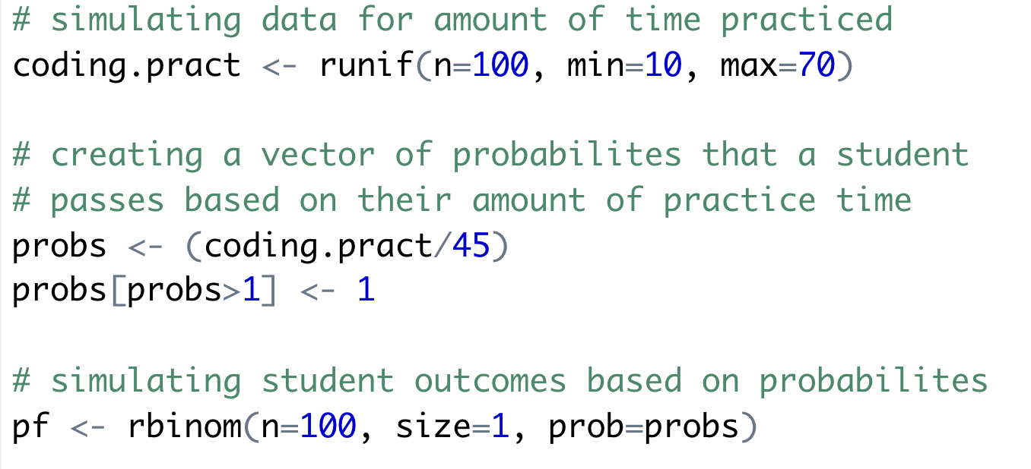
Logistic Regression

Slide 7
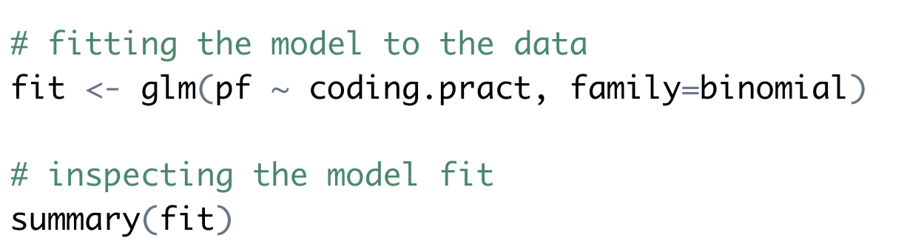
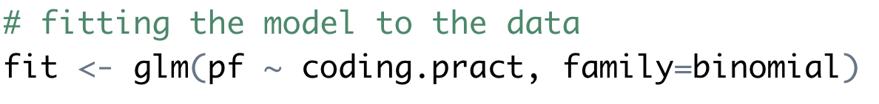
Logistic Regression

Slide 8
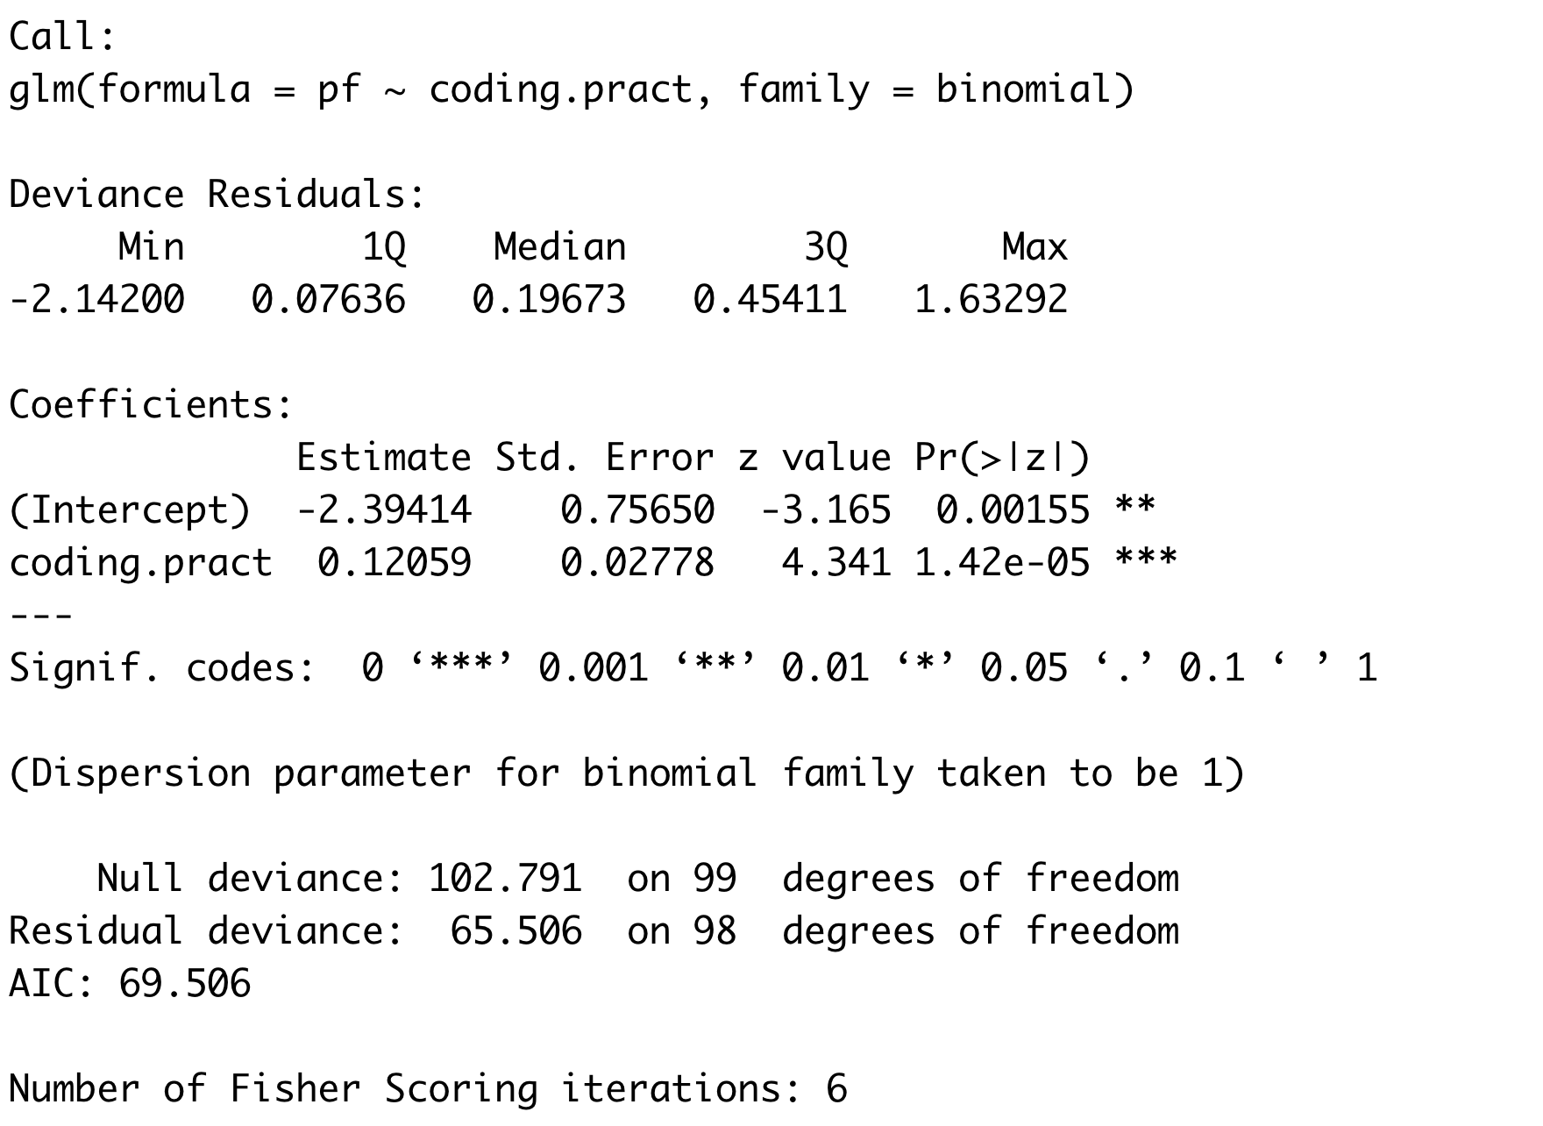
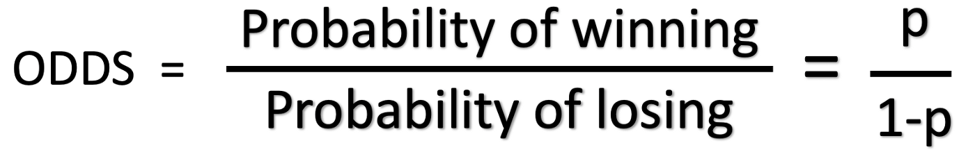
Logistic Regression
log(odds)

Slide 9
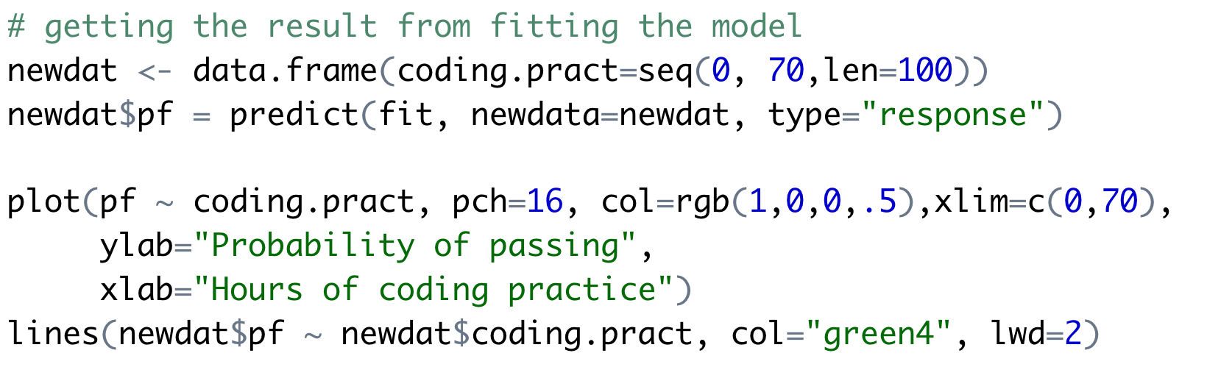
Logistic Regression

Slide 10
Logistic Regression

Slide 11
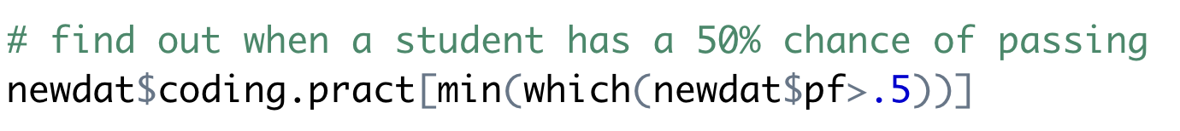
Logistic Regression
> 25.45

Slide 12
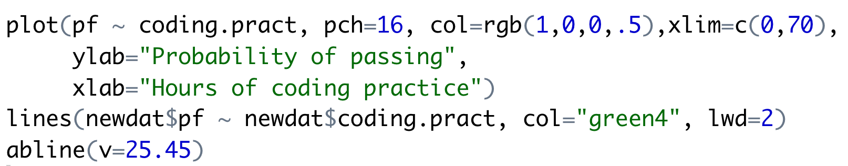
Logistic Regression
> 25.45

Slide 13
Logistic Regression
> 25.45

Slide 14
Logistic Regression
> 25.45
How does this compare to what we expected from the simulation?
> 25/45
[1] 0.5555556

Slide 15
Saturday
10AM to 1PM
BSBE 115

