Slide 1
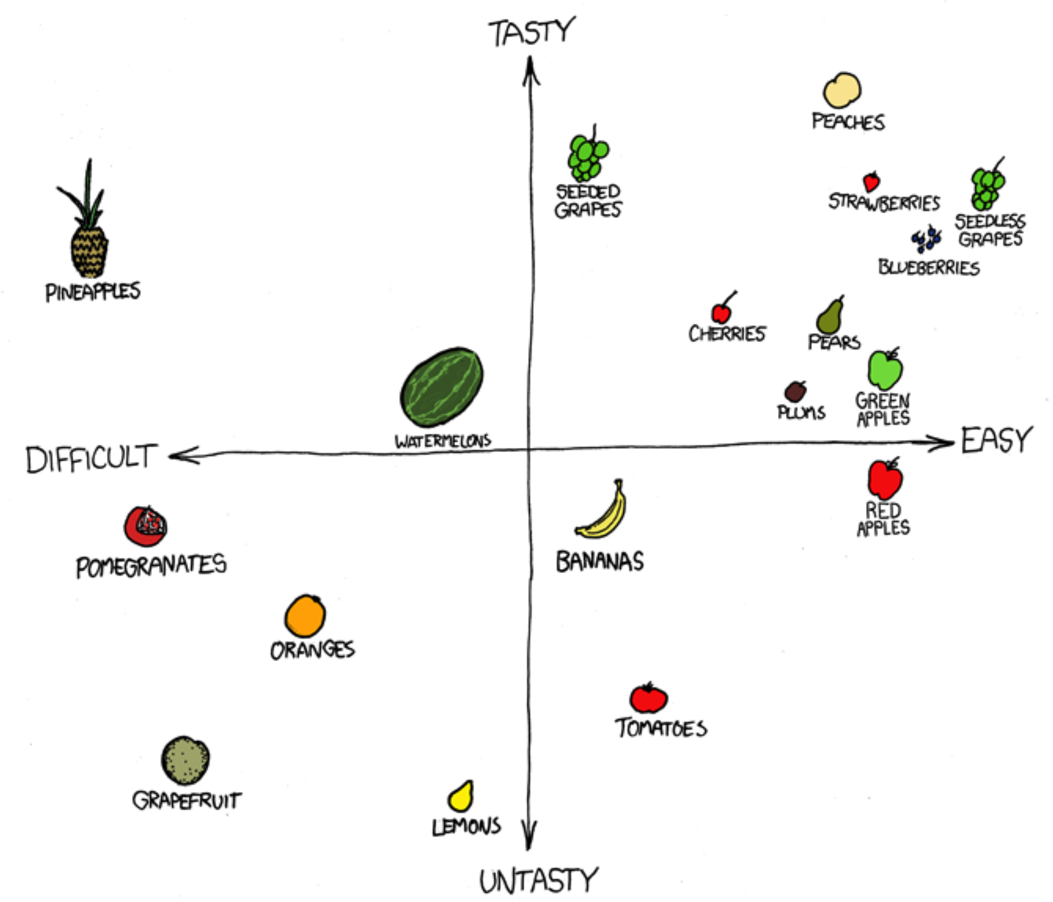
Dimensionality Reduction Principal component analysis Corrections for multiple tests Biology 683 Heath Blackmon

Slide 2
What are multiple comparisons/testing
Horsebean | Linseed | Soybean | Sunflower | Meatmeal | Casein
179 | 205 | 189 | 205 | 179 | 205
216 | 198 | 186 | 198 | 216 | 198
165 | 212 | 175 | 212 | 165 | 212
183 | 218 | 193 | 218 | 183 | 218
169 | 210 | 149 | 210 | 169 | 210
FWER = 1-(1-alpha)^{m}
FWER = 1-(1-0.05)¹⁵
45% chance of false positive

Slide 3
What are multiple comparisons/testing
Horsebean | Linseed | Soybean | Sunflower | Meatmeal | Casein
179 | 205 | 189 | 205 | 179 | 205
216 | 198 | 186 | 198 | 216 | 198
165 | 212 | 175 | 212 | 165 | 212
183 | 218 | 193 | 218 | 183 | 218
169 | 210 | 149 | 210 | 169 | 210
FWER = 1-(1-alpha)^{m}
FWER = 1-(1-0.05)¹⁵
45% chance of false positive

Slide 4
Bonferroni Correction
With the Bonferroni correctio method we divide alpha by number of comparisons being completed.
0.05/15 = 0.0033333
FWER = 1-(1-0.00333)¹⁵
5% chance of false positive
FWER = 1-(1-0.05)¹⁵
45% chance of false positive

Slide 5
False Discovery Rate
An alternative approach is to decide what proportion of positive results we are ok with having be false positives. This is a common approach in genetic scans (GWAS). The math is bit more complicated but FDR approaches and Bonferroni methods are available in the p.adjust function.

Slide 6
Why do we do dimensional reduction?
Datasets are getting bigger and bigger
Understanding our data is often the new bottleneck
We can’t think well beyond 3-4 dimensions
We can’t illustrate well beyond 2-3 dimensions

Slide 7
What is principal component analysis
PCA is a dimensional reduction tool that takes many (possibly correlated) measurements and transforms it into a smaller set of uncorrelated measuerments.

Slide 8
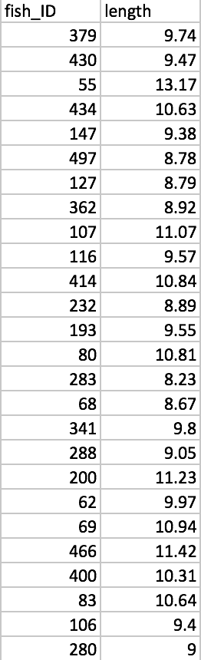
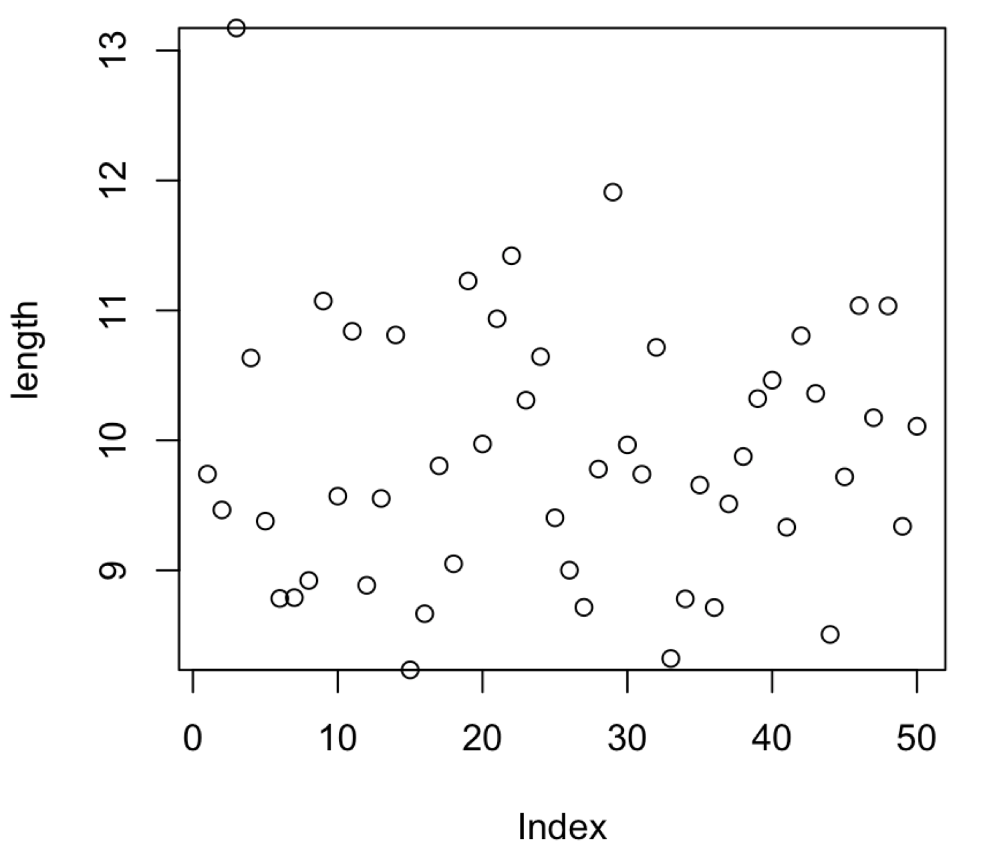
One dimensional data

Slide 9
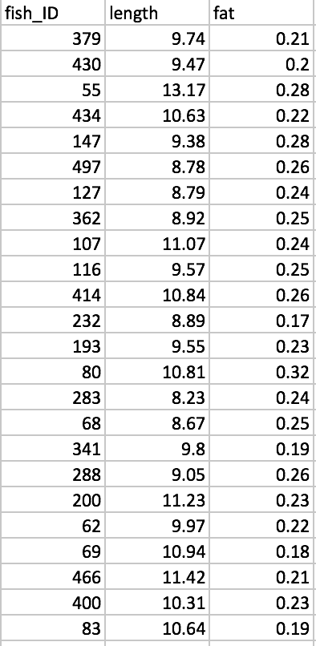
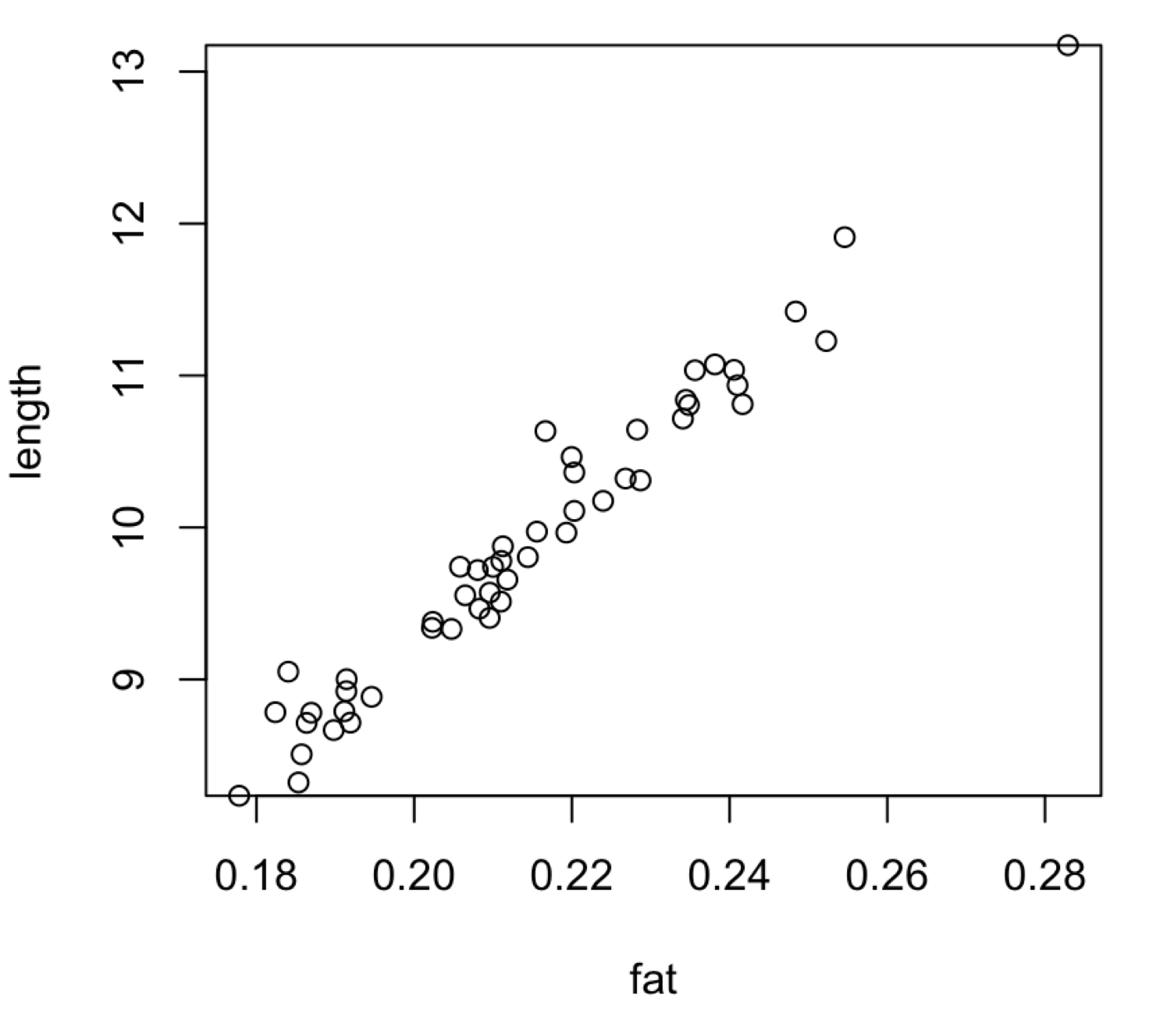
Two-dimensional data

Slide 10
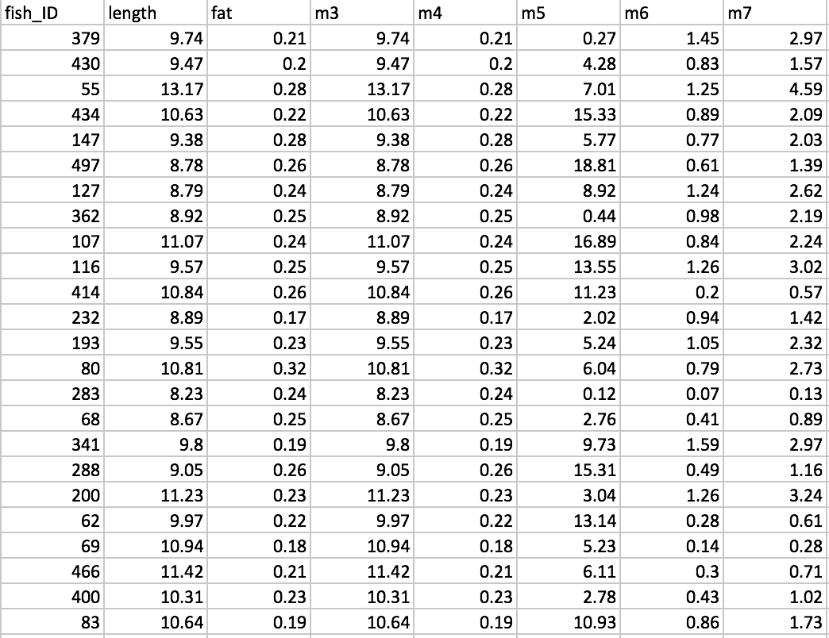
High dimensional data
What are our options?

Slide 11
Dimensionality reduction - PCA
PC1
PC2

Slide 12
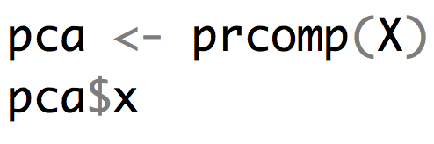
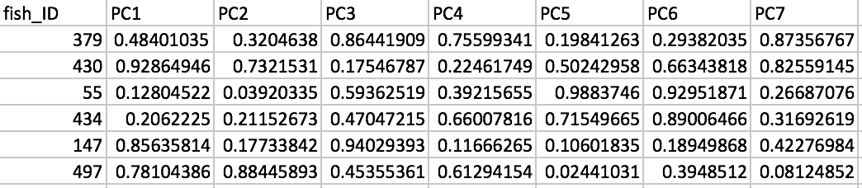
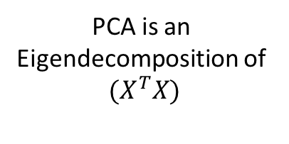


The math behind - PCA
M measurements
PCA is an
Eigendecomposition of
$${(X}^{T}X)$$
= X
nxm matrix
$$W$$
= loadings
mxm matrix
N samples
$$T=X∙W$$
= T
nxm matrix
This is T a nxm matrix that has our PC scores. The first column of the matrix will be the one that captures the most variation.

Slide 13
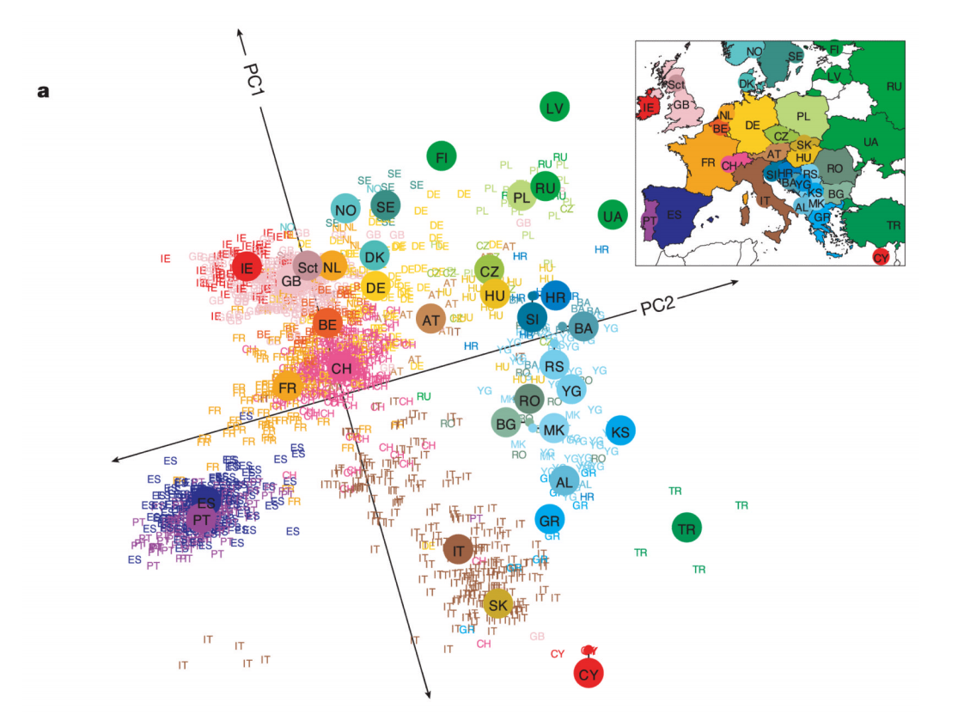
How do people use PCA
Input data: 500,000 SNP genotypes for 3000 Europeans.
3000 rows
500,000 columns
What are PC1 and PC2?

Slide 14
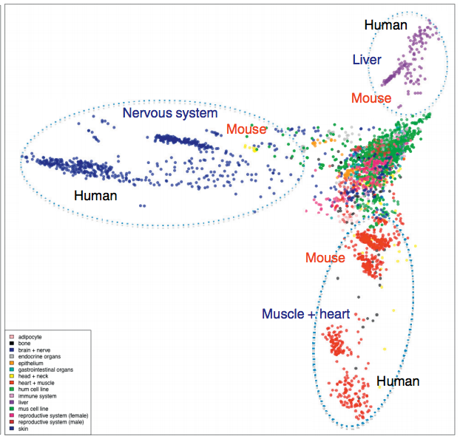
How do people use PCA
Input data:
Expression level for 1000s of genes
In 100s of cells (color indicates type of cell)
What are the PCs here?

Slide 15
How do people use PCA
Input data:
Radseq data (genotypes at 100s of loci)
For a large number of species or strains

Slide 16
How do people use PCA
Input data:
Radseq data (genotypes at 100s of loci)
For a large number of species or strains

Slide 17
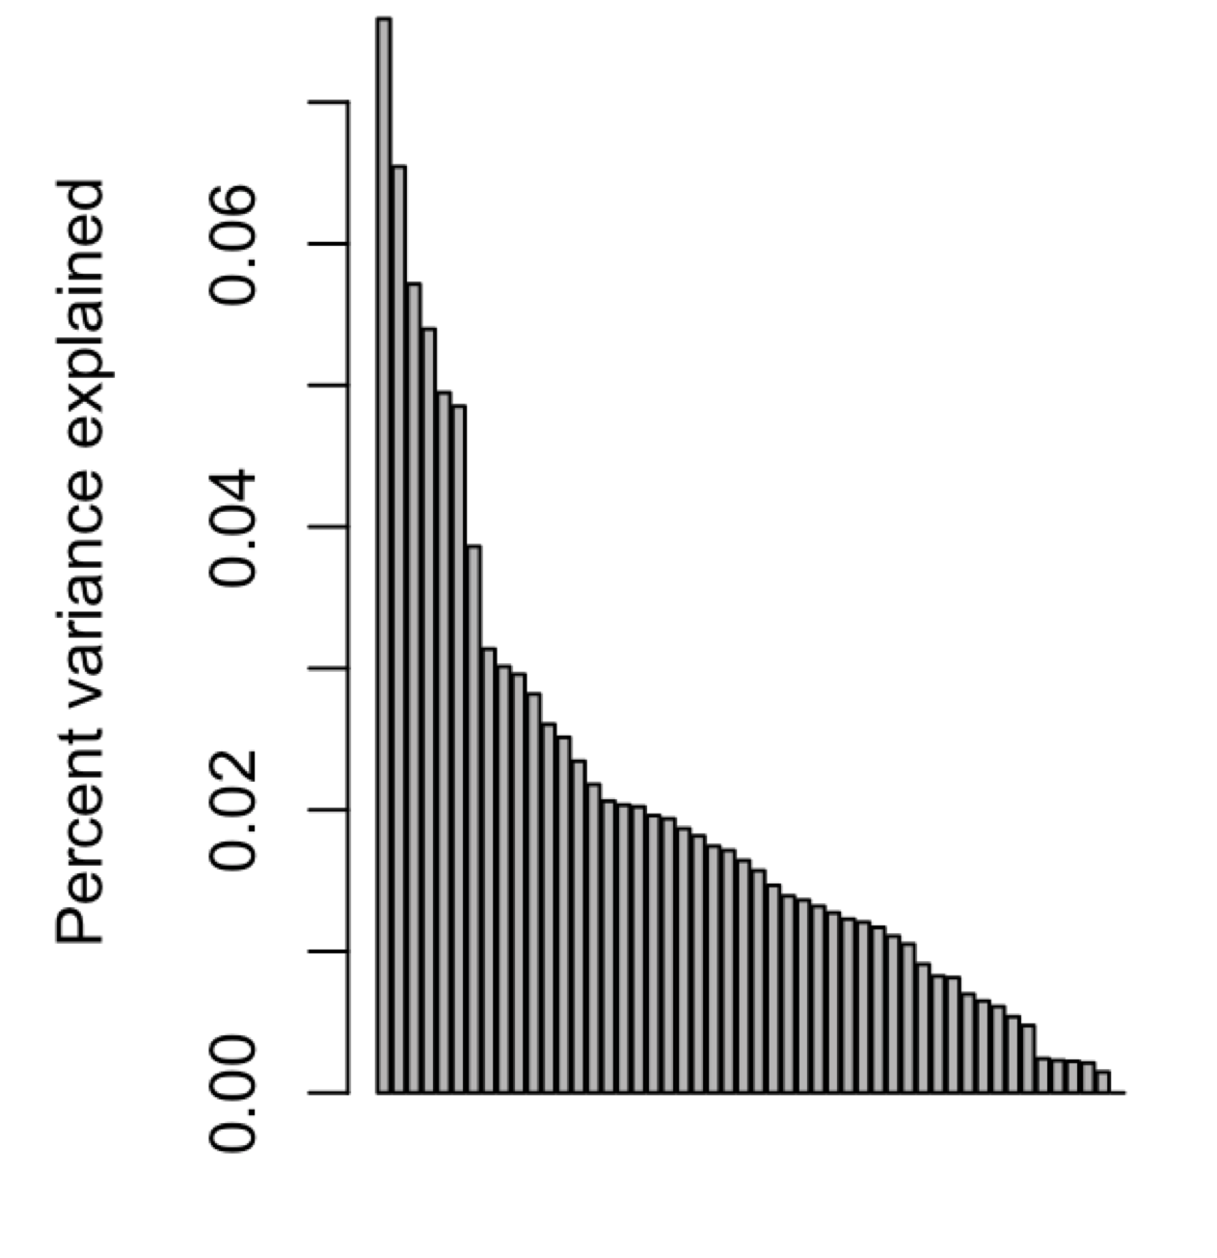
How informative is your PCA
Scree Plot: A plot that illustrates the proportion of total variance that is captured by each principal component.
Steep means you can greatly reduce dimensionality without losing information

Slide 18
Alternatives
Discriminate function analysis: This is similar to PCA but you assign groupings to the data first and the discriminating components best parse your assigned groups from one another.

Slide 19
An example of useful and less useful dimensional reduction
Example in Rmarkdown
Standard Packages
stats – this is part of the base install and has the function prcomp
New Packages
car – data.ellipse function
FactoMineR – PCA function

