Slide 1
Reading and writing data
dat <- read.csv(“filename.csv”)
write.csv(dat, file = “filename.csv”)

Slide 2
Permutation vs Monte Carlo

Slide 3
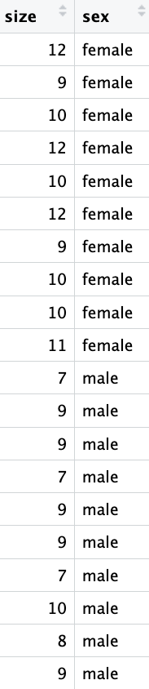
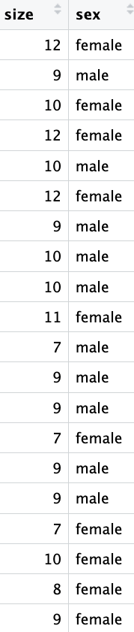
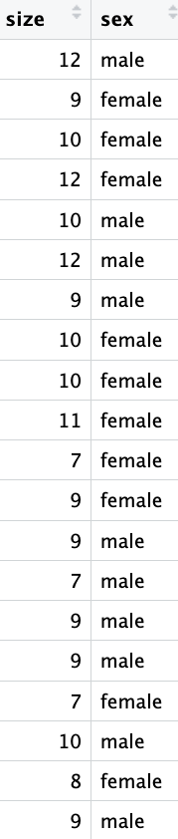
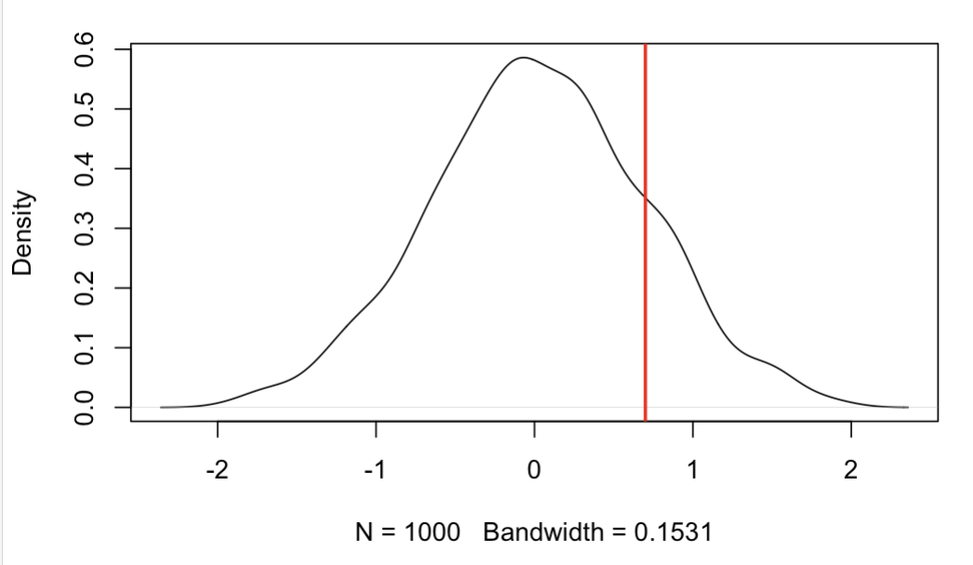
Permutation test
Pick a stat and measure it for your empirical data: mean difference = 2.1
……
Example in R
0.7
-0.3

Slide 4
Correlation

Slide 5
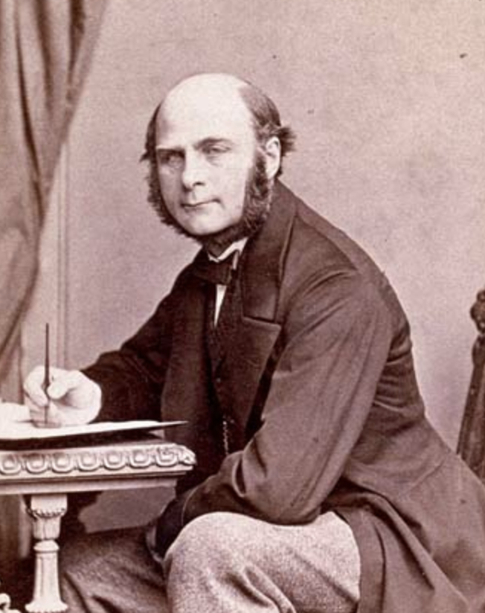
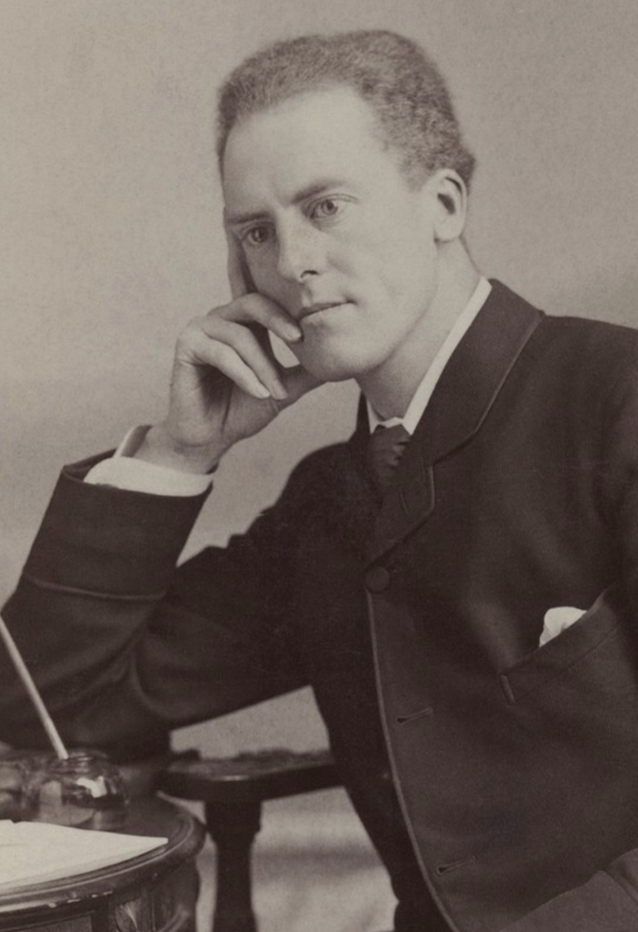
Correlation and Causation
The correlation is a foundational concept in the biological sciences
Pearson’s correlation coefficient:
$$r\left(X,Y\right)=\frac{cov(X,Y)}{s_{x}s_{y}}$$
Francis Galton
1822 - 1911
Karl Pearson
1857 - 1936
$$cov\left(X,Y\right)=\frac{\sum_{i=1}^{n}{\left(X_{i}−\overline{X}\right)\left(Y_{i}−\overline{Y}\right)}}{n−1}$$
Notes:
Galton invented term eugenics cousins with darwin mention regression to the mean
Pearson invented modern concept of and widely applied to r. Also eugenicist and racist

Slide 6
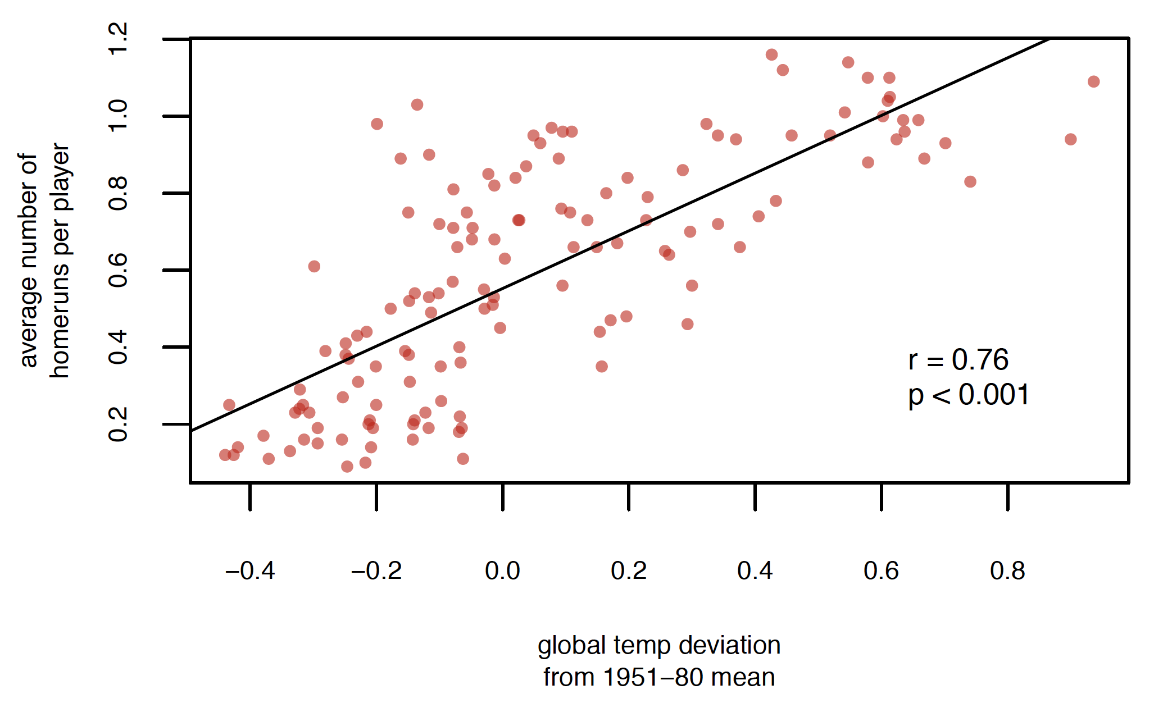
Interpret with caution

Slide 7
Obviously these covary with time
Average number of
home runs per game

Slide 8
Pearson’s Correlation Coefficient
Assumes that the data are roughly from a bivariate normal distribution
Would not be appropriate when:
Relationship is non-linear (possible solutions?)
Dataset contains extreme outliers (evaluate leverage)
Data are in multiple distinct clouds of points (what could cause this?)

Slide 9
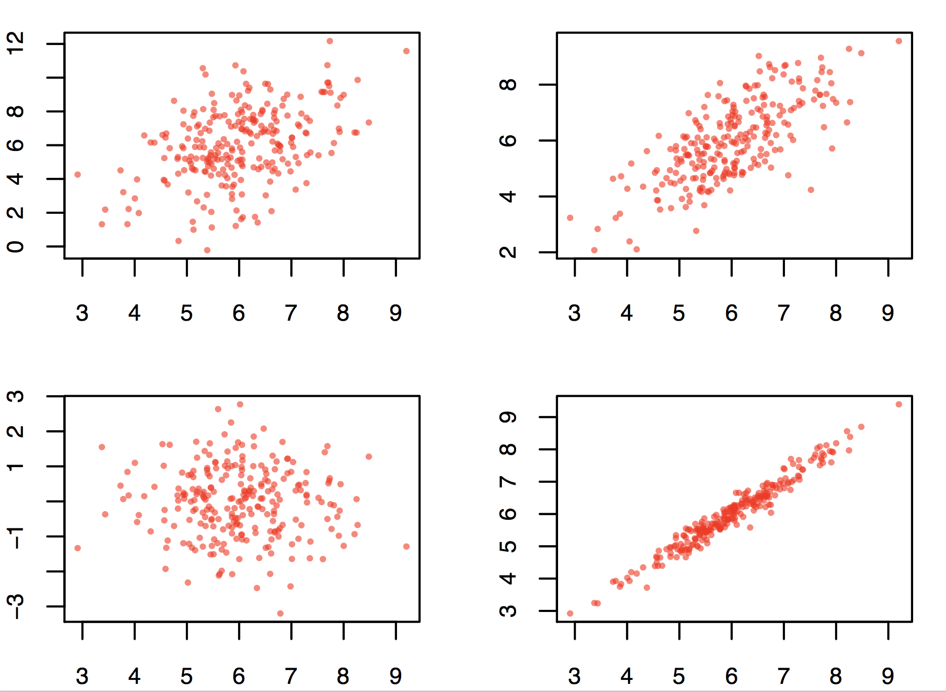
Good data

Slide 10
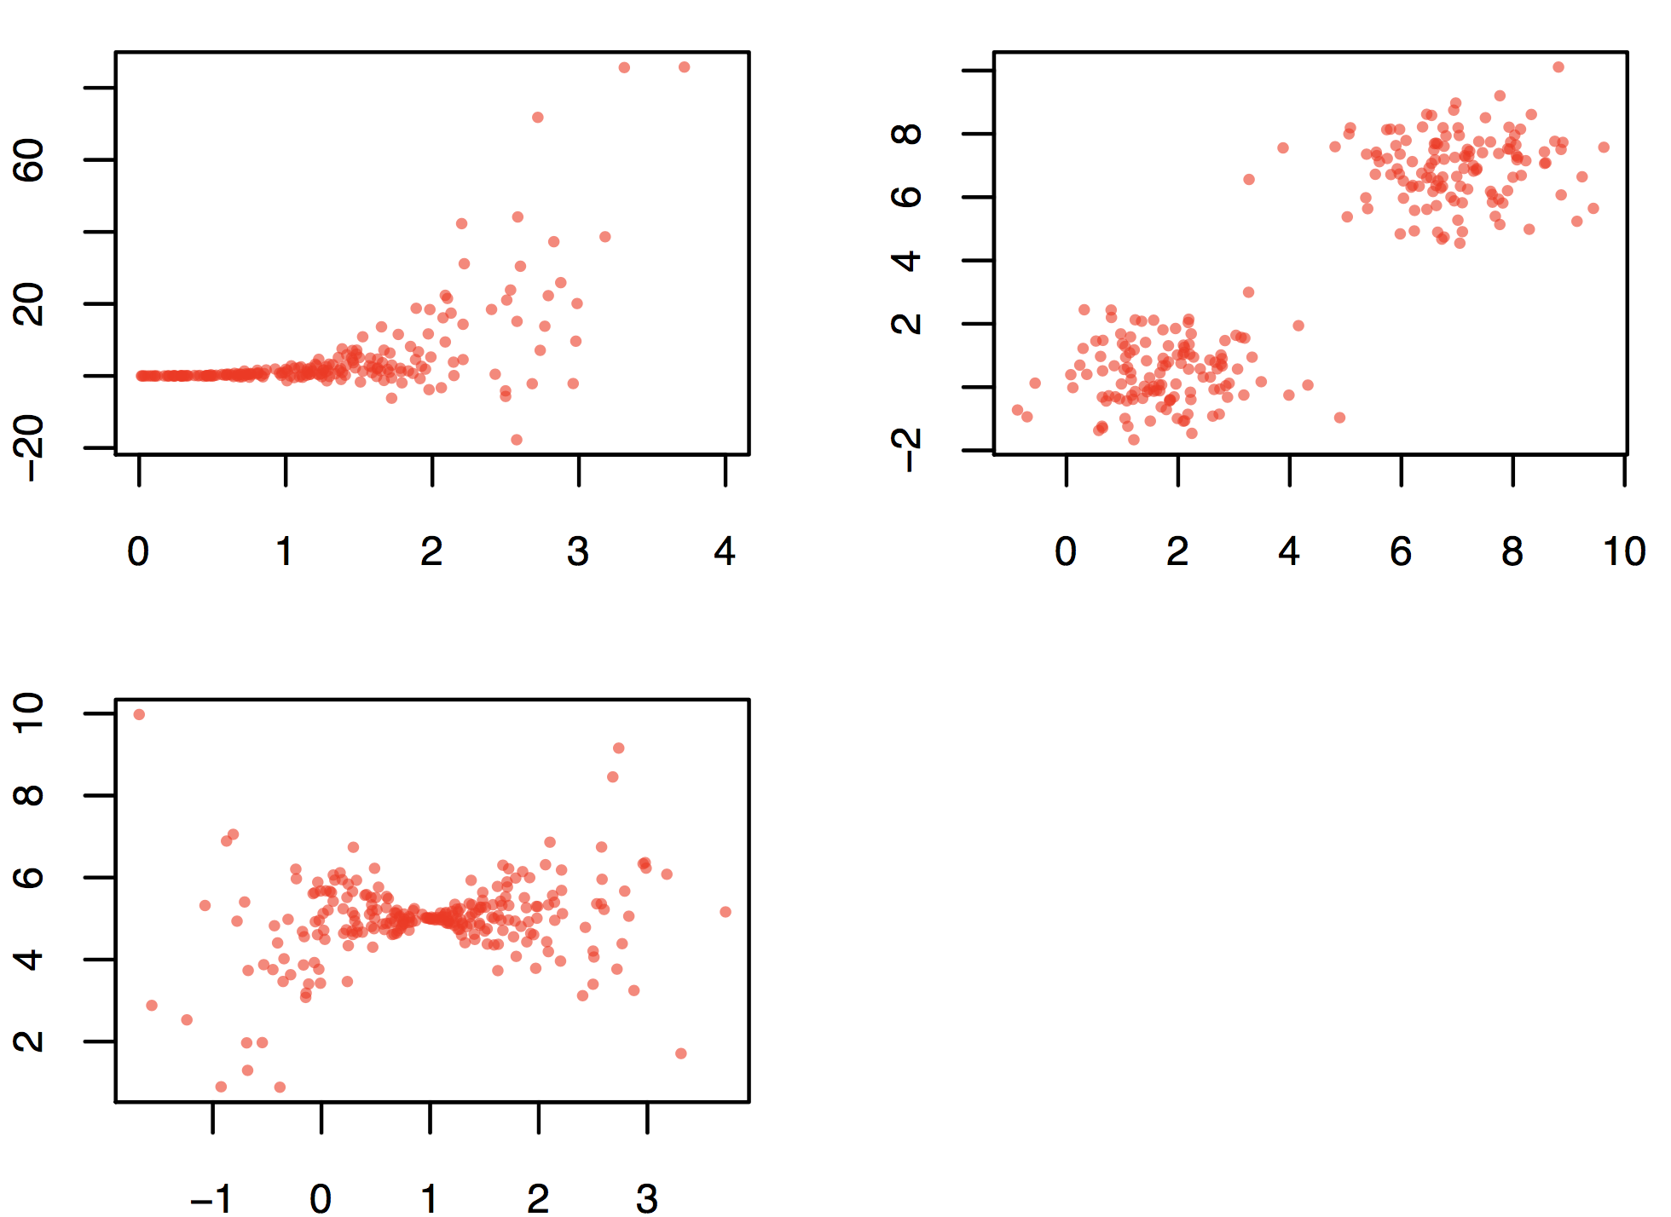
Bad data
$$r\left(X,Y\right)=\frac{cov(X,Y)}{s_{x}s_{y}}$$
$$cov\left(X,Y\right)=\frac{\sum_{i=1}^{n}{\left(X_{i}−\overline{X}\right)\left(Y_{i}−\overline{Y}\right)}}{n−1}$$
Correlation simulator

Slide 11
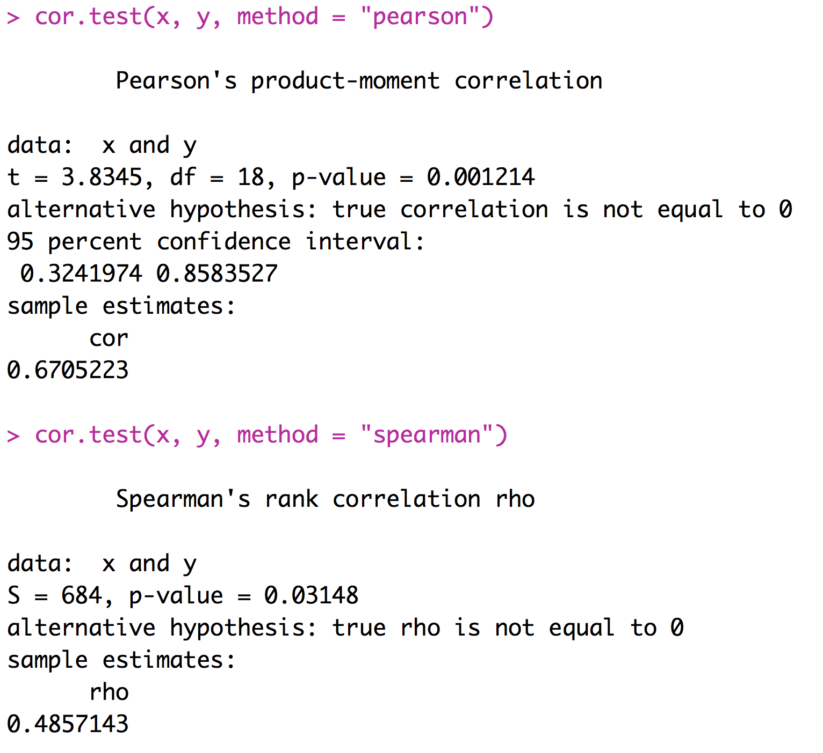
Spearman’s Rank Correlation
An alternative to Pearson’s correlation coefficient for data that depart substantially from bivariate normality
Based on ranks

Slide 12
Correlation Summary
Correlations are very important
We are interested in correlations between values of treatments and response variables
We are interested in correlations between various factors that could affect the response variable
We need to think about correlations between explanatory variables and potentially confounding variables
Many types of experiments call for the calculation and consideration of correlation coefficients

Slide 13
ANOVA

Slide 14
Analysis of Variance
Used to compare the means among more than two groups
If you are comparing three groups, for instance, you cannot just do three pair-wise t-tests – this approach would cause too many false positives
ANOVA takes into account the fact that you are comparing multiple groups and controls the false positive rate.

Slide 15
Analysis of Variance
A | B | C
2 | 5 | 7
2 | 8 | 4
3 | 8 | 5
5 | 7 | 4

Slide 16
Analysis of Variance
A | B | C
2 | 5 | 7
2 | 8 | 4
3 | 8 | 5
5 | 7 | 4
$$f statistic=\frac{\frac{\sum_{j=1}^{p}{n_{j}{({\overline{x}}_{j}−\overline{x})}^{2}}}{{df}_{ssb}}}{\frac{\sum_{j=1}^{p}{\sum_{i=1}^{n_{j}}{{(x_{ij}−{\overline{x}}_{j})}^{2}}}}{{df}_{ssw}}}$$

Slide 17
Analysis of Variance
A | B | C
2 | 5 | 7
2 | 8 | 4
3 | 8 | 5
5 | 7 | 4
$$f statistic=\frac{\frac{\sum_{j=1}^{p}{n_{j}{({\overline{x}}_{j}−\overline{x})}^{2}}}{{df}_{ssb}}}{\frac{\sum_{j=1}^{p}{\sum_{i=1}^{n_{j}}{{(x_{ij}−{\overline{x}}_{j})}^{2}}}}{{df}_{ssw}}}$$
number of groups -1
number of sample – number of groups

Slide 18
Analysis of Variance
A | B | C
2 | 5 | 7
2 | 8 | 4
3 | 8 | 5
5 | 7 | 4
$$f statistic=\frac{\frac{\sum_{j=1}^{p}{n_{j}{({\overline{x}}_{j}−\overline{x})}^{2}}}{{df}_{ssb}}}{\frac{\sum_{j=1}^{p}{\sum_{i=1}^{n_{j}}{{(x_{ij}−{\overline{x}}_{j})}^{2}}}}{{df}_{ssw}}}$$

Slide 19
Analysis of Variance
A | B | C
2 | 5 | 7
2 | 8 | 4
3 | 8 | 5
5 | 7 | 4
$$f statistic=\frac{\frac{\sum_{j=1}^{p}{n_{j}{({\overline{x}}_{j}−\overline{x})}^{2}}}{{df}_{ssb}}}{\frac{\sum_{j=1}^{p}{\sum_{i=1}^{n_{j}}{{(x_{ij}−{\overline{x}}_{j})}^{2}}}}{{df}_{ssw}}}$$

Slide 20
Analysis of Variance
A | B | C
2 | 5 | 7
2 | 8 | 4
3 | 8 | 5
5 | 7 | 4
$$f statistic=\frac{\frac{\sum_{j=1}^{p}{n_{j}{({\overline{x}}_{j}−\overline{x})}^{2}}}{{df}_{ssb}}}{\frac{\sum_{j=1}^{p}{\sum_{i=1}^{n_{j}}{{(x_{ij}−{\overline{x}}_{j})}^{2}}}}{{df}_{ssw}}}$$

Slide 21
Analysis of Variance
A | B | C
2 | 5 | 7
2 | 8 | 4
3 | 8 | 5
5 | 7 | 4
$$f statistic=\frac{\frac{\sum_{j=1}^{p}{n_{j}{({\overline{x}}_{j}−\overline{x})}^{2}}}{{df}_{ssb}}}{\frac{\sum_{j=1}^{p}{\sum_{i=1}^{n_{j}}{{(x_{ij}−{\overline{x}}_{j})}^{2}}}}{{df}_{ssw}}}$$

Slide 22
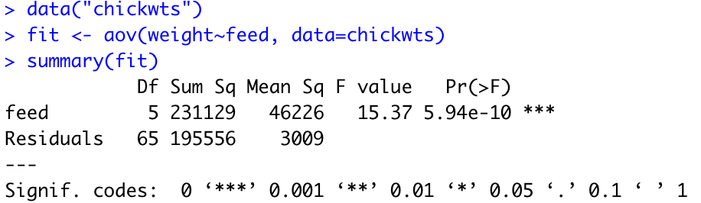
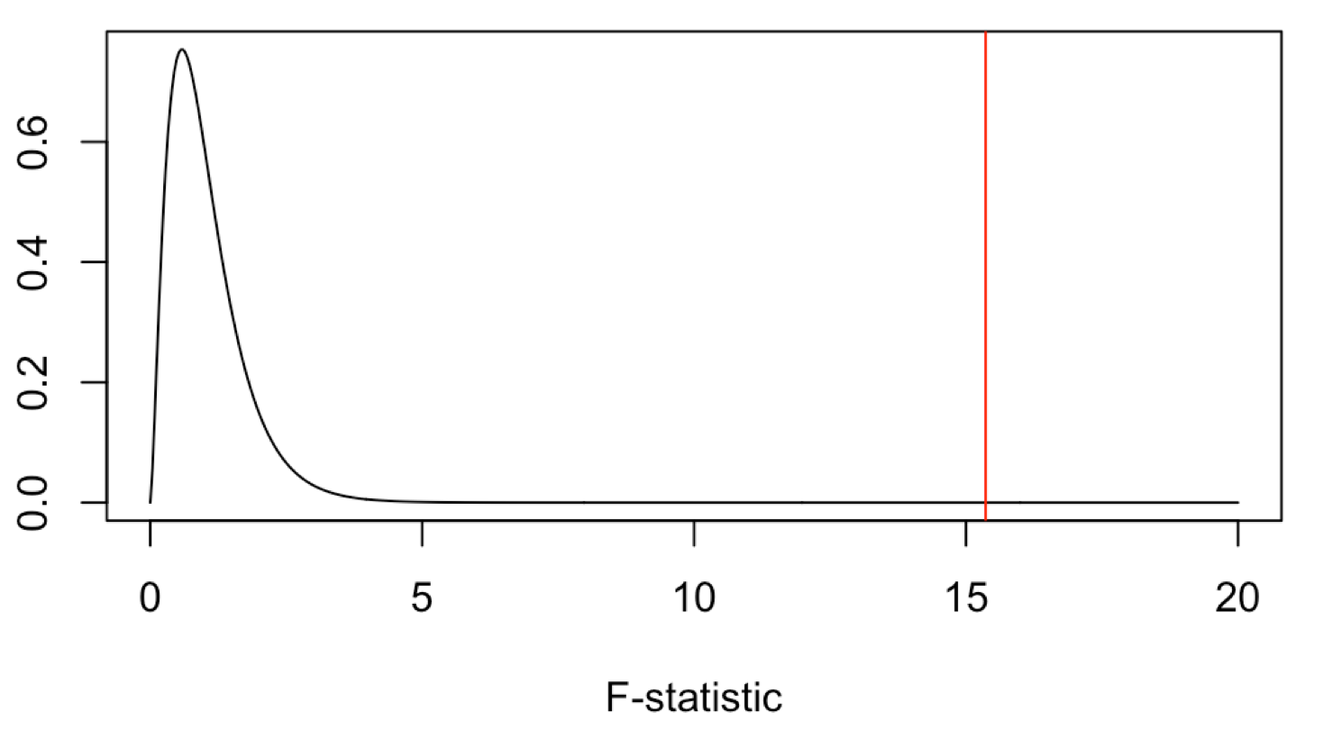
Running ANOVA in R
$$f statistic=\frac{\frac{\sum_{j=1}^{p}{n_{j}{({\overline{x}}_{j}−\overline{x})}^{2}}}{{df}_{ssb}}}{\frac{\sum_{j=1}^{p}{\sum_{i=1}^{n_{j}}{{(x_{ij}−{\overline{x}}_{j})}^{2}}}}{{df}_{ssw}}}$$
This significant result tells us that at least one of the groups of chickens have significantly different mean weights than at least one other groups. (significant ANOVA result allows us to reject the null that they are all the same)

Slide 23
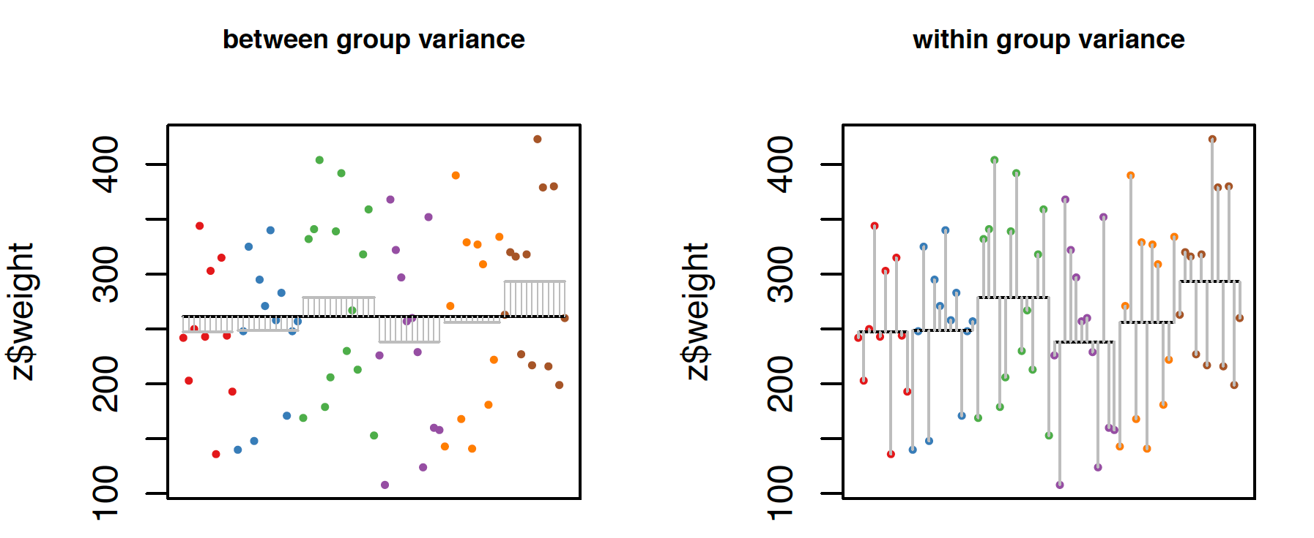
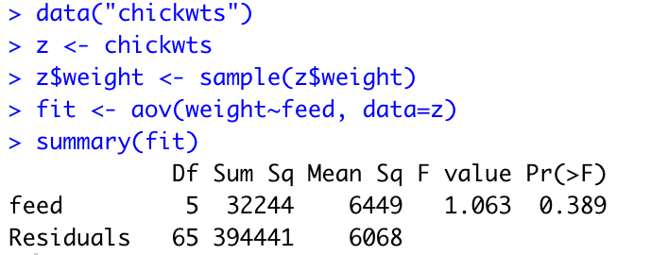
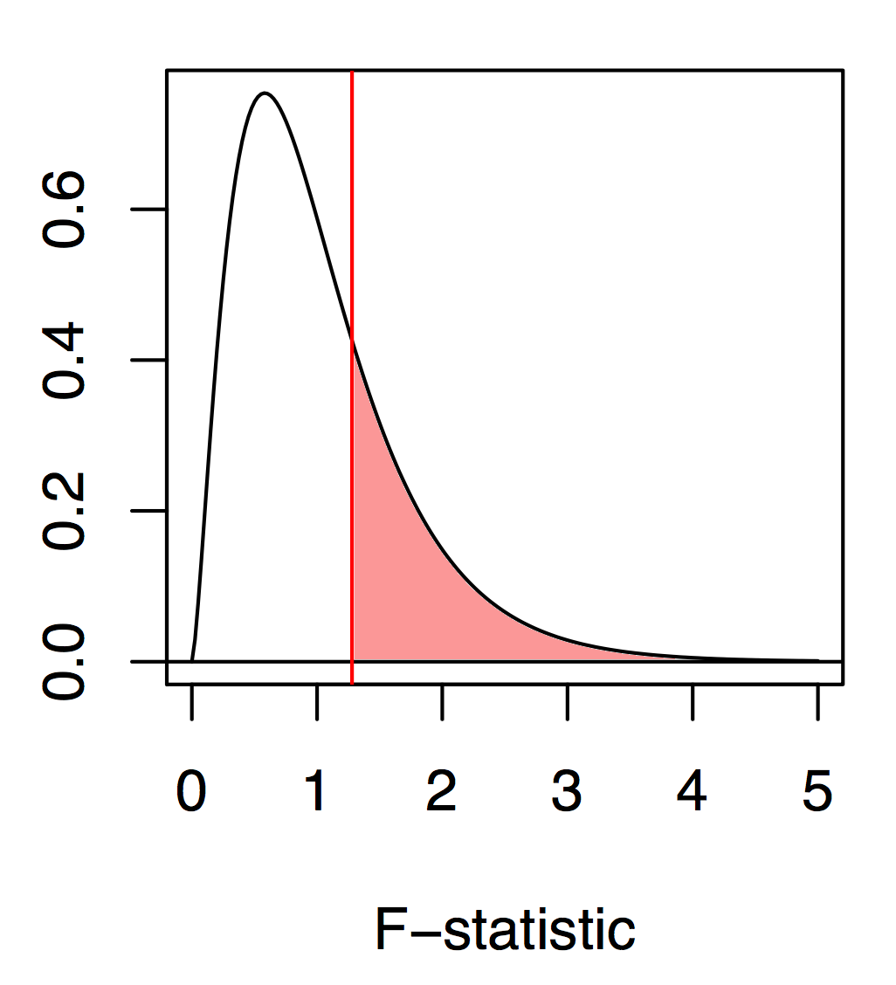
Running ANOVA in R

Slide 24
Post-hoc tests
If your ANOVA is significant, you may be interested in discovering which groups are different from one another
A variety of post-hoc comparisons of the means can be used
Fisher’s LSD
Least conservative test, basically uses t-tests to compare the means
Scheffe’s method
Performs all comparisons simultaneously, but has relatively low power
Tukey-Kramer method
A pair-wise method, like a t-test, but corrected for multiple comparisons

Slide 25
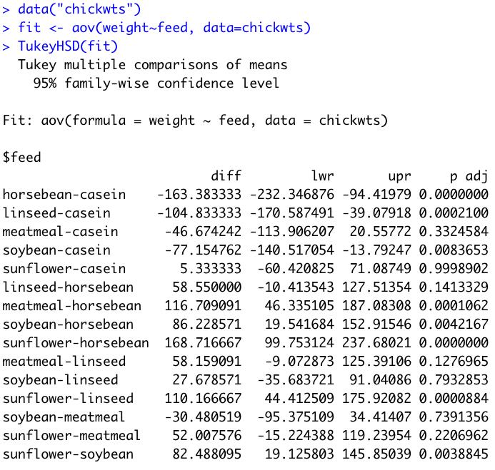
Post-hoc tests
anova and aov functions will both perform an ANOVA but the results are stored slightly differently. For this posthoc test we want the aov format

Slide 26
Interpreting post-hoc tests
When we examine all the significantly different ones we can draw several conclusions:
Chicks fed casein are significantly heavier than those fed horsebean, linseed, and soybean.
Chicks fed horsebean are significantly lighter than those fed meatmeal, soybean, and sunflower.
Chicks fed sunflower are significantly heavier than those fed linseed or soybean.

Slide 27
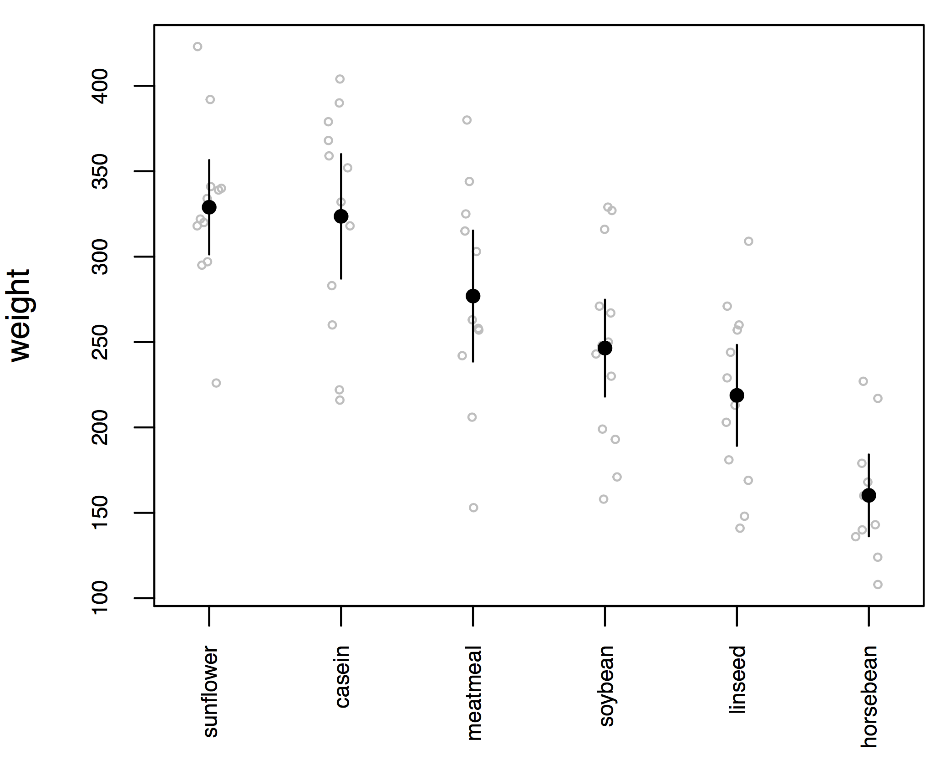
Plotting this kind of data
Our results from the ANOVA and Tukey match up pretty well with our rules of thumb about 95% CI overlaps

Slide 28
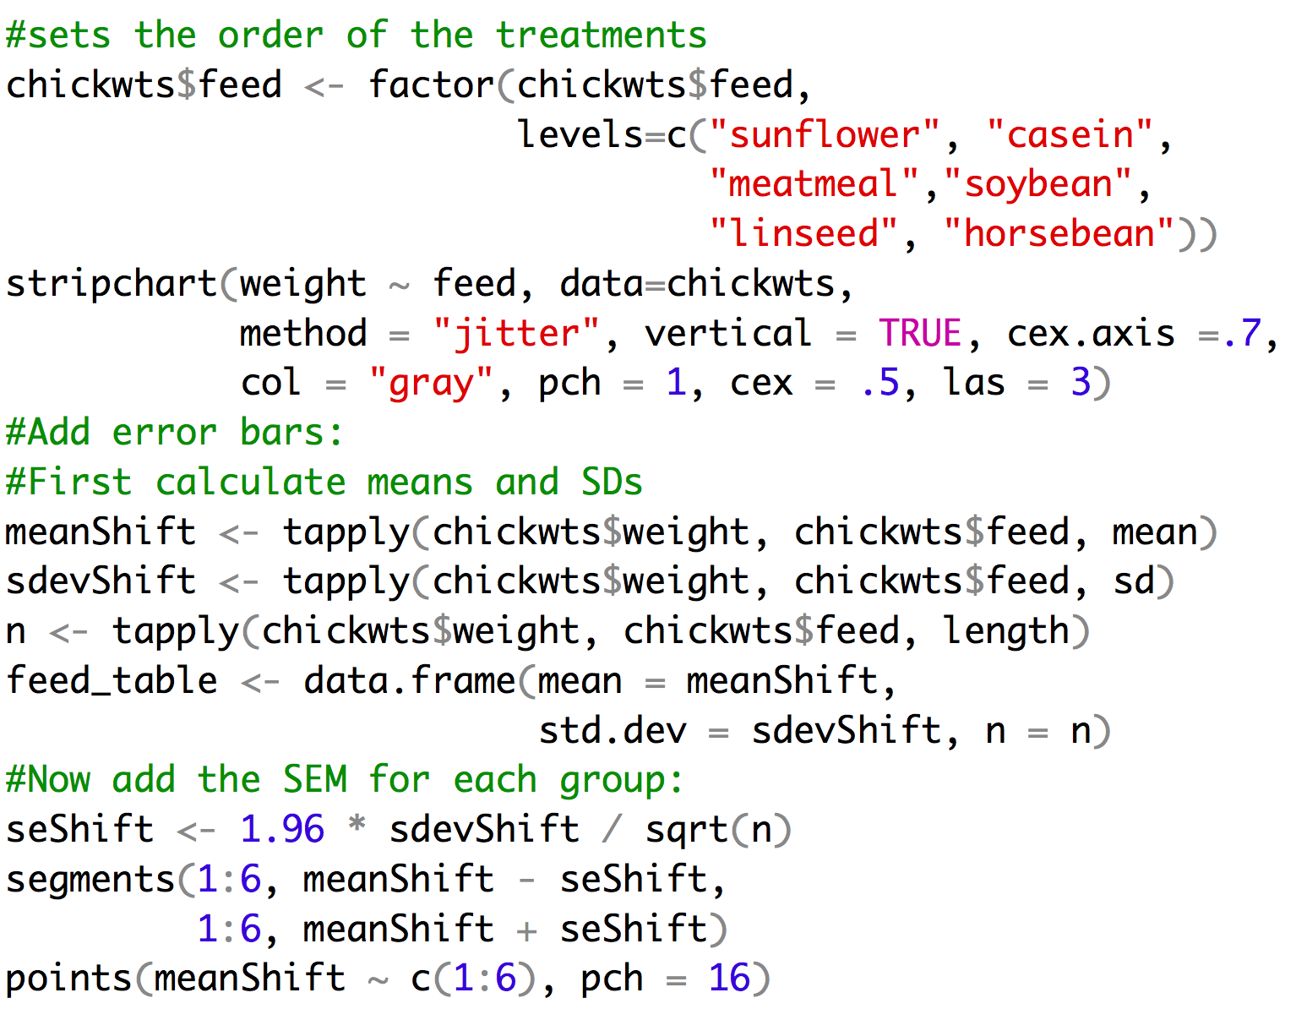
Example of code

Slide 29
Assumptions of the ANOVA
The variable is normally distributed within each group
The variance is the same in the different groups
The design is balanced – you have the same sample size for each group
But… ANOVA is fairly robust to violations of these assumptions

Slide 30
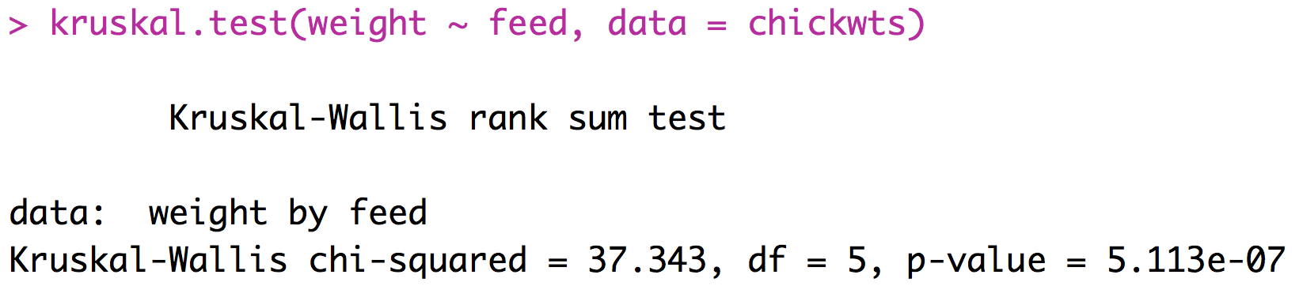
A Non-Parametric Alternative
Kruskal-Wallis Test
Based on ranks
The multiple-group version of the Mann-Whitney U-test
R-implementation:
p-value suggests this
test has lower power
than ANOVA

Slide 31
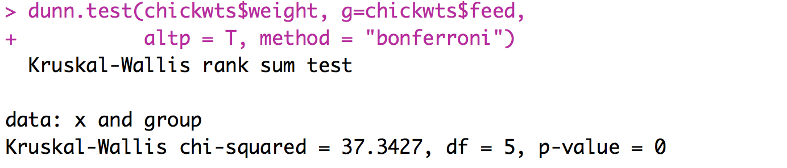
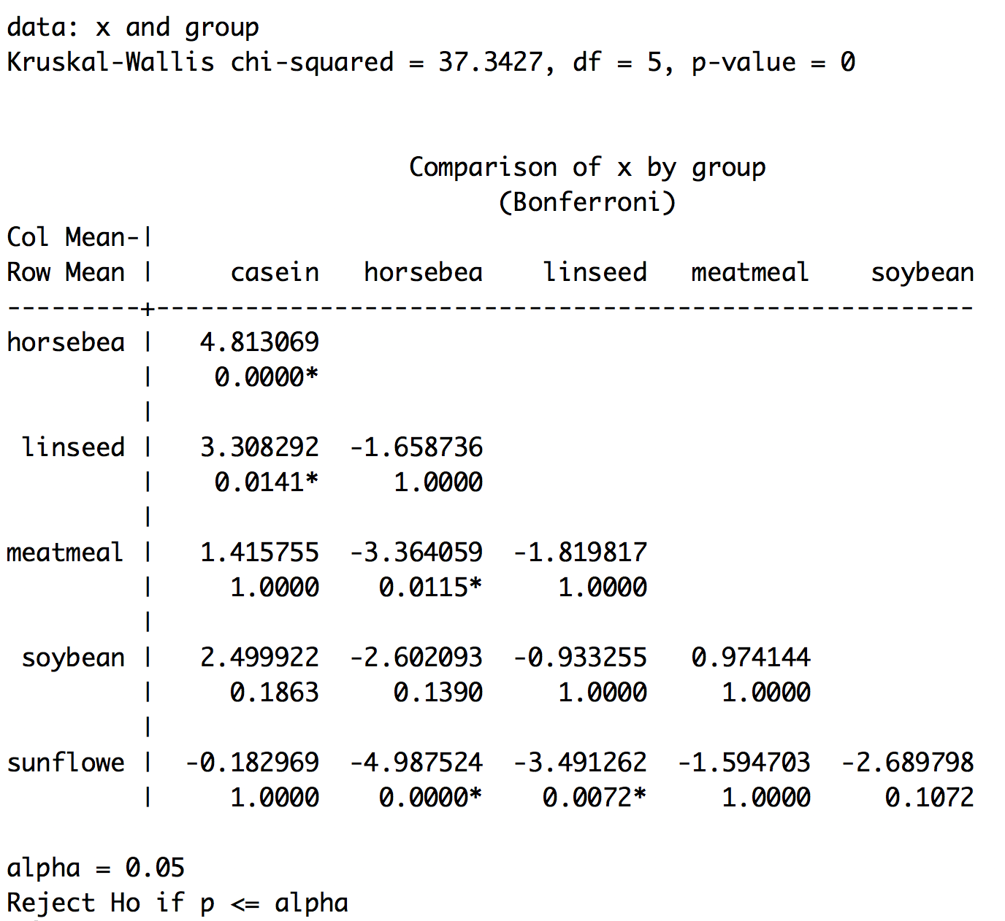
A Non-Parametric post-hoc
Dunn’s test – is the non-parametric equivalent of the Tukey
  Not in base R need to install:
  install.packages(“dunn.test”, dependencies=TRUE)

Slide 32
ANOVA Summary
ANOVA is the foundation of essentially all tests comparing multiple means
Don’t make it too complicated – the null hypothesis is simple: they are all the same.
Post-hoc tests are important for determining which means are the source of a significant ANOVA.
You can only justify a post-hoc test if the ANOVA is significant in the first place.
Before applying ANOVA, check that your data fit the assumptions (consider transforming the data lots of times this will be based on your biological knowledge because you will have insufficient data to say much about the observed distribution)

Slide 33
ANOVA Practice Problems
Use the chick weights dataset included in R data("chickwts"). Reduce the data down to just soybean and sunflower. Run an ANOVA and determine whether these foods lead to significant differences in weight.

Slide 34
Hypothesis testing has limits
Often times we want to say more than something has an effect. We want to understand exactly how a predictor variable impacts a response variable.
Often times we have complex relationships where several variables (continuous and discrete) impact our response variable and we need to understand how all of these things work together to determine our observations.
This is when we should think about moving to generalized linear models!

Slide 35
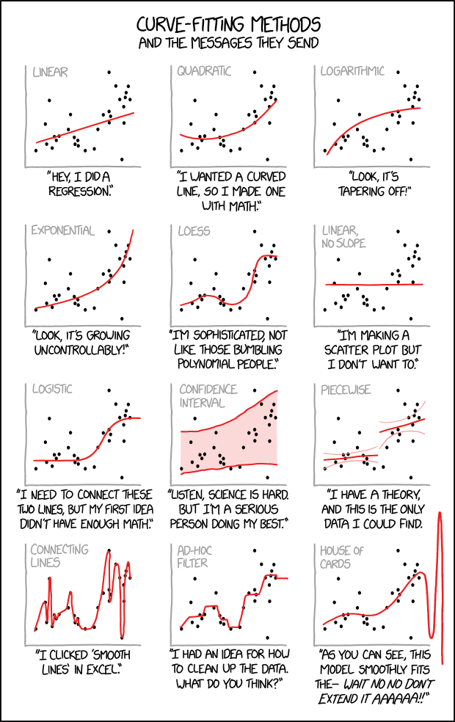
Regression

Slide 36
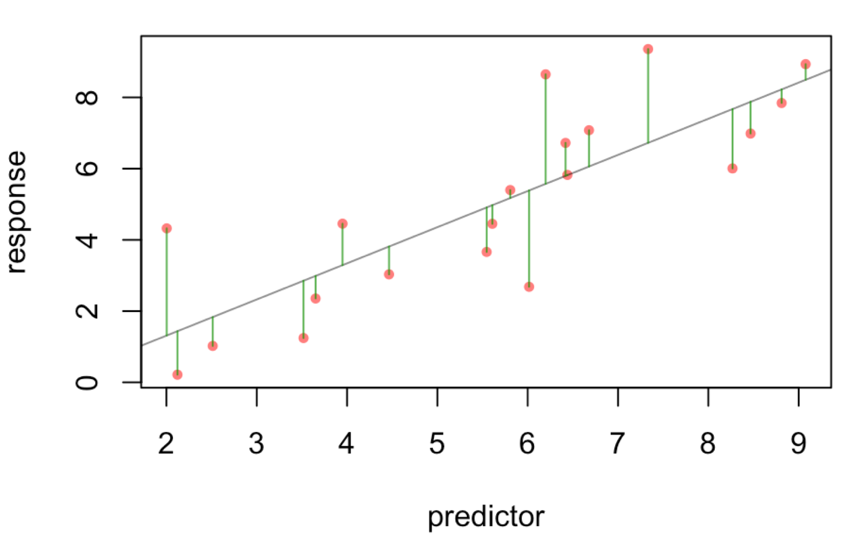
Regression in R
With linear regression we find the linear equation that best predicts the values of Y based on the values of X.
$y=bx+a$
Least-squares regression minimizes the squared deviations of the data points from that line.

Slide 37
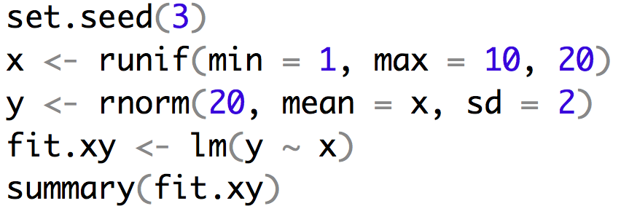
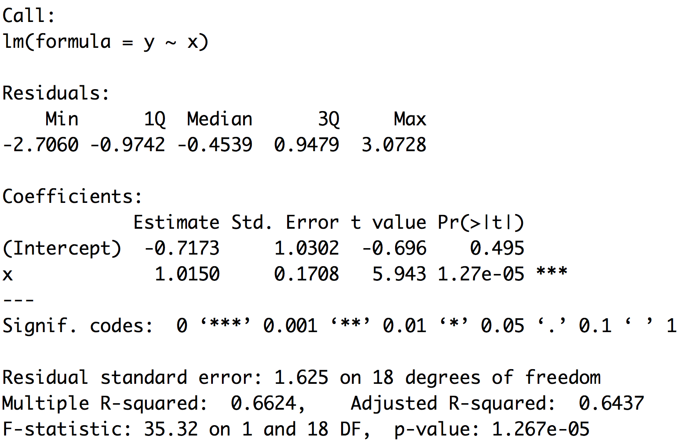
Example of regression
$$y=bx+a$$
$$t= \frac{β_{0}}{{SE}_{b}}$$

Slide 38
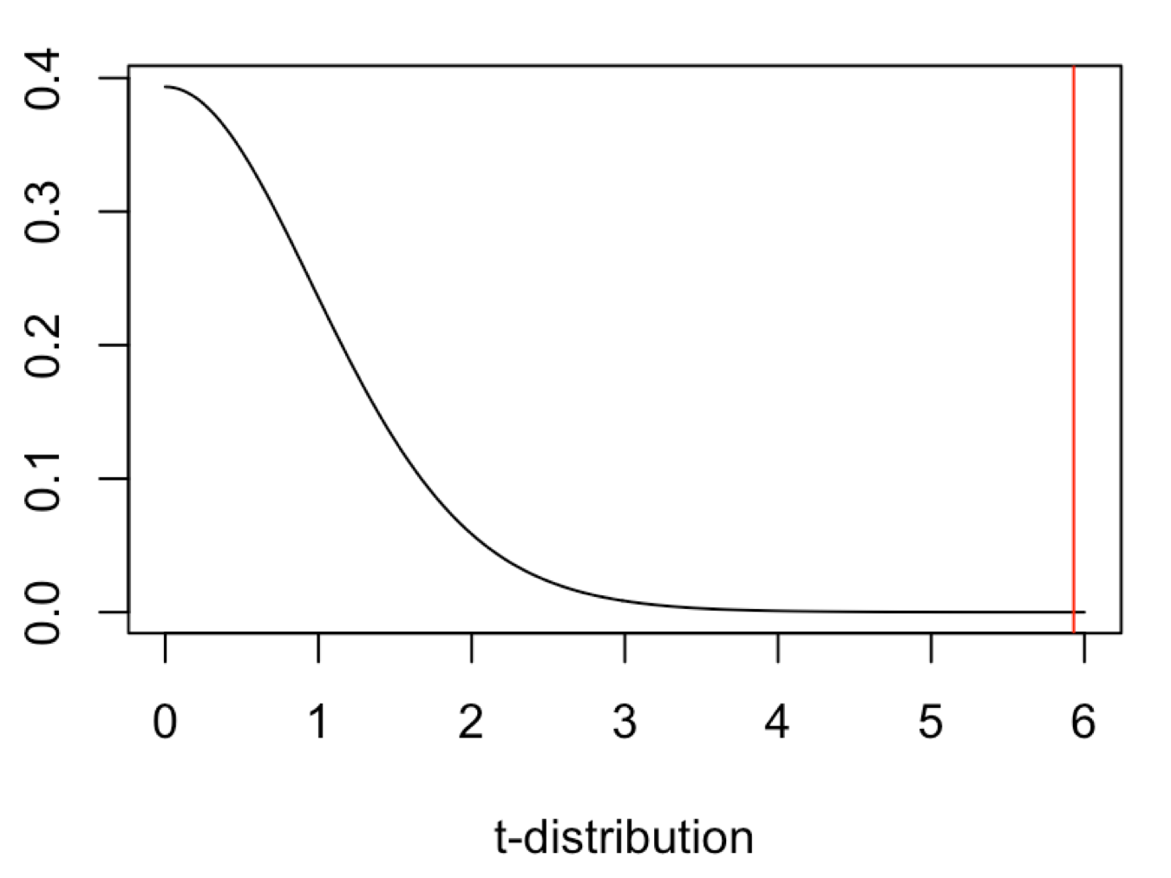
Example of regression
$$y=bx+a$$
$$t= \frac{ β_{0}}{{SE}_{b}}$$

Slide 39
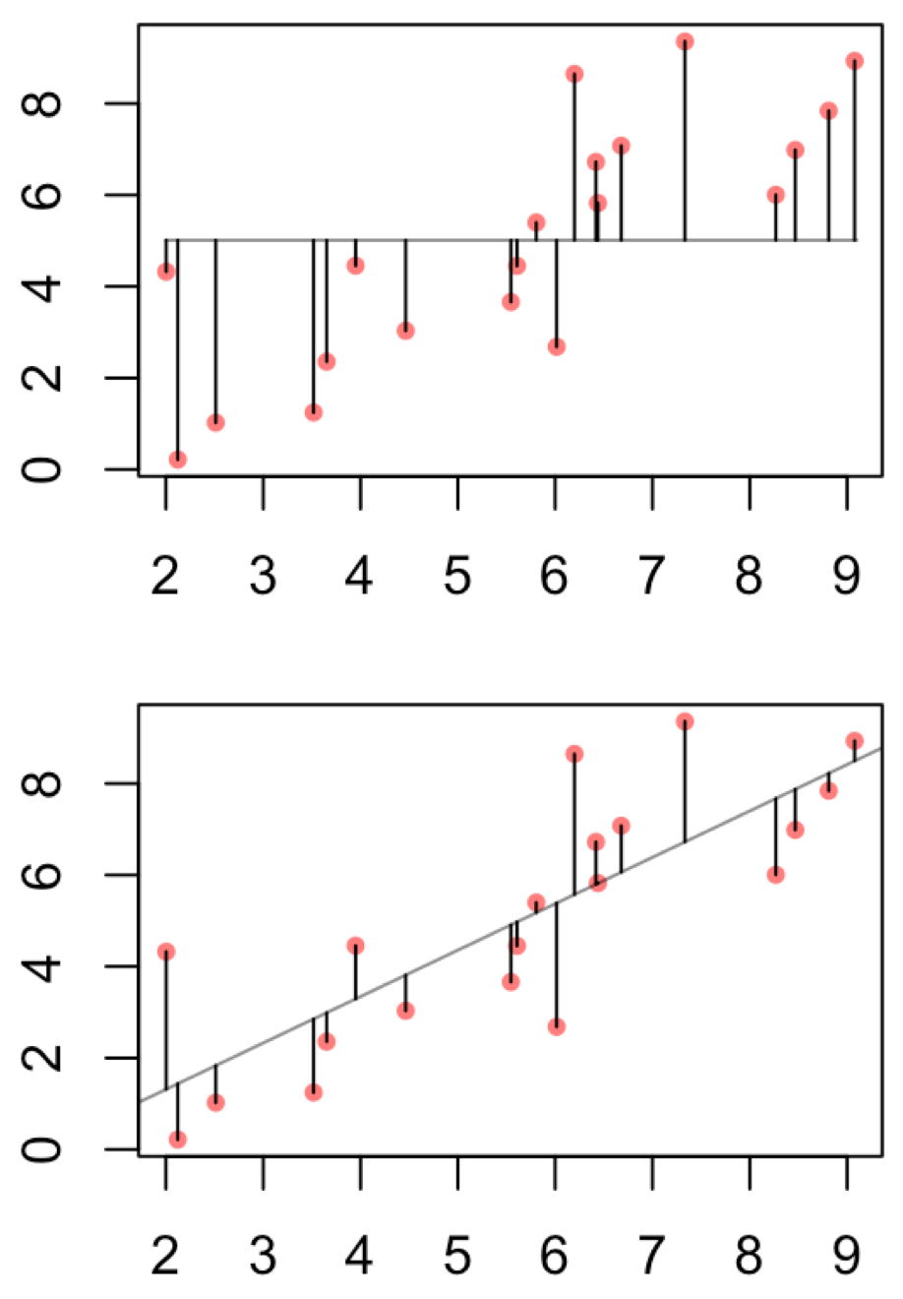
Example of regression
This can help to justify the biological importance
assuming you have a regression that is significant.
It is the proportion of total variance explained by
the regression.

Slide 40
Multiple vs Adjusted R-squared
Adjusted R-squared penalizes for additional parameters

Slide 41
Linear regression uses
Depict the relationship between two variables in an eye-catching fashion
Test the null hypothesis of no association between two variables
  The test is whether or not the slope is zero
Predict the average value of variable Y for a group of individuals with a given value of variable X
  variation around the line can make it very difficult to predict a value for a given individual with much confidence
  Predictions outside of the range of observed data is generally discouraged
Used both for experimental and observational studies

Slide 42
What are Residuals
In general, the residual is the individual’s departure from the value predicted by the model
In this case the model is simple – the linear regression – but residuals also exist for more complex models
For a model that fits better, the residuals will be smaller on average
Residuals can be of interest in their own right, because they represent values that have been corrected for relationships that might be obscuring a pattern.

Slide 43
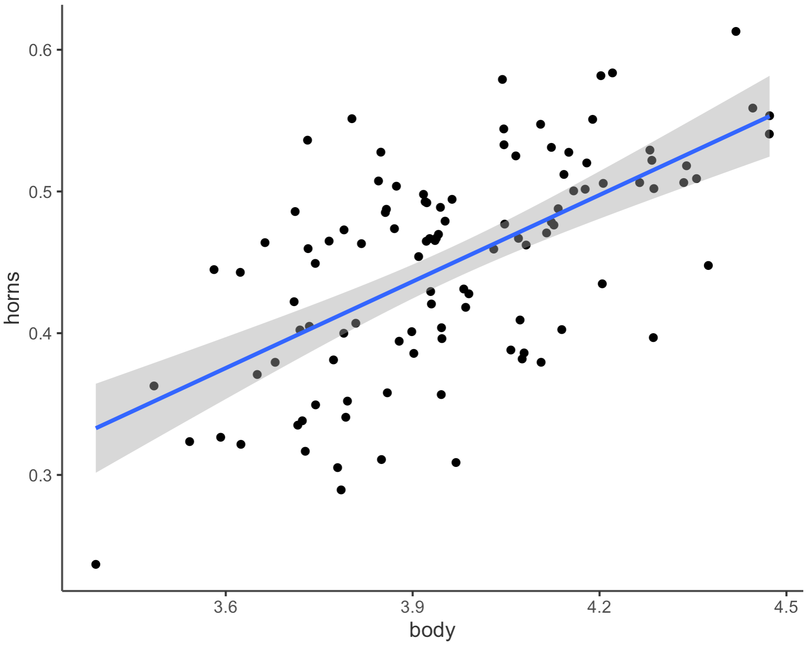
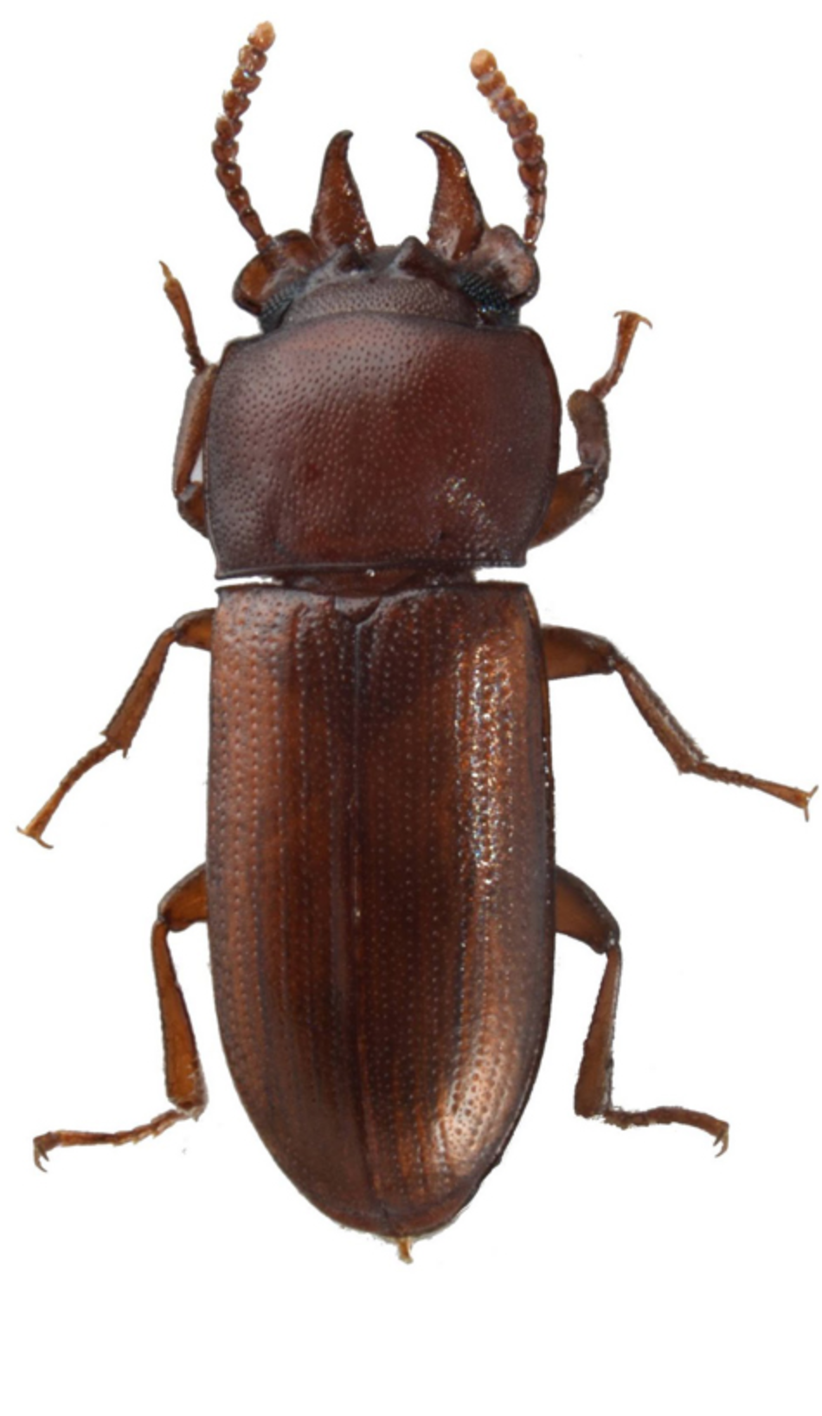
What are Residuals
Horn Size
Body Size

Slide 44
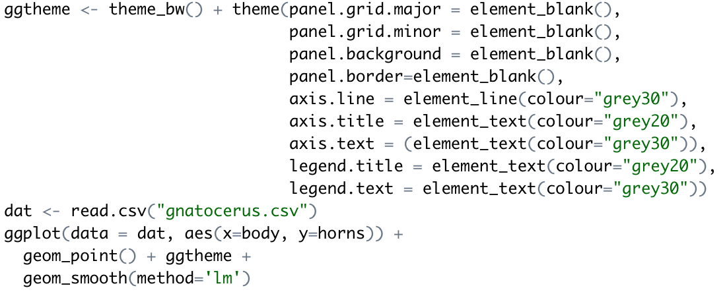
Making that plot

Slide 45
Strong Inference for Observational Studies
Noticing a pattern in the data and reporting it represents a post hoc analysis
This is not hypothesis testing
The results, while potentially important, must be interpreted cautiously
What can be done?
Based on a post-hoc observational study, construct a new hypothesis for a novel group or system that has not yet been studied

Slide 46
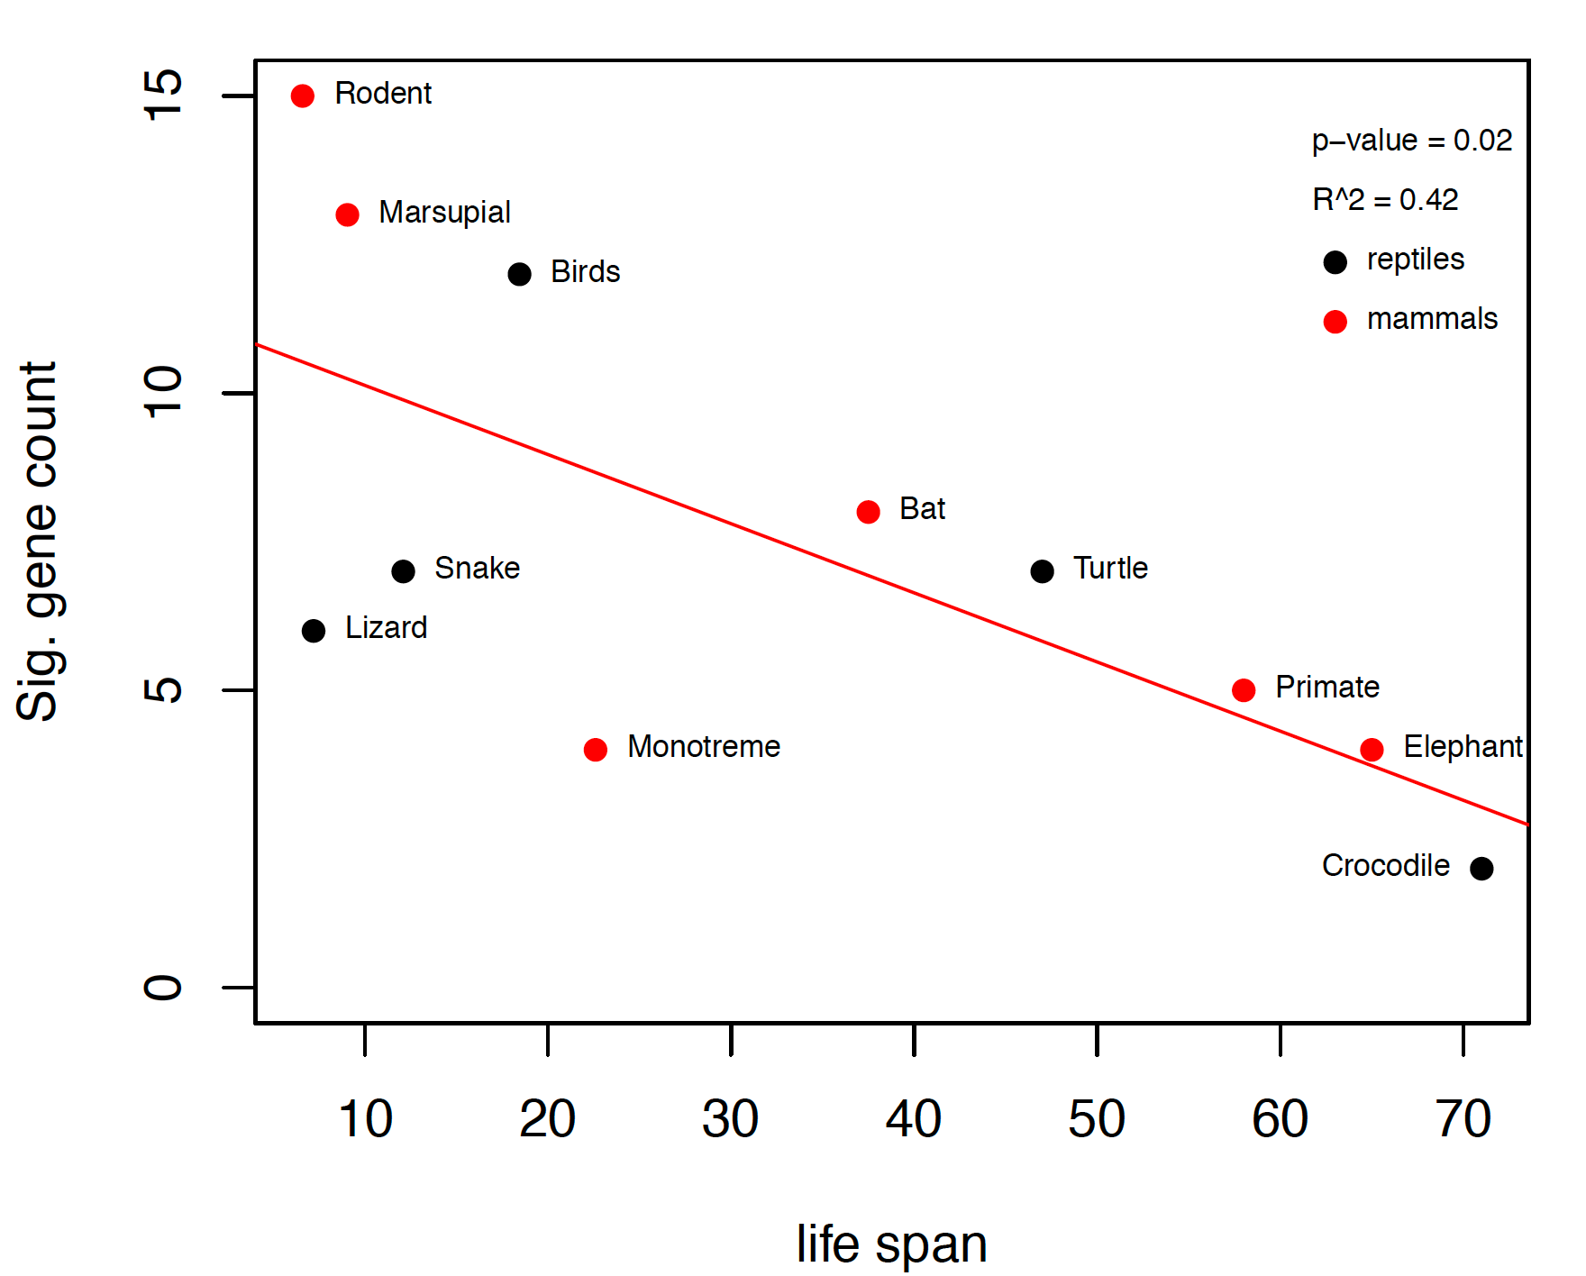
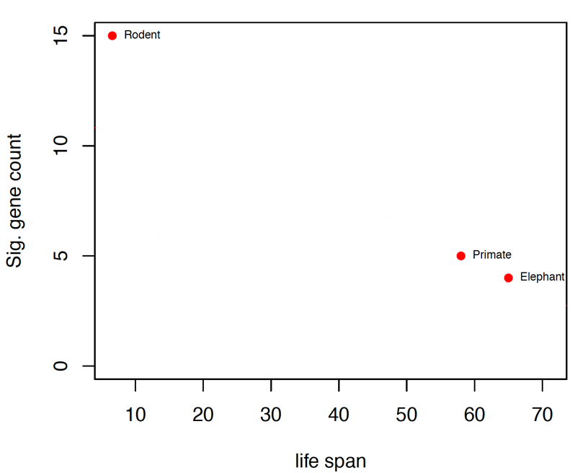
Example
We already knew that the P53 network is important in guarding against cancer in long lived species.
We also knew that primates and elephants show rather little change in this network when compared to rodents.
Collect data on many more species and test apriori hypothesis that there will be a significant and negative regression coefficient.

Slide 47
Assumptions of Linear Regression
The true relationship must be linear
At each value of X, the distribution of Y is normal (i.e., the residuals are normal)
The variance in Y is independent of the value of X
Note that there are no assumptions about the distribution of X

Slide 48
Common Problems
Outliers
  Regression is extremely sensitive to outliers
  The line will be drawn to outliers, especially along the x-axis
  Consider performing the regression with and without outliers
Non-linearity
  Best way to notice is by visually inspecting the plot and the line fit
  Try a transformation to get linearity [often a log transformation]
Non-normality of residuals
  Can be detected from a residual plot
  Possibly solved with a transformation
Unequal variance
  Usually visible from a scatterplot or from a residual plot

Slide 49
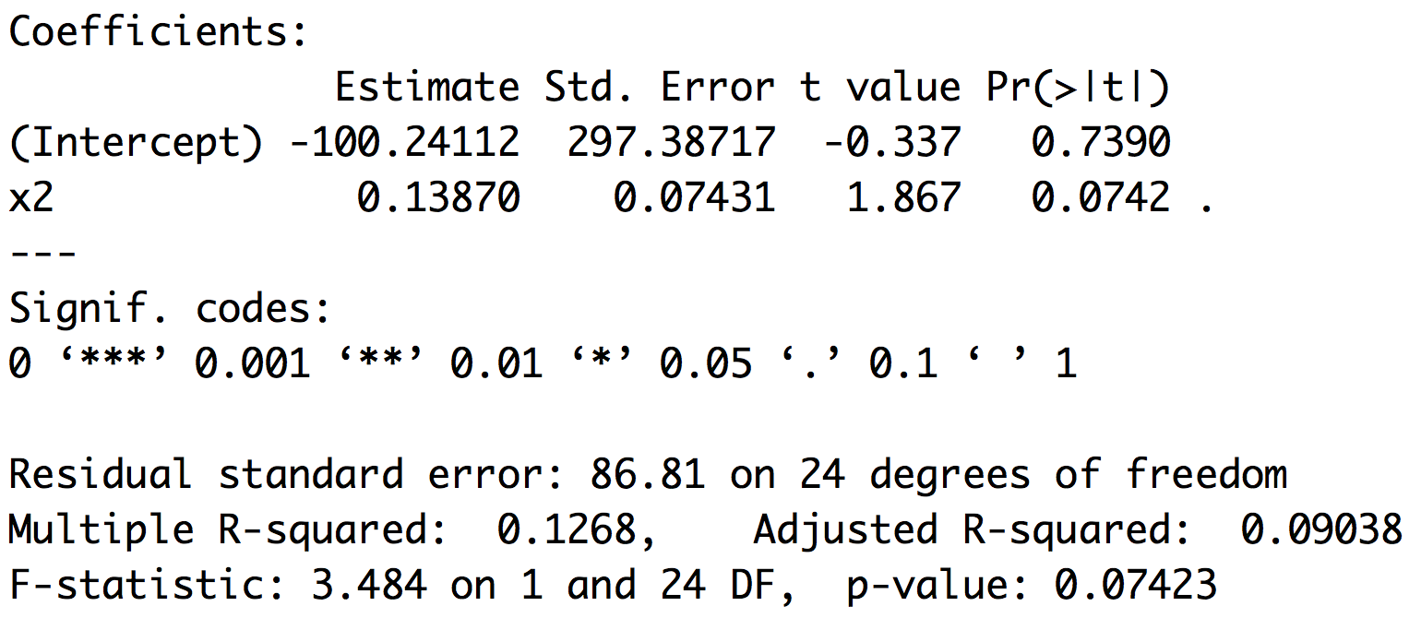
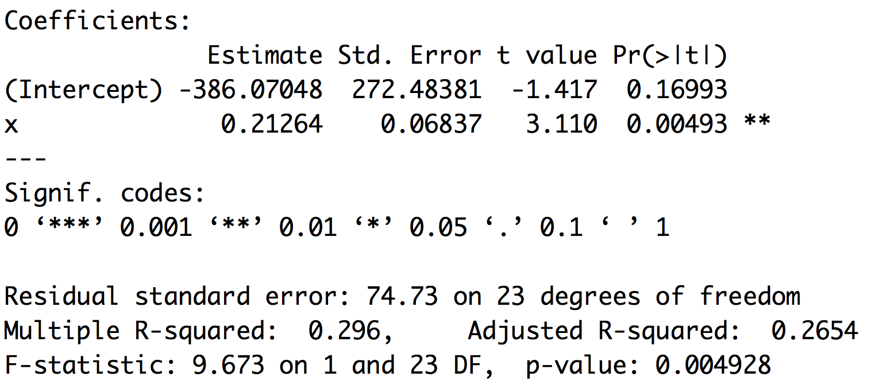
Outliers
Leverage and cooks distance
Theil–Sen estimator

Slide 50
Moving past simple models
The reason ANOVA is so widely used is that it provides a framework to simultaneously test the effects of multiple factors
ANOVA also makes it possible to detect interactions among the factors
ANOVA is a special case of a general linear model
Linear regression is a special case of a general linear model

Slide 51
GLM and LM function in R
The GLM and LM function in R takes equations that can be described with the following operators
+ +X include this variable
: X:Z include the interaction between these variables
∗ X∗Y include these variables and the interactions between them
^ (X + Z + W)^3 include these variables and all interactions up to three way

Slide 52
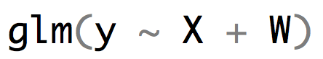

R versus the math implied
$y_{i}=β_{0}+β_{1}X_{i}+β_{2}W_{i}+ε_{i}$
$y_{i}=β_{0}+β_{1}X_{i}+β_{2}W_{i}+β_{3}{X_{i}W}_{i}+ε_{i}$

Slide 53
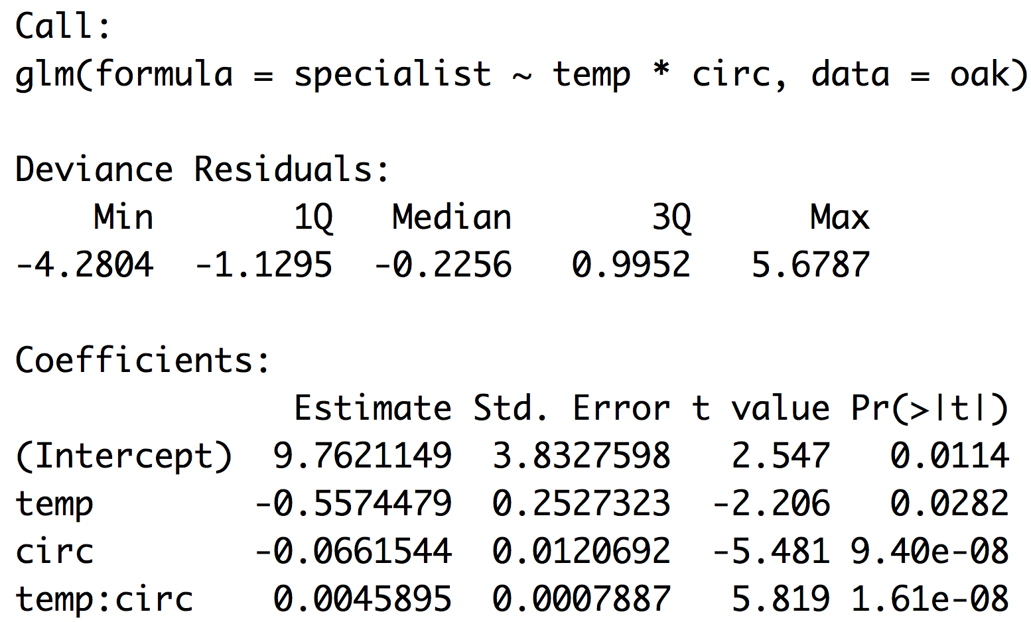
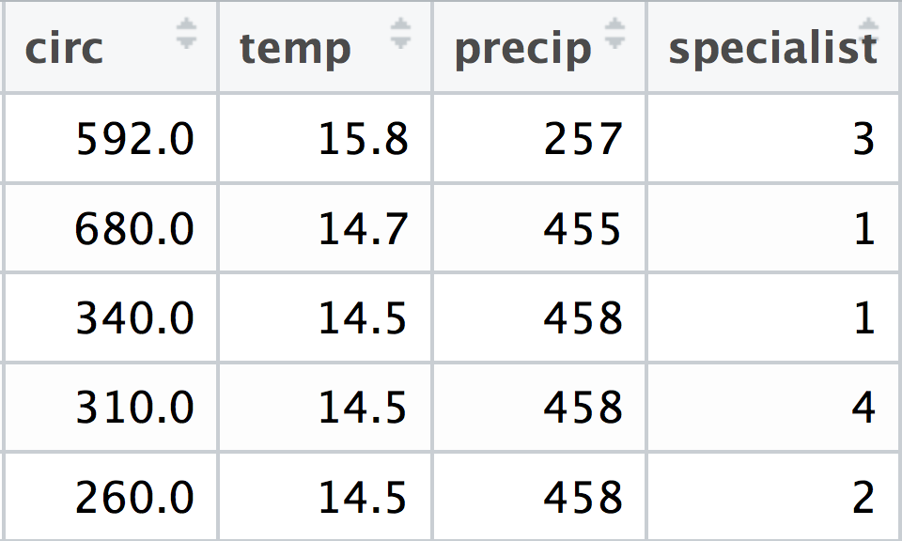
R versus the math oak example
$$y_{i}=β_{0}+β_{1}{temp}_{i}+β_{2}{circ}_{i}+β_{3}{{temp}_{i}circ}_{i}$$

Slide 54
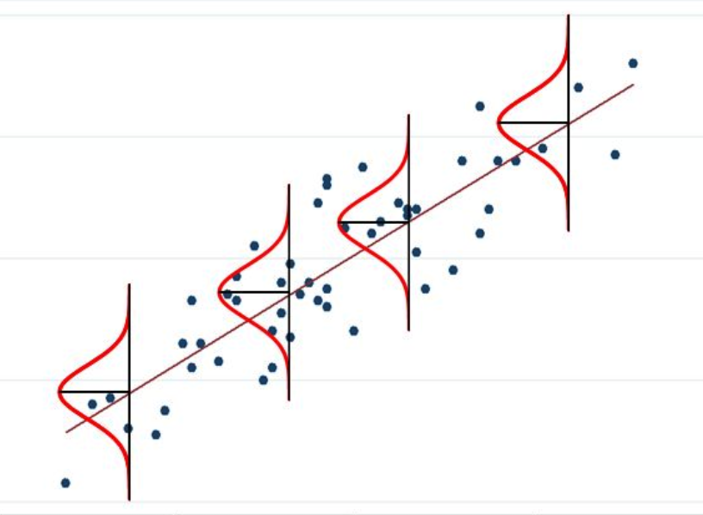
When the response variable isn’t normal

Slide 55
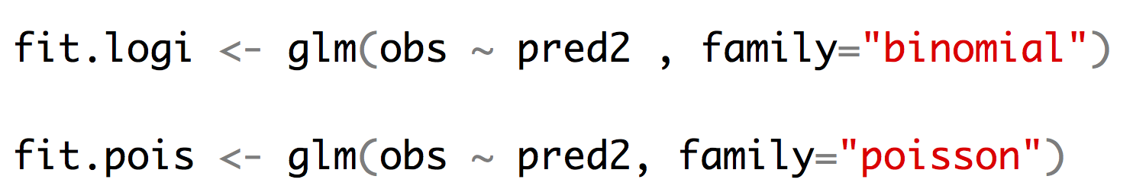
Other kinds of regression
Logistic regression allows us to fit a binary response variable (absent/present; alive/dead) with one or more categorical or continuous predictor variables.
Poisson regression allows us to fit a response variable that is Poisson distributed (number of extinctions in a unit of time, number of colonies per plate, (number of occurrences for rare events)) with one or more categorical or continuous predictor variables.

Slide 56
Model Selection

Slide 57
Likelihood and AIC model selection
Think of likelihood as how probable the observed data are under the current model. When we fit a glm we are getting the likelihood of the data assuming the best values for the parameters (beta coefficients). For any empirical dataset these will be very small numbers. It is easy for computers to store the log of very small numbers which means that log likelihoods will be negative numbers.
likelihood = .01
likelihood = .0001
ln(L) = -4.6
ln(L) = -9.2
better fit
worse fit
Adding additional predictor variables will always improve the fit of the data under the model.
R example
So we must penalize for extra parameters
R example
fit1 <- glm(y ~ a)
fit2 <- glm(y ~ a + b)
logLik(fit1)
anova(fit1, fit2, test=“LRT”)

Slide 58
Likelihood and AIC model selection
$$AIC=2k −2ln⁡(L)$$
k number of parameters
ln(L) log likelihood of the data (a big negative number)
Models with smaller numbers are better
Differences in AIC can be used to evaluate evidence for one model vs. another.
A model with a ΔAIC value within 1-2 of the best model has substantial support, and should be considered along with the best model.
A ΔAIC value within only 4-7 units of the best model has considerably less support.
A ΔAIC value > 10 indicates that the worse model has virtually no support and should not be consideration.
Burnham and Anderson 1998

Slide 59
Likelihood and AIC model selection
LRT: Does adding this predictor variable reduce the deviation from predictions more than I would expect if the predictor had no impact on the response variable (alpha = .05)
AIC: Is about comparing models and finding the model(s) that seem to match with the data we are observing.
If you are going to use AIC to choose “best” model pay attention to close seconds and whether they “tell a different story”

Slide 60
GWAS

Slide 61
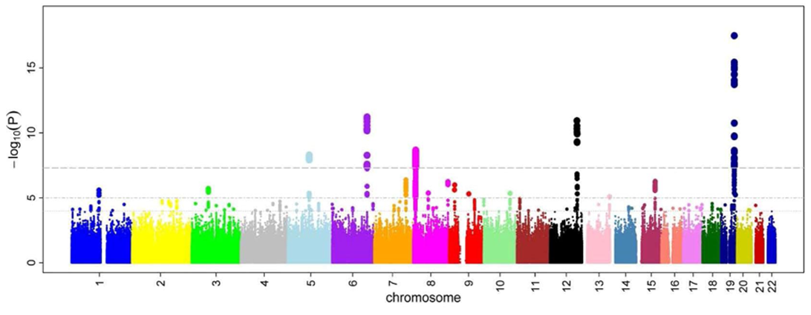
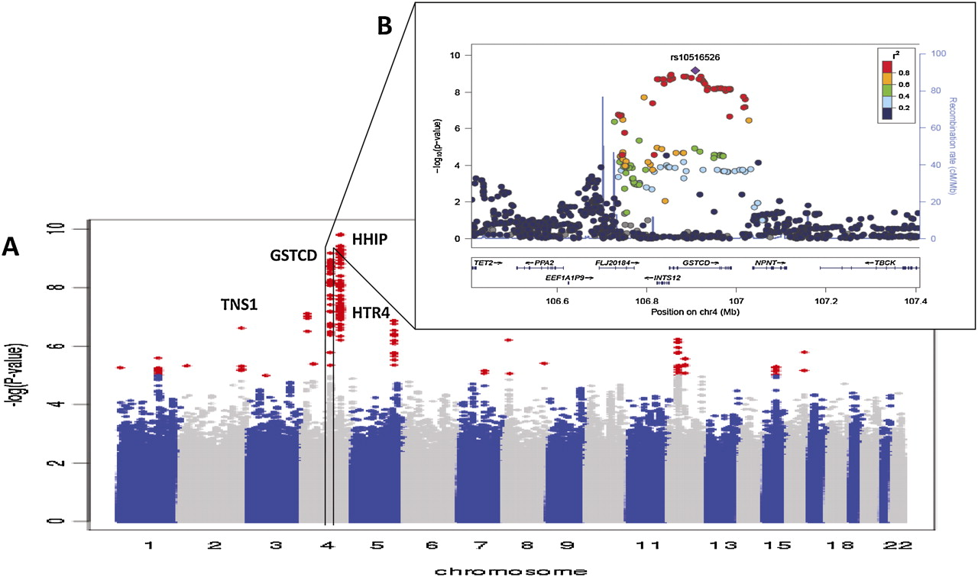
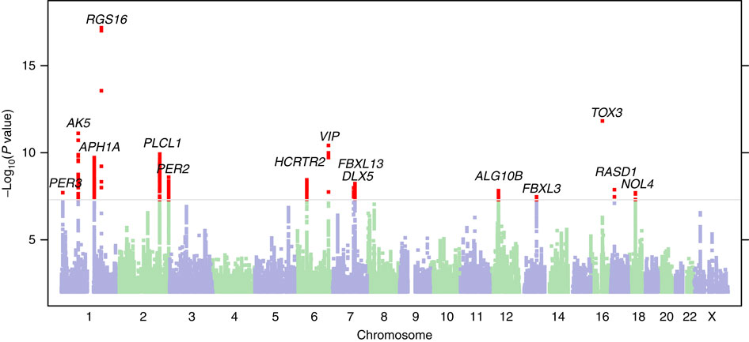
GWAS

Slide 62
GWAS
GWAS: Genome wide association study.
The goal of GWAS is to determine what genes have alleles that are responsible for a trait of interest. The trait can be any measurable trait in any organism that you wish to study. For instance, a disease in humans, an economically important trait of a crop or domestic animal, an adaptation like a certain color pattern in birds, etc.

Slide 63
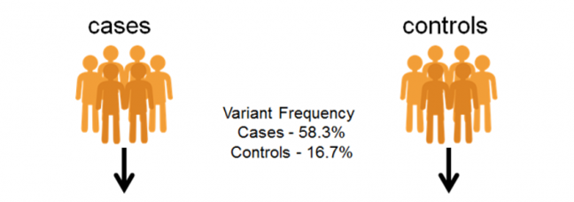
GWAS – Discrete condition (often disease)
>case 1
CATACTACTACTGAACGTTTGCTCCTGCtactatctctctctctctctctttctctctctctctctCATGC >case 2
AGTTGACTACTGCATACTCGTGCTAGCTGACTGTCGTACGTACGTAGCTAGTGATCGATCGATGCTAGCTA>case 3
CATACTACTACTGAACGTTTGCTCCTGCtactatctctctctctctctctttctctctctctctctCATGC >control 1
AGTTGACTACTGCATACTCGTGCTAGCTGACTGTCGTACGTACGTAGCTAGTGATCGATCGATGCTAGCTA>control 2
CATACTACTACTGAACGTTTGCTCCTGCtactatctctctctctctctctttctctctctctctctCATGC >control 3
AGTTGACTACTGCATACTCGTGCTAGCTGACTGTCGTACGTACGTAGCTAGTGATCGATCGATGCTAGCTA

Slide 64
GWAS – Continuous trait
>sample 1
CATACTACTACTGAACGTTTGCTCCTGCtactatctctctctctctctctttctctctctctctctCATGC >sample 2
AGTTGACTACTGCATACTCGTGCTAGCTGACTGTCGTACGTACGTAGCTAGTGATCGATCGATGCTAGCTA>sample 3
CATACTACTACTGAACGTTTGCTCCTGCtactatctctctctctctctctttctctctctctctctCATGC >sample 4
AGTTGACTACTGCATACTCGTGCTAGCTGACTGTCGTACGTACGTAGCTAGTGATCGATCGATGCTAGCTA>sample 5
CATACTACTACTGAACGTTTGCTCCTGCtactatctctctctctctctctttctctctctctctctCATGC >sample 6
AGTTGACTACTGCATACTCGTGCTAGCTGACTGTCGTACGTACGTAGCTAGTGATCGATCGATGCTAGCTA

Slide 65
GWAS – Continuous trait
AGTTGACTACTGCATACTCGT
AGTTGACTACTGCATACTCGT
AGTTGACTACTGCATACTCGT
AGTTGACTACTGCATACTCGT
TGTTGACTACTGCATACTCGT
AGTTGACTACTGCATACTCGT
TGTTGACTACTGCATACTCGT
TGTTGACTACTGCATACTCGT
AGTTGACTACTGCATACTCGT
TGTTGACTACTGCATACTCGT
TGTTGACTACTGCATACTCGT
TGTTGACTACTGCATACTCGT
coat color
Not significant
AA AT TT

Slide 66
GWAS – Continuous trait
AGTTGACTACTGCATACTCGT
AGTTGACTACTGCATACTCGT
AGTTGACTACTGCATACTCGT
AGTAGACTACTGCATACTCGT
TGTAGACTACTGCATACTCGT
AGTAGACTACTGCATACTCGT
TGTAGACTACTGCATACTCGT
TGTTGACTACTGCATACTCGT
AGTAGACTACTGCATACTCGT
TGTAGACTACTGCATACTCGT
TGTTGACTACTGCATACTCGT
TGTTGACTACTGCATACTCGT
coat color
Highly significant!
AA AT TT

Slide 67
GWAS - Problems
What is the problem with doing this across the whole genome?
Multiple tests lead to more false positives!
require a higher level of significance 5x10⁻⁸
only look at the very most significant
lots of more complicated approaches too!
What is one of the most basic requirements of almost all statistical tests?
Tests normally assume independence of the data points!
Samples from a population will be related to each other due to ancestry (trees!)
DNA sequencing is not done equally in all groups of people (western samples are usually over represented

Slide 68
GWAS - Problems
What is epistasis?
It is the case where the impact of a genotype at one locus depend on the genotype at another locus!
To find this type of effect you would need to look at all pairs of genotypes. How many tests would we need to do then?
About 6 orders of magnitude more tests would be required.
Humans have around 4,000,000 sites that are variable like this which equates to 7,999,998,000,000
GG
GT
TT
AA AT TT

Slide 69
GWAS - Problems
What about the environment?
Many diseases have a strong environmental component (heart disease, diabetes, cancer, etc.)
If these are left out of the study often what is discovered is actually genetic variation that happens to coincide with environmental factors?
If a disease is more common in Europeans than Africans or Asians but it is because of a lifestyle characteristic any genetic variation that is common in Europeans but rare in Africans and Asians could appear associated with the disease.

Slide 70
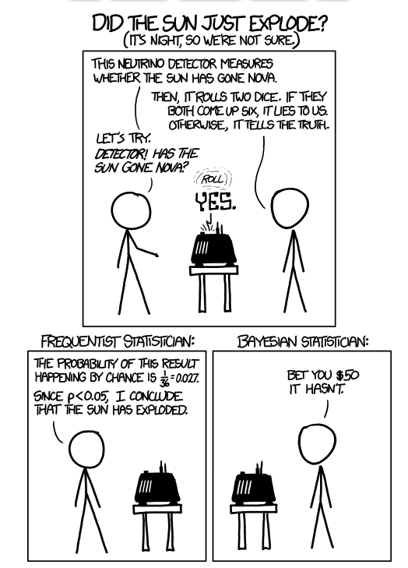
Bayesian Approaches

Slide 71
Frequentist approach
You have a null hypothesis and calculate the probability of observing your data under that hypothesis.
Null: The sun has not exploded
$$\operatorname{Pr}\left(det yes | sun is ok\right)=0.027=\frac{1}{6}×\frac{1}{6}$$
this is less than the typical $∝$ level of 0.05 so we reject the null that the sun is ok.

Slide 72

Bayesian approach
$$\operatorname{Pr}\left(A | B\right)= \frac{Pr⁡(B|A)×Pr⁡(A)}{Pr⁡(B)}$$
$$\operatorname{Pr}\left(nova | det yes\right)= \frac{Pr⁡(det yes|nova)×Pr⁡(nova)}{Pr⁡(\det{yes})}$$
$$\operatorname{Pr}\left(nova | det yes\right)<<0.00000000037 \frac{1×0.0000000001}{0.027}$$

Slide 73
Bayesian approach
Imagine a disease present in 1 person per 100,000. If you take a test that correctly returns a positive result 99.9% of the time when someone is infected but has a false positive rate of 0.5%.
How likely are you to have the disease if you test positive?
Should you be concerned if you test positive?
Bayes’ theorem provides a natural way to think about this.
Lets do this!

Slide 74
Bayesian approach
$$\operatorname{Pr}\left(inf | pos.test\right)= \frac{Pr⁡(pos.test|inf)×Pr⁡(inf)}{Pr⁡(pos.test)}$$
$$\operatorname{Pr}\left(inf | pos.test\right)=0.001= \frac{0.999×0.00001}{0.00501}$$
Which means that you have only a 0.1% chance of having the disease even if you test positive.
What if your doctor noticed a symptom that made them give you this test what changes?

Slide 75
Priors
$$\operatorname{Pr}\left(A | B\right)= \frac{Pr⁡(B|A)×Pr⁡(A)}{Pr⁡(B)}$$
Pr(A) this is the prior. It is powerful because it allows you to incorporate previous knowledge into your analysis, but it can lead to very bad inference if you are careless.

Slide 76
Bayesian methods in practice (MCMC)
In practice our models are quite complex with many parameters we would like to estimate. Each of these has its own prior distribution. The way that we explore the space of solutions is using an MCMC.
Pick an arbitrary starting point
Calculate the current probability $p_{t}$
Generate a change to one of our parameters
Calculate the new probability $p_{t+1}$
Accept new parameter value with probability $\frac{p_{t+1}}{p_{t}}$
Return to step 3 (repeat for a really long time)
$$\operatorname{Pr}\left(A | B\right)= \frac{Pr⁡(B|A)×Pr⁡(A)}{Pr⁡(B)}$$

Slide 77
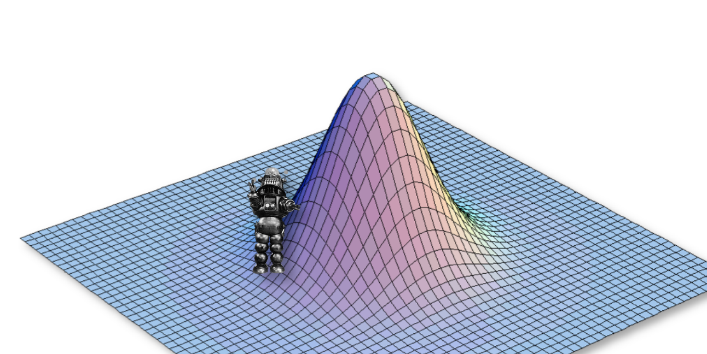
Bayesian methods in practice (MCMC)

Slide 78
Bayesian methods in practice (MCMC)

Slide 79
Bayesian methods in practice (MCMC)

Slide 80
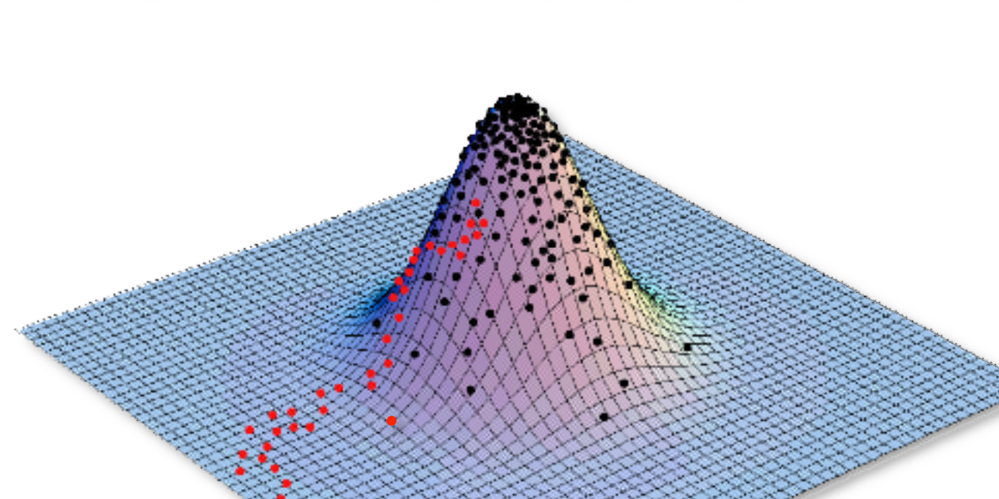
Bayesian methods in practice (MCMC)

Slide 81
Steps in a Bayesian analysis
Choose appropriate priors to use for your parameters
Run your mcmc (How long? How many times?)
Once you are confident in your run remove burn-in
Check to make sure priors didn’t determine outcome.
Make estimates of parameters based on the post burn-in results
  Use summaries appropriate for Bayesian methods.

Slide 82
Assessing Convergence
R example

Slide 83
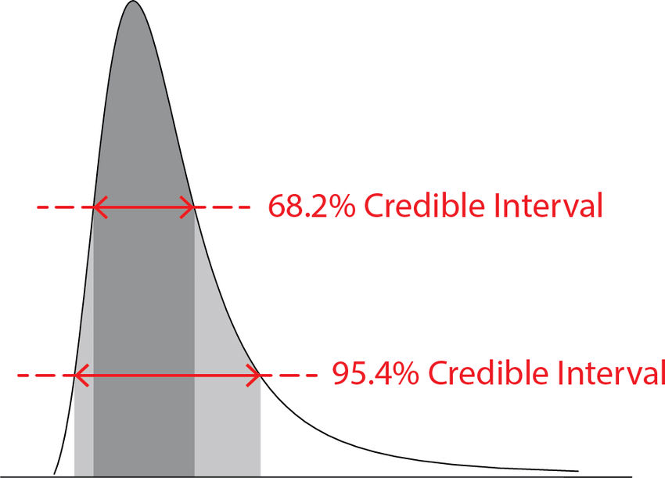
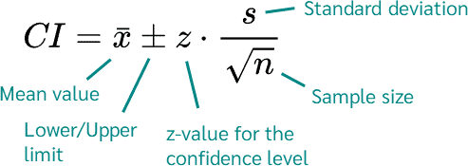
Uncertainty
Credible Interval vs Confidence Interval
R example

Slide 84
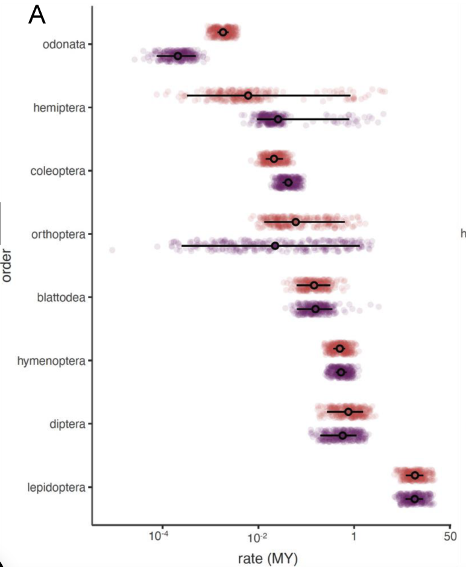
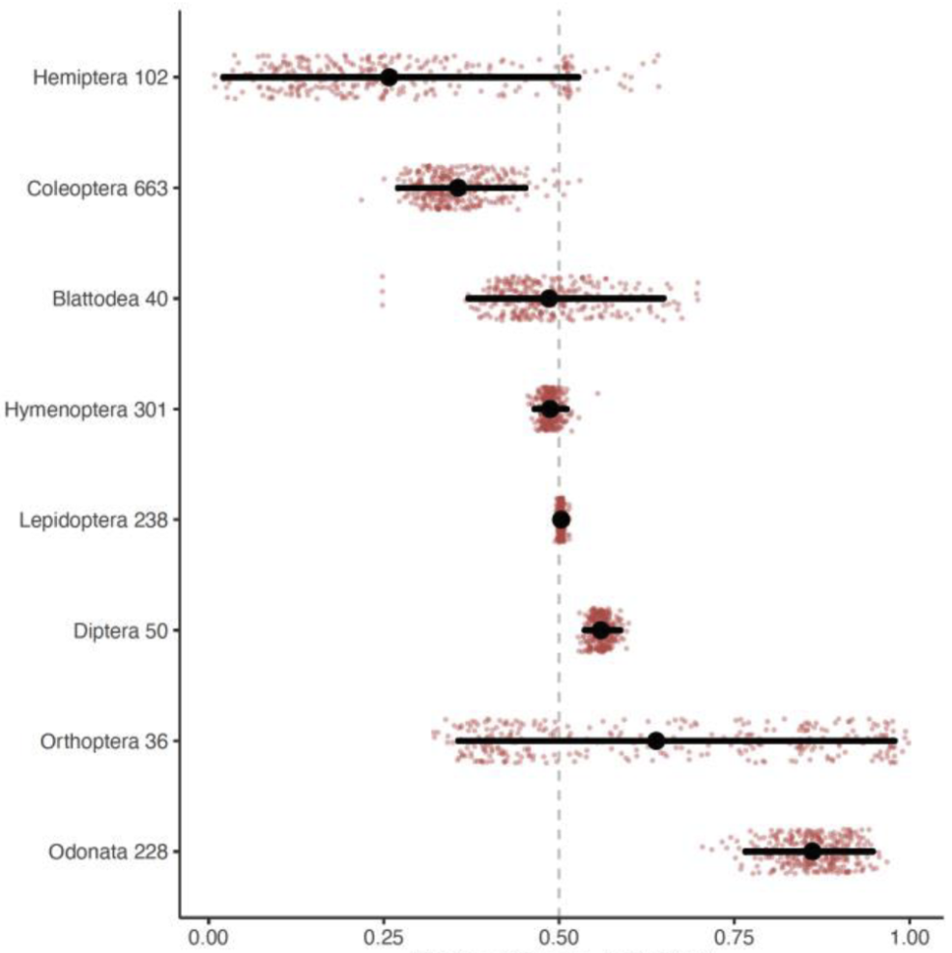
Inferences from posterior distributions

Slide 85


Inferences from posterior distributions

Slide 86


Inferences from posterior distributions

Slide 87
The power of Bayesian approaches
With a Bayesian approach we can take into account all types of uncertainty and be more conservative.
Phylogenetic
Model selection uncertainty
Parameter value uncertainty
Uncertainty in measurements

