Slide 1
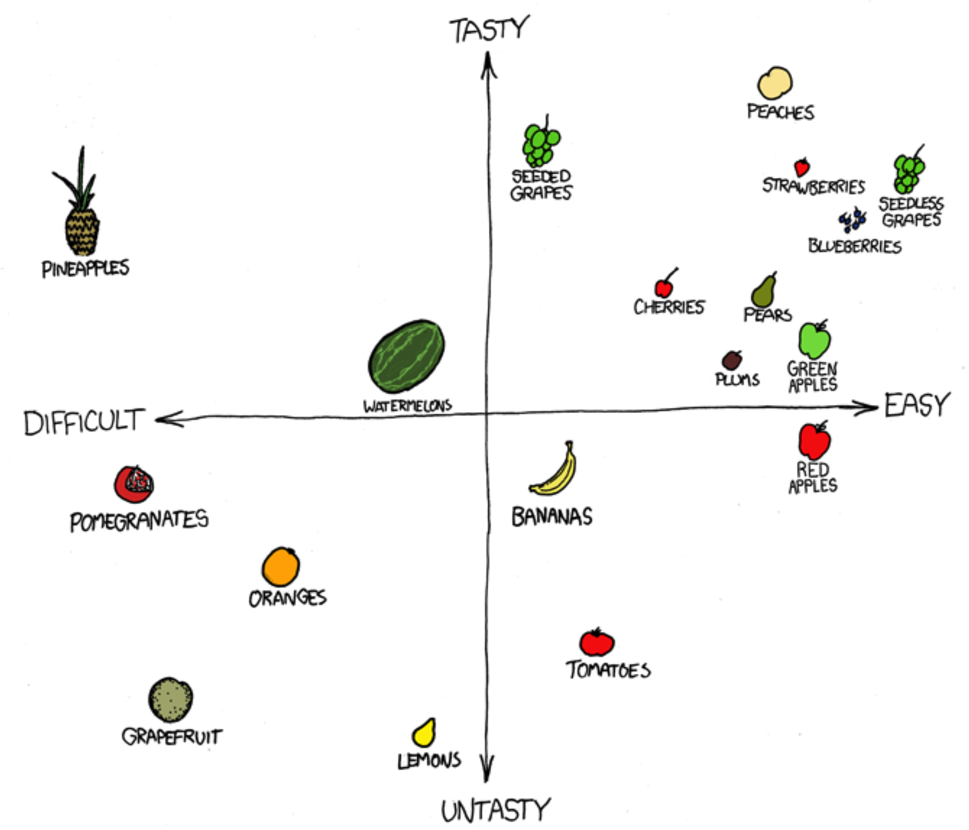
Dimensionality Reduction Principal component analysis Biology 683 Lecture 9 Heath Blackmon

Slide 2
Recently
Fixed vs Random Effect
Problems with model choice
Hypothesis testing vs wrapping our heads around data

Slide 3
Why do we do dimensional reduction?
Datasets are getting bigger and bigger
Understanding our data is often the new bottleneck
We can’t think well beyond 3-4 dimensions
We can’t illustrate well beyond 2 dimensions

Slide 4
What is principal component analysis
PCA is a dimensional reduction tool that takes many (possibly correlated) measurements and transforms it into a smaller set of uncorrelated measuerments.

Slide 5
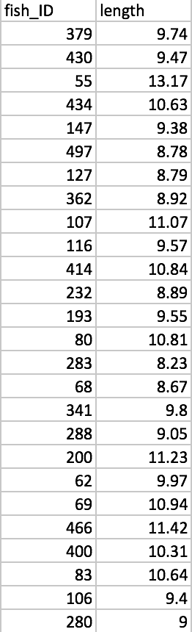
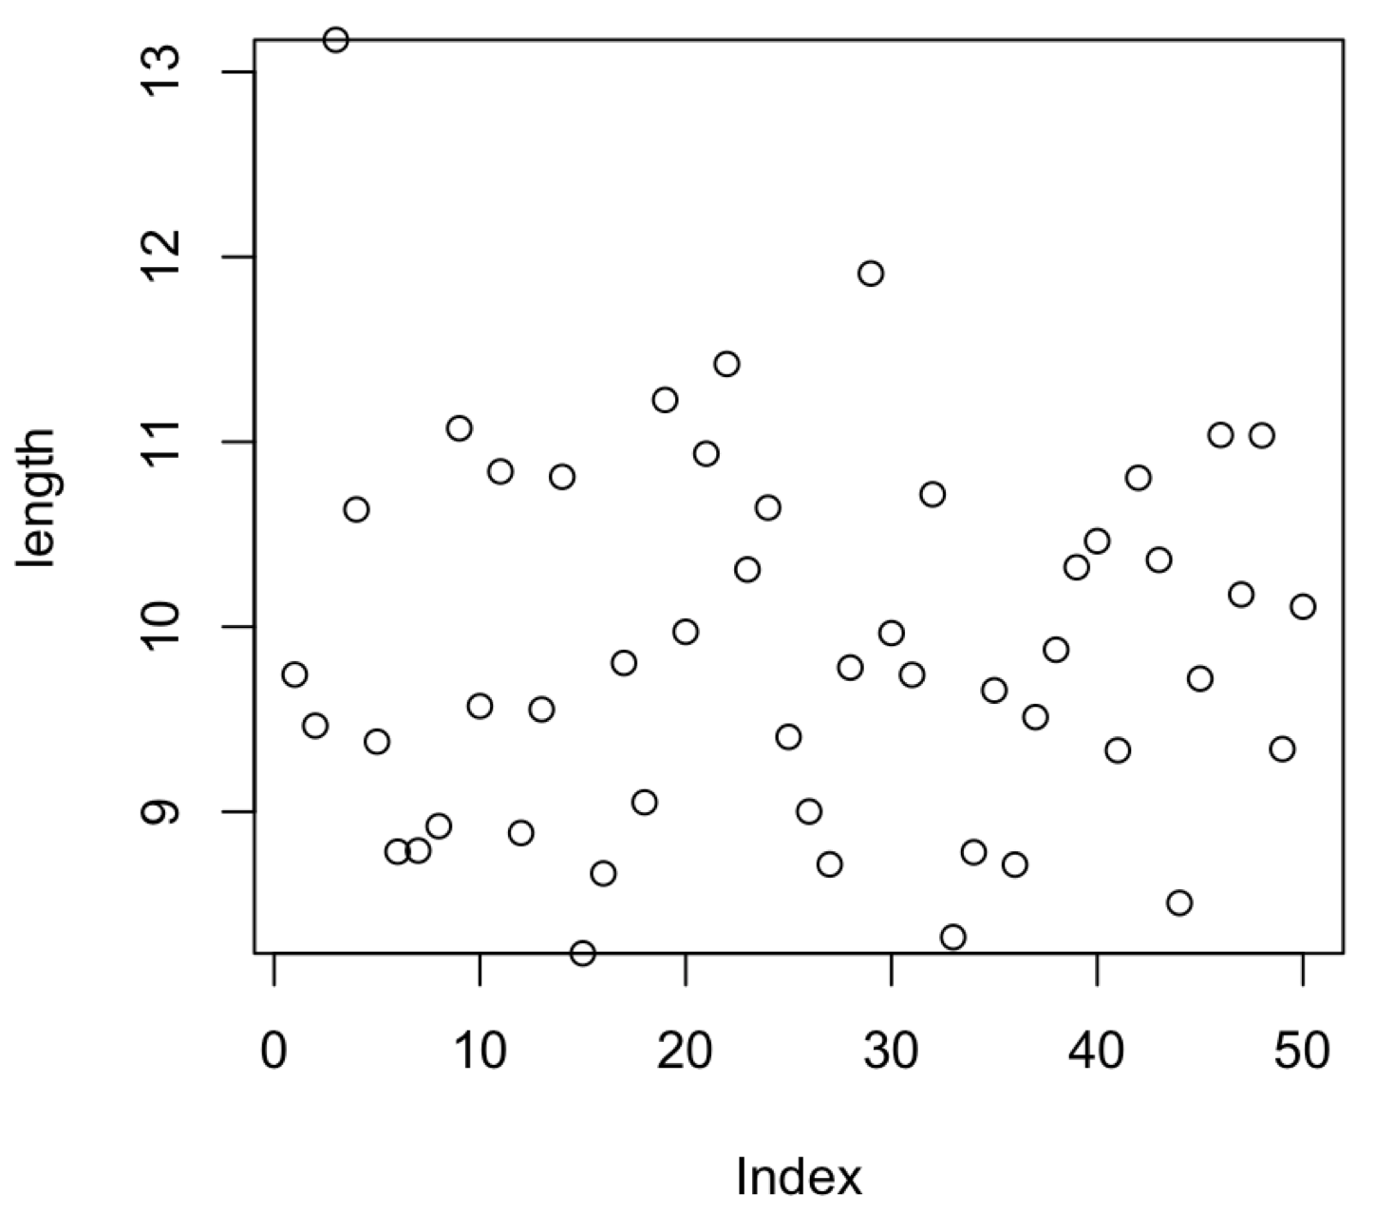
One dimensional data

Slide 6
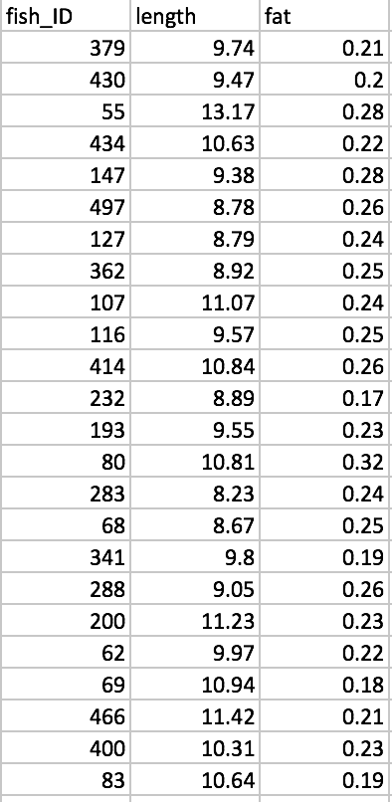
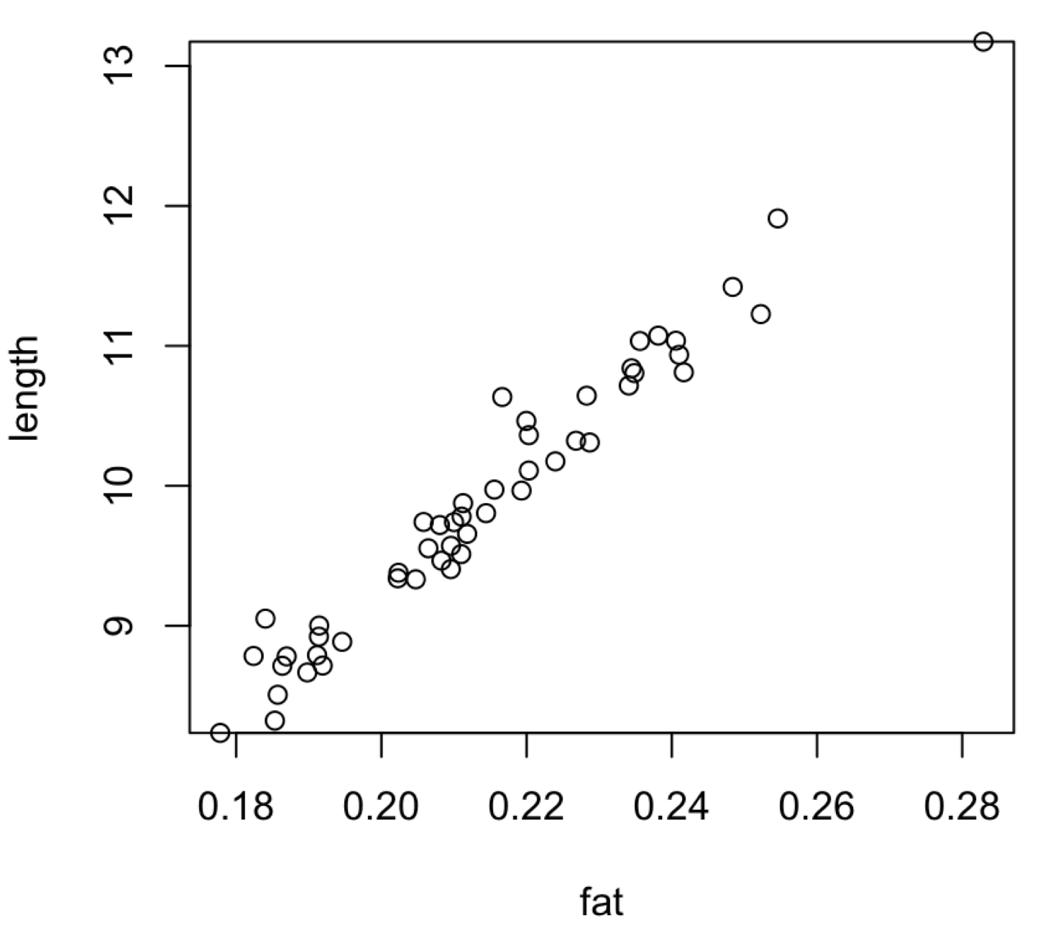
Two-dimensional data

Slide 7
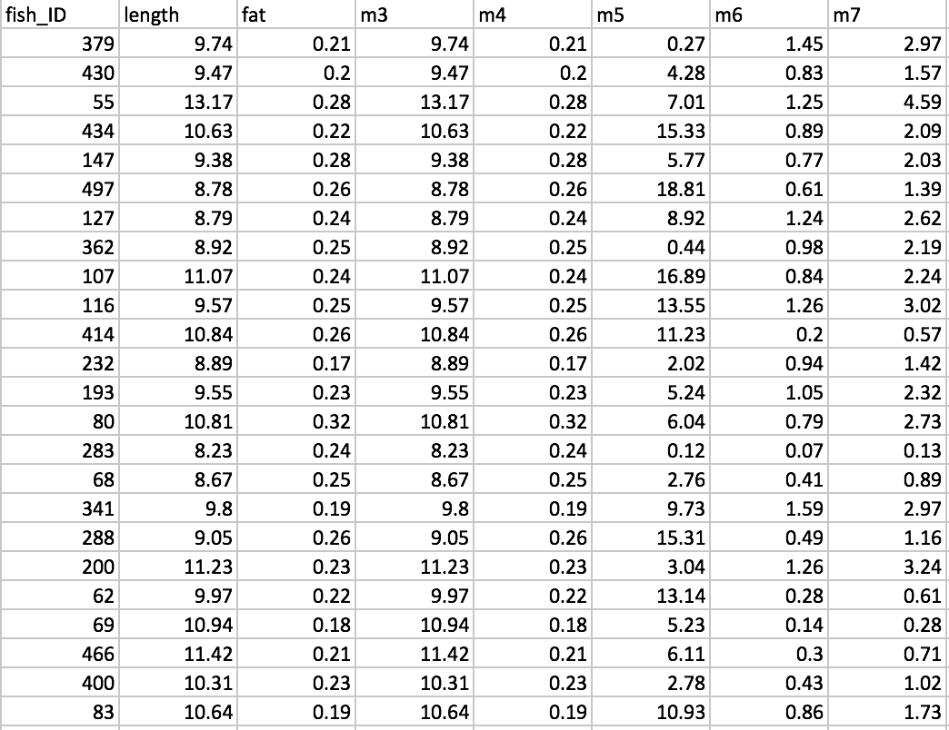
High dimensional data
What are our options?

Slide 8
Dimensionality reduction - PCA
PC1
PC2

Slide 9
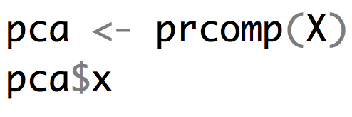
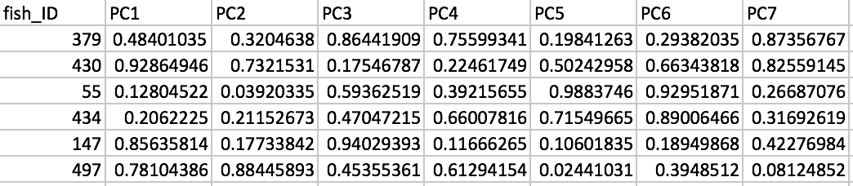
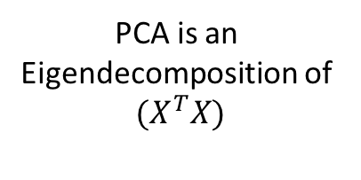


The math behind - PCA
M measurements
PCA is an
Eigendecomposition of
$${(X}^{T}X)$$
= X
nxm matrix
$$W$$
= loadings
mxm matrix
N samples
$$T=X∙W$$
= T
nxm matrix
This is T a nxm matrix that has our PC scores. The first column of the matrix will be the one that captures the most variation.

Slide 10
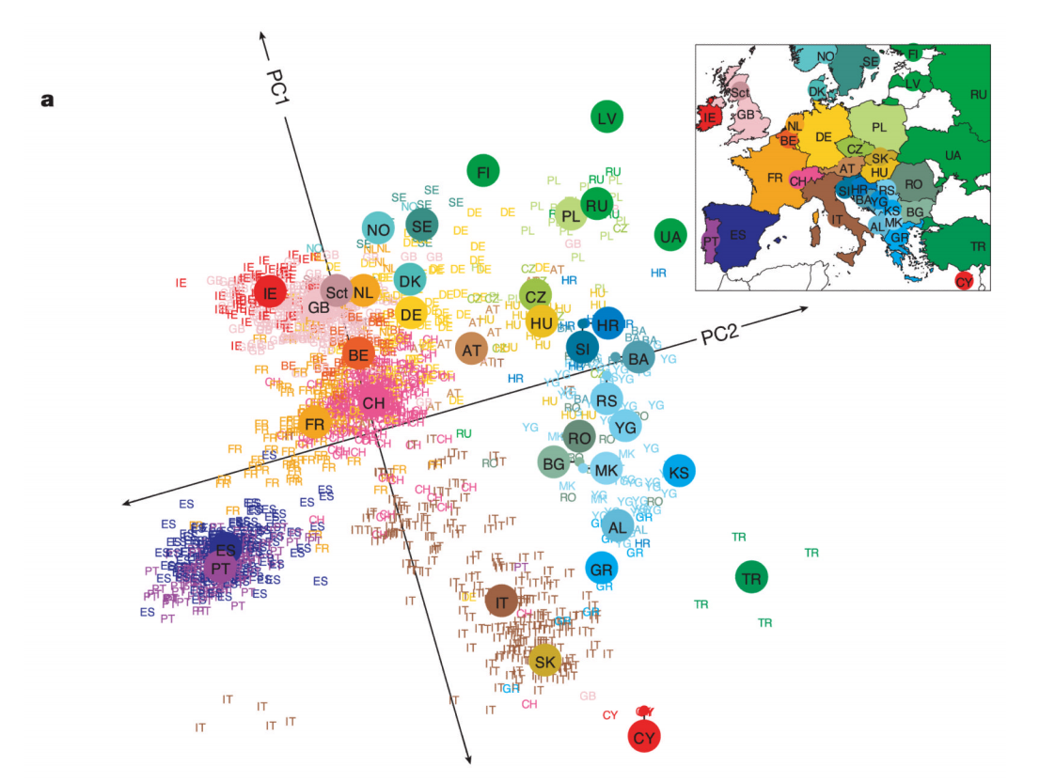
How do people use PCA
Input data: 500,000 SNP genotypes for 3000 Europeans.
3000 rows
500,000 columns
What are PC1 and PC2?

Slide 11
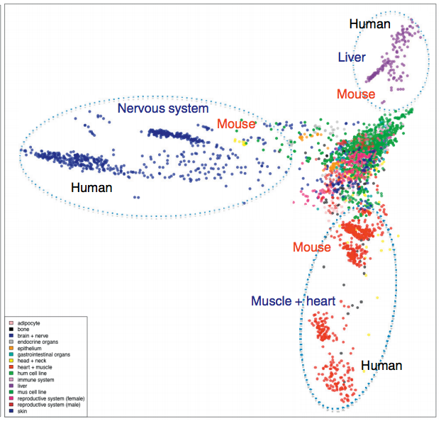
How do people use PCA
Input data:
Expression level for 1000s of genes
In 100s of cells (color indicates type of cell)
What are the PCs here?

Slide 12
How do people use PCA
Input data:
Radseq data (genotypes at 100s of loci)
For a large number of species or strains

Slide 13
How do people use PCA
Input data:
Radseq data (genotypes at 100s of loci)
For a large number of species or strains

Slide 14
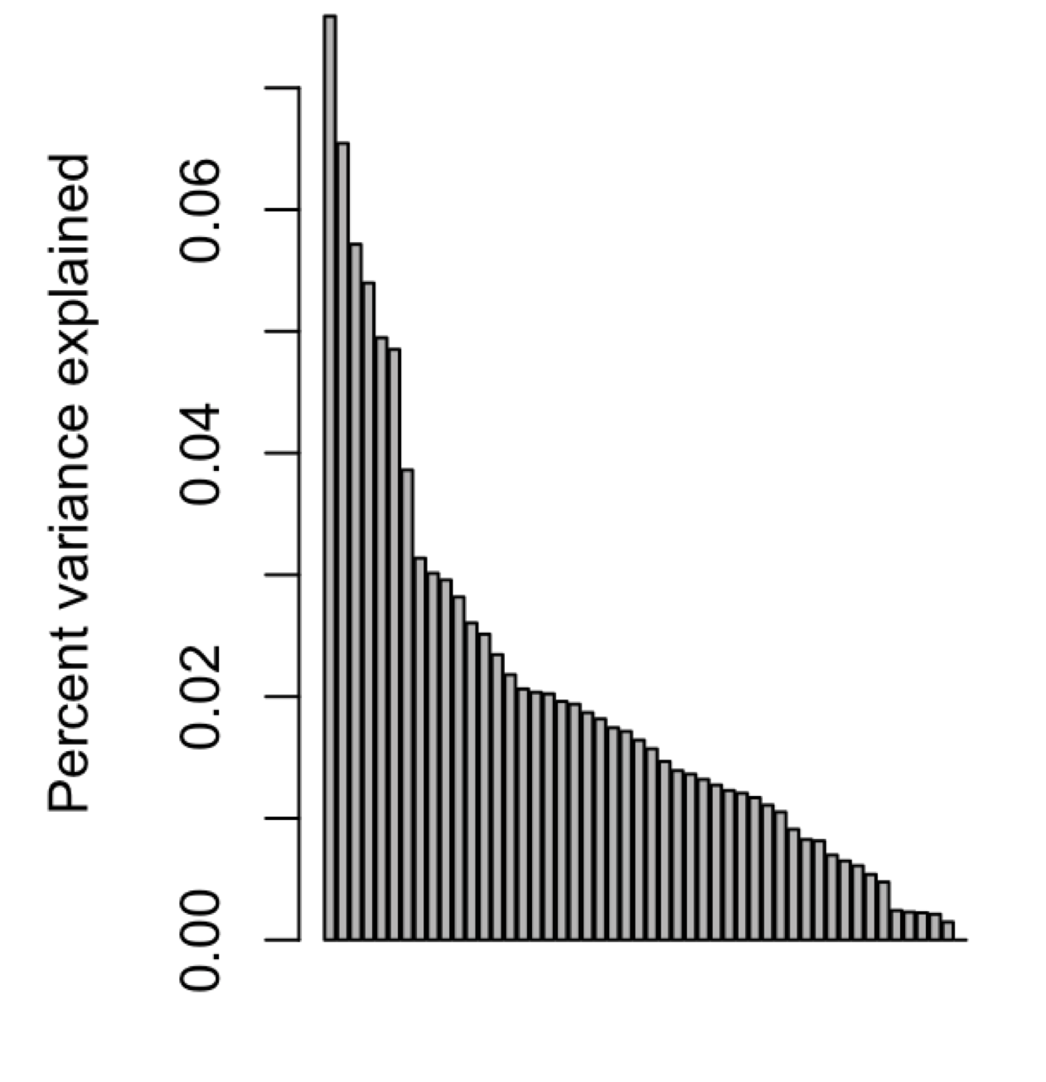
How informative is your PCA
Scree Plot: A plot that illustrates the proportion of total variance that is captured by each principal component.
Steep means you can greatly reduce dimensionality without losing information

Slide 15
How informative is your PCA
Why does this scree plot have relatively flat slope?
What information is present in the data what is being lost if we look at only 1 or 2 dimensions?

Slide 16
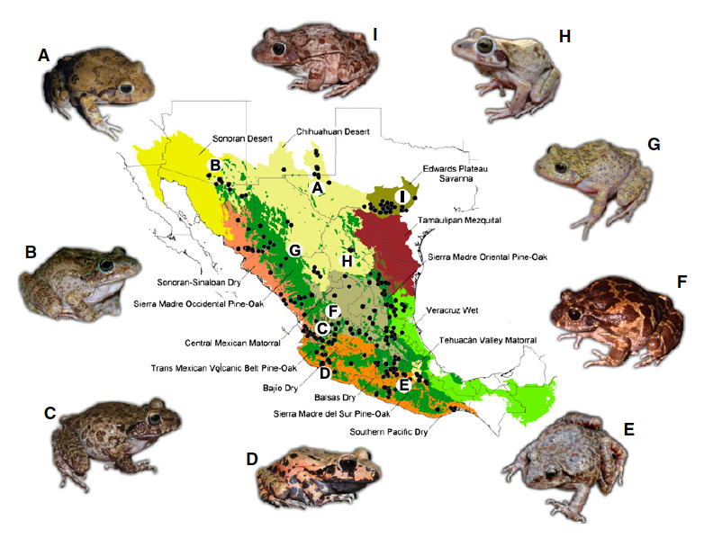
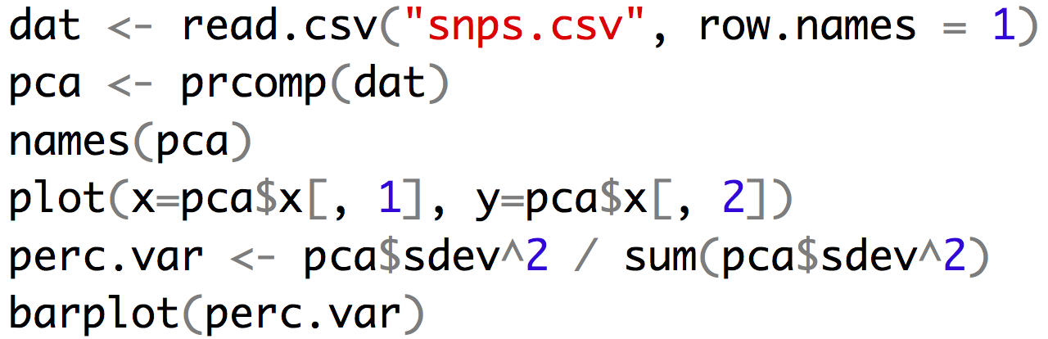
An example

Slide 17
Alternatives
Discriminate function analysis: This is similar to PCA but you assign groupings to the data first and the discriminating components best parse your assigned groups from one another.

Slide 18
For Thursday
Bring laptop to class!
Heath Blackmon
BSBW 309
coleoguy@gmail.com
@coleoguy

