Slide 2
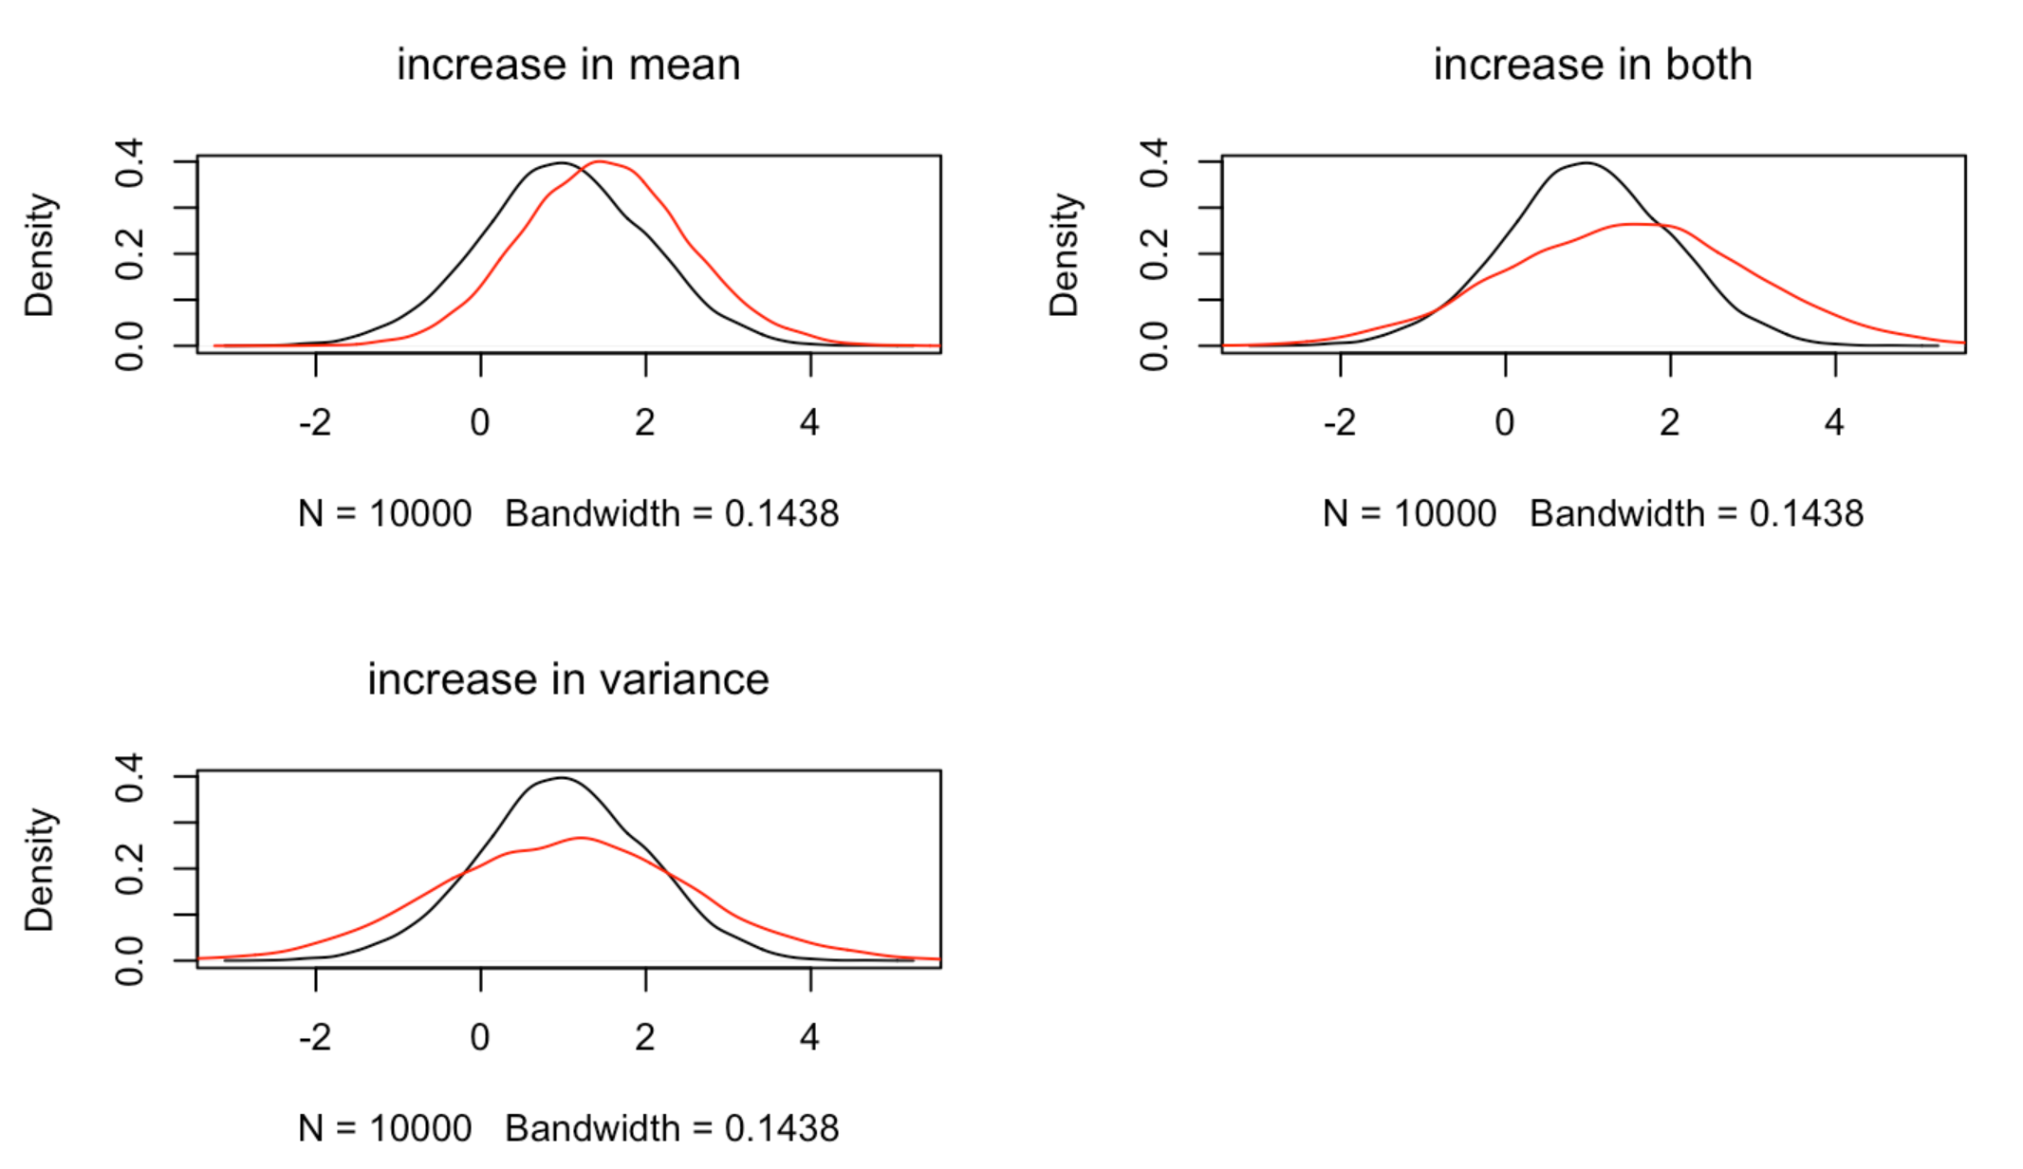
Mean and variance

Slide 3
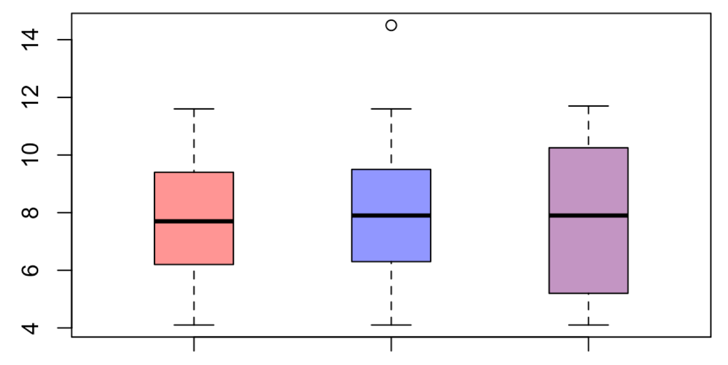
Box Plot
Interquartile
Range

Slide 4
Box Plot
Range of all data

Slide 5
Box Plot
Data points more than 1.5
Interquartile ranges away
from the median

Slide 6
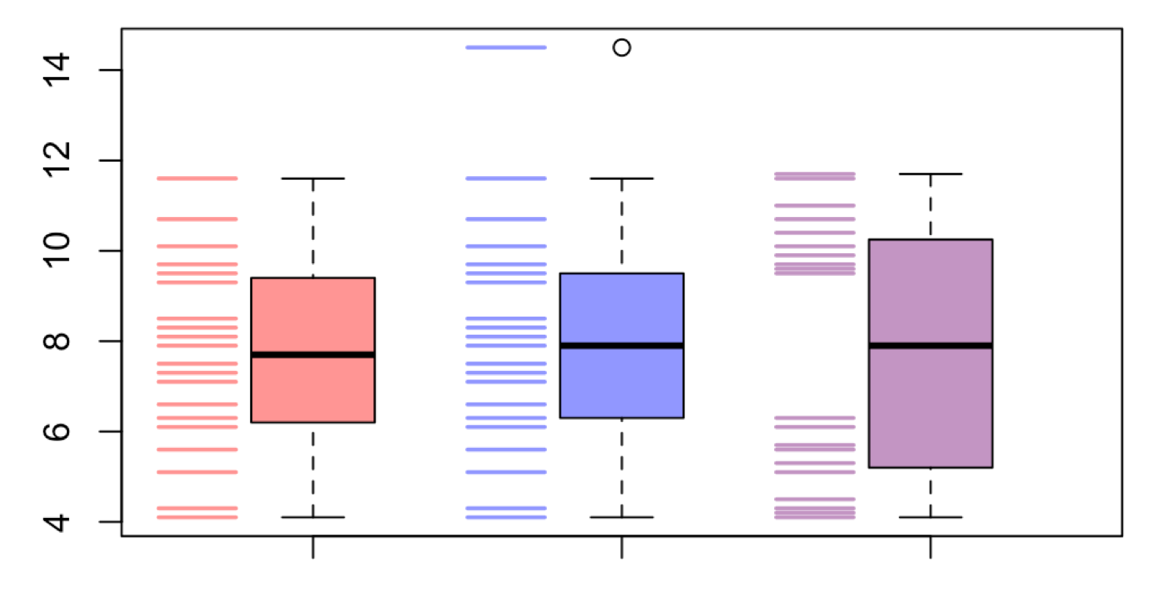
Box Plot

Slide 7
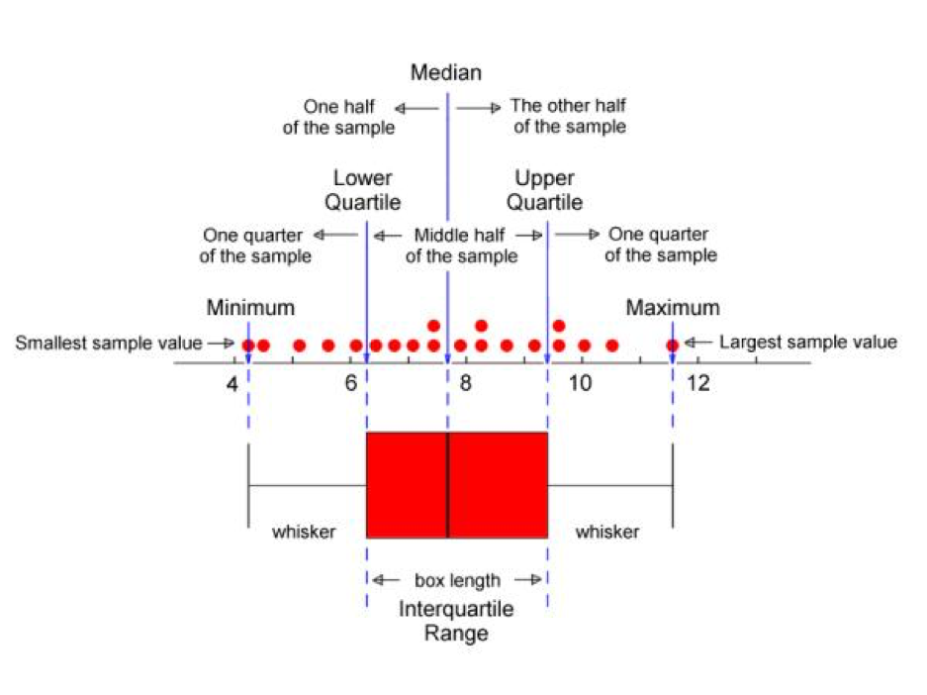
Box Plot

