Slide 1
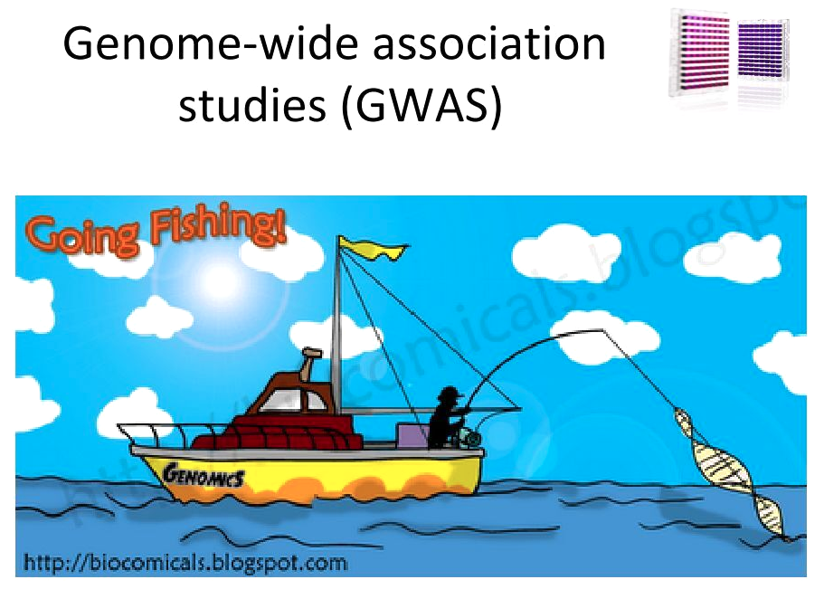
Week 10

Slide 2
Things you should be doing to prepare for final
Practicing GLMs
fixed and random effects (use the chrysina dataset)
choose among possible models
Continue practicing making plots
pdf output, sized appropriately, beautiful, elegant, tell a story
general R coding

Slide 3
repeated median regression (Theil-Sen Estimator)
simulate x and y with medium strength relationship and add one outlier
standard regression record Beta
record slope between all pairs and find median slope
repeat standard regression without outlier

Slide 4
GWAS
GWAS: Genome wide association study.
The goal of GWAS is to determine what genes have alleles that are responsible for a trait of interest. The trait can be any measurable trait in any organism that you wish to study. For instance, a disease in humans, an economically important trait of a crop or domestic animal, an adaptation like a certain color pattern in birds, etc.
GWAS uses existing segregating variation in a population
QTL creates a collection of crosses designed specifically for mapping the trait.

Slide 5
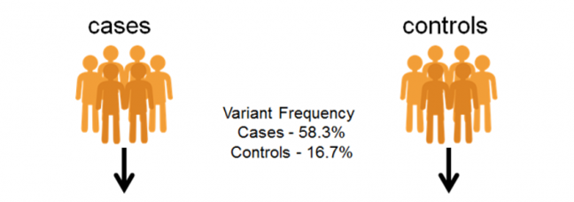
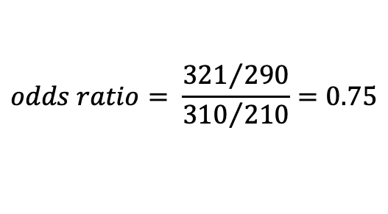
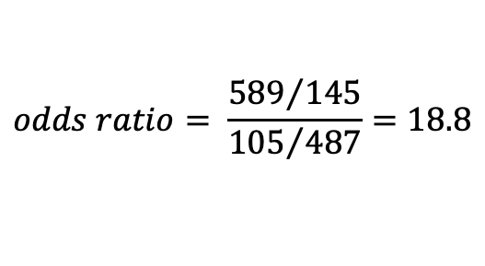
GWAS – Discrete condition (often disease)
 | Case | Control
Allele G | 589 | 145
Allele C | 105 | 487
$$odds ratio= \frac{{589}/{145}}{{105}/{487}}=18.8$$
>case 1
CATACTACTACTGAACGTTTGCTCCTGCtactatctctctctctctctctttctctctctctctctCATGC >case 2
AGTTGACTACTGCATACTCGTGCTAGCTGACTGTCGTACGTACGTAGCTAGTGATCGATCGATGCTAGCTA>case 3
CATACTACTACTGAACGTTTGCTCCTGCtactatctctctctctctctctttctctctctctctctCATGC >control 1
AGTTGACTACTGCATACTCGTGCTAGCTGACTGTCGTACGTACGTAGCTAGTGATCGATCGATGCTAGCTA>control 2
CATACTACTACTGAACGTTTGCTCCTGCtactatctctctctctctctctttctctctctctctctCATGC >control 3
AGTTGACTACTGCATACTCGTGCTAGCTGACTGTCGTACGTACGTAGCTAGTGATCGATCGATGCTAGCTA
 | Case | Control
Allele G | 321 | 290
Allele C | 310 | 210
$$odds ratio= \frac{{321}/{290}}{{310}/{210}}=0.75$$

Slide 6




GWAS – Continuous trait
>sample 1
CATACTACTACTGAACGTTTGCTCCTGCtactatctctctctctctctctttctctctctctctctCATGC >sample 2
AGTTGACTACTGCATACTCGTGCTAGCTGACTGTCGTACGTACGTAGCTAGTGATCGATCGATGCTAGCTA>sample 3
CATACTACTACTGAACGTTTGCTCCTGCtactatctctctctctctctctttctctctctctctctCATGC >sample 4
AGTTGACTACTGCATACTCGTGCTAGCTGACTGTCGTACGTACGTAGCTAGTGATCGATCGATGCTAGCTA>sample 5
CATACTACTACTGAACGTTTGCTCCTGCtactatctctctctctctctctttctctctctctctctCATGC >sample 6
AGTTGACTACTGCATACTCGTGCTAGCTGACTGTCGTACGTACGTAGCTAGTGATCGATCGATGCTAGCTA

Slide 7
GWAS – Continuous trait
AGTTGACTACTGCATACTCGT
AGTTGACTACTGCATACTCGT
AGTTGACTACTGCATACTCGT
AGTTGACTACTGCATACTCGT
TGTTGACTACTGCATACTCGT
AGTTGACTACTGCATACTCGT
TGTTGACTACTGCATACTCGT
TGTTGACTACTGCATACTCGT
AGTTGACTACTGCATACTCGT
TGTTGACTACTGCATACTCGT
TGTTGACTACTGCATACTCGT
TGTTGACTACTGCATACTCGT
coat color
Not significant
AA AT TT

Slide 8
GWAS – Continuous trait
AGTTGACTACTGCATACTCGT
AGTTGACTACTGCATACTCGT
AGTTGACTACTGCATACTCGT
AGTAGACTACTGCATACTCGT
TGTAGACTACTGCATACTCGT
AGTAGACTACTGCATACTCGT
TGTAGACTACTGCATACTCGT
TGTTGACTACTGCATACTCGT
AGTAGACTACTGCATACTCGT
TGTAGACTACTGCATACTCGT
TGTTGACTACTGCATACTCGT
TGTTGACTACTGCATACTCGT
coat color
Highly significant!
AA AT TT

Slide 9
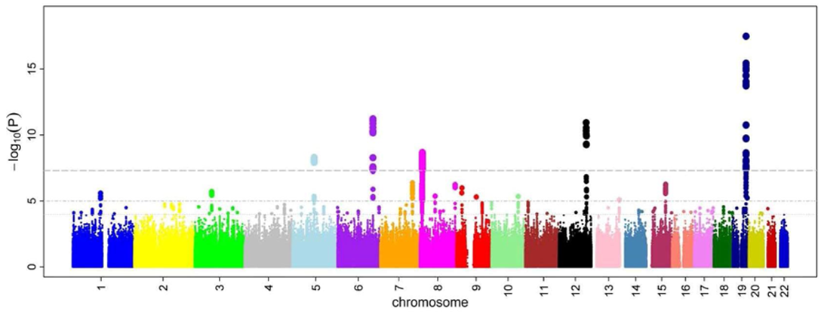
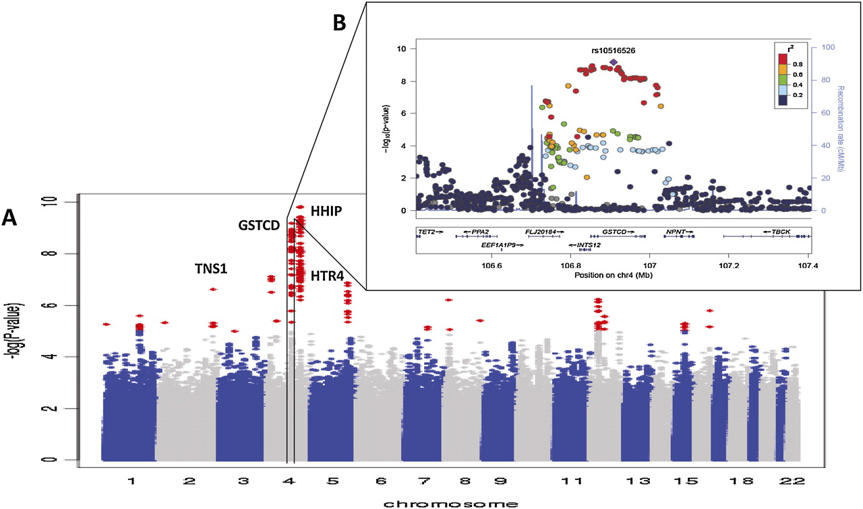
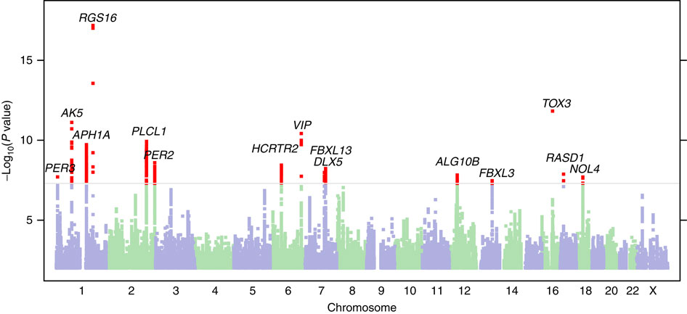
GWAS
R examples

Slide 10
GWAS - Problems
What is the problem with doing this across the whole genome?
Multiple tests lead to more false positives!
require a higher level of significance 5x10⁻⁸
only look at the very most significant
lots of more complicated approaches too!
What is one of the most basic requirements of almost all statistical tests?
Tests normally assume independence of the data points!
Samples from a population will be related to each other due to ancestry (trees!)
DNA sequencing is not done equally in all groups of people (western samples are usually over represented

Slide 11
GWAS - Problems
What is epistasis?
It is the case where the impact of a genotype at one locus depend on the genotype at another locus!
To find this type of effect you would need to look at all pairs of genotypes. How many tests would we need to do then?
About 6 orders of magnitude more tests would be required.
Humans have around 4,000,000 sites that are variable like this which equates to 7,999,998,000,000
GG
GT
TT
AA AT TT

Slide 12
GWAS - Problems
What about the environment?
Many diseases have a strong environmental component (heart disease, diabetes, cancer, etc.)
If these are left out of the study often what is discovered is actually genetic variation that happens to coincide with environmental factors?
If a disease is more common in Europeans than Africans or Asians but it is because of a lifestyle characteristic any genetic variation that is common in Europeans but rare in Africans and Asians could appear associated with the disease.

Slide 13
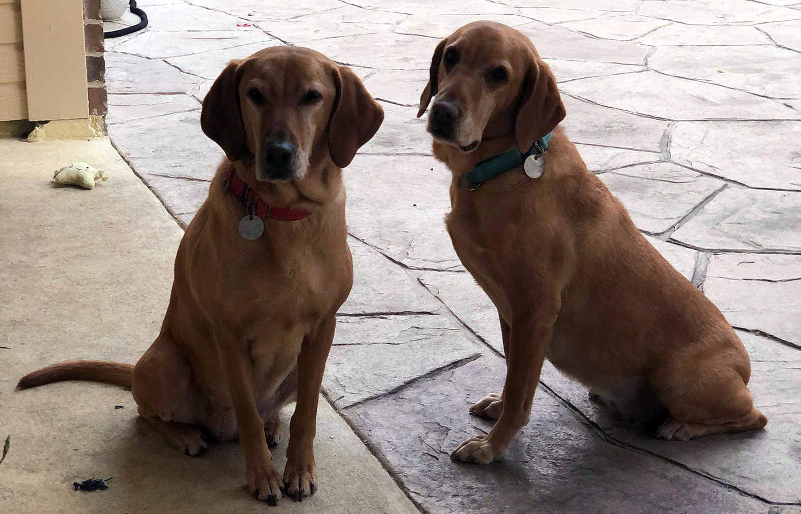
Applications and benefits of GWAS
Widely used in agriculture and domestication. For instance, you can do a GWAS on wild strains of rice (which have lots of variation in things we care about like grain size, growing time, etc.) This GWAS can tell you what variants at what locations in the genome should be introgressed into domestic varieties in hopes of introducing favorable traits.
Widely used in medicine to identify the genes responsible for disease. This is
often the first step necessary in being able to create an animal model for a
disease that will then allow researchers to study the disease and develop
pharmaceutical interventions.
Many diseases have multiple different underlying genetic causes and treatments
that are available may only work on some forms of the diseases. Thanks to GWAS studies we now know what these different causal genes are. Now patients can be genotyped at these causative loci and medication can be tailored to their version of the disease. (precision or personalized medicine)
Applied in a more limited fashion to inform patients of risk that they will develop more severe versions of a disease. For instance depending on your genotype at a gene you may choose a more aggressive form of treatment.

Slide 14
Complex Disease / Complex Phenotypes
Many diseases are what we call complex diseases. There is no one gene responsible for the disease. Instead the disease can manifest due to variations in 10 or 100s of different genes in the genome acting in concert with the environment. GWAS is less insightful (though still important) for diseases like this.
Schizophrenia: Not really a clearly delineated disease like say COVID, type 1 diabetes, or cystic fibrosis. Instead it is a constellation of symptoms that individuals exhibit to varying degrees.
From studies of multiple generations of families we know that 20-30% of risk is inherited (genetic). The other 70-80% of your risk of developing the disease is environmental and is poorly understood. Massive GWAS studies with 1000s of individuals have studied the genetic component. These studies have identified more than 100 different loci in the genome that seem to have some predictive power. However, these variations are associated with an increase in risk and there are many people who carry many alleles that increase risk but that never develop the disease.
GWAS in R

