Slide 1
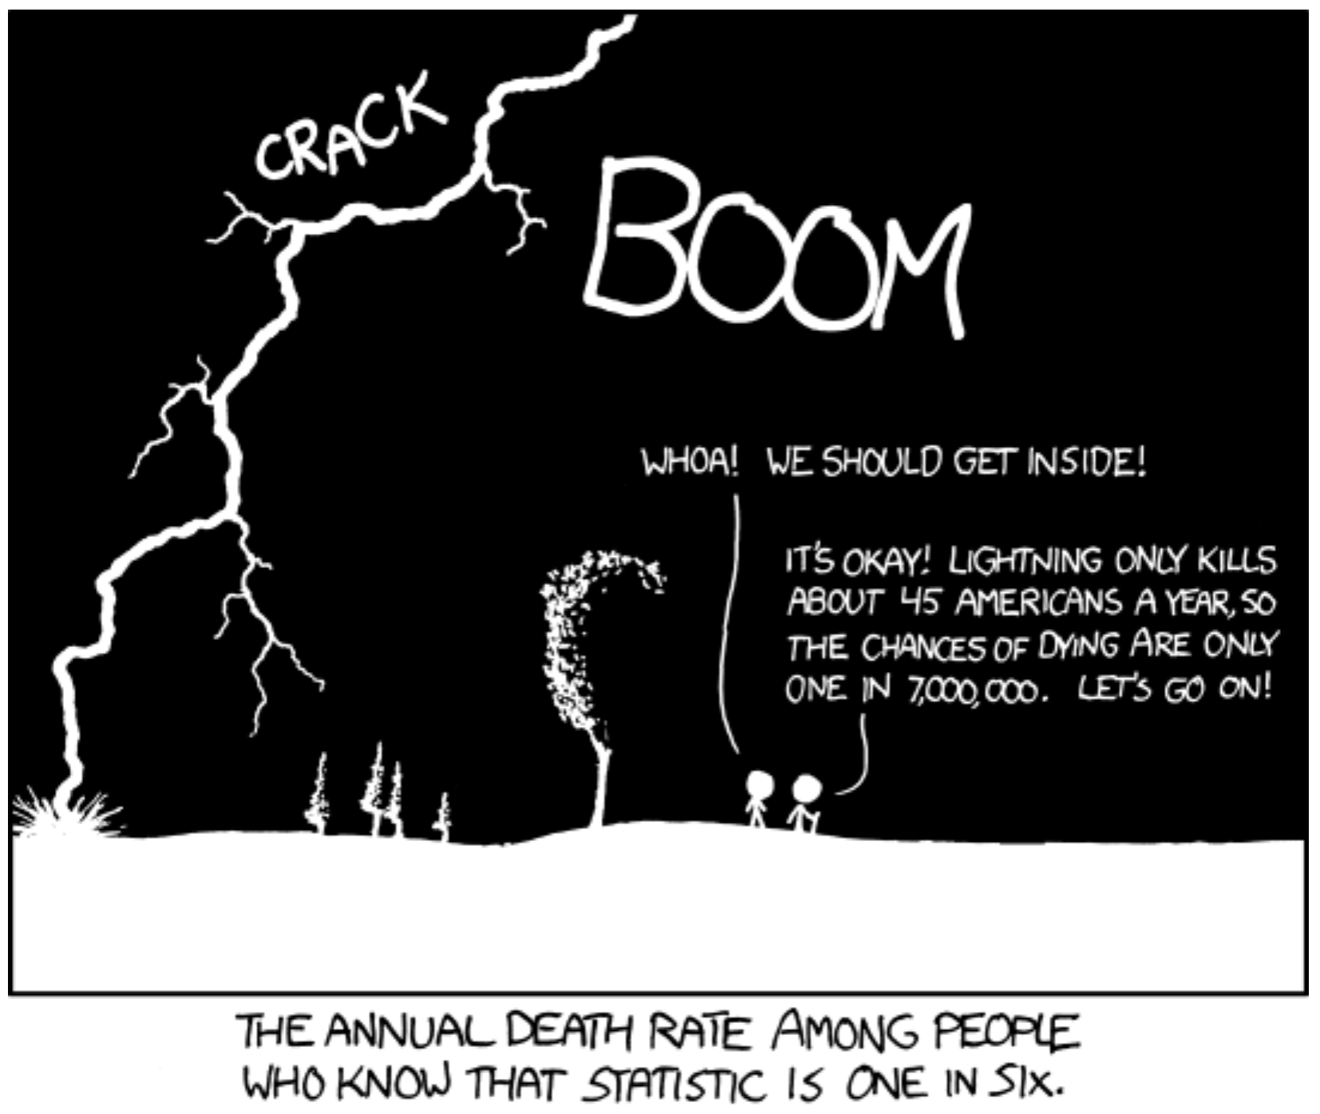
Probability and Discrete Variables Biology 683 Heath Blackmon

Slide 2
Last week
If I say the 95% CI is 1.2-1.7, what do I mean?
What is the difference in a parameter and a statistic?

Slide 3
Today
Basic experimental reminders
Basics of Probability
Binomial and Chi-square tests

Slide 4
Some Experimental Design Considerations
Why do I need a control?
To interpret an experiment, we need to compare the experimental subjects to the correct reference group.
What about observational studies?
What is an appropriate control?
Ideal controls are identical to the experimental population, except for the one parameter being manipulated
The control population should be similar in all other respects to the experimental population
The control population should experience sham manipulations that simulate any manipulations applied to the experimental population
Sometimes you might need multiple different controls.

Slide 5
Avoiding Experimenter Bias
Experimenter bias is real
The results of your study can be influenced by your expectations
Some precautions
Randomize assignment of subjects to controls and treatments (use R or random.org).
Humans are bad at recognizing and creating randomness.

Slide 6
Avoiding Experimenter Bias
Use a blind or double-blind experimental design
Blind: the subject doesn’t know whether it’s an experimental or control subject
Double-blind: neither the researcher nor subject know which subjects are experimental versus control
How can you apply this to your research?

Slide 7
Confounding Variables
A difference between groups that the experimenter fails to account for
A hidden variable that creates an apparent causal relationship that isn’t real
An experiment with confounded variables can be impossible to interpret and impossible to fix

Slide 8
Confounding Example
Study type
Gene expression level
Diversification
Lung cancer and coffee
Behavior
Effective population size
Confounding variable
recent gene duplication
unobserved traits
coffee smoking correlation
maternal effects
breeding system

Slide 9
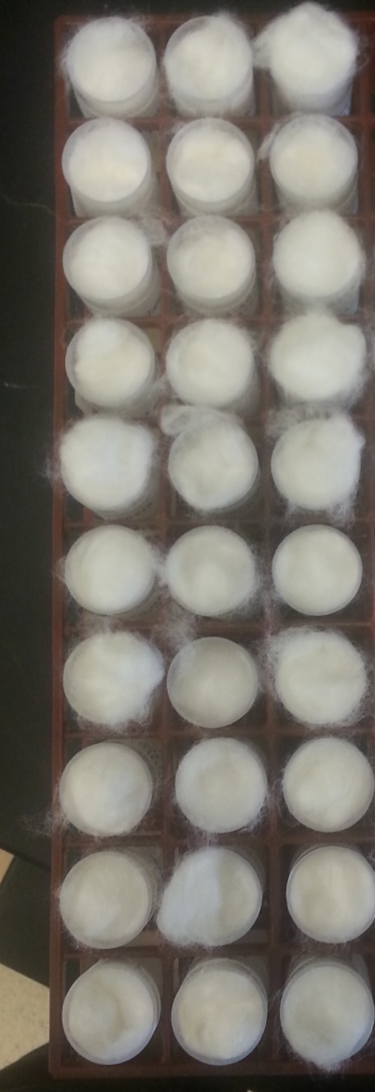
Redesign the procedure
Media A
Collect 750 beetles from a population cage.
Create 30 new vials with 25 beetles each.
Make the first 15 of these control vials and use food media A.
Make the next 15 of these experiment vials and use food media B.
Place in a rack as shown and place in the incubator.
Measure growth at day 15.
Media B

Slide 10
Pseudoreplication
Occurs when the apparent sample size is larger than true sample size
10 rats are studied and tested on three consecutive days, resulting in 15 observations for the control group and 15 observations for the treatment groups
The experiment is conducted in two tanks: tank 1 has hormone added, tank 2 is the control tank. 10 fish are tested per tank.
We are testing for the effects of mating system on genome size. We use 5 outbreeding insects and 5 inbreeding species of beetles.
Beetles are segregated by sex into two vials, with 10 individuals per vial. I draw a male and female at random and test them, returning them to the vials at the end. I perform a total of 40 such tests.

Slide 11
Biological and Technical Replicates
A biological replicate involves a new, independent test subject
A technical replicate involves repeating the same procedure on a new sample from the same subject
Technical replicates do not contribute to your estimates of population-level parameters, but they can increase the precision of measurements on individuals

Slide 12
Which kind of replication
In general, biological replicates are superior to technical replicates, because biological replicates increase power.
Technical replicates are useful when the technique in question sometimes produces extremely inaccurate results, which must be pruned from the dataset. An example is qPCR, where occasional extreme outliers are common.

Slide 13
Best Practices
Ensure as much as possible that controls and experimental individuals are from identical populations (except for the factor of interest)
Treat your controls as similarly as possible to the experimental subjects (sham injections, placebos, etc.)
Conduct your control manipulations in parallel with your experimental manipulations
Think about all possible confounding variables and establish a plan to eliminate or correct for them before you start!

Slide 14
Everything I do is an Experiment
You should approach everything you do in the lab from the perspective of an experiment
Always do the appropriate controls for PCR, transformations, etc.
Troubleshooting is experimenting
Think about how you will describe the experiment before you embark on it
You will see that simplicity is extremely valuable
Think about the analysis you will do before you get started

Slide 15
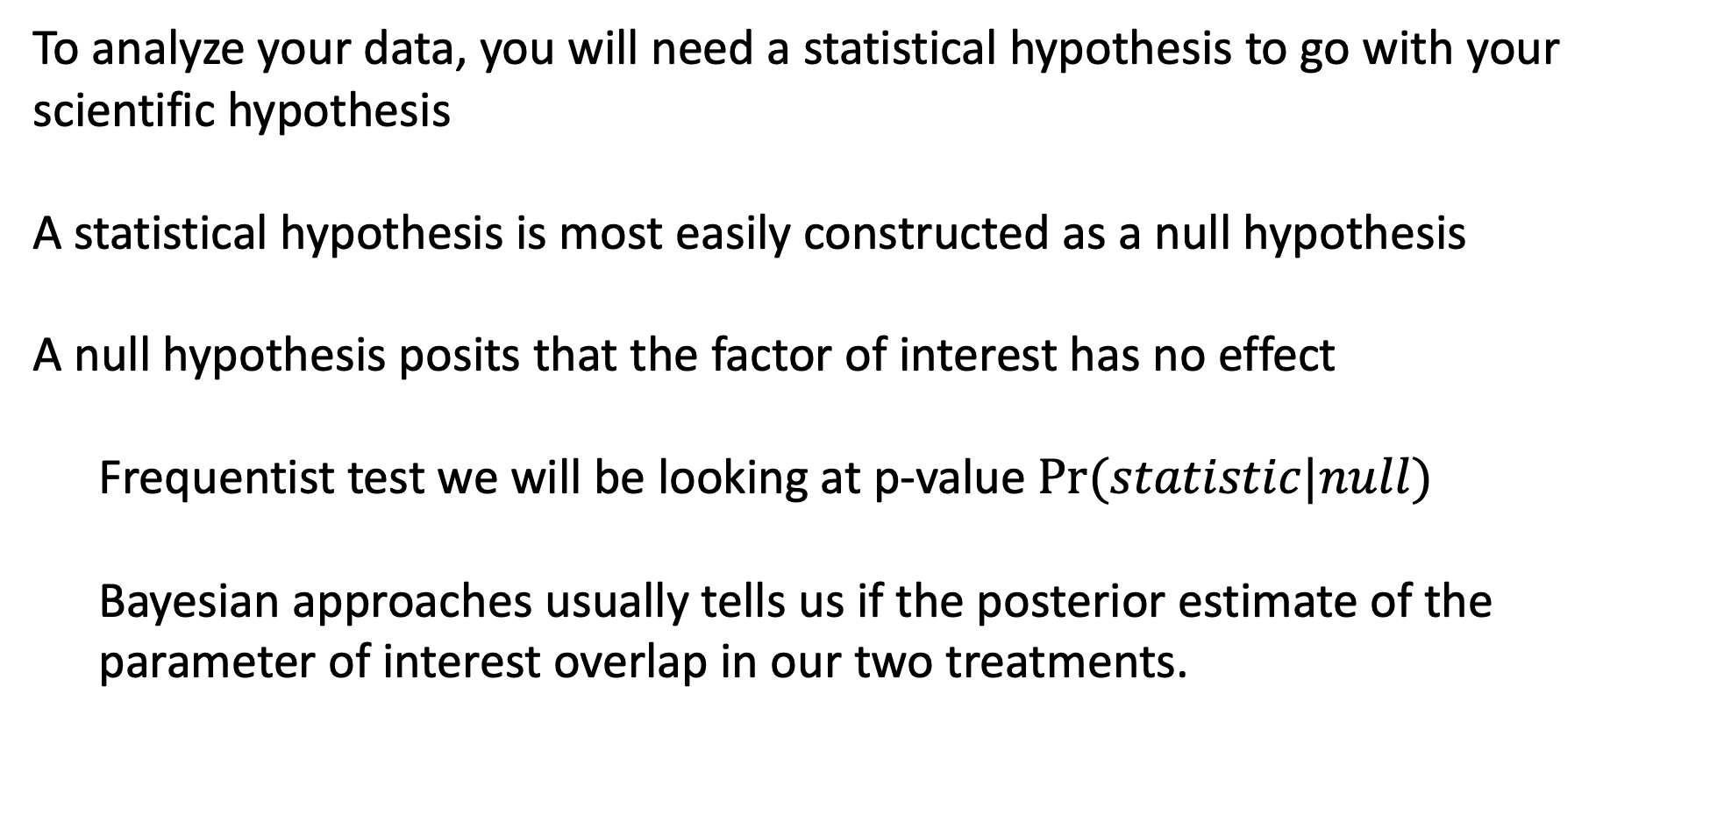
The Null Hypothesis
To analyze your data, you will need a statistical hypothesis to go with your scientific hypothesis
A statistical hypothesis is most easily constructed as a null hypothesis
A null hypothesis posits that the factor of interest has no effect
Frequentist test we will be looking at p-value $Pr⁡(statistic|null)$
Bayesian approaches usually tells us if the posterior estimate of the parameter of interest overlap in our two treatments.

Slide 16
Examples of Null Hypotheses
Fertilizer has no effect on the growth rate of oak trees.
Blocking olfactory cues has no effect on mate choice in swordtail fishes.
Rates of genome evolution are the same in two populations.
Mutations in the 5’ UTR of msl-2 have no effect on translation.

Slide 17
Rejecting the Null
Your statistical test will attempt to reject the null hypothesis
If you reject the null, then one of the alternative hypotheses must be true – though not necessarily the one you believe to be true!
You cannot prove a hypothesis, but
As frequentist you can find support for an alternative by rejecting the null. The more convincing the null and the more well designed the experiment the more evidence you provide for your alternative.
As a Bayesian you can compare support for two competing hypotheses.

Slide 18
Type I versus Type II Error
Type I error refers to rejecting a true null hypothesis
Type II error refers to failing to reject a false null hypothesis
Power is a description of our probability of rejecting a false null hypothesis
We usually set up statistical tests to avoid Type I errors, at the expense of possibly committing Type II errors
Type I error = FALSE POSITIVE
1 – Type 2 error = POWER

Slide 19
Analyzing Proportions
Several chapters in the book deal with this topic
The experiment boils down to this:
Your subjects have some alternative outcomes
Each individual has some probability of each outcome
You are trying to find the conditions that impact that probability
When would this type of problem come up in the biological sciences?

Slide 20
Terms to know for probability
Sample space: All the potential outcomes of a random trial.
Probability: The proportion of events with a given outcome if the random trial was repeated many times.
Mutually exclusive: If one outcome excludes the others, they are mutually exclusive.
Conditional probability: The probability of one outcome, if we know that some other outcome occurred.
Independent: When one outcome provides no information about another, they are independent.
Non-Independent: When knowing one outcome changes the probability of another, they are non-independent.

Slide 21
Terms to know for probability
Conditional probability: The probability of being struck by lightning changes if you know the statistic about 45 American a year being killed by lightning

Slide 22
A simple example
What is the probability of drawing an ace then a king from a deck cards?
What is the sample space?
Are the events independent or dependent?
What is the probability of this event?
What is the conditional probability of drawing a king if we have already drawn an ace?
assume standard deck with no jokers

Slide 23
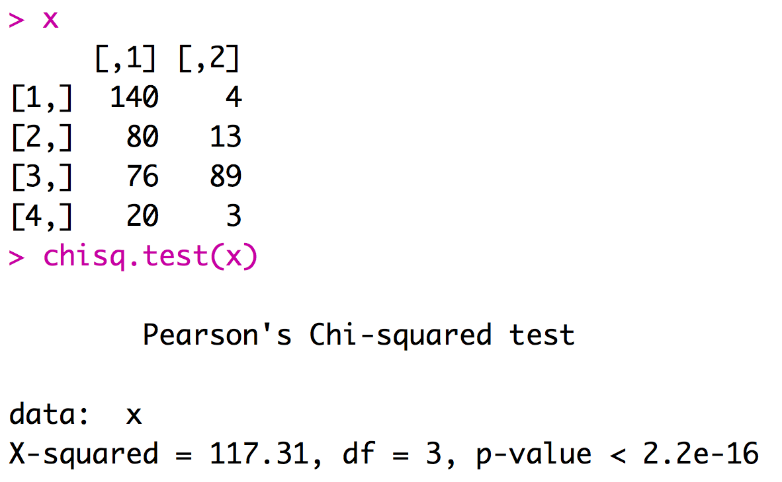
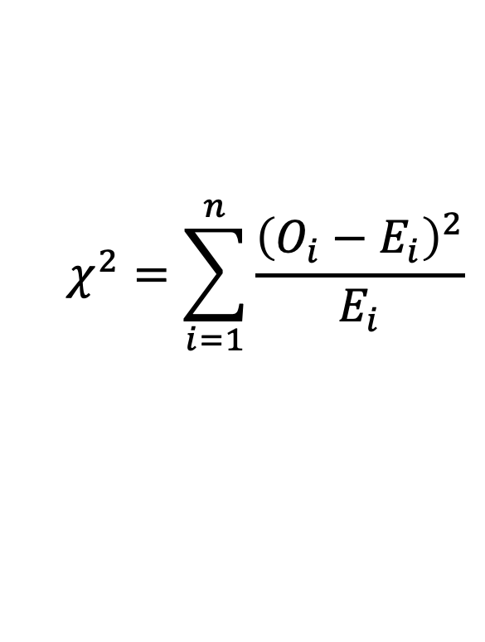
What is a p-value?
Is the probability of finding the observed, or more extreme, statistic when the null hypothesis is true (generating the data).
Number of women on titanic who survived (first column) or died (second column) in first, second, third, or crew classes (rows 1:4 respectively).
$$χ^{2}=\sum_{i=1}^{n}{\frac{{\left(O_{i}−E_{i}\right)}^{2}}{E_{i}}}$$

Slide 24
Misconceptions about p-values
The p-value is not the probability that the observed statistic is due to random chance.
A p-value is not the probability that your alternative is false.
A p-value is not the probability that the null hypothesis is true.
The magnitude of the p-value does not indicate the importance of an effect. Statistical significance does not equate to biological significance.
Studies with p-values on opposite sides of 0.05 are equally “correct”.

Slide 25
There are many ways of calculating p-values
Traditional statistical tests
For many questions/experiments there isn’t a ready made statistical test.
- Randomization of datasets
- Comparison to simulated datasets

Slide 26
Binomial Test
A test to determine whether or not the observed proportion adheres to the expected proportion under the null hypothesis
Some possible uses:
Are frogs equally likely to be right or left handed?
Is the sex ratio half male and half female?
Are the offspring phenotypes a 3:1 ratio?
Do some beetles win more fights?

Slide 27
Binomial Test
As in most statistical tests, a test statistic is compared to a distribution
In this case, the test statistic is just the observed number (number of right-handed toads, number of females in the population, number of fights won)
Note that this test is only appropriate when there are two categories of individuals and your hypothesis allows you to provide a probability of the outcomes.

Slide 28
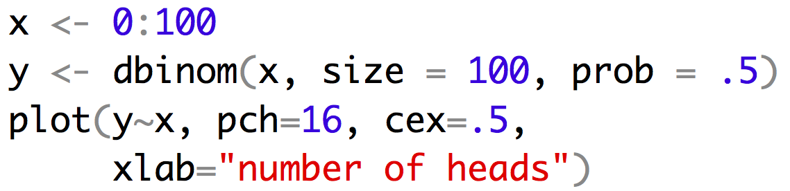
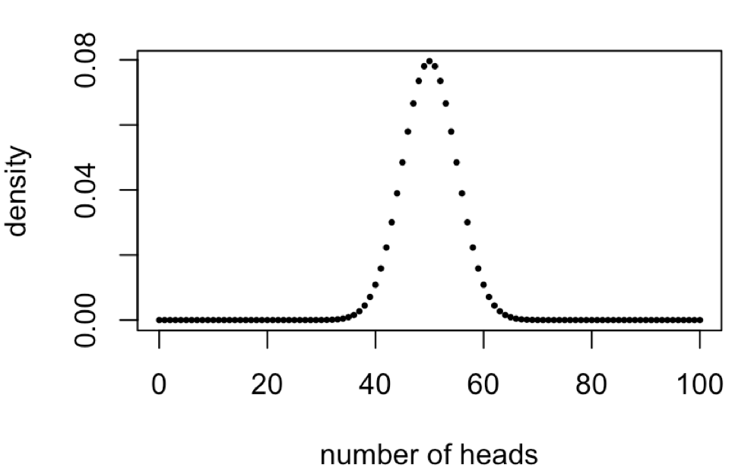
Binomial Test
With the binomial test our null hypothesis is the probability of one of the two outcomes. This probability and the number of observations defines the distribution we will compare our observation to.
Distribution when the null is 50% and we have 100 observations
use a simulation to see if you can replicate this curve

Slide 29
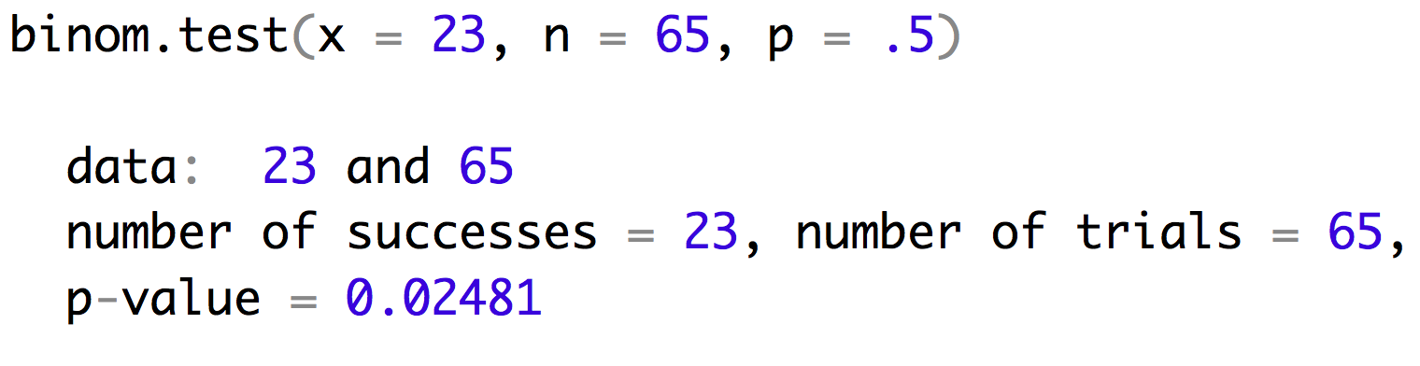
Binomial Test
Lets look at an example with sex ratio. You are hybridizing closely related species (with XY sex chromosomes) so you know Haldane’s rule states that the males might be more rare. When you survey the offspring you find 23 males out of 65 offspring. Does this result support Haldane’s rule occuring in your system?

Slide 30
Binomial Test
Lets look at an example with sex ratio. You are hybridizing closely related species (with XY sex chromosomes) so you know Haldane’s rule states that the males might be more rare. When you survey the offspring you find 23 males out of 65 offspring. Does this result support Haldane’s rule occuring in your system?

Slide 31
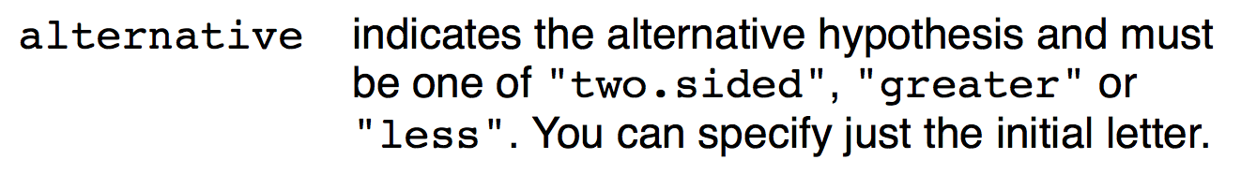
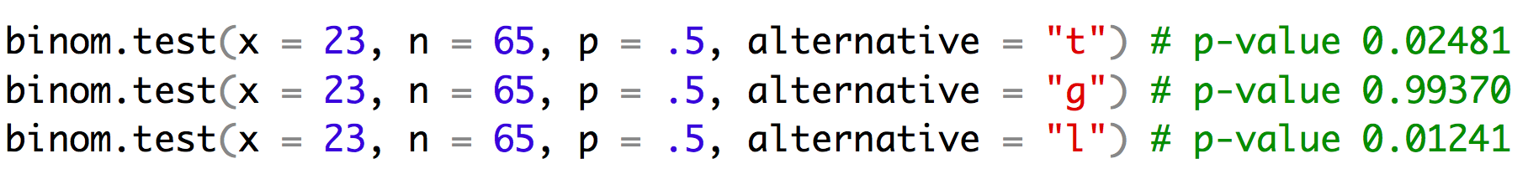
Binomial Test
binom.test has an argument alternative

Slide 32
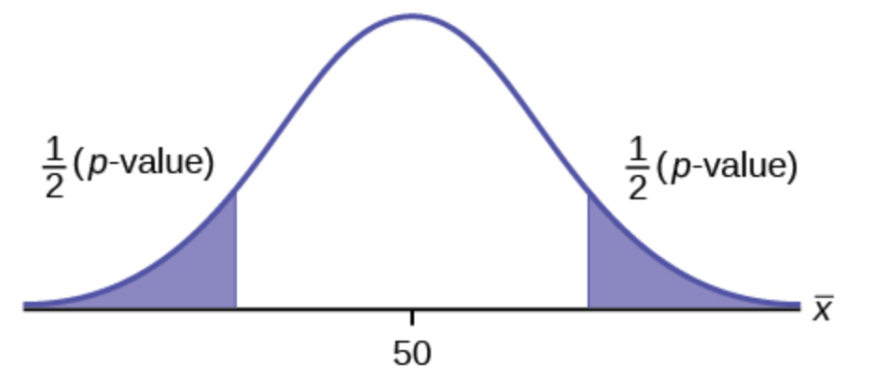
Binomial Test
Alternative = two.sided
What is the probability that I would see a skew in the sex ratio this great or greater.
In this case our observed number of males was -1.2 standard deviations from the mean. So our p-value is the area under the curves above 1.2SD and below -1.2SD.
-1.2 SD
1.2 SD

Slide 33
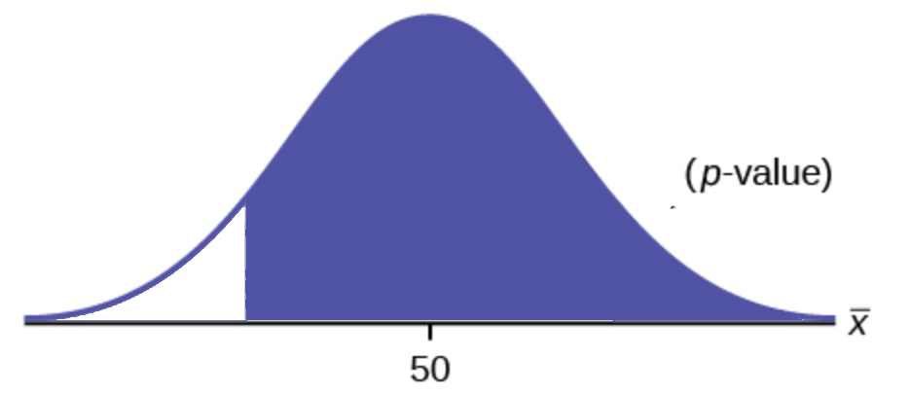
Binomial Test
Alternative = greater
What is the probability that I would see a larger number of males.
In this case our observed number of males was -1.2 standard deviations from the mean. So our p-value is the area under the curves above -1.2SD.
-1.2 SD

Slide 34
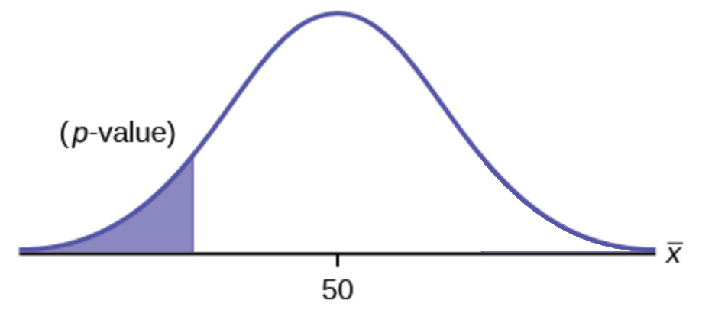
Binomial Test
Alternative = less
What is the probability that I would see this many or fewer males.
In this case our observed number of males was -1.2 standard deviations from the mean. So our p-value is the area under the curves below -1.2SD.
-1.2 SD
If before we collected this data we wanted to answer the question: “Are males more rare than females?” Then we have an apriori hypothesis that we should see fewer males than females so we could justify using this more powerful test.

Slide 35
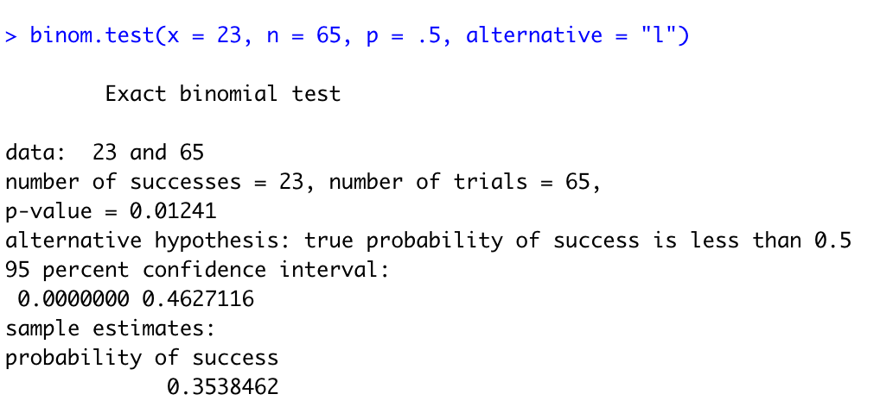
Reporting the Results
Our offspring ratio shows a significantly fewer males than would be expected under a 1:1 sex ratio (0.35, 95% CI: 0.24-0.48, binomial test, n = 65, p < 0.025).

Slide 36
Reporting the Results
This populations shows a significantly fewer males than would be expected under a 1:1 sex ration (0.35, 95% CI: 0.24-0.48, binomial test, n = 65, p < 0.025).
For very small p-values, we just say that p is very small (< 0.001 or < 0.0001).
Most journals/subdisciplines will have conventions about how certain tests are reported.
Most journals italicize mathematical variables, so n and p would be italicized. They also normally would be lower case.

Slide 37
$χ^{2}$ Test
This test compares the observed number in each category to expectations based on the null hypothesis (if there are only two categories, it approximates the binomial test with probability of 50%)
It can also be used to test for independence of two variables, and then it is called a contingency χ2-test.
We will use data from the Titanic and
see if some females were more likely to
survive than others.
Female adults on the Titanic
 | Survived | Died
1st | 140 | 4
2nd | 80 | 13
3rd | 76 | 89
Crew | 20 | 3

Slide 38
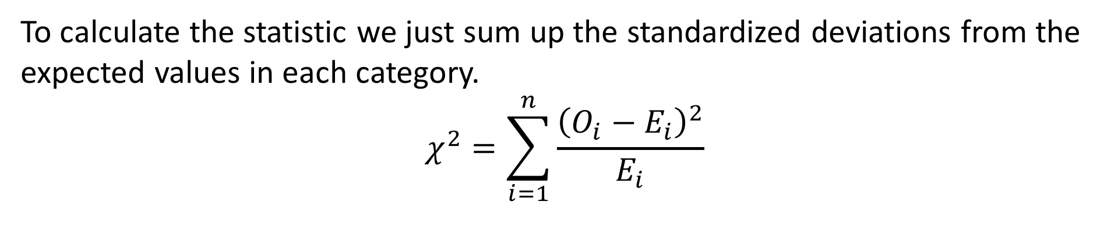
$χ^{2}$ Test
To calculate the statistic we just sum up the standardized deviations from the expected values in each category.
$$χ^{2}=\sum_{i=1}^{n}{\frac{{\left(O_{i}−E_{i}\right)}^{2}}{E_{i}}}$$

Slide 39
$χ^{2}$ Test
To calculate the statistic we just sum up the standardized deviations from the expected values in each category.
$$χ^{2}=\sum_{i=1}^{n}{\frac{{\left(O_{i}−E_{i}\right)}^{2}}{E_{i}}}$$
Female adults on the Titanic
 | Survived | Died | total
1st | 140 | 4 | 144
2nd | 80 | 13 | 93
3rd | 76 | 89 | 165
Crew | 20 | 3 | 23
total | 74.4% | 25.6%

Slide 40
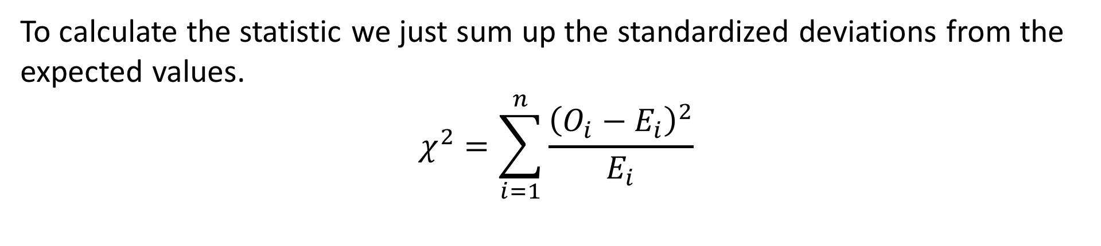
$χ^{2}$ Test
To calculate the statistic we just sum up the standardized deviations from the expected values.
$$χ^{2}=\sum_{i=1}^{n}{\frac{{\left(O_{i}−E_{i}\right)}^{2}}{E_{i}}}$$
Female adults on the Titanic
 | Survived | Died
1st | 140 | 4 | 144
2nd | 80 | 13 | 93
3rd | 76 | 89 | 165
Crew | 20 | 3 | 23
total | 74.4% | 25.6%
Expected
 | Survived | Died
1st | .744 x 144 | .256 x 144
2nd | .744 x 93 | .256 x 93
3rd | .744 x 165 | .256 x 165
Crew | .744 x 23 | .256 x 23

Slide 41
$χ^{2}$ Test
To calculate the statistic we just sum up the standardized deviations from the expected values.
$$χ^{2}=\sum_{i=1}^{n}{\frac{{\left(O_{i}−E_{i}\right)}^{2}}{E_{i}}}$$
Female adults on the Titanic
 | Survived | Died
1st | 140 | 4 | 144
2nd | 80 | 13 | 93
3rd | 76 | 89 | 165
Crew | 20 | 3 | 23
total | 74.4% | 25.6%
Expected
 | Survived | Died
1st | 107 | 37
2nd | 69 | 24
3rd | 123 | 42
Crew | 17 | 6

Slide 42
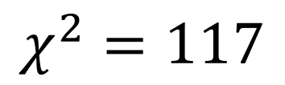
$χ^{2}$ Test
To calculate the statistic we just sum up the standardized deviations from the expected values.
$$χ^{2}=\sum_{i=1}^{n}{\frac{{\left(O_{i}−E_{i}\right)}^{2}}{E_{i}}}$$
Observed
 | Survived | Died
1st | 140 | 4
2nd | 80 | 13
3rd | 76 | 89
Crew | 20 | 3
Expected
 | Survived | Died
1st | 107 | 37
2nd | 69 | 24
3rd | 123 | 42
Crew | 17 | 6
$$χ^{2}=117$$

Slide 43
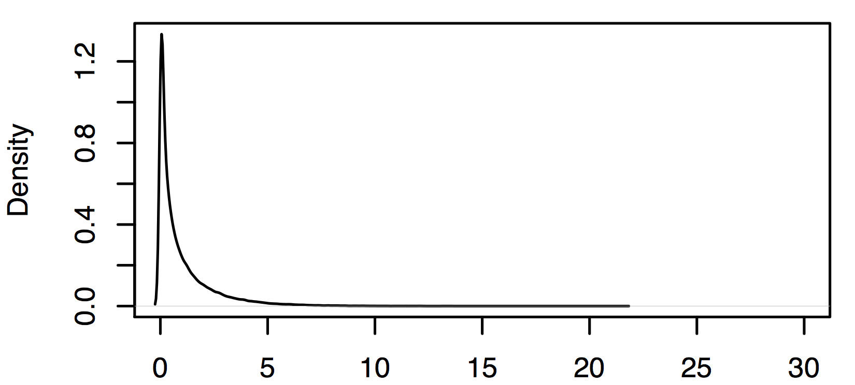
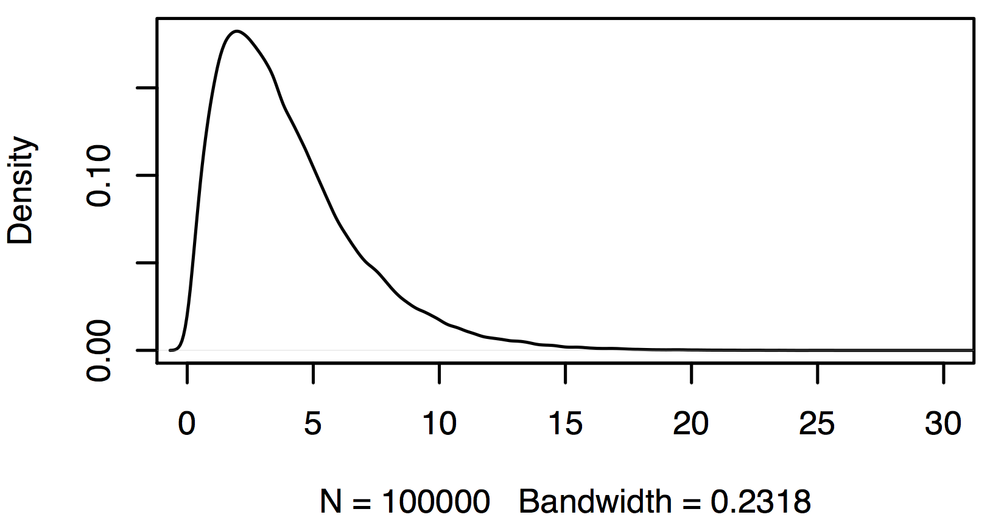
$χ^{2}$ Test
The shape of the chi square distribution depends on the degrees of freedom (df).
df = (no. rows – 1)(no. cols -1)
df = (4– 1)(2 -1)
df = 3
df=1
df=3
Female adults on the Titanic
 | Survived | Died
1st | 140 | 4
2nd | 80 | 13
3rd | 76 | 89
Crew | 20 | 3

Slide 44
My take
Much of what was presented today forms the basis of logically thinking about your experimental results. Similarly these topics are key to your ability to evaluate the evidence presented in the papers that you read. I will definitely ask you multiple questions on your midterm and final that will require you to think clearly about these topics.

Slide 45
My expectations for you
Concepts |  | R coding | Stats
Reproducibility crisis | Probability | <- [] + - / %% : == != | binom.test
Importance of stats training | Bayesian vs ML | %in% | chisq.test
Rules for plots | Null hypotheses | c, rep, data.frame, list, for,
Populations and samples | P-values | if, print, rnorm, plot, hist,
Types of data | Replicates (bio/tech) | density, names, barplot,
Data summary |  | arrows, lines, points, text,
Uncertainty |  | rgb, polygon, read.csv,

Slide 46
Thursday
Evaluate sex ratio of in two frog crosses. We cross species 1 and 2 and obtain 126 offspring 52 of them are male.
1) what is our null hypothesis going to be?
2) does this result support Haldane's rule?
3) what is the minimum number of offspring required to detect a significant deviation from our expectation under the null hypothesis?
We cross females from one strains of fish with males from another strain. A proportion of our offspring have an unusual color pattern.
1) What null might we construct for this data?
2) Can we reject this null?
3) What might we infer from this data?
 | Males | Females
Color Pattern Present | 31 | 4
Color Pattern Absent | 68 | 89

