Slide 1
Hypothesis Testing Biology 683 Lecture 4 Heath Blackmon

Slide 2
Last week
Homework: Filenames!!!
lastname-hw.xxx
Describe a difference between a Bayesian and frequentist approach to statistics.

Slide 3
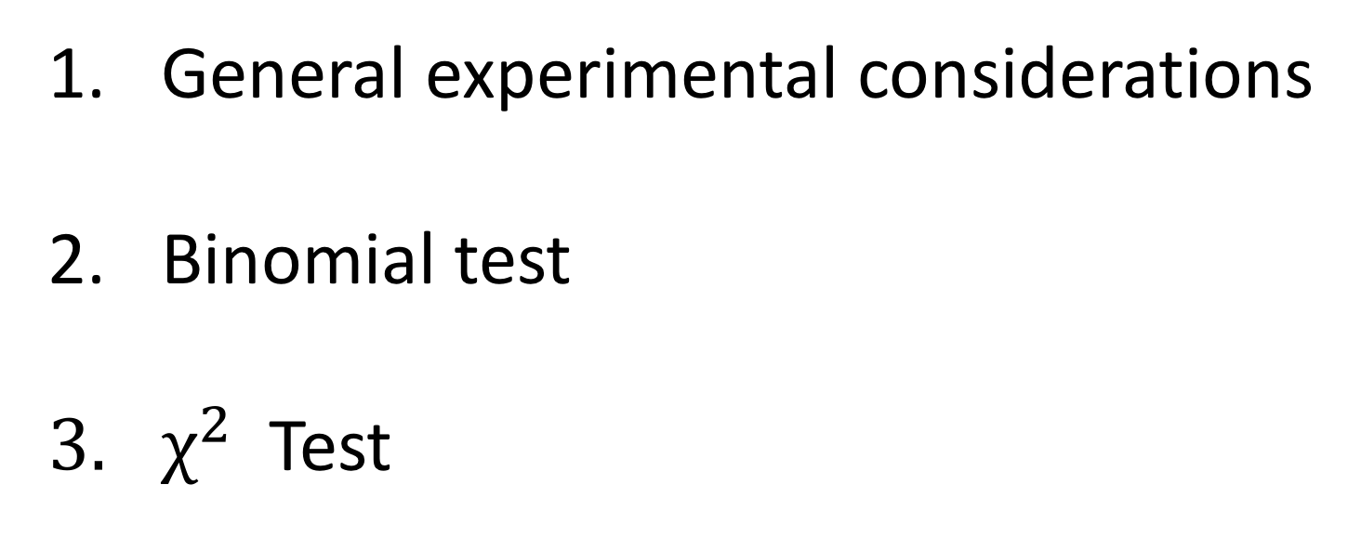
Today
General experimental considerations
Binomial test
$χ^{2}$ Test

Slide 4

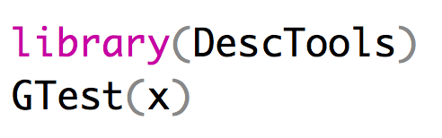
Some other tests
An odds ratio test compares the probability of something happening in two different groups: odds of cancer in smokers versus non-smokers
The Fisher’s Exact Test computes exact probabilities (much like the binomial test) for a 2x2 contingency table
A G-test of independence is basically a χ2-test with a slightly different test statistic

Slide 5
For Thursday
Read chapter WS 6-9
Bring laptop to class!
Heath Blackmon
BSBW 309
coleoguy@gmail.com
@coleoguy

