Slide 1
Continuous Variables Biology 683 Heath Blackmon Size is often exponentially distributed in populations. Imagine that you sample a population and get the mean size in your sample. You then repeat this process many times; what will the distribution of your means look like? What is the definition of a p-value?

Slide 2
Today
Shifting gears because of reality!

Slide 3
Today
We are going to flip this class starting today!
You will absolutely need to schedule an hour or so some time each week to review the basic weekly page.
Class time will be spent strictly on practice problems and group discussion.
Data focused
Statistically literate
Highly Productive
Lets take a look at the updates to the course website.

Slide 4
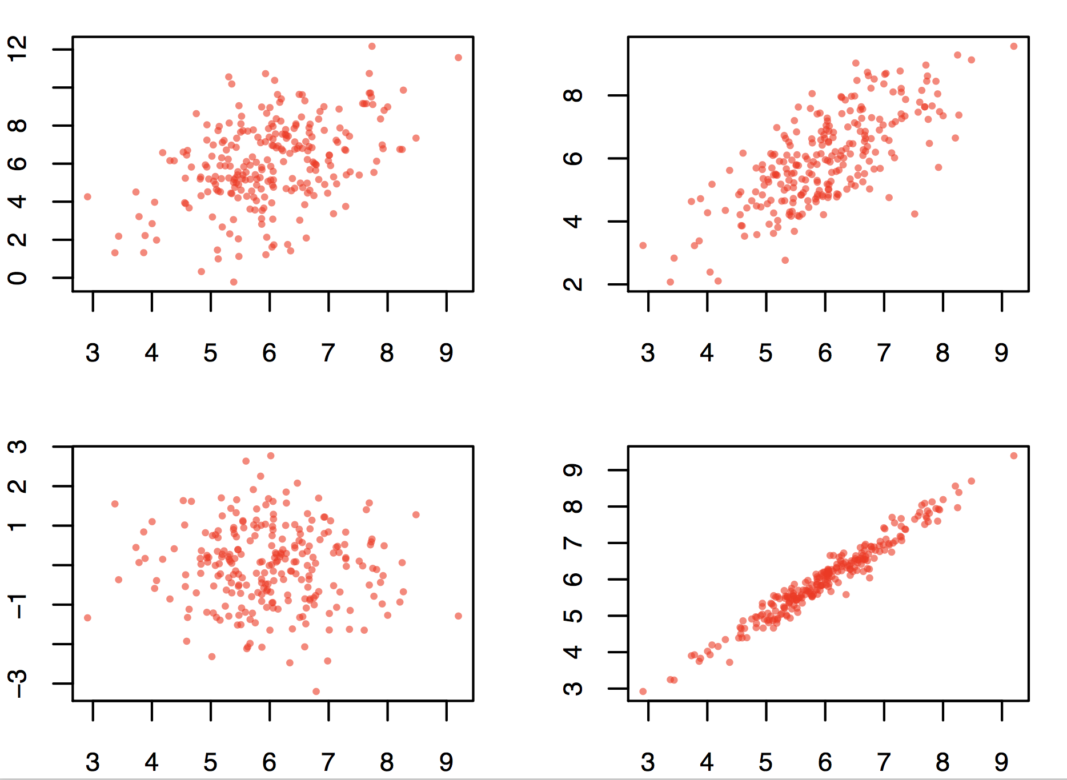
Good data

Slide 5
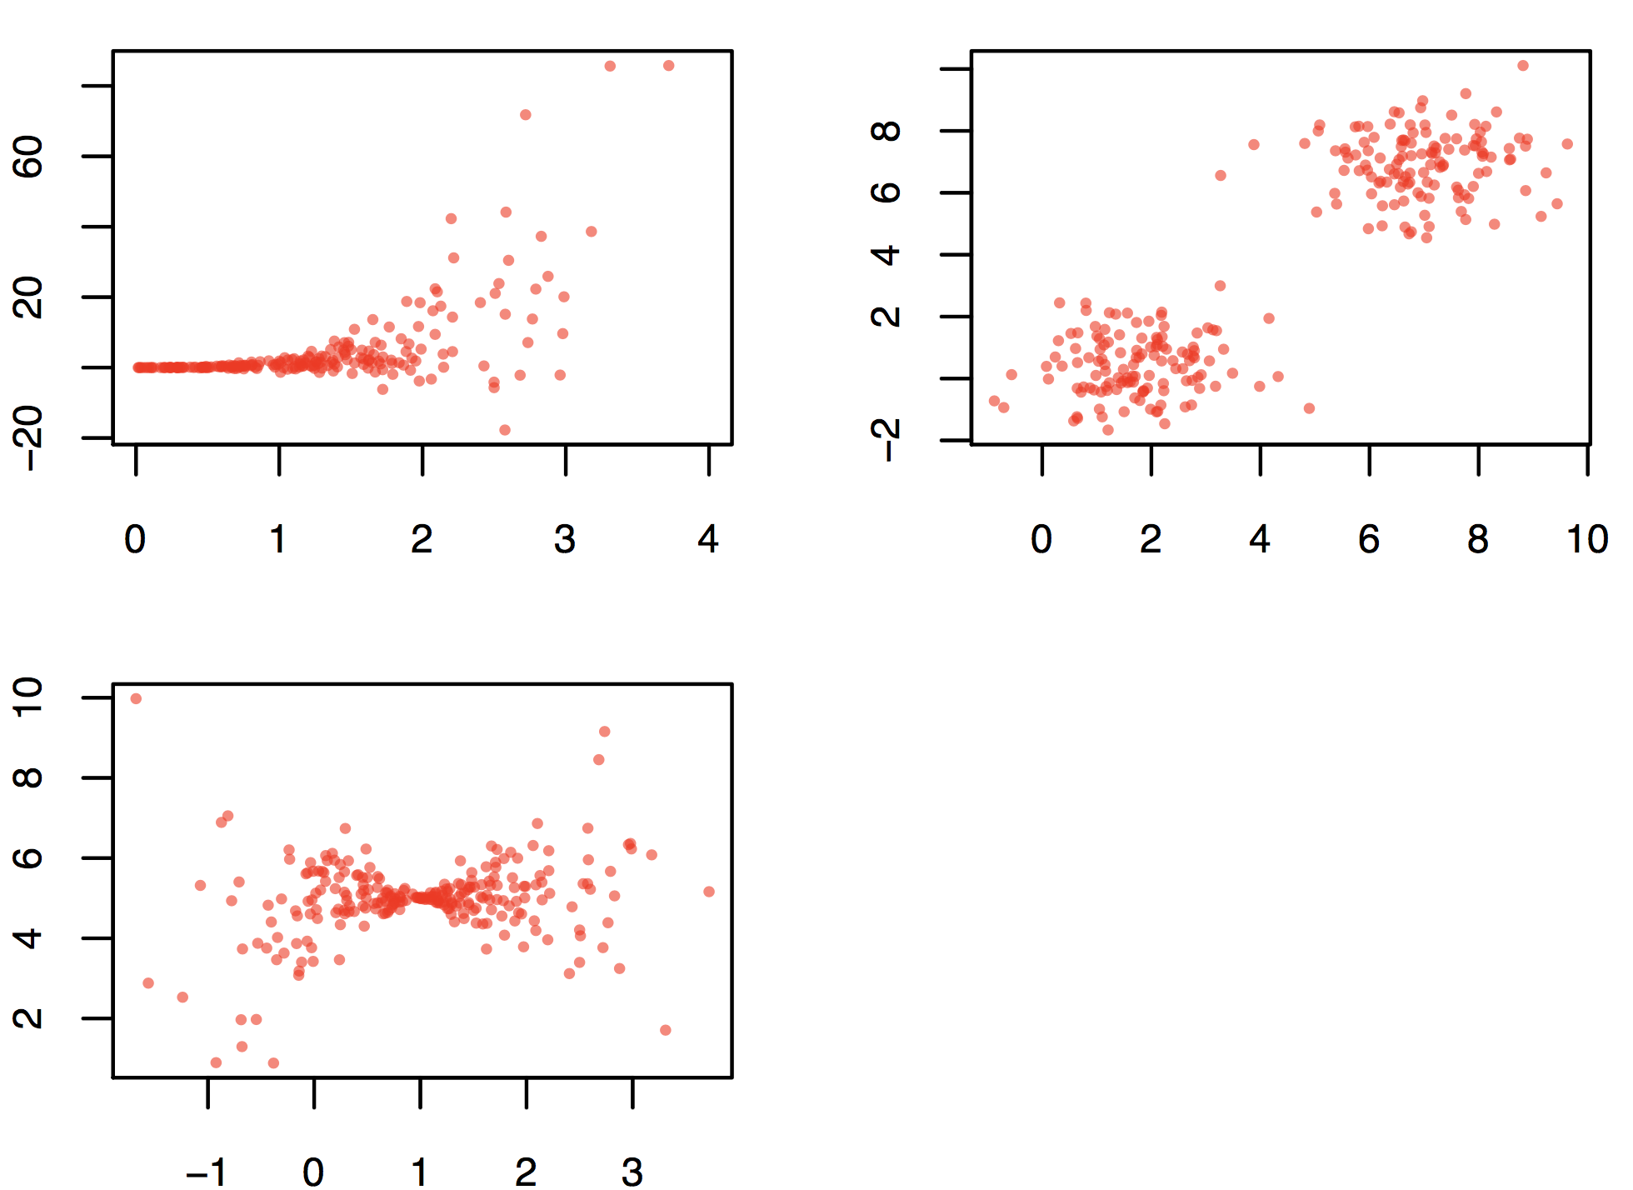
Bad data
Correlation simulator

