Slide 1
Experimental Design Biology 683 Lecture 1 Heath Blackmon

Slide 2
Today
Introductions
Name
Lab
Project / Data
Syllabus / website
Big problems in stats (outside world / within academia)
Why you need this class
Prep for Thursday

Slide 3
My Objectives
Help you build an intuitive understanding of statistics
Get you comfortable with the idea of coding in R
Help you develop the skills to build informative, honest, and intuitive data visualizations in R
Help you develop the skills to handle datasets in R
Help you develop the confidence to think about the characteristics of the data that you will be collecting in your research and how you might analyze it.
Notes:
Talk about vaccines, immigration, tax policy, conservation, global warming, teaching

Slide 4
The public impression of statistics
There are three kinds of lies: lies, damned lies, and statistics
You can make statistics say anything
Statistics are no substitute for good judgement
Notes:
Talk about vaccines, immigration, tax policy, conservation, global warming, teaching

Slide 5
My opinions
Misuse or ignorance of statistics is unethical as a scientist
Poor training and maleficence are both responsible for failures
Statistical literacy in the general public is essential
Do your part: learn science of important topics and help friends and family understand them! This includes the statistical analysis

Slide 6
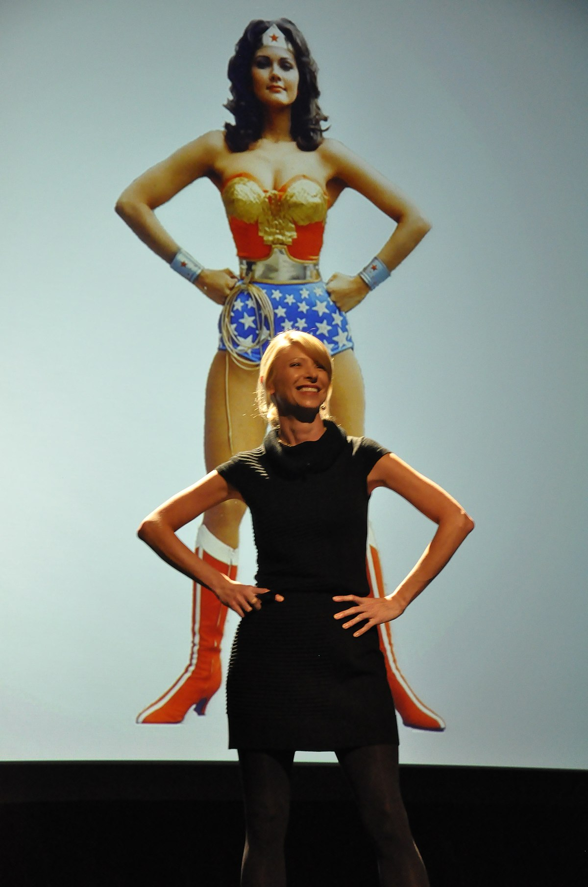
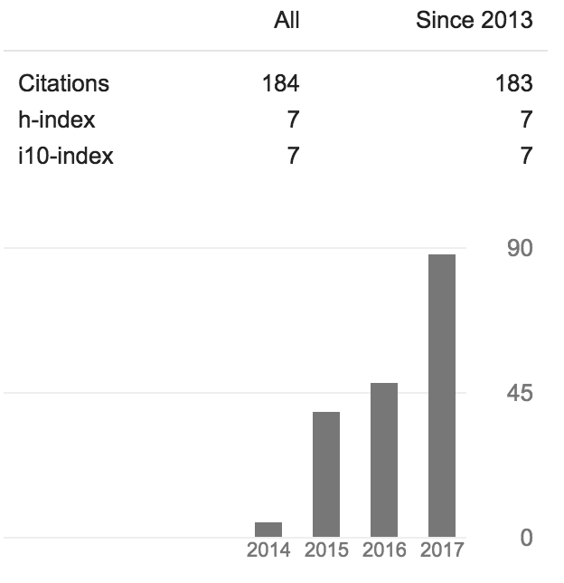
Reproducibility crisis
Started in the social sciences but some problems are widespread
pressure to publish
file drawer problem
small sample sizes
p-hacking
unethical researchers
Amy Cuddy
TED Talk 47 Million views
(2nd most populat TED Talk)

Slide 7
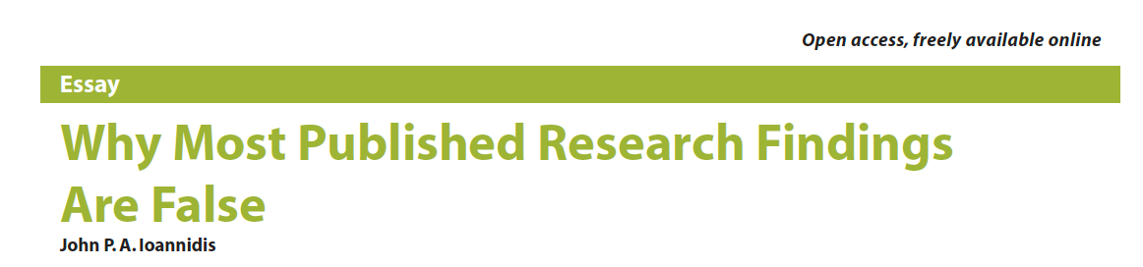
Solutions
Study preregistration
PeerJ / PLOS ONE
Preprint Servers
Altimetrics
Systemic change - unlikely

Slide 8
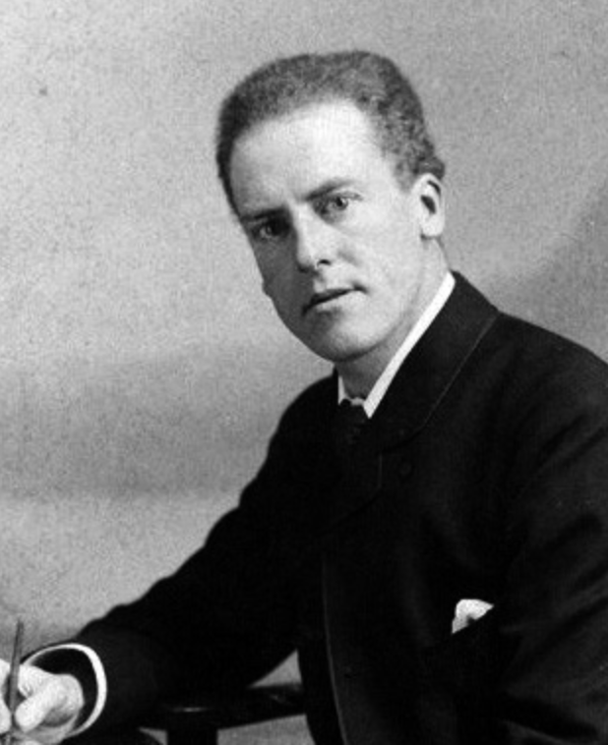
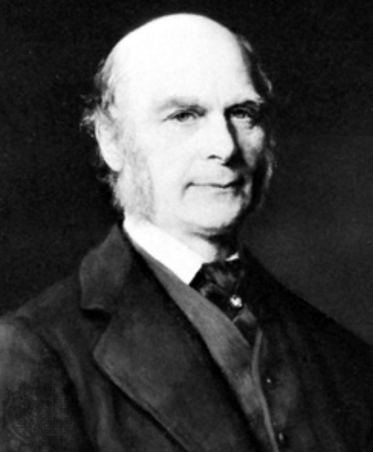
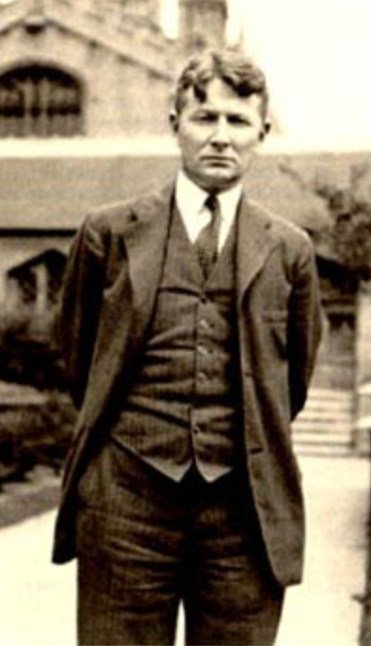
The Origin of Statistics
In many ways modern statistics was an offshoot of evolutionary biology (1900 rediscovery of Mendel’s work was motivating problem).
K. PEARSON
1857-1936
CORRELATION
F. GALTON
1822-1911
REGRESSION
R. FISHER
1890-1962
ANOVA
S. WRIGHT
1889-1988
PATH ANALYSIS

Slide 9
Why do biologists need statistics
We want to test hypotheses.
To test a hypothesis we have to design an experiment
Not all experiments have a traditional control and experimental treatment and this isn’t always how we want to test a hypothesis
It is quite possible to design a study or collect data that cannot answer the questions that we have
This leads to poor manuscripts and can lead to bad practices like p-hacking – or mastering out

Slide 10
Experimental Design
To design an experiment you need to understand how the data will be analyzed statistically.
How can you sample the population in which you are interested?
What tests are appropriate for your data?
What biases must be controlled for?
What sample size will be necessary?

Slide 11
Why not just collaborate with a statistician
In some cases this is a great option, but you have to understand enough to communicate.
If you publish a study you are responsible for its validity.
For most experiments simple methods suffice.
In many fields of biology there are sets of statistical tests that are expected for certain types of data.
For all of these reasons statistical analysis needs to involve people who understand the biological problem

Slide 12
My stats philosophy
Statistics is just another tool
My responsibility as a scientists is to report the truth as accurately as possible and statistics help me in this regard
We may NEED statistics to discern patterns in our data
You need to understand where the signal that makes for a significant test comes from. Visualizing your data in the right way can do this!

Slide 13
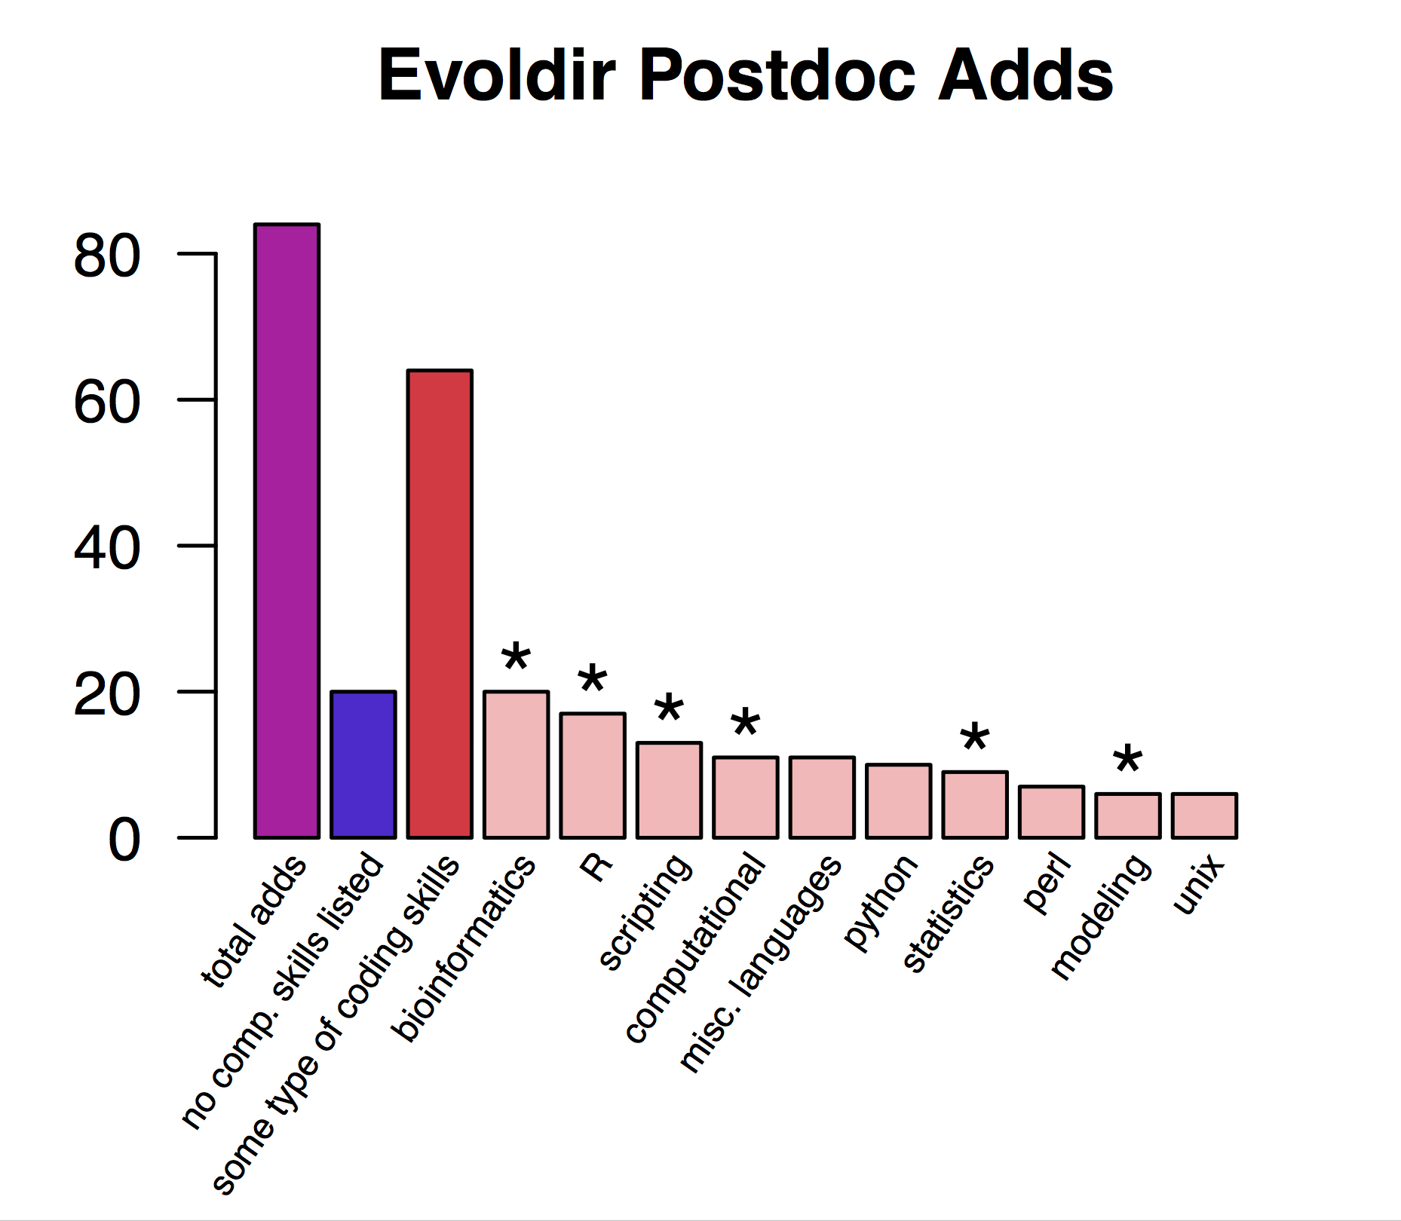
Why am I teaching this class?
December 1, 2017 – January 15, 2018
74%

Slide 14
What is R
R is an open and free statistical programming language that focuses on stats and graphics
It works very similarly on all major operating systems
It’s also a full-fledged high level programming language (similar to Python)
FYI: Very popular in industry so looks great on a CV.

Slide 15
Why use R
Many statistical approaches have been implemented in the R environment.
Because it’s open source, there are no proprietary secrets, as might be hiding in commercially available statistical packages.
Any program written in R will have access to all of R’s tools for statistics and graphing.
New methods of analysis are being implemented in R by the scientists developing the methods.

Slide 16
Why use R
If you use R you can include a script with your manuscript
Reproducibility / Open science
Reviewing
Revising
Many methods (mixed models, quantitative genetics, etc.) are only available in R.
PLOTTING
Once you’ve learned one language you can learn others more easily.

Slide 17
Downsides of R
Learning curve
Anyone can make a package - so there is some junk out there
Memory issues
No language lasts forever and no language can do everything
Python
Awk
Julia

Slide 18
Installing R and RStudio
Installing R
Go to the R homepage and click download R.
Pick a mirror that is in Texas or at least in the United States.
Select the correct version for your system and follow the prompts.
Installing Rstudio
Go to the RStudio homepage and click on the download link below the free version of RStudio Desktop.
Select the correct version for your system and follow the prompts.

Slide 19
For Thursday
Do homework 1.
Install R and Rstudio on a laptop
Come and see me BEFORE class on Thursday if you run into problems
Read chapters 1 and 2 of WS – good supplemental readings too!
Bring laptop to class every day from here on out! Bring a charger if you are not 100% positive that your battery will last.
Heath Blackmon BSBW 309A coleoguy@gmail.com

