Slide 1
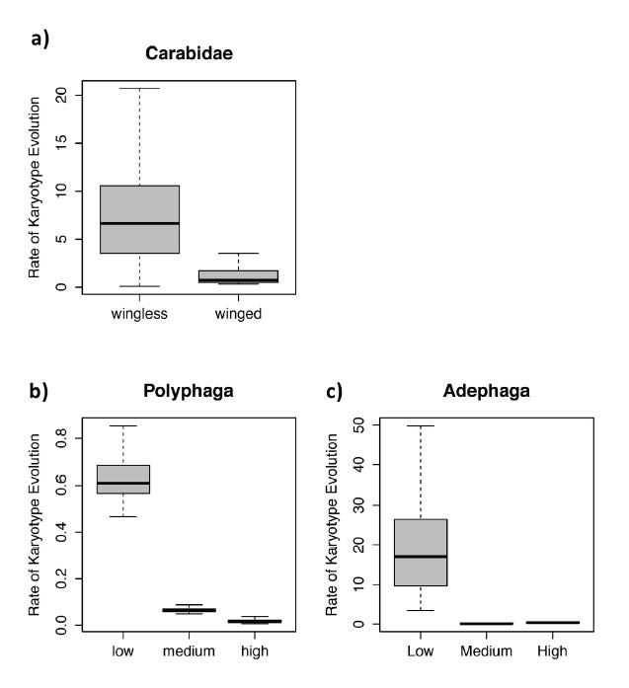
boxplot

Slide 2
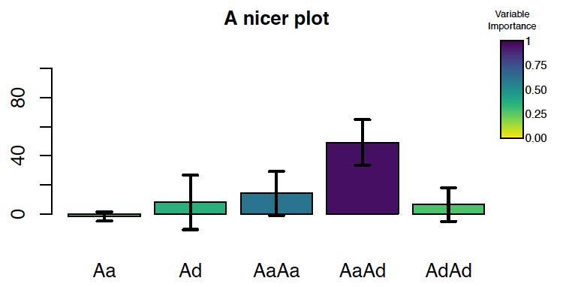
Color blind friendly viridis package

Slide 3
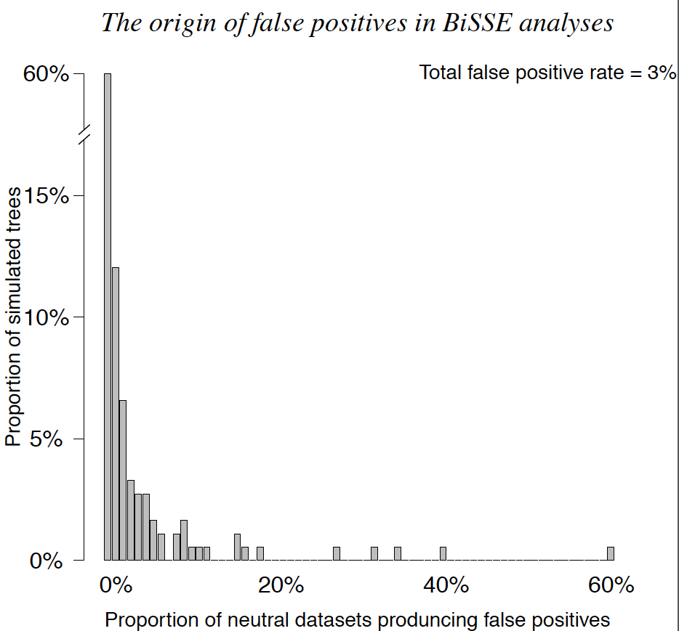
Vertical barplot

Slide 4
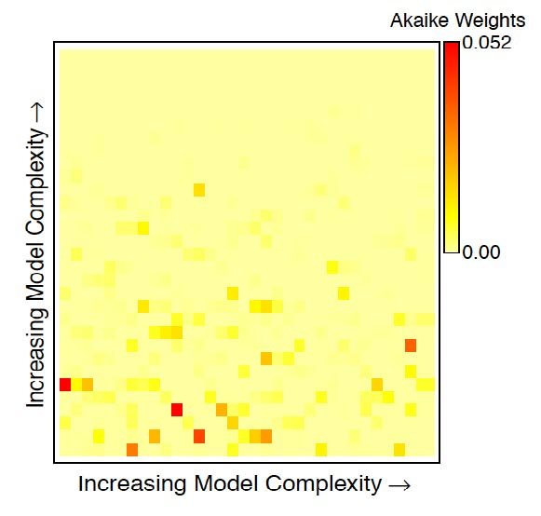
heatmap

Slide 5
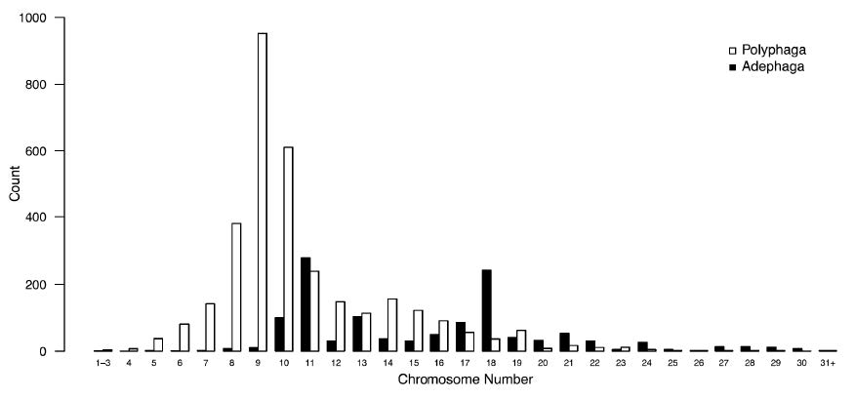
Side by side histogram

Slide 6
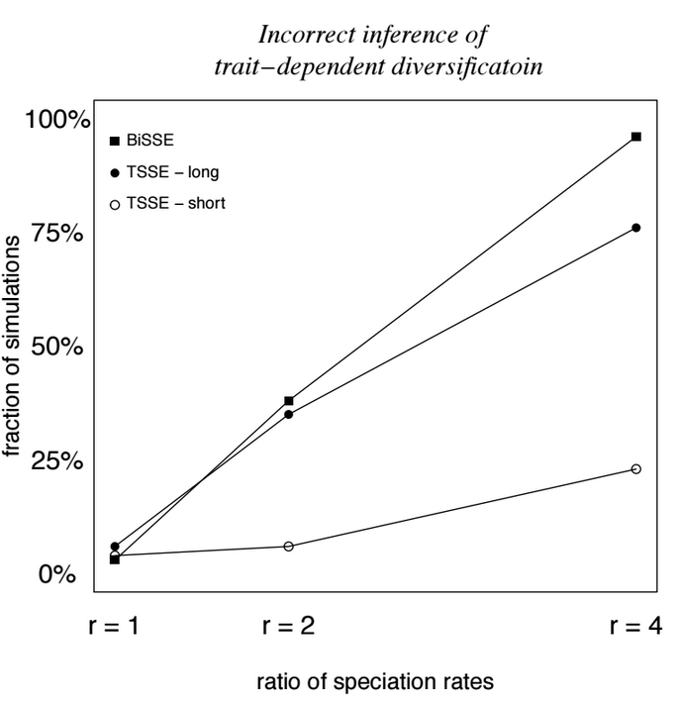
XY scatter

Slide 7
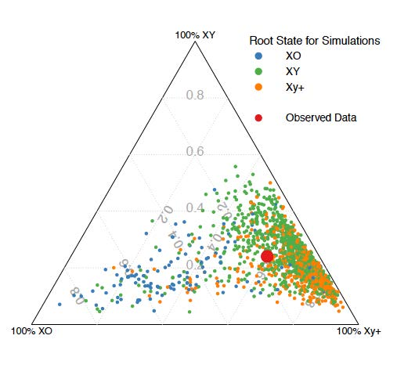
Ternary plot

Slide 8
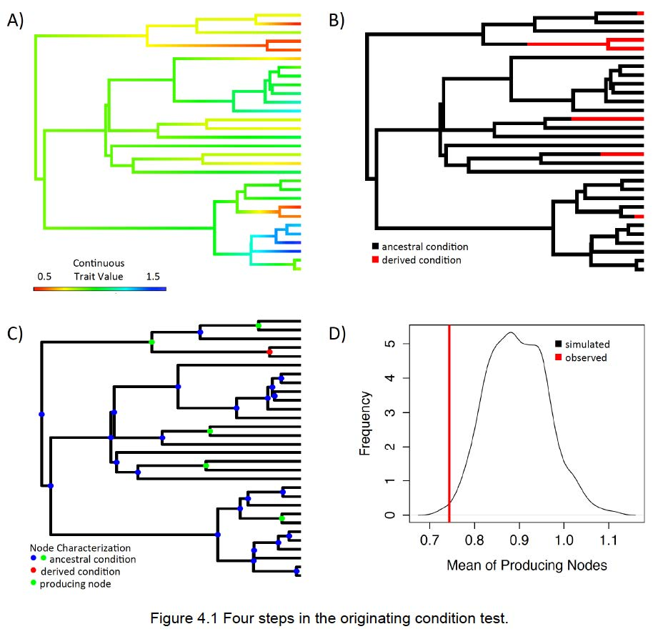
Lots of stuff
Phylogeny +
Heatmap
Density plot
Phylogeny +
XY scatter

Slide 9
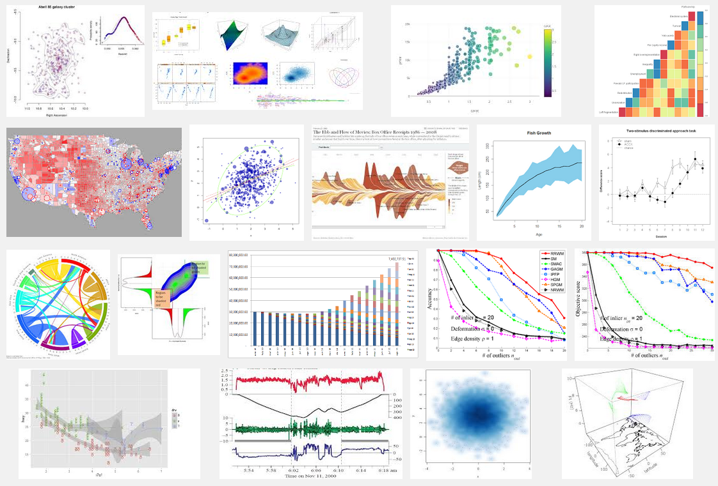
Lots of stuff

