Slide 1
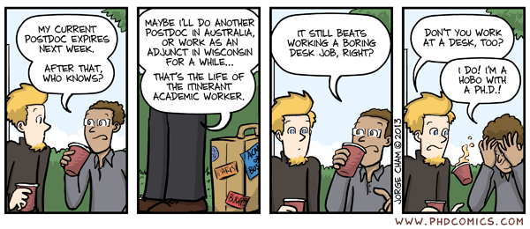
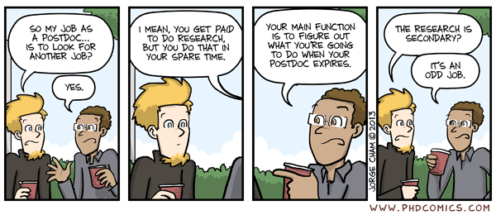

Slide 2
Misconception #1: I will do a postdoc to buy myself some time and “figure it out later”
Misconception #2: The PhD is the “end game”
Misconception #3: There are tons of careers out there for PhD’s which will make the transition into any these careers easy
Misconception #4: I have gained enough transferable skills in graduate school to distinguish myself from everyone else
Misconception #5: I can get “any” job out of graduate school or a postdoc
Misconception #6: Entry Level PhD Careers are no different than mid-level or even senior and there is no need to distinguish in terms of what is feasible.

Slide 3
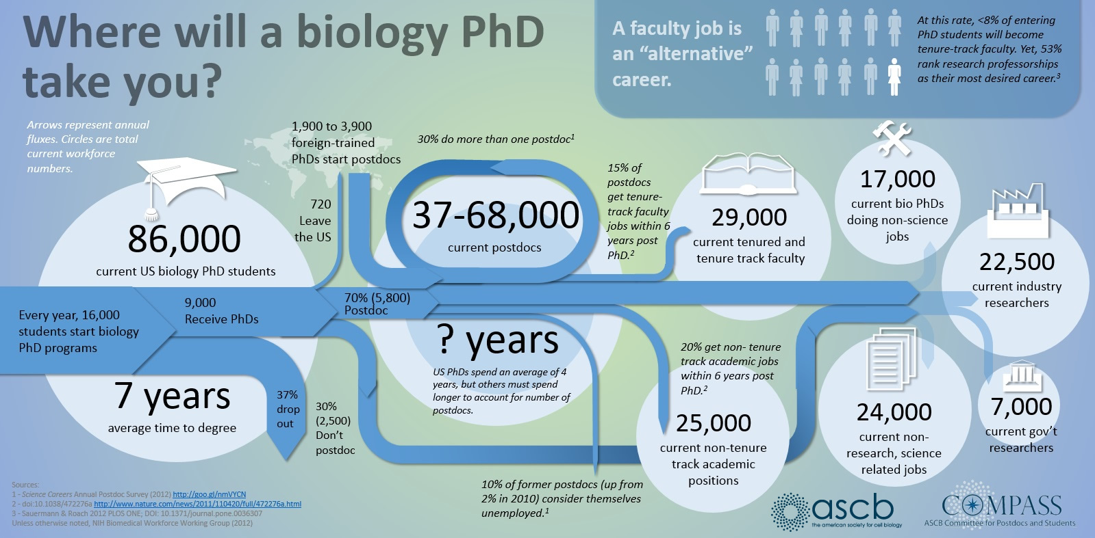

Slide 4
 | R1 | PUI
Startup | 6-7 figure | 0-low six
PhD students | required | none
postdocs | expected | very rare
train undergrads | optional | required
lab space | okay to amazing | zero to great
service | minimal | moderate to high
courses per year | 0 to 3 | 3 to 8
class size | seminar to 100+ | <10 to 100+
Postdoc expected | Always | Often straight from Ph.D.
who does research | PI, technicians, postdocs, grad students, undergrads | PI and undergrads
how much money are you handlings | 100K+ per year | 0-50K per year
how do you get tenure
Grants | 100K+ per year | any money (20k) is big plus
Publications | >2 per year | maybe one or two
Service | a little bit | non-trivial
Teaching | don't suck | teach well and a lot

Slide 5
2022 R1 Search
Search received 150 applicants for evolution positions
12 were invited for interviews
3 (2%) were hired
all had grants funded while postdocs or prior to starting positions
16, 17, and 29 pubs at point of hiring
All gave engaging exciting talks and interviews
2022 PUI Search
Search received 9 applicants for A&P/microbiology positions
5 were invited for interviews
4 (44%) were hired
all had TA experience in A&P or micro labs
2 from Ph.D. programs 2 from postdoc positions

Slide 6
2022 R1 Search
Search received 150 applicants for evolution positions
12 were invited for interviews
3 (2%) were hired
all had grants funded while postdocs or prior to starting positions
16, 17, and 29 pubs at point of hiring
All gave engaging exciting talks and interviews
2022 PUI Search
Search received 9 applicants for A&P/microbiology positions
5 were invited for interviews
4 (44%) were hired
all had TA experience in A&P or micro labs
2 from Ph.D. programs 2 from postdoc positions

Slide 7
Academia
Teaching Research
Government
Enforcement Research Advising
Entrepreneur
Consulting
Non-Profit
Outreach Research
Industry
Sales Research

Slide 8
Academia
Teaching Research
Government
Enforcement Research Advising
Entrepreneur
Consulting
Non-Profit
Outreach Research
Industry
Sales Research

Slide 9
Academia
Teaching Research
Government
Enforcement Research Advising
Teaching experience
Certificates show training
Internships
Communication
Research in right area
Internships
Research in right area
Internships
Papers
Grants
Postdoc
Entrepreneur
Consulting
An Idea
Soft Skills
Money
Soft Skills
Field specific knowledge
Non-Profit
Outreach Research
Industry
Sales Research
Research in right area
Internships
Experience
Research in right area
Soft Skills
Internships
Research in right area
Skill set
Internships

Slide 10
Academia
Teaching Research
Government
Enforcement Research Advising
Teaching experience
Certificates show training
Internships
Communication
Research in right area
Internships
Research in right area
Internships
Papers
Grants
Postdoc
Entrepreneur
Consulting
An Idea
Soft Skills
Money
Soft Skills
Field specific knowledge
Non-Profit
Outreach Research
Industry
Sales Research
Research in right area
Internships
Experience
Research in right area
Soft Skills
Internships
Research in right area
Skill set
Internships

Slide 11
Industry/non-academic
Vice President | $391,095
Chief Scientific Officer (CSO) | $205,159
Director | $178,457
Manager | $135,124
Senior Researcher | $132,672
Senior Researcher | $129,007
Govt. Non-supervisory Pro. | $98,198
Staff Scientist | $91,447
Laboratory Manager | $67,951
Research Technician | $55,140
Academia
Department Head | $159,022
Professor | $151,825
Associate Professor | $105, 499
Assistant Professor | $90,899
College Instructor | $74,964

Slide 12
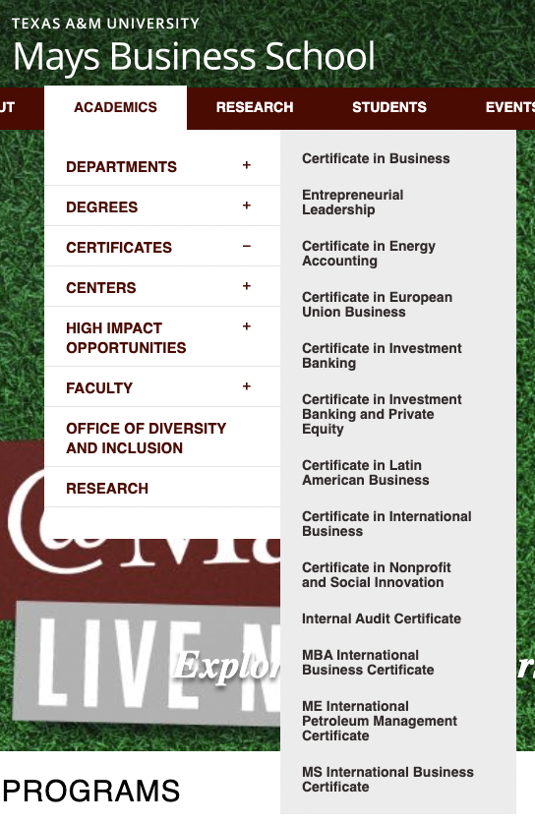

Mentors and networking
-conferences (coffee/PI)
-cold emails
-social media
-workshops/working groups
Your image
-linkedIn
-website
-cv/resume (Michelle Jonika)

