Slide 1
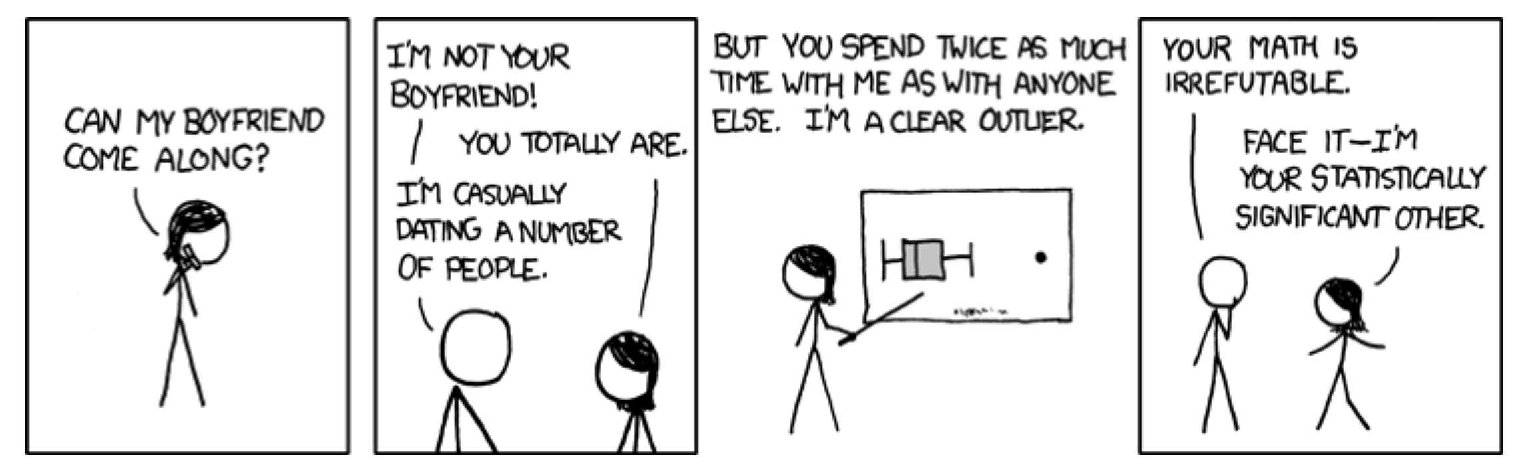
Binary Response Variables, Random vs Fixed Effects, and Outliers
Biology 683
Lecture ?
Heath Blackmon

Slide 2
Logistic Regression
Questions where the response variable is binary are common.
Dispersal vs Non-dispersal
Survival
Presence/Absence of a trait
Infected/uninfected

Slide 3
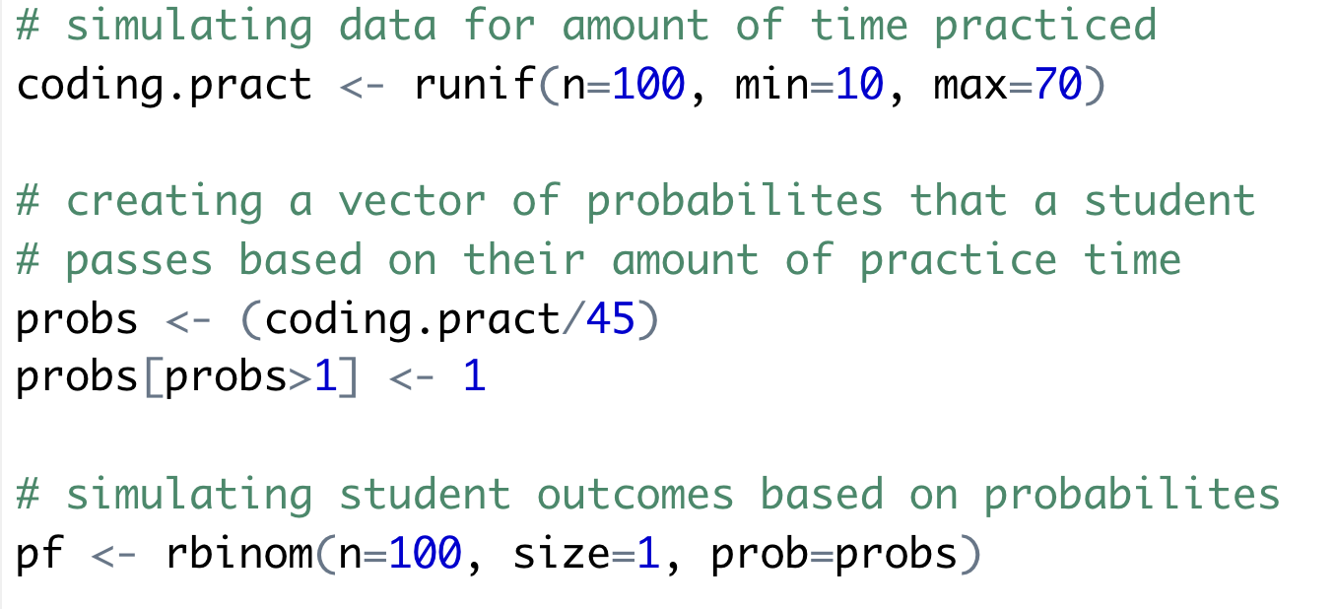
Logistic Regression

Slide 4
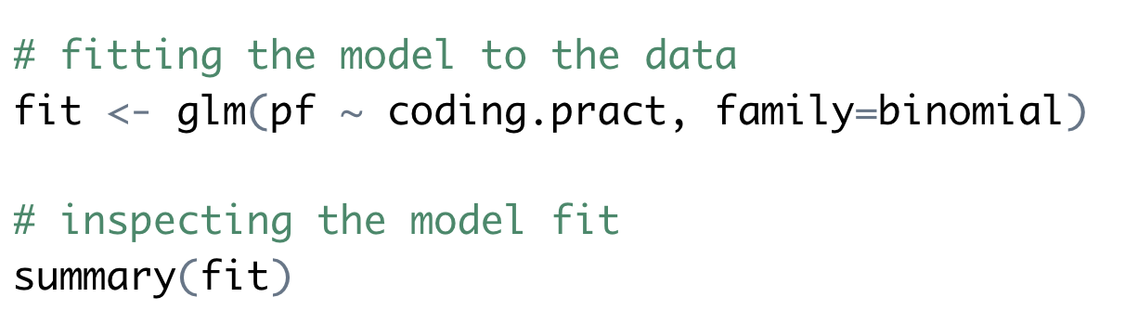
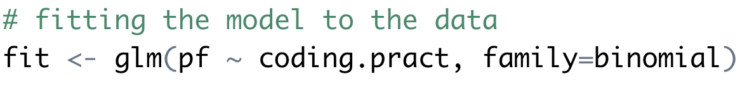
Logistic Regression

Slide 5
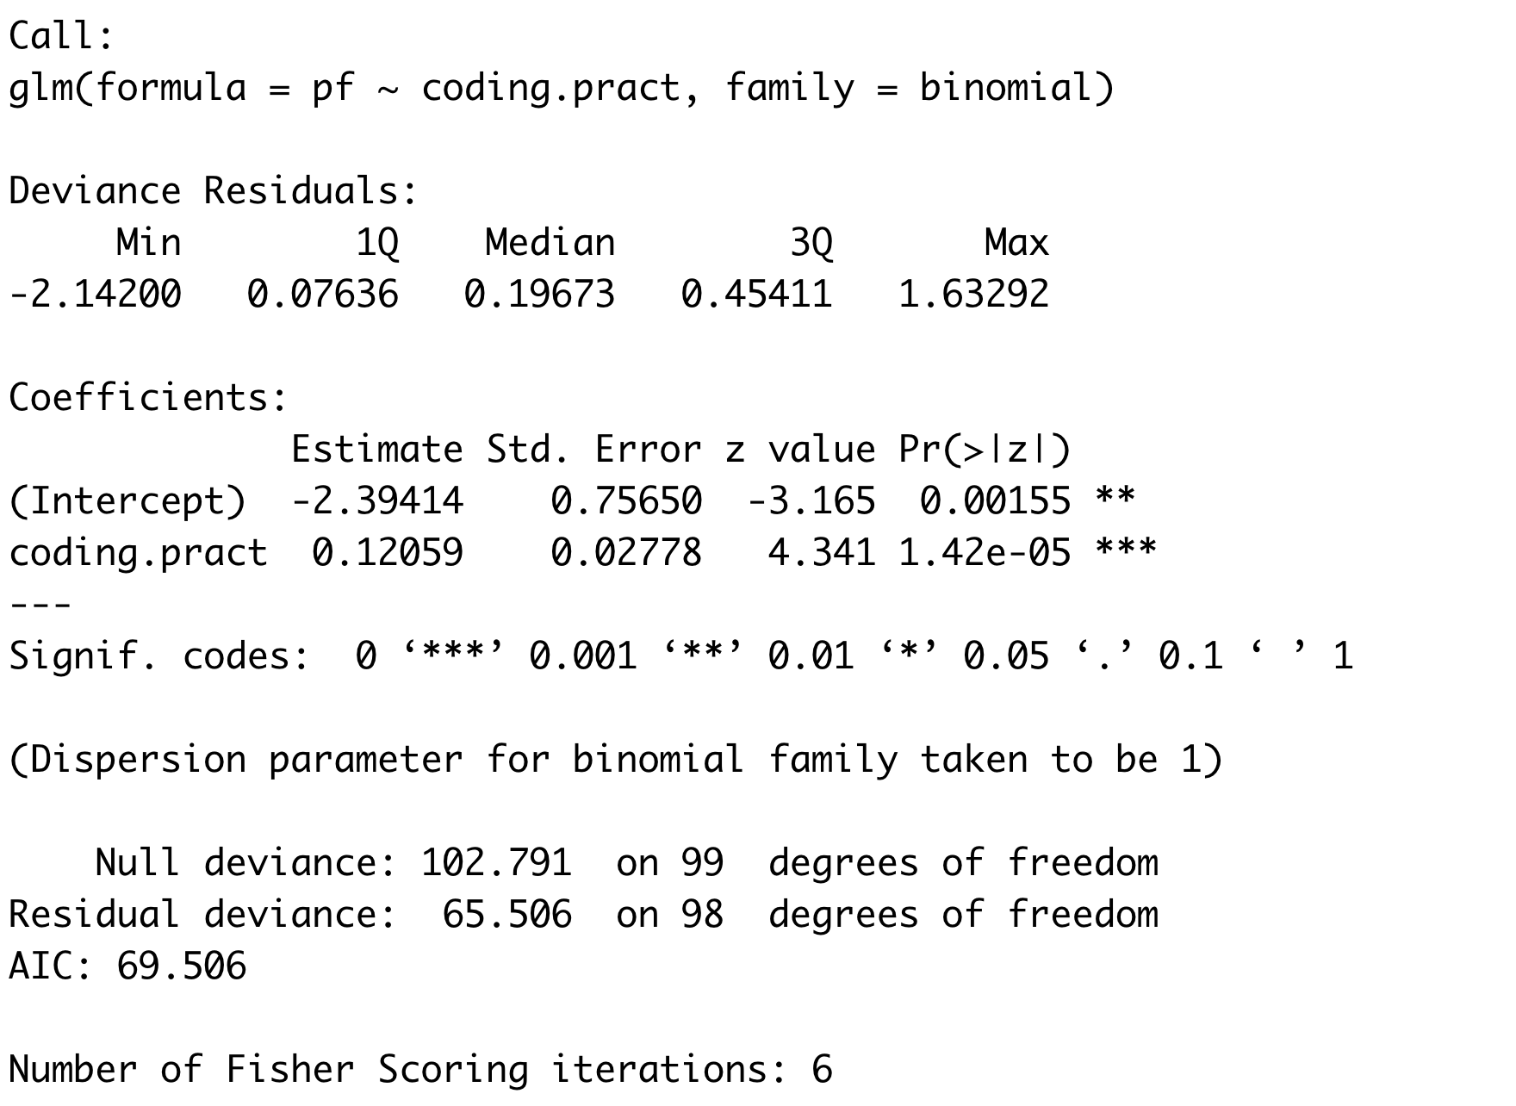
Logistic Regression

Slide 6
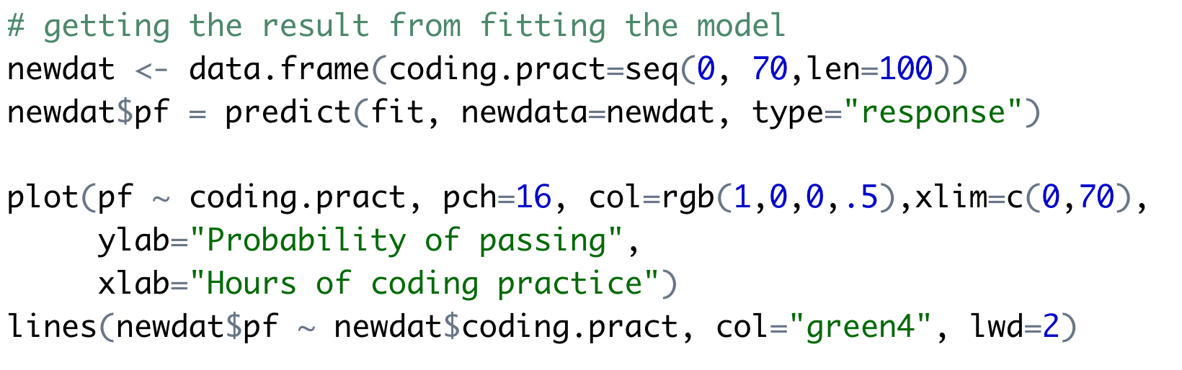
Logistic Regression

Slide 7
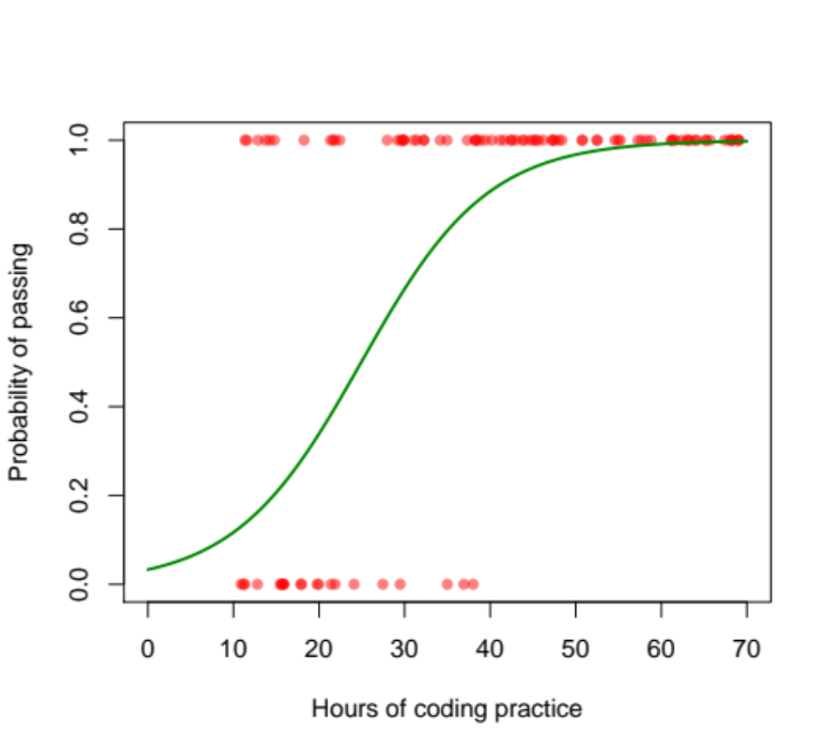
Logistic Regression

Slide 8
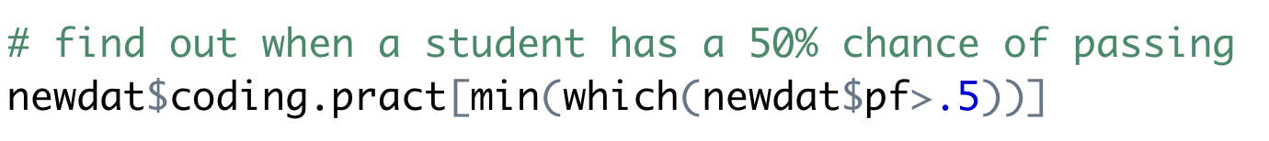
Logistic Regression
> 25.45

Slide 9
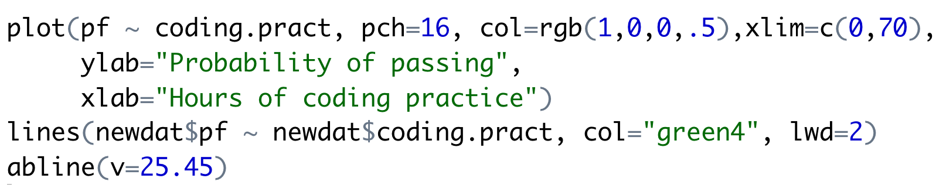
Logistic Regression
> 25.45

Slide 10
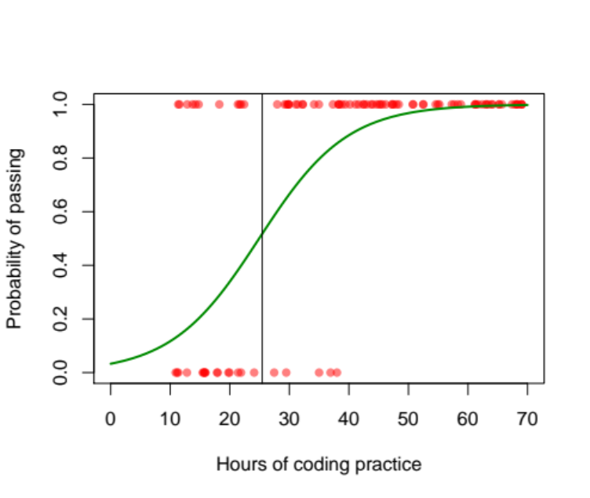
Logistic Regression
> 25.45

Slide 11
Logistic Regression
> 25.45
How does this compare to what we expected from the simulation?
> 25/45
[1] 0.5555556

Slide 12
Mixed models
Mixed models are models that include fixed and and random effects.
Fixed effects can be repeated by other researchers. These are the variables that you are interested in studying.
Random effects are usually nuisance parameters. These are variables that other researchers cannot replicate and you are not interested in inferring anything about them.

Slide 13
Mixed models
These are the variables whose impact we wish to determine
  Characteristics of the media or habitat
  Alternate medical treatments
  Age groups
  Time points
Conclusions that you reach are only applicable to the groups or treatments you include in the study

Slide 14
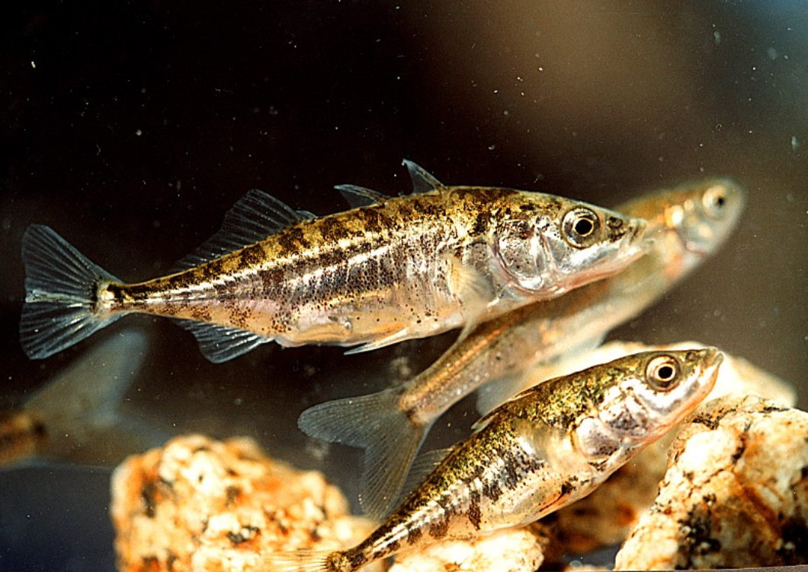
Example of fixed effects
Reciprocal relocation experiment to investigate how genotype and habitat interact to determine the fitness of stickleback fish (Rundle 2002).
 |  | Source habitat
 |  | Shallow | Deep
Test habitat | Shallow | 12 fish | 11 fish
 | Deep | 7 fish | 11 fish

Slide 15
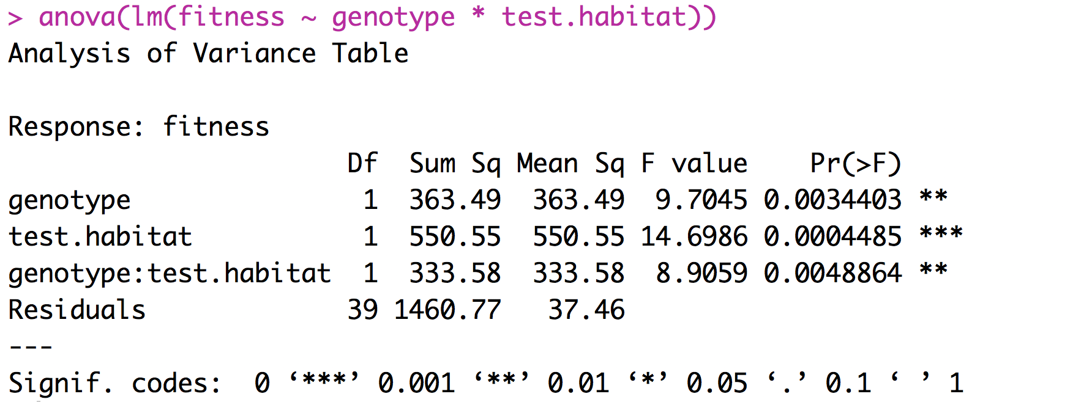
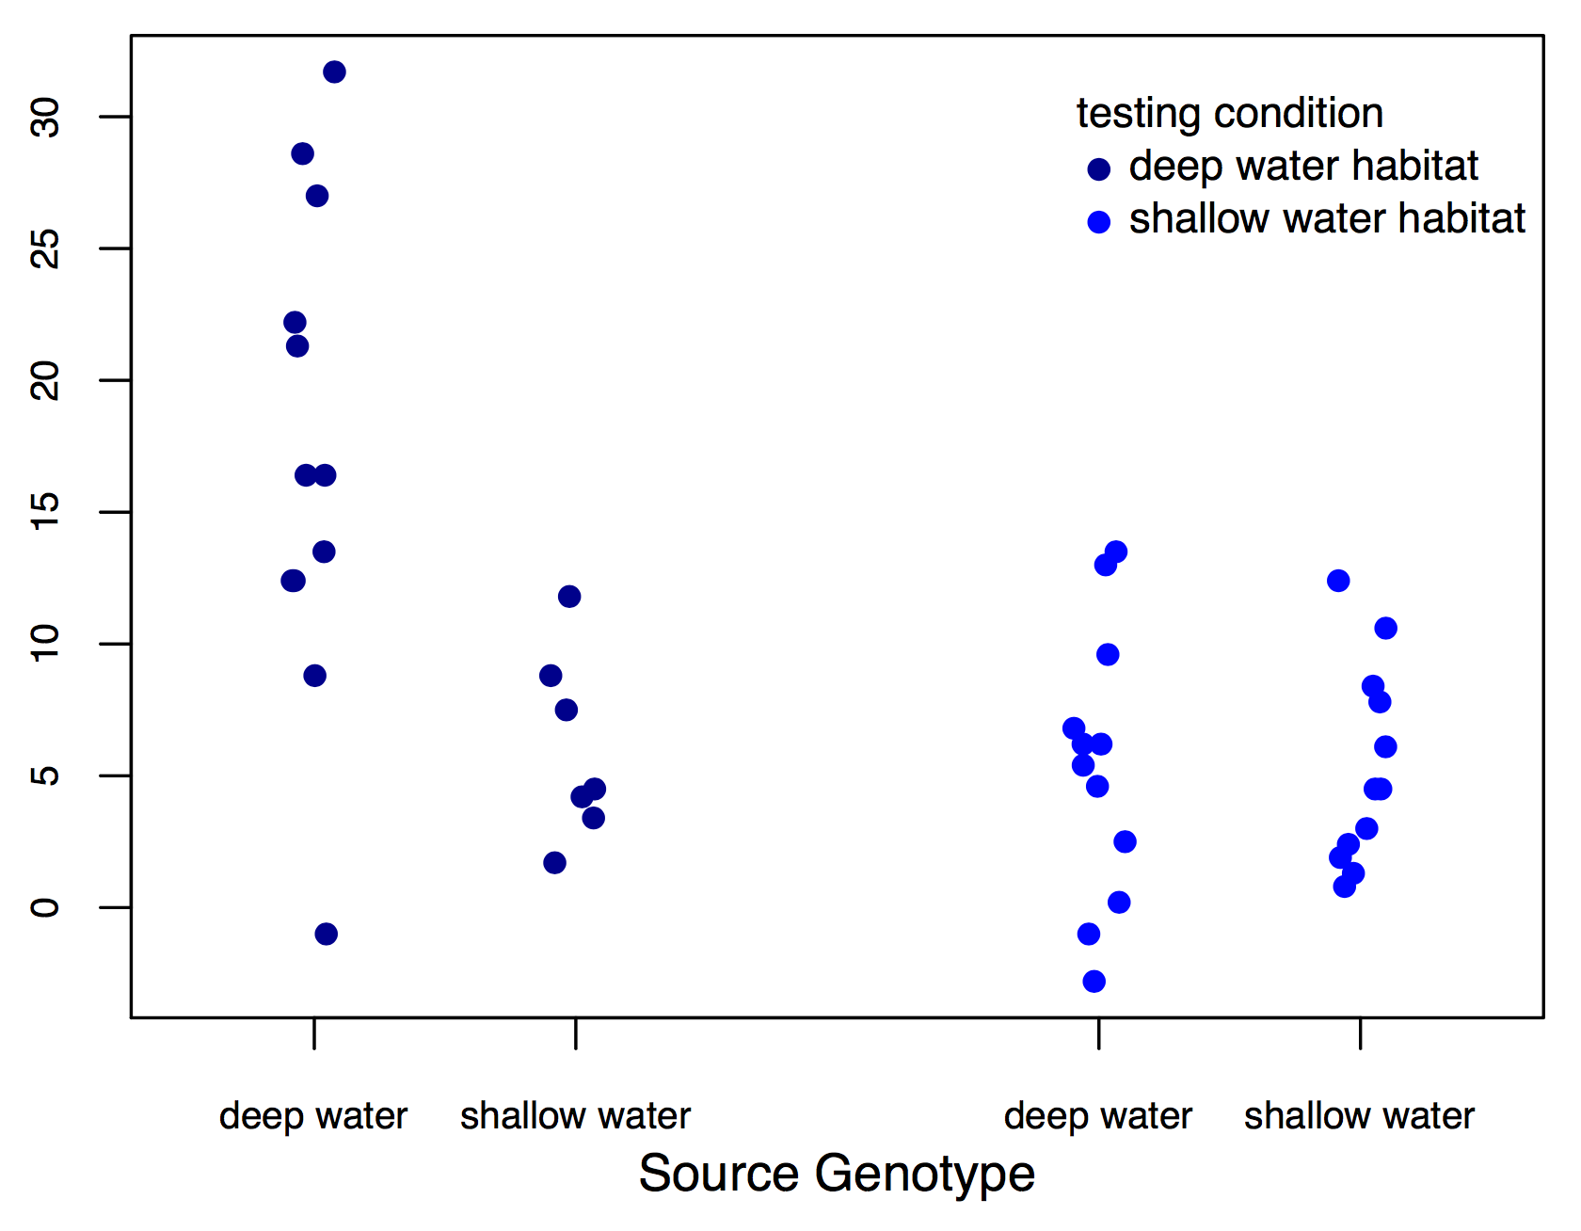
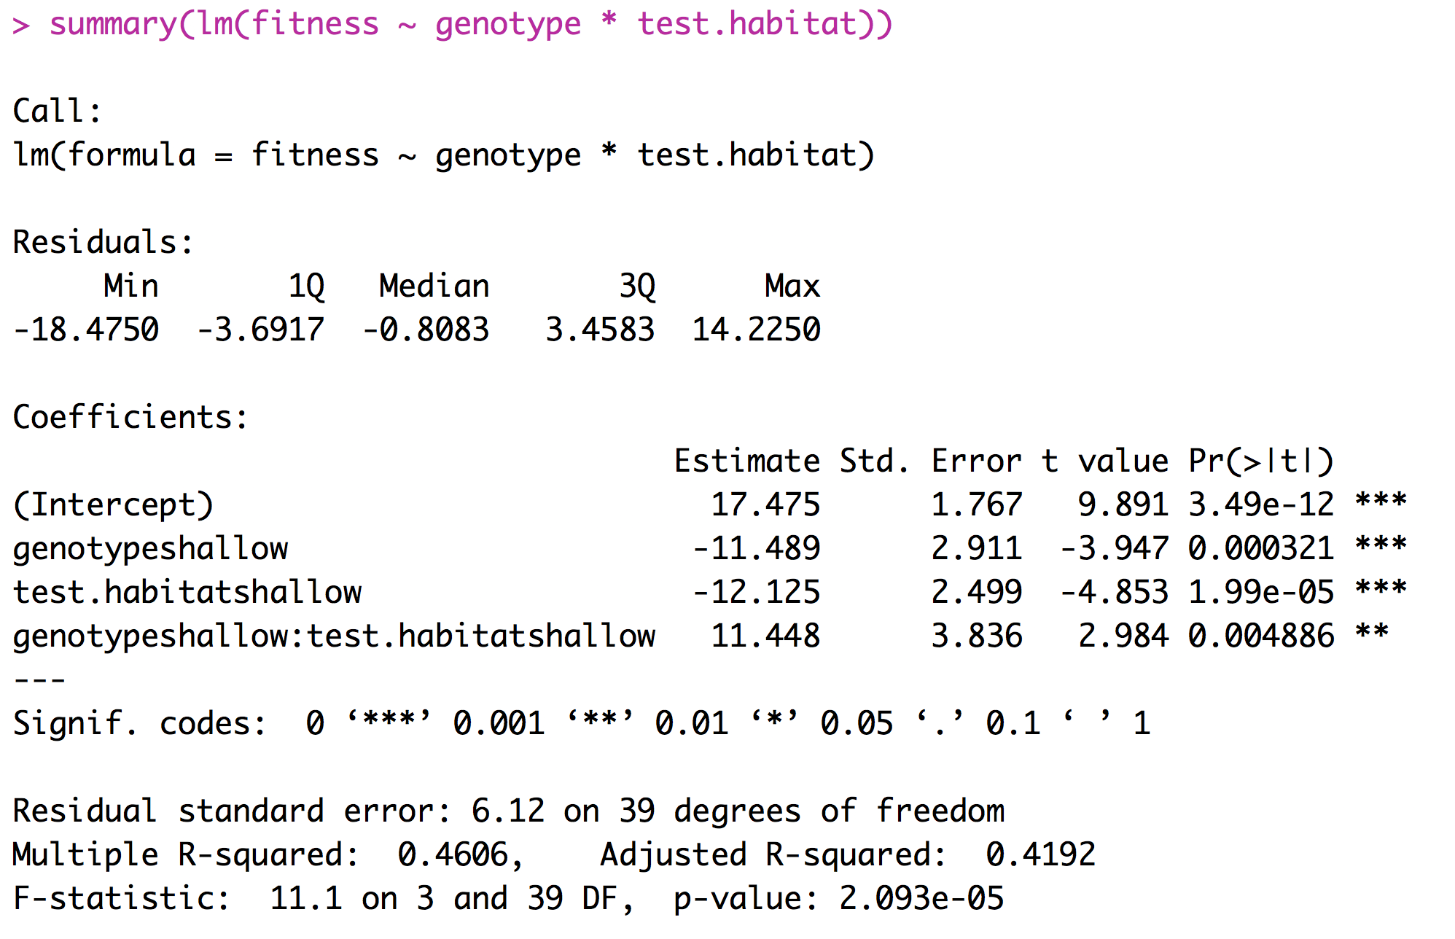
Example of fixed effects (two factor ANOVA)
fitness

Slide 16
Interpreting Coefficients

Slide 17
What is a random effect
These are randomly sampled categories of a variable that represent groups of individual measurements. Usually random effects are not repeatable.
  Study sites
  Environmental chambers
  Families made up of siblings
  Measurements within individuals
Conclusions that you reach are applicable only to the sample being studied.

Slide 18
What is a random effect
Sometimes random effects are a nuisance
Field sites
Environmental chambers
Field plots
Repeated measures
Occasionally random effects are of great interest
Families - Heritability
Individuals – Breeding value

Slide 19
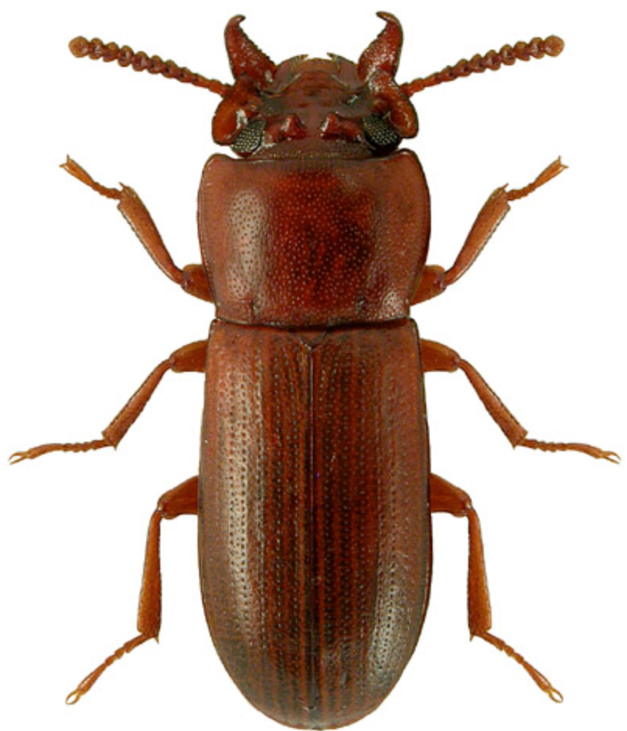
Example of random effects
Impact of selective regime on horn size. Measure both the left and right horn in 25 beetles from two different selective regimes.
Horn size | Beetle | Selective regime
256 276 321 321 423 401 381 409 | 1 1 2 2 3 3 4 4 | High High High High Low Low Low Low

Slide 20
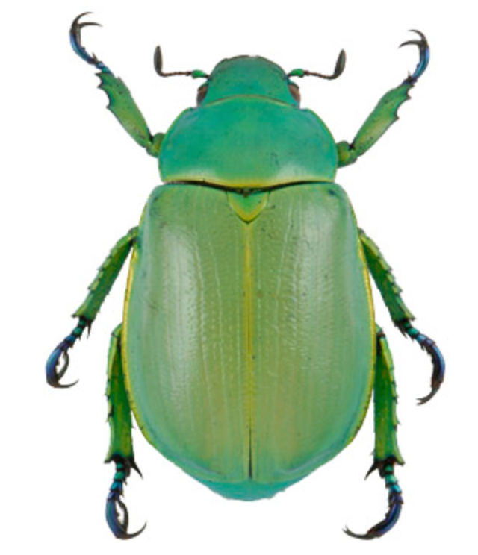
Example of random effects
Identifying the predictors for the presence or absence of Chrysina beetles.
Number collected | oak | juniper | site | date | trip
8 2 1 5 4 6 0 7 | 1 1 0 0 1 1 1 1 | 0 1 1 1 1 0 1 1 | 21 13 31 15 21 13 31 15 | 210 210 211 212 242 242 245 245 | A A A A B B B B

Slide 21
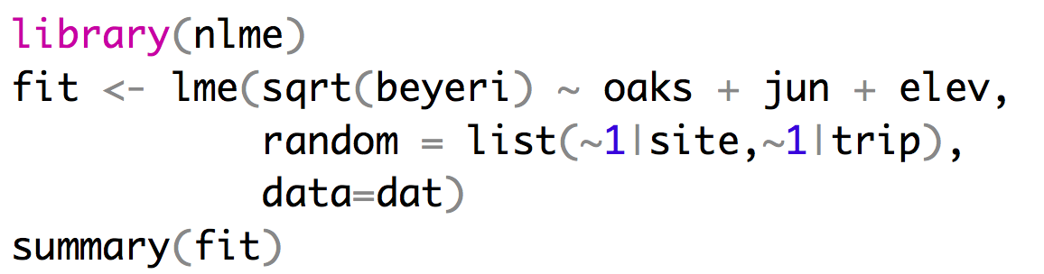
Implementing a mixed effects model
Mixed effect models can be fit using the LME function from the package nlme.
Fixed effects
Random effects
Repeated measures at sites can’t
be treated as independent

Slide 22
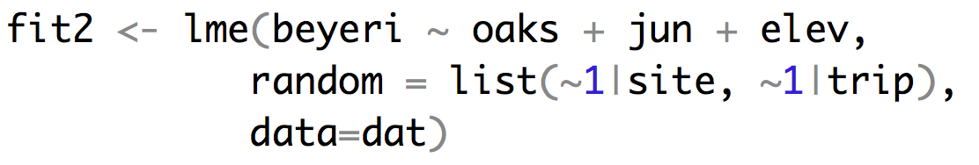
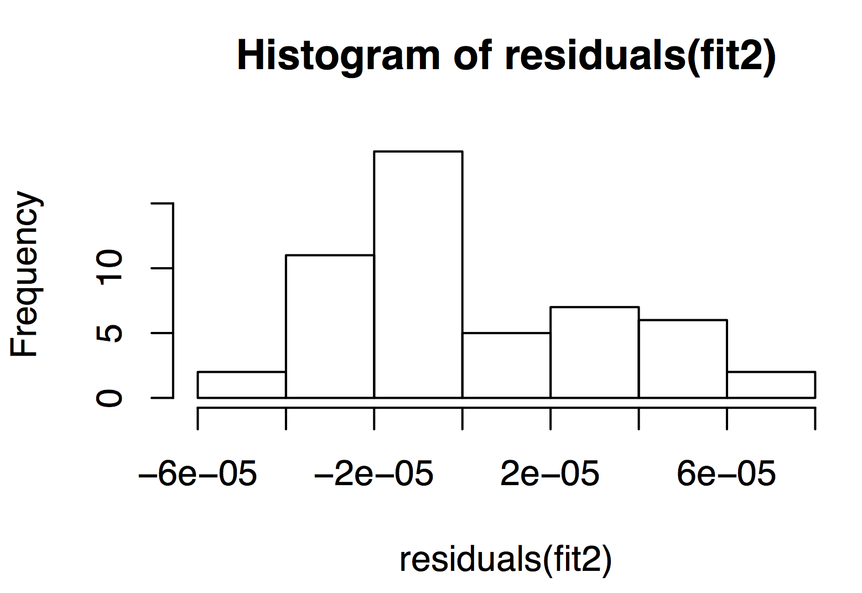
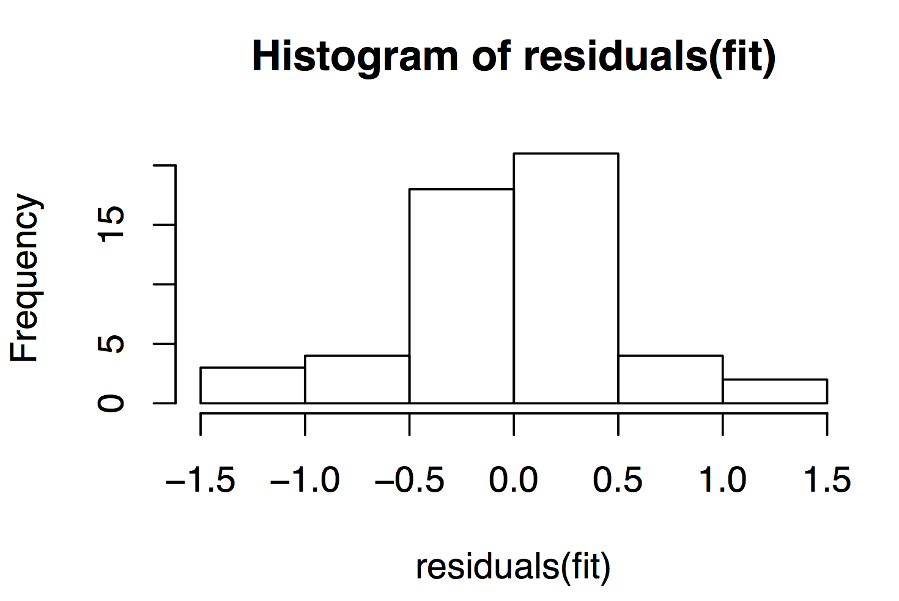
Implementing a mixed effects model

Slide 23
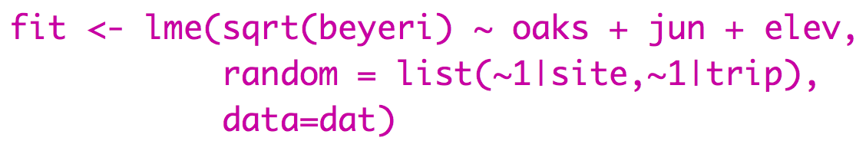
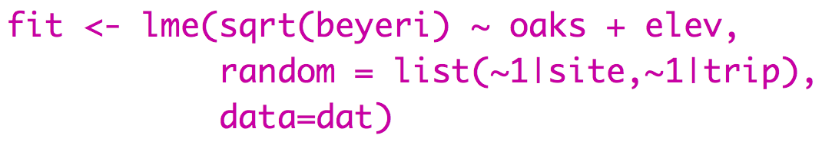
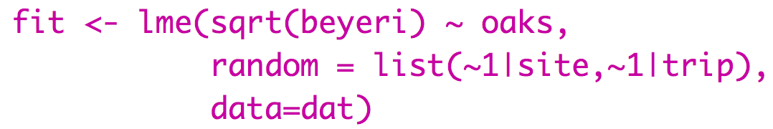
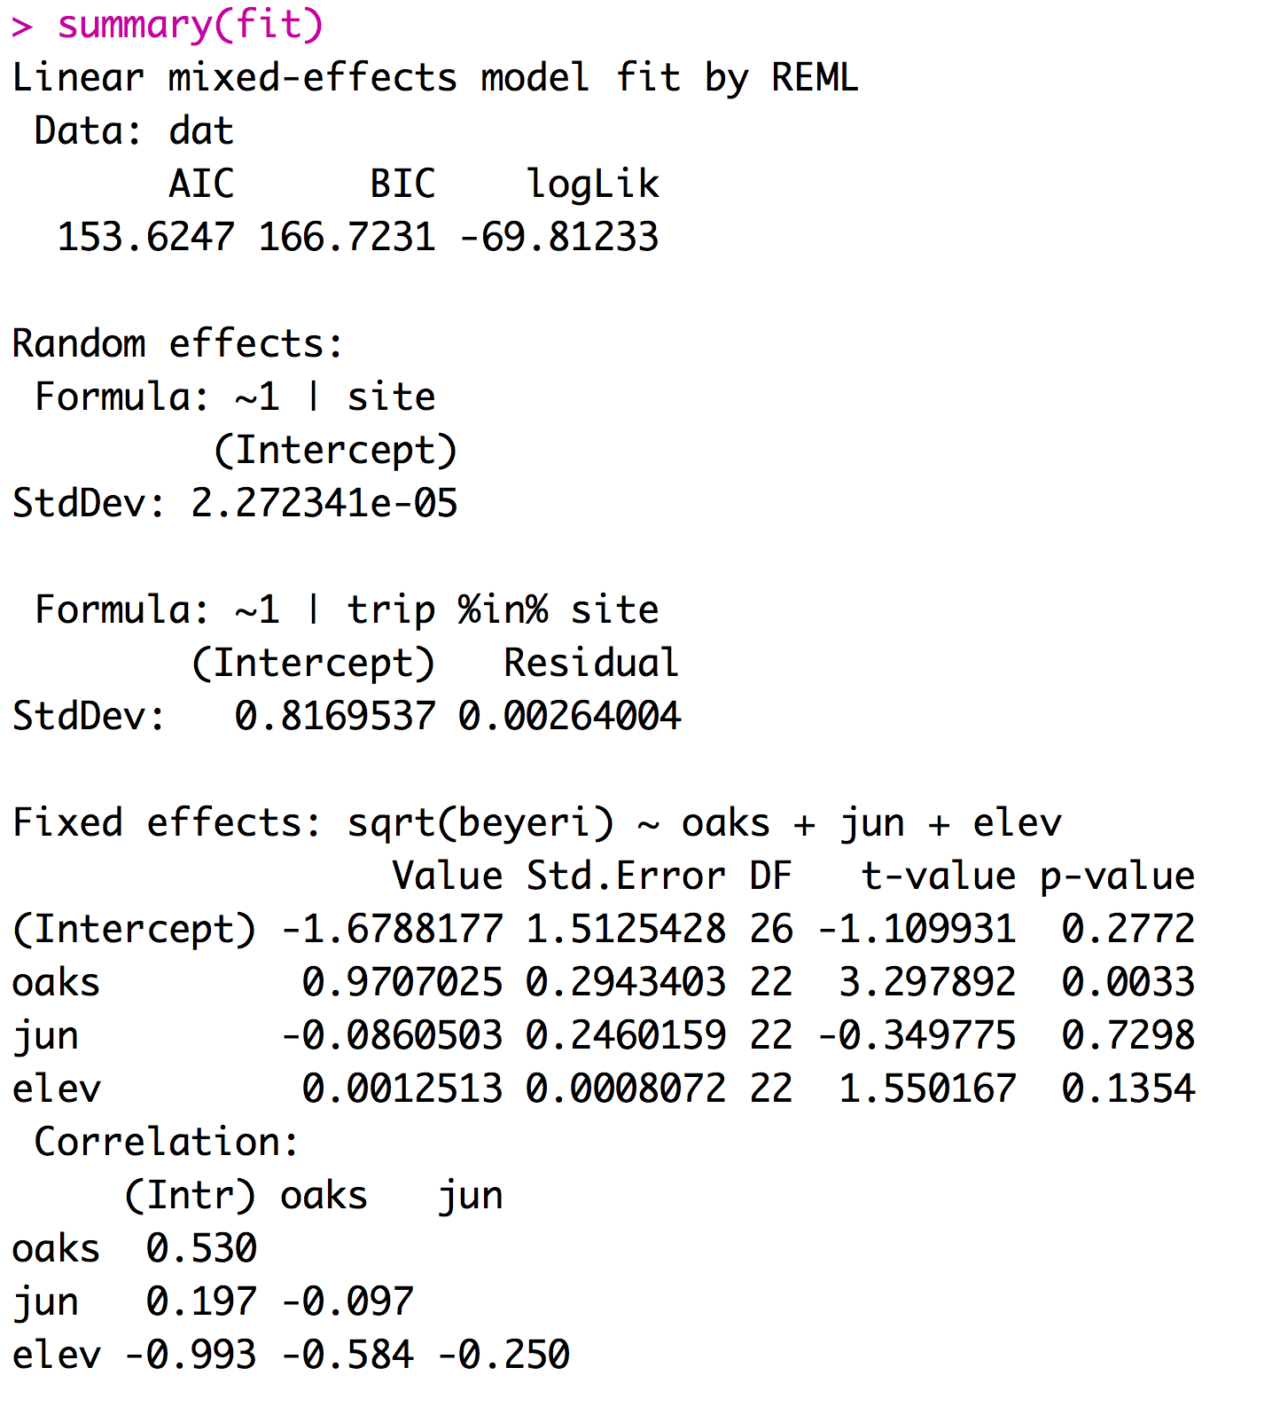
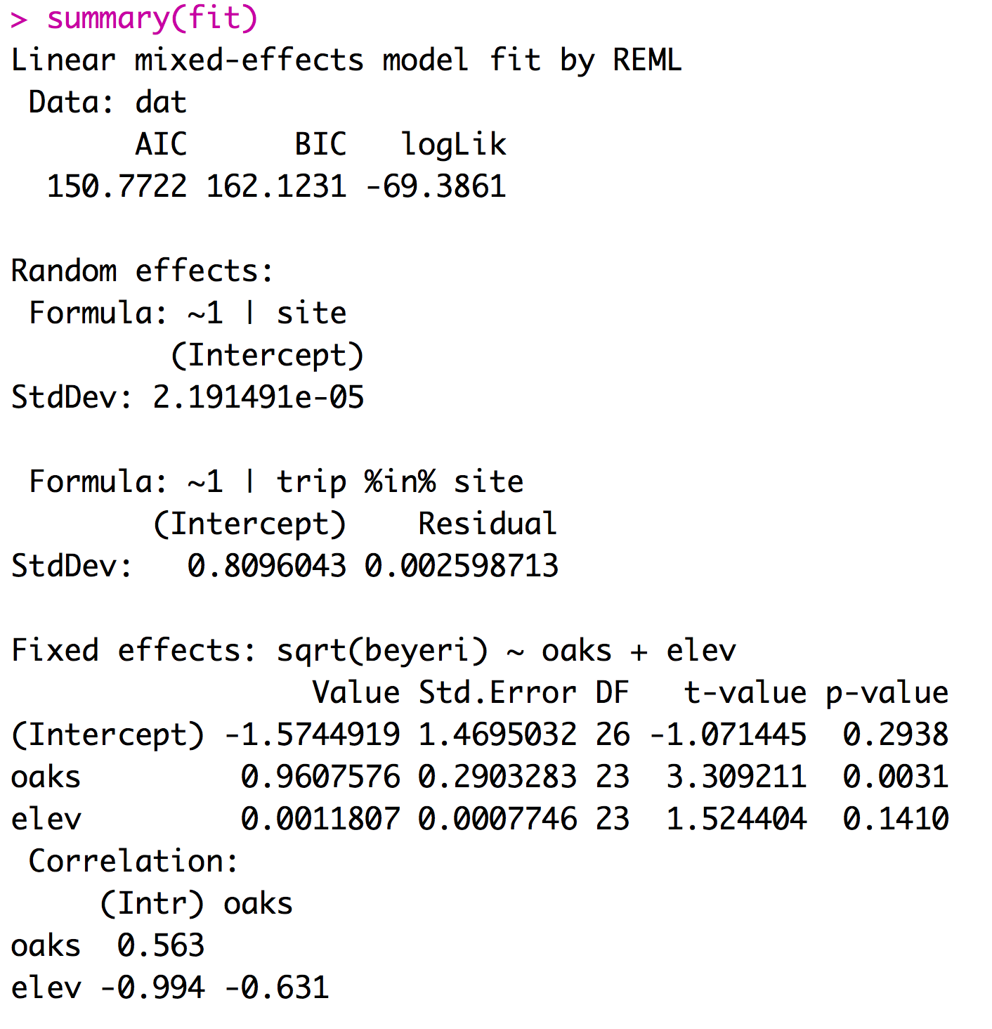
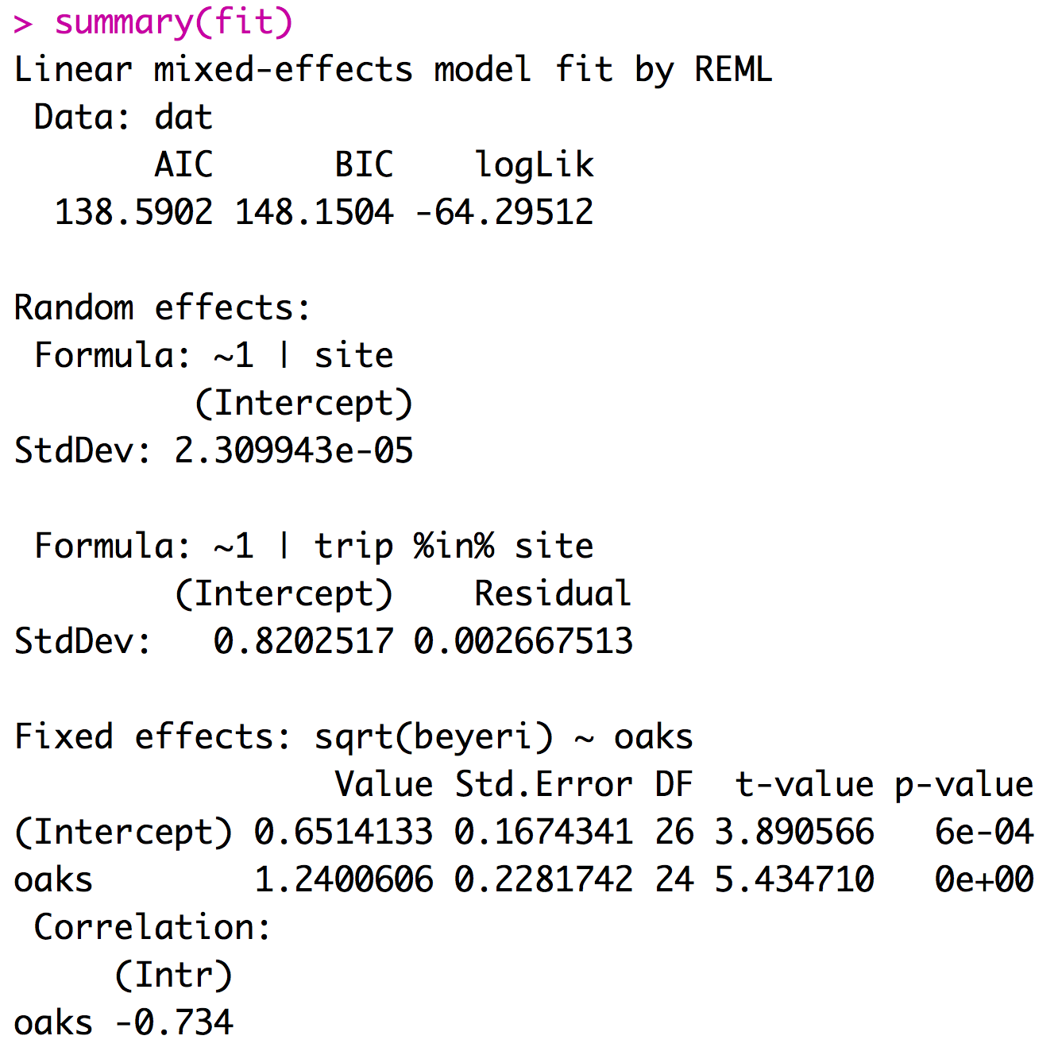
Implementing a mixed effects model
Mixed effect models can be fit using the LME function from the package nlme.
If you report your df with your F-statistic the reviewer will know if you did the right type of model

Slide 24
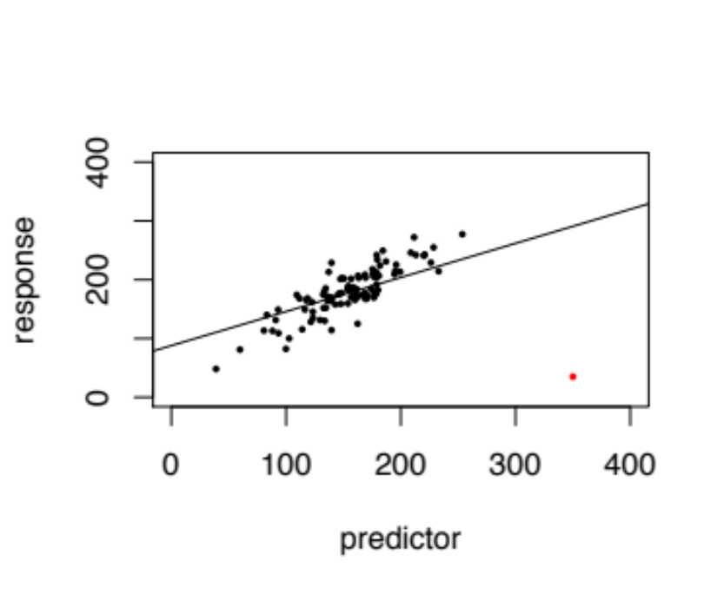
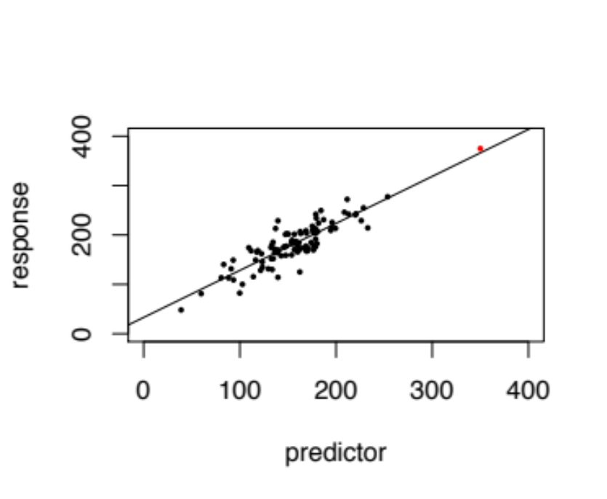
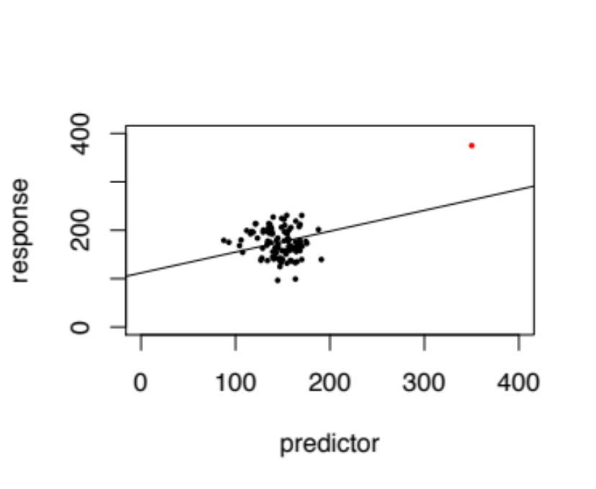
4 Types of outliers
1) Obviously erroneously recorded or measured data
3) Extreme data point that impacts statistic of interest.
2) Extreme data point that doesn’t impact statistic of interest but does impact p-value.
4) Extreme data point that creates significance.

Slide 25
Considerations for models with random effects
Most software will assume that all factors are fixed unless you specify them as mixed.
Designating factors as random effects takes extra work.
The lm function treats all predictors as fixed effects.
Treating random effects as fixed effects is fundamentally wrong.

Slide 26
Links
MCMCMglmm: Fit mixed models with phylogenetic or pedigree information in a Bayesian framework.
Outlier Package: Apply outlier tests to identify possible outlier datapoints - I don’t recommend this.

Slide 27
For Thursday
Install the package ggraptR.
Download these datasets from course website:
az.csv This file contains the data for the number of Chrysina beetles collected in different habitats
fish2.cscv This file contains the data for fish fitness in different habitats with different genotypes
Explore these using fixed and mixed effect models. In class on Thursday we will dive into these and play with these data creating ggplot figures using ggraptR.

